Slide 1
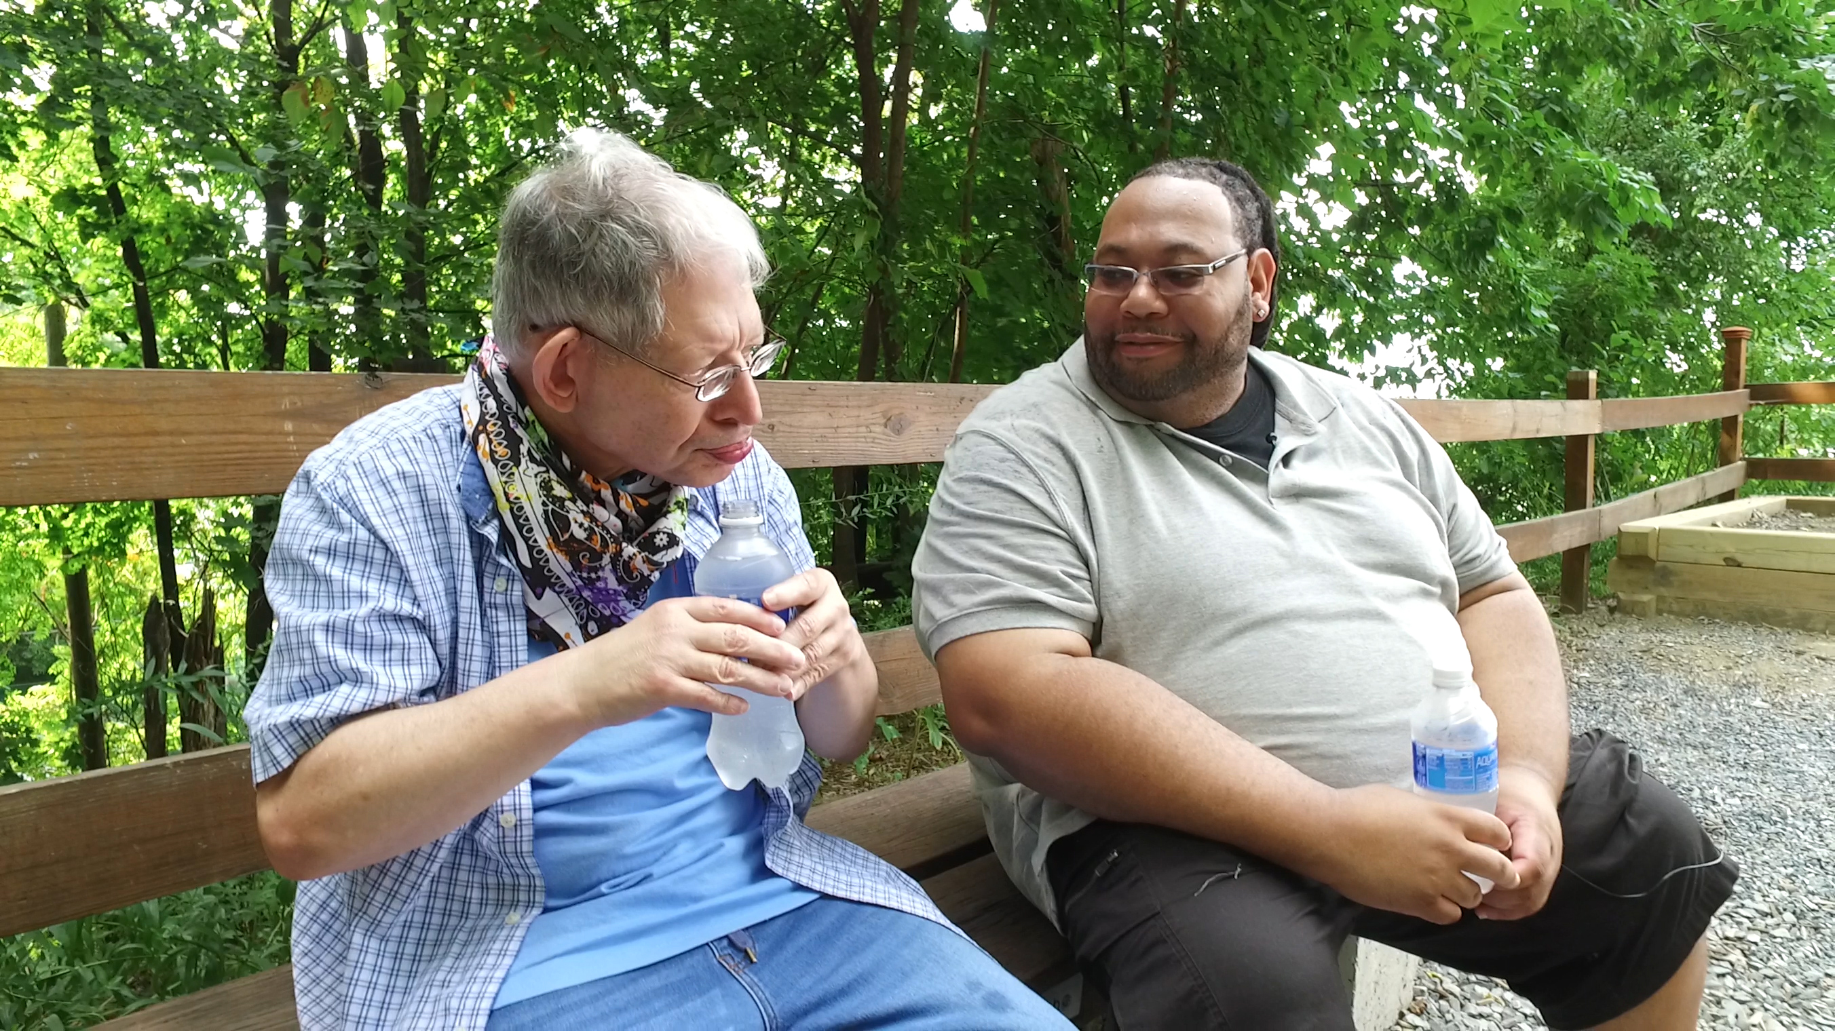
Notes:
Host and Co-host notes for pre-meeting setup
Actions before the session:
Slide #1 – Update presenter names
Hide the other region’s consultant slide, as applicable
Hide other regions workshop slide for Upcoming Workshops, as applicable
In the Practice session before participants log on
Check that the presenter can share their screen and run videos as needed
Check that the presenter marks “Share Computer sounds” and “Optimize Screen sharing for video clip” so that any videos shown can be heard by others – it is on the same screen that you choose which screen to share.
Make Coaches "Co-hosts"
Confirm polls are loaded - host
Turn on transcript –host
Break-out Groups – host
Take attendance
Timekeeper
Host / Welcome people as they arrive & arrive late – assign someone
Monitor Chat – assign someone
Turn on record, as desired
Subtitles – turned on, each participant can control turning on and off
At end of presentation:
MAKE SURE TO STOP RECORDING AT THANK YOU SLIDE
Note to Facilitator
Bold Text = Timing
Italicized Text = Notes – do not read
Regular Text = Talking Points

Slide 2

Understanding Your Data and Workforce Strategies
Workshop Series
Insert Facilitator Name and Affiliation
tenncare.ici.umn.edu
Notes:
Timing: intro section (slides 2-9): 15 minutes
Action – Record as desired
Welcome to session # in our QuILTSS Initiative kickoff workshop series.
My name is xx and I am a xx with the Institute on Community Integration at the University of Minnesota. I am here today with my colleagues from the University of MN, __________ and ________________. Also Regional Coaches from Tennessee ____________________ and ___________________.
Thank you so much for joining us today. During today’s session we will talk about some retention strategies.
If being recorded: This webinar is currently being recorded. We will send the recording to you if you would like to view again or share with others in your organization.

Slide 3
Welcome to Session 3:
Assessing Your Need: Evidence-Based Practices and Organizational Capacity
Notes:
Talking Points
Today’s session is on Assessing your Needs. We will take a closer look at evidence-based practices and organizational capacity or readiness.

Slide 4
Using Zoom
Your microphones will be muted when enter. Please keep them turned off unless you're speaking.
Name yourself
  First name
  Name of your organization
Use for questions or comments.
We will use “Reactions” such as “thumbs up” though-out the workshop.
Live Script
Camera on as you are able to and comfortable.
Take care of your needs. If you need a break, take one.
Be Understanding of “co-workers”
Chat
Notes:
Talking Points:
Some of us are used to working on Zoom in a group, while others are less familiar.
Please keep your microphone on mute when you’re not speaking today to help reduce background noise. When you’re in breakout groups, feel free to unmute and discuss the topic within your group. If you are able, we’d appreciate it if you keep your video on today. Its important for all of us to be able to see and get to know one another in these meetings. We understand if you need to shut off your video for a few moments if you need to step away, but please turn your video back on when you return.
When you logged into Zoom today, you might have typed in a name for yourself. To help us get to know one another, we ask you to rename yourself with this information on your screen:
Your name, your organization name. If you are a group of people watching from one computer in an organization, you can shorten to first names and your organization name.
To do this, look on the bottom of your screen for participants, click on that and on the right side of your screen a white column will appear. Hoover over your name and two buttons will appear mute and more. Click on more, then click on rename. Rename yourself then click OK.
The Chat function is at the bottom of the page. It looks like a little speaking bubble. If you have a questions or something you want to add to the discussion you can use Chat. We will be monitoring Chat throughout the session.
Using Chat to submit a question, simply click on the button that looks like this in your toolbar.
Please feel free to send questions at any time during the presentation. We will have time at the end for discussion and questions, so you can type them in the chat and we’ll go over them at the end.
When you click on “Participants,” you’ll see some buttons to interact with the presentation. You can say yes, no, go slower, go faster, and when you click on “More” you will find that you can use the thumbs up or thumbs down buttons. You can also let us know if you need to step away for a quick break to use the rest room or fill your coffee cup. Suffering is optional.
When we take breaks we do ask that everyone turn their camera during the break then turn it back on when you return or use reactions when you return so that we know when we are ready to start again.
Finally, we are all still working from home at the University of Minnesota. Explain “coworkers” you share your space with.

Slide 5
Welcome & Introductions
Notes:
Transition slide

Slide 6
Breakout Group Activity
Getting to Know You Your name / organization
Your role in the organization today
What is one ‘aha’ moment you had after reviewing your organizational profile?
Breakout Group
  1 facilitator in each group and 1 reporter
  Give everyone enough time to have a turn.
Notes:
Timing: 5-8 minutes breakout
Facilitor Note:
Activity: 5 people per breakout, each person gets one minute, assign 1 consultant or coach to each breakout group
Purpose: Gives consultants and coaches opportunity to learn who is in the room.
Talking Points:
We are going to have the opportunity to get to know who is in the workshop today. In a moment but not yet, you will be send to a Breakout room with 5-6 others.
Everyone will have the:
Opportunity to introduce your self with your name, your organization and your role in the organization.
And answer the questions on the screen.
When you get to your group, find one facilitator and another person to report back for the group the responses to the two questions.
Facilitor Note:
When the group returns call on the reporter from each group to report back on themes for questions

Slide 7
Goals for this session
Reflect on the connection between assessment and your workforce practices
Learn more about the 8 steps of implementation and the components of an intervention plan
Review your organization’s capacity and processes
Explore workforce challenges and strategies to address them
Continue thinking about your desired workforce outcome
Notes:
Talking points
We have several goals for today’s session. These goals include (review goals on the slide)

Slide 8
Items to have with you today:
  Your organization’s 2019 profile
  2020 TN Workforce Initiative Organizational Self Assessment Workbook (www.tenncare.ici.umn.edu )
Notes:
Talking Points:
During today’s session we will be using the 2020 TN Workforce Initiative Organizational Self Assessment Workbook. You will also want to have a copy of your organization’s profile with you for reference.
Do you have your copy with you? If not, take a moment to get it.
Here is link to page with Self Assessment workbook: https://tenncare.ici.umn.edu/dsp-workforce-toolkit/organizational-readiness/tenncare-self-assessment-workbook-and-action-plan

Slide 9
Evidence-based Practice and Organizational Readiness
Reflection: Section 1: Assessment and Using Workforce Data
Notes:
Timing for this section (slides 9-17): 20 minutes (excluding optional activity on next slide)
Talking Points:
Last session we began talking about evidence-based practice and organizational readiness. It is common for organizations to go from identifying a problem to implementing a solution without including steps for assessment, measurement and evaluation. During the last session we learned about implementation science and how the effectiveness of the intervention is drastically impacted by the way its implemented.
The research tells us that implementation matters and it takes time. If you have tried a strategy in the past, but didn’t have the support, time, or staff to implement, you are unlikely to see the changes you hope to see.
Last session we asked you to complete section 1 of your Organizational Self-Assessment on Assessment and Using Workforce Data.
Quick show of hands, using the thumbs up if you were able to do additional work on this section last week. I understand you have full schedules. I just wanted to check in to get a sense of where the group is at. Transition to next slide

Slide 10
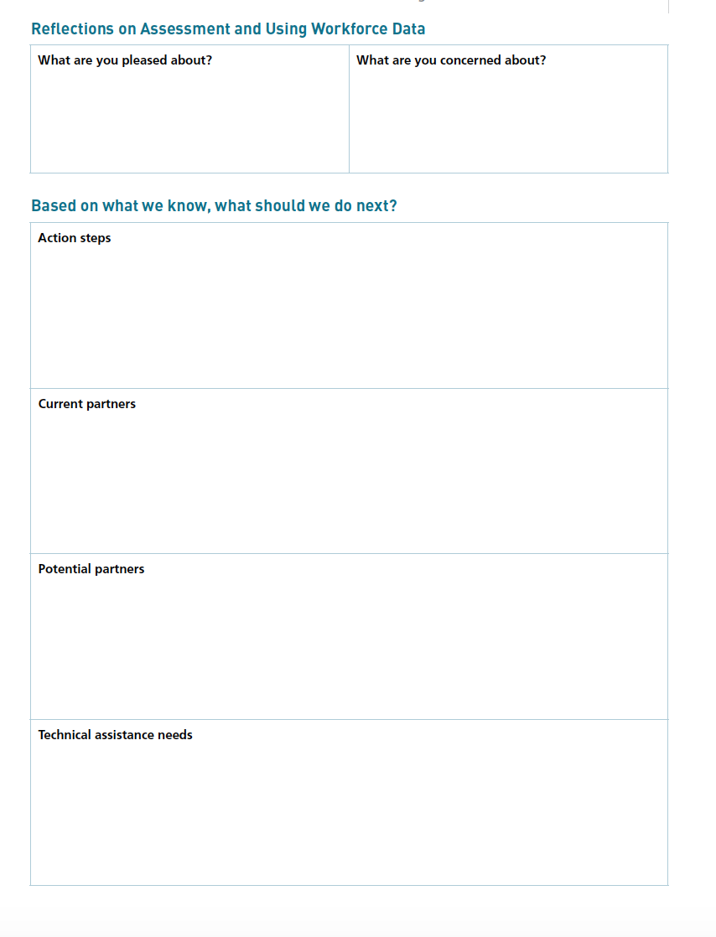
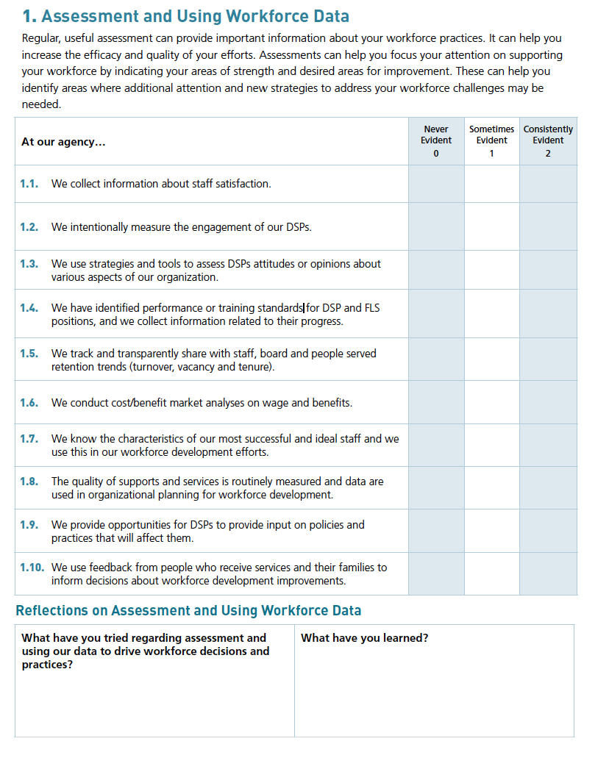
Notes:
Talking Points:
Section 1 is about reflecting on the items you already may collect that can be used for assessment of your workforce. This is intended to be a discovery tool to help you explore what you’re already doing and areas where you might want to put some attention as you move forward.
There are ten initial questions that we will lead you through. You’ll think about what you know you’re currently doing based on the following scale. For each item, you can indicate: Never evident, Sometimes evident, or Consistently evident.
The difference between sometimes and consistently might be that if the practice is used by some staff or some areas of the organization, you’d rate as “sometimes evident.” If the practice is used consistently by most staff, you’d rate as “consistently evident.” if you don’t know about the practice, rate it is “never evident,” but you put a star next to it and you can ask questions of your colleagues in the next weeks to better understand if someone is doing something with the practice.
This is intended to be a simple tool to help you start thinking about what you’re currently doing.
After you do that, take a few minutes to reflect on what you’ve tried, and what you’ve learned today. If you have time, you can keep working on those reflection questions on page 7.
Facilitor Note:
Optional Activity (would take 10 minutes):
If time, go to breakout groups. If no time, read questions as a full group, leaving time for participants to answer questions in their workbook.
10 minutes: 2-3 minutes for the initial questions, 3-4 minutes for the reflections, 2-3 minutes to share out in small groups.

Slide 11
Poll Question #1 What workforce assessments have you tried? (Select all that apply)
  Staff satisfaction survey
  New staff survey
  Exit interviews or surveys
  Training needs assessment (new hires)
  Inventory of current employee skills
  Competency assessments
  Organizational commitment survey
  Teamwork assessment
  Supervisor training needs assessment
  Personality or style inventories
Notes:
Poll
Talking points
Let’s take a quick poll. - you can pick multiple answers. Your answer are anonymous. Read slide.
Facilitor Note:
In debrief poll, review results.
Ask: Anything surprise or jump out at you – spend no more than 3 minutes on this-watch/resist the deep dive conversation

Slide 12
Assessment and Using Workforce Data
Evidence-based practice & organizational readiness
How do we know what works?
Why do we ask so many questions about your organization?
Why so many assessments and so much data?
Notes:
Talking Points:
Last session we asked you to think about assessment and how you use workforce data in your organizations by reviewing and complete section 1 on pages 6-7 in the organizational self assessment workbook.
Its important that we consider evidence-based practice & organizational readiness when thinking about implementing strategies to improve workforce outcomes.
How do we know what works?
Why do we ask so many questions about your organization?
Why so many assessments and so much data?

Slide 13
Why Assess?
Identify staffing challenges
  Site specific challenges can be important (consider site-by-site assessments and data collection)
Select strategies to address challenges
Use baseline data to track which interventions are working
Notes:
Talking Points:
We can use assessment in different ways. For example, you have workforce data for your organization; however you may want to drill down and look at assessment of the problem at the site level. The Retention Trends and Summary worksheet on page 22 is a resource for you to use to understand turnover and retention at a site level.
Assessments can also help in the selection of strategies and be used as baseline data to track which strategies or interventions are working or not working.

Slide 14
Common Challenges
Finding qualified employees
Employees do not understand their job roles
Employees quit within a few weeks or months (meaning significant effort must be spent to replace them).
Employees don’t have access to timely training
Training is not effective
Employees display poor job skills
Employees do not get along with each other or the people they support
There is conflict between employees and supervisors or employers
Low employee morale
Wages or benefits don’t meet the needs of employees
Lack of employee engagement
Notes:
Talking points:
Some of the common workforce challenges organizations face include: briefly read some from the slide
Without assessment, it may be difficult to discover these problems.

Slide 15
Types of Assessment
Tracking Retention Trends
Turnover rate worksheet
Vacancy rate worksheet
Tenure of current employees worksheet
Tenure of leavers worksheet
Assessing Attitudes or Opinions
Exit interviews or surveys
New staff survey
Organizational commitment survey
Staff satisfaction survey
Teamwork assessment
Personality or style inventories
Identifying Performance or Training Standards
Job description review
Competency assessments
Inventory of current employee skills
Performance review system
Training needs assessment
Job analysis assessment
Analyzing Cost and/or Benefit costs
Wage/benefit market analysis
Recruitment and hiring bonuses effectiveness analysis
Recruitment source cost-benefit analysis
Notes:
Talking Points:
Thinking about those workforce challenges, we’ve identified different types of assessments organizations can consider using as part of the organization’s workforce development plan. Read a few from slide

Slide 16
Assessing Workforce Challenges
Problem and Assessment Guide workbook page 23
Identified Problem | Assessment Area
Trouble finding new employees Difficulties recruiting qualified direct support professionals | Recruitment source cost-benefit analysis Vacancy rates Wage/benefit market analysis Recruitment and hiring bonuses effectiveness analysis
New hires quit in the first six months Constantly hiring new employees to replace those who have left | Tenure of leavers Tenure of current employees Turnover rates Staff satisfaction survey New staff survey Exit interviews or surveys
New employees are unsure of job roles and functions | Job description review Training needs assessment (new hires)
Difficulty finding training that addresses the skills needed by employees | Training needs assessment Inventory of current employee skills
Poor performance Training doesn’t produce desired results | Competency assessments Performance review system
Morale problems | Staff satisfaction survey Organizational commitment survey
Conflict between staff and supervisors or managers Employees complain about their supervisor | Team work assessment Supervisor training needs assessment Staff satisfaction survey
Co-workers don’t get along | Team work assessment Staff satisfaction survey Personality or style inventories
Long-term staff are dissatisfied or quit the organization | Staff satisfaction survey Training needs assessment Exit interview or surveys
Step 1 Identify and assess
Notes:
Talking Points:
Step one of the 8 steps of implementation is to identify and assess workforce challenge. The guide on page 23 of your workbook can help you identify assessment areas that align with the problem you’ve identified.
In the poll we did, you identified assessments you have used at your organization. Thinking about those assessments, did they align with the workforce problem you wanted to address?
Give an example from the slide.
Transition to next slide

Slide 17
Breakout Conversation
  What ways do you currently assess workforce challenges in your organization?
  Where are you confident? Where is more work needed?
  What questions does this raise for you?
  What will you do differently?
Notes:
Timing: 5 minutes for breakout and 5 minutes full group
Facilitor Note:
Activity: (5 minutes) – 5 people per breakout, each person gets one minute, assign 1 consultant or coach to each breakout group
Purpose: Gives providers opportunity to reflect with one another and facilitators learn where the providers are
Talking Points:
We are going to have the opportunity to get to know who is in the workshop today. In a moment but not yet, you will be send to a Breakout room with 5-6 others.
Everyone will have the opportunity to reflect on and answer the questions on your screen.
When you get to your group, find one facilitator and another person to report back for the group the responses to the two questions.
Facilitor Note:
When the group returns call on the reporter from each group to report back on themes for questions.

Slide 18
Methods for Taking Action
Section 2: Organizational Capacity and Processes
Notes:
Timing for this section (slides 18-25): 7-9 minutes
Talking Points:
We’ll talk about methods for taking action at your organization, including What you can do today and What you will take back to your organization

Slide 19
Change Strategies
How direct support professionals are:
recruited,
selected, and
on-boarded
trained
Aim: Improve the likelihood that employees you hire will be able to meet the needs of the individuals being supported.
Notes:
Talking Points:
The focus of change within your organization is changing how DSPs are recruited, selected, onboarded, and trained. These changes should result in improving the likelihood that employees hired will be able to meet the needs of the individuals being supported.

Slide 20
The Change Process
Assess
Decide
Create
Act
Evaluate
Revise
Assess to Identify Problems and Successes
Know the scope and nature of the problem(s)
Make sure you also maintain what is going well for continued success
data
Notes:
Talking Points:
The change process is a cycle that includes:
assessing the situation,
deciding what is the greatest need,
planning a strategy to address the need,
acting to put the plan into action,
evaluating the results, and
revising the plan based on the evaluation.
We will focus on strategies and information that will help you in the assessment and evaluation phases of the cycle for Direct Support Professional Workforce issues.

Slide 21
Why is an Action Plan important?
Create a strong vision regarding the importance and outcome of change.
Find a leader or group of leaders who are interested and invested in change.
Give the planning and development process sufficient time and resources.
Set target completion dates within the plan for the achievement of specific goals.
Plan to revise and update the plan itself on a regular basis.
Notes:
Talking Points:
To create change you need an action plan. An action plan can…
Help create a strong vision the importance and outcome of change
Helps you find a leader who are interested and invested in change
Gives the planning and development process sufficient time and resources,
It helps you set target dates for achieving specific goals
It helps the team make a plan for when and why you will update and revise the plan on a regular basis. We need to comeback and revisit what is happening with the plan so that we can be proactive in taking action.

Slide 22
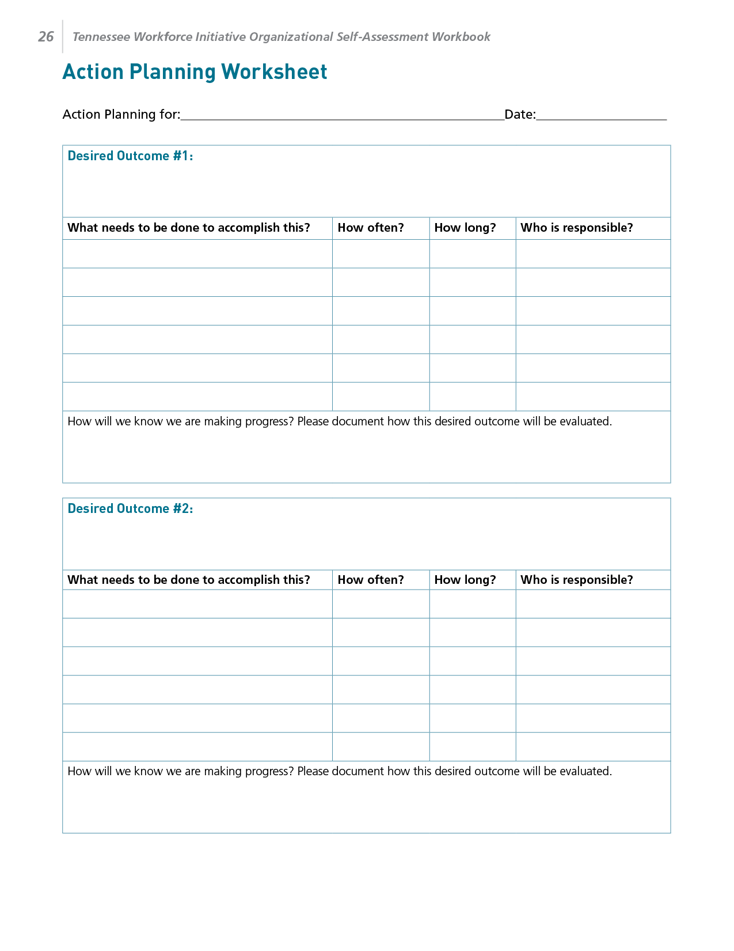
Notes:
Talking Points:
Turn to page 26 in the self-assessment workbook. The title of this page is the “Action Planning Worksheet.” On this page, you will see several copies of the chart that is pictured on the screen.
In the top box called “Desired outcome #1,” you can jot down ideas from your conversation about what you would like to see changed.
For the present time, you can ignore the rows below this, as we will fill in this information in future sessions in the workshop.
Then, take a xx minute break.

Slide 23
8 Steps for Implementation-Workforce Strategies
Step 4
Step 3
Identify
barriers to implementation
Step 2
Identify components of the strategy
Step 1
Select an intervention strategy
Identify and assess the problem
Larson & Hewitt, 2005
Notes:
Facilitor Note:
Review exploration/discovery questions on page 21 in the Self Assessment Workbook- prompt to follow along in the workbook
Talking Points:
8 Steps for Implementing Workforce Strategies
Step 1: Identify and assess the problem
What problem or challenge will your organization address?
How big is the challenge?
What is the baseline level of performance at your site in regard to this challenge?
Step 2: Select an intervention strategy
What strategy do you propose to address this challenge?
Step 3: Identify components of the strategy.
What are the major components of the intervention strategy?
What will you do?
What are the steps involved in this intervention?
Who will be involved in developing, implementing, and evaluating the intervention/ What roles will each person play?
What are the costs associated with this intervention (e.g., time, resources)?
Step 4: Identify barriers to implementation
What are the main barriers to using this intervention?
Who needs to know about and/or be involved in decision making (e.g., board of directors, administration, staff, individuals who receive supports, family members, other stakeholders)?

Slide 24
8 Steps for Implementation-Workforce Strategies
Step 8
Step 7
Evaluate success
Step 6
Implement
the strategy
Step 5
Set goals,
measure progress & establish a time frame
Identify support for the strategy
Larson & Hewitt, 2005
Notes:
Step 5: Identify support for the strategy
What are the arguments the planning team will use to support use of this intervention strategy?
How will these arguments enlist support from various stakeholders?
Step 6: Set goals, measure progress & establish a time frame
What do you want to see impacted and when?
What are the outcomes you would like to see?
How will you monitor the progress?
Who needs to be involved in collecting and summarizing data on your progress?
What are the timelines and the benchmarks?
Step 7: Implement the strategy
What are the first steps on your action plan?
How and when will you meet with your team to report on implementation?
Step 8: Evaluate success
When will you meet with your implementation team to review your progress?
Are you making progress as expected?
How will you celebrate your successes?
How will you communicate your successes

Slide 25
Workforce Initiative Timeline-Cohort 2
SEPTEMBER 2020 | OCTOBER 2020 | NOVEMBER –DECEMBER 2020 | JANUARY –FEBRUARY 2021 | MARCH–APRIL 2021 | MAY–JULY 2021 | AUGUST 2021 and beyond
Email with 2019 profile, invitation to view pre-kickoff webinar Identify key contacts, potential team members | Kickoff workshops on Understanding your data and Workforce Toolkit overview Start Self-Assessment Workbook Select level of consultation (begins) Start using an action plan | Kickoff workshops Review Assessment results Complete Self-Assessment Workbook View webinars and review toolkit (begins) Confirm organizational readiness (begins) | Organization Level Meetings via Zoom Video Conference or Conference Call Participate in Year 3 2020 Survey (begins) Organization Team implement the strategy (begins) Participate in Regional Community of Practice | Organization Level Meetings via Zoom Video Conference or Conference Call Participate in Regional Community of Practice | Organization Level Meetings via Zoom Video Conference or Conference Call | Participation in Community of Practice Year 3 2020 Survey Results Participate in webinar to review Year 3 – 2020 Survey Organizational Profile
Step 1: Identify and assess the problem
Step 2: Select an Intervention Strategy
Step 3: Identify components of the strategy
Step 4: Identify barriers to Implementation
Step 5: Identify support for the strategy
Step 6: Set goals, measure progress & establish a time frame
Step 7: Implement the strategy
Step 8: Evaluate success
Notes:
Facilitor Note: Give overview, highlighting where we are now and where we’re going.
Talking Points
This is a refresher, on page 20 of your workbook, here is the timeline with the 8 steps for implementation included in the arrows across the bottom half of the sheet.
Any questions?

Slide 26
Stretch Break
Take 5 minutes to stretch and refresh
Notes:
Timing: 5-7 minutes
Talking Points
Turn off video and audio when you leave. Turn video back on when you return so we know you are back.
Facilitor Note
To check in with folks who don’t have their video on, ask for reactions

Slide 27
Self-Assessment Workbook
Section 2: Organizational Capacity and Processes
Notes:
Timing for this section (slides 27-31): 15-20 minutes
We are going to move into an activity that you can do in small groups. Turn in your self-assessment workbook to page 8-9. You’ll get a chance to think about your organization’s current practices and reflect on where you’re at.

Slide 28
Notes:
Talking Points:
Section 2 looks like the images on your screen. Section 2 is about reflecting on the organizational practices and processes that can support your efforts and processes you may already have in place. This is intended to be a discovery tool to help you explore what you’re already doing and areas where you might want to put some attention as you move forward.
Just as with section 1, section 2 is intended to be a simple tool to help you start thinking about what you’re currently doing.
After you do that, take a few minutes to reflect on what you’ve tried, and what you’ve learned today. If you have time, you can keep working on those reflection questions on page 7.
Facilitor Note
Optional 10-minute Activity:
If time, go to breakout groups. If no time, read questions as a full group, leaving time for participants to answer questions in their workbook.
10 minutes: 2-3 minutes for the initial questions, 3-4 minutes for the reflections, 2-3 minutes to share out in small groups.

Slide 29
Reflecting on Your Organizational Capacity and Processes
What is your organization’s capacity for change?
What processes are in place to respond to changes in workforce development practices?
Notes:
Facilitor Note
Summarize Slide. This is transition slide that leads into the breakout conversation.
Talking point
Let’s take some time to explore this in smaller groups – move to next slide

Slide 30
Breakout Conversation
Reflecting on Your Organizational Capacity and Processes
What is one thing that you’ve tried regarding organizational capacity and processes to address workforce challenges?
  What were you pleased about?
  What have you learned?
  What are you concerned about?
Based on this, what next steps are you thinking about?
Notes:
Timing: 5 minutes for breakout and 5 minutes full group
Facilitor Note
Activity : (5 minutes) – 5 people per breakout, each person gets one minute, assign 1 consultant or coach to each breakout group
Purpose: Gives consultants and coaches opportunity to learn who is in the room.
Talking Points:
We are going to have the opportunity to get to know who is in the workshop today. In a moment but not yet, you will be sent to a Breakout room with 5-6 others.
Everyone will have the opportunity to:
answer the questions on the screen.
When you get to your group, find one facilitator and another person to report back for the group the responses to the two questions.
Facilitor Note
When the group returns call on the reporter from each group to report back on themes.
If there is a whiteboard take this information down.

Slide 31
Connecting Workforce Challenges & Strategies
Page 24 TN Workforce Initiative Organizational Self-Assessment Workbook
Notes:
Transition slide
Timing for this section: 10-15 minutes
Facilitor Note
This last piece is to set the stage for connecting workforce challenges to the strategies/tools that will follow in Sessions 4, 5, 6

Slide 32
Poll Question #2 - What is the single most important workforce challenge you have today? (Select one)
Few qualified applicants/trouble finding new workers
Turnover rates are too high/New hires quit in first 6 months
New DSPs unsure of job roles and functions
Supervisors have difficulty finding the time to coach and mentor new staff
Lack of training opportunities
Poor Performance/Training doesn’t produce desired results
Supervisor reporting being overwhelmed, don’t know how to do their job
Morale problems
Conflict between staff and supervisors or managers
Co-workers don’t get along
Notes:
Poll
Talking points
Let’s take a quick poll. - you can only pick one answer. Your answer are anonymous.
Facilitor Note
Read slide.
In debrief poll, review results.
Ask: Anything surprise or jump out at you – spend no more than 3 minutes on this-watch/resist the deep dive conversation

Slide 33
Activity
Notes:
Talking Points:
Now that you have your organizational profile in front of you, turn to page 24 in your self-assessment workbook. The page in the workbook should have a chart on it, like the one on your screen.
In the poll you just took, we asked you to identify the single most important workforce challenge your organization is facing, the challenge most of you selected was [facilitator insert challenge with most votes] if you locate that challenge in the far-left column, then look in the column just to the right, you see a number of strategies that you might consider or for some of you already doing that align with that challenge.
As you read along, feel free to take your own notes, you might highlight strategies you've already tried or circle those you're interested in learning more about. This is an activity that you can take back to your organization and review with others who are working with you on workforce development.
Over the next three sessions we will be providing an overview of the workforce strategies and tools available to you in the TN Workforce toolkit. Today we wanted you to see the connection between workforce challenges and strategies to consider as you work through your 8 steps to implementation.
Note to Facilitator: You can walk through this worksheet with participants using the poll responses to guide which challenges to review and invite participants to follow along in page 24 for and note those strategies they have tried or circle those they are interest in learning more about. The intent of this activity is to set the stage for the next 3 sessions where we will provide an overview of workforce strategies and tools available in the workforce toolkit.
Transition to last 3 conclusion slides.

Slide 34
What’s Next
Session 4: Overview of TennCare Workforce Toolkit: Recruitment & Selection Strategies
Homework before our next session:
Review the Organizational Workforce Self-Assessment Workbook
Identify your organization’s key contacts
Check out TN DSP Workforce Toolkit: https://tenncare.ici.umn.edu/
Notes:
Timing for final 4 slides: 3-7 minutes
Talking Points
Your next Workshop is Session # where we will discuss……………………………………. Your organizations key contacts should plan to attend this workshop. You can invite other members of your team to attend any of the upcoming workshops as you like. You should have already received the link to this and the other workshops. If you don’t have the link please contact us at the email address on the bottom of the screen: dsp-tn@umn.edu
We will be meeting on: (insert date and time)
Your homework is: Read slide

Slide 35
Questions?
You will receive the slides from today’s workshop so that you can have further discussions about the information in this session.
If you have questions:
Contact your University of Minnesota workforce consultant
Email us at: dsp-tn@umn.edu
If you haven’t provided us with your Key Contacts please do
at: umn.qualtrics.com/czkickoff
Notes:
Facilitator Note: improvised based upon the amount of time left. Either:
We have a little bit of time for questions.
If we don’t have time to answer your question, please contact your UMN consultant or email us at dsp-tn@umn.edu

Slide 36
Upcoming Kick-off Sessions
Session 4: Overview of TennCare Workforce Toolkit: Recruitment & Selection Strategies
Session 5: Overview of TennCare Workforce Toolkit: Retention Strategies-Part 1
Session 6: Overview of TennCare Workforce Toolkit: Retention Strategies-Part 2
Session 7: Planning Your Next Steps: Measuring Outcomes of Implementation and Creating a Practical Action Plan for Change
Notes:
Facilitor Note: Review information on the slide

Slide 37
Thank you
See you next week!

