Slide 1
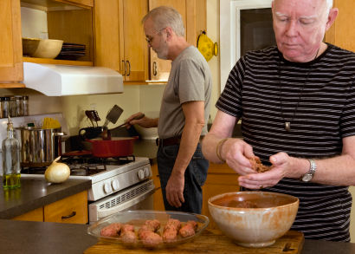
Presenter Prep Slide Only
Notes:
To Prepare:
Turn on Live Transcript and record if applicable
prepare (Name of Learning Lab) and PDF of slides (without notes) to put in chat
Slide #2 – Update presenter names
Check that the presenter can share their screen
Prepare polls/breakout groups if a large group
Assign an attendance taker, timekeeper, chat monitor
Note to Facilitator:
Bold Text = Timing
Italicized Text = Notes – do not read
Regular Text = Talking Points

Slide 2
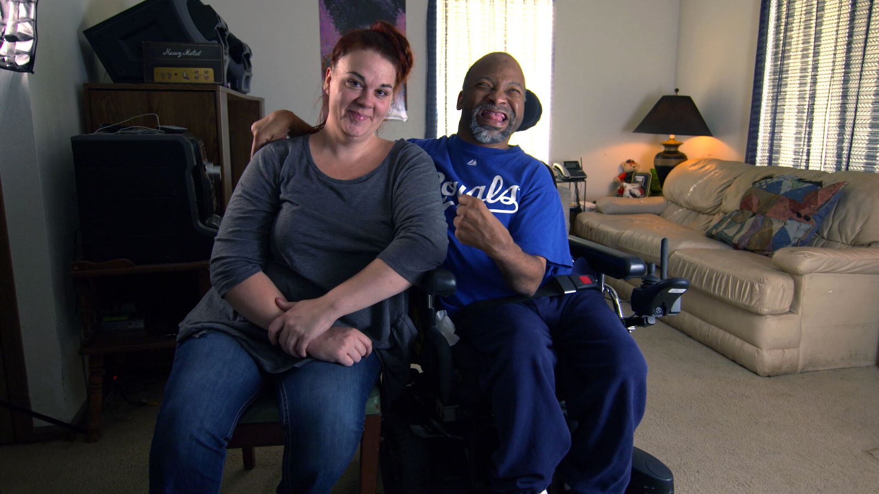
Employment and Community First CHOICES
Workforce QuILTSS Initiative
Learning Lab
Best Practices for Target Marketing
Megan Sanders
Institute on Community Integration
University of Minnesota
tenncare.ici.umn.edu
Notes:
Time 30-60 seconds
Talking Points
Welcome to our xx Learning Lab – xx
My name is xx and I am a xx with xx.
Acknowledge other UMN staff and the Regional Coaches (Don’t all on them for opening round)
If Learning Lab is being recorded, let them know they can contact you if they would like a copy.

Slide 3
Using Zoom
Your microphones will be muted when enter. Please keep them turned off unless you're speaking.
Name yourself
  First name
  Name of your organization
Use for questions or comments.
We will use “Reactions” such as “thumbs up” though-out the workshop.
Live Script
Camera on as you are able to and comfortable.
Take care of your needs. If you need a break, take one.
Be Understanding of “co-workers”
Chat
Notes:
Time: 30-60 seconds
Talking Points:
Some of us are used to working on Zoom in a group, while others are less familiar.
Please keep your microphone on mute when you’re not speaking today to help reduce background noise. When you’re in breakout groups, feel free to unmute and discuss the topic within your group. If you are able, we’d appreciate it if you keep your video on today. Its important for all of us to be able to see and get to know one another in these meetings. We understand if you need to shut off your video for a few moments if you need to step away, but please turn your video back on when you return.
When you logged into Zoom today, you might have typed in a name for yourself. To help us get to know one another, we ask you to rename yourself with this information on your screen:
Your name, your organization name. If you are a group of people watching from one computer in an organization, you can shorten to first names and your organization name.
To do this, look on the bottom of your screen for participants, click on that and on the right side of your screen a white column will appear. Hoover over your name and two buttons will appear mute and more. Click on more, then click on rename. Rename yourself then click OK.
The Chat function is at the bottom of the page. It looks like a little speaking bubble. If you have a questions or something you want to add to the discussion you can use Chat. We will be monitoring Chat throughout the session.
Using Chat to submit a question, simply click on the button that looks like this in your toolbar.
Please feel free to send questions at any time during the presentation. We will have time at the end for discussion and questions, so you can type them in the chat and we’ll go over them at the end.
Also when you click on “Participants,” you’ll see some buttons to interact with the presentation. You can say yes, no, go slower, go faster, and when you click on “More” you will find that you can use the thumbs up or thumbs down buttons. You can also let us know if you need to step away for a quick break to use the rest room or fill your coffee cup. Suffering is optional.
When we take breaks we do ask that everyone turn their camera during the break then turn it back on when you return or use reactions when you return so that we know when we are ready to start again.
Finally, we are all still working from home at the University of Minnesota. Explain “coworkers” you share your space with.

Slide 4
Open Round
Getting to Know You
Your name and role in the organization
What is one question you have regarding targeted marketing as a recruitment tool?
Notes:
Time: 3-5 min
We would like to start with a little time to get to know you and see if you have any initial questions. We’ll try to make sure we cover these questions. Please introduce yourself with the following: read slide
Note: If group is larger (more than 3 providers), type in chat
Alternate question: What is one thing you hope to get out of today’s Learning Lab? / What is one question you have on this topic?

Slide 5
Goals for this session
By the end of the Learning Lab, providers should have an understanding of how to plan for targeted marketing.
Understand the Targeted Marketing tools that are accessible to you.
Notes:
Timing: 1 minute
Our goal for today’s learning lab is read slide

Slide 6
Building & Strengthening the DSP Workforce
Recruitment Strategies | Selection Strategies | Retention Strategies
Effective Marketing Public service announcements (PSA) Targeted marketing Recruitment and hiring bonuses Recruitments sources | Structured behavioral interviews Realistic job preview | Orientation and onboarding Competency-based training Employee Development Job Analysis Job Descriptions Recognition Programs Coaching & Mentoring Mentoring Performance coaching Networking Employee Engagement & Organizational Participation Professional Development Developing career paths Professionalizing DSP roles Wage and Benefit Policy Change
Notes:
Time: 30 seconds
Remind attendees to consider the problem they are trying to solve with this tool – explain where the strategy falls.

Slide 7
Strategies to Support the Development of Targeted Marketing Materials
1. Identify the needs and perceptions of current employees and potential new hires.
2. Craft an organizational identity.
3. Create or update the organization’s mission and vision statements.
4. Identify and remove barriers to attracting high-quality recruits.
5. Package the organization’s image.
6. Spread the word to potential employees.
7. Enhance the organization’s visibility.
8. Monitor and update the plan as needed.
Notes:
Timing: 1- 2 minutes
Talking Points:
Slide was pulled directly from webinar on Targeted Marketing. Important to think about these steps. For more information on these steps, you can watch the Targeted Marketing webinar.
https://tenncare.ici.umn.edu/dsp-workforce-toolkit/recruitment/target-marketing-flyers-and-tools
We’ll be focusing on step 5-7. At this point, you should’ve already completed steps 1-4. THIS INCLUDES finding out who are your “successful” employees.
These steps Look very overwhelming, but it’s possible you are already doing many of them – and if you aren’t you might be able to combine with other efforts. For example, identifying the needs and perceptions of current employees and potential new hires can be done through an employee survey you are already doing. Your surveys can help figure out who your “stayers” are – not just the people who tend to apply and get hired, but the people who stay and are successful at your organization. These are they kind of people you want to recruit.

Slide 8

5. Package the organization’s image
Notes:
Timing: 1-2 minutes
Talking Points:
After figuring out the group you are trying to recruit, it’s important to think and brainstorm about how you are packaging your organization’s image.
Think about what would attract desired DSPs to your organization. Ask your most successful employees, that attracted them to the job and why they stay.
Could package in flyers, ads, etc.
Share flyer location and explain it was developed with ICI at UMN (https://www.ancor.org/toolkit/employers/recruiting-flyers)
Ask who these flyers are for and give other examples if applicable
Provider who created them for college students – emphasized the clinical experience they could get for medical career, scholarships available, etc.

Slide 9

6. Spread the Word to Potential Employees
7. Enhance the organization’s visibility
Internal Sources
External Sources
  Do your research!
Notes:
Timing: 1-2 minute
Talking Points:
Internal Sources:
Amplify recruitment bonuses if you have them. If not, consider it.
On top of regular recruitment, could give bonuses/pay hourly rate to DSPs willing to attend recruitment event, flyer their community, etc.
Reach out to your best past employees, people receiving services and their family/friends, board or committee members, case managers and other friends of the organization. Provide them with a flyer, social media post, or email template to ease the work they have to do on their end.
External Sources: Check your assumptions! Do some research to find out where to market – for example, would a certain coffeeshop board work, or is this group more virtual?
If they’re virtual, do they use LinkedIn, Monster, etc; would advertising on a social media and increasing your presence on TikTok, Instagram, etc. bring in more of the population you’re looking at?
Google is your friend here
Are newspapers or specific online publications how people in your community get their information?
Are there certain areas the population you’re looking to recruit spend their time? (i.e. places of worship, colleges, a community center, etc.)
Are there organizations who help this population find jobs that you can partner with? For example, in TN you might be able to connect with Youth Villages for young adults (17-22)
Unsure? ASK THE DSPS AT YOUR ORG.
Example: flyers that were hanging up had specific contacts. Were in buildings of university where social services majors and medical-related majors hang out. Even at ICI!

Slide 10
Strategies to Support the Development of Targeted Marketing Materials again
1. Identify the needs and perceptions of current employees and potential new hires.
2. Craft an organizational identity.
3. Create or update the organization’s mission and vision statements.
4. Identify and remove barriers to attracting high-quality recruits.
5. Package the organization’s image.
6. Spread the word to potential employees.
7. Enhance the organization’s visibility.
8. Monitor and update the plan as needed.
Notes:
Timing: 1-2 minute
Talking Points:
Explain that step 8 is key to continuing to make sure this process works – your stayers may change, and you may have to make changes to your identity, image, etc.
Just like any plan, no program is completely static.

Slide 11
Discussion + Questions
Notes:
Timing: 10 minutes Small group, leaving time for Large group report back – 5-7 minutes
Talking Point
Any questions about the tool?

Slide 12
Closing Round
  What’s your next step?
Notes:
Time: 30 seconds –
Talking points
Ask one person to report their next step, then explain we’re here to help as you think about your next steps. Encourage them to think about next step of applying what they learned today, and to add it to their action plan. Transition to next slide to explain if they have questions or want help planning, they can attend office hours or schedule 1:1 consultation time.
Facilitator note. If there is a whiteboard take this information down.

Slide 13
Questions?
Other ways to learn more:
Checkout the Tenncare Workforce Toolkit at: tenncare.ici.umn.edu
Contact your consultant at: dsp-tn@umn.edu
Join our Monthly Office Hours
Notes:
Time: 15 seconds
Talking Points
Here are ways to keep in touch with us and continue your learning.

Slide 14
For more details
tenncare.umn.ici.edu
DSP Workforce Toolkit
Recruitment
Targeted Marketing
Notes:
Time: 30 seconds
Explain that this learning lab was just a place to start – the webinar is more detailed
Talking Points
This the path to the Targeted marketing webinar. It is on the tenncare website, go to the DSP Workforce Toolkit, Recruitment and then go to the Targeted Marketing section.

Slide 15
Upcoming Events
Upcoming Learning Labs:
  Developing a Score Guide for the Structured Behavioral Interview - July 29, 1-1:45pm CT
  Hold the Ladder: Taking the First Step to Implement a Career Ladder to Retain Quality Staff - August 12, 2-2:45pm CT
Upcoming Community of Practice:
  Middle Region: Tuesday, July 27, 2021 12pm-2pm CT, 1pm-3pm ET.
  West Region: Monday, August 16, 2021 10am-12pm CT, 11am-1pm ET.
  East Region: Wednesday, August 18, 2021 10am-12pm CT, 11am-1pm ET.
Notes:
Time: 30-60 seconds
Talking Points:
Brief summary, direct to website for reg links https://tenncare.ici.umn.edu/community-of-practice

Slide 16
Thank you!

