Slide 1



Welcome to the Webinar Series on the Workforce Toolkit
We will begin at 2:00 p.m. central
Notes:
Host and Co-host notes for pre-meeting setup​​
Actions before the session:​​
Slide #1 – Update presenter names​​
Hide the other region consultant slide, as applicable​​
Hide other regions workshop slide for Upcoming Workshops, as applicable​​
In the Practice session before participants log on​​
Check that the presenter can share their screen and run videos as needed​​
Check that the presenter marks “Share Computer sounds” and “Optimize Screen sharing for video clip” so that any videos shown can be heard by others – it is on the same screen that you choose which screen to share. ​​
Make Coaches "Co-hosts"​​
Confirm polls are loaded - host​​
Turn on transcript –host ​​
Break-out Groups – host ​​
Take attendance​​
Time keeper​​
Host / Welcome people as they arrive & arrive late – assign someone​​
Monitor Chat – assign someone ​​
Turn on record, as desired ​​
Subtitles – turned on, each participant can control turning on and off ​​
At end of presentation:​​
MAKE SURE TO STOP RECORDING AT THANK YOU SLIDE​​
​
Note to Facilitator​​
Bold Text = Timing ​​
Italicized Text = Notes – do not read ​​
Regular Text = Talking Points ​​

Slide 2

Professionalizing DSPs and their Career Path
Presenter's name and affiliation
Notes:
Time: This slide deck is meant to be completed in 40-45 minutes. Several slide are transitional such as Slide 4. Content slide each take about 1 minute per slide.
Facilitor Note:
Update slide presenter information
Action – Record as desired
Talking Points:
Welcome.
My name is xx and I am a xx with the Institute on Community Integration at the University of Minnesota. I am here today with my colleagues from the University of MN, __________ and ________________. Also Regional Coaches from Tennessee ____________________ and ___________________.
Thank you so much for joining us today. If being recorded: This webinar is currently being recorded. We will send the recording to you if you would like to view again or share with others in your organization.
I’m pleased to have the opportunity to speak today on this important topic of professionalizing DSPs and their career path.
DSPs are often considered generalists who have to be able to provide many different types and levels of support in many different settings across a wide range of activities throughout the lifespan of people with disabilities.
Supporting the DSP in their professional development by creating career pathways is an important strategy for keeping great DSPs.
Today we will learn the basic steps in building a career pathway (ladder) or credentialing program in their organization. I’ll also share examples of different career ladders and credentialing programs currently available for DSPs.

Slide 3
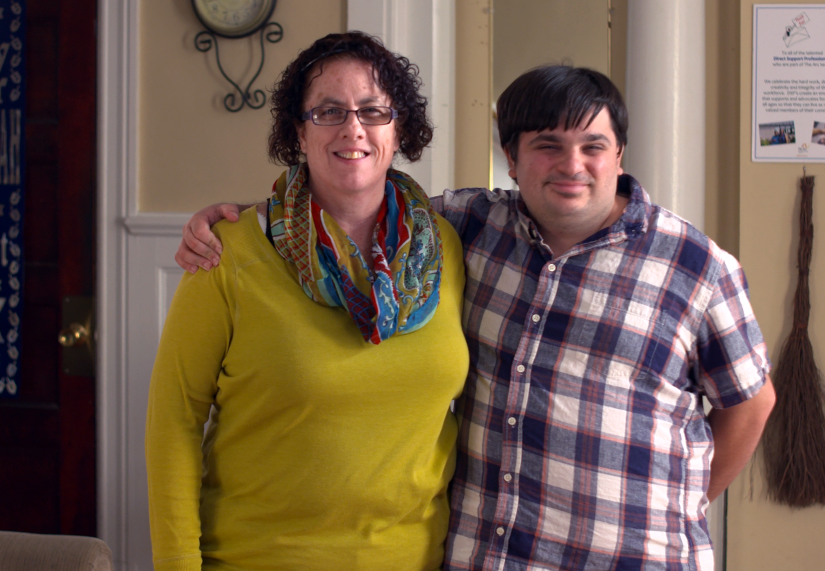
In today’s webinar we will
Learn why professionalizing the role of the DPS is important.
Learn the difference between career ladders and credentialing.
Learn how to build a career pathway for direct support professionals (DSPs) in your organization.
Notes:
Talking Points:
DSPs are often considered generalists who have to be able to provide many different types and levels of support in many different setting across a wide range of activities throughout the lifespan of people with disabilities.
Supporting the DSP in their professional development by creating career pathways is an important strategy for keeping great DSPs.
Today we will learn the basic steps in building a career pathway (ladder) or credentialing program in their organization. I’ll also share examples of different career ladders and credentialing programs currently available for DSPs.

Slide 4
Who Are Direct Support Professionals?
Notes:
Facilitor Note:
the next slide is a short clip from Invaluable that you can play after this slide – they do hand in hand.
Talking Points
Paid staff who support people with IDD to live their lives and enjoy the same opportunities and experiences as people without disabilities.
What are some of the job titles used in your organizations? Share in chat
Different employer-described job titles:
Direct Support Worker
Direct Support Specialist
Rehabilitation Specialist
Family Care Provider
Job Coach
Residential Counsel
Personal Assistant
Employment Specialist
And more . . .
DSPs are often considered generalists who have to be able to provide many different types and levels of support across a wide range of activities throughout the lifespan of people with intellectual and developmental disabilities (IDD).
They support people in whatever ways they need to enhance their inclusion and independence.
DSPs are usually hired in family/individual homes, intermediate care facilities, small community residential group homes, community job sites, vocational and day training programs, and other locations.
According to 2018 NCI staff stability report, the direct support workforce includes full-time (66%) and part-time (34%) employees (NCI, 2018). [LOCATE TN NUMBERS]
Most employers use the occupational title of Direct Support Professional, yet many DSPs may have different titles including direct support specialist, personal care assistant, habilitation specialist, job coach, residential counselor, family care provider, personal assistant, and others.

Slide 5

Notes:
Link to Invaluable Clip: https://youtu.be/WvWNyVp_JPM

Slide 6
Professionalizing
The DSP Role
Notes:
Transition slide

Slide 7
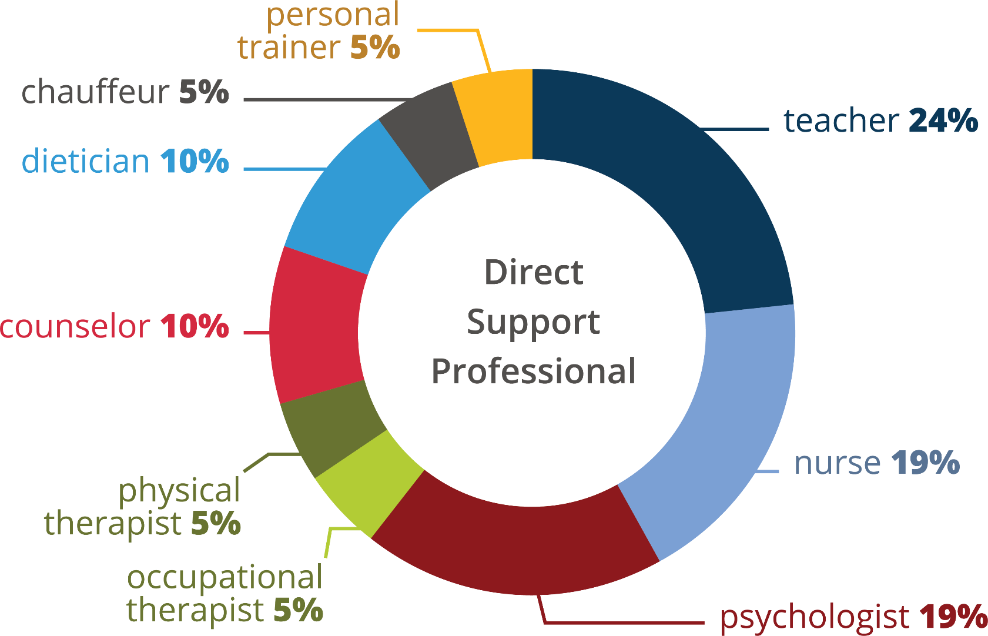
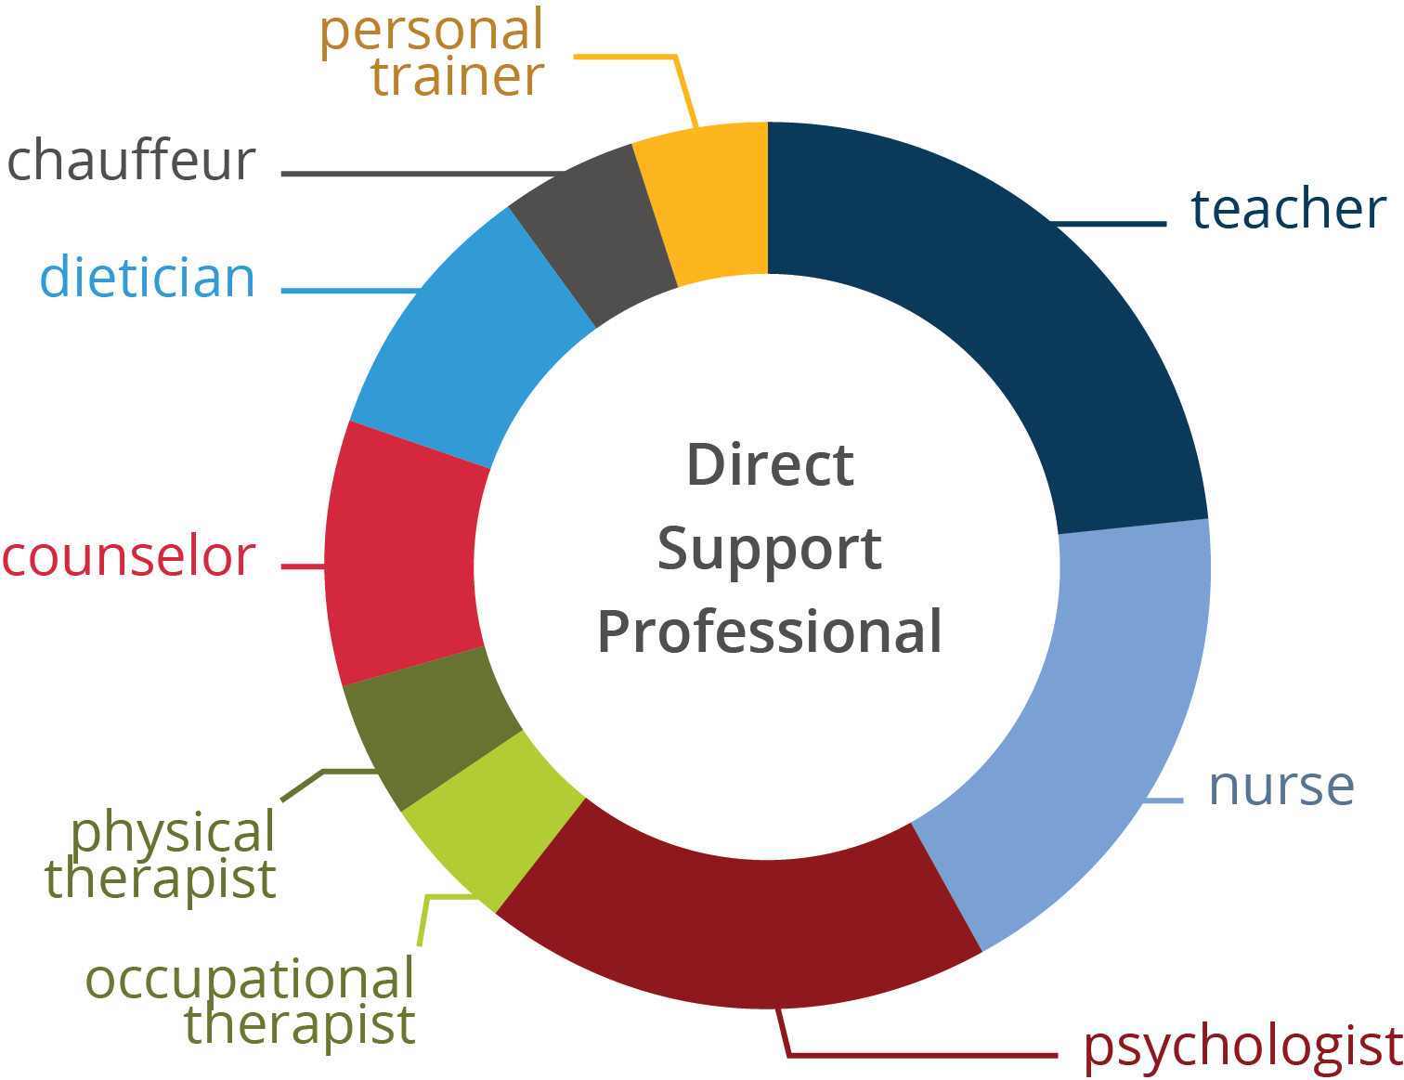
DSPs Are Professionals
Hewitt 2017
Notes:
Talking Points
The DSP role has often been viewed by policy makers and others as an entry level, low-skill job. This is not the case.
DSPs support people in advocating and facilitating services, provide emotional support and ensuring that people are healthy and safe in their homes.
The roles that DSPs played in the lives of people they support are almost endless and constantly evolving.
They are often expected to know and comply state and federal regulations, ensure accurate record – keeping and maintain current training requirements.
They are also expected to put quality in their work through their direct engagement, relationships and interactions with people they support. Lots of expectations, little pay and little recognition
The DSP is a complex but rewarding job. They are critical to people they support (drivers, counselors, chefs, community navigators, job coaches, accountants, nurses, etc.). They need training and often specialized skills.
Despite this, few states require any specialized training for DSPs.
Facilitor Notes: The percentages, if asked:
Personal trainer 5
Teacher 24
Nurse 19
Psychologist 19
OT 5
PT 5
Counselor 10
Dietician 10
Chauffer 5

Slide 8

Factors that Undermine Professionalizing the DSP Role
Lack of…
  Investment in the workforce by state governments & federal agencies
  Standard Occupational Classification (SOC) within the Bureau of Labor Statistics
  Data to measure fiscal or service impacts
  Systemic solutions to meet the growing demand for this workforce
Notes:
Talking Points:
What we know from decades of research is that there are key factors that have and continue to undermine professionalizing the DSP role including
Lack of sustained investment in workforce development across state and federal LTSS.
Lack of a SOC
Lack of data that connects investments to outcomes for people
Lack of system-level solutions to address rapidly increasing demand
The good is that there are efforts underway at both the state and federal levels to address these deficits in the current DSW workforce. Your participation in this TennCare initiative is one example and national organizations are working at the federal level to advocate for solutions to address these as well.

Slide 9
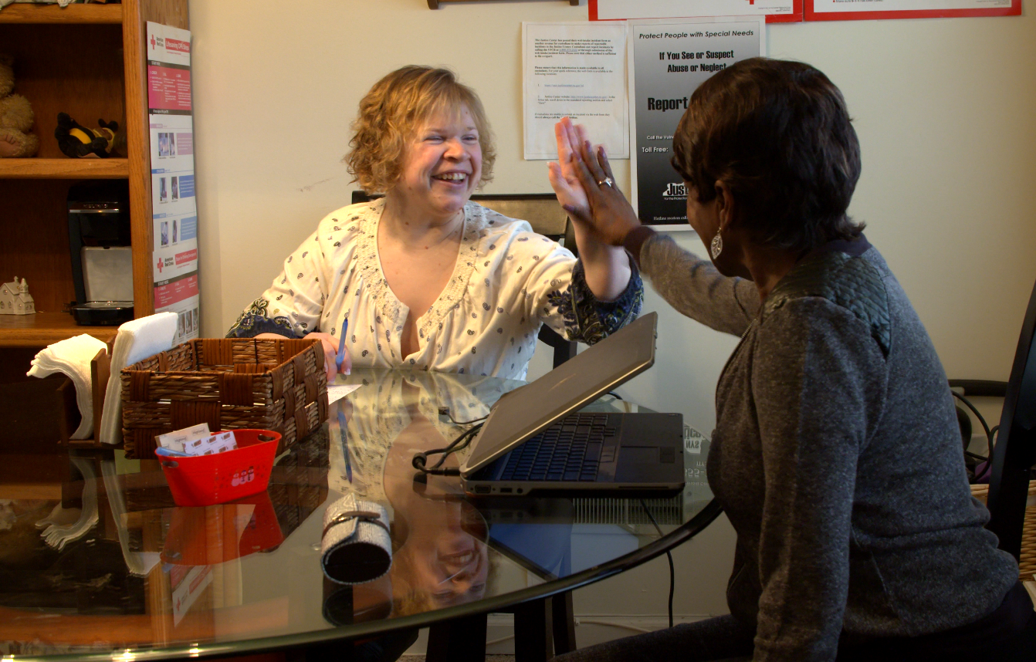
The Case for Professionalizing the DSP Role
Develop a Standard Occupational Code to monitor the workforce and workforce conditions (wages, turnover, and more)
Develop and implement competency-based career pathways and credentialing opportunities to ensure appropriate training for workers, and ways that workers can specialize their skills
Pair credentials and advanced specialties to wage increases that compensate the workforce for their skills
Notes:
Talking Points:
According to NADSP, there is easy answer to fixing the current workforce issues. However, based on research in other industries and through national discussions, creating a credentialing structure that can be easily implemented across the country has true potential for systemic impact.
Like nursing practice (e.g., LPN, CNA, RN, etc.), instituting a career ladder program for upward movement of DSPs as they enter this field of work is also an important step towards professionalizing the DSP role. Introduction of a career laddering program promotes tenure (NADSP, 2019).
In the absence of a degree seeking program, competency-based credentialing programs for DSPs can ensure that DSPs develop and use appropriate knowledge, skills and attitudes needed to do this job.

Slide 10
Poll Question
Do you currently use a career pathway program in your organization?
Yes
No
Maybe
Notes:
Poll
Facilitor Notes:
Have this poll ready to go. Read the question and give instructions for the poll. Give people about a minute to complete. Give them a 30 second warning for closing the poll.
Talking Points:
Let’s pause for a brief moment to respond to this poll? How many of you currently use a career pathway program in your organization?
Pause 15-30
Review the results.
That’s response aligns with responses I receive when I’ve asked this question during other presentations.
Move to next slide on building a career pathway program in your organization.

Slide 11
Building a Career Pathway Program
Career Ladders
Notes:
Transition Slide
Talking Points:
One strategy an organization can use to promote the DSP as a profession is to implement a career pathway program. A career pathway program

Slide 12
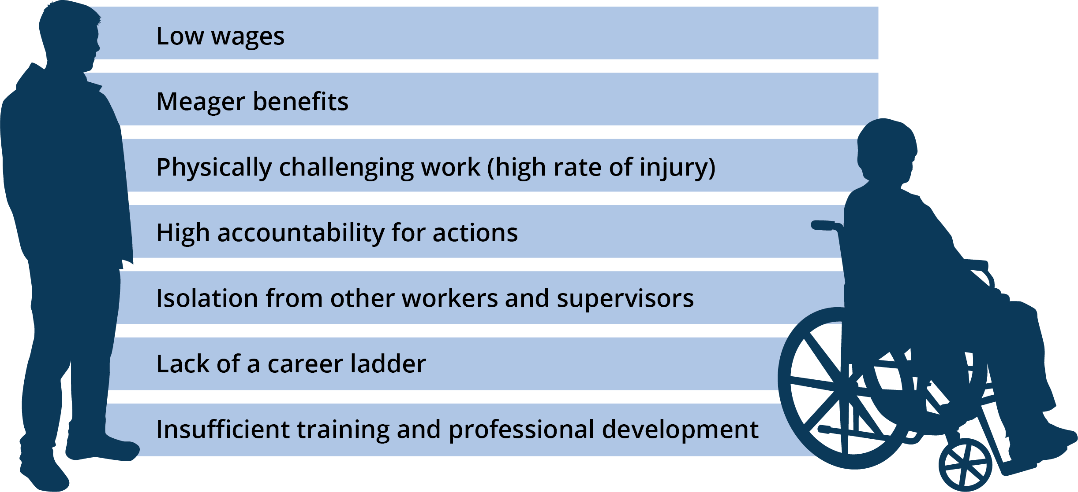
Workforce Conditions that Deter Entry into the Profession
(Source: President’s Committee for People with Intellectual Disabilities, 2017)
Notes:
Talking Points:
While low wages is the primary reason people don’t consider the profession - approximately 54% of DSPs’ families qualify for public benefits due to low income.
There are a lot of interventions that can address some of these issues.
One of them is the Career Pathways or Credentialing program.
Source: PCPID report., 2019

Slide 13

Why a Career Ladder?
Improve skills of workers
Create professional career paths
Improve quality and safety of supports
Entice workers to stay in the field
Improve pay and benefits
Enhance the status of DSPs & FLSs
Improve access to competency-based education and training
Notes:
Facilitor Notes:
Read through some of these examples on the slide.

Slide 14
Career Ladder and Credentials
Career ladders are ways that workers can gain professional recognition within their organization and the field for training and specialized skills
Credentials involve state and/or nationally recognized training requirements and an exam where the learner earns a specialized degree upon successful completion
Notes:
Talking Points:
I wanted to pause here to note the difference between career ladders and credentialing programs.
Career Ladders = gain professional recognition within their organization and the field for training and specialized skills
Credentialing = state and/or nationally recognized training requirements and an exam where the learner earns a specialized degree
Facilitor Notes:
This is focusing on building career ladders; however, will also share information about credentialing programs. as well that includes examples of current programs a little later in the presentation.

Slide 15
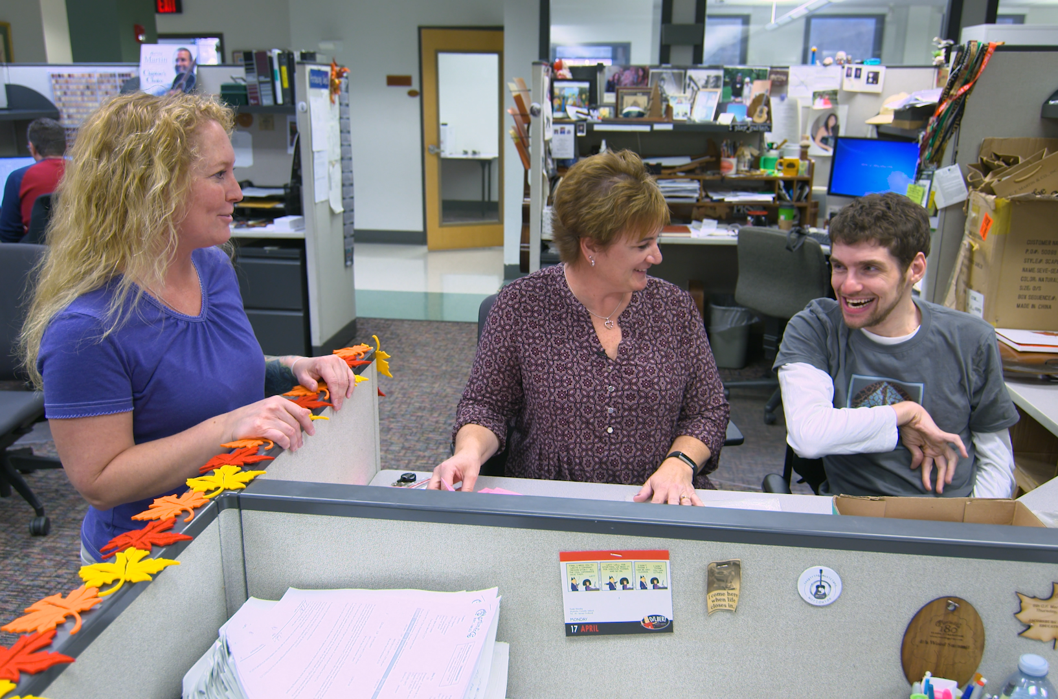
Eight Steps to Build a DSP Career Ladder
Hold stakeholder group gathering
Develop mission, vision, values, and goals
Create framework
Investigate and locate possible funding sources
Design training components
Implement program
Evaluate program
Plan for sustainability
Notes:
Talking Points:
We have identified 8 steps to building a DSP Career Ladder.
In the next few slides, we will be looking at each of the steps needed to create a career ladder program.
As you listen, take note which steps you have completed if you have already have a career ladder or credentialing program in your organization. Or note what steps you might need to consider if you are just starting out.

Slide 16

Hold Stakeholder Group Gathering
  Make a list of invitees
  Set a date and time to meet
  Set regularly scheduled meetings
  Get commitment from members
Notes:
Talking Points:
The first step to creating your own program is to talk with your stakeholders.
Consider all those who are important to help you think through the process and navigate it along with you.
Are they organizational decision makers? What influence do they have in your agency? What are they bringing to the table?
(Maybe provide specific examples of people/positions who could be stakeholders.)

Slide 17

Develop Mission, Vision, Values, and Goals
  Identify why a career ladder program will meet your needs
  Develop a work plan and timeline
  Identify desired outcomes
Notes:
Talking Points:
Next you want to work with those stakeholders to help you develop your mission, vision, values and goals specific to your career ladder program.
If you have or are working to develop a strategic plan to guide your organization, you can consider incorporating the two.
This is an important step because it helps you be clear about how the outcomes of this program will connect to and support outcomes for people who are supported by DSPs through your organization.

Slide 18

Create a Program Framework
  Agency – DSP Career Paths
  Nationally – NADSP Credentialing Program
  Nationally – DOL Apprenticeship Programs
  Statewide – DSP Certification
Notes:
Talking Points:
In this step, you want to create a framework for your program. Will you have different levels of DSPs in your organization? Are there training requirements for each level? Who is eligible to participate in a career ladder program?
There are model frameworks that exist at different levels.,
Review information on the slide.
Highlight DSP 1, 2, 3, specialty framework in 2 different national models.
National Alliance for Direct Support Professionals (NADSP)
DOL – Department of Labor

Slide 19

Investigate/Locate Possible Funding Sources
  Investigate & apply for grant funding
  Reallocate provider resources
  Use savings due to reduced turnover/vacancy
  CMS – Money Follows the Person
  Partnering with community colleges & workforce centers
  Legislative funding proposals tied to wage initiatives
Notes:
Talking Points:
Of course, an important step is to ensure that resources/funding are available to pay for the program. Some examples include:
Facilitor Note:
Review slide.

Slide 20

Design Program Components
  Identify skill & competency areas
  Education & training
  On-the-job training
  Mentoring & coaching
  Competency measures
  Application process & entrance criteria
  Evaluation plan
  Marketing plan
Notes:
Talking Points:
Next, your team will need to focus on designing the program. In doing that they should consider:
Facilitor Note:
Review elements on the slide.

Slide 21

Implement Program
  Kick-off & rollout program
  Baseline data collection
  Schedule regular meetings with cohort
  Update/revise plan
  Celebrate successes
Notes:
Talking Points:
You’ve completed your design, now its time to implement. Some key considerations when implementing your career ladder program include:
Facilitor Note:
Review the slide

Slide 22

Evaluate Program
  Data collection
  Analyze data
  Develop evaluation report
  Report back to stakeholders
  Revise program based on results
Notes:
Talking Points:
Evaluation is a critical step – it is the opportunity to review what is working, what’s not working and what changes are needed based on the data you are getting. If one of your desired outcomes for implementing a career ladders program is to retain great DSPs and after implementing, you will want to be sure you structure your evaluation to measure change in turnover or tenure.
This allows the organization to make changes to the program based on the evaluation data.

Slide 23

Plan for Sustainability
  Oversight
  Funding
  Commitment
Notes:
Talking Points:
Finally, when implementing a career ladder program its critical to plan for sustainability. Key elements to consider are:
Oversight – who are the key leaders who will keep this moving forward?
Funding – what are plans for funding in next 3-5 years? is this program included in the organization’s strategic plan?
Commitment – by board and organization leadership to ensure continuity when there are changes in leadership

Slide 24
What are potential barriers that you or your team may encounter while trying to implement these steps and how you may overcome them?
Use the chat box to share your responses.
Notes:
Facilitor Note:
You may have them share their list with the person sitting next to them when in-person. Online, you may have everyone review the steps and then share with the group one barrier and how they may overcome it.
Move to next slide to refresh member of 8 steps
Talking Points
Steps:
Hold stakeholder group gathering
Develop mission, vision, values, and goals
Create credentialing framework
Investigate/locate possible funding sources
Design credentialing components
Implement credentialing program
Evaluate credentialing program
Plan for sustainability

Slide 25

Review: Eight Steps to Build a DSP Career Ladder
Hold stakeholder group gathering
Develop mission, vision, values, and goals
Create framework
Investigate and locate possible funding sources
Design training components
Implement program
Evaluate program
Plan for sustainability
Notes:
Facilitor Note:
Show this slide to refresh participants memory on the eight steps

Slide 26
Building a Career Pathway Program
Credentialing
Notes:
Transition Slide
Talking Points:
We’ve talked about career ladders, and I want to spend a few minutes talking about credentialing programs and share some examples of both.

Slide 27
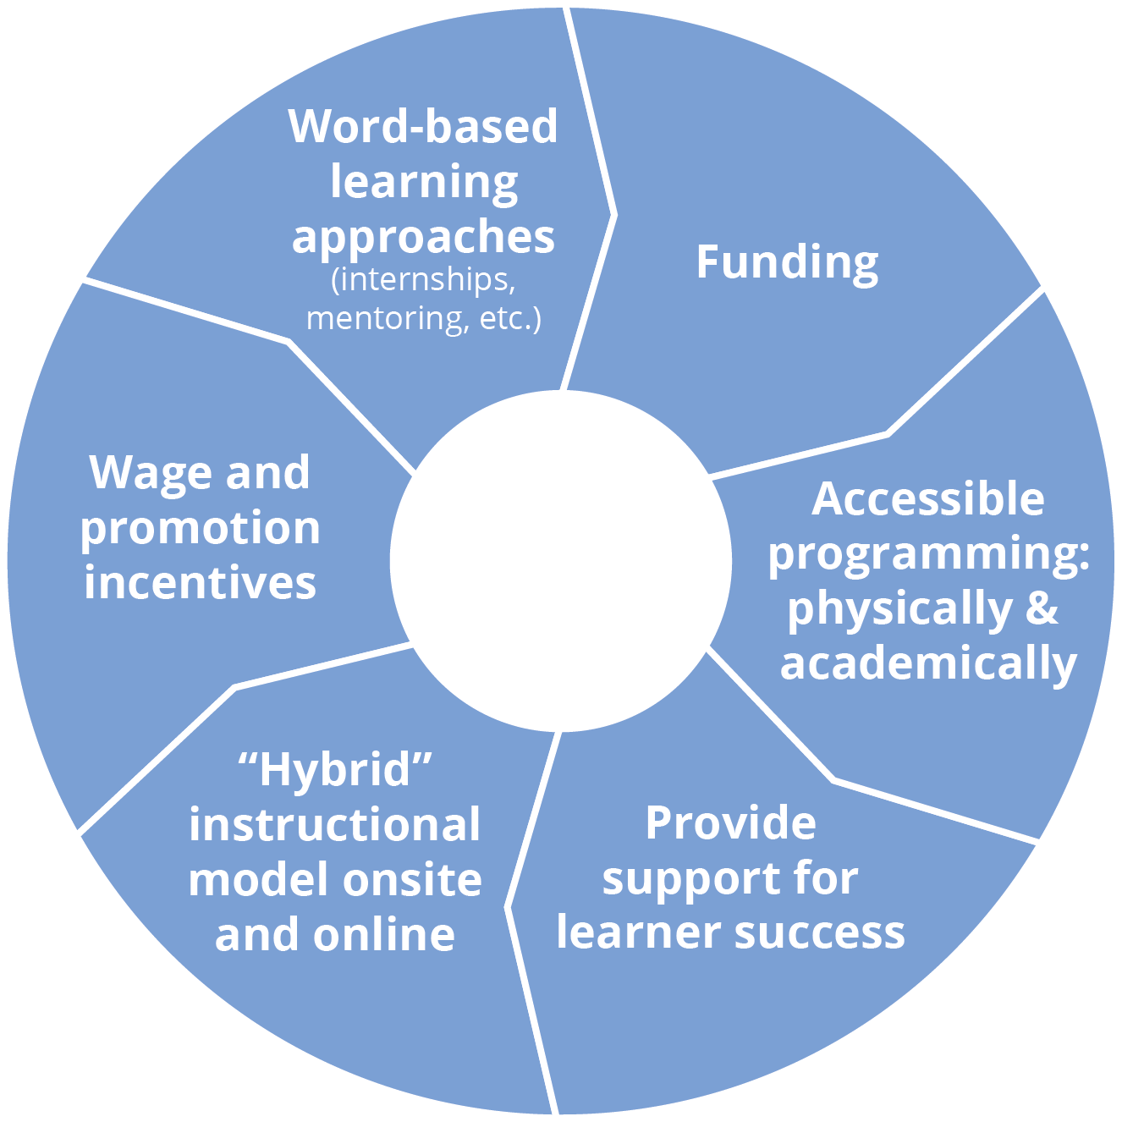
Research on features needed in a statewide DSP credentialing program
Desired program
components
(Source: Hewitt et al., 2015)
Notes:
Talking Points:
Stakeholders (self advocates, families, policy leaders etc) felt that these components need to be present to facilitate a successful credential structure.
At this time there is no state or national credential has been required for DSP practice.

Slide 28
Benchmarks of a Quality Credential Program
Competency Based
Transportable
Stakeholder Guided
Accessible
Articulates to other educational awards
Adds value
Uses valid, reliable, fair assessments
Incorporates method of revising standards
Requires periodic recertification/renewal
https://z.umn.edu/FICredentialing
From Taylor, M. A. (2007). If you build it, they will come. Frontline Initiative: Credentialing, 7(2).
Notes:
Facilitor Note: https://z.umn.edu/FICredentialing
Review slide
Talking Points:
Competency Based — draws for relevant, validated competency set
Transportable — parallel curricula & identical awards at different sites
Stakeholder Guided — includes educators, employers, employees, consumers
Accessible — cost, location, support
Articulates to others the educational awards AA, BA
Must add value-higher wage, college credit, expanded career opportunities
Use valid, reliable, fair assessments of KSAs
Incorporate method of revising standards
Call for periodic recertification/renewal

Slide 29
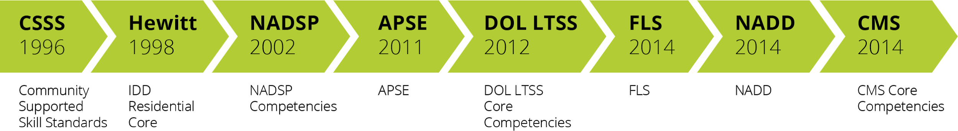
DSP competency sets 1996 - 2014
Notes:
Talking Points:
As with most of our workforce tools and strategies, there foundation is the DSP competency sets that have evolved to the current CMS Core Competencies
Acronyms
NADSP = National Alliance for Direct Support Professionals
APSE = Association of People Supporting Employment First
DOL = Department of Labor
FLS = Frontline Supervisor
DSP = Direct Support Professional
LTSS = Long Term Services and Supports
CMS = Centers for Medicare/Medicaid Services
NADD = National association for individuals with developmental disabilities and mental health needs
IDD = Intellectual and Developmental Disabilities

Slide 30
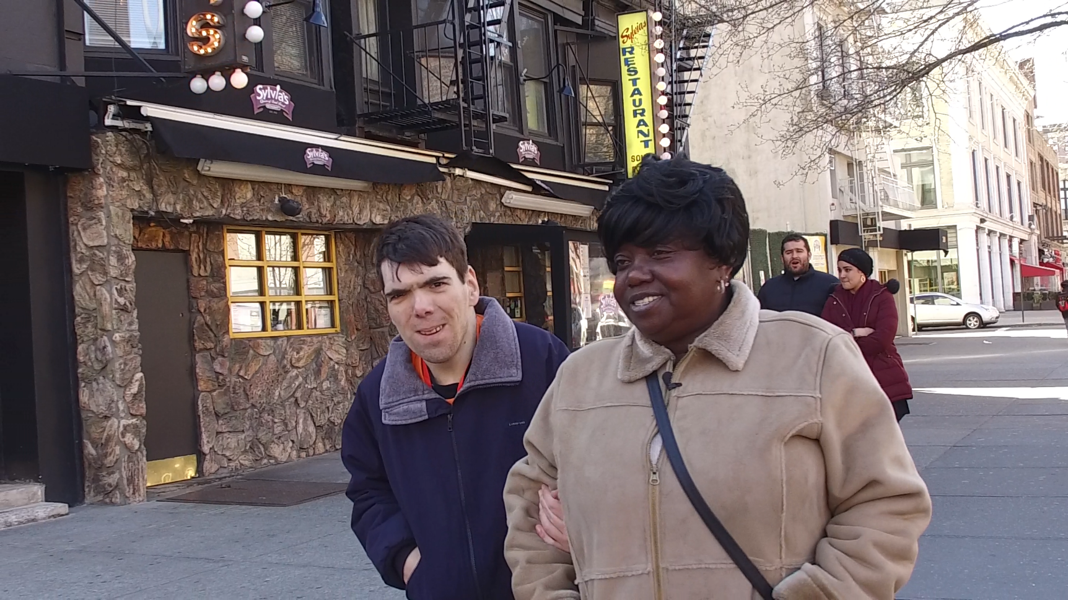
Framing with Skill Competencies
Competency-based
Promote career pathways
Based on Nationally Validated Competency Areas and Code of Ethics
Notes:
Talking Points:
Credentialing programs are focused on developing of skill competencies.
Direct Support Professional Competency Areas (NADSP, 2016a)
NADSP Code of Ethics (NADSP, 2016b)
National Frontline Supervisor Competencies (Sedlezky, Reinke, Larson, & Hewitt, 2013)

Slide 31
Measuring Competencies and Skills
Level 1
Knowledge Testing
Level 2
Performance Evaluation
Level 3
Applying Knowledge & Skills
Notes:
Talking Points:
Level 1 = Knowledge Testing
Examples: Pre and post testing
Level 2 = Performance Evaluation
Examples: On-the-job skill demonstration & assessment
Level 3 = Application of Knowledge & Skills
Examples: Portfolio & authentic work samples

Slide 32
Training Linked to Competencies
Communication | CMS Competency | TN QuILTSS Institute Badge | NADSP Core Competencies
Competency | The DSW builds trust and productive relationships with people s/he supports, co-workers and others through respectful and clear verbal and written communication. | The DSW builds trust and productive relationships with people s/he supports, co-workers and others through respectful and clear verbal and written communication. | The Direct Support Professional should be knowledgeable about the range of effective communication strategies and skills necessary to establish a collaborative relationship with the participant.
Skill Statement | Uses positive and respectful verbal, non-verbal and written communication in a way that can be understood by the individual, and actively listens and responds to him or her in a respectful, caring manner. | Work with the person supported so s/he has the time and other support needed to receive, consider, understand, and provide nonverbal communication and information. | The competent DSP uses effective, sensitive communication skills to build rapport and channels of communication by recognizing and adapting to the range of participant communication styles.
Notes:
Talking Points:
Here’s a quick comparison of the area of communication and the similarities and differences in the competency and skills statement across CMS, QuILTSS and NADSP.

Slide 33

Examples of Career Ladder &
Credentialing Programs
QuILTSS Institute - Pre-Early Service Training
Department of Labor Apprenticeship Program
NADSP Voluntary Certification Program &
E-Badge Academy
State Certification Program Using College of Direct Supports
GearUp-The New York DSP Credentialing Model
Notes:
Talking Points:
Let’s spend a few minutes looking at some examples to see if there are models that peak your interest to explore further.

Slide 34
Poll Question
Is your organization ready to participate in The QuILTSS Institute Workforce Development program?
Yes
No
Already participating
Notes:
Poll
Facilitator Notes:
First a quick poll
Read the slide.
Review results.
Thanks this is helpful information for us to consider.

Slide 35
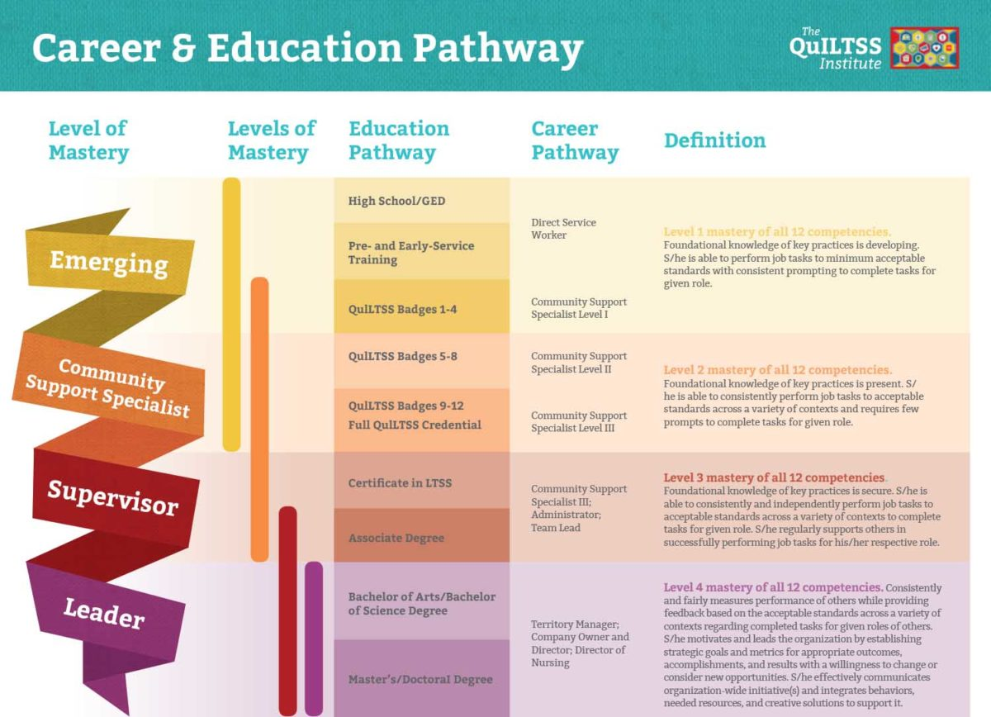
Notes:
Talking Points:
This is from the website and outlines QuILTSS approach to integrating career ladders (pre/early service training) and credentialing (QuILTSS badges 1-12)
From the website:
The QuILTSS Institute courses align to a recognized career and education pathway. As a direct service worker completes courses and demonstrates competence, the individual is able to advance in the education and talent pipeline. For each set of four competency badges you earn, you will increase a level in the Community Support Specialist designation.
For those completing the program in Tennessee, this may result in higher wages.
The Bureau of TennCare recognizes that successfully completing The QuILTSS Institute Workforce Development program will require you to make a number of personal sacrifices so you can better yourself professionally. They also recognize that your growth as a professional adds value to the services and supports you provide TennCare members, improving their quality of care and quality of life. Therefore, TennCare is working to be able to offer you increased wages as you grow in your career.
Why shouldn’t you earn higher wages for your increased competence?
As part of the upcoming Tennessee State budget that would begin July 1, 2020, TennCare plans to request funding to extend wage increases to people providing direct support in TennCare’s long-term services and supports programs (nursing facilities and home and community-based services) as they complete phases of the QuILTSS Workforce Development Training Program. It’s a new value-based approach that will help to reward providers and specifically reward you for the higher level of training and competency you bring to your daily work. Of course, the ability to do that will depend on the budget request being approved. You can find updates as the budget process moves forward in 2020.

Slide 36
of TN QuILTSS
Source: Charla Long, 2017
Notes:
Talking Points:
The QuILTSS Institute courses align to a recognized career and education pathway. As a direct service worker completes courses and demonstrates competence, the individual is able to advance in the education and talent pipeline. Through the Bureau of TennCare, earning each designation of a Community Support Specialist allows the employee to receive additional wages.
The following is from this webpage: https://quiltss.org/our-team/
Semester #1
Person-Centered Practices – 2 credits
Evaluation & Observation – 2 credits
Communication – 1 credit
Professionalism & Ethics – 1 credit
Total credits earned for Semester #1 – 6 credits
Semester #2
Community Inclusion & Networking – 2 credits
Community Living Skills & Supports – 2 credits
Empowerment & Advocacy – 1 credit
Health & Wellness – 1 credit
Total credits earned for Semester #2 – 6 credits
Semester #3
Crisis Prevention & Intervention – 2 credits
Cultural Competency – 2 credits
Education, Training & Self-Development – 1 credit
Safety – 1 credit
Total credits earned for Semester #3 – 6 credits

Slide 37












TN QuILTSS Institute Badges
Notes:
Talking Points:
Quick refresher of the badges
https://quiltss.org/programs/#juumhijrkn This web page appears to describe the badges and competencies
This is what the web page says about where the competencies are based on:
Workforce Development Training Courses
The following workforce development offerings are based on the Centers for Medicare & Medicaid Services (CMS) Direct Service Workforce Core Competencies, released in December 2014. These competency courses are designed to strengthen and enhance today’s direct service workforce through the ongoing development of these individuals’ knowledge, skills, abilities, and intellectual behaviors.
The competency areas are the same, but the skill statements are different from the CMS Core competencies.
Here is the listing for each of the badges from the webpage:
Professionalism and Ethics
Communication
Evaluation and Observation
Community Living Skills & Supports
Community Inclusion & Networking
Empowerment & Advocacy
Health & Wellness
Cultural Competency
Crisis Prevention & Intervention
Safety
Education, Training & Self-Development
From the website:
The QuILTSS Institute courses align to a recognized career and education pathway. As a direct service worker completes courses and demonstrates competence, the individual is able to advance in the education and talent pipeline. For each set of four competency badges you earn, you will increase a level in the Community Support Specialist designation.
For those completing the program in Tennessee, this may result in higher wages.
The Bureau of TennCare recognizes that successfully completing The QuILTSS Institute Workforce Development program will require you to make a number of personal sacrifices so you can better yourself professionally. They also recognize that your growth as a professional adds value to the services and supports you provide TennCare members, improving their quality of care and quality of life. Therefore, TennCare is working to be able to offer you increased wages as you grow in your career.
Why shouldn’t you earn higher wages for your increased competence?
As part of the upcoming Tennessee State budget that would begin July 1, 2020, TennCare plans to request funding to extend wage increases to people providing direct support in TennCare’s long-term services and supports programs (nursing facilities and home and community-based services) as they complete phases of the QuILTSS Workforce Development Training Program. It’s a new value-based approach that will help to reward providers and specifically reward you for the higher level of training and competency you bring to your daily work. Of course, the ability to do that will depend on the budget request being approved. You can find updates as the budget process moves forward in 2020.

Slide 38
ECF Competency Topics
1. Disability Rights Movement
2. Universal EVV System Training
3. Standard Precautions
4. Introduction to Employment and Community First (ECF)
5. Importance of Employment
6. Everyone Can Learn
7. Supporting Community Participation
8. Importance of Full Citizenship and Valued Social Roles
Notes:
Facilitator Notes:
EVV = Electronic Visit Verification
Talking Points
As ECF providers you are familiar with these competency topics.

Slide 39
ECF Competency Topics
9. HCBS Settings Rules (Providers are Required to Use with DSPs)
10. Introduction to Supporting People
11. Keys to Supporting People to Form and Keep Relationships
12. Working with Individuals and Families
13. Positive Behavior Supports
14. Self-Determination for Personal Expression
15. Keeping People Safe
Notes:
Talking Points
As ECF providers you are familiar with these competency topics.

Slide 40
DOL Apprenticeship Program
On-the-Job Learning (OJL): 3,000-4,500 hours
Related Instruction: 220 hours
Three Levels
  DSP Registered
  Initial Certification
  Advanced Certification
Notes:
Talking Points:
Identifies competencies (NADSP)
Organizes training needs
Provides a structure for skill demonstration
Offers recognition
Credential
Wages
Facilitor Notes (if asked about specifics)
DSP-R (Registered)
Criminal background check
Letter of commitment
40 hours of initial instruction
Code of ethics commitment
DSP-IC (Initial Certification)
72 hours of related instruction (72+40=112)
Three CSSS required competencies (communication, documentation, community living skills)
Three additional CSSS competencies
Work samples in four areas
1,200-1,800 hours of OJL
Code of ethics commitment
DSP-AC (Advanced Certification)
DSP-IC is a pre-requisite
108 Hours related instruction (108+112=220)
Remaining nine CSSS
Work samples in four or more areas
1,800-2,700 hours of OJL

Slide 41


NADSP Voluntary Credentialing Program
DSP-R (Registered)
DSP-I (Certified)
DSP-II (Certified)
DSP–III–Specialist Areas
Notes:
Facilitor Note: Link to Comparison between E-Badge Academy and Traditional NADSP Certification: https://nadsp.org/wp-content/uploads/2019/05/NADSP-E-Badge-Academy-Certification-Comparison.pdf
Talking Point:
NADSP’s Voluntary Credentialling Program has four levels as you can see here.
Facilitor Note: Details about each level if asked.
DSP - R (Registered)
Criminal background check
Letter of commitment to DSP work and study
Code of Ethics commitment
Letter of reference from employer
Proof of at least 6 months of employment in human services
Application fee of $50
DSP-I (Certified)
DSP-R is a pre-requisite
Proof of completion of NADSP accredited training/education program
100 hours of related instruction
1,500 hours of OJL
Portfolio work samples in 4 of 15 NADSP Competency Areas, evaluated by an independent NADSP team
Code of Ethics commitment
Application Fee - $100
DSP-II (Certified)
DSP-I pre-requisite
Proof of completion of NADSP accredited training/education program
100 hours of related instruction
3,000 hours of OJL
Portfolio work samples in 4 additional NADSP Competency Areas, evaluated by an independent NADSP team
Code of Ethics commitment
Application Fee - $50.00
DSP-III – Specialist Areas
Health Support
Employment Support
Inclusion
Positive Behavior Supports
Mentoring and Supervision
Aging Supports
DSP – III
DSP-II is a pre-requisite
Proof of completion of NADSP accredited training/education program
40 hours of training in Area of Specialty
Additional 1,500 hours of OJL
Portfolio work samples in 3 additional NADSP Competency Areas, evaluated by an independent NADSP team
Code of Ethics commitment
Application Fee - $100

Slide 42

NADSP Voluntary Credentialing Program
NADSP Code of Ethics
Accredited Education Training on 15 NADSP Competency Areas
Skill Demonstration and Assessment-The DSP Portfolio
Portfolio Development-NADSP
E-Badge Academy
Portfolio Review and Assessment
Notes:
Talking Points
NADSP Code of Ethics
Person-Centered Supports
Promoting Physical & Emotional Well-Being
Integrity and Responsibility
Confidentiality
Justice, Fairness, Equity
Respect
Relationships
Self-Determination
Advocacy
NADSP 15 DSP Competencies
Participant Empowerment
Community Living Skills and Supports
Communication
Documentation
Assessment
Community and Service Networking
Facilitation of Services
Education, Training, & Self-Development
Advocacy
Crisis Prevention & Intervention
Vocational, Educational, & Career Support
Organizational Participation
Building & Maintaining Friendships and Relationships
Providing Person-Centered Supports
Supporting Health & Wellness
Skill Demonstration/Assessment-NADSP E-Badge Academy
Candidate’s Portfolio
A collection of work & study: work samples, reflection, and related instruction
Proof of mastery and ethical application of skills and knowledge
Demonstrate competence in 8 of 15 Competency Areas
Submitted to trained portfolio reviewers
Portfolio Development- NADSP E-Badge Academy
Reflective Statement
Work Samples
Written journal entries
Photo essay
Slide presentation
Audio tapes
Brochures
Importance of Work Samples:
Reflects change in service delivery
Illustrates improved outcomes for person receiving services
Shows individual growth
Portfolio Review and Assessment
Evaluating Work Samples
Trained portfolio reviewers
Established guidelines
Practice
Proficient
Advanced

Slide 43

State Certification Program Using DirectCourse: College of Direct Supports
DSP-1
DSP-2
DSP-3
Notes:
Talking Points
Explain what a CDS course is and how it is accessed.
For TennCare, they are using QuILLTS. Is this just one example from Minnesota or anther state?
DSP-1
1 Module + First Aid & CPR
8 CDS Courses: Based on 3 Competency Areas and State Training Requirements
Training Hours: 58 + OJL Hours: 600
DSP-2
2 Modules
7 CDS Courses: Based on 3 Competency Areas
Total Training Hours: 124
Total OJL Hours: 1,200
Portfolio work sample based on 4 Competency Areas
DSP-3
3 Modules
12 CDS Courses (Electives May be Added): Based on 9 Competency Areas
Total Training Hours: 220
Total OJL Hours: 3,000
Portfolio work sample- 4 more Competency Areas

Slide 44
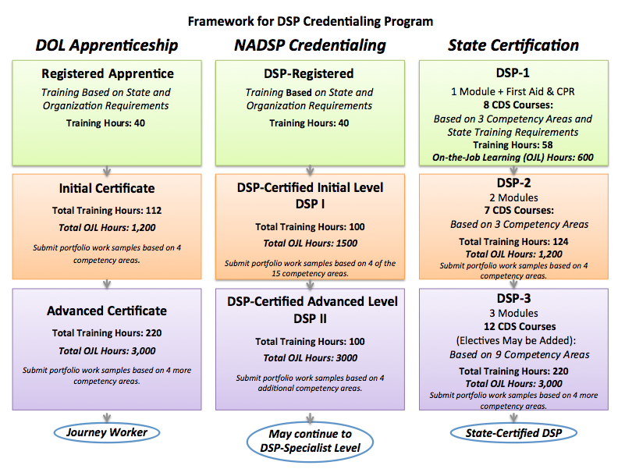
Notes:
Facilitor Note:
Nice visual, but very small and scrunched, so it is difficult to read.
Need to locate source citation

Slide 45
(Source: Hewitt et al., 2015)
Notes:
Talking Points
Features of the Proposed Credentialing Model – proposed by and for whom?
Includes both private and public sector organizations statewide.
97,382 DSPs in the private sector and 13,024 in the public sector
Annual enrollment growth targets from 3% to 20% of DSPs statewide in five years.
Demand for services is expected to grow at a rate of 9% each year.
In five years, aims to award credentials to 24,008 DSPs in the private sector and 3,211 DSPs in the public sector.
Financial Model
Includes training costs for targeted enrollment based on online training, interactive classroom-based learning, and work-based learning methods
Includes program implementation in private and public sector, and establishing and running a governing administrative body

Slide 46

8 Steps for Implementing Career Ladders or Credentialing
Step 1: Identify and assess the problem
Step 2: Select an intervention strategy
Step 3: Identify components of the strategy
Step 4: Identify barriers to implementation
Larson & Hewitt, 2005
Notes:
Talking Points:
Walk through the steps on the slide using example of developing a career pathway program in their organization
Use QuILTSS Institutte ECF topics as an example

Slide 47

8 Steps for Implementing Career Ladders or Credentialing
Step 5: Identify support for the strategy
Step 6: Set goals, measure progress & establish a time frame
Step 7: Implement the strategy
Step 8: Evaluate success
Larson & Hewitt, 2005
Notes:
Facilitor Note:
Walk through the steps on the slide.

Slide 48
Resources
CMS Core Competencies
https://www.medicaid.gov/sites/default/files/2019-12/dsw-core-competencies-final-set-2014.pdf
QuILTSS Institute Career & Education Pathway
https://quiltss.org/wp-content/uploads/2019/01/QuILTSS-Career-Education-Pathway.pdf
NADSP E-Badge Academy
https://nadsp.org/e-badges/
Two NADSP Credentialing Models: A Comparison
https://www.youtube.com/watch?v=2dJerQ_3Grs
Frontline Initiative –Credentialing
https://ici.umn.edu/products/Frontline_Initiative/FI_7_2.pdf
Invaluable-The Unrecognized Profession of Direct Support
https://ici.umn.edu/product/invaluable/main
Notes:
Facilitor Note: Reference for this slide deck
References:
Bureau of Labor Statistics (BLS), U.S. Department of Labor. (2017, April). Job openings and labor turnover — February 2017. (News Release USDL-17-0416).
Bureau of Labor Statistics (BLS), U.S. Department of Labor (2016, May). Labor force characteristics of foreign-born workers summary. (News Release USDL-16-0989).
Bureau of Labor Statistics (BLS), U.S. Department of Labor. (2015, December). Fastest growing occupations. Occupational Outlook Handbook.
Espinoza, R. (2017). Federal policy priorities: Strengthening the direct careworkforce. Bronx NY: Paraprofessional Healthcare Institute [PHI].
Hewitt, A., & Larson, S. (2007). The direct support workforce in community supports to individuals with developmental disabilities: Issues, implications, and promising practices. Developmental Disabilities Research Reviews, 13, 178-187. doi:10.1002/mrdd.20151
Hewitt, A., Taylor, M., Kramme, J., Pettingell, S., Sedlezky, L. (2015). Implementing Direct Support Professional Credentialing in New York: Final Technical Report. Albany: Office for People with Developmental Disabilities. Retrieved from https://opwdd.ny.gov/opwdd_about/commissioners_page/CredentialTechnicalReport.
Paraprofessional Healthcare Institute (PHI). (2015). Paying the price: How poverty wages undermine home care in America. Washington, D.C.: Author.
Paraprofessional Healthcare Institute (PHI). (2011, February). Who are direct-care workers? PHI Facts. Washington, D.C.: Author.
President’s Committee for People with Intellectual Disabilities [PCPID] (2017). Report to the President 2017 America’s Direct Support Workforce Crisis: Effects on People with Intellectual Disabilities, Families, Communities and the U.S .Economy. Washington, D.C.: The Administration for Community Living.

Slide 49
Questions?
To receive the slides from today’s webinar or to further discuss this strategy:
Contact your UMN workforce consultant
Go to: tenncare.ici.umn.edu
Email us at: dsp-tn@umn.edu
Notes:
Facilitor Notes:
Update this slide’s contact information

Slide 50
Next Workforce Toolkit Webinars
The DPS Workforce Initiative Online Toolkit
May 18, 10-11 a.m. Central Time
Peer Mentoring Program
May 21, 2–3 p.m. Central Time
Employee Development
June 25, 2–3 p.m. Central Time
Notes:
Facilitor Notes:
Update this slide’s information

