Slide 1
Community of Practice
November 12th, 2024 • 3:00 – 4:15 p.m.

Slide 2
Land Acknowledgement
In Minnesota, we are standing on Miní Sóta Makhóčhe, the rightful homelands of the four Dakhóta Oyáte nations, the seven Anishinaabeg nations, and other indigenous peoples. We recognize that the U.S. did not uphold its end of the land treaties. It is the current and continued displacement of indigenous peoples that allows the State of Minnesota to exist today.

Slide 3
Affirmation of Commitment
At the Institute on Community Integration, we affirm our commitment to address systemic racism, ableism, and all other inequalities and forms of oppression to ensure inclusive communities.
Funding Statement
Funding for today’s Learning Community Event is provided by state appropriation through the Minnesota Office of Higher Education.

Slide 4
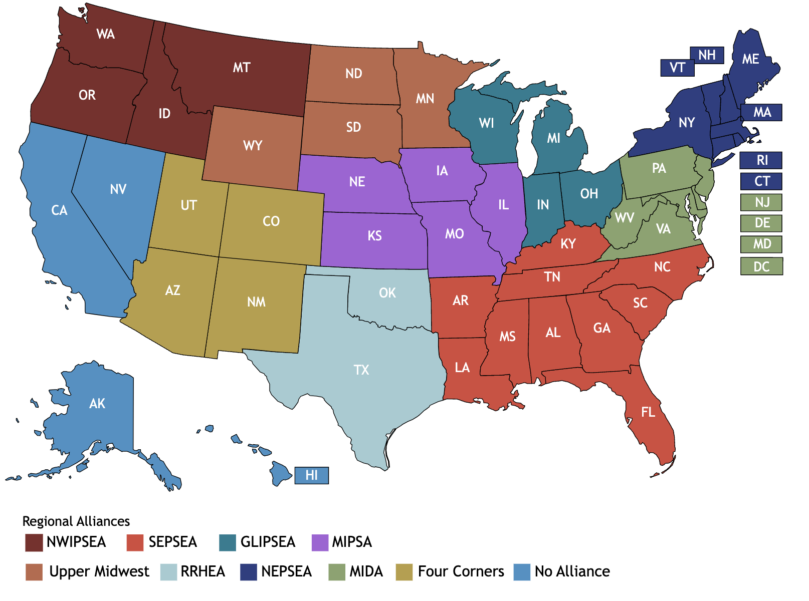
Upper Midwest Regional Alliance

Slide 5
Employment & Vocational Rehabilitation
Dante Allen Rehabilitation Services Administration Listening Session
Strengthening Higher Education and Vocational Rehabilitation Partnerships (VCU)
National Employment Partnership Workgroup
Top Strategies for Statewide Collaboration
Think College - New Employment and Vocational Rehabilitation Resources
Access to Better Careers (UMD-College Park)
Career- Focused Program of Study
Meaningful Internships and Employment
Leveraging Existing Campus Resources
VR Partnership

Slide 6
Mental Health Strategies for College Students with IDD
College Student Mental Health Crisis
LImited Campus Mental Health Resources
Students with IDD encounter additional barriers to access mental health services
Mental Health Professionals - Additional training and preparedness to work with students with IDD
Support Strategies
Proactive culture to identify/disclose and assess for support mental health needs
Educate
Develop Self-Awareness
Review/Revise policies
New Resource

Slide 7
Including Indigenous People and Tribal Colleges
Indigenous Initiatives Across the AUCD Network
South Dakota - Oyate Circle- South Dakota University
Arizona - Native Center for Disabilities - University of Arizona
New York - Strong Center for Developmental Disabilities - University of Rochester

Slide 8
Using Research to Improve Student Outcomes
The presentation highlighted the annual report for the Transition and Postsecondary Education Programs for Students with Intellectual Disability (TPSID).
Key Takeaways:
134 programs with almost 5,000 students
98% of students were in at least 1 inclusive course
More than 29,000 inclusive courses were taken
74% of student had paid employment 1 year after graduating
70% after 2 years
Annual Report can be viewed in the Google Drive

Slide 9
Using Research to Improve Student Outcomes Cont.
Inclusive Research Symposium
Key Takeaways:
Find accessible ways to use student voices.
Photovoice Narrative
Use universal design for learning (UDL) framework for surveys.
Include individuals with intellectual disabilities as co-researchers.
Let the data drive your argument with:
School Officials
Stakeholders
Legislature
Families

Slide 10
Program Accreditation
There is a push for program accreditation on a national level.
Why?
To demonstrate quality programming and improve student outcomes.
For eligibility, the program needs to:
be a Comprehensive Transition and Postsecondary (CTP) Program
serve students with intellectual disabilities
exist for 3 years and have two graduated cohorts
Offer a credential issued by an institute of higher education

Slide 11
Program Accreditation Cont.
The process includes:
Providing evidence of your program meeting 10 standards
A site visit
Peer review process
Current accredited programs have found:
Increased program visibility
Increased interest from donors
Improvements in program
Programs will be able to apply for accreditation in the Fall of 2026.
BUT, start collecting evidence now to speed up the process.

Slide 12
Supporting Development of Inclusive Higher Education Around the World
Think College Global Reach
Study Abroad opportunities
International students studying at US institutions
US providing international technical assistance
International collaborations

Slide 13
Hierarchy of Disability and Lateral Ableism
Study followed students in an inclusive higher education program
Research highlighted the prevalence of hierarchy of disability and ableism students with IDD had toward their peers
People with disabilities also perpetuate ableism
Need for continued conversations

Slide 14
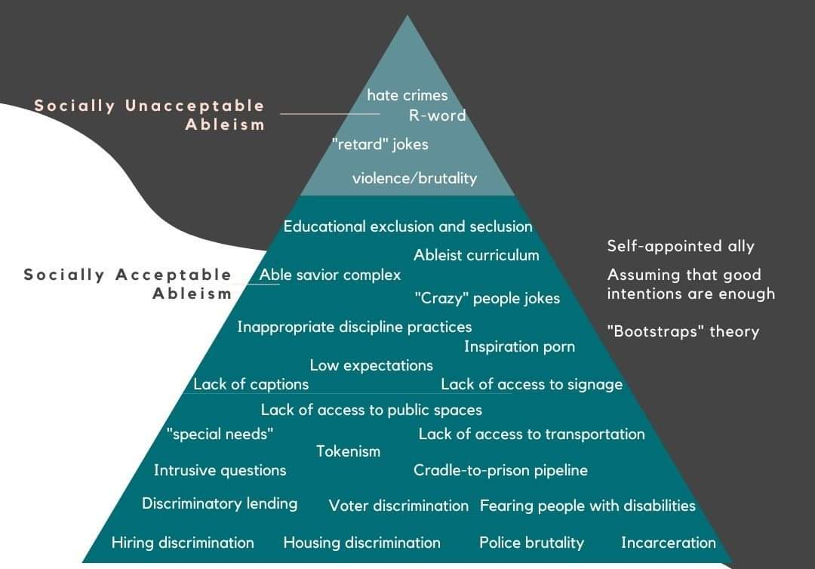
Ableism
Ableism: The discrimination or prejudice against people who have disabilities. Ableism can take the form of ideas and assumptions, stereotypes, attitudes and practices, physical barriers in the environment, or larger scale oppression.

Slide 15
Study Demographics
15 Participants
73% white, 13% Asian, 13% Black/African American
46% Female, 46% Male, 6% non-binary
Qualitative Methods
Participant Observations
Interviews
Focus Groups

Slide 16
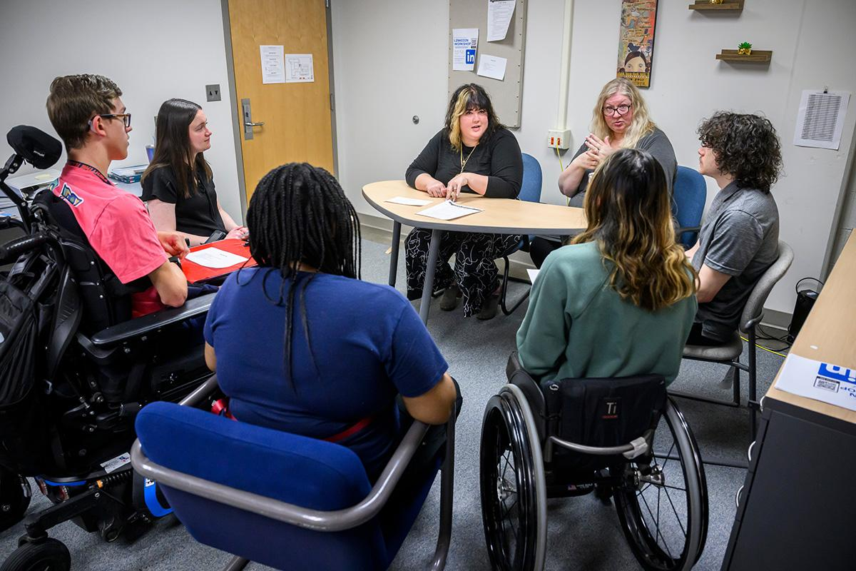
Lateral Ableism
Lateral ableism: is when a disabled person is biased against another disabled person. A disabled person can discriminate against or overlook another disabled person. It can be intentional or not.

Slide 17
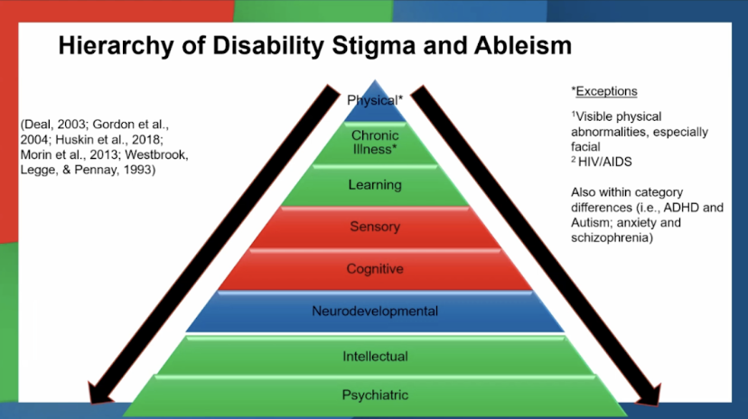
Hierarchical Ableism
Hierarchical Ableism: a social construct that makes certain kinds of disabilities more acceptable than others.

Slide 18
Impacts of Lateral Ableism Between Students
Needing more support perceived as “bad”
Believing they are above needing support
Showing preference for individuals who communicate similarly
Privileging people with verbal speech
Comparing success

Slide 19
Being Anti-Ableist
Explore our ableist beliefs
Stop using ableist language
Help others do better when they display ableism
Listen to people's experiences with disabilities
When we fight ableism, we create a better, more just world for those living with disabilities.

