Slide 1
MIHEC Learning Community
October 15, 2024 • 6:00 – 7:15 p.m.

Slide 2
Land Acknowledgement
In Minnesota, we are standing on Miní Sóta Makhóčhe, the rightful homelands of the four Dakhóta Oyáte nations, the seven Anishinaabeg nations, and other indigenous peoples. We recognize that the U.S. did not uphold its end of the land treaties. It is the current and continued displacement of indigenous peoples that allows the State of Minnesota to exist today.

Slide 3
Affirmation of Commitment
At the Institute on Community Integration, we affirm our commitment to address systemic racism, ableism, and all other inequalities and forms of oppression to ensure inclusive communities.
Funding Statement
Funding for today’s Learning Community Event is provided by state appropriation through the Minnesota Office of Higher Education.

Slide 4
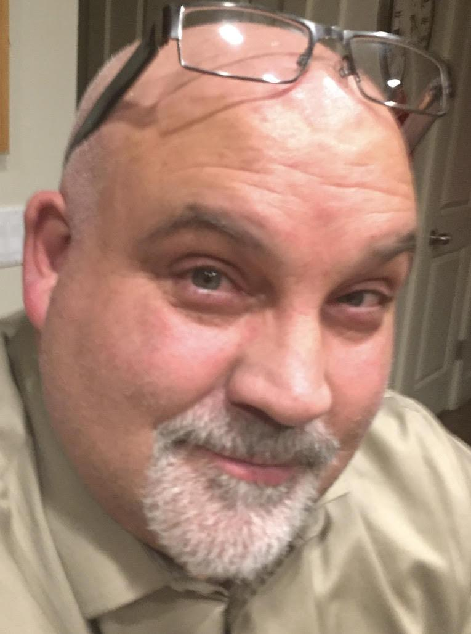
Russ Thelin, M.S., LVRC, CRC
Russ Thelin, M.S., CRC, CRL, is a Senior Policy Fellow at the Institute for Community Inclusion, University of Massachusetts Boston, with 34 years of experience in vocational rehabilitation, including leadership roles in Utah's state office. He specializes in vocational rehabilitation counseling, organizational change, business engagement, and inclusive post-secondary education.

Slide 5
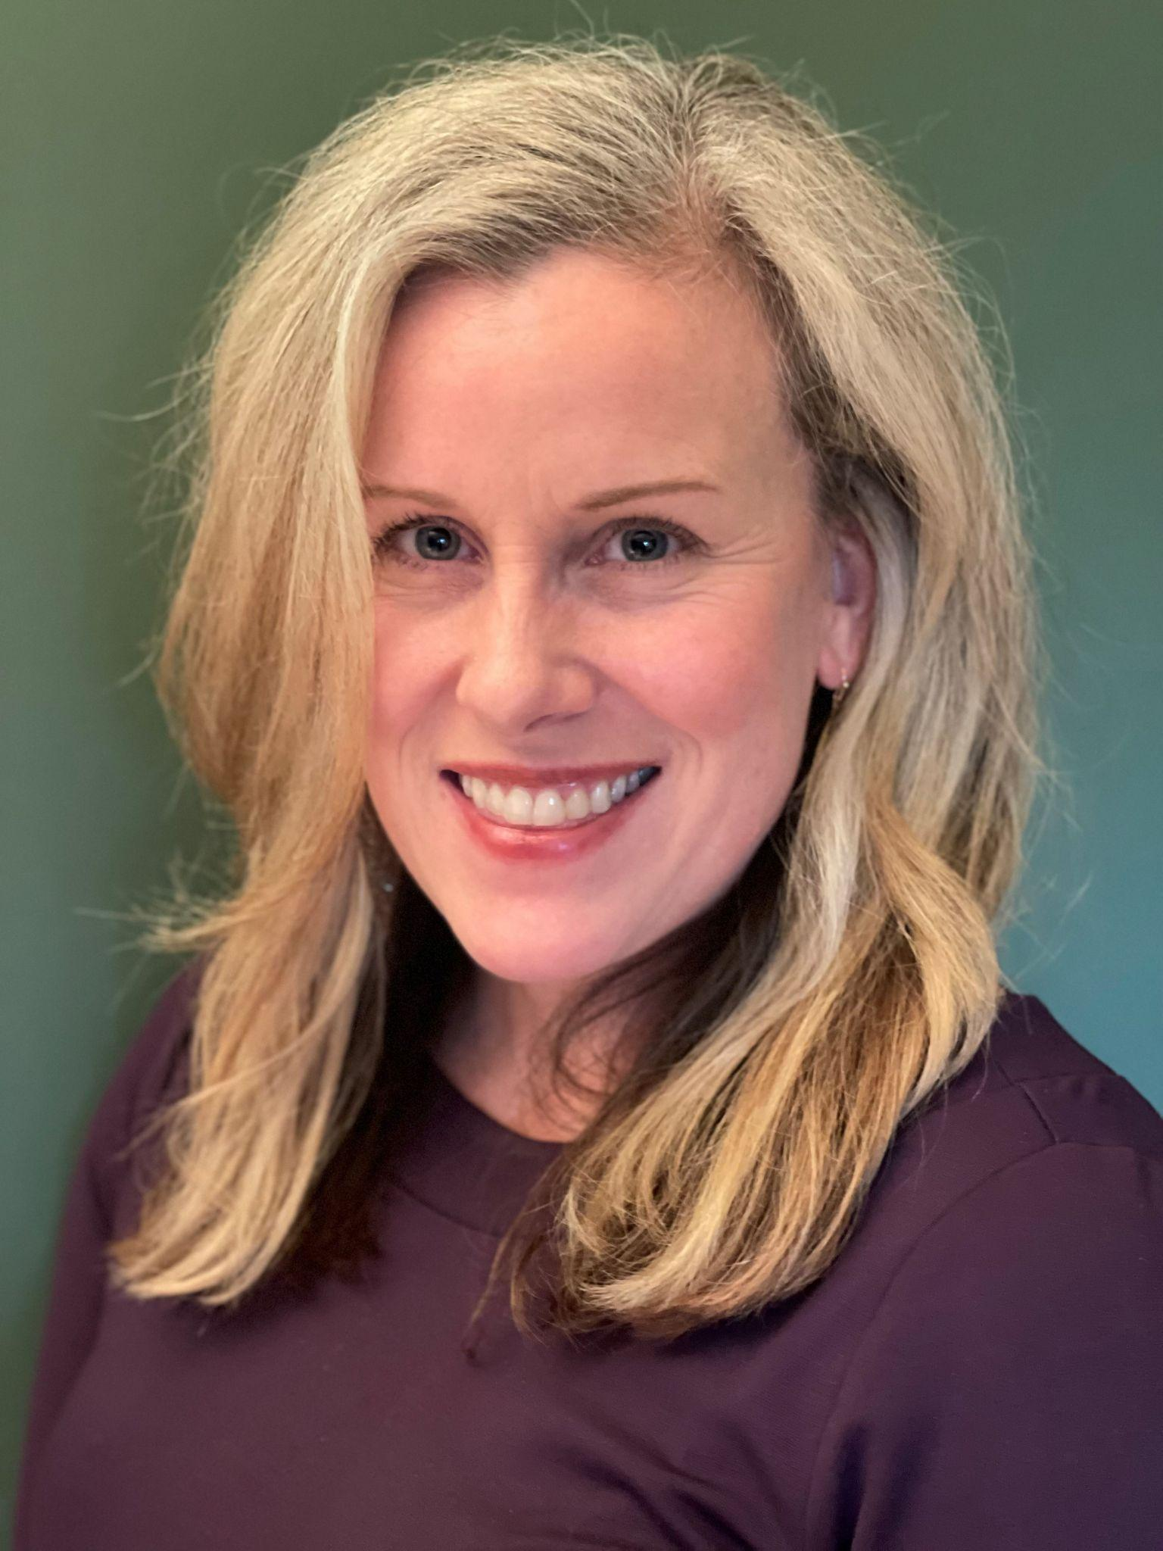
Alyssa Klein M.S., CRC
Alyssa has 28 years of experience with Vocational Rehabilitation Services, starting as a career guidance counselor for youth and adults with disabilities. In her current statewide role, she focuses on policy, interagency initiatives, and training to support youth with disabilities in postsecondary education, independent living, and employment.

Slide 6
WHAT IS VOCATIONAL REHABILITATION, REALLY?
A PRESENTATION FOR THE MIHEC LEARNING COMMUNITY EVENT
OCTOBER 15, 2024

Slide 7
INTRODUCTIONS
Russ Thelin, Senior Policy Fellow, University of Massachusetts, Institute on Community Inclusion (ICI)
Alyssa Klein, Youth Services Coordinator, MN Department of Employment and Economic Development (DEED)-Vocational Rehabilitation Services (VRS)

Slide 8
LET’S START AT THE BEGINNING
Since the inception of the public VR program in 1920, it has gone through a host of legislative reauthorization amendments.
While changes have occurred through these reauthorizations, some objectives of the VR program have been constant, though some elements under these objectives have seen change.
For this presentation let’s focus on these constants, of which I want to highlight three…

Slide 9
1. PURPOSE
“the Rehabilitation Act of 1973 . . . seeks to empower individuals with disabilities to maximize employment, economic self- sufficiency, independence, and inclusion in and integration into society.” (34 CFR 361)

Slide 10
DISCUSSION ON PURPOSE
“Maximize employment, economic self- sufficiency, independence, and inclusion in and integration into society.”
Legislative “jobs” program?
Or “social justice program for people with disabilities?

Slide 11
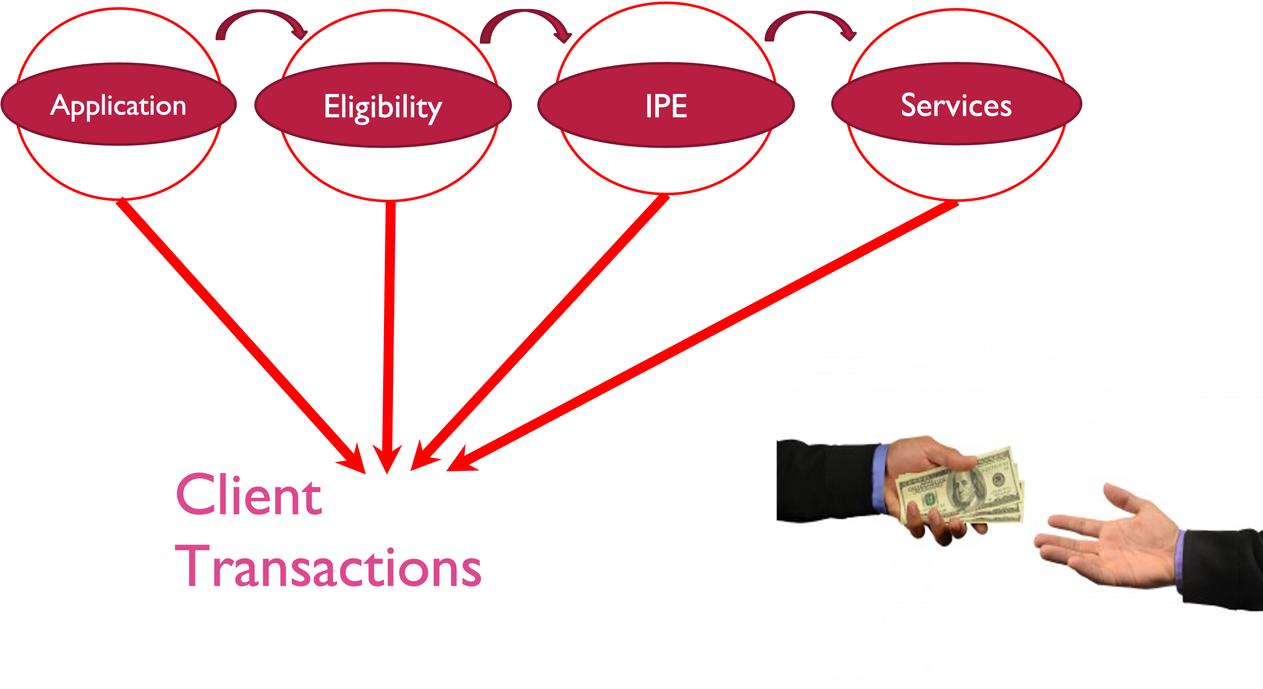
Transactional Rehabilitation

Slide 12
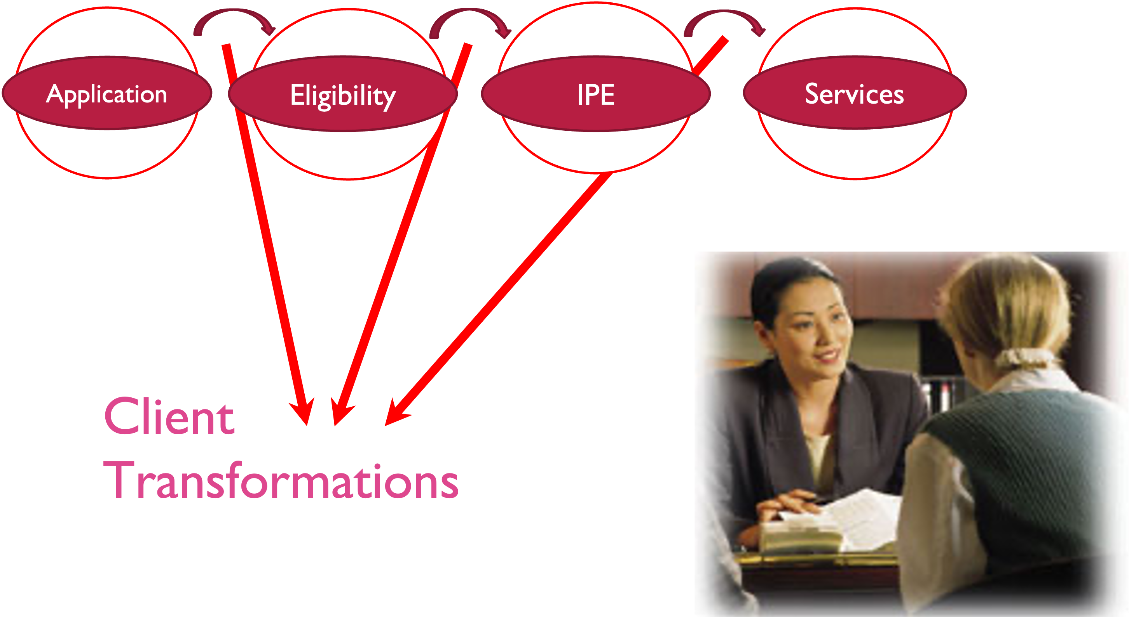
Transactional Rehabilitation II

Slide 13
3. KEY ELEMENTS WHEN WORKING WITH VR
Communicate to Build Partnerships
Counseling is an integral part of the VR program
Any service needs to be in an Individual Plan for Employment (IPE)

Slide 14
3. KEY ELEMENTS WHEN WORKING WITH VR II
An unwanted decision by VR is not the final word, there is always due process
Work with the counselor
Ask for a supervisory review
Request an administrative review
Client Assistance Program
Fair Hearing/Impartial Hearing

Slide 15
RESOURCES FOR WORKING WITH VR CODE OF FEDERAL REGULATIONS FOR VR, COMMENTS SECTION
34 CFR 361.48(b): Services for individuals who have applied or been determined eligible for VR services (Advanced Traning)
“Of these commenters, a few suggested that§361.48(b)(6) allow DSUs to provide tuition and other services for students with intellectual or developmental disabilities in a Comprehensive Transition and Postsecondary Program.”

Slide 16
RESOURCES FOR WORKING WITH VR CODE OF FEDERAL REGULATIONS FOR VR, COMMENTS SECTION CONTINUED…
34 CFR 361.48(b): Services for individuals who have applied or been determined eligible for VR services (Advanced Traning)
“Similarly, we clarify here that the vocational and other training services specified in final§361.48(b)(6) encompass tuition and other services for students with intellectual or developmental disabilities in a Comprehensive Transition and Postsecondary Program for Students with Intellectual Disabilities.”

Slide 17
RESOURCES FOR WORKING WITH VR TRANSITION GUIDE TO POSTSECONDARY EDUCATION & EMPLOYMENT FOR STUDENTS AND YOUTH W/ DISABILITIES (RSA, 2020)
https://sites.ed.gov/idea/files/postsecondary-transition-guide-august-2020.pdf: Vocational Rehabilitation Supports for Postsecondary Education
“The VR program assists individuals with disabilities, including students and youth with disabilities, to acquire the knowledge and skills needed to achieve employment that can sustain economic independence.”

Slide 18
RESOURCES FOR WORKING WITH VR TRANSITION GUIDE TO POSTSECONDARY EDUCATION & EMPLOYMENT FOR STUDENTS AND YOUTH W/ DISABILITIES (RSA, 2020) CONTINUED. . .
https://sites.ed.gov/idea/files/postsecondary-transition-guide-august-2020.pdf: Vocational Rehabilitation Supports for Postsecondary Education
“If it is determined to be necessary. . . VR agencies can provide financial support to eligible individuals to pay for or offset higher education-related expenses, including college expenses not covered by student financial aid, or disability related expenses.”

Slide 19
RESOURCES FOR WORKING WITH VR INCREASING POSTSECONDARY OPPORTUNITIES & SUCCESS FOR STUDENTS AND YOUTH WITH DISABILITIES (OSERS AND OPSE, 2019)
https://thinkcollege.net/sites/default/files/files/resources/increasing-postsecondary-opportunities-and-success-09-17-2019.pdf: Can VR funds be used to support a student with a disability in a CTP?
“Yes. VR funds can be used to support students with disabilities in CTPs if certain conditions are met. Students, youth, and their families, with the assistance of the VR program as appropriate, should consider the wide array of postsecondary options that are available, including but not limited to, two- and four-year colleges and universities, career and technical schools, adult education programs, . . .

Slide 20
RESOURCES FOR WORKING WITH VR II INCREASING POSTSECONDARY OPPORTUNITIES & SUCCESS FOR STUDENTS AND YOUTH WITH DISABILITIES (OSERS AND OPSE, 2019)
https://thinkcollege.net/sites/default/files/files/resources/increasing-postsecondary-opportunities-and-success-09-17-2019.pdf: Can VR funds be used to support a student with a disability in a CTP?
“. . . and comprehensive transition and postsecondary education programs. A comprehensive transition program is an example of one postsecondary option for which the VR program could provide assistance to students and youth with intellectual disabilities when appropriate and agreed to on their approved IPE.

Slide 21
RESOURCES FOR WORKING WITH VR THINK COLLEGE
Think College Home Page
https://thinkcollege.net/
Think College Resource Library (VR Specific)
https://thinkcollege.net/resource-search?sort=field_resourc_publication_date&order=desc

Slide 22
RESOURCES FOR WORKING WITH VR II THINK COLLEGE
Technical Assistance (VR Specific)
Russ Thelin, M.S., CRC, CRL
Senior Policy Fellow, Institute for Community Inclusion, UMass Boston
russell.thelin@umb.edu

Slide 23
Minnesota’s VR Program: Vocational Rehabilitation Services

Slide 24
Vocational Rehabilitation Services (VRS)
State employment services agency that serves people with disabilities
Division of the Department of Employment and Economic Development (DEED)
State Services for the Blind (SSB) is a sister agency that serves those who are blind, low vision or DeafBlind
Partner in the CareerForce system
50 CareerForce locations in the state
VRS serves youth and adults: Any Age 14+!

Slide 25
Services VRS Provides
Career Counseling
Job Training
Job Placement
Services to Keep a Job
Students ages 14 until 22: Pre-Employment Transition Services
And more!

Slide 26
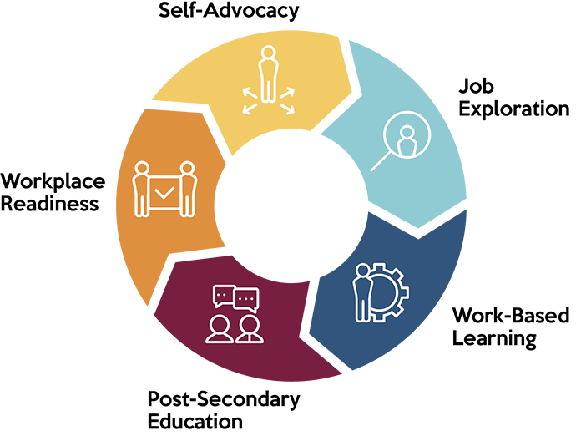
Pre-Employment Transition Services (Pre-ETS)
Job Exploration Counseling
Work-Based Learning Experiences
Postsecondary Education Counseling
Workplace Readiness Training
Instruction in Self-Advocacy

Slide 27
Students: Two VRS Staff Assigned to Every School
VR Counselor and Pre-ETS Representative
No wrong door: Send referrals to either staff person
Find the staff assigned to your school
Or email Alyssa at alyssa.klein@state.mn.us

Slide 28
Adults: Accessing VRS
Until December: Contact the VRS Office nearest to where you live
December: Launching a centralized virtual intake unit
Click here for more info

Slide 29
Contact Information
Alyssa Klein, DEED-VRS Statewide Youth Services Coordinator, Alyssa.Klein@state.mn.us
VRS Website: https://mn.gov/deed/job-seekers/disabilities/

Slide 30
Q and A: Please type your questions and comments for discussion in the chat.
Please complete the poll–we appreciate your feedback!

Slide 31
MIHEC Contact Information
Email: MIHEC@umn.edu
Website: MIHEC.ici.umn.edu
Thank you for joining us!
Optional further discussion until 7:15 pm

