Slide 1

Presenter Prep Slide Only
Notes:
To Prepare:
Turn on Live Transcript and record if applicable
prepare Cost of New Hire Tool and PDF of slides (without notes) to put in chat
Slide #2 – Update presenter names
Check that the presenter can share their screen
Prepare breakout groups if a large group
Assign an attendance taker, time keeper, chat monitor
Note to Facilitator:
Bold Text = Timing
Italicized Text = Notes – do not read
Regular Text = Talking Points

Slide 2

Employment and Community First CHOICES
Workforce QuILTSS Initiative
Learning Lab
What is the Cost of a New Hire?
Megan Sanders
Institute on Community Integration
University of Minnesota
tenncare.ici.umn.edu
Notes:
Time: 30 seconds
Talking Points
WELCOME:
Welcome to our first Learning Lab – What is the Cost of a New Hire?
My name is xx and I am a xx with xx.
If Learning Lab is being recorded, let them know they can contact you if they would like a copy.

Slide 3
Using Zoom
Your microphones will be muted when enter. Please keep them turned off unless you're speaking.
Name yourself
  First name
  Name of your organization
Use for questions or comments.
Live Script
Camera on as you are able to and comfortable.
Take care of your needs. If you need a break, take one.
Understanding of “co-workers”
Chat
Notes:
Time: 60 seconds
Talking Points:
Some of us are used to working on Zoom in a group, while others are less familiar.
Please keep your microphone on mute when you’re not speaking today to help reduce background noise. When you’re in breakout groups, feel free to unmute and discuss the topic within your group. If you are able, we’d appreciate it if you keep your video on today. Its important for all of us to be able to see and get to know one another in these meetings. We understand if you need to shut off your video for a few moments if you need to step away, but please turn your video back on when you return.
When you logged into Zoom today, you might have typed in a name for yourself. To help us get to know one another, we ask you to rename yourself with this information on your screen:
Your name, your organization name. If you are a group of people watching from one computer in an organization, you can shorten to first names and your organization name.
To do this, look on the bottom of your screen for participants, click on that and on the right side of your screen a white column will appear. Hoover over your name and two buttons will appear mute and more. Click on more, then click on rename. Rename yourself then click OK.
The Chat function is at the bottom of the page. It looks like a little speaking bubble. If you have a questions or something you want to add to the discussion you can use Chat. We will be monitoring Chat throughout the session.
Using Chat to submit a question, simply click on the button that looks like this in your toolbar.
Please feel free to send questions at any time during the presentation. We will have time at the end for discussion and questions, so you can type them in the chat and we’ll go over them at the end.
Also when you click on “Participants,” you’ll see some buttons to interact with the presentation. You can say yes, no, go slower, go faster, and when you click on “More” you will find that you can use the thumbs up or thumbs down buttons. You can also let us know if you need to step away for a quick break to use the rest room or fill your coffee cup. Suffering is optional.
When we take breaks we do ask that everyone turn their camera during the break then turn it back on when you return or use reactions when you return so that we know when we are ready to start again.
Finally, we are all still working from home at the University of Minnesota. Explain “coworkers” you share your space with.

Slide 4
Welcome & Introductions
Notes:
Transition slide

Slide 5
Open Round
Getting to Know You
Your name and role in the organization
What is one question you have about determining the cost of a new hire?
Notes:
Time: 3-7 minutes
Talking Points
We would like to start with a little time to get to know you and see if you have any initial questions. We’ll try to make sure we cover these questions. Please introduce yourself with the following: read slide
Note: If group is large, can have them type in chat.
Alternate question: What is one thing you hope to get out of today’s Learning Lab? / What is one question you have on this topic?

Slide 6
The Cost of a New Hire Tool
Notes:
Transition slide
Time: 10 seconds
Talking Points
The Cost of a New Hire tool is not a tool that we have used or is available on the toolkit.

Slide 7
Goals for this Learning Lab
Given the Cost of New Hire Worksheet, providers should be able to understand how to use the tool and understand next steps.
Notes:
Time: 30 seconds
Talking Points
Our goal for today’s learning lab is read slide

Slide 8
Building & Strengthening the DSP Workforce
Recruitment Strategies | Selection Strategies | Retention Strategies
Effective Marketing Public service announcements (PSA) Targeted marketing Recruitment and hiring bonuses Recruitments sources | Structured behavioral interviews Realistic job preview | Orientation and onboarding Competency-based training Employee Development Job Analysis Job Descriptions Recognition Programs Coaching & Mentoring Mentoring Performance coaching Networking Employee Engagement & Organizational Participation Professional Development Developing career paths Professionalizing DSP roles Wage and Benefit Policy Change
Notes:
Time: 30 seconds
Talking Points
Many of these Learning Labs will be about tools you can use to improve recruitment, selection, or retention.
This tool is a discovery tool - important to continue to find out how much you’re spending and brainstorm solutions to reduce costs like this.
Shows the importance of all three of these – from recruitment to selecting the person who will stay longer to keeping people throughout the onboarding, training, and professional development process.
This tool is a good jumping off point to use in technical assistance or office hours with UMN consultants.

Slide 9
$2,413 - $5,200
Average Cost to Replace DSPs
ANCOR, 2009; Larson et al. 2016
Notes:
Time: 1-2 minutes
Talking Points
According to our research, High turnover has been well-documented in the DSP workforce for nearly three decades. Costs associated with replacing DSPs range between $2,413 and $5,200. (2010) this has an impact on organizations – continuously hiring and replacing staff becomes very costly and money that could be used to keep dsps through professional development opportunities, bonuses, and higher wages can dwindle.
Many studies have attempted to calculate the average cost to replace dsps. ANCOR estimated the cost to be 4872/DSP in 2009 and Larson estimated 3278/DSP.
Note that your cost might be higher, dependent on pay of employees or new initiatives.
As I said earlier, calculating your cost to replace dsps can be used as a discovery tool to find what you’re using in each of these areas of recruitment, selection, and retention. It can be used to further understand the cost of turnover, help understand where to grow so that turnover is lower and help understand the cost savings and where that money can go.

Slide 10
How to Use this Information:
Higher numbers could be a good thing!
Be careful if reducing cost: could increase turnover!
This tool does not solve a problem, instead it helps with the exploration process!
Notes:
Time: 1 minutes
Talking Points
High costs in some areas versus other does not necessarily mean you should reduce your costs but draws out the importance of each of these items being wroth the money.
May help you find out that a tool is not worth the cost.
This tool does not solve a single problem – instead, it helps illustrate the importance of keeping people and not just continuing to pull people in.

Slide 11
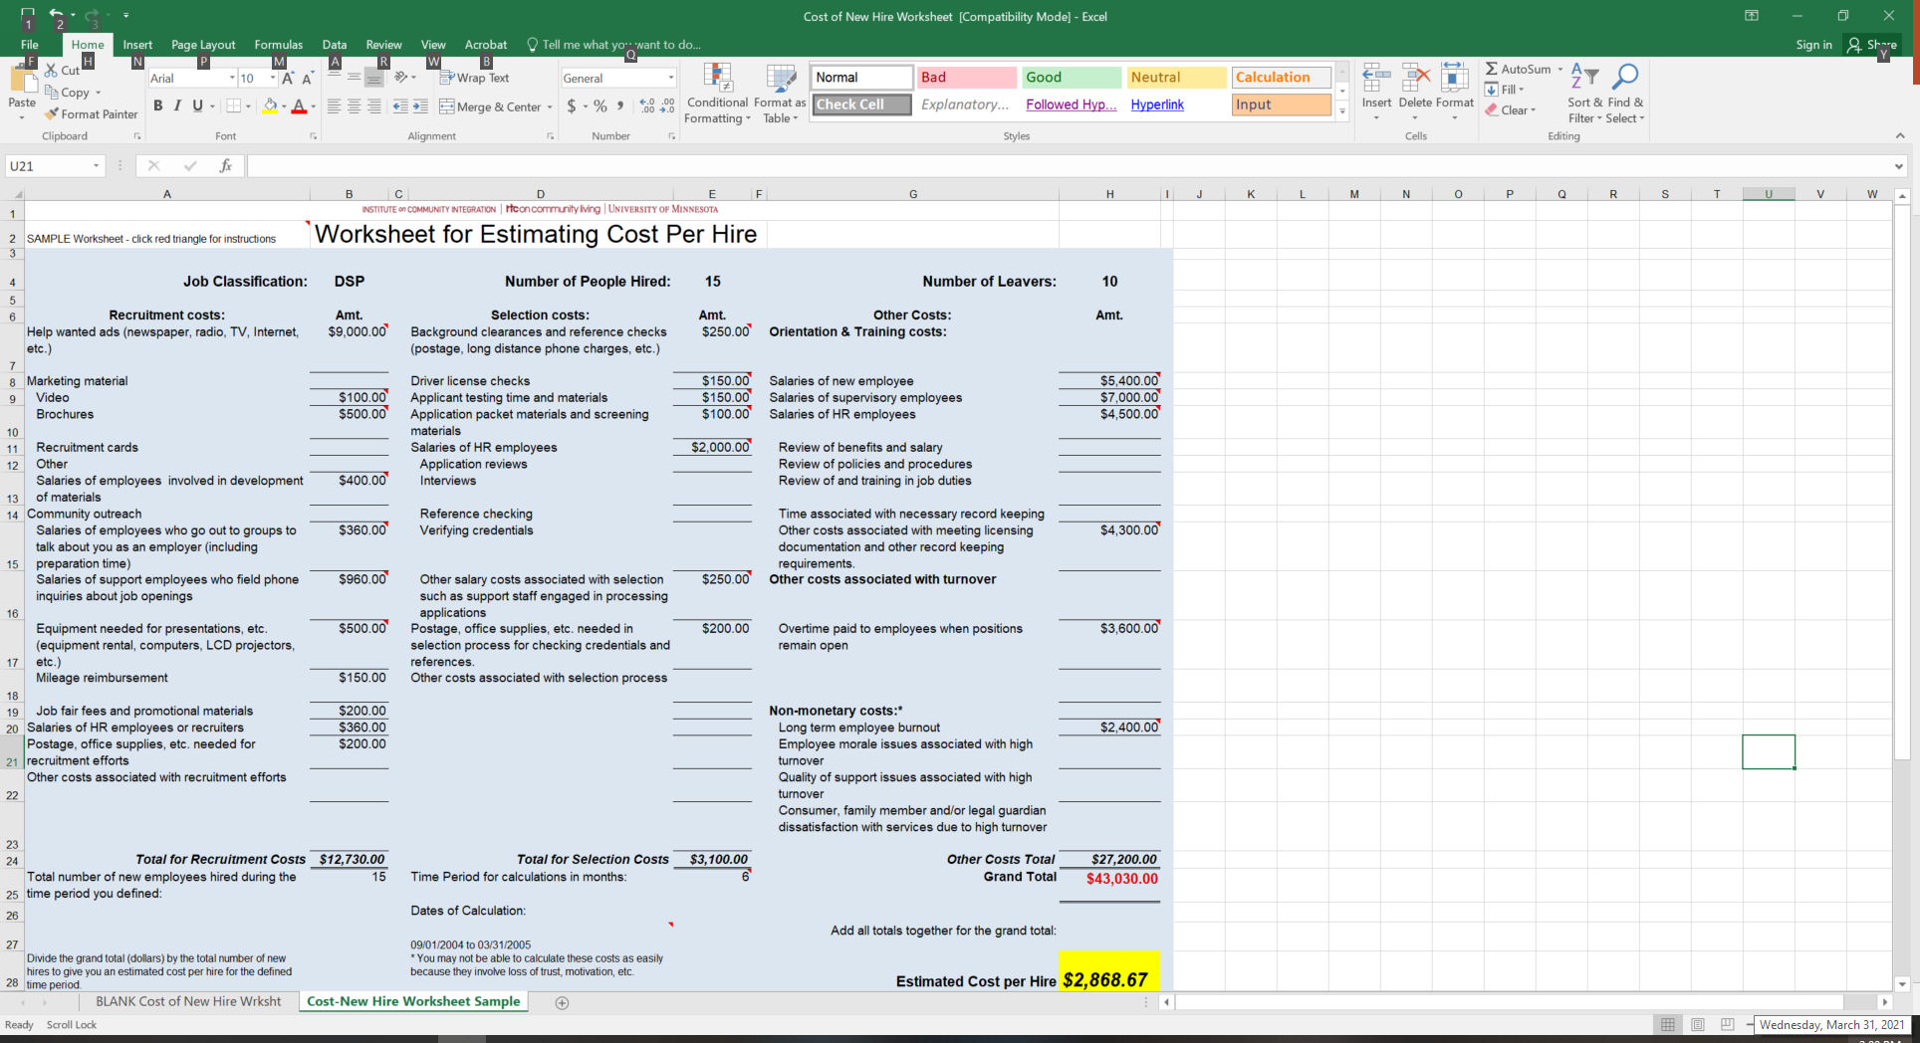
Worksheet for Estimating Cost of New Hire 1
Notes:
Time: 1 minute
Talking Points
Put tool in chat again
You can open the tool now or follow along with these screenshots.
We don’t expect you to have all of this information today to fill out.
You’ll see at the bottom one of the tabs is an example, while the other is a blank sheet. We recommend you use the blank sheet for yourself, and the sample for a reference if you get confused. We’ll be looking at screenshots from the sample sheet so you can see what it looks like with actual data.

Slide 12
Worksheet for Estimating Cost per Hire 2
Notes:
Time: 2 minutes
Talking Points
You’ll see the red outlining the top section and the bottom section. These are two important sections to first consider. You can type in your job classification at the top – in this case, DSP.
First, you’ll need to think about what time period you want to consider. The example uses a 6-month time period – from sept-march. It’s important that in this time period you have people you have hired, otherwise the results will not be useful.
Once you determine your time period, you can fill that in the “time period for calculations in months” and “dates of classification” at the bottom of the sheet. Then you can look at your data and see how many DSPs you hired (putting that in the bottom and top of the sheet) and how many DPSs left during that time period.
You will need to have the time period and number of employees hired during that time period filled in those bottom spots, otherwise the sheet will not calculate correctly.

Slide 13
Worksheet for Estimating Cost per Hire 3
Notes:
Time: 1 minute
Talking Points
This sheet is divided into 3 areas: recruitment, selection, other.
Each section calculates totals automatically as long as time period and # of employees are filled in.
Point out 5 totals: recruitment, selection, other, grand, and cost/hire

Slide 14
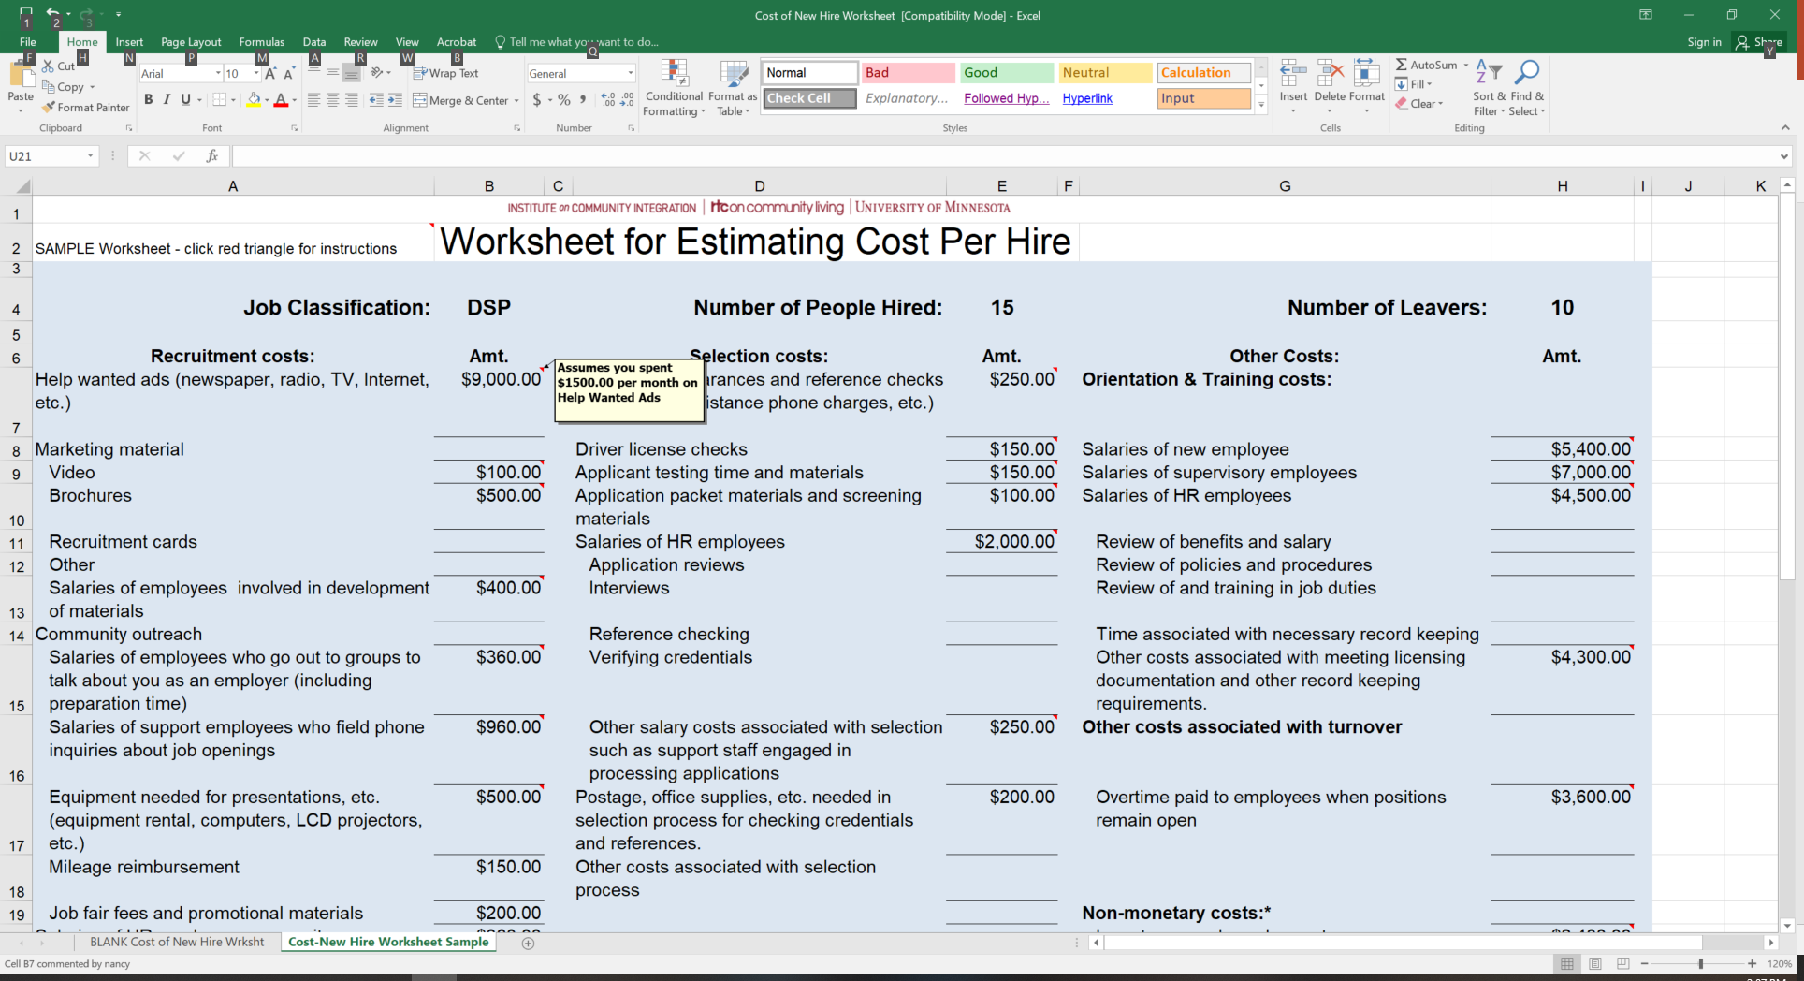
Worksheet to Estimate Cost per Hire 4
Notes:
Time: 1 minute
Talking Points
Both sheets have small red triangles in many of the boxes you can fill in.
Roll over triangles with your cursor and they’ll tell you how to fill them out.
In the sample worksheet we’re looking at now, it shows how it was calculated but in the blank ws it shows more general advice. Both can be useful if a particular entry is confusing.
For example, if you put your cursor over the $9000 next to help wanted ads, read yellow box.

Slide 15
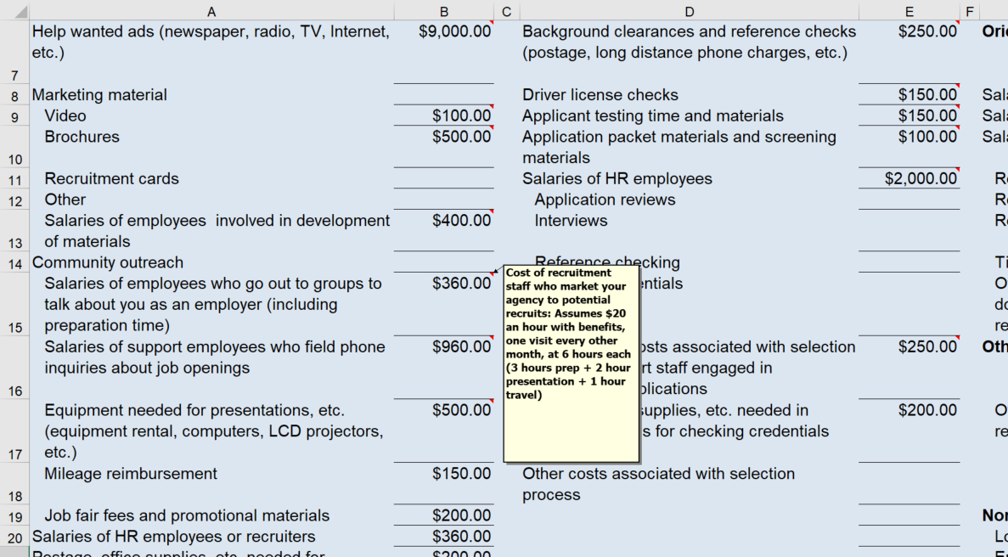
Worksheet to Estimate cost per Hire 5
Notes:
Time: 1 minute
Talking Points
Some entries ask for calculations of salaries. For example, as shown in this section, read yellow box
In areas like these, cost might be higher because you pay your employees more. High costs not bad!

Slide 16
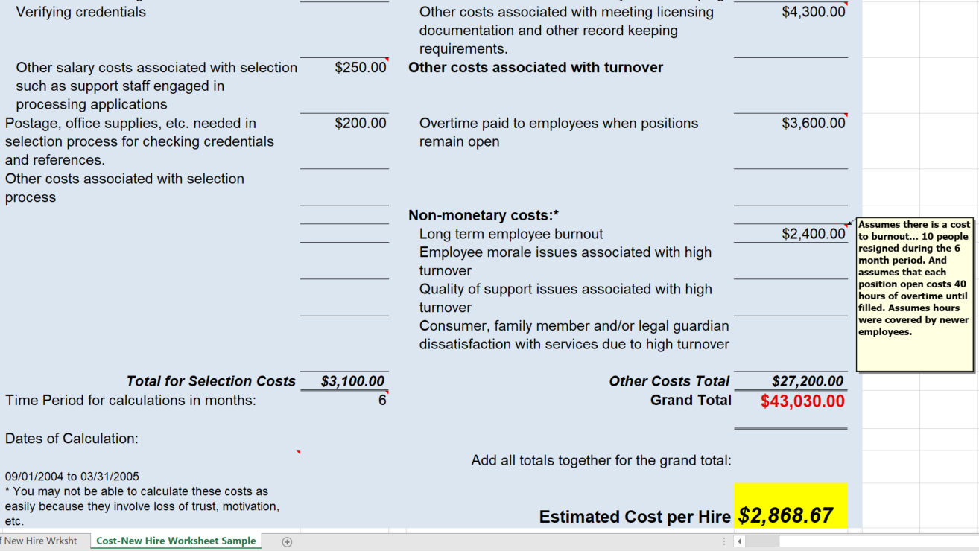
Worksheet to Estimate Cost per Hire 6
Notes:
Time: 1 minute
Talking Points
The final section is other costs associated with turnover. This includes overtime, which is important to calculate to determine true costs.
Nonmonetary costs: You may not be able to calculate these costs as easily because they involve loss of trust, motivation, etc. There are many studies that show the incredible impact the turnover has on other DSPs, persons served, and families of persons served
Some MAY be able to be calculated depending on your org. In this sample…read yellow box

Slide 17
Worksheet to Estimate Cost per Hire 7
Notes:
Time: 1-5 minute
Talking Points
Post tool in chat again
This is the tool. If you have questions as you’re working through it, reach out.

Slide 18
Questions and Discussion
Notes:
Transition slide
Any questions about the tool?

Slide 19
Closing Round
  What’s your next step?
  How will you use this tool and information in your organization?
Notes:
Time: 3-8 minute
Talking Points
May stay in large group depending on size.
If Breakout room conversation: Breakout Time in small group 10 minutes ; Breakout groups – 4-5 per group, follow-up similar pattern of splitting MCOs between groups, select someone to take notes and someone to report – can be the same person Report Out to Large group- 5 minutes
Work with providers to encourage use as a discovery tool and a way to see growth and REALLY see where costs go.
How will you use this tool? What is important for you? What is your next step?

Slide 20
How to Use this Information: (re-visited)
Higher numbers could be a good thing!
Be careful if reducing cost: could increase turnover!
This tool does not solve a problem, instead it helps with the exploration process!
Notes:
Time: 1 minute
Talking Points
Reminder: high costs could be good; reducing cost may increase turnover or have other unintended consequences. This tool is a great start for use with consultants and coaches in office hours, intensive tech assistance, etc.
Can be used when talking to legislators / folks in your org – by investing in DSPs, the cost may be higher but retaining DSPs means freeing up that money elsewhere – to raise pay, etc.

Slide 21
For more details
tenncare.umn.ici.edu
Toolkit
Organizational Readiness
Self-Assessment Workbook & Action Plan
Notes:
Time: 1 minute
Talking Points
Tool can be used in conjunction with self ass workbook and action plan.
If you find your turnover to be high, means pretty costly. more discovery is typically needed. Are you hiring the right people for the job? Is there a reason they’re leaving?
The way you recruit workers, select DSPs, and retain DSPs might impact turnover at your org.
You can do more discovery at tenncare.umn.ici.edu.

Slide 22
Questions
  Check out the Tenncare Workforce Toolkit at: tenncare.ici.umn.edu
  Contact your UMN consultant at: dsp-tn@umn.edu
  Attend Monthly Office hours
Notes:
Time: 1 minute
Talking Points
If you have questions about this tool later, these are ways you can contact us. We can work together to figure out next steps in office hours or through individual technical assistance.
Read slide

Slide 23
Office Hours
  East Region:
    1st Friday 9-11:00 am CST
    3rd Friday 9-11:00 am CST
  Middle Region:
    1st Wednesday 1-3:00 pm CST
    3rd Wednesday 1-3:00 pm CST
  West Region:
    2nd Monday 9-11:00 am
    2nd Wednesday 9:00–11:00 am
Notes:
Time: 1 minute
Talking Points
Read slide and explain office hours

Slide 24
Upcoming Events
Upcoming Learning Labs:
  Starting/Sustaining a Mentoring Program – April 20 9:30-10:15 am CST
  Staff Satisfaction Surveys and How to Use Them – May 4 10:00-10:45 am CST
  Assessing Your Website – May 17 10:30-11:15 am CST
Upcoming Community of Practice:
  East: April 13, 12:00 - 2:00pm CST, 1:00 – 3:00pm EST
  Middle: April 19, 10:00am - 12:00pm CST
  West: April 21, 9:00 – 11:00 am CST
Notes:
Time: 1 minute
Talking Points
Read slide and explain upcoming learning labs/CoPs.

Slide 25
Thank you
Notes:
Thank providers. If there is extra time, let them know you’ll stay on if they have questions.

