Slide 1
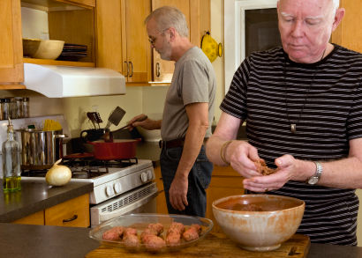
Presenter Prep Slide Only
Notes:
To Prepare:
Turn on Live Transcript and record if applicable
prepare (Name of Learning Lab) and PDF of slides (without notes) to put in chat
Slide #2 – Update presenter names
Check that the presenter can share their screen
Prepare polls/breakout groups if a large group
Assign an attendance taker, timekeeper, chat monitor
Note to Facilitator:
Bold Text = Timing
Italicized Text = Notes – do not read
Regular Text = Talking Points

Slide 2
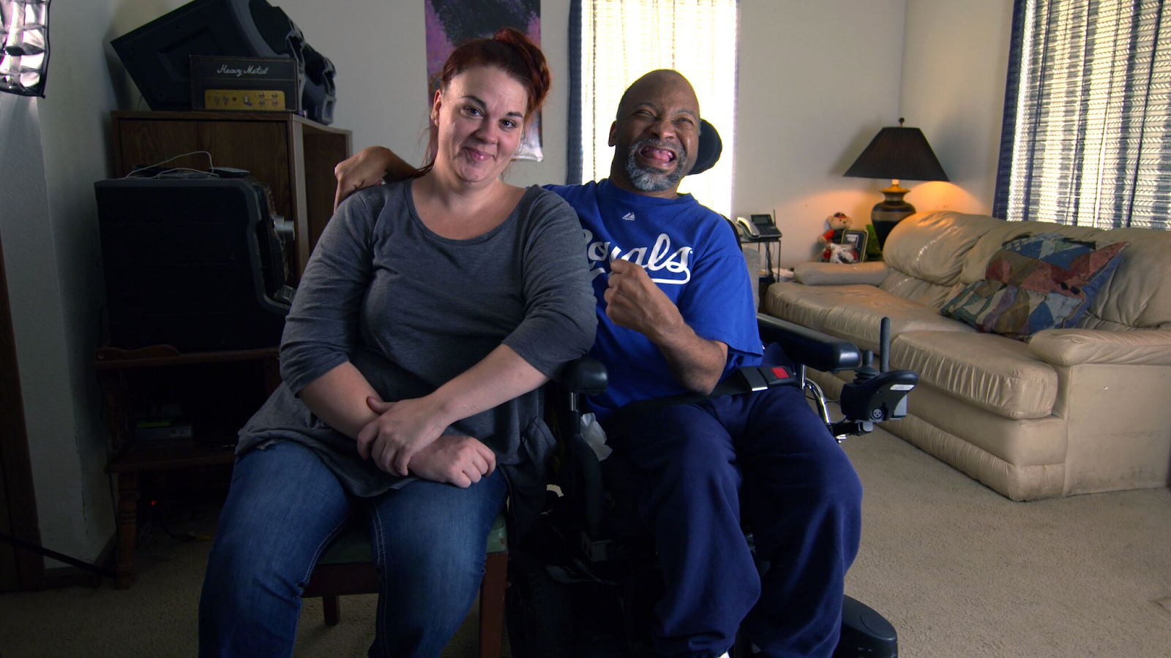
Employment and Community First CHOICES
Workforce QuILTSS Initiative
Learning Lab
Best Practices for Using Frontline Supervisor Assessments
Claire Benway MA
Institute on Community Integration
University of Minnesota
tenncare.ici.umn.edu
Notes:
Time: 15 seconds
Talking Points:
Welcome and introduce self
Acknowledge other UMN staff and the Regional Coaches (Don’t call on them for opening round)
If Learning Lab is being recorded, let them know they can contact you if they would like a copy.

Slide 3
Using Zoom
Your microphones will be muted when enter. Please keep them turned off unless you're speaking.
Name yourself
  First name
  Name of your organization
Use for questions or comments.
We will use “Reactions” such as “thumbs up” though-out the workshop.
Live Script
Camera on as you are able to and comfortable.
Take care of your needs. If you need a break, take one.
Be Understanding of “co-workers”
Chat
Notes:
Time: 30-60 seconds
Talking Points:
Some of us are used to working on Zoom in a group, while others are less familiar.
Please keep your microphone on mute when you’re not speaking today to help reduce background noise. When you’re in breakout groups, feel free to unmute and discuss the topic within your group. If you are able, we’d appreciate it if you keep your video on today. Its important for all of us to be able to see and get to know one another in these meetings. We understand if you need to shut off your video for a few moments if you need to step away, but please turn your video back on when you return.
When you logged into Zoom today, you might have typed in a name for yourself. To help us get to know one another, we ask you to rename yourself with this information on your screen:
Your name, your organization name. If you are a group of people watching from one computer in an organization, you can shorten to first names and your organization name.
To do this, look on the bottom of your screen for participants, click on that and on the right side of your screen a white column will appear. Hoover over your name and two buttons will appear mute and more. Click on more, then click on rename. Rename yourself then click OK.
The Chat function is at the bottom of the page. It looks like a little speaking bubble. If you have a questions or something you want to add to the discussion you can use Chat. We will be monitoring Chat throughout the session.
Using Chat to submit a question, simply click on the button that looks like this in your toolbar.
Please feel free to send questions at any time during the presentation. We will have time at the end for discussion and questions, so you can type them in the chat and we’ll go over them at the end.
Also when you click on “Participants,” you’ll see some buttons to interact with the presentation. You can say yes, no, go slower, go faster, and when you click on “More” you will find that you can use the thumbs up or thumbs down buttons. You can also let us know if you need to step away for a quick break to use the rest room or fill your coffee cup. Suffering is optional.
When we take breaks we do ask that everyone turn their camera during the break then turn it back on when you return or use reactions when you return so that we know when we are ready to start again.
Finally, we are all still working from home at the University of Minnesota. Explain “coworkers” you share your space with.

Slide 4
Open Round
Getting to Know You
Your name and role in the organization
What is one question you have on when it comes to assessing your Frontline Supervisors?
Notes:
Timing: 3-5 min
Talking Points:
If more than 3 providers – use Chat
We would like to start with a little time to get to know you and see if you have any initial questions. We’ll try to make sure we cover these questions. Please introduce yourself with the following: read slide
Alternate question: What is one thing you hope to get out of today’s Learning Lab? / What is one question you have on this topic?

Slide 5
Frontline Supervisor Assessment
Notes:
Transition slide

Slide 6
Goals for this session
To understand the Frontline Supervisors Assessment tool and how it can support FLS in their roles.
Understand how to use this tool as part of a larger employee development program.
Notes:
Time: 1 minute
Our goal for today’s learning lab is read slide
Purpose of the assessment:
This assessment is designed to be used as one method to help Frontline Supervisors (FLS) and Frontline Supervisor candidates evaluate their current performance level and create a self-development plan in these areas.
What we know is self assessment if critical. If organizations are encouraging that and providing the tools and resources for people to do it well employee engagement will most likely increase in other aspects of the role or organization.

Slide 7
Building & Strengthening the DSP Workforce
Recruitment Strategies | Selection Strategies | Retention Strategies
Effective Marketing Public service announcements (PSA) Targeted marketing Recruitment and hiring bonuses Recruitments sources | Structured behavioral interviews Realistic job preview | Orientation and onboarding Competency-based training Employee Development Job Analysis Job Descriptions Recognition Programs Coaching & Mentoring Mentoring Performance coaching Networking Employee Engagement & Organizational Participation Professional Development Developing career paths Professionalizing DSP roles Wage and Benefit Policy Change
Notes:
Time: 30 seconds
Remind attendees to consider the problem they are trying to solve with this tool – explain where the strategy falls.
This tool will fall into the Employee Development section of our strategies. This is solidly in the retention section.
This is a tool that should be used to evaluate and support not as a punitive measure.
The goal is to always help employees identify opportunities for growth.
When there is a clear understanding of what a person is required to do in their role the opportunity to hold themselves accountable is easy.

Slide 8

FLS Assessment tool
DSP Workforce Toolkit
Notes:
Timing: 10 minutes max (1-3 slides)
Talking Points:
Le’ts take a look at this tool.
Go to the tool and show them the whole thing. You will then take them into the Quick break down on the next slide.

Slide 9
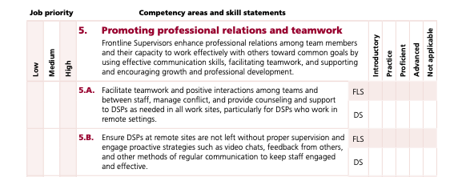
Quick Break Down
Notes:
Time: 1-2 minutes
Talking Points:
This assessment really is broken down into 3 parts.
Competency or standard – What we are expecting a person to do.
Job Priority – That is identifying how important this particular competency or skill standard is to the role
Use the following definitions when considering the FLS job priority level After the relevant competency areas have been identified (those marked as “high” or “medium” priority), the assessment is ready to be utilized by Direct Supervisors and FLS.
The rating on the right about how well they do.
This in itself has two sections one for the person and one for the Direct supervisors. This supports evaluation by both people.
While self-assessment is critical, it is suggested that a direct supervisor also complete this form in order to provide a more well-rounded view of the FLS or FLS candidate’s current skill set
Self Assessment. - Let’s look at that section
Managers or direct Supervisor’s assessments
Does the person effectively meet the unique needs of each organization, we encourage program directors to customize this FLS assessment tool by considering how each competency area (and individual skill statements, if desired) aligns with the organization’s mission and goals. Given the services provided by the organization, by identifying those competency areas and skill statements that are considered high priority or medium priority.

Slide 10
Employee Growth and Advancement
Use this tool as part of the interview process to see where people need supprot
Use this as an opportunity to evaluate potential superviors from your current DSPs
Notes:
Time: 30 seconds
Talking Points:
Connecting to career ladders and opportunities for advancement.
By having a tool that clearly identify what you are looking for in a supervisors you can then support the people within your organization to better understand if this is a role they feel they would like to peruse.
You can also utilize this tool when evaluating if your other tools such as Job descriptions and interview questions match what you are asking your FLS to do.

Slide 11
Discussion + Questions
Notes:
Timing: 10 minutes Small group, leaving time for Large group report back – 5-7 minutes
Talking Points:
Any questions about the tool?
Are you using any type of tool?

Slide 12
Closing Round
  What’s your next step?
Notes:
Time: Up to 7 minutes or longer if you have extra time
Talking Points:
Dependent on time: can skip this slide, do round robin, ask for one example, etc.
Ask one person to report their next step, then explain we’re here to help as you think about your next steps. Encourage them to think about next step of applying what they learned today, and to add it to their action plan. Transition to next slide to explain if they have questions or want help planning, they can attend office hours or schedule 1:1 consultation time.
Facilitator note. If there is a whiteboard take this information down.

Slide 13
Questions?
Other ways to learn more:
Checkout the Tenncare Workforce Toolkit at: tenncare.ici.umn.edu
Contact your consultant at: dsp-tn@umn.edu
Join our Monthly Office Hours
Notes:
Time: 15 seconds
Talking Points
Here are ways to keep in touch with us and continue your learning.

Slide 14
For more details
tenncare.umn.ici.edu
Toolkit
Retention
Frontline Supervisor – The Critical Role
Webinar
Notes:
Time: 30 seconds
This the path to the Frontline Supervisor – The Critical Role webinar. It is on the Tenncare website, go to the DSP Workforce Toolkit, then in the Retention section you will find it.

Slide 15
Upcoming Events
Next Learning Lab:​
Targeting the Right DSPs: July 15, 10-10:45am CT
Visit tenncare.ici.umn.edu for other upcoming Learning Labs
Upcoming Community of Practice:​
Middle Region: Tuesday, July 27, 2021 12pm-2pm CT, 1pm-3pm ET. ​
West Region: Monday, August 16, 2021 10am-12pm CT, 11am-1pm ET. ​
East Region: Wednesday, August 18, 2021 10am-12pm CT, 11am-1pm ET.
Notes:
Time: 30-60 seconds
Edit slide as needed regarding upcoming workshops
Registration links: https://tenncare.ici.umn.edu/community-of-practice

Slide 16
Thank you

