Slide 1

Notes:
Facilitator’s Notes: Pre-presentation ONLY – show next slide to audience
Actions for Prior to the session:
Slide #1 – Update presenter names
Set up Polls
Update Opening Round Question
Facilitator’s Notes:
Actions for Prep time just before the session:
Check that the presenter can share their screen, run videos and video work
Check that the presenter marks “Share Computer sounds” and “Optimize Screen sharing for video clip” so that any videos shown can be heard by others – it is on the same screen that you choose which screen to share.
Check you polls -
Assign someone to set up Break-out Groups
Assign taking attendance
Assign a timekeeper
Assign a Host
Assign someone to monitor Chat
Assign someone to turn on record
Turn on Auto-script

Slide 2
Understanding Your Data and Workforce Strategies
Workshop Series
Cohort 3
Presenter's name and affiliation
tenncare.ici.umn.edu
Notes:
Facilitator’s Notes:
Actions - Share this Opening slide - 10 minutes Prior to the session as people log in so they can know they are in the right place.
Welcome

Slide 3
none
Welcome to Session 1
Getting Started:
TN Workforce Initiative Overview and Understanding DSP Workforce Issues
Notes:
Talking Points
Timing: about 15 minutes
During today’s session, we will be providing an overview of the TN Quiltss project and this workshop.
We will also talk about the data around the DSP workforce, both nationally and up close in TN.

Slide 4
Using Zoom
Name yourself
  First name and the pronouns you use
  Name of your organization
Use Chat for questions or comments.
Please keep your microphone off until the activities & discussion.
Keep your camera on if you are comfortable.
Live Auto-Script is available.
You may use Reactions such as thumbs up throughout.
Thank you for being understanding of colleagues.
Chat
Notes:
Talking Points:
Some of us are used to working on Zoom in a group, while others are less familiar.
Review items quickly

Slide 5
Welcome & Introductions
Notes:
Transition slide
Next, we will introduce our team.

Slide 6
Introductions – TennCare & TNCO
TennCare
Shannon Nehus & Patty Killingsworth
TNCO
Robin Atwood
Notes:
Facilitator’s Notes:
Timing - no more than 2-3 minutes for slides 6-10 so you have time for provider introductions.
Talking Points:
We are going to start with introductions starting with the leaders from Tenncare and TNCO.

Slide 7





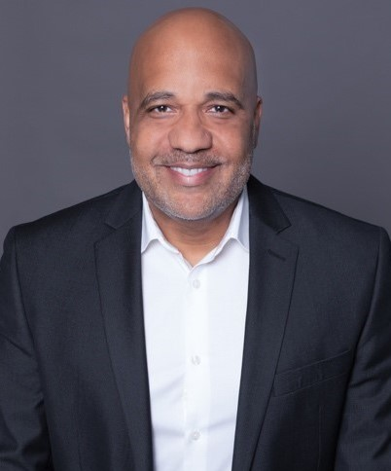
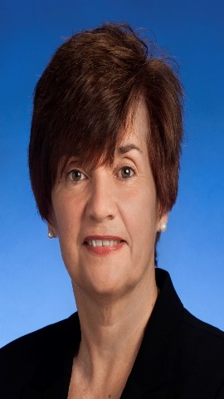

Meet Your Regional Coaches
Ashante Hodges
Beulah Brooks
Joy Dalton
Faith Franklin
Dana Scott
Naveh Elder
Nichelle Johnson
Robin Wilmoth
Notes:
Talking Points:
With us in each regions are your Regional
Let’s start with __________________________________. Please say your name, where you work and the role you play there.
Call upon each Coach
Thank you everyone. Before we have you introduce yourself, we are going to give you an overview of what we will be doing today and over the next month in these workshops.

Slide 8










Meet Your U of M Workforce Consultants
Amy Hewitt
Barb Kleist
Sandy Pettingell
Bill Tapp
Julie Kramme
Chet Tschetter
Claire Benway
Sarah Hall
Megan Sanders
Mark Olson
Notes:
Talking Points:
I would like you to meet the team from the University of Minnesota.
On the top we have Amy Hewitt is the Director of the Institute on Community Integration at UMN. While she won’t be part of these workshops she has been instrumental with our work together.
Barb Kleist is the Project Manager.
Sandy Pettingell is a Research Associate at ICI. She has been deeply involved in the survey and providing profiles to each organization.
Bill Tapp from Knoxville – Our local coordinator/consultant in Tennessee
Finally, Chet and Megan are the representatives from the University of Minnesota who will be supporting Cohort 3 in your efforts. You may have contact with the rest of the team with other projects that we will talk about later.
Finish with “Together with ________________ we will be leading all of the workshops and providing consultations to organizations.
Timing - no more than 2-3 minutes for slides 6-10 so you have time for introductions.

Slide 9
Poll Question #1 - What are some of the roles, current or past, that influence your work? (Select all that apply)
Person with lived experience/person with a disability
Parent
Sibling/Family member
Friend
Guardian
Ally/Advocate
Direct Support Professional
Frontline Supervisor/Manager
Executive Director/CEO
Health & Human Services Professional/Policymaker
Notes:
Added poll question slide to precede conversation – Can keep or delete depending on timing.
Talking Points:
Many of us working in this field have worn and maybe are still wearing different hats that inform and influence our work. Let’s do a quick poll to see what are the different roles you have both currently and in the past the influence your work today supporting people with disabilities in community living.
Read slide

Slide 10
Group Activity
Getting to Know You
Breakout Group
  1 facilitator and 1 reporter in each group
  Give everyone enough time to have a turn.
Your name and organization
Your role in the organization today
What is one thing your organization did to celebrate DSP week or recognize DSPs during the year?
Notes:
Activity : (5 minutes) – 5 people per breakout, each person gets one minute, assign 1 consultant or coach to each breakout group OR ask them to put in chat
Purpose: Gives consultants and coaches opportunity to learn who is in the room.
Talking Points:
We are going to have the opportunity to get to know who is in the workshop today. In a moment but not yet, you will be send to a Breakout room with 5-6 others.
Everyone will have the:
Opportunity to introduce your self with your name, your organization and your role in the organization.
And answer the questions on the screen.
What is one thing your organization did to celebrate DSP week or to recognize DSPs during the year?
When you get to your group, find one facilitator and another person to report back for the group the responses to the two questions.
When the group returns call on the reporter from each group to report back on themes for questions #1 and #2.

Slide 11
Overview of Workshop Series
What we will cover in Sessions 1-2
Notes:
Time: 5 minutes for Overview of Series Section
Facilitator’s Notes:
BRIEFLY go over the workshop series do not get into the weeds, high level overview
Talking Points:
Next, we will give you an overview of the entire kick-off workshop series.

Slide 12
Goals for the Kick-Off Workshop Series
Review & understand organizational workforce survey data
Assess organizational capacity for workforce development
Learn about tools and strategies for workforce recruitment, selection, and retention
Explore tools and strategies based on data
Learn about measuring outcomes of implementation
Notes:
Facilitator’s Notes:
BRIEFLY go over the workshop series do not get into the weeds, high level overview
Talking Points
During the Kickoff Workshops we have a number of things that we want to you do and learn about.
The first is that you review and understand your organizations workforce survey data. Each organization took the 2020 workforce survey and has been provided with a profile that is unique to your organization. You also have the regions and the state data to compare it to. We will be covering the survey later in this session.
Briefly review other goals

Slide 13
Goals for Part 1 of Today
  Understand TN Workforce Initiative
  Understand and define DSP Workforce Issues
  Understand the effects of DSP Workforce Issues
Notes:
Talking points
We have several goals for today’s session. These goals include (review goals on the slide)

Slide 14
Overview of TN Workforce Initiative
QuILTSS Workforce Development – Shannon Nehus
Notes:
Time: 10 seconds
Talking Points
We wanted to make sure we have shared understanding of this project.
We begin with Shannon to talk about TennCare Workforce Development

Slide 15
Workforce Development
Notes:
Time: 26 minutes for Overview of TN Workforce Initiative Section
Facilitator’s Notes: Shannon Nehus leads this section
Talking Points
Thank you for being here today for the Year 3 Kickoff Training to Understanding your Survey Data and thank you for completing the survey.
We are at the stage to use data for the surveys – your data, regional and statewide data to inform and expand the conversation about wages, benefits and ways to find and keep good employees and enhance the access to quality home and community-based services for people with IDD.
Before we get into the details of that work, I want to give you an overview of Quality Improvement in Long Term Services and Supports (QuILTSS) Workforce Development Initiatives – Tennessee’s Initiatives.

Slide 16
QuILTSS Workforce Development
  Where we began
  Stakeholder feedback from meetings conducted across the state identified the quality and competency of the workforce as one of the most important drivers of quality that impacts the day-to-day lives of people who receive services
  Workforce development is a foundational component of quality improvement – of value-based delivery system reform
Notes:
We listened to stakeholders. Eight locations around the state (2012). Over a thousand participants attended and completed feedback cards.

Slide 17
LTSS Workforce Development
Develop a comprehensive competency-based workforce development program and credentialing registry.¹
Better for Workforce
Opportunity to both learn and earn acquiring shorter term credentials with clear labor market value
Portable credentials across providers, programs, and service settings
Earn college credit and certificate; apply toward degree program—education path for direct support professionals
Build competencies to access higher wages and advanced jobs—career path for direct support professionals
Learning and relationship management system matches worker with coach/mentors/career planning support
Better for Members
& Providers
Promotes delivery of high-quality person-centered services
Supports competency and continuity of staff for members and providers
Online registry for matching by individuals, families, providers based on needs/interests of individual
Alignment improves member experience
Agencies employing better trained and qualified staff will be appropriately compensated for the increased competency of staff and higher quality of care experienced by individuals they serve
¹ for deployment through secondary, vo-tech, trade schools, community colleges, and 4-year institutions, offering portable, stackable credentials and college credit toward certificate and/or degree program

Slide 18












QuILTSS Badges

Slide 19
QuILTSS Workforce Development
  7 Key Tenets
Competency-Based
Require Demonstration
Micro-Credentialing System
Portability through Registry
Faculty, Coach and Mentor Supported
Clear Career and College Pathways
Credit-Bearing Framework

Slide 20
QuILTSS Workforce Development slide 2
Connected to Governor’s higher ed priorities
  Drive to 55* and the “Last Dollar Funding” programs
    Tennessee Promise and Tennessee Reconnect**
Partnered with Tennessee Board of Regents and Tennessee Higher Education Commission
  Tennessee Community Colleges (CCs)
  Tennessee Colleges of Applied Technology (TCATs)
Award 18 hours of college credit and a post-secondary credential
  Integrates work-based learning hours
  Embed within a variety of degree paths including new Associates Degree
*Governor-led initiative to get 55% of Tennessee’s adults with a post-secondary credential by 2025
**Last dollar funding programs which offer up to 2 years of post-secondary education at a CC, TCAT,
or other eligible institution for students after high school or returning adult learners, respectively

Slide 21
Understanding Workforce Challenges
New “Insights”:
  Escalating challenges with recruitment and retention in longstanding Section 1915(c) waivers
    Most significant factor impacting implementation of Employment and Community First CHOICES
    To provide high quality services and supports, must have competent staff to deliver them
Notes:
Reference challenges related to Covid

Slide 22
Addressing Workforce Challenges
New “Opportunities”:
  Design and implement additional competency-based training and education programs to align with and sustain VBP models
    Pre- and Early-Service components across LTSS programs
    Self-Direction of Health Care Tasks
      Medication Administration
    Respiratory Care
    Diabetes Management
  A competency-based training program for employment supports staff
  A competency-based training program on supporting people with challenging behavior support needs
  A competency-based training program for Alzheimer’s/Dementia
  A competency-based training program for HealthLink (behavioral health home) providers to increase their capacity to provide high quality services and achieve VBP performance expectations
Notes:
Speak here to the other opportunities for competency-based training other than the 12 badges

Slide 23
Addressing Workforce Challenges slide 1
New “Opportunities”: A Multi-Prong Approach
(in addition to competency-based training)
Workforce Capacity-Building Investments
Establish processes for collection/use of workforce-related data at provider and system levels to target and measure improvement efforts over time
  Comprehensive statewide data analysis to target investments, track improvement over time
  Provider-specific analysis and training/technical assistance to providers in analyzing and using their own data to guide/evaluate their organization’s efforts to address workforce issues
Engage national experts to provide capacity-building training and technical assistance to providers to support adoption of evidence-based and best practices that have been shown to result in more effective recruitment, increased retention, and better outcomes for people served

Slide 24
Addressing Workforce Challenges slide 2
New “Opportunities”: A Multi-Prong Approach
(in addition to competency-based training)
  Workforce Incentives in the form of increased wages for higher
  levels of competency, i.e., training/certification, and tenure
  Provider Incentives for practices that will lead to desired
  outcomes:
    Data collection, reporting, and use at the provider level
    Adoption of evidence-based and best practice approaches to workforce recruitment/retention and organization culture/business model changes
  Transition to financial incentives for specific workforce and quality of life outcomes once practices expected to result in the outcomes have been effectively adopted
Outcomes for persons served will be ultimate measure

Slide 25

Addressing Workforce Challenges slide 3
Competency-Based TRAINING Program
Non-Recurring INVESTMENT in Capacity- Building Supports
Aligned Financial INCENTIVES

Slide 26
QuILTSS Workforce Development slide 1of 3
Status Detail
WF 2018 Survey and report complete
WF 2019 Survey and report complete
WF 2020 Survey and report complete
Annual report includes State and Provider Level Findings Reports (descriptive statistics for key variables such as turnover, vacancy, and wages)
Year 1 Understanding Survey Data Training Cohort 1 September 2019
Year 2 Understanding Survey Data Training Cohort 2 October 2020
Year 3 Understanding Survey Data Training Cohort 3 October 2021
  Year 1 - Three training sessions in each grand region of Tennessee helped Cohort 1 Providers understand how to best utilize their Survey Report data, including identification of workforce interventions that are provider-specific.
    Understanding Survey data and methods for taking-action
    Selecting workforce solution strategies based on data
    Measuring outcomes of implementation
  Year 2 – Replicate survey, analysis, reporting, training, and technical assistance with Cohort 2 Providers
  Year 3 – Replicate survey, analysis, reporting, training, and technical assistance with Cohort 3 Providers

Slide 27
QuILTSS Workforce Development slide 2 of 3
Status Detail
A Workforce Data Toolkit has been developed. The baseline Workforce Data Toolkit is used for in-person Identified Provider training sessions. The Workforce Data Toolkit includes evidence-based tools to use for workforce solutions pertaining to the following subject matter areas
  Realistic job preview
  Public Service Announcements
  Structured behavioral interview protocols for all CMS core competency areas
  Targeted marketing materials
  z.umn.edu/tenncareworkforcetoolkitorganizational-readiness
A classroom training module that teaches providers how to use the tools in the Workforce Data Toolkit has been developed and is used for each Cohort.

Slide 28
QuILTSS Workforce Development slide 3 of 3
Status Detail
Post-Regional Technical Assistance to Providers will occurs in Q4 following Workforce Training.
  In addition to Regional Training, targeted in-depth technical consulting is provided to all Identified Providers in three separate phases/cohorts to help Providers understand Survey Report data, develop an action plan, and implement workforce solution strategies
    Phase 1 Cohort 1 completed year-long technical consultation October 2020 with their first Tennessee Community of Practice meetings
    Phase 2 Cohort 2 completed year-long consultation September 2021
    Phase 3 Cohort 3 kick-off October 2021 with Understanding Survey Data Training
Workforce Coaches were identified and trained in Q2 2020 to conduct Post-Regional Training and assist Identified Providers in understanding the Workforce Data Toolkit
  A Workforce Coach will be matched with an assigned mentor for one full Phase of Post-Regional Training. Once the Workforce Coach completes an initial phase of mentoring, the Workforce Coach shall serve in a co-trainer role with the mentor
Building Capacity in Tennessee.
  Following an initial phase of mentorship, and a subsequent phase of co-training, the Tennessee Workforce Coach shall function as a TA Consultant and conduct Post-Regional Training and provide Workforce Data Toolkit guidance independent from the mentor

Slide 29
Key Project Activities
Annual Workforce Survey
TN DSP Workforce Toolkit
Customized TN-Specific Workforce Tools for Recruitment, Selection, and Retention
Training and Consultation on DSP Workforce Strategies
TN Workforce Coaches Training
Regional Workforce Communities of Practice
Notes:
Time: 4 minutes on Key Projects – Survey-Workbook Section
Talking Points
Thank you, Shannon for that in depth overview.
Review project activities listed, explain that we will go more in depth during the two sessions this week and next week.

Slide 30

Annual Survey – Quick Snapshot
12-month calendar year timeframe
2018 (47 organizations)
2019 (75 organizations)
2020 (63 organizations)
Notes:
Talking Points
We have collected three years of annual organizational data. We will review this later, and will be sending you all your 2020 organizational profile. Years 1, 2, and 3 are on the website (tenncare.ici.umn.edu) with the reports, regional profiles, and state profiles. If you have questions, we will have time to address them later today.

Slide 31
Cohort 3 Overview
Training and Workforce Consultation
Notes:
Cohort 3 Overview timing: 10 minutes
Transition slide

Slide 32
Workforce Initiative Timeline-Cohort 3
OCTOBER 2021 | NOVEMBER 2021 | DECEMBER 2021 | JANUARY –FEBRUARY 2022 | MARCH–JULY 2022 | AUGUST 2022 and beyond
GETTING STARTED Email invitation to kick-off events Identify key contacts, potential team members SESSION ONE: Kickoff workshop Workforce Initiatives Overview Understanding your data: Overview of Survey Results, Profiles and Interpreting Data Introduce Self-Assessment Workbook & Eight Steps of Implementation | SESSION TWO: Kickoff workshop (cont’d) Assess your needs: Evidence Based Practices and Organizational Capacity Overview of TennCare Workforce Toolkit: Recruitment, Selection and Retention Planning your next steps: Measuring Outcomes of Implementation and Creating a Practical Action Plan for Change Collaborative Consultation Conference | SELF-PACED AND ENGAGEMENT Complete Self-Assessment Workbook Review toolkit & view webinars Confirm organizational readiness (begins) Collaborative Consultation Conference (cont’d) Participate in Community of Practice | ENGAGEMENT Organization consultation virtual meetings begin Participate in Workforce Development Workshops | Organization consultation virtual meetings Organization Team implement the strategy (begins) Participate in Regional Community of Practice Participate in Year 4 2021 Survey | Participation in Community of Practice Year 4 2021 Survey Results Participate in webinar to review Year 4 – 2021 Survey Organizational Profile
Notes:
Talking Points
Let’s take a look at the Timeline for the Workforce Initiative for this cohort.
In October and November – we are starting the Workshops, and you are introduced to the Self –Assessment Workbook and your data profiles
You will also begin to consider the level of technical assistance that your organization prefers. You will learn more about this in a bit.
Action plans will be started.
Explain the rest of the slide.
During this year, your organization will be moving through the 8 steps of implementation at your own pace. And with being in the middle of a pandemic, we know that priorities shift according to what is occurring with COVID-19 and the people who accept services from you and the people who provide services.
We will talk more about the 8 steps on the next slide.
This timeline and the 8 steps are included in the Self Assessment Workbook
Are there any questions?

Slide 33
8 Steps for Implementation – Workforce Strategies
Step 4
Step 3
Identify
barriers to implementation
Step 2
Identify components of the strategy
Step 1
Select an intervention strategy
Identify and assess the problem
Larson & Hewitt, 2005
Notes:
Talking Points
We will talk more later today about implementation science, but wanted to give you a broad overview of the 8-step framework for implementation of workforce strategies. We will be using this to guide our two sessions we have together. You can use these 8 steps when you implement workforce strategies to address challenges in your organization.
Step one is identifying and accessing the problem. Use data to identify the problem, and this will help you find the proper intervention to use. We will be focusing on step 1 today, giving an overview of workforce data and then zooming in on Tennessee and your specific organization.
In Step 2 you will select an intervention strategy from the workforce toolkit, tenncare.ici.umn.edu. We will talk more about the different strategies you can use to address your workforce challenges next week at session 2.
During Step 3 your team will identify the components of the strategy.
Then you will identify barriers to implementing the strategy…

Slide 34
8 Steps for Implementation – Workforce Strategies continued
Step 8
Step 7
Evaluate success
Step 6
Implement
the strategy
Step 5
Set goals,
measure progress, & establish a time frame
Identify support for the strategy
Larson & Hewitt, 2005
Notes:
Talking Points
…then figuring out the supports that you need and are available to you.
Step 6 is where you will set your goals, based upon what you have learned in step 1-5, while establishing how you will measure your process, and a timeframe. We will review a helpful worksheet that we’ve included in the toolkit for you to use next week.
Then it is time to implement the strategy and using what you decided in Step 6, you will evaluate the success of the strategy.
Again, we will be focusing on step 1, identifying and assessing the problem, today, and steps 2-8 next week.

Slide 35
Menu of Technical Assistance
Naveh Eldar
BlueCare Tennessee
Naveh_Eldar@bcbst.com
Joy Dalton
Amerigroup
Joy.dalton@Amerigroup.com
Nichelle Johnson
UnitedHealthcare
Nichelle_h_johnson@uhc.com
Robin Wilmoth
DIDD
Robin.wilmoth@tn.gov
Survey Data
Access to Workforce toolkit
Option to participate in Community of Practice
AND
Notes:
Everyone gets data, option for community of practice, toolkit, meeting with collaborative WFD team to determine level of engagement ( we will get the notes written for this)

Slide 36
Breakout Conversation
  Of what you just heard, what is most exciting?
  Do you have any questions or concerns?
Notes:
Facilitator Notes:
Timing: 3 minutes, lead into break
Ask participants to answer questions in chat, and once questions are answered, take a break.
If someone is attending only by phone, ask them to unmute and share with us.

Slide 37
Stretch Break
Take 5 minutes to stretch and refresh.
Notes:
Time: 10 Minutes, Break should occur 5 minutes before the start of the second hour of the session.
Talking Points
Turn off video and audio when you leave.
Once break is over, check in with folks to make sure they are back by using reactions, camera on, etc

Slide 38
Understanding DSP Workforce Issues
Workforce is the Key to Quality
Notes:
Time: 15 minutes for this section (slides 40-54)
Talking Points
Welcome back from break.
In the next section, we will look into understanding workforce issues. To better understand the issues, we need to first understand who DSPs are and what they do.

Slide 39
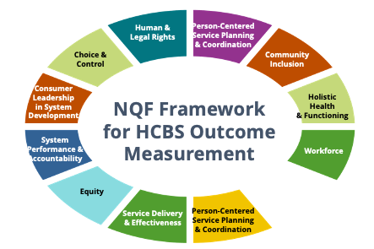

Intersection
Direct Support Workforce Quality Long-Term Services and Supports
Notes:
Talking Points
In our work at ICI there is a strong intersection between the direct support workforce and quality long term services and supports.
What we know from our research is that you really can’t talk about quality of long-term services and supports without talking about the direct support workforce.
The quality of supports a person receives affects their quality of nearly all areas of life. And we continue to study the relationship between the two.
So...we want to improve the DSP workforce so that people with disabilities receive better long-term services and supports and, thus, experience a greater quality of life.
The workforce is a domain in this framework (dark green box on the right), so is part of the LTSS that people with disabilities receive.
NQF=National Quality Forum

Slide 40

Who are we talking about?
Direct Support Professionals
  personal care attendant
  direct care worker
  direct support staff
  community living specialist
  job coach
  employment specialist
  etc.
Notes:
Talking Points
How we answer this questions is a big part of the problem.
We use so many different names of we use for Direct Support Professionals or DSPs
And what most people don't understand are the many roles that DSPs play. They are teachers, health care workers, cooks, drivers and so much more
First let's talk about the names that DSPs go by.
These are some of the names that we have heard in Tennessee for DSPs.
What titles does your organization use? (only take a minute on this question)
It is important to note DSPs are not recognized by the Bureau of Labor Statistics, and does not have its own job category, but are most often reflected in the job category of personal care attendants.
This is not an accurate placement by job duties as it does not reflect the community-based aspect of the work.
It also does not allow us to accurately capture wages and worker benefits when so many different jobs are lumped into the one category.
Efforts to work with a group of federal agencies to address this issue has been ongoing and continues to be a critical issue if we are to provide better information to policy makers about the workforce realities of these distinct groups of workers.

Slide 41

Clip from Invaluable (the movie about DSPs)
Notes:
Facilitator’s Notes:
When sharing video on screen – make sure to check the box for other to be able to hear the video
Talking points
We'd like you to watch this short 1 minute video clip from the movie Invaluable to hear about the many roles DSP’s play across the county, as well as the scope of their work.
Play video, when it is over, go to the next slide to talk about the scope of work.
Link to clip: https://www.youtube.com/watch?v=WvWNyVp_JPM&list=PLbrrhT8nj86wpPGTGTdwwpbrGQ_Q7h9Qr&index=6

Slide 42
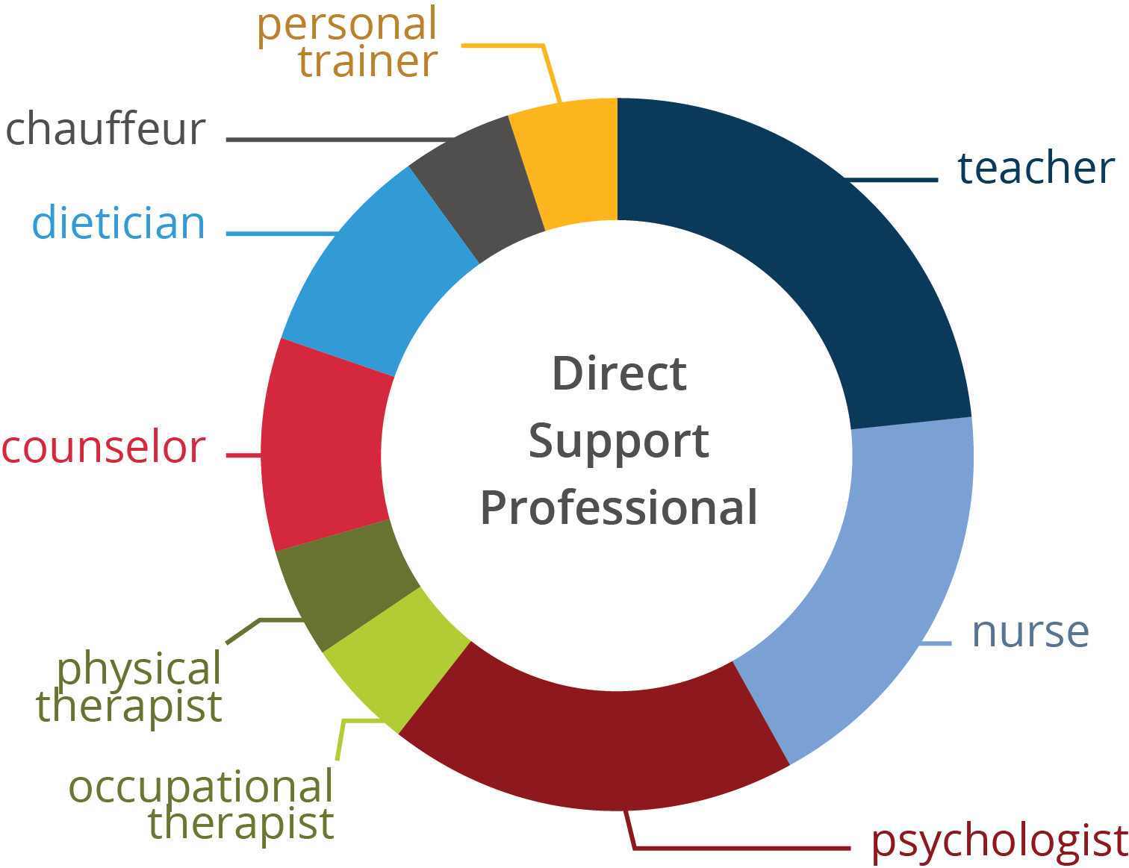
DSP Scope of Practice - Multidisciplinary
Notes:
Talking Points
The scope of the DSPs work is broad and complex.
On any given day, a DSP may required to take on the role of a nurse (dispense meds) , teacher (help someone learn a new bus schedule), psychologist (support someone to process their feelings), dietician (plan and prepare nutritious meals) etc.
Our descriptive language too often speaks of these DSPs as being entry level and low wage workers. And that narrative has to change.
DSPs do many things that in many states licensed practical nurses (LPNs) are not allowed to do. We need to focus on the complex skills these employees need to evolve to be competent and confident at what they do.
I also want you to take note that most of the different roles represented on this circle that a DSP might have on any given day require some form of certification or licensure, yet in many states if not most, DSPs do not have this requirement.

Slide 43


86%
WOMEN
An Increasingly Diverse Home Care Workforce
The typical home care worker is a woman in her 40s — many are
immigrants and/or older women of color.
The demographics are changing.
53%
PUBLIC ASSISTANCE
63%
PEOPLE OF COLOR
47
MEDIAN AGE
31%
IMMIGRANTS
SOURCE: PHI (2021). For detailed citations and information about PHI's research methodology, please contact info@phinational.org
Notes:
Talking Points
This is a snapshot of home care worker workforce data from PHI for 2021. The profile of a typical home care worker in the United states is a woman in her 40’s and many are immigrants and/or women of color. Almost one in four home care workers are parents.
As we track trends in these data points, we see that the demographics are changing. Two things in particular that we continue to look at are the median age and the increasing numbers of direct care workers who are accessing public assistance benefits.
How does this profile compare to your organization?
Looking at the PHI snapshot of data from Tennessee
89% of your direct workforce are women TN
38% of your workforce uses Public Assistance TN
39% are people of Color TN
40 years old is the median age and TN
8% of Tennessee direct care workforce are immigrants TN
PHI is a national organization that is focused on the direct care workforce. They are one of the key sources of national data related to the direct care workforce and we regularly reference their national/state data in our work at ICI. They have ties to the union/labor movement. Here is a link: https://phinational.org/ to learn more about their work. Well talk about some of their other data throughout today.

Slide 44
Defining the Workforce Issues
Notes:
Talking Points
Now that we have a better understanding of the DSPs in the workforce, we will explore the issues faced in the workforce.

Slide 45
Factors Influencing the Crisis
Growth # of People with ID/DD Receive Services (390% in 20 years)
Major shifts in service system
Changing expectations toward person centered
People with IDD live longer (age 66)
Changing demographics (more aging Americans)
Growing diversity
Economic stability and growth
Notes:
Talking points
There are a number of factors influencing the workforce crisis, a few factors include:
Aging = increased demand for support with ADLs
In 2014 there were 46.2 million Americans 65 years or older, making them roughly 15% of the U.S. population (one in every seven people in the U.S.). This number is expected to double by 2060, to approximately 98 million (ACL, 2017). Among this demographic, roughly 30% of those who live in the community report having difficulty with activities of daily living (ADLs), and 95% of those who receive institutional care report needing such support.
Fewer younger = fewer adults entering workforce in 2020
Adults age 16–24 and 104,697,000 adults age 25–54 will enter the workforce in 2020, representing a projected decline since 1994 of 13% and 4% respectively
Growing diversity = driven by immigration and increases of diverse racial and ethnic groups already residing in the United States
By 2055, the U.S. will not have a single racial or ethnic majority. This significant projected change has been and will continue to be driven by immigration and increases of diverse racial and ethnic groups already residing in the United States. According to a recent Pew Research Center report, nearly 59 million immigrants have arrived in the U.S. in the past 50 years, mostly from Central and South America, the Caribbean and Asia. Roughly 14% of the U.S. population is foreign-born, compared with just 5% in 1965 (Pew Research Center, 2016). In the upcoming decades, it is anticipated that most of the U.S. population growth will be linked to new Asian and Hispanic immigration and to growth in the population the U.S. Census calls “native-born,” who may also be of Asian, Hispanic/Latino and other ethnicities

Slide 46
Direct Support Workers
From: Occupational Projections for Direct-Care Workers 2012–2022
Notes:
Talking Points
Tracking trends over the last decade, the number of Direct support workers (home care, nursing home, other industries) continues to rise every year.
In addition, direct care workers is the among the largest occupational groups in the U.S. in 2020, above retail salespeople, teachers, cashiers, law enforcement officers, fast food workers, and registered nurses.
We need strategies to better support this workforce and organizations that employ them in order to support the growing need for qualified, competent people in these positions.
According to recent PHI reporting, nationally, by 2028 the total project job openings will reach nearly 8.2 million. In Tennessee this projected total is 56,580 which represents a 6% rate of growth.
The critical question continues to be where will we find these DSPs and how do we keep them.

Slide 47
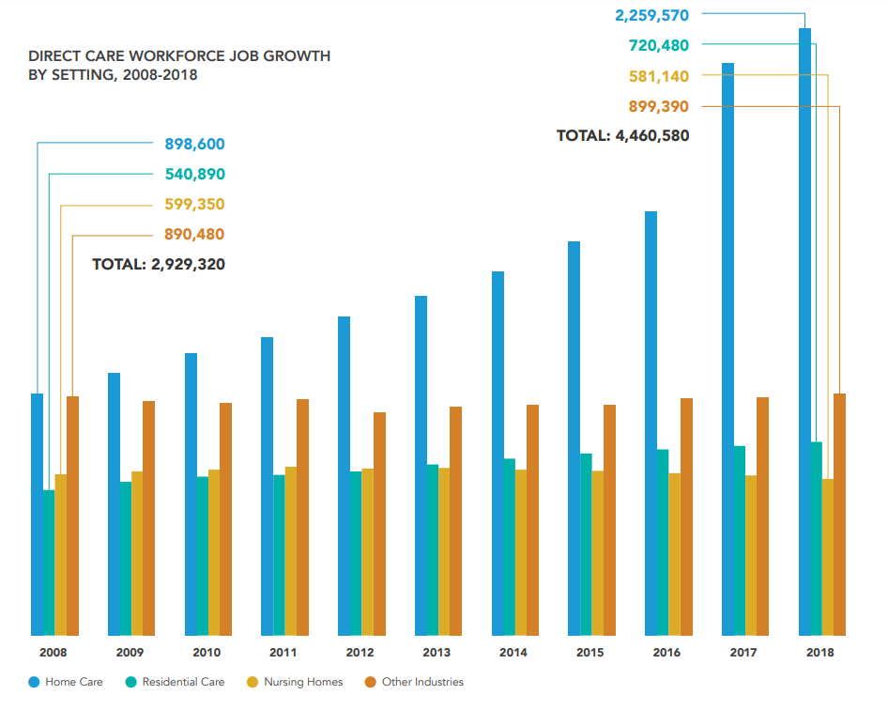
Number of DSPs in U.S.
PHI. “Workforce Data Center.” Last modified December 17, 2018.
https://phinational.org/policy-research/workforce-data-center/
Notes:
Facilitator’s Notes:
This slide has not been updated for 2019. It is fine to use as an illustration of data visualization for our purposes. In reviewing the 2019 data, the trajectory for the trend lines would continue in the same predictable pattern.
Talking Points
We have found PHI data sets to be most helpful in understanding the scope of the DSW workforce. While there isn’t a standard occupational code for DSP, the PHI data captures the largest group of direct care workers that includes DSPs.
Some trends to note in the number of DSPs in U.S. Between 2007-2017. Updated national and TN State data is available for 2019 at PHI’s workforce data center.
For facilitator information only:
2007
Home care 30%
Nursing homes 21%
Other industries 49%
Total Direct Care Workers 2,820,190
2017
Home care 49%
Nursing homes 14%
Other industries 37%
Total Direct Care Workers 4,310,240

Slide 48
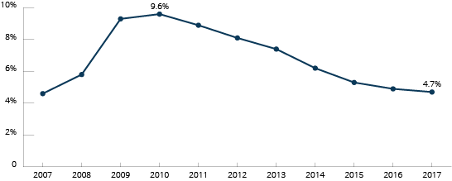
U.S. Unemployment Rate Over Time 2007–2019
2018 4%
2019 3.7%
Notes:
Talking Points
There is a connection between the unemployment and direct support workforce stability. What we know from research is that there is a correlation between recruitment and retention of DSPs and FLSs and the unemployment rate. When unemployment is low the pool of qualified direct support professionals shrinks and competition for workers increases.
There are regional differences at the national and state levels. We have heard stories from cohort 1 organizations about recruitment challenges and the increased competition from other service industries such as retail and fast food.

Slide 49
LTSS and U.S. Economy
2007-2017
1 million+ direct care jobs (54% growth)
1 in 6 new jobs in U.S. was in LTSS
4/5 new jobs were in home care
From: Graph from PHI Data Brief Here's How we Achieve a Strong Economy: Invest in Direct Care Workers
Source: U.S. Bureau of Labor Statistics (BLS), Current Employment Statistics (CES). 2017. Employment, Hours, and Earnings - National. https://www.bls.gov/ces/; analysis by PHI (October 4, 2017).
Notes:
Talking Points
Looking at the connection between LTSS and the US economy between 2007-2017, according to the US Bureau of Labor Statistics there has been a:
31% growth in the long term care industry compared to overall job growth of 6%
There has been a 1 million plus or 54% growth in direct care jobs
1 in 6 new jobs were in LTSS; and
4 out of 5 of those new jobs were in home care
LTSS = Long Term Services and Supports

Slide 50
Projected Aging of the Direct-Care Workforice in United States
PHI, 2012 for 2010 and 2020 and for 2015: PHI. “Workforce Data Center.” Last modified November 10, 2017.
https://phinational.org/policy-research/workforce-data-center/
Notes:
Talking Points
This graph of national data illustrates the challenge of finding 1 million new workers in a time when the workforce is aging and there is a projected decline in 2 key categories of workers between the ages of 16-34 and 35-54.
So we have looked at some of the factors influencing this workforce crisis now let’s take a look at workforce conditions that discourage people from considering direct support as a profession/career.
Describe graph

Slide 51
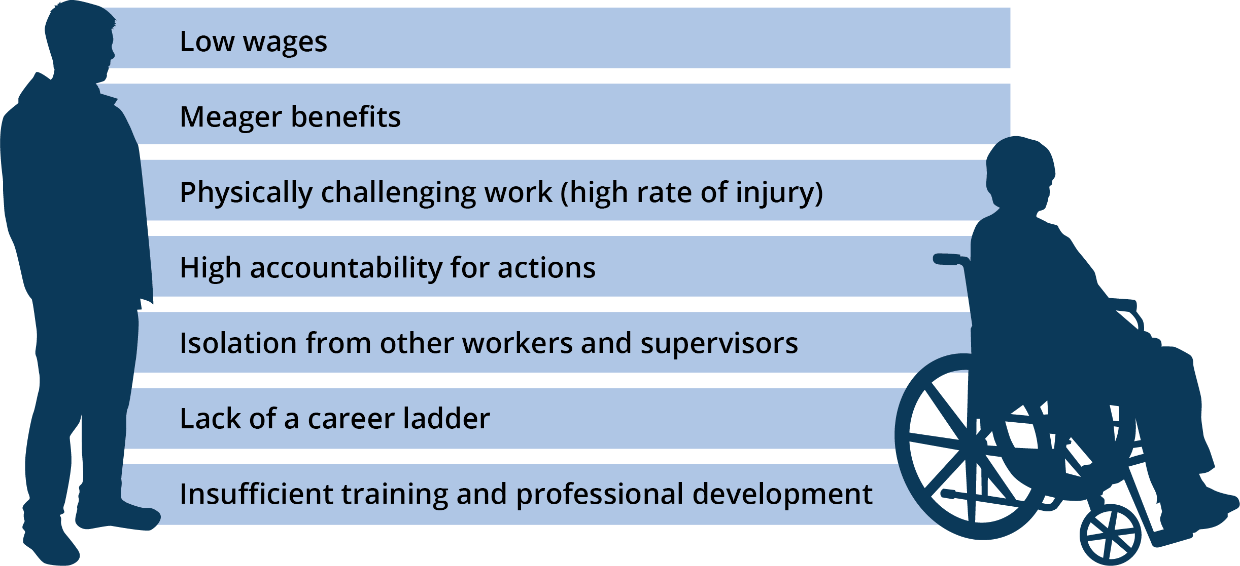
Workforce Conditions that Deter Entry into the Profession
Source: President’s Committee for People with Intellectual Disabilities, 2017
Notes:
Talking Points
Finding and keeping great DSPs is a challenge when you consider the workforce conditions that discourage people to considering a career as DSP.
Over the years, through our research and technical assistance, we have worked on identifying and evaluating strategies in workforce development to address these challenges.
Read workforce conditions on the slide
How does your organization stack up against these conditions?

Slide 52
Effects of DSP Workforce Challenges
DSPs, Individuals Supported, Families, Organizations, Systems
Notes:
Time: 5 minutes – Effects of DSP Workforce Challenges
Talking Points
We’ve talked about the data impacting the DSP workforce. Now let's look at how the workforce challenges effect the people closest to the work.

Slide 53

Direct Support Professionals
Tired and Overworked
  High stress/burnout
  Working 2-3 jobs
Isolated and Alone
High Expectation Discrepancy
Injury
Poverty
Notes:
Talking Points
Many DSPs are just plain tired and over worked.
They often are working overtime or multiple jobs to make ends meet, meaning that their work-life balance is skewed.
They are stressed because of money, and many are dependent on govt support and/or lacking affordable housing.
We know that when people aren't at their personal best, they are more likely to make a poor judgement call or have accidents, which leads to higher rates of injury.
This all effects the lives of the people they are there to support.
This is also leading to a higher rate of stress and burnout for the DSPs
We also know that DSPs are more isolated now then they have ever been.
When community living meant you lived in a large group home and went to the local workshop, DSPs had co-workers who worked beside them, they had supervisors who were there much of the time and they had specialists like nurses and therapists and likely a medical doctor that were there occasionally and at least you could call them 24/7. Now in the predominate community service in the U.S. none of this support is there. With COVID –19 this issue has become even greater.
It is more typically than not DSPs work alone and there is no opportunity for overlapping hours.
DSPs report that they feel isolated, they want opportunities to learn from and network with one another.
We know that over the past 30 years as our ideology and understanding of community living and participation have changed so have the expectations placed on DSPs.
We expect a tremendous amount of these workers.
Yet little else has changed. Training hours have not increased, pay has not increased, opportunities for growth and development have not increased….
And we wonder why the desired outcomes simply are not present.
Facilitator Note: Read slide and ask for a reaction (thumbs up) for those who have noticed DSP experiencing these symptoms due to workforce challenges.

Slide 54

Individuals Who Receive LTSS
Health, safety, and well-being risks
Lack of growth and development
  Relationship-based profession
Fewer opportunities for inclusion and participation
Notes:
Talking Points
When our DSPs aren’t performing their best, the people supported have higher health and safety risks.
They have less opportunity for personal growth and development.
Fewer opportunities to build meaningful relationships and participation in their community
Facilitator Note: Read slide and ask for a reaction (thumbs up) for those who have noticed individuals who are supported by DSPs experiencing these symptoms due to workforce challenges.

Slide 55

Families
Worried about access and quality
Unable to keep jobs or accept promotions
Family member at home longer
Stress and related health issues
Notes:
Talking Points
The workforce challenges really effect the families of the people receiving supports.
Families worry about their loved ones getting access to the services they need, and then they worry about the quality of the services.
Some family members have experienced job loss or haven't been able to accept promotions
Families worry about the safely of their loved one who no longer lives at home. They may be used to being the primary caregiver and shifting their role can be difficult.
Having a loved one with a disability can be stressful, which can take a toll on the family members’ health. They may put their loved one's health and needs before their own.
Facilitator Note: Read slide and ask for a reaction (thumbs up) for those who have noticed families experiencing these symptoms due to workforce challenges.

Slide 56

Organizations
Focus on getting people in
  Lowering expectations of qualifications
Supervisors in crisis management vs mentoring and supervision
Risks and high costs of injury
Notes:
Talking Points
Organizations are struggling to find qualified staff. Many have lowered their expectation of qualifications just to get people in the door and to fill a position. We have people says, "If they have a pulse, they aren't in trouble with the law and they pass a drug test, we will hire them."
Supervisors are working in crisis mode. And when you're doing this, you aren't able to provide supportive supervision that promotes growth of the DSP.
When you combine low expectations for who is being hired and supervisors working in crisis, the risk of injury, for the staff and the people receiving supports increases.
Facilitator Note: Read the slide and ask for a reaction (thumbs up) for those who have noticed their organization experiencing these symptoms due to workforce challenges.

Slide 57
Impact of Staff Turnover
UMN Intervention Implementation Studies
Active Support (Larson, Tichá, & Qian, 2014)
Self-Determination (Abery & Tichá, 2014)
Comprehensive Training (Hewitt, Nord, & Bogenshutz, 2014)
Participatory Planning and Decision-Making Group (PPDM) (Abery, Tichá, & Qian, 2015)
Notes:
Facilitator’s Notes: Spend only 15-30 seconds on this slide.
Talking Points:
We just discussed the impact that the DSP crisis is having on many different groups of people.
At the University of MN, there are quite a few impact of staff turnover studies. Some are listed here. We don’t have time to review them today ,but if you want details of these studies please contact us.
So, all of this is to say that the workforce matters. Whatever it is that we are trying to do to support people through our research, training, outreach and technical assistance is affected by the direct support workforce.
Notes:
In our intervention research at the University of Minnesota, we have consistently seen site level turnover impact the effectiveness of our interventions. Here are a few examples:
Researchers replicated the Active Support intervention in Minnesota group homes. Due to high turnover, many DSPs who were trained were no longer present at the homes during follow-up. Only 61% of DSPs received both components of the training at the 3-month observation. This affected intervention fidelity as well as outcomes for those in the group homes.
In the self-determination training intervention, the house "culture" had a stronger effect than any other intervention variable. This likely included staff turnover and its impact on the behavior of individuals served.
In the comprehensive training intervention, similar patterns emerged among the 136 sites. Overall, turnover and vacancies were predictors of employment, friendship, social relationships, choice, and community participation outcomes for people with disabilities.
Participatory Planning and Decision-Making Groups were held to understand the barriers and facilitators for the successful implementation of interventions in residential settings for individuals with disabilities. Staff turnover was identified as a barrier to program implementation and sustainability by national and international experts. One related anecdotal theme that has been coming up repeatedly has been the effect of the economic situation (low levels of unemployment) on the quality of staff pool, and consequently the lack of stable high-quality staff in the homes of people with IDD
57

Slide 58


Recruitment & Retention:
A Self-Advocate Perspective
We want staff who show up on time and help us get the stuff done we need to get done.
We want people who are paid enough to stay so they like what they are doing.
We want people who respect us and are respected for what they do and the pay they earn.
Source: IMPACT, 2008
Cliff Poetz, Advocacy Leader
Notes:
Timing: 5 minutes for this section
Talking Points
A leader in the self-advocacy movement, Cliff Poetz, spoke about the importance of DSPs. Read the slide.

Slide 59
Understanding the Problem(s)
COMPLEX issues
No single solution
Your team must own the issues and lead change
Notes:
Talking Points
The reality is that if it were easy to address the workforce crisis, it would have been solved long ago.
The challenges that organizations are experiencing are complex. There is no single solution, and likely multiple solutions are needed to address the issues.
We challenge your organization to start understanding and tracking your data while addressing a critical workforce challenge in your organization.
During this process, you may identify multiple strategies that you would like to try. That’s great.
We challenge you to start addressing one, and then progressively refine your efforts to incorporate additional strategies when you are ready and have the resources to do so.

Slide 60
Type in Chat
  What did you hear that was an “Ah-Ha” moment?
  What is something you want to know more about?
Notes:
Facilitator’s note: Ask organizations to type in the chat what they heard so far today that was surprising or an “aha” moment. Explain that we will continue on to break

Slide 61
Stretch Break
Take 5 minutes to stretch and refresh.
Notes:
Time: 10 Minutes, Break should occur 5 minutes before the start of the second hour of the session.
Talking Points
Turn off video and audio when you leave.
Once break is over, check in with folks to make sure they are back by using reactions, camera on, etc

Slide 62
Understanding Your Data: Overview of Survey Results Profile and Interpreting Data
Notes:
Timing for slides 63-88: 25 minutes
Talking Points:
We talked through a lot of what’s going on nationally, now we’re going to continue to assess the problem, specifically in TN, regionally and statewide, and we’ll talk about how you can compare your data to statewide and regional data.
The 2020, year 3 sample included 63 organizations. This is a combination of Cohort 1, Cohort 2, and you, Cohort 3, organizations.

Slide 63
Goals for Part 2
Learn more about your organization’s workforce
Review the results of the 2019 QuILTSS Initiative survey by state and region
Compare your organization’s workforce data to region and state averages
Start thinking about your desired workforce outcome
Notes:
Talking points
We have several goals for today’s session. These goals include (review goals on the slide)

Slide 64
Items you should have with you:
  Your organization’s 2020 profile – Sent to your email you used to register today
  2020 Organizational Workforce Data Chart located on page 5 in your 2020 Organizational Self Assessment Workbook (www.tenncare.ici.umn.edu)
Notes:
Talking Points:
Please make sure you have the following.
Explain where they can find their organization’s profile.
Insert link to SAW in the chat

Slide 65
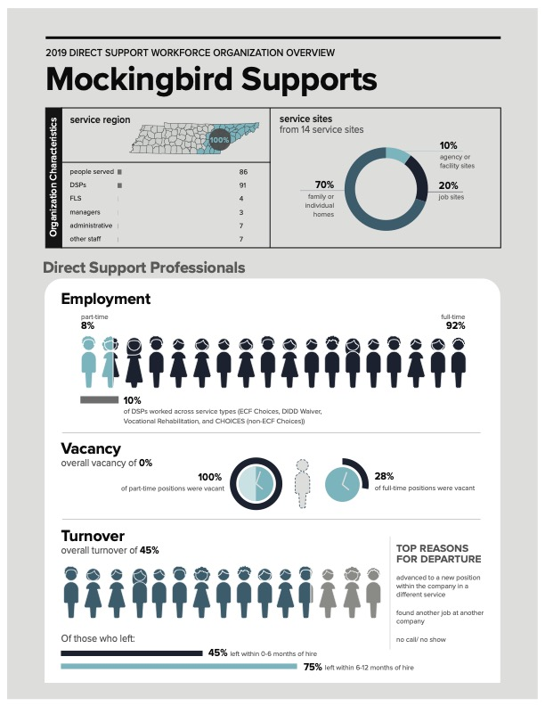
Your organization’s data
Notes:
Talking Points:
You should’ve just received an email from dsp-tn@umn.edu containing your organization’s individualized profile. If you do not have it, please message us with your organization name and email.
There were a few outcomes on the profile that were computed by the data provided, and we will show you all these formulas today.
Please pull out the profile to have it in front of you now. If you don’t have yours, please send me a message in the chat with your organization name and your email address and we will resend it.
Poll on next slide

Slide 66
Poll Question #3 - How familiar are you with the kinds of data on your profile?
Not at all familiar – I’ve never seen these kind of data before
A little familiar – we track some of these data in our organization
Familiar – we track many of these data regularly
Very familiar – we track these data regularly and we use them for decision making
Notes:
Poll
Talking Points:
These are just some of the points of data you may be already collecting that might inform your next steps. We know there is so much data you can track, from recruitment and marketing data, to opinions and retention trends, to exit interviews.
Read poll options, once poll is closed, comment on what you see.

Slide 67
Data-Based Decision Making
Understanding your organization’s data
Notes:
Talking Points
The importance of looking at your data is not so much to keep score, but to use the data to inform your efforts and decision making about addressing your workforce challenges.
If your organization is like many other provider organizations, you experience difficulties in recruiting, selecting, training, and/or retaining DSPs and FLSs.
Knowing your data and how your data compares to other organizations like yours can help you be better informed about selecting a strategy to address one of these challenges.
As you become more familiar with your data over time, you can compare your organizational data with your own numbers to see your changes over time.
For example, Cohort 1 organizations have 3 years of data that they can use to inform their workforce activities and see if the strategies they have implemented have made difference in their data.
Ultimately, using your data for decision making can help you to work smarter, not harder.

Slide 68


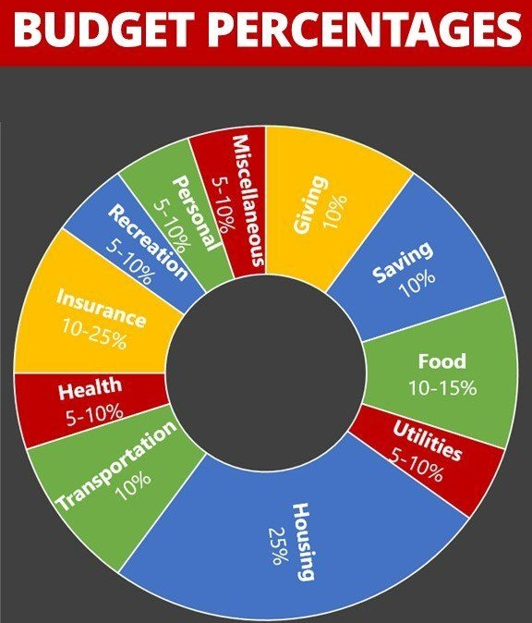
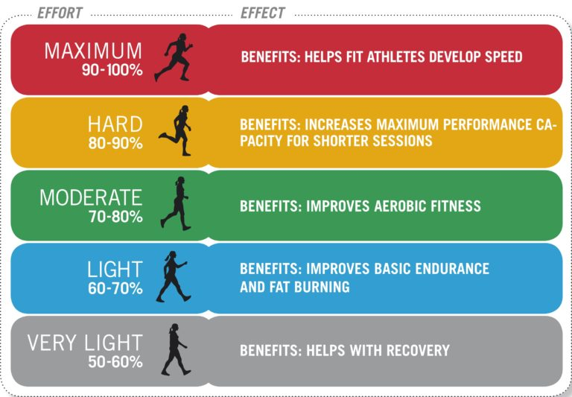
Data we might use for decision-making
Notes:
Talking Points:
Thinking more broadly about using data in our lives, are there other kinds of data you use for decision making? Can you think of any kinds?
As you’re thinking, here are a few examples on your screen. Explain one of them.
Do you have a smart watch with rings that track your active calories burned, or number of times you’ve stood up and walked around today? All of that information can be used to inform your choices about exercise and activity.
Do you use a budget to help you track your spending? Maybe you use some kind of rule of thumb like the one on your screen or a credit card report to help you track where your money is going. Knowing how you spend can help you make informed decisions about your choices in the future.
Finally, report cards may have kind of data the help you inform your efforts in spending your time and energy as you or your children or grandchildren study. Ideally, your grade should reflect how well you have mastered the content.
What other kinds of data do you use in your personal or work life? You can use the chat box or unmute your microphone to tell us.
[A few examples: taking temperature when going to work or school during the COVID-19 pandemic (going home if temperature is above 100.4), keeping track of your mileage you’ve driven on this tank of gas to make sure you fill up again before you run out, etc.]

Slide 69
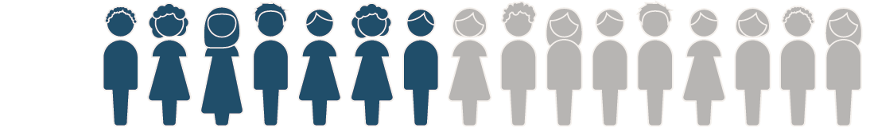


Understanding Direct Support Workforce Data
State level studies
COVID19 national study
Secondary analyses
Staff Stability Survey
BLS data
ACS data
State level studies
Notes:
Talking Points:
How many of you collect workforce data in your organizations? Ask for thumbs up
How many of you use this data to make decision around which strategies or solutions to try to address a particular workforce challenge you may have? Ask for thumbs up
Collecting and analyzing your workforce data is an important step in considering strategies for improving workforce stability in your organizations and at all levels. Understanding workforce data can help you make decisions about choosing workforce solutions that are most likely to result in improving workforce stability.
These are the current most commonly used data sources and include state level studies, national staff stability survey and data from Bureau of Labor Statistics and census data.
We have found PHI data sets to be most helpful in understanding the scope of the DSW workforce. While there isn’t a standard occupational code for DSP, the PHI data captures the largest group of direct care workers that includes DSPs. One thing to be cautious of when comparing your data to other data sources is to ensure that the data are computed in similar ways and with similar populations. When we discuss PHI data, for example, we know that the data might include additional workers.
Some ways we use workforce data include:
Is in our legislative advocacy
To increase accuracy in separating information DSP who with certain populations or types of services
To make informed policy and practice decisions
To drive Data-based decision making within states, counties and organizations
To create wage scales within organizations

Slide 70
Annual Survey
Covers the 12-month calendar year
2018 (47 organizations)
2019 (75 organizations)
2020 (63 organizations)
Notes:
Talking Point:
We have collected 3 years of annual organizational data. There were changes to survey used between year 1 and year 2. Year 3 we added questions about your experiences during COVID-19.
Results of year 1 with 2018 data and year 2 with 2019 data were compiled in the corresponding reports, along with state and regional profiles. These are available on the website.
We will look today at results from the Year 3 2020 survey results that are also available in report and profiles, and will be available on the website. The profiles contain selected information – not all the information provided by organizations that completed the survey are compiled in the profiles. The profiles are designed to include information that is particularly important for decision making regarding workforce recruitment and retention.
STOP FOR QUESTIONS.
Quick snapshot of data:
12 month period the data reflects
January 1, 2019 - December 31, 2019
When it was fielded
March 2, 2020; closed May 13, 2020
Response rates
Of the 124 providers in the sample
18.7% (20) did not respond at all
11.3% (12) had incomplete data
70% (75) submitted a year #2 survey
Of the 75 submitted surveys
53.3% (40) participated in Year 1 survey
46.7% (35) were new participants

Slide 71
Activity
Notes:
Talking Points:
Page 5 of your self-assessment workbook has a chart on it like the one on your screen.
On the left of the chart are the types of data that are included on the organizational, regional and state profiles.
The data from the top box on the profile are not included in the chart, as those are more descriptive data about your organization and don’t lend them selves as well to comparison.
The middle columns in the chart are labeled at the top with “our organization,” ”our region,” and “State of Tennessee.” As we move through this presentation of data, you’ll have the opportunity to fill in “state of tennesee” and use the profile we sent you to fill in the “our organization” columns. We will give you time to do this as we review each piece of data.
Later this week, you’ll want to go to the website and find your region’s data and fill this in as well. This can give you more focused information regarding what organizations near you are experiencing.
On the right, there is a small space for you to make notes as we go along today. You can note data where you have some questions or concerns that you’d like to revisit later.
Facilitator note: When reviewing the data later, slow down and allow time for organizations to do this!

Slide 72
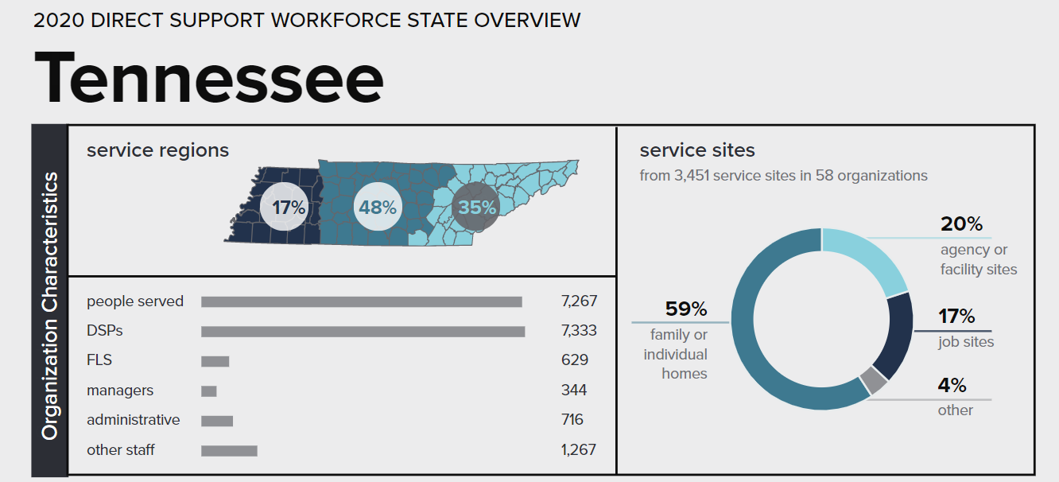
Organizational Characteristics
Notes:
Talking Points:
Shown on your screen is the first box from the state of Tennessee profile from the 2019 survey results. These data are not included in the chart in your self-assessment workbook, so you don’t need to enter them there.
In the organizational characteristics section of the profiles, there is some descriptive information provided that we will cover briefly.
In the service regions section, 48% of people served are in the middle region of the state, 35% are in the east region, and 17% in the west region of the state.
There were 7,267 people who received services across the organizations that reported. 7,333 DSPs were employed and 629 frontline supervisors. The other employees at the organizations are also listed in the state profile. [don’t read the rest of them…]
There were 3,451 services sites reported, which broke down into the following percentages: 59% of services were provided in family or individual homes, 20% were in agency or facility sites (including group homes), 17% in job sites, and 4% were provided in other types of sites. You can find more information about the other types of sites in the report.
This information is meant to help place you in the data. Where does your organization stand in relation to state-wide data?

Slide 73
Direct Support Professionals next section
Employment
Notes:
Talking Points:
The next section of will include information about state and regional comparison data on the employment of direct support professionals. Moving down the profile, this information is below the organization characteristics section.

Slide 74
Defining Roles of DSPs vs Frontline Supervisors
Direct Support Professionals
Frontline Supervisor
50%+ hours spent in direct support tasks (e.g. personal care, home care, community integration)
primary responsibility (50%+ of their role) is supervision of DSPs.
Notes:
Talking Points:
In the survey we asked about Direct Support Professionals (DSPs) and Frontline Supervisors (FLSs).
There are many job titles for both direct support professionals and frontline supervisors, so before we discuss the information reported on these workers, we wanted to be clear about the definitions we provided in the survey for these workers when we asked about them.
Please note that these definitions are based on job descriptions for employees. Given that some workers may shift into different roles or work additional hours, the job descriptions are the best way to categorize employees and is also more likely to align with the ways that human resource staff can provided data.
Direct support professionals were defined as, “those employees whose job descriptions require them to provide at least 50% of their scheduled hours doing direct support tasks.” Depending on the settings where you provide services, these may include personal care, medication administration, job supports, transportation, budgeting, and other tasks. Some DSPs provide supervision to other DSPs, but many organizations have found it helpful to use this designation to separate DSPs from FLSs, whose primary task is supervision of DSPs.
The survey included organizations that employ DSPs in family model provider.
Frontline supervisors are distinguished by a different definition in which the employee provides at least 50% of their scheduled role in supervision of DSPs. They may also provide some direct support, but their primary responsibility, that is at least 50% of their job description, is in supervision. We often get questions about how to count FLS because many are providing direct support due to high vacancy rates and the inability to hire enough staff to fill all funded positions. This is where to refer to job descriptions if you have questions. FLS may have job titles like program director, house supervisor, house coordinator or others.
We will first be reviewing data about DSPs.

Slide 75
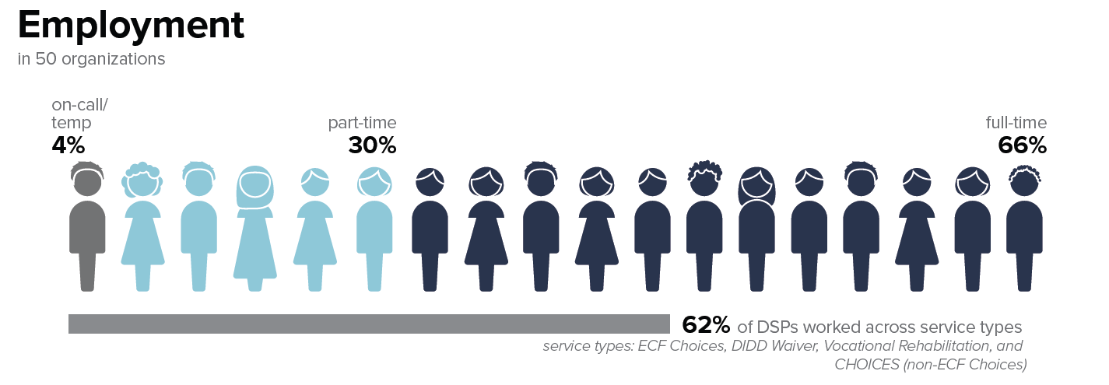
DSPs Employed – State
Notes:
Talking Points:
Looking first at the Direct Support Professionals in the state.
These are your first data points to enter into the “state of tennessee” column on your organizational workforce chart. Of the 50 organizations who participated,
4% of the DSPs are on-call, temporary or PRN staff. These are employees who do not work regular hours. As a note, they are not part time or full time DSPs who work extra hours on an as-needed basis. They are not considered part time or full time DSPs. On call/temporary DSPs are not included in our numbers for turnover, for example, as we expect them to come and go.
Across the state, 30% of DSPs were part time DSPs.
Finally, 66% of DSPs were considered “full time” by their organization. Organizations may have defined their DSPs as full time in different ways (for example working 30 hours per week, 40 hours per week, or another designation). Organizations also reported on the survey how they define “full time” for DSPs. If you’re interested to see how organizations responded to this question you can consult the 2019 report.
Make sure to note these statewide data points on the organizational workforce data chart. Pause.
Finally, we asked organizations to indicate the percentage of DSPs who work across service types in their organization. Statewide, 62% of DSPs worked across service types, meaning that they worked in ECF CHOICES, as well as another service type including DIDD Waiver, Vocational Rehabilitation, and CHOICE (non-ECF CHOICES). This data point is not on your organizational workforce data chart but is an interesting piece of information to know about ECF Choices providers.

Slide 76

Projected Growth of Workforce
2016-2026 (BLS)
Percent change from 2016-2026
PHI. “Workforce Data Center.” Last modified December 17, 2018.
Notes:
Talking Points:
A few points of comparison with other available data about the direct support workforce. PHI analyzes data collected through the Bureau of Labor Statistics, including projected growth of various workforces over time. If you’ll remember, there is no SOC code for Direct Support Professionals, but DSPs are sometimes counted are home care workers. The growth in demand for home care workers is depicted in the top bars on the screen. In 2016, nearly 2 million home care workers were documented. There is a 52% increase in demand for homecare workers projected by 2026. In 2026, the demand for these workers is expected to be over 3 million!
There are some other comparison figures on the screen to show the differences in demand. Demand for nursing home workers is expected to remain steady in the same time period. The average of other industries is expected to grow 16%.
This means that the demand for home care workers is expected to grow by over three times that of other workforces.
These help provide some national context for understanding the workforce challenges that many organizations are currently experiencing. Given these statistics, we might expect that there are pipeline programs or other ways for people to learn about careers in home care or as direct support professionals, but unfortunately this is not often the case.

Slide 77
Tennessee: Occupational Growth Projections, 2014-2024
Notes:
Talking Points:
PHI includes a database of state specific data. On the screen are some of data collected by SOC codes, showing the demand for these workers in Tennessee specifically. You can see that demand for all classes of these workers that provide supports in the community is higher than that of all occupations (which is denoted by the gray bar on the bottom).
Describe slide
The community-based positions, including personal care aids and home health aides is higher than nursing assistants.

Slide 78
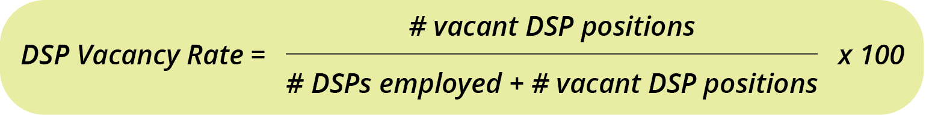
Formula for Vacancy Rate
Notes:
Talking Points:
Moving onto vacancy rate on your profiles, before we show you the data we would like to show you how it is calculated.
Some significant challenges in our industry stem from a high number of vacant but funded positions.
Vacancy rates are the percentage of positions that are funded but were unfilled on the last day of the period – in this case, on December 31, 2020.
Vacancy is one of the computed measures in the survey – meaning that we utilize the information provided regarding staffing to compute vacancy rates for you.
The formula for vacancy rate is provided in the workbook from the kickoff workshops
Vacancy is computed by taking the total number of vacant positions on December 31, 2020 divided by the total number of positions on the same date.
The total number of positions is the total number of DSPs employed plusthe total number of vacant positions.
Then this is multiplied by 100 to get a percentage.
In the QuILTTS Survey, we computed this for overall, part time and full time DSPs.

Slide 79
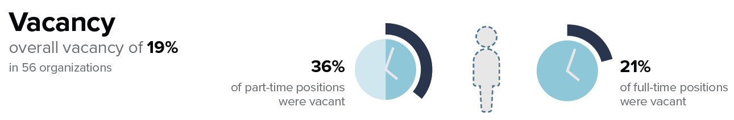
Vacancy – State
Notes:
Talking Points:
Statewide, in 2020, there was an overall vacancy rate of 19%. This means that 19% of DSP positions in the state were unfilled on the last day of the year.
You can add this into your workbook. Pause
We don’t have spaces for you to add part time and full-time vacancy rates, but these are provided on the profiles.
Of note, there was a higher vacancy rate among part time DSP positions.

Slide 80
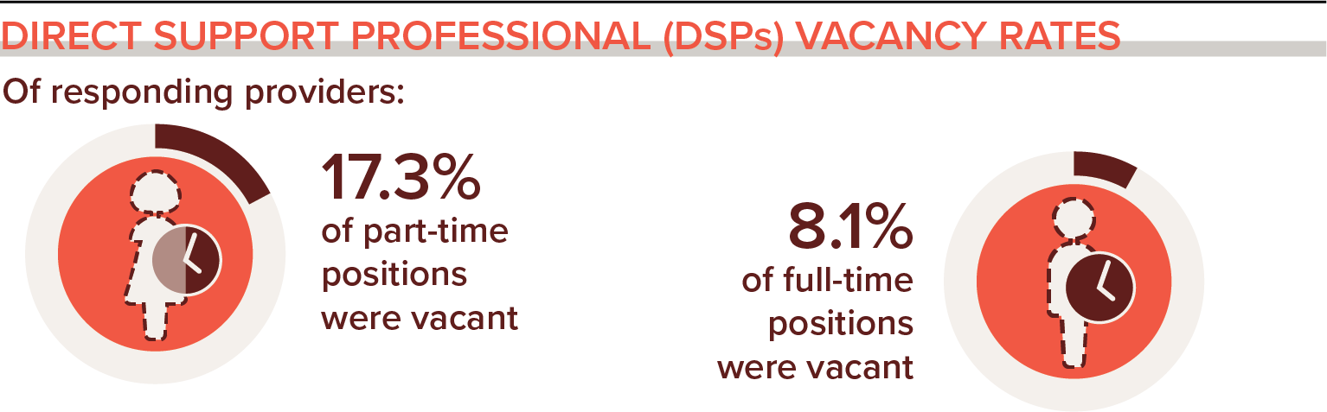
2017 National DSP Vacancy Rates
National Core Indicators. (2019). National Core Indicators 2017 Staff Stability Survey Report. Retrieved from the National Core Indicators website: www.nationalcoreindicators.org/resources/staff-stability-survey/
Notes:
Talking Points:
On your screen right now are national data from 2017 from the NCI Staff Stability survey. You’ll recall that these workers are specifically those that employ DSPs. In 2017, 19 states (including some in TN) plus the District of Columbia provided data for this report.
Across these states, over 17% of part time DSP positions were vacant, and 8% of full time DSPs were vacant. The 2019 data was similar – 8.5% for full-time and 11.2% average for part-time.
This information is provided in order to help understand the national landscape regarding demand for DSPs.

Slide 81
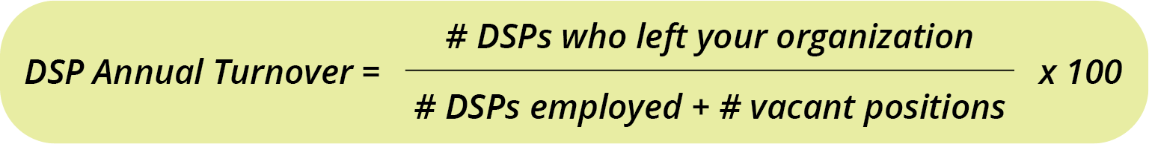
Calculating Annual Turnover
(Crude Separation Rate)
Notes:
Talking Points:
Moving on to turnover…
Turnover is the other measure that we compute for your organization using the formula on the screen. Like the formula for vacancy rate, this formula is also provided in the self assessment workbook
There are many ways to calculate turnover, and it is important to make sure that you are comparing data that are computed using the same formula (or note the differences when interpreting).
We compute turnover using the formula for annual crude separation rate.
The formula is: the total number of DSPs who left in the calendar year (2020 in this case) divided by the total number of DSP positions, which includes: the number of DSPs employed plus the number of DSP vacant positions.
That number is multiplied by 100 to get a percentage.

Slide 82
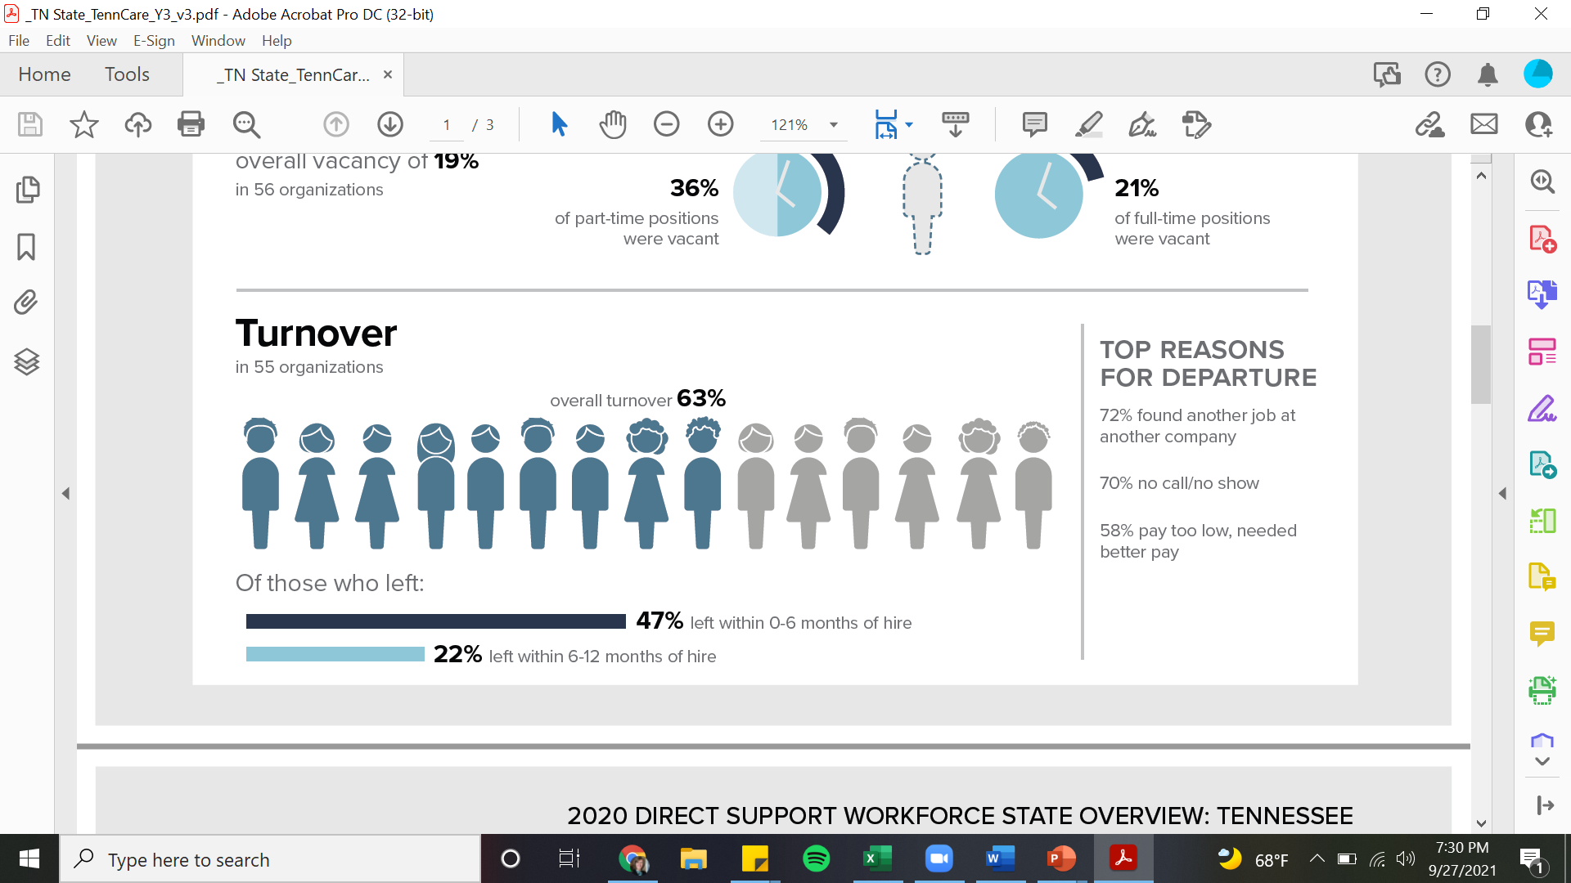
Annual Turnover – State
Notes:
Talking Points:
Statewide, 63% of DSPs left their positions in 2020. You can note this number in your workbook chart. Pause
We also collected top reasons for DSP departure from organizations that collected this information. Organizations could select the top three reasons, as well as the option to write in an “other” reason. The top reasons for DSP departure in the state are read reasons for depature.
You can note those in the state and your region and note if any of your reasons differ. This can be particularly helpful information for addressing workforce challenges – specifically trying to address reasons why DSPs leave if those reasons are in your control.

Slide 83
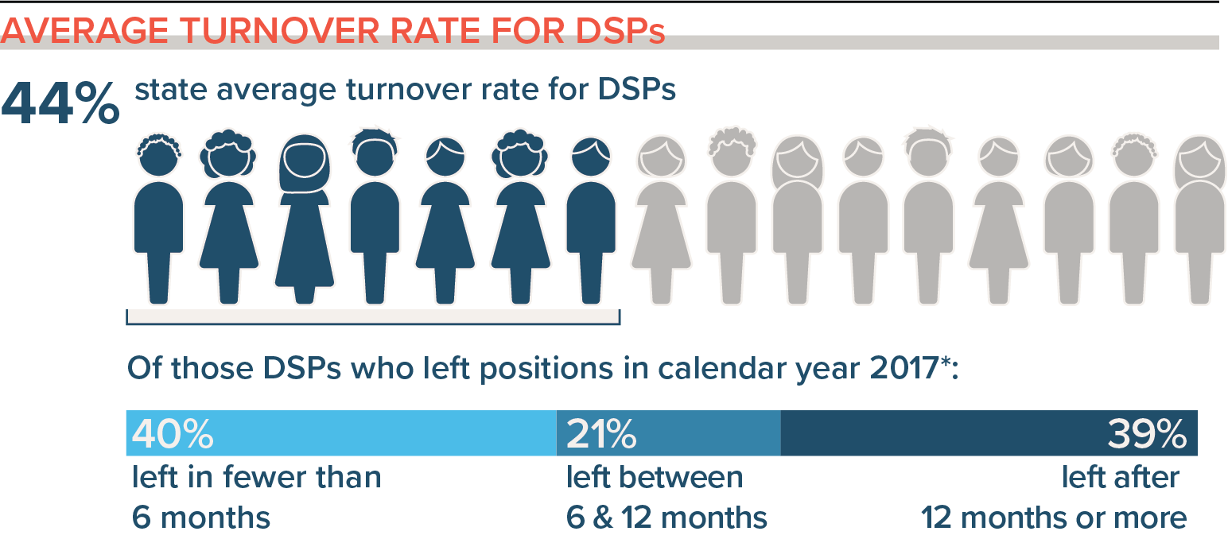
2017 DSP Average Turnover Rate
National Core Indicators. (2019). National Core Indicators 2017 Staff Stability Survey Report. Retrieved from the National Core Indicators website: www.nationalcoreindicators.org/resources/staff-stability-survey/
Notes:
Talking Points:
Looking at the NCI data from 2017 in 19 states including TN and the District of Columbia, 44% of DSPs left their positions in the calendar year. Note that NCI does not use “vacancies” in their computation for turnover so the formula results in a slightly different result - it is not directly comparable.
Of those who left their position, a slightly percentage of DSPs left between 0-6 months and between 6-12 months.
This can indicate that strategies are needed to support DSPs early in their TN.

Slide 84
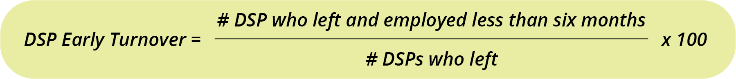
Early Turnover Formula
Notes:
Talking Points:
We also included some tenure specific information related to turnover. In addition to reporting the number of DSPs who left in the calendar year, we asked you to report how many left who had been employed between 0-6 months when they left, and those who had been employed between 6-12 months before they left. This formula is in your workbook as well.
Note that this is a portion of the DSPs who left, not a percentage of your DSP staff which includes those who stayed.
To compute early turnover, that is those staff who left between 0-6 months tenure, take the number of DSPs who left and were employed less than six months by: the number of DSPs who left in the year (the number you used in the annual turnover computation). Multiply this by 100 to get the rate of DSP early turnover. The formula is repeated with the number of DSPs who left with 6-12 months of tenure in the calendar year.

Slide 85
Early Turnover – State
Notes:
Talking Points:
Of those DSPs who left the organization, 47% left with 0-6 months of hire. 22% who left had been employed between 6-12 months of hire.
What this can indicate is that more strategies are needed to hire DSPs with appropriate expectations about the job, and more support for training, supervision, matching or mentoring DSPs in the early months of the job.
Over half of the workforce who left had been working for less than six months. Many who have worked as DSPs know that six months is not long enough to have learned this role, and when workers leave within six months of being hired, this is likely to impact peoples’ quality of life and the morale of other workers. The good news is that there are strategies identified to help address these challenges over time. We’ll discuss these strategies next week.
As a note, if your organization did not provide any vacancy data for DSPs, turnover could not be computed. Turnover could be computed only if all the data points were provided. Otherwise, your profile will say “data not available.” if you can find the applicable data, you can use the formulas on page 19 of your workbook to compute any missing data points on the infographic.

Slide 86
2017 DSP Early Turnover Rate
National Core Indicators. (2019). National Core Indicators 2017 Staff Stability Survey Report. Retrieved from the National Core Indicators website: www.nationalcoreindicators.org/resources/staff-stability-survey/
Notes:
Talking Points:
Looking at the same 2017 NCI data, of those who left their position, 40% left in fewer than 6 months and 21% left between 6 and 12 months.
This can indicate that strategies are needed to support DSPs early

Slide 87
Direct Care Worker Median Hourly Wage Comparison in the United States, 2017
DSPs
U.S. Bureau of Labor Statistics, Occupational Employment Statistics: https://www.bls.gov/oes/
Notes:
Timing for wages: 4 minutes
Talking Points:
Now we’re going to look at some data around wages.
Wages for direct support professionals have been low when compared to entry level workers that require less skill. On the screen are average hourly wages paid to various worker groups in 2017 based on data from the Bureau of Labor Statistics. Wages for home health and personal care aids nationally were around $11 per hour, compared to parking enforcement workers earning $18.76 per hour and refuse and recyclable materials collectors earning $17.39 per hour.

Slide 88
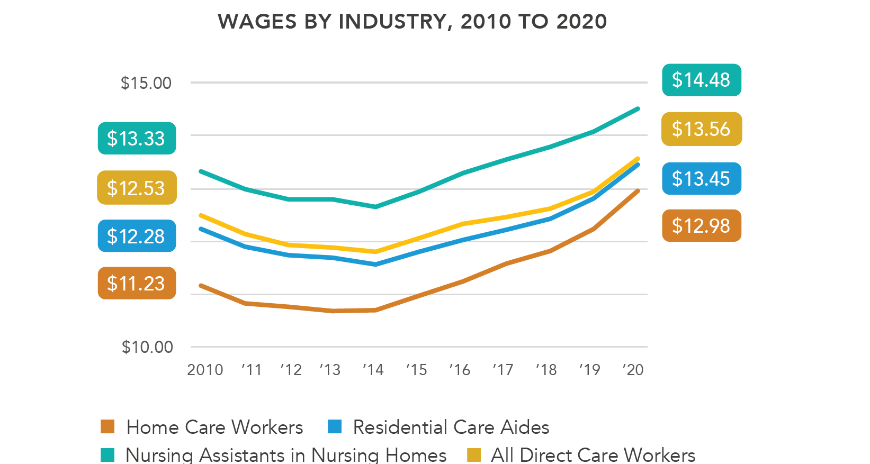
United States DSP Wages Over Time
PHI. “Workforce Data Center.” Last modified 2021.
https://phinational.org/policy-research/workforce-data-center/.
Notes:
Talking Points:
Furthermore, DSP wages are one of the most alarming and discouraging trends. As we track DSP wages over time and adjust for inflation the wage has gone down over time, yet cost of living continues to rise for these already low paid workers.
In every state, every year, wage and rate increase campaigns occur. These ask DSPs, people with IDD, families and allies to write letters and go to state capitols and tell their stories. Well this slide tells you how effective that strategy has been.
While the news is not good, there is something else on this slide that is worth pointing out. In the U.S. Certified Nursing Assistants are required to have a credential that is usually offered in post secondary educational programs or by an employer in partnership with an educational institution. CNAs work in institutional care. Yet they are required to be credentialed. While their wages have on average gone down over time, they earn $2.00 more than non credentialed workers.
“Home Care” includes all direct care workers who are employed in two industries: Services for the Elderly and Persons with Disabilities and Home Health Care Services. “Nursing Homes” reflects nursing assistants employed in the Nursing Care Facilities (Skilled Nursing Homes) industry. Total includes all industries where direct care workers are employed.

Slide 89
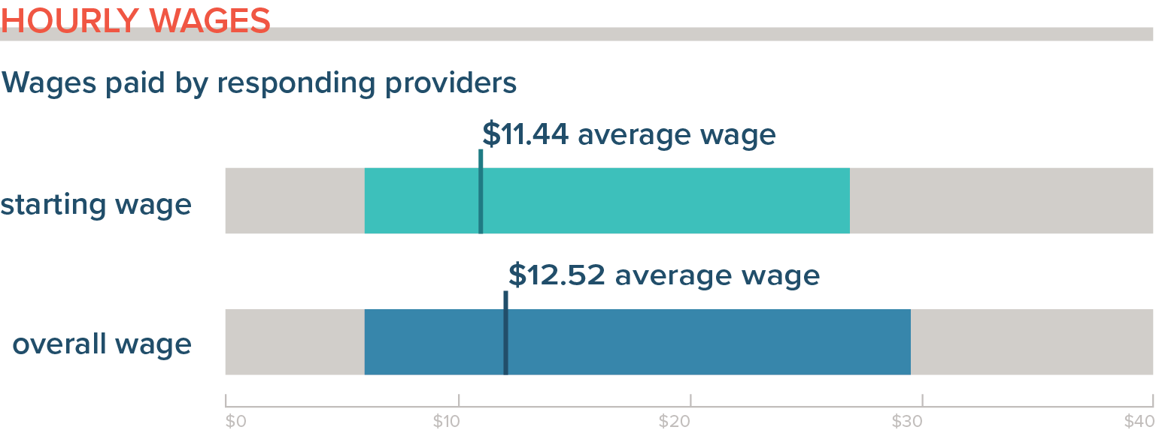
2017 National DSP Wages
National Core Indicators. (2019). National Core Indicators 2017 Staff Stability Survey Report. Retrieved from the National Core Indicators website: www.nationalcoreindicators.org/resources/staff-stability-survey/
Notes:
Talking Points:
In 2017 in the NCI Staff Stability Survey, the average starting wage paid to DSPs was $11.44 per hour. It was $12.52 on average for the workforce in the states that participated. This is less than one dollar difference between starting and average wages.
One consideration is to look at the wages paid to your veteran workers and determine if the wages paid to them reflect the level of skill that they have developed through longer tenure on the job. Looking at rewarding workers (in a number of ways) for longer tenure is an important retention strategy.

Slide 90
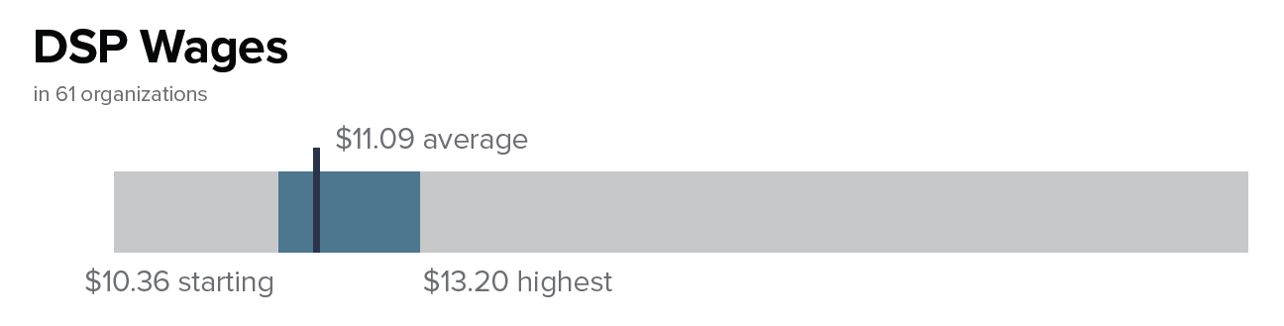
Wages - State
Notes:
Talking Points:
In 2020 in Tennessee, the average starting wage paid to DSPs was $10.36 per hour.
The average wage was $11.09 per hour, and
on average, the highest wage paid to a DSP was $13.20 per hour.
Costs of living in Tennessee may be lower than they are nationally, as these numbers are below the national averages in the NCI Staff Stability survey. Asking about costs of living in an area is an important retention question to ask when considering the supports needed for workers to stay on the job.
You can note these wages in the ”state” column on your chart. Pause

Slide 91
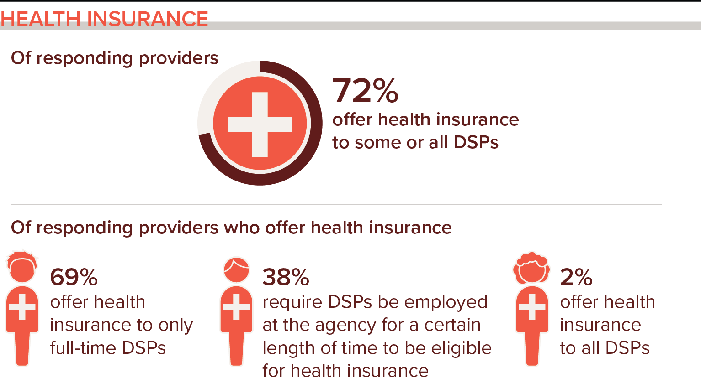
Health Insurance for DSPs
National Core Indicators. (2019). National Core Indicators 2017 Staff Stability Survey Report. Retrieved from the National Core Indicators website: www.nationalcoreindicators.org/resources/staff-stability-survey/
Notes:
Timing for benefits: 3 minutes
Talking Points:
Availability of benefits is another important factor in retaining workers over time. NCI asks questions about benefits, specifically about health insurance in slightly different ways that we do on our survey. In 2017, 72% of organizations that participated in that survey offered health insurance to some or all DSPs.
Of those organizations that offer health insurance, 69% of organizations offer health insurance to full time DSPs only.
Of those organizations that offer health insurance, a little more than one third require DSPs to be employed for a certain length of time to be eligible for benefits.
Only 2% of organizations that offer health insurance offer it to all DSPs.

Slide 92
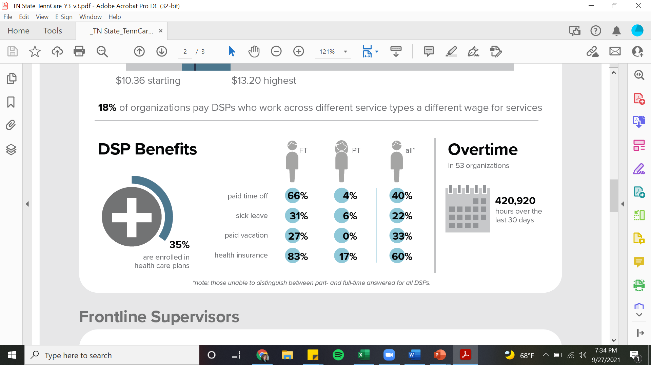
Benefits – State
Notes:
Talking Points:
On average across the state, for organizations that offer health insurance, 35% of DSPs are enrolled in health care plans through the organization. You can note this number on your chart in the workbook. Pause
Look at the numbers in the bubbles on the right side of the screen. These percentages are the number of organizations that checked “yes” to offering these benefits to DSPs. This information will look like check marks on your organizational profile – indicating that you offer the type of benefit if you offer any of these benefits to DSP. The types of benefits that we asked about were:
Paid time off.
Paid sick leave
Paid vacation
Health insurance.
The three columns are for offering the type of benefit to full time DSPs (however the organization defined those workers), to part time DSPs, and to “all DSPs”, which was the organizations that did not distinguish between full time and part time DSPs.
If you organization does not offer these benefits to DSPs, none of the bubbles would be checked. Overall, organizations were more likely to offer these types of benefits to full time DSPs than to part time DSPs.
Most organizations offer some type of paid time off to DSPs, but there are some that do not. Just over 83% of organizations offer health insurance to full time DSPs. Given that only 34% on average are enrolled in health care plans when they are offered indicates that DSPs may be offering health insurance through another source, or they may be uninsured.

Slide 93
Overtime – State
Notes:
Timing for this slide: 1 minute
Talking Points:
Turning now from benefits to overtime hours paid to DSPs, we know from previous research that many DSPs will work additional hours when asked in order to help make ends meet financially. Additionally, people who receive supports are in need of DSPs to fill vacancies in any reasonable ways possible.
We didn’t provide a column on the chart in your workbook for you to compare your number of overtime hours paid as these numbers reported on this slide and the regional slide are total numbers in the region, rather than average numbers. Overtime hours depends somewhat on the size of your organization and the number of people served, so we provided only the sum total for the state and the region.
Statewide, organizations that completed the survey reported over 420,920 overtime hours in the last 30 day period when they completed the survey. Sometimes overtime hours are more or less dependent upon the time of the year when the survey was completed so this number is reflective of mid 2020 numbers.
If you pay out a lot of overtime hours, what may be helpful to consider is that overtime hours are paid at time and half, and it is worth asking the question about raising wages paid to DSPs on the front end (that is, their base wages) rather than paying overtime hours to help stabilize the workforce. However, prior to doing this, it is important to ask your workers who take on overtime hours if they are dependent upon overtime hours to pay their bills and if you could raise wages enough to ensure that they will stay with your company.

Slide 94
Frontline Supervisors Data
Direct Support Worker
Frontline Supervisor
50%+ hours spent in direct support tasks (e.g. personal care, home care, community integration)
primary responsibility (50%+ of their role) is supervision of DSWs.
Notes:
Timing for FLS section: 3 minutes
Talking Points:
The next section turns from looking at information related to DSP staffing and compensation to frontline supervisors. We know that FLS are an important reason why DSPs stay in their jobs, and the quality of supervision that DSPs receive from FLS may be a major reason why they stay or they leave their position. Therefore, knowing the stability of your FLSs can be an important part of the equation for stabilizing your DSP workforce.
As a reminder, FLS are the level of staff whose primary responsibility is to provide supervision to DSPs. While they may provide some direct support, more than 50% of their role is to supervise DSPs.

Slide 95
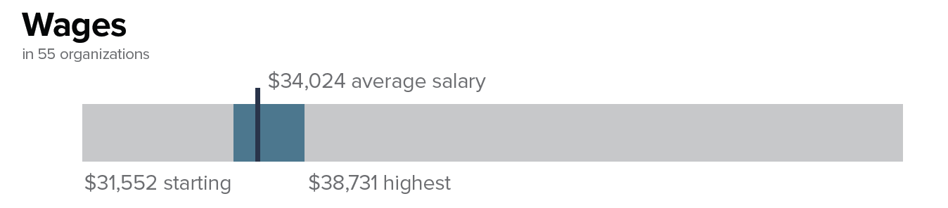
FLS Wages – State
Notes:
Talking Points:
For wage data, the survey asked your organization to report annual wage data rather than hourly wage data.
Across the state of Tennessee, the average starting FLS wage was $31,552. The average FLS salary was $34,024. The highest average FLS salary was $38,731. You can note these data in your chart in the workbook.
Pause.

Slide 96
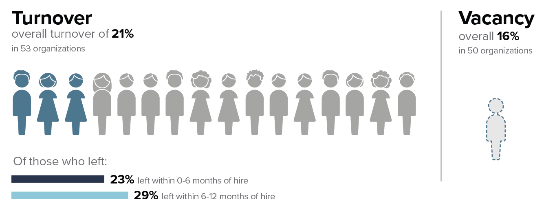
FLS Turnover & Vacancy – State
Notes:
Talking Points:
Turnover for FLS was calculated in the same way for FLS as they were for DSPs, but just using the data collected from different questions on the survey that asked specifically about FLSs.
For the organizations that reported on FLS, 21% left their positions in the calendar year. You can write this in for the “state” number in the chart.
In the same way that we asked organizations to report on the number of DSPs who left their position who left between 0-6 months tenure and between 6-12 months tenure, we asked organizations to report this information for FLS.
Of the FLS who left in 2020, 23% left within 0-6 months of hire and 29% left within 6-12 months of hire. This indicates that better supports for newly hired FLS may also be needed.
Of the FLS positions in the state, 16% of funded positions were vacant on the last day of 2020.
You can note these data in your workbook now. Pause

Slide 97

Employment and Community First CHOICES Workforce QuILTSS Initiative Survey 2020
Year 3 Report
z.umn.edu/tenncare-report-2020
Notes:
Timing: 5 minutes for this section
Talking Points:
To see the full report and to see the state profiles and regional profiles to compare to your data, go to the link shown on your screen and in the chat. You can also find this on the tenncare website, tenncare.umn.edu

Slide 98
Breakout Conversation (a new one)
Connecting challenges, data, and information to strategies
  What stands out to you?
  What surprises you?
  What concerns you?
  Who else do you need to talk with in your organization about your workforce data, challenges you’re identifying, and what you’d like to see change?
Notes:
Timing: 3 minutes before the break
Ask people to share in chat or unmute if they don’t have access to chat. Once they share, they can go on break.

Slide 99
Stretch Break
Take 5 minutes to stretch and refresh.
Notes:
Time: 10 Minutes, Break should occur 5 minutes before the start of the second hour of the session.
Talking Points
Turn off video and audio when you leave.
Once break is over, check in with folks to make sure they are back by using reactions, camera on, etc

Slide 100
Interpreting Your
Organization’s Data
Section by Section Review
Notes:
Talking Points:
After this all this data, we wanted to pause for a few minutes to let you take a look at the information presented to start to identify any areas that you might want to target with a strategy to see change over time.

Slide 101
8 Steps for Implementation - Workforce Strategies
Step 4
Step 3
Identify
barriers to implementation
Step 2
Identify components of the strategy
Step 1
Select an intervention strategy
Identify and assess the problem
Larson & Hewitt, 2005
Notes:
Time: 15 seconds
Talking Points:
You’ve seen this set of slides quite a few times already – but right now we’re focusing on steps 1, identifying and assessing the problem…

Slide 102
8 Steps for Implementation - Workforce Strategies
Step 8
Step 7
Evaluate success
Step 6
Implement
the strategy
Step 5
Set goals,
measure progress & establish a time frame
Identify support for the strategy
Larson & Hewitt, 2005
Notes:
Time: 15 Seconds
Talking Points:
…and step 8, evaluating success. Both are key to measuring your problems and evaluating your successes.

Slide 103
Types of Assessment
Identifying Performance or Training Standards
Job description review
Competency assessments
Inventory of current employee skills
Performance review system
Training needs assessment
Job analysis assessment
Analyzing Cost and/or Benefit costs
Wage/benefit market analysis
Recruitment and hiring bonuses effectiveness analysis
Recruitment source cost-benefit analysis
Tracking Retention Trends
Turnover rate worksheet
Vacancy rate worksheet
Tenure of current employees' worksheet
Tenure of leavers worksheet
Assessing Attitudes or Opinions
Exit interviews or surveys
New staff survey
Organizational commitment survey
Staff satisfaction survey
Teamwork assessment
Personality or style inventories
Notes:
Talking Points:
We just talked a lot about the data that we compiled for you and how it compares to the state of TN and on a national level. We’ll talk more about how to use that data to inform workforce strategies next week. However, we first want to talk about other data you might be collecting or might want to collect.
We’ve identified different types of assessments organizations can consider using as part of the organization’s workforce development plan. Read a few from slide

Slide 104
Poll Question #3 - What types of data do you already collect?
Staff Satisfaction Survey
Exit Interviews/Surveys
Training Needs Assessment of New Hires
Competency Assessments
Tenure of Employees
Teamwork Assessment or Personality Inventories
Cost/Benefit Analysis
Recruitment Data
Other Retention Data
Other
Notes:
Poll
Talking Points:
These are just some of the points of data you may be already collecting that might inform your next steps. We know there is so much data you can track, from recruitment and marketing data, to opinions and retention trends, to exit interviews.
Read poll options, once poll is closed, comment on what you see.

Slide 105
Assessing Workforce Challenges
Problem and Assessment Guide, Workbook page 21
Identified Problem | Assessment Area
Trouble finding new employees Difficulties recruiting qualified direct support professionals | Recruitment source cost-benefit analysis Vacancy rates Wage/benefit market analysis Recruitment and hiring bonuses effectiveness analysis
New hires quit in the first six months Constantly hiring new employees to replace those who have left | Tenure of leavers Tenure of current employees Turnover rates Staff satisfaction survey New staff survey Exit interviews or surveys
New employees are unsure of job roles and functions | Job description review Training needs assessment (new hires)
Difficulty finding training that addresses the skills needed by employees | Training needs assessment Inventory of current employee skills
Poor performance Training doesn’t produce desired results | Competency assessments Performance review system
Morale problems | Staff satisfaction survey Organizational commitment survey
Conflict between staff and supervisors or managers Employees complain about their supervisor | Team work assessment Supervisor training needs assessment Staff satisfaction survey
Co-workers don’t get along | Team work assessment Staff satisfaction survey Personality or style inventories
Long-term staff are dissatisfied or quit the organization | Staff satisfaction survey Training needs assessment Exit interview or surveys
Step 1 Identify and assess
Notes:
Talking Points:
This table is in your self assessment workbook on page 21. It can help guide you once you know your main problem.
Give an example from the slide.
In the poll we did, you identified assessments you have used at your organization. Thinking about those assessments, did they align with the workforce problem you wanted to address?? Give example in table.

Slide 106
Using your data
Baseline
Ongoing monitoring
Periodic Review
Notes:
Talking Points:
It’s important to think about data collection before you even start implementation. You will see this slide again, but you want to use your data to monitor the strategies you decide to implement at your organization.
It’s important to collect information about where you’re currently at – before changing anything about your current practices. This is your “baseline’ measurement.
Plan to measure your progress over time – figure out how frequently it would be helpful to monitor your progress (and remember to be practical). You’ll participate in the annual survey again next year, but you might want to set up a spreadsheet or report with some meaningful data by quarter or month to help your team better understand your progress. We’ll talk more about this when we talk with you about evaluation.
The third component is to set aside time to review your data. Its important to not just collect your data, but to use it to help you inform your efforts. And most importantly, you can use the data you collect to celebrate your successes. Some organizations also like to provide their data for stakeholder and share with others about the successes of their efforts.
This can really tell you if a strategy is working and if you need to make changes to the strategy. You don’t want to be implementing a strategy that isn’t working for your organization.

Slide 107
Common Challenges
Finding qualified employees
Employees do not understand their job roles
Employees quit within a few weeks or months (meaning significant effort must be spent to replace them).
Employees don’t have access to timely training
Training is not effective
Employees display poor job skills
Notes:
Talking points:
Using the data we looked at today along with any other data you collect, you might begin to have some idea of what your challenges are.
On this slide, we list just some of the challenges that you may already know of. They include read from slide (two slides)

Slide 108
Common Challenges (continued)
Employees do not get along with each other or the people they support
There is conflict between employees and supervisors or employers
Low employee morale
Wages or benefits don’t meet the needs of employees
Lack of employee engagement
Notes:
Talking points:
Read more
Without collecting data with periodic reviews, it may be difficult to discover these problems or to continue tracking the problems.

Slide 109
Organization Self-Assessment Workbook
Purpose:
To identify areas of strengths and areas of needed improvement in your respective organizations to build capacity to address direct support workforce issues.
Key Sections:
Organization Key Information
Self-Assessment
Moving Towards Improvement
Tools and Additional Resources
Notes:
Talking Points:
Note: this is the last section before ending.
We’ve provided you with the Self-Assessment workbook. You should’ve received it in an email sent to you, but it can also be found on the toolkit. This is the workbook that you were looking throughout the session today.
Send link via chat: https://tenncare.ici.umn.edu/dsp-workforce-toolkit/organizational-readiness/tenncare-self-assessment-workbook-and-action-plan
The purpose of this workbook is to have one place for you to capture your work, ideas, and resources. When you go back to your organizations you can share what you’ve already done. Read purpose on the slide
You may need input from others in your organization to complete the workbook. You may have already reviewed it, or maybe you haven’t even opened it yet.
Let’s a quick review of the different sections of the workbook
The first section is the: Organization Key Information – you will want to complete this so everyone on this team from your organizations knows who else is on the team including who your Consultants and Coaches are.
The next section on Self-Assessment will ask you to consider your organization in relation to:
Assesses and uses Workforce Data
The Organizational Capacity or Readiness along with your Processes
Recruitment and Selection Processes
Orientation and Training
Retention Strategies
Evaluation practices.
The next section is Moving Toward Improvement. This section, in conjunction with the resources and technical assistance we provide, you can use this section to create a plan to implement workforce strategies so that your organization can move toward improvement.
Finally, the last section includes other tools and resources that will be helpful to you such as:
Retention Trends and Summary Worksheet
Challenge/Intervention Strategy Matrix
Summary Overview of Workforce Toolkit
Action Planning Worksheet

Slide 110
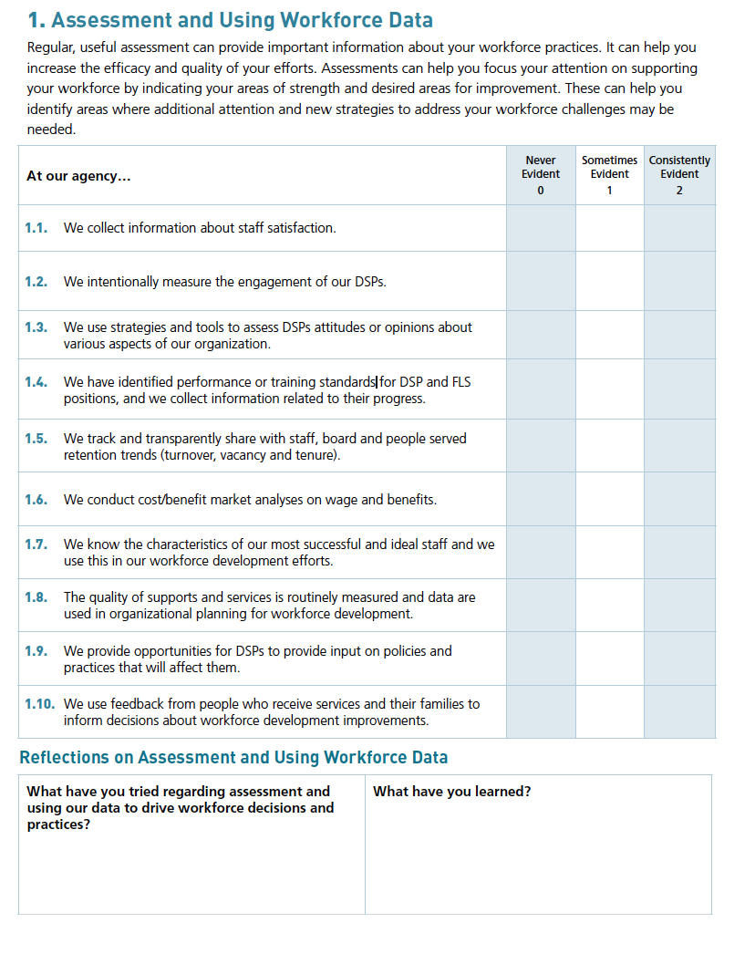
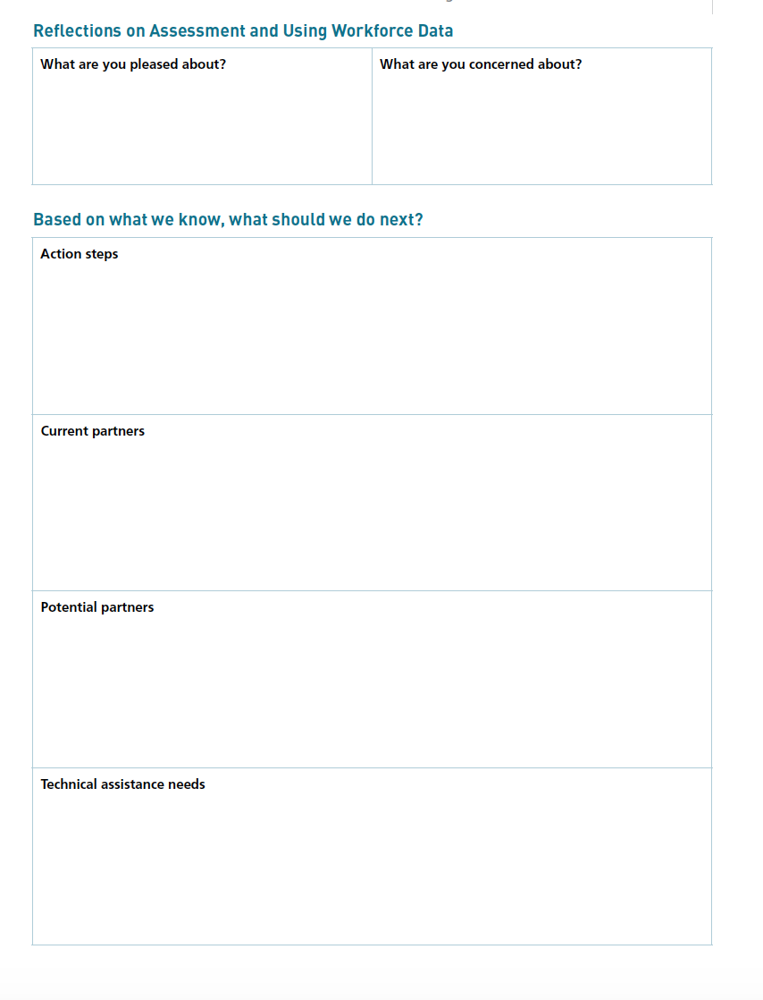
Self-Assessment Workbook, Page 5 & 6
Notes:
Talking Points:
In the second section of the workbook, on page 5 of the workbook, are self-assessment areas. This is another way to collect data around your organization. Section 1, Assessment and Using Workforce Data, of the Self-Assessment Workbook looks like the images on your screen.
This section is about reflecting on the items you already may collect that can be used for assessment of your workforce. This is intended to be a discovery tool, continuing with step 1 of the 8 step process, to help you explore what you’re already doing and areas where you might want to put some attention as you move forward.
While we don’t have time to go through this today, we encourage you to go through these sections with your team. For each item, you can identify whether it is “never evident,” “sometimes evident,” or “consistently evident.” Note that marking an item as “never evident” isn’t necessarily a bad thing – it may not be a priority for your organization. However, it is something you may want to look into more.
As you are working your way through the workbook, it may be most useful to compete the checklist and the reflection questions. You can revisit the action planning later, when you are ready to consider your workforce strategy you will implement.

Slide 111
Likely, more than a single solution is needed.
But a single solution is a place to start.
Notes:
Section Timing: 5 minutes
Talking Points:
You may be overwhelmed after looking at your data today.
What we know about the workforce from decades of research it is likely the case that there is not a single “silver bullet” solution is needed by your organization to solve your workforce issues.
However making an informed decision to implement a strategy with the tools you have can be the first step in improving your practices. You might need to try several strategies over time, but we suggest first gathering a team to start with one strategy
We aim to provide you with resources across these sessions and in future consultation to help you get started.

Slide 112
8 Steps for Implementation-Workforce Strategies
Step 4
Step 3
Identify
barriers to implementation
Step 2
Identify components of the strategy
Step 1
Select an intervention strategy
Identify and assess the problem
Larson & Hewitt, 2005
Notes:
Talking points:
Remember that we are working our way through the 8 steps for implementation. We just worked through step 1, how to identify and assess the workforce problems at your agency.
Next week will be talking more about steps 2-8 – the strategies you can select from and how to plan, implement, and evaluate these strategies.

Slide 113
8 Steps for Implementation-Workforce Strategies continued
Step 8
Step 7
Evaluate success
Step 6
Implement
the strategy
Step 5
Set goals,
measure progress & establish a time frame
Identify support for the strategy
Larson & Hewitt, 2005
Notes:
Talking points

Slide 114
Workforce Initiative Timeline-Cohort 3
OCTOBER 2021 | NOVEMBER 2021 | DECEMBER 2021 | JANUARY –FEBRUARY 2022 | MARCH–JULY 2022 | AUGUST 2022 and beyond
GETTING STARTED Email invitation to kick-off events Identify key contacts, potential team members SESSION ONE: Kickoff workshop Workforce Initiatives Overview Understanding your data: Overview of Survey Results, Profiles and Interpreting Data Introduce Self-Assessment Workbook & Eight Steps of Implementation | SESSION TWO: Kickoff workshop (cont’d) Assess your needs: Evidence Based Practices and Organizational Capacity Overview of TennCare Workforce Toolkit: Recruitment, Selection and Retention Planning your next steps: Measuring Outcomes of Implementation and Creating a Practical Action Plan for Change Collaborative Consultation Conference | SELF-PACED AND ENGAGEMENT Complete Self-Assessment Workbook Review toolkit & view webinars Confirm organizational readiness (begins) Collaborative Consultation Conference (cont’d) Participate in Community of Practice | ENGAGEMENT Organization consultation virtual meetings begin Participate in Workforce Development Workshops | Organization consultation virtual meetings Organization Team implement the strategy (begins) Participate in Regional Community of Practice Participate in Year 4 2021 Survey | Participation in Community of Practice Year 4 2021 Survey Results Participate in webinar to review Year 4 – 2021 Survey Organizational Profile
Notes:
Talking Points
As a reminder, to place us in the timeline, here is your general timeline, knowing that it should be flexible.
Are there any questions?

Slide 115
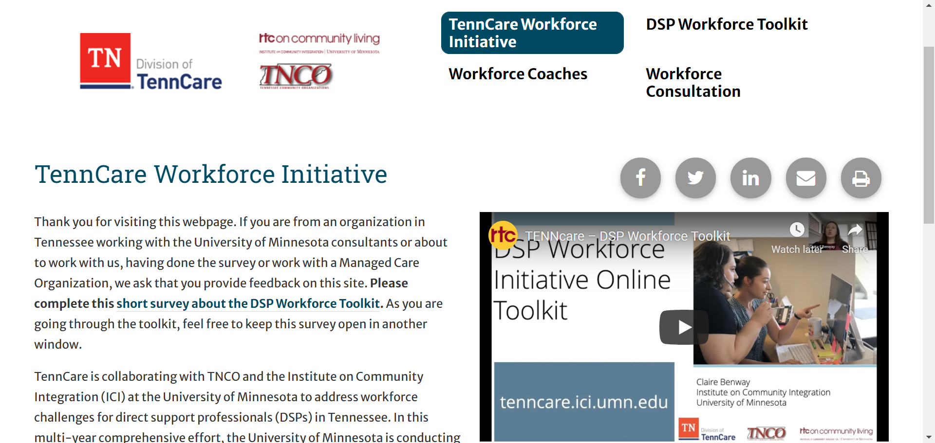
TennCare Website: tenncare.ici.umn.edu
Notes:
Talking Points:
Other than the self-assessment workbook, another resource that will help guide you through implementation of workforce interventions is the toolkit, at Tenncare.ici.umn.edu. This is a rich resource of tools that are available to you and your organization.
We will review the toolkit more next session, but tenncare.ici.umn.edu will take you to the homepage. On the homepage are links at the top to see the workforce coaches, the DSP workforce toolkit, and workforce consultation. There is also a video on the homepage that tells you more about the toolkit gives you information about the workforce initiative.

Slide 116
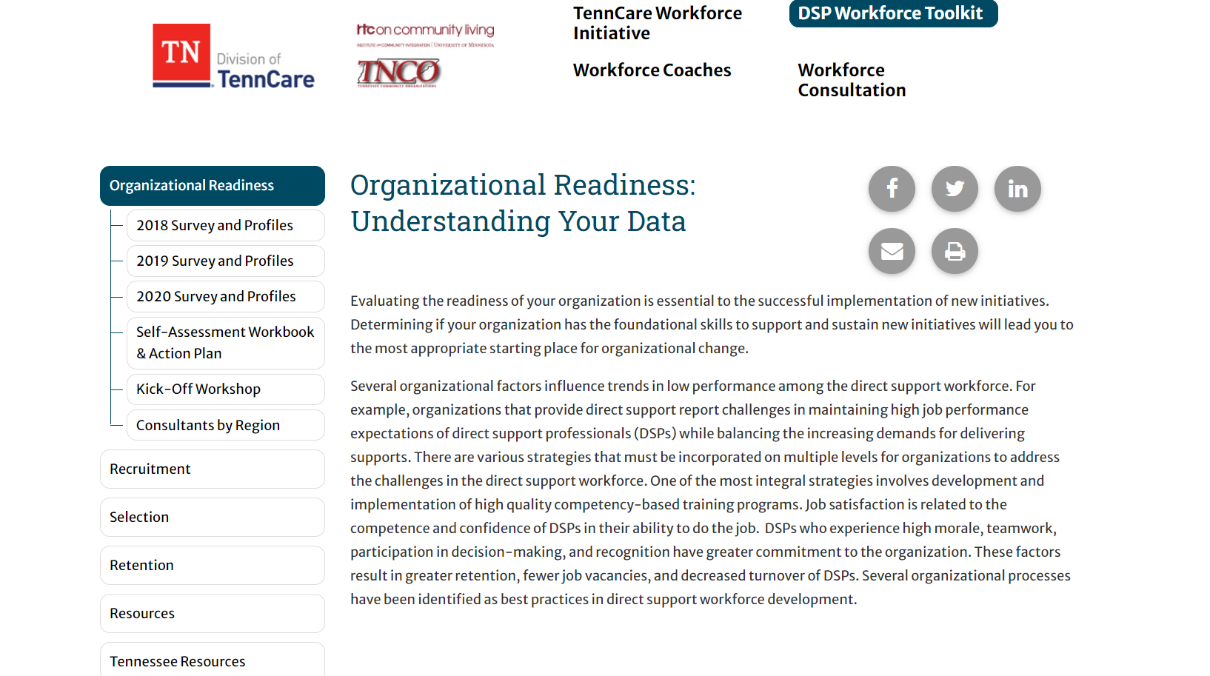
DSP Workforce Toolkit: tenncare.ici.umn.edu
Notes:
Talking Points:
Clicking on the DSP workforce toolkit link brings you to this page shown on your screen. The bar on the left guides you through the items that you will find useful.
Of note, the 2020 survey report and state and regional profiles can be found by clicking on “2020 Survey and Profiles.” A copy of the self-assessment workbook and action plan (which we will continue to use next week) is available as well.
Finally, clicking on recruitment, selection, and retention tabs will open different workforce resources that you can use to implement strategies in your organization.
Feel free to explore these on your time. We will be diving deeper into these strategies next week.

Slide 117
Time to Reflect
  What’s your next step?
Notes:
Timing: There is approx. 3-5 minutes of content left. Adjust timing as needed for this activity. If no time, urge providers to consider their next step on their own before next week.
Talking Points:
We have just a few minutes left, but before we wrap up, we’d like to give you time to consider your next step. We know the importance of creating a plan to move forward with everything you learned today.
Your next step could be as simple as gathering your team, watching webinars on the tenncare website, or working on filling out the self-assessment workbook.

Slide 118
What’s Next
Session 2 – November 3
Assessing Your Need: Evidence-based Practices and Organizational Capacity
Overview of TennCare Workforce Toolkit: Recruitment, Selection and Retention
Planning your next steps: Measuring Outcomes of Implementation and Creating a Practical Action Plan for Change
Notes:
Time: Wrap up 3 minutes
Your next Workshop is Session 2 where we will spend time read slide.
You can invite other members of your team to attend.
We will be meeting on November 3. Just like this week’s session, you have an option to attend in the morning or the afternoon. You should’ve already received an invitation to register for session 2. If you didn’t, please contact us at dsp-tn@umn.edu

Slide 119
Before Session 2
Review and Complete pages 5-6 of the Organizational Workforce Self-Assessment Workbook including the Workforce Data Chart – either electronically or on paper
  Electronically @ z.umn.edu/TennCareSelfAssessment
Check out TN DSP Workforce Toolkit: https://tenncare.ici.umn.edu/
Think about which consultation option you will choose and come with questions!
Notes:
Before the next session
Read slide

Slide 120
Electronic Organization Self-Assessment Workbook
z.umn.edu/TennCareSelfAssessment
Benefits:
  1) When you “submit” you will receive everything you provided electronically
  2) Consultant can have results more easily.
Notes:
Talking Points:
The self-assessment workbook was intended to be an important discovery tool for your team to understand your areas of strength and areas for growth. This information is intended to help you and your consultant team to understand your priorities and needs.
The link on the screen is a place for your team to enter the information to provide you with an electronic record and to communicate with your consultants.
Read slide
Provide link in chat

Slide 121
Bring your organization’s profile to Session #2
Notes:
Talking Points
Please make sure that you have a copy of your organization’s profile data when you attend session #2. If you do not have access to this information, please check with the person who invited you to the kickoff workshop webinars, or email us at dsp-tn@umn.edu

Slide 122
Questions?
You will receive the slides from today’s workshop so that you can have further discussions about the information in this session.
You can find the State and Regional profiles on the website tenncare.umn.ici.edu.
If you have questions:
Email us at dsp-tn@umn.edu
Notes:
Talking Points:
Facilitator Note: improvised based upon the amount of time left.
We have a little bit of time for questions.
If we don’t have time to answer your questions, please email us at dsp-tn@umn.edu

