Slide 1
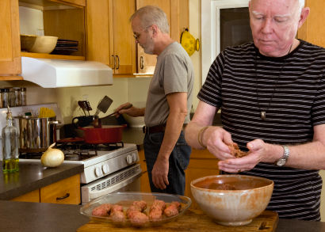
Presenter Prep Slide Only
Notes:
To Prepare:
Turn on Live Transcript and record if applicable
prepare (Name of Learning Lab) and PDF of slides (without notes) to put in chat
Slide #2 – Update presenter names
Check that the presenter can share their screen
Prepare polls/breakout groups if a large group
Assign an attendance taker, timekeeper, chat monitor
Note to Facilitator:
Bold Text = Timing
Italicized Text = Notes – do not read
Regular Text = Talking Points

Slide 2
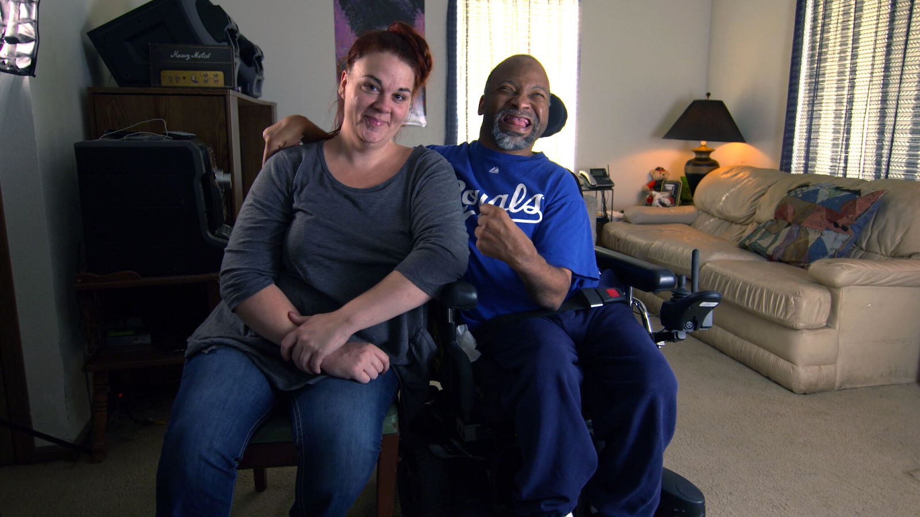
Employment and Community First CHOICES
Workforce QuILTSS Initiative
Learning Lab
The Ease of Applying through your Website
Insert presenter name and affilation
tenncare.ici.umn.edu
Notes:
Time: 15 seconds
Talking Points
Welcome to our Learning Lab – on The Ease of Applying through you Website
My name is xx and I am a xx with xx.
Today’s Learning Lab is being recorded, contact us if you would like a copy.

Slide 3
Using Zoom
Your microphones were muted when enter to reduce back ground noise
Name yourself
  First name
  Name of your organization
Use for questions or comments.
We will use “Reactions” such as “thumbs up” though-out the workshop.
Live Script
Camera on as you are able to and comfortable.
Take care of your needs. If you need a break, take one.
Be Understanding of “co-workers”
Chat
Notes:
Time:30-60 seconds
Talking Points:
Some of us are used to working on Zoom in a group, while others are less familiar.
Please keep your microphone on mute when you’re not speaking today to help reduce background noise.
If you are able, we’d appreciate it if you keep your video on today. Its important for all of us to be able to see and get to know one another in these meetings. We understand if you need to shut off your video for a few moments if you need to step away, but please turn your video back on when you return.
When you logged into Zoom today, you might have typed in a name for yourself. To help us get to know one another, we ask you to rename yourself with this information on your screen:
Your name, your organization name. If you are a group of people watching from one computer in an organization, you can shorten to first names and your organization name.
To do this, look on the bottom of your screen for participants, click on that and on the right side of your screen a white column will appear. Hoover over your name and two buttons will appear mute and more. Click on more, then click on rename. Rename yourself then click OK.
The Chat function is at the bottom of the page. It looks like a little speaking bubble. If you have a questions or something you want to add to the discussion you can use Chat. We will be monitoring Chat throughout the session.
Using Chat to submit a question, simply click on the button that looks like this in your toolbar.
Please feel free to send questions at any time during the presentation. We will have time at the end for discussion and questions, so you can type them in the chat and we’ll go over them at the end.
Also when you click on “Participants,” you’ll see some buttons to interact with the presentation. You can say yes, no, go slower, go faster, and when you click on “More” you will find that you can use the thumbs up or thumbs down buttons. You can also let us know if you need to step away for a quick break to use the rest room or fill your coffee cup. Suffering is optional.
When we take breaks we do ask that everyone turn their camera during the break then turn it back on when you return or use reactions when you return so that we know when we are ready to start again.
Finally, we are all still working from home at the University of Minnesota. Explain “coworkers” you share your space with.

Slide 4
Welcome & Introductions
Notes:
Transition slide
Time: 5 seconds
Talking Points
Mention other UMN staff and Regional Coaches

Slide 5
Open Round
Getting to Know You
Your name and role in the organization
What is one question you have on regarding the Ease of Applying through your organization’s website?
Notes:
Time: 3-7 minutes
Talking point
We would like to start with a little time to get to know you and see if you have any initial questions. We’ll try to make sure we cover these questions. Please introduce yourself with the following: read slide
Facilitator Note:
If group is large, can have them type in chat.
Alternate question: What is one thing you hope to get out of today’s Learning Lab? / What is one question you have on this topic?

Slide 6
Goals for this session
Identify tips for assessing website for ease of applying
Notes:
Time: 15 seconds
Talking Points
Our goal for today’s learning lab is for you to be able to look at your organization’s website and assess it through the eyes of someone who would like to learn about the organization and apply for a DSP position.

Slide 7
Building & Strengthening the DSP Workforce
Recruitment Strategies | Selection Strategies | Retention Strategies
Effective Marketing Public service announcements (PSA) Targeted marketing Recruitment and hiring bonuses Recruitments sources Website | Structured behavioral interviews Realistic job preview | Orientation and onboarding Competency-based training Employee Development Job Analysis Job Descriptions Recognition Programs Coaching & Mentoring Mentoring Performance coaching Networking Employee Engagement & Organizational Participation Professional Development Developing career paths Professionalizing DSP roles Wage and Benefit Policy Change
Notes:
Time: 15 seconds
Facilitator Note:
Remind attendees to consider the problem they are trying to solve with this tool – explain where the strategy falls.

Slide 8
Assess the Website
Do images represent the people supported and the people you want to apply?
Easy to find Employment from Homepage?
Easy to find open positions?
  Description / Realistic Job Preview
What is unique about working for the organization?
Easy to apply?
  Online / Print
  What does it look like?
What happens after application is received?
  When and how?
Contact Information Easy to Find?
Notes:
Facilitator Notes
Ask Participants to look at their website while doing thru this information – so they can identify their strengths and areas to improve
Time: 7-10 minutes
Talking Points
Is your Website Up-to-date?
You have probably heard the phrase “A picture is worth a thousand words”.
Are there images of people that represent the people who receive support?
People who work for the organization or that you want to work at the organization?
If you are trying to attract more people from a particulate group of people you need to use images that reflect them.
Is it clear that you have employment from your homepage? www.icanmn.us? https://www.phoenixresidence.org/index.html
How can people apply? Online and Download application
What does it look like – does it look easy to complete and is it easy to complete?
Length of application
Keep it short ---- “ Contact information”
Auto response after apply?
When and how do you contact the applicant?
Is it easy to find contact information – phone and email address, or send a message directly to the organization from the website
Are there images of people that represent the people who receive support?
People who work for the organization or that you want to work at the organization?
If you are trying to attract more people from a particulate group of people you need to have images of them.

Slide 9
Discussion + Questions
Notes:
Time: up to 10 minutes
Talking Point
What questions do you have?

Slide 10
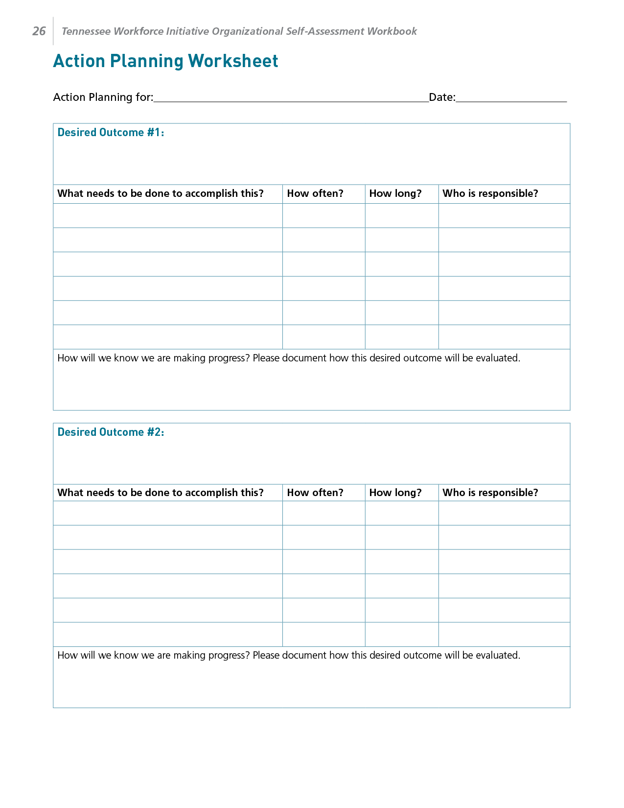
Action Planning Worksheet
Notes:
Time:1 minute
Talking Points
You may want to pull out your action plan and add accessing your website to it.
This can be found in your Self-Assessment Workbook

Slide 11
Closing Round
  What’s your next step?
Notes:
Time: 2-4 minutes
Facilitator note
If there is a whiteboard take this information down.
May stay in large group depending on size.
If Breakout room conversation: Breakout Time in small group 10 minutes ; Breakout groups – 4-5 per group, follow-up similar pattern of splitting MCOs between groups, select someone to take notes and someone to report – can be the same person Report Out to Large group- 5 minutes

Slide 12
Questions?
Other ways to learn more:
Checkout the Tenncare Workforce Toolkit at: tenncare.ici.umn.edu
Contact your consultant at: dsp-tn@umn.edu
Join our Monthly Office Hours
Notes:
Time: 15 seconds
Talking Points
Here are ways to keep in touch with us and continue your learning.

Slide 13
Office Hours
  East Region:
    1st Friday 9-11:00 am CST
    3rd Friday 9-11:00 am CST
  Middle Region:
    1st Wednesday 1-3:00 pm CST
    3rd Wednesday 1-3:00 pm CST
  West Region:
    2nd Monday 9-11:00 am
    2nd Wednesday 9:00–11:00 am
Notes:
Facilitator Notes
Read slide and explain office hours

Slide 14
Upcoming Events
Upcoming Learning Labs:
Need to add
Upcoming Community of Practice:
  July / Location TBD
  October / Location TBD
Notes:
Time: 15 seconds
Facilitator Note
Edit slide as needed regarding upcoming workshops

Slide 15
Thank you

