Slide 1
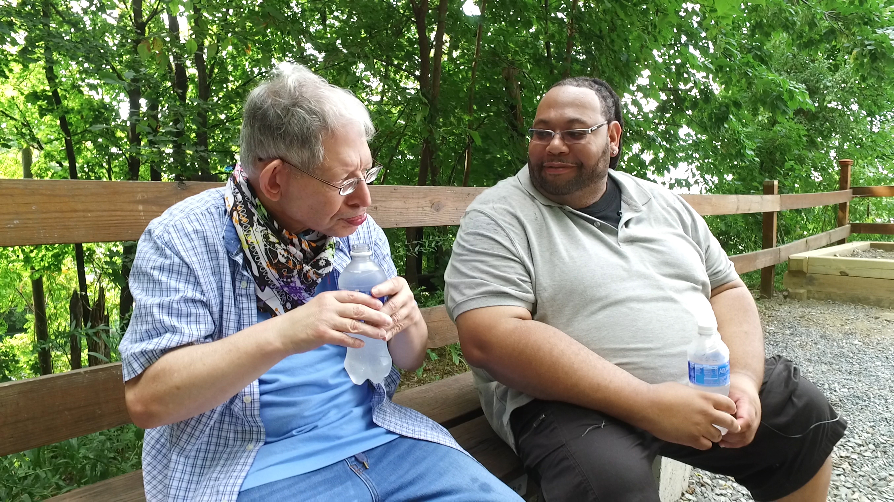
Notes:
Host and Co-host notes for pre-meeting setup
Actions before the session:
Slide #1 – Update presenter names
Hide other region consultant slide, as applicable
Hide other regions workshop slide for Upcoming Workshops, as applicable
In the Practice session before participants log on
Check that the presenter can share their screen and run videos as needed
Check that the presenter marks “Share Computer sounds” and “Optimize Screen sharing for video clip” so that any videos shown can be heard by others – it is on the same screen that you choose which screen to share.
Make Coaches "Co-hosts"
Confirm polls are loaded
Turn on transcript
Break-out Groups
Take attendance
Timekeeper
Host / Welcome people as they arrive & arrive late
Monitor Chat
Turn on record, as desired
Subtitles – turned on, each participant can control turning on and off
At end of presentation:
MAKE SURE TO STOP RECORDING AT THANK YOU SLIDE
Note to Facilitator
Bold Text = Timing
Italicized Text = Notes – do not read
Regular Text = Talking Points

Slide 2

Understanding Your Data and Workforce Strategies
Workshop Series
Presenter's name and affiliation
tenncare.ici.umn.edu
Notes:
Timing for Intro/Welcome (slides 2-10): 10-15 minutes
Action – Record as desired
Welcome to session # in our QuILTSS Initiative kickoff workshop series.
My name is xx and I am a xx with the Institute on Community Integration at the University of Minnesota. I am here today with my colleagues from the University of MN, __________ and ________________. Also Regional Coaches from Tennessee ____________________ and ___________________.
Thank you so much for joining us today. During today’s session we will talk about some retention strategies.
If being recorded: This webinar is currently being recorded. We will send the recording to you if you would like to view again or share with others in your organization.

Slide 3
Welcome to Session 5: Overview of TennCare Workforce Toolkit: Retention Strategies – Part 1
Notes:
Talking Points:
Today we are going to start to look at Retention strategies for DSPs.
Retention is such an important issue that we are covering part 1 today and we will cover part 2 next week.

Slide 4
Using Zoom
Your microphones will be muted when enter. Please keep them turned off unless you're speaking.
Name yourself
  First name
  Name of your organization
Use for questions or comments.
We will use “Reactions” such as “thumbs up” though-out the workshop.
Live Script
Camera on as you are able to and comfortable.
Take care of your needs. If you need a break, take one.
Be Understanding of “co-workers”
Chat
Notes:
Talking Points:
Some of us are use to working on Zoom in a group, while others are less familiar.
Please keep your microphone on mute when you’re not speaking today to help reduce background noise. When you’re in breakout groups, feel free to unmute and discuss the topic within your group. If you are able, we’d appreciate it if you keep your video on today. Its important for all of us to be able to see and get to know one another in these meetings. We understand if you need to shut off your video for a few moments if you need to step away, but please turn your video back on when you return.
When you logged into Zoom today, you might have typed in a name for yourself. To help us get to know one another, we ask you to rename yourself with this information on your screen:
Your name, your organization name. If you are a group of people watching from one computer in an organization, you can shorten to first names and your organization name.
To do this, look on the bottom of your screen for participants, click on that and on the right side of your screen a white column will appear. Hoover over your name and two buttons will appear mute and more. Click on more, then click on rename. Rename yourself then click OK.
The Chat function is at the bottom of the page. It looks like a little speaking bubble. If you have a questions or something you want to add to the discussion you can use Chat. We will be monitoring Chat throughout the session.
Using Chat to submit a question, simply click on the button that looks like this in your toolbar.
Please feel free to send questions at any time during the presentation. We will have time at the end for discussion and questions, so you can type them in the chat and we’ll go over them at the end.
Also when you click on “Participants,” you’ll see some buttons to interact with the presentation. You can say yes, no, go slower, go faster, and when you click on “More” you will find that you can use the thumbs up or thumbs down buttons. You can also let us know if you need to step away for a quick break to use the rest room or fill your coffee cup. Suffering is optional.
When we take breaks we do ask that everyone turn their camera during the break then turn it back on when you return or use reactions when you return so that we know when we are ready to start again.
Finally, we are all still working from home at the University of Minnesota. Explain “coworkers” you share your space with.

Slide 5
Items to have with you today:
  2020 TN Workforce Initiative Organizational Self Assessment Workbook (www.tenncare.ici.umn.edu )
  Your organization’s 2019 profile
Notes:
Talking Points:
During today’s session we will be using the 2020 TN Workforce Initiative Organizational Self Assessment Workbook. You will also want to have a copy of your organization’s profile with you for reference.
Do you have your copy with you? If not, take a moment to get it. I’ll ask one of my UMN team member to put the link in the chat for you to download from the TennCare Workforce Toolkit.
Action: Put self assessment workbook link in chat: https://tenncare.ici.umn.edu/dsp-workforce-toolkit/organizational-readiness/tenncare-self-assessment-workbook-and-action-plan

Slide 6
Welcome & Introductions
Notes:
Transition slide

Slide 7
Breakout Group Activity
Getting to Know You
Your name / organization
Your role in the organization today
What is one ‘aha’ moment on the Recruitment and Selection Toolkit session last week?
Breakout Group
  1 facilitator in each group and 1 reporter
  Give everyone enough time to have a turn.
Notes:
Activity: (5 minutes) – 5 people per breakout, each person gets one minute, assign 1 consultant or coach to each breakout group
Purpose: Gives consultants and coaches opportunity to learn who is in the room.
Talking Points:
We are going to have the opportunity to get to know who is in the workshop today. In a moment but not yet, you will be send to a Breakout room with 5-6 others.
Everyone will have the:
Opportunity to introduce your self with your name, your organization and your role in the organization.
And answer the questions on the screen.
What is one ‘aha’ moment on the Recruitment and Selection Toolkit session last week?
When you get to your group, find one facilitator and another person to report back for the group the responses to the two questions.
When the group returns call on the reporter from each group to report back on themes for questions #1 and #2.

Slide 8
Goals for this session
Learn about retention strategies and tools available in the TN Workforce Toolkit.
Learn about the key components of retention strategies and tools covered during this session.
Begin to think about which retention strategies would address your organization's specific workforce challenges.
Notes:
Talking Points:
During our last session we talked about recruitment and selection and how workforce strategies can impact the turnover that occurs during the first six months of employment. For the next two sessions we’re going to look at workforce strategies that can address turnover that occurs during that 6-12 month tenure for a new employee.
Our goals for this session include: read slide

Slide 9
8 Steps for Implementation - Workforce Strategies
Step 4
Step 3
Identify
barriers to implementation
Step 2
Identify components of the strategy
Step 1
Select an intervention strategy
Identify and assess the problem
Larson & Hewitt, 2005
Notes:
Talking Points:
Consistent with implementation science, reminder that:
We will be using the 8 step framework for implementation of workforce strategies – let’s do a quick overview as we will be revisiting these in more depth in future sessions
Step one is identifying and accessing the workforce challenge that your organization decided to address.
In Step 2 you will select an intervention strategy from the workforce toolkit.
During Step 3 your team will identify the components of the strategy.
Then you will identify barriers to implementing the strategy

Slide 10
8 Steps for Implementation - Workforce Strategies
Step 8
Step 7
Evaluate success
Step 6
Implement
the strategy
Step 5
Set goals,
measure progress & establish a time frame
Identify support for the strategy
Larson & Hewitt, 2005
Notes:
Talking Points:
In the sixth step you will decide on your goal, how you will measure your progress and establish a time frame that works for you organization
Next is the implementation of strategy and finally evaluating if the strategy was successful.
We will keep referring to these 8 step through out the workshops and we will use them during consultations.

Slide 11
Intervention Strategies
Step 2 – Select an Intervention Strategy
Notes:
Timing for section (slides 11-17): 9 minutes
Talking Points:
Let’s move into step 2 of implementation: selecting an intervention strategy

Slide 12
Building & Strengthening the DSP Workforce
Recruitment Strategies | Selection Strategies | Retention Strategies
Effective Marketing Public service announcements (PSA) Targeted marketing Recruitment and hiring bonuses Recruitments sources | Structured behavioral interviews Realistic job preview | Orientation and onboarding Competency-based training Employee Development Job Analysis Job Descriptions Recognition Programs Coaching & Mentoring Mentoring Performance coaching Networking Employee Engagement & Organizational Participation Professional Development Developing career paths Professionalizing DSP roles Wage and Benefit Policy Change
Notes:
Talking Points:
These are the three major section of the different areas we will be learning about. In an earlier session we will focused in on Recruitment and Selection Strategies.
We do know that all these areas really do connect And are depended on each other for success. Where an organization may be very strong in one area they may have room for improvement in another.
As you look at your data and your current strategies, this is our opportunity to support you in understanding where you can start
During this session we will first be exploring Retention Strategies
We will focus today on the first three: Orientation and onboarding, competency-based training, Employee Development, including Job Analysis and Job Descriptions
Next week we will take a look at rest of the strategies

Slide 13
Retention
Workbook Section 5: Recruitment
Notes:
Transition Slide

Slide 14
Notes:
Talking Points:
Section 5 of the self assessment workbook looks like the images on your screen. Section 5 is about reflecting on the organizational practices and processes that can support your efforts and processes you may already have in place. This is intended to be a discovery tool to help you explore what you’re already doing and areas where you might want to put some attention as you move forward.
There are six questions that we will lead you through in small groups. You’ll think about what you know you’re currently doing based on the following scale. For each item, you can indicate: never evident, Sometimes evident, or Consistently evident.
This is intended to be a simple tool to help you start thinking about what you’re currently doing.
Optional Activity: If time, read each question and allow time for provider responses.

Slide 15
Identify and Assess- Retention
Step 1 – Identify and assess the problem
Notes:
Transition Slide

Slide 16
Poll Question #1 – Which of these retention strategies has or does your organization use to retain DSPs? (Select all that apply)
Orientation
Onboarding
Competency-based training
Employee Development Programs
Job Analysis
Job Descriptions
Notes:
Poll
Talking Points:
Let’s take a quick poll. - you can pick multiple answers. Your answer are anonymous. Read slide.
In debrief poll, review results.
Ask: Anything surprise or jump out at you – spend no more than 3 minutes on this-watch/resist the deep dive conversation

Slide 17
Retention Strategies
  Orientation and Onboarding
  Competency Based Training
  Employee Development
    Job Analysis
    Job Descriptions
Notes:
Talking Points:
These are the Retention Strategies we are going to cover during this week’s session. Read slide
We’ll cover the remaining retention strategies during next week’s session.

Slide 18
Orientation and Onboarding
Step 2 – Select an intervention strategy
Step 3 – Identify components of the strategy
Notes:
Timing for section (slides 18-23): 7 minutes
Talking Points:
As we look at each of the tools, we’ll be going through steps 2 and 3.
We’ll start with orientation and onboarding.

Slide 19

Orientation and Onboarding
Orientation is an event
Onboarding is a process
Supervision is critical
Notes:
Talking points:
Many times we use the terms Orientation and Onboarding as if they are the same things.
They aren’t they are different.
Read slide
Throughout both Orientation and Onboarding supervision and feeling connected to the people in the organization is critical to the DSPs success.

Slide 20
Orientation is an Event
Orientation is an event which is part of the onboarding process.
Introduction to the individuals being supported
Introduction to the job and co-workers
Introduction to the organization
Introduction to the worksite and expectations
Introduction to rules, policies, and responsibilities
Time for required HR paperwork
First steps in onboarding
Notes:
Talking points:
Orientation is an event that is part of the onboarding process.
It covers an introduction to the people being supported, the job, and co-workers.
Human Resources (HR) is often involved in the management of personnel files, benefits, and any necessary paperwork.
Orientation is often considered the first phase of onboarding.
Optional Engagement Questions: Is this what your orientation looks like? How many hours of orientation to you provide to newly hired DSPs?

Slide 21
Onboarding is a process
Onboarding is more than orientation
Process of socializing, engaging, and acclimating new DSPs to the organization
Comprehensive process lasting up to 12 months or more
Builds attitudes, knowledge, and skills for the job
Improves productivity
Decreases stress
Increases self-confidence
Notes:
Talking points:
Orientation and onboarding are related but are not the same thing.
They each serve a different purpose. Onboarding is a process of socializing and engaging employees in the organization from day one.
It can last up to a year or more depending on the organization.
The purpose of onboarding is to prepare, orient, integrate, and engage the new hire for the job and organization.
It is a proactive process that helps build self-confidence for the job.
It helps new hires ”fit in.” It helps them feel welcomed and supported. It helps them become productive workers in the shortest time possible.
Optional Engagement Questions: Show of hands (use reactions), how many of you have an onboarding process?, How long is the onboarding process in your organization?, What things do you do in Onboarding to help a new DSP feel connected to the organization, and the people?

Slide 22
Supervision is Critical
Welcome, support, and engage new DSPs in the job and organization
Teach and train on required work skills
Communicate clearly
Provide regular check-ins and feedback on progress
Listen
Role model
Coach and mentor
Answer questions
Show appreciation and respect for all workers
Be available
Notes:
Talking points:
Frontline supervisors play an important role in whether new DSPs stay or leave early in their employment. The Supervisor can really make a new DSP feel welcome and supported by how they engage with them. And the opposite can happen if the Supervisor doesn’t have the skills, or even the wherewithal to engaged in a supportive and welcoming way.
It can be really helpful if the FLS is involved in the selection process. If they were a part of the interview or RJP there will be more of a personal connection between.
FLS are key to teaching requited work skills.
It is important that FLS provide regular check-ins and feedback though-out the onboarding process so that the new DSP feels supported and listened to. DSPs need clear communication to understand what is expected of them.
FLS are not the only role models for new DSPs --- existing staff members, as well as coaches and mentors can help new DSPs learn how to do their job, the organization by answering questions, and showing appreciation and respect for all staff members help a person feel supported.
How DSPs are treated makes a difference in their commitment to the job.

Slide 23
For more details
tenncare.ici.umn.edu
Toolkit
Orientation & Onboarding
Webinar
Notes:
Read slide

Slide 24
Competency Based Training
Step 2 – Select an intervention strategy
Step 3 – Identify components of the strategy
Notes:
Timing for section (slides 24-38): 13-15 minutes
Talking Points:
Now we’ll be looking at competency based training as an intervention strategy. Think about steps 2 and 3 of the 8 step implementation process as we review competency based training.

Slide 25
Competency in direct support
Competency standards are foundational in key processes of workforce development:
  Recruitment, hiring, and selection
  Curriculum development
  Training program implementation, staff development
  Performance evaluation
  Career pathways, ladders and lattices:
      Apprenticeship programs
      Credentialing and certification systems
Campion et al., 2011
Notes:
Talking Points:
Competencies are considered a foundation for workforce development and standardization.
When rigorously developed and effectively implemented, competencies serve the important function of informing Direct Support Professionals and their supervisors about requirements of job performance.
Competencies also provide indicators that are necessary to develop effective curriculum for Direct Support Professionals training, orientation, and continuing staff development.
Competencies provide guidance within key processes of workforce development, including recruitment, curriculum development, training and staff development, and credentialing.
25

Slide 26
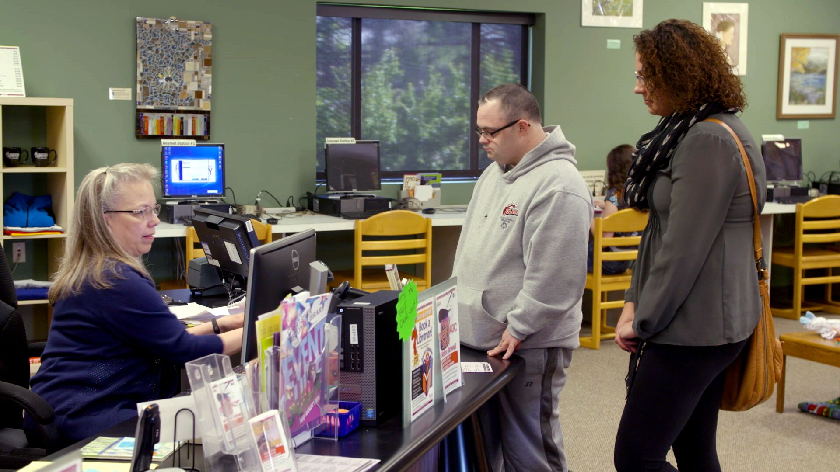
Why create a culture of learning with competency based training?
Notes:
Talking points:
Quality of services depends on the quality and stability of the workforce
Competency is the key to a well-trained, competent workforce, which promotes satisfaction with one’s job, and thus retention rates. We also know that a justification to increased wages is the demonstration of competence, this is true across industries and has yet to be fully embraced within the LTSS.
A culture of learning encourages workers to not only work together better but to also improve needed skills. It is a way to engage workers in continuous learning. It encourages knowledge transfer and knowledge retention using strategies that reinforce learning. It supports good skill and work habit development.
A culture of learning should be a value held and supported by leadership and workers alike. When workers have the skills they need to provide high quality supports, people with disabilities live better lives.
Organizations benefit through reduced turnover and vacancy rates. This saves money, which in turn can be used to improve wages and benefits. Organizations also benefit from reduced incidents and accidents when workers have the skills they need, which again saves money – money that can be reallocated to career path programs.

Slide 27
Competency-based training and education
Knowledge
Skills & Abilities
Intellectual Behaviors
Application & Transfer
What do I need to know? What theories or ideas?
What do I need to be able to do?
What dispositions must I display?
Where must I be able to apply these KSAs, and at what level?
Focus on what’s needed to be successful –outcomes.
Source: Charla Long, 2017
Notes:
Competency-based training and education is designed to provide DSPs with the requisite knowledge, skills and attitudes they need to be competent in their role supporting people. The key components of competency based training and education are:
Knowledge. What does the DSP need to know? What are the theories or ideas they need to understand? Some examples: communication, cultural competence, person-centered thinking, self-determination, supporting decision making (Note to facilitators: come up with your own using the competency set)
Skills and Abilities – What does the DSP need to be able to do? How do they demonstrate that they can put what they learn into practice?
What dispositions does the DSP display? What is the DSPs attitudes toward people disabilities and their work? How do they approach working with co-workers, supervisors?
Apply and Transfer – A competent DSP will demonstrate that they not only acquired the knowledge and skills but also that they can apply and adapt what they’ve learned to different environments or types of people being supported.
The point is that competency based training and education focuses on what a DSP needs to be successful – the outcomes.

Slide 28
Unbalanced Scales: Need vs. Reality
240+ hours
minimally needed to meet basics
40+ hours provided
Balance is achieved when
Training competence
Notes:
Talking Points:
Currently most states require about 40 hours of training for DSPs. Most of that training could be characterized as compliance training. However, what we’ve learned from our research is that a DSP needs 240 or more hours of training minimally to meet basic competency standards.
Scales are tipped in the wrong direction
Question for engagement: How many hours of training are required for your organization? – put your response in the chat box.
The good news is that there are resources and training available to help organizations bridge that critical training gap to move from compliance focused training to competency based training.
Competence Based Training helps to achieve a balance

Slide 29
Align Training With Outcomes
Direct Support Professional : MODULE | Individual with Disability: OUTCOME
Professionalism | Satisfaction with Staff
Community Inclusion Person Centered Planning | Community Inclusion
Individual Rights and Choice Civil Rights and Advocacy | Choices & Rights
Safety at Home and in the Community Supporting Healthy Lives Personal Care | Health & Safety
You’ve Got a Friend | Friends & Family
Employment Supports Home and Community Living Personal Care | Work, Day, and Home
Notes:
Talking Points:
It is also critical that you begin thinking about how what you are training toward links directly to outcomes that you are seeking.
This is a snapshot from the study of how DSP training modules were matched with individual outcomes. We wanted to know if DPS training in specific areas had an effect on individual outcomes.

Slide 30
Competency-Based Training in Tennessee
QuILTSS Institute
  Tennessee Apprenticeship Initiative (New)
College of Frontline Supervision & Management (CFMS)
Notes:
Talking Points:
As Shannon shared in session one, that the QuILTSS Institute is the one of the three legs of the stool for Tennessee workforce development.
Connected to the QuILTSS Institute is a new apprenticeship initiative, you’ll have the opportunity to learn more about each of these in webinars tentatively planned for late January/early February.
Additionally, organizations participating in cohort 2 will have the opportunity to access the College of Frontline Supervision and Management curricula, which is an online training curriculum that is part of the College of Direct Supports developed by the ICI’s Research and Training Center on Community Living at the University of Minnesota.
As we work with organizations to identify retention trainings, our goal is to work with organizations to create and implement training processes that will help you improve workforce stability and reduce turnover.

Slide 31












QuILTSS Institute Badges
Notes:
Talking Points:
Shannon from TennCare, shared details about this in session one. For today, we just wanted you to see where it fits into our workforce toolkit.

Slide 32
Focus on Training for Frontline Supervisors
DSP turnover is lower when
  DSPs feel valued
  DSPs feel they are treated fairly
Reasons DSPs leave
  issues with co-workers
  issues with supervisors
Notes:
Talking Points:
Let’s spend some time on the Frontline Supervisor or FLS. The way we define FLS – is that they Perform Supervisor tasks more than 50% of the time. We do know that because of the workforce challenges that many FLS work direct support more than 50% of the time.
They play a very big role in organizations staff retention.
Read slide
The ability of the FLS to support and maintain positive working relationships, empower staff, be fair with everybody at all times and mediate peer conflicts is key to the success of the team. This is complex work & HOW have we helped them to prepare for this job??
We know that the role of the frontline Supervisors is critical to the success of DSPs. For Frontline Supervisors to excel in their roles, need to have very clear job expectations and understand what they need to know and do. The development and validation of a frontline supervisory competency set is the foundational component to all workforce development activities.
32

Slide 33
Supporting Frontline Supervisors
Use evidence based Frontline Supervisor Competencies that reflect best practice in current service system.
Use on-line workforce development tools utilizing these competencies, including:
  candidate assessment tool
  peer assessment
  selection tool
  training and development tool
  performance evaluation
Notes:
Talking Points:
This is a lot of pressure on frontline supervisors. So how do we prepare and support our Frontline Supervisors?
Competencies serve the function of informing workers, providers, and individuals-supported about the requirements of job performance.
There are online workforce development tools and assessments you can use to assess and develop competencies.
Allow time to read slides or read out loud
33

Slide 34
National Frontline Supervisor Competencies
Direct Support
Health, Wellness, & Safety
Individual Support Plan Development, Monitoring, and Assessment
Facilitating Community Inclusion Across the Lifespan
Promoting Professional Relations and Teamwork
Staff Recruitment, Selection, and Hiring
Staff Supervision, Training and Development
Quality Assurance
Advocacy & Public Relations
Leadership, Professionalism, & Self-Development
Cultural Responsiveness & Awareness
Notes:
Talking Points:
Frontline supervisors are important in the implementation of interventions designed to improve the direct support workforce.
I cannot think of a harder job than that of a frontline supervisor.
Unfortunately this group of workers often gets promoted from the role of DSP with a trial by error approach to learning about their new job duties. How many of you have promoted a really great DSP, only to find out that they struggled in the role as frontline supervisors? (hand raise or other reaction) Great DSPs don’t always translate into great frontline supervisors.
As such, efforts have been made to identify the competencies they need to develop and to evolve training programs targeted to FLSs. There 11 different competencies in the National Frontline Supervisor Competencies developed by the University of Minnesota.
Facilitator Note: Transition to next slide with resources.
34

Slide 35



Frontline Supervisors-The Critical Line
Notes:
Talking Points:
The development and validation of a frontline supervisory competency set is the foundational component to all workforce development activities. Using a Frontline Supervisor Assessment of competency can help identify strengths and areas of need for DSPs. The Frontline Supervisor Assessment can be used to identify training needs for the individual.
How are you training and evaluating frontline supervisor competence?
Transition to next directcourse training slide

Slide 36

DirectCourse
Online Curricula for Life in Community
College of Direct Support/College of Frontline Supervision & Management
University of Minnesota, Research & Training Center on Community Living
College of Employment Services
University of MA/Boston, Institute for Community Inclusion
College of Personal Assistance & Caregiving
University of California San Francisco, Center Community Living Policy
College of Recovery & Community Inclusion
University of Minnesota, Research & Training Center on Community Living & Temple University Collaborative on Community Inclusion of Individuals with Psychiatric Disabilities
Person Centered Counseling Training
University of Minnesota, Research & Training Center on Community Living & The Learning Community for Person Centered Practices
http://directcourse.com/
Notes:
Talking Points:
There are a growing number of curricula that are designed to teach skills and competencies identified in the DSW competency sets mentioned earlier. The DirectCourse curricula originates from the University of Minnesota’s Research and training center.
Each course and lesson in CDS is connected to aligned with the NADSP, NADD, CMS and FLS core competencies. There’s a link for you to learn more about DirectCourse.
As I mentioned earlier, organizations looking to explore competency-based training for Frontline Supervisors will have access to the College of Frontline Supervision and Management (CFSM) curriculum.
Facilitators Note: The next slide has a summary of the course content available through CFSM.

Slide 37

Sample of College of Frontline Supervision & Management Curriculum
Preparing for the Supervisor’s Job in Human Services
Your First Few Weeks and Months as a Supervisor
Fueling High Performance
Recruitment and Selection
Training and Orientation
Notes:
Talking Points:
Here’s a summary of courses available through DirectCourse's College of Frontline Supervision and Management

Slide 38
For more details
tenncare.ici.umn.edu
Toolkit
Competency Based Training & Frontline Supervision
Webinar
Notes:
Read slide

Slide 39
Stretch Break
Take 5 minutes to stretch and refresh
Notes:
Turn off video and audio when you leave. Turn video back on when you return so we know you are back.
To check in with folks who don’t have their video on, ask for reactions

Slide 40
Employee Development Programs
Step 2 – Select an intervention strategy
Step 3 – Identify components of the strategy
Notes:
Timing for section (slides 40-48): 10 minutes
Talking Points:
The last retention strategy that we will be focusing on today is Employee Development Programs.
(ask for reactions, raise hand, etc) How many of you have implemented an employment development program in your organization?

Slide 41
Investing in Employee Development
Job Analysis and Assessment
Job Descriptions
Employee Development Programs
Performance Assessment
Notes:
Talking Points:
Research shows that investing in employee development can improve employee retention.
These are four key areas of employee development that when implemented with fidelity may reduce employee turnover.
Optional Questions to ask, or read slide
How many of you conduct job analysis and assessments for your employees?
Do your employees have job descriptions?
What are some of the activities that are part of your employee development program?
Do you conduct annual performance assessments in your organization?
Let’s take a closer look at each of these. As you listen, take note of what you are doing in your own organization in these areas and which ones you might want to dive deeper with your workforce consultant and coaches.

Slide 42

Job Analysis
A Job analysis is a detailed examination of:
The task and interrelated task that the job consists of (the employee’s role).
Conditions under which the employee is to perform the job key duties and functions.
The key characteristics of the job as they relates to knowledge, skills and attitudes, including physical working conditions.
Notes:
Talking Points:
A job “analysis” is defined as a detailed study or assessment of job (duties, assignments, responsibilities, tasks) in order to learn more about a specific job.
The job analysis process helps employers learn more about the parts of the job that are important and how they are implemented. The job analysis process forms the basis for other HR related processes such as: developing effective training programs, selection of employees, setting up of performance standards and assessment of employees ( performance appraisal) and employee compensation plans.
The main purpose of a job analysis is to answer the following questions:
Why does the job exist, why did we create this job, and for what?
What physical and mental activities does the candidate or employee need to undertake?
Where is the job suppose to be performed?
What qualities and qualifications are required to perform the job?

Slide 43

Job Descriptions are a Useful Retention tool
Useful for communicating job expectations
  Tells potential job candidates what the job requires
Useful when there are accommodation requests
Useful for performance evaluations
Useful for compensation reviews
Notes:
Talking Points:
Accurate job descriptions are a useful retention tool because when employees know the expectations of the job, they are better able to perform. When they perform better and are supported they have longer tenure.
And when job candidates know what the job requirement are they can make an informed decision about accepting job offers.
Additionally, job descriptions can help provide a consistent standard for job performance assessments / evaluations, determining accommodation requests, and compensation reviews.
Identify skills, knowledge, and attitudes needed for the job
Identify competency and skills needed
Identify essential functions and job duties
Identify clear minimum requirements for the job
Justify exempt and non-exempt status

Slide 44

Employee Development Programs
Develop knowledge, skills and attitudes for the job
Build and improve job performance
Contribute to organizational success
Improve the quality of supports
Support a line of succession within the organization
Provide promotional opportunities within the organization
Build professional relationships between employee and supervisor
Notes:
Talking Points:
Organization often focus on meeting mandated training requirements rather than providing training to develop knowledge, skills and abilities needed by DSPs and FLSs.
Employee development programs goes beyond just meeting training requirements. It actually develops employee Knowledge Skills and Attitude and promotes professionalism in the work place. And provides a highly skilled workforce for employers.
Employee development programs are an investment in the workforce. They utilize methods, efforts or initiatives to enhance the Knowledge Skills and Attitude of employees. It is a two way effort between the employee and employer. Employees with the support of the organization participate in strategic training programs to upgrade their Knowledge Skills and Attitudes usually to benefit the organization’s goals. These differ from career development programs which are usually focused on training and education programs with a personal focus for the employee to enhance skills so they can change careers, earn more money or apply for promotions.
Why they are important. – review the list on slide

Slide 45

Key Components to Planning Effective Employee Development Programs
Utilize the job analysis and assessments materials
Identify skills needed for each position – job descriptions
Identify outcomes for individuals being supported
Identify possible skill gaps
Align organization’s mission, vision and values
Allocate of human and financial resources
Solicit and garner buy-in from decision makers /stakeholder
Notes:
Talking Points:
Planning an effective employee development program utilized some of the same tools needed for a good job analysis.
What are the skills needed in each position and at what proficiency level? How important are they to the job? This will helps organizations develop training priorities for employee development programs.
The program goals and outcomes should be aligned with the organizational mission, vision and values, as well. Also spoken of as part of the eight steps to creating Career Ladders.
Employee development programs do not run themselves, so it is important to identify both financial and human resources that can sustain this program.
Develop a plan and budget then solicit buy-in from decision makers and stakeholders to begin or enhance the employee development program.

Slide 46

Employee Performance Assessments
Annual job review
Performance review
Employee performance appraisal
Employee performance evaluations
Others?
Notes:
Talking Points:
Bullets are examples of different names for employee performance assessments.
Once accurate job descriptions have been finalized they can be use for employee job performance assessments.
Employee performance assessments are known by different names. For the purposes of this training employee assessments means a formal process by which an employee’s performance on the job is measured by a set of standards. It includes the capacity, quality, and /or ability of an employee to meet or exceed the requirements of the job.

Slide 47
Developing an Employee Performance Assessment Process
Develop an assessment format
Identify performance standards and review schedules
Identify feedback guidelines for reviewers
Schedule performance assessment interviews
Notes:
Talking Points:
When an organization begins to develop or revise an employee performance assessment process it is important to use thoughtful planning and to consider the uniqueness of each position in the organization.
There are 4 key components in a employee performance assessment process, listed here.
You can learn more about these 4 components in the webinar on Employee Development available in the TN DSP Workforce Toolkit

Slide 48
For more details
tenncare.ici.umn.edu
Toolkit
Employee Development Programs
Webinar
Notes:
Read slide

Slide 49
What are the Challenges?
Step 4: Identify barriers to implementation
Step 5: Identify support for the strategy
Notes:
Timing for sections (slides 49-52): 5 minutes
Talking Points:
Let’s say that the challenges your organization is facing is that DSP’s are quitting between 6-12 months or even after working in your organization after a year. They tell you that they are unsure of their job roles, they don’t get enough training and or support from their supervisors.
Some of the strategies we discussed align with these strategies.
If you are considering using one of the strategies that we just discussed, you will want to think about what barriers you might face to implement, which is step 4. If you’ve already tried some of these strategies and you didn’t get the results you expected, explore why. What got in the way?
Once you’ve identified barriers to implementation and have plans in place to address them, the next step is to ensure you have adequate support to implement. What resources both financial and human do you have available? Do you need the support of the board? The executive leadership?

Slide 50
Connecting challenges, data, and information to strategies
Step 6 – Set goals, measure progress and establish a time frame
Notes:
Talking Points:
As we talked about earlier, the next step in implementation is to think about the goal(s) you want to set.
You will also need to consider your timeline for implementation and how you will measure progress, will you meet regularly to review and track progress? How often will you meet? What results/data will you focus on in measuring your progress?

Slide 51
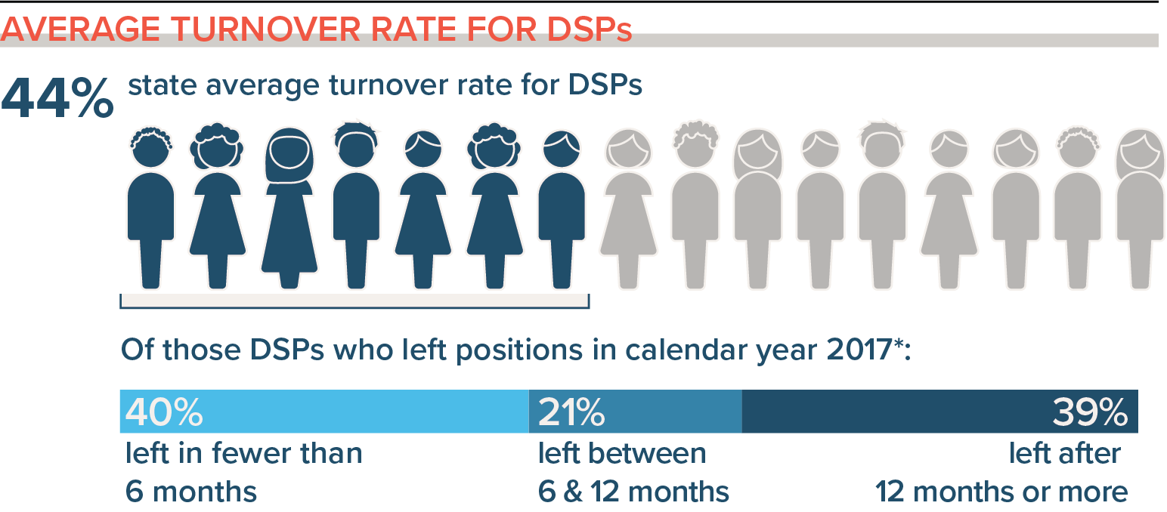
Retention Strategies
Connecting strategies with the data
Notes:
Talking Points:
If the data you are focusing on is the turnover rate, you will need to select the strategies that will work best for your organization.
It should be based on the detail in your data, then you can select and fully develop the strategy through all of the implementation stages to get the best result.
If you don’t get positive results, you may have selected the wrong strategy. But you still have good data that can guide you to what to try next.

Slide 52
Self-Assessment Workbook
Matrix - workbook page 24
Step 2-Select an Intervention Strategy
Challenges
Poor performance
Intervention Strategies
Training doesn’t produce results
Review & Update Job Descriptions
Effective orientation
Improve co-worker support for new hires
New staff unsure of job roles & functions
Performance evaluations
Supervisor Training & Mentoring
Competency-based training
Supervisors overwhelmed
Notes:
Talking Points:
In the Self-Assessment workbook, on page 24 you will find a Matrix of Workforce Challenges and Intervention Strategies.
When your challenges are: read challenges section
There are many strategies that correspond with these challenges, including…read intervention strategies section

Slide 53
Breakout Conversation
Reflecting on Your Retention Practices
What retention strategies that we’ve covered today have you tried in your organization to address workforce challenges?
  What were you pleased about?
  What have you learned?
  What are you concerned about?
Based on this, what next steps are you thinking about?
Notes:
Total timing for activity: 10 minutes
Activity : (5 minutes) – 5 people per breakout, each person gets one minute, assign 1 consultant or coach to each breakout group
Purpose: Gives consultants and coaches opportunity to learn who is in the room.
Talking Points:
We are going to have the opportunity to get to know who is in the workshop today. In a moment but not yet, you will be send to a Breakout room with 5-6 others.
Everyone will have the opportunity to:
answer the questions on the screen.
When you get to your group, find one facilitator and another person to report back for the group the responses to the two questions.
When the group returns call on the reporter from each group to report back on themes for questions #1 and #2.

Slide 54
Goals Setting and Measurement
What change do we want to see?
(SMART Goals)
How are we going to measure
Trackable and measurable
vs. anecdotal
How long will this take/how long will we measure for?
How will we know its working?
(Step 8 – Evaluate Success)
Notes:
Timing for sections (slides 54-59 – final slides before wrapup): 5 minutes
Talking Points:
When you are ready to set your goals and measurements you may want to use these questions.
What change do we want to see? (SMART Goals)
How are we going to measure
Trackable and measurable vs. anecdotal
How long will this take/how long will we measure for?
How will we know its working? (Step 8 – Evaluate Success)
Notes about SMART Goal for facilitators (not script)
S = Specific
Be as clear and specific as possible with what you want to achieve. The more narrow your goal, the more you’ll understand the steps necessary to achieve it.
Example: “I want to earn a position managing a development team for a startup tech company.”
M = Measurable
What evidence will prove you’re making progress toward your goal? For example, if your goal is to earn a position managing a development team for a startup tech company, you might measure progress by the number of management positions you’ve applied for and the number of interviews you’ve completed. Setting milestones along the way will give you the opportunity to re-evaluate and course-correct as needed. When you achieve your milestones, remember to reward yourself in small but meaningful ways.
Example: “I will apply to three open positions for the manager of a development team at a tech startup.”
A = Achievable
Have you set an achievable goal? Setting goals you can reasonably accomplish within a certain timeframe will help keep you motivated and focused. Using the above example of earning a job managing a development team, you should know the credentials, experience and skills necessary to earn a leadership position. Before you begin working toward a goal, decide whether it’s something you can achieve now or whether there are additional preliminary steps you should take to become better prepared.
Example: “I will update my resume with relevant qualifications, so I can apply to three open positions for the manager of a development team at a tech startup.”
R = Relevant
When setting goals for yourself, consider whether or not they are relevant. Each of your goals should align with your values and larger, long-term goals. If a goal doesn’t contribute toward your broader objectives, you might rethink it. Ask yourself why the goal is important to you, how achieving it will help you and how it will contribute toward your long-term goals.
Example: “To achieve my goal of being in leadership, I will update my resume with relevant qualifications so I can apply to three open positions for the manager of a development team at a tech startup.”
T = Time-based
What is your goal time-frame? An end-date can help provide motivation and help you prioritize. For example, if your goal is to earn a promotion to a more senior position, you might give yourself six months. If you haven’t achieved your goal in that timeframe, take time to consider why. Your timeframe might have been unrealistic, you might have run into unexpected roadblocks or your goal might have been unachievable.
Example: “To achieve my goal of being in leadership, I will update my resume with relevant qualifications so I can apply to three open positions for the manager of a development team at a tech startup this week.”
Why should I use SMART goals?
Using the SMART goal framework sets boundaries and defines the steps you’ll need to take, resources necessary to get there and milestones that indicate progress along the way. With SMART goals, you’re more likely to achieve your goal efficiently and effectively.

Slide 55
Putting the Plan into Action
Step 7 – Implement the strategy
Notes:
Talking Points:
When a strategy has been assessed and developed it is time to implement it, which is step 7 of the implementation plan .

Slide 56
Organization Self-Assessment Workbook
Pages: 26 – 27
Action Planning Worksheet
Notes:
Talking Points:
The action planning worksheet can be used to develop your strategies and divide the work among your team.
Note: worksheet is on the next slide

Slide 57
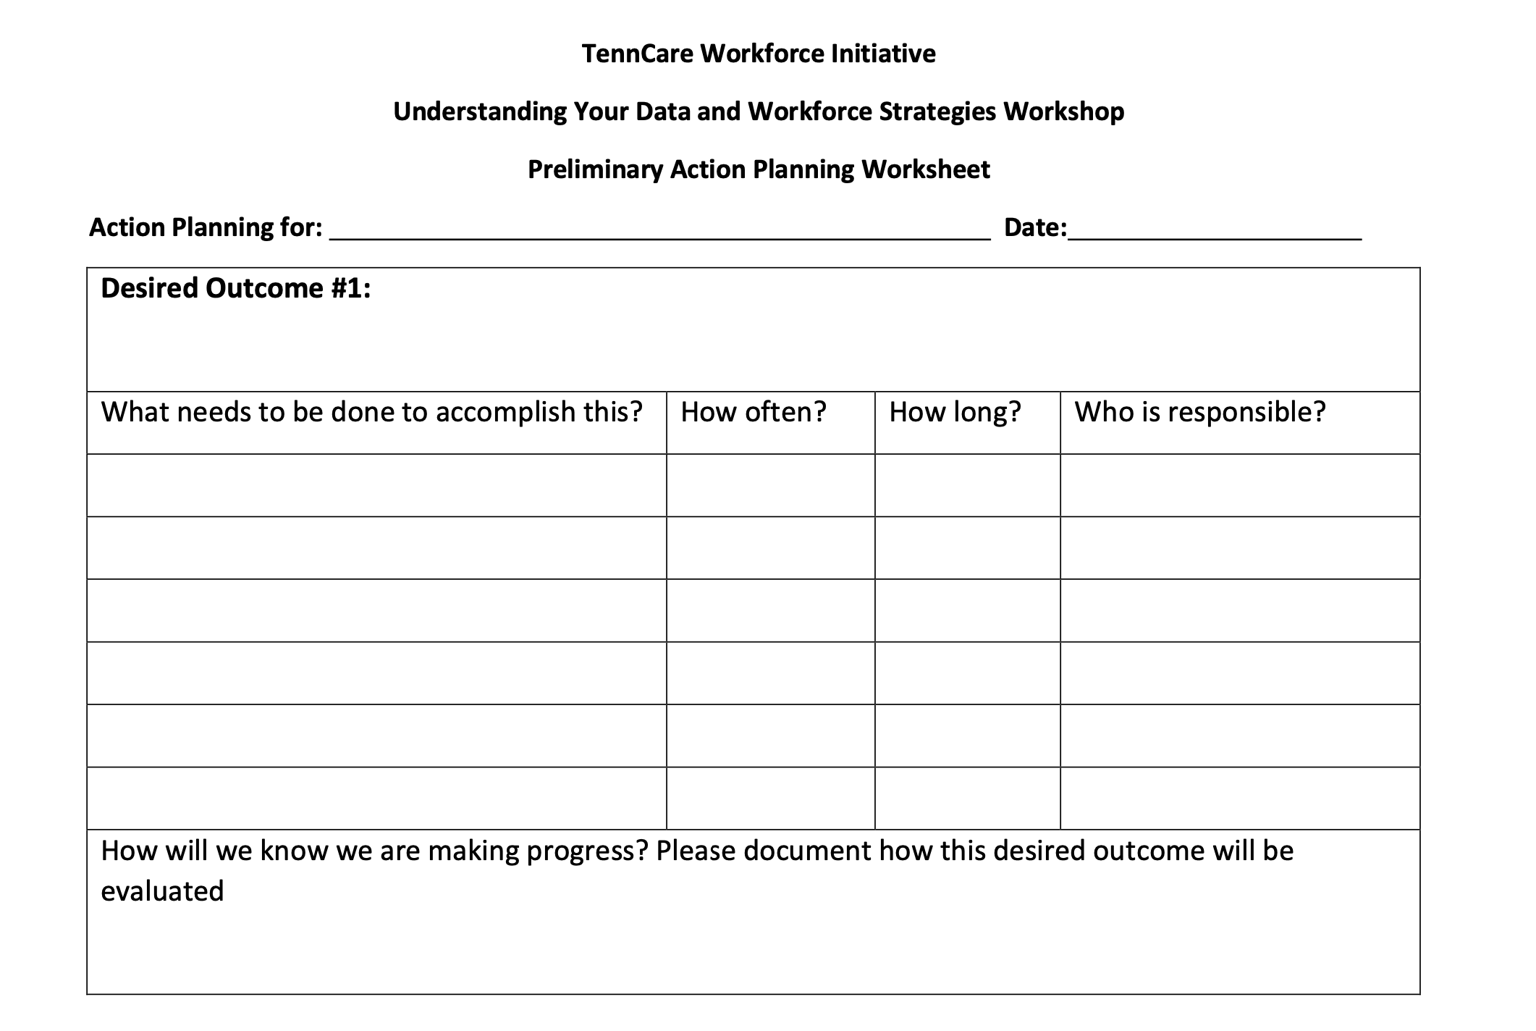
Notes:
Talking Points:
Explain the action planning worksheet on pages 26-27:
Identify what the strategy is and the desired outcome
What steps will need to be done to accomplish the outcome?
How often or when will you start the working on that step?
How long will it take?
Who will be responsible for it?
How many of you are starting to think about action plans? You may already have a similar planning process within your organization that you will use. For others, using the action planning worksheet may be a way to bring focus to some of your current and future workforce activities.

Slide 58
Evaluating the Efforts
Step 8 - Evaluate Success
Notes:
Talking Points:
Step 8, evaluation, is extremely important because it helps the organization to circle back and celebrate success, learn where additional needs may arise and revise plans to move forward.
The action planning worksheet can help you with step 8. (On next slide)

Slide 59
Notes:
Talking Points:
It is important to decided when you will evaluate your progress and How you will know if you are making progress, or in other words how will you evaluate it. What data do you collect or would you need to collect to know you are making progress?

Slide 60
Questions about Retention Strategies Covered Today?
You will receive the slides from today’s workshop so that you can have further discussions about the information in this session.
If you have questions:
Contact your University of Minnesota workforce consultant
Email us at: dsp-tn@umn.edu
If you haven’t provided us with your Key Contacts please do
at: https://z.umn.edu/C2KeyContacts
Notes:
Facilitator Note: improvised based upon the amount of time left. Take questions if time, otherwise give contact info. Need 3-5 minutes for the last 3 slides.

Slide 61
What’s Next
You will receive the slides from today’s workshop so that you can have further discussions about the information in this session.
Session #6: Overview of TennCare Workforce Toolkit: Retention Strategies - Part 2
  Homework before our next session:
  Review the Organizational Workforce Self-Assessment Workbook sections on Retention with your teams
  Check out Retention Strategies and Tools on TN DSP Workforce Toolkit: https://tenncare.ici.umn.edu/
Notes:
Talking Points:
Your next Workshop is Session # where we will discuss……………………………………. Your organizations key contacts should plan to attend this workshop. You can invite other members of your team to attend any of the upcoming workshops as you like.
We will be meeting on: (insert date and time)
You should have already received the link to this and the other workshops.
If you don’t have the links please contact us at the email address on the preview screen: dsp-tn@umn.edu
Your homework is:
To complete the Self-Assessment Workbook if you haven’t already
Check out the Workforce website to see what is available to you. This is a rich resource of tools that are not available to you. This website has been developed for Tennessee providers who are involved in this Workforce Initiative, so the website and tools should not be shared with other organizations or individuals who are not a part of this project.
Go to the last slide

Slide 62
Upcoming Kick-off Sessions
Session 6:
  Overview of TennCare Workforce Toolkit: Retention Strategies - Part 2
Session 7:
  Planning Your Next Steps: Measuring Outcomes of Implementation and Creating a Practical Action Plan for Change
Notes:
Edit slide as needed regarding upcoming workshops

Slide 63
Thank you
See you next week!
Notes:
Thank you and goodbyes

