Slide 1



Welcome to the Webinar Series on the Workforce Toolkit
We will begin at 2:00 p.m. central
Notes:
Host and Co-host notes for pre-meeting setup​​
Actions before the session:​​
Slide #1 – Update presenter names​​
Hide the other region consultant slide, as applicable​​
Hide other regions workshop slide for Upcoming Workshops, as applicable​​
In the Practice session before participants log on​​
Check that the presenter can share their screen and run videos as needed​​
Check that the presenter marks “Share Computer sounds” and “Optimize Screen sharing for video clip” so that any videos shown can be heard by others – it is on the same screen that you choose which screen to share. ​​
Make Coaches "Co-hosts"​​
Confirm polls are loaded - host​​
Turn on transcript –host ​​
Break-out Groups – host ​​
Take attendance​​
Time keeper​​
Host / Welcome people as they arrive & arrive late – assign someone​​
Monitor Chat – assign someone ​​
Turn on record, as desired ​​
Subtitles – turned on, each participant can control turning on and off ​​
At end of presentation:​​
MAKE SURE TO STOP RECORDING AT THANK YOU SLIDE​​
​
Note to Facilitator​​
Bold Text = Timing ​​
Italicized Text = Notes – do not read ​​
Regular Text = Talking Points ​​

Slide 2
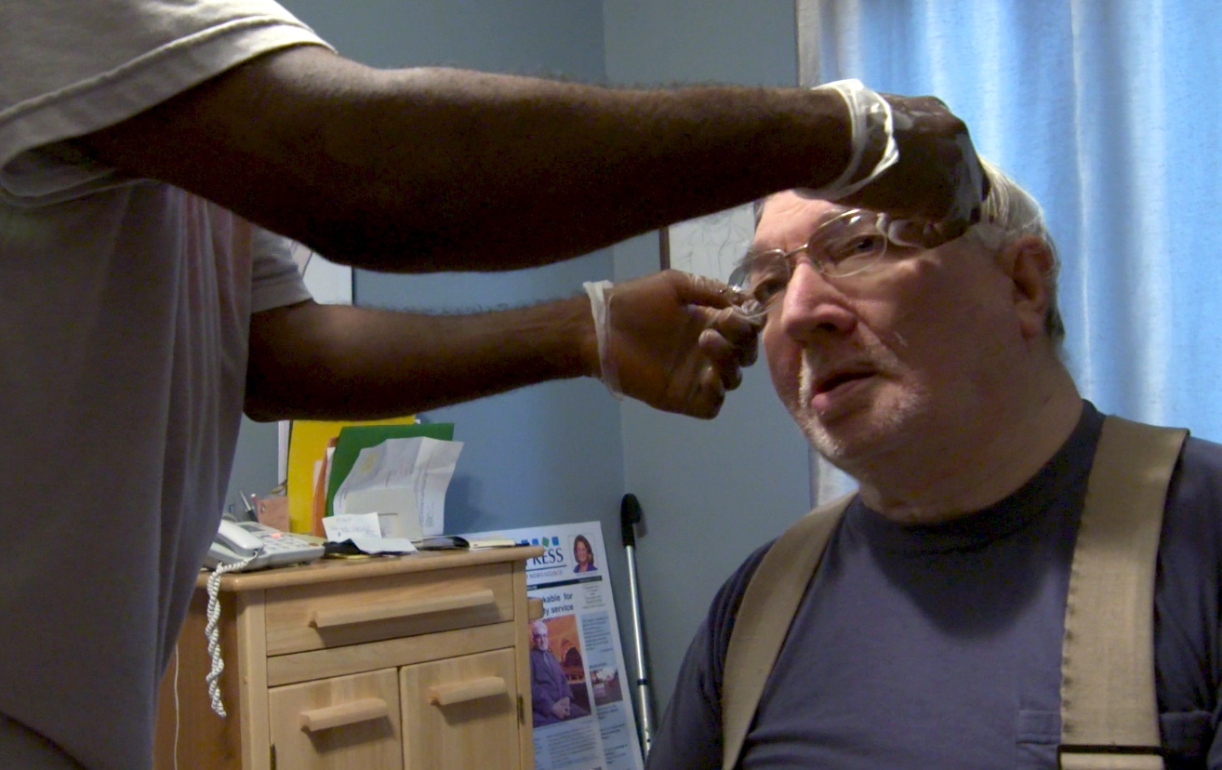
Selection & Retention Strategies
Realistic Job Preview
Claire Benway & Chet Tschetter
University of Minnesota
Notes:
Time: This slide deck is meant to be completed in 40-45 minutes. Several slide are transitional such as Slide 3. Content slide each take about 1-2 minute per slide unless otherwise noted on the slide notes.
Facilitator Note: Update slide presenter information. Record as desired
Talking Points:
Welcome.
My name is xx and I am a xx with the Institute on Community Integration at the University of Minnesota. I am here today with my colleagues from the University of MN, __________ and ________________. Also Regional Coaches from Tennessee ____________________ and ___________________.
Thank you so much for joining us today.
Facilitator Note: If being recorded: This webinar is currently being recorded. We will send the recording to you if you would like to view again or share with others in your organization.
Talking Points
I’m pleased to have the opportunity to speak today on this important topic of the Realistic Job Preview or what we sometimes refer to as the RJP.
We know that many of you are considering using the RJP as a part of your selection and retention strategy.
I will share with you information on what the RJP is and why it is effective.
Then we will be talking with you about how to develop an RJP.

Slide 3
Retention Starts at Selection
Notes:
Talking Points
Many of you want to increase your retention of Direct Support Professional.
People tend to think that retention starts when someone starts their new job, but that really it starts at selection.
The employer needs to feel like or think the DSP who is a good match for the organization, or the family is critical, but also critical that the DSP feels or thinks that they are a good match for the job, the organization or family.
Those decisions need to be made before a person accepts the position.

Slide 4
Realistic Job Preview
Recruitment
Selection & Retention
Targeted Marketing
Public Service Announcements (PSAs)
Realistic Job Previews
Structured Interviewing
DSP Competencies
Education and Training
Credentialing and Career Paths
Recognition
Membership and Networking
Notes:
Facilitator Note: This is a reminder to show where this tool fits into the whole process.
Talking Points
There are two main areas we are looking with the DSP toolkit.
First is Recruitment – and if you joined us during our last webinar you learned about Targeted Marketing. Coming on March 2 we will have a webinar on the Public Service Announcement.
The second is Selection and Retention with the RJP being one of the tools.
Sometimes people confuse a promotional video that they may have on their website or who at tradeshow with the RJP.
Promotional videos focus on things that are all positive about the organization or
the job.
The RJP tells a more realistic story.
We will be addressing the other areas of retention listed here in future webinars.

Slide 5
Realistic Job Previews (RJPs)
Present non-distorted information to job applicants:
about the job (positive and challenging)
about the people receiving services, their supporters, and the employer
during the interview process, and before a job offer is made
Notes:
Facilitator Note: This is the initial explanation and setting of the stage for what an RJP is. Take as much time as you need but know you will be diving into this content as you progress through the slides.
Talking Points
I told you the RJP is different than a promotional video and this is how it is different.
The RJP provides a non-distorted picture or explanation to job applicants.
It show both the positive and the challenging parts of the job.
The applicants can learn about:
the people they may be hired to support
their family or friends
and about the employer and their culture, vision and mission
I am going to talk with you in a few minutes about the different ways you can do an RJP, such as a video, a photo album and more.
For instance, if the employer has a video, they may show it to applicant before the interview and ask questions of the candidate about the RJP.
Or you may use the RJP as a part of or after the interview.
If the RJP is touring the day program or work site, you could do this before, during or after the interview. When I was a camp director of a large sight, I would meet the candidate and while giving them a tour of the camp, I asked many of our interview questions while on the tour.
The important thing is that it is done before a job offer.

Slide 6
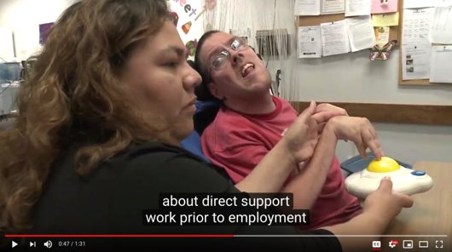
Direct Support: A Realistic Job Preview
https://www.youtube.com/watch?v=TCOj7weR2Jg
Notes:
Facilitator Note: : https://www.ancor.org/toolkit/employers/realistic-job-preview. This in one of the three free ANCOR RJP preview that last 60-90 seconds.
Show the short preview. Be sure to set up the clip you are showing so they can see how it connects to the organization or field it is showing.
Talking Points
Let’s talk about the short preview of an RJP.
Facilitator Note: Go to the next slide for discussions questions.

Slide 7
What did you learn from the RJP?
What are 2 job duties you learned about?
Did they address the work schedule? Wages?
What do staff enjoy about being a DSP?
What do the staff find as challenging about being a DSP?
What did you learn about the mission, vison, and values of the employer?
What is one thing you learned about the people receiving services?
What else?
Notes:
Facilitator Note: Lead a discussion
Time 3-5 minutes
Talking Points:
You saw a short part of an RJP that we produced for ANCOR. We will be working in Tennessee this spring to develop a Tennessee specific RJP. Please talk to your consultant if your organization is interested in being involved in making the RJP.
These are things that you want the job candidate to learn from watching the RJP.
You can use the RJP to help the candidate learn:
about job duties, work schedule and wages.
what the DSPs enjoy and find challenging about the job.
The RJP has an opportunity for the candidate to learn about the mission, vision and values of the employer.
About the people receiving services?
About how the candidate should really consider if the job is a match for them?

Slide 8
Many people do not know about careers in direct support
Notes:
Facilitator Notes: Utilize this slide to help people understand that the career of a Direct Support Professional is not always clear to all people.
Talking Points:
Many people really don’t know about careers in direct support, or maybe never thought that it was a career for them.
This could be for many reasons
maybe they don’t know someone who receives services
Maybe they don’t really know what skills a person needs to be a DSP
Or maybe they just haven’t considered it.

Slide 9
A Realistic Job Preview can:
Inform applicants about direct support field
Increase the visibility of DSP as a career choice
Increase the visibility of people who receive supports in their community
Enhance their understanding about the tasks and duties of DSPs so that those who accept the job are more likely to be qualified for or interested in the work
Notes:
Facilitator Note: This is an overview of what an RJP can do to support people. This is intended to help explain to others what the RJP can do to support your retention efforts.
Talking Points
The RJP lets candidates know about working in the direct support field and a career choice
It increases the visibility of the people who are receiving services
Many people don’t really understand the day-to-day tasks and duties of a DSP.
By sharing an RJP with the applicant, it enhances their understanding and allows them to make a better decision about if the job, and the organization is a match for them.

Slide 10
Realistic Job Previews
Methods
Who
Video/photo album/picture board
In person (site tour, volunteer, internship)
Interviews with people receiving services, their supporters, direct support Professionals, and frontline supervisors
Combination of these
Job candidates
When
As a part of the interview process
Before a job offer
Notes:
Talking Points
There are different methods use for RJP
videos are popular
photo albums or display boards
In-person – site visits or tours, volunteering or internships.
I spoke with a provider in Tennessee who told me that they have the candidate spend 15-30 minutes shadowing a DSP as part of the interview or RJP.
Talking with people receiving services, their supports (family and friends)
Talking to DSPs and frontline supervisors
Or doing a combination of these things.
RJP is for the candidate that you are interested in hiring
It is part of the interview process before a job offer is made, so that they have a non-distorted image of the job.
You want the candidate to understand what the job really is, so they can make an informed decision.

Slide 11
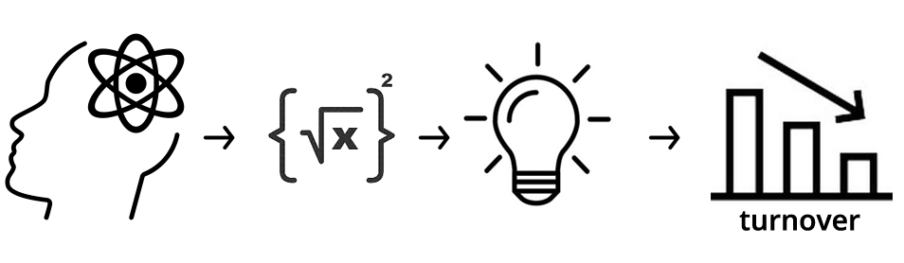
The Science Behind the RJP
Notes:
Talking Points
There is a science behind the RJP and how it reduces turn over and we will talk about the science behind it.

Slide 12
Benefits of Realistic Job Previews
Candidates understand job expectations before they start the job
Candidates can make an informed decision
Candidates can self-select out
Notes:
Talking Points
RJPs help ensure that candidates who accepts a position will be less likely to leave the position due to not understanding what the job was really going to be like or dissatisfaction with the wages, hours, benefits and organization.
Candidates who viewed or participated in an RJP have fewer unmet expectations.
The candidate can make an informed decision because they know more.
They can decide if the job or organization is a match for them.
Or they can opt out on their own before they accept or start the job.
Every time a staff starts and quits in the first in the first 6 months it cost you time and money.
But that isn’t all, it takes an emotional toll on people who receive services, their families and the other staff.

Slide 13
Realistic Job Previews Affect Retention
RJPs can improve retention rates by 9% - 17%
RJPs increase retention of workers
  For agencies with 12% annual retention rates, use of RJP increased it by 50%
  For agencies with 24% annual retention rates, use of RJP increased it by 20%
(McEvoy & Cascio 1985; Premack & Wanous, 1985)
Notes:
Talking Points
Here is the data to support the RJP.
Using an RJP can improve retention rates by 9-17%
For employers with a 12% annual retention rate, then used of an RJP , retention increased by 50%. They increased their retention from 12% to 24%
For employers with a 24% annual retention rate, then used the RJP, their retention increased by 20%. They increased from 24% to nearly 29%.

Slide 14
Making a Realistic Job Preview
Notes:
Talking Points
Now you know why the RJP is important and the data behind it, next we will look at thinks to think about make one and what is important to communicate in an RJP.

Slide 15
Developing the Realistic Job Preview
Gather information
Summarize information
Select strategy & method
Implement and evaluate
Revise and update
Action plan
Notes:
Talking Points
In this next you will learn about how to develop a RJP.
There are the important steps to developing an RJP that we will cover in more depth.
And as you just learned that the RJP doesn’t need to be in a fully produced video, there are other ways to do it.
These are the 6 steps
Starting with gathering information
Summarize information
Select strategy & method
Implement and evaluate
Revise and update
Action plan
We will break them down and cover all of them.

Slide 16
GATHER INFORMATION
Who can provide an accurate picture of the job of a DSP?
  People receiving services and their supporters
  Direct Support Professionals
  Frontline Supervisors
  Others?
Notes:
Facilitor Note: This is a great opportunity to walk participants through who during the development or process of creating an RJP are good people to include. Review the information on the slide then provide a brief description of each and the why behind why they are important to involve.
Talking Points:
Who can provide an accurate picture of the job of a DSP? You want to have a plan for what information you want to gather, because what isn’t going to work, is to go out and take a bunch of video, if you are using a video format, of people in their daily lives without of any sort of understanding of what you want to communicate about being a DSP. There are many RJPs on the web that you could use but they might not communicate the messages that your organization wants potential DSPs to learn regarding the people that your organization sorts. You want to communicate about the positions you are hiring for and about your organization. It is important to interview a variety of people.
People receiving services and their supporters – The people who are receiving services and support know best what they want from a DSP. They will be able to share what it important to them.
Direct Support Professionals - When supporting a person in their lives DSP get to know them on a very personal level. They are excellent resources to tell you about what its like to support people.
Frontline Supervisors – FLS can provide valuable insight into what the role will be long term, as well as if there is any opportunity for moving up within the organization.
Others? - Who else would you enroll into this process?

Slide 17
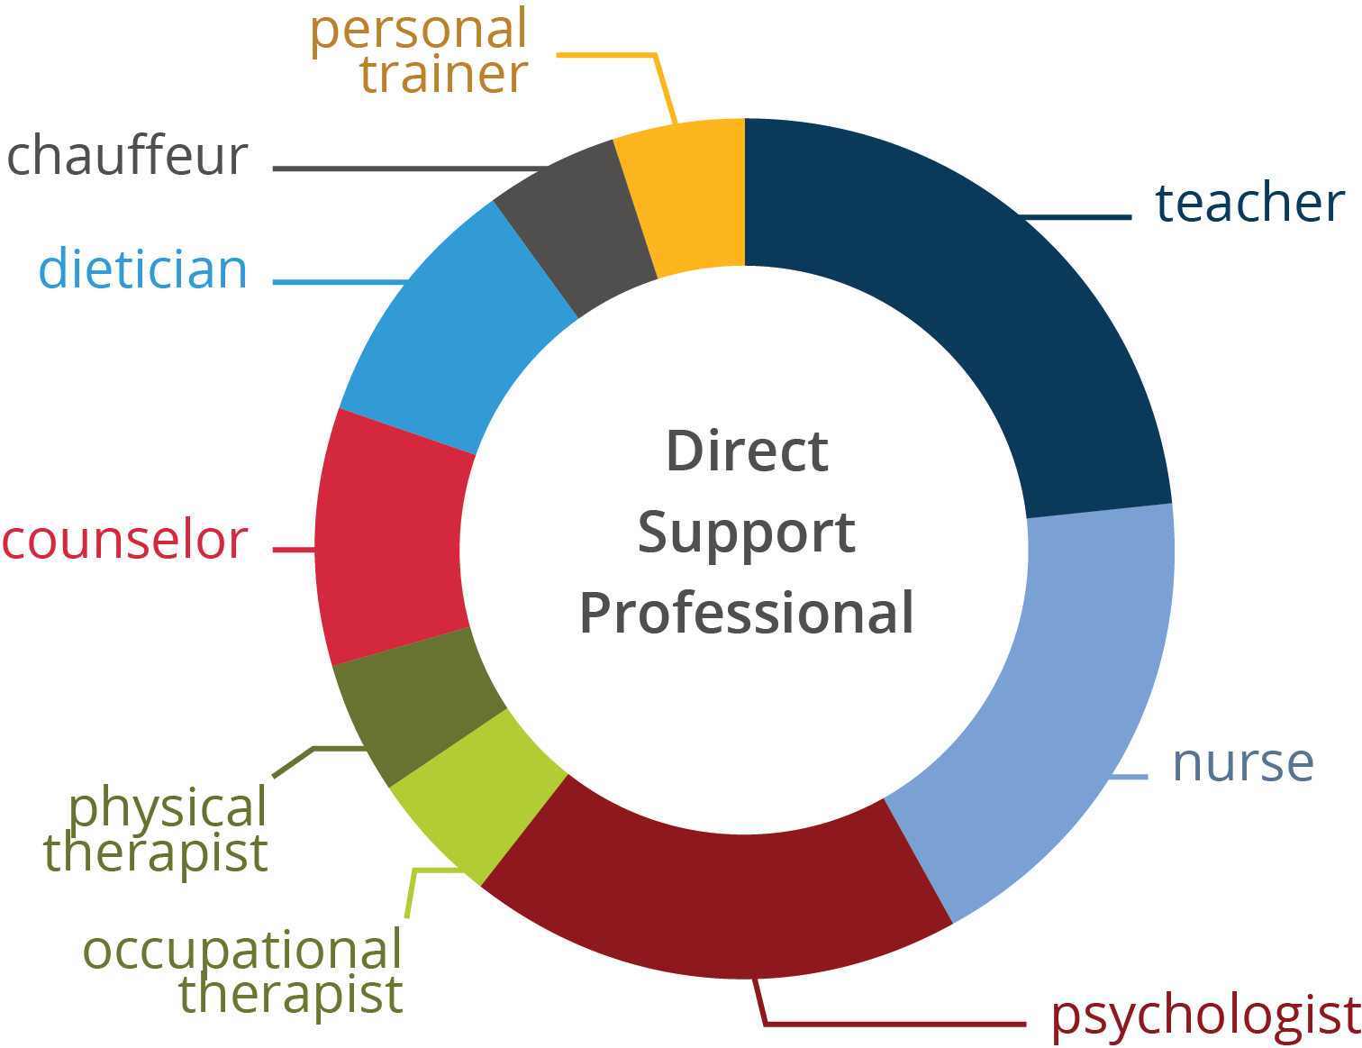
GATHER INFORMATION
Scope of the work
Specific work experiences with persons served,
co-workers, families
Work hours and flexibility
Positive & challenging experiences
Success stories by DSPs
Notes:
Facilitor Note: Use this slide to review the different aspects of the role of a DSP that we don't always think about. And connect it back to Gathering information for putting together an RJP or implementing an existing one into and organiztion.
Talking Points:
Each organizations will look different to reflect the duties of their positions. Remember that most importantly an effective RJP must contain the following (From Slide)
Scope of the work - What the DSP Does
Specific work experiences with persons served, co-workers, families – Experiences they may draw from
Work hours and flexibility – An accurate picture of the hours and time commitment including overtime and mandated time.
Positive & challenging experiences – What is great and what is more difficult?
Success stories by DSPs – an uplifting story to illustrate how rewarding this work is.

Slide 18
GATHER INFORMATION
Physical demands of the job
  Personal care
  Lifting requirements
  Standing/walking/bending/stooping
  Challenging actions or behaviors
Notes:
Facilitor Note: This is to further delve into what needs to be accurately portrayed in an RJP.
Talking Points –
Physical demands of the job can be intense. To be sure that people understand that its important to include within the RJP. These are not negotiable actives typically and if a potential DSP is not comfortable to able to perform these that will be a prob
Personal care
Lifting requirements
Standing/walking/bending/stooping
Challenging actions or behaviors

Slide 19
GATHER INFORMATION
What are unique issues, circumstances, or differences that DSPs encounter for this employer?
  Characteristics of persons served
  Family & friend involvement
  Vehicle use
  Location of work environment
What is unique about the employer?
What sets this employer apart from other employers?
Notes:
Facilitor Note: Further explanation of RJP needs
Talking Points:
Every person served is unique and has a different personality and likes and dislikes. This is a job where people support people.
What are unique issues, circumstances, or differences that DSPs encounter for this employer?
Characteristics of persons served – Likes, dislikes, service preferences etc..
Family & friend involvement – Who are the most important people in their lives
Vehicle use -
Location of work environment
What is unique about the employer?
What sets this employer apart from other employers?

Slide 20
GATHER INFORMATION
  Organizaiton and Human Resources specific oinformation
    Pay and benefits
    Training
    Advancement opportunities
    Recognition
Notes:
Facilitor Note: Further explanation of RJP needs.
Talking Points
Organization and Human Resources specific information
Pay and benefits
Training
Advancement opportunities
Recognition

Slide 21
Developing the Realistic Job Preview
Gather information
Summarize information
Select strategy & method
Implement and evaluate
Revise and update
Action plan
Notes:
Talking Points
Step 2 is to Summarize the information that you just gathered.
You have done a lot of discovery about your organization.

Slide 22
  SUMMARIZE INFORMATION
What themes emerged from the information that you gathered?
How can and will you use the themes you discovered in the way you develop your RJP?
What will be the essence of your message?
Notes:
Talking Points
When you were gathering information, were there any themes that started to emerge that you would like to use in the RJP?
With this information you will be able to use themes to communicate the essence of your message.

Slide 23
Developing the Realistic Job Preview
Gather information
Summarize information
Select strategy & method
Implement and evaluate
Revise and update
Action plan
Notes:
Talking Points
Our third step is to choose our strategy and method.
As we said before there are a variety of strategies and methods to develop your RJP, and you want to choose the one that makes the most sense for the organization.

Slide 24
SELECT A METHOD
Which of the three basic Realistic Job Preview methods will you use to deliver your message and why?
  Job information presentation (video, scrapbook, promotional material, etc.)
  Work site visit
  Face-to-face-interviews
Will you preview and evaluate other RJP products to see what you like and what will be a good fit?
  If yes, which one(s)?
Notes:
Talking Points
When you think about selection a method for a Realistic Job Preview, we often think about the video, but there are other ways to effectively communicate what the job is really like. We have seen really great scrapbooks or photo albums that people who receive services have developed to see if someone would be a good fit to support them, as well as providers who have developed scrapbooks or photo albums for specific work sites that really tell the story of what the work and the people are really like.
Touring a work location can be highly effective as well as face to face interview with people receiving services and their family members as well as currently employed DSPs.
Consider if you will preview and evaluate the RJP products to see what you like and what will be a good fit for your organization.
Promotional materials are just that, they promote the organization and only show the positive and designed to get someone interested in the organization --- you may use these at job fairs, on your website, in your email signature and other times or places the public may interact learn about the organizations.

Slide 25
SELECT A METHOD
Five Key Characteristics of Effective RJPs Clarity of purpose
Credible information
Complete and customized information
Balanced information
Presented early in the interview process
Notes:
Facilitator Note: Source: Slide 7 of CDS on RJP
Talking Points
When selecting a method, you want to think about the five key things that effective RJPs include to be clear about it’s purpose.
You need credible information that is in the RJP and how will it be customize the information for the organization, and the people supported.
You want to have a good balance of both the rewarding and the challenging aspects of the job.
And as we said before you want to present the RJP early in the interview process. Maybe before the interview or following the interview. Without a doubt before a job offer is made, so that the candidate has a realistic idea of that the people, the job and the organization are all about.
The RJP is a selection strategy and leads to retention. We hear time and time again that people leave the role of DSP because they didn’t really understand what the job was going to be like. The RJP can help improve retention, because a candidate may realize that during the interview and after experiencing the RJP that the job isn’t a good match for them, and self-select to not move forward in the interview process.

Slide 26
SELECT A METHOD
What will work for you?
Which RJP method & strategy will you use?
Who will lead and who will support the RJP process?
Do you have the support of others in your organization?
Will your organization financially support the RJP?
Notes:
Talking Points
When selecting the method that will work best for you, you will also need to make decisions about who will lead and support he RJP process.
Find out if you have support of others in your organization. This is so important to have the support of others. Several people in the organization may be involved in developing the RJP and you want to have their positive energy and support.
This is especially if you need financial support.

Slide 27
Developing the Realistic Job Preview
Gather information
Summarize information
Select strategy and method
Implement and evaluate
Revise and update
Action plan
Notes:
Talking Points
The 4th step after you have selected the strategy and method is to Implement and evaluate.
Part of a successful RJP is having an implementation plan.
This is asking and deciding how and when the RJP will be used. It would be wise, if you aren’t already to start to track retention data to if or how the RJP is impacting hiring and retention.
You will want to decide how you will evaluate the effectiveness of the RJP, as well as when – which will be part of you action plan that we will be talking about soon.

Slide 28
IMPLEMENT AND EVALUATE
How and when will you start to create and use the RJP? What’s your timeline?
Who will implement and support the implementation of the RJP?
What barriers do you anticipate? How will you overcome those barriers?
How will you measure the effectiveness of the RJP (turnover, overtime)?
Notes:
Talking Points
Once you have decided what type of RJP you will develop, you will decide who and when you will make and use the RJP. What are your timelines? Who is going to be interviewed or involved in making it or if it is a tour, who will being giving the tour and what is their script?
Part of a successful RJP is having an implementation plan.
This is asking and deciding how and when the RJP will be used. It would be wise, if you aren’t already to start to track retention data to if or how the RJP is impacting hiring and retention. You may pilot it with a few people and get feedback from them.
What barriers do you think you will experience
You will want to decide how you will evaluate the effectiveness of the RJP, as well as when – which will be part of you action plan that we will be talking about soon.

Slide 29
Developing the Realistic Job Preview
Gather information
Summarize information
Select strategy and method
Implement and evaluate
Revise and update
Action plan
Notes:
Talking Points
When we start to think about the next step which is the idea of revising and updating. We know that the information and the visuals do become dated.
We all know that we wore some awesome outfits and had some stylish hair styles in the 80’s and 90’s . But when we look at them now that those outfits and styles belong in the 80s or 90s. They don’t represent us today.
Thinking about this, if you RJP is getting dated, are their ways to edit and make changes.
We know that over the years some providers change their services. Does the RJP represent the services you are currently providing and the people you are supporting?
Does it include a variety of demographics of the DSPs that work for the organization or that you want to work for the organization.

Slide 30
REVISE AND UPDATE
Using your evaluation results, how will you decide whether or not your RJP needs changes?
How will you decide what changes to make?
Make sure that you have a plan for evaluation and updating your RJP on a regular basis, including any time you restructure or make changes in your organization.
Notes:
Talking Points
Use the evaluation results to decide whether your RJP needs to change. Who makes these decisions?
Make sure to have a plan for evaluation any time you have a restructure or change in your organization so that the RJP isn’t forgotten about, and everyone thinks it is someone else’s job to evaluate the RJP.

Slide 31
Developing the Realistic Job Preview
Gather information
Summarize information
Select strategy and method
Implement and evaluate
Revise and update
Action plan
Notes:
Talking Points:
Once you have worked through the different steps it is key that you develop an action plan that is attainable and sustainable. Lets look at what that means on the next slide.

Slide 32
ACTION PLAN
Include a series of action steps in developing and implementing the RJP.
Note who is responsible.
When will they start and when should task be completed?
What are the resources needed?
Evaluation:
  How will you know the RJP is done to the quality you desire?
  How will you know the RJP is effective?
  How will you keep it fresh and relevant?
Notes:
Facilitor Note: Walk participants through the action planning phase, This may be different based upon who is in the presentation. The Bullets on the page are there to guide you through. This can be connected to a worksheet to workbook very easily
Talking Points:
No initiative will happen without action planning. And action planning isn’t reaction planning.
Take a moment and consider the following questions. They are essential to a successful implementation of this strategy.
Include a series of action steps in developing and implementing the RJP.
Note who is responsible.
When will they start and when should task be completed?
What are the resources needed?
Evaluation:
How will you know the RJP is done to the quality you desire?
How will you know the RJP is effective?
How will you keep it fresh and relevant?

Slide 33
Resources
ANCOR RJP
NYSACRA RJP
http://www.directsupportprofessional.org
The Arc RJP
  Staff Recruitment, Retention, Training Strategies for Community Human Services Organizations, Sheryl A Larson & Amy S Hewitt, 2005. https://ici.umn.edu/products/docs/Staff_Recruitment_book/Staff_Recruitment_book.pdf
Notes:
Talking Points
Here are some resource for the RJP that we have discussed.

Slide 34
Resources continued
College of Direct Support College of Frontline Supervisors and Management
    Recruitment and Selection
    Realistic Job Preview
Larson, S., & Hewitt, A. (2012). Staff Recruitment, Retention, Training Strategies for Community Human Services Organizations. Retrieved from: https://ici.umn.edu/products/view/580
O’Nell, S., Hewitt, A. & Larson, S., Removing the Revolving Door: Strategies to Address Recruitment and Retention Challenges.
https://rtc.umn.edu/docs/rrd_facguide.pdf
Notes:
Talking Points
These are also some additional resources for you.

Slide 35
Questions?
Contact: dsp-tn@umn.edu
Notes:
Facilitor Notes: This is the time for questions by the participants. You will need to determine how much time you have for questions.
Provide a way for the participants to reach you.

Slide 36
Check out the Workforce Toolkit at: tenncare.ici.umn.edu
!
Notes:
Facilitor Notes: Encourage people to use the Tenncare Workforce Toolkit..

Slide 37
Upcoming events
Thank you!
Notes:
Facilitor Notes: Provide any other tools and future tenncare events such as training or community of practice.

