Slide 1
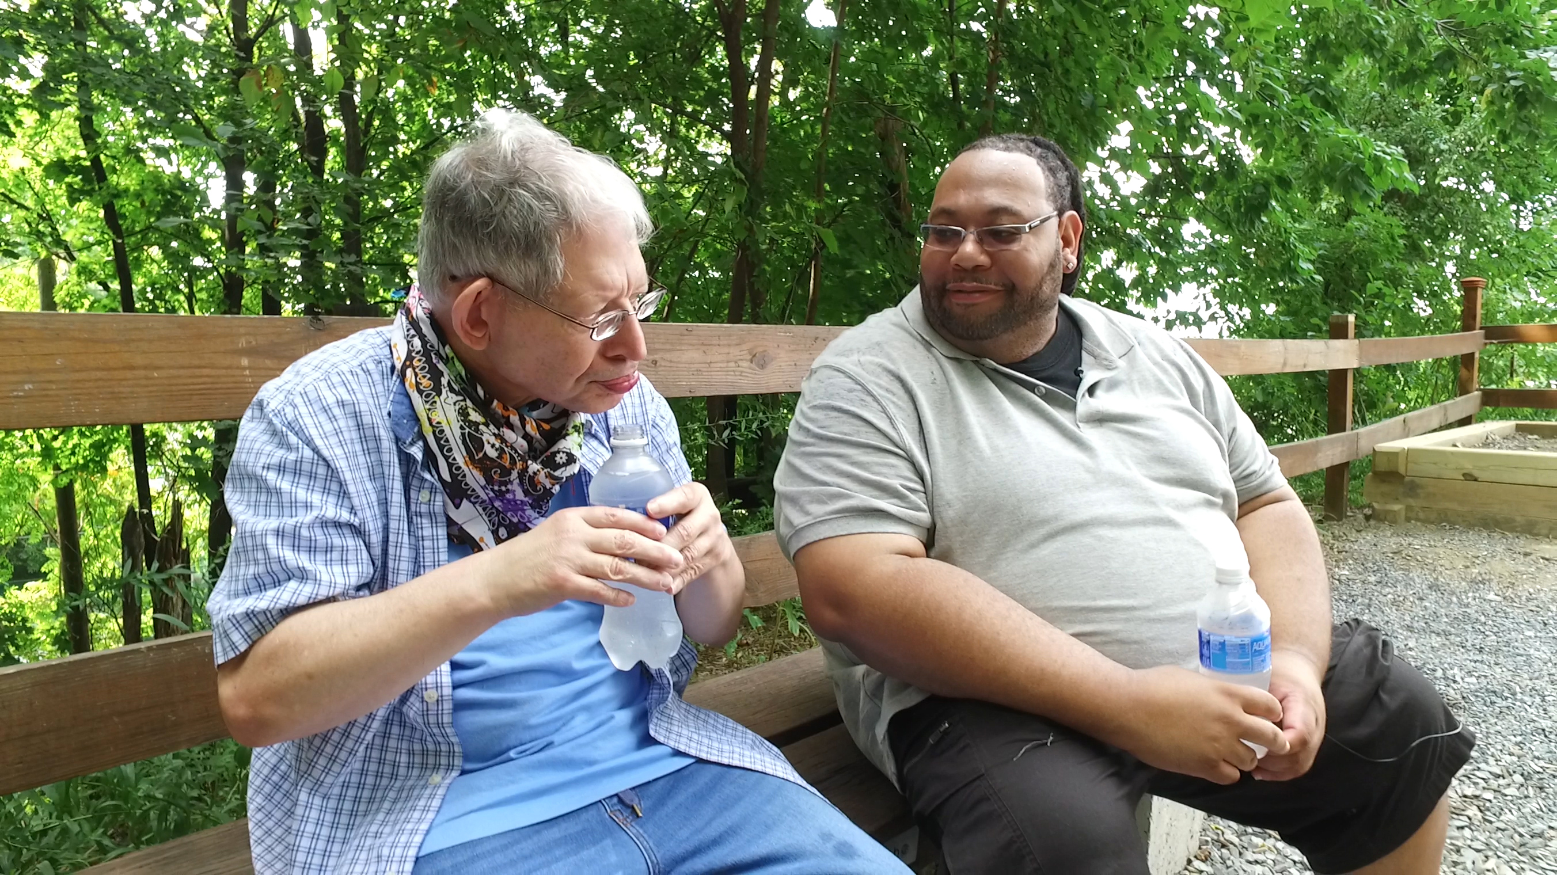
This is a Facilitator Set-up slide only
Notes:
Host and Co-host notes for pre-meeting setup
Actions before the session:
Slide #1 – Update presenter names
Hide the other region’s consultant slide, as applicable
Hide other regions workshop slide for Upcoming Workshops, as applicable
In the Practice session before participants log on
Check that the presenter can share their screen and run videos as needed
Check that the presenter marks “Share Computer sounds” and “Optimize Screen sharing for video clip” so that any videos shown can be heard by others – it is on the same screen that you choose which screen to share.
Make Coaches "Co-hosts"
Confirm polls are loaded - host
Turn on transcript –host
Break-out Groups – host
Take attendance
Timekeeper
Host / Welcome people as they arrive & arrive late – assign someone
Monitor Chat – assign someone
Turn on record, as desired
Subtitles – turned on, each participant can control turning on and off
At end of presentation:
MAKE SURE TO STOP RECORDING AT THANK YOU SLIDE
Note to Facilitator
Bold Text = Timing
Italicized Text = Notes – do not read
Regular Text = Talking Points

Slide 2

Understanding Your Data and Workforce Strategies
Workshop Series
Cohort 3
Insert Facilitator Name and Affiliation
tenncare.ici.umn.edu
Notes:
Time:
Timing: intro section (slides 2-8 including activity):
Facilitor note:
this slide is up about 10 minutes prior to start and for a minute or two as people log in.
During this time as people are logging in, you can ask people to Name them selves with their first name / their organization / their pronouns (make sure you have yours done too)
Action – Record

Slide 3
Welcome & Introductions
Notes:
Time: 1 minute
Welcome to the second workshop in the 2-part series on the QuILTSS Initiative kickoff.
My name is xx and I am a xx with the _________________________________. I am here today with my colleagues from _____________ from __________________and ________________ from __________________.
And also, with us today from the Institute on Community Integration at the University of Minnesota are Megan Sanders and Chet Tschetter.
Thank you so much for joining us today. In a few minutes you will get to introduce yourself in a breakout room as we prepare for today.
This training is currently being recorded. We will be available to you upon request.

Slide 4
Session 2:
Planning your Next Steps for Implementing Workforce Strategies
Notes:
Time: 30 seconds
Talking Points
In today’s workshop we are going to quickly review the strategies in the Toolkit, followed by taking a look at Assessing your Needs.
In Part 4, the last half of the workshop you will have the chance to take a closer look at evidence-based practices and your organizational capacity or readiness.

Slide 5
Using Zoom
Your microphones were muted when enter. You are able to turn them on so that you can ask questions or share with the group.
Please have your Camera if you are comfortable.
Name yourself
  First name
  Name of your organization
  Your Pronouns
Use for questions or comments.
We will use “Reactions” such as “thumbs up” though-out the workshop.
Live Script is enabled, and you can control that yourself from the lower ribbon on your screen.
Take care of your needs. If you need a break, take one.
Be Understanding of “co-workers” who may have interruptions.
Chat
Notes:
Time: 2 minutes
Talking Points:
Quick review of this; how to use Zoom was already discussed in the previous session

Slide 6
Items to have with you today:
  Your organization’s 2020 profile
  2020 TN Workforce Initiative Organizational Self Assessment Workbook (www.tenncare.ici.umn.edu )
  Chat: Megan if you need your organization’s profile.
Notes:
Time: 1 minute
Talking Points:
During today’s session we will be using the 2020 TN Workforce Initiative Organizational Self Assessment Workbook.
Facilitor Note: Put link to the SAW into Chat
We will put a link to it in Chat if you need it.
You will want to have a copy of your organization’s profile with you for reference.
If you don’t have it, do take a moment to get it.
If you weren’t here last week, and didn’t receive your organization’s profile, please send a message to Megan from the Univ. of MN, in chat with the email address she can email it to this morning.

Slide 7
Activity
Getting to Know You
Your name / organization
Your role in the organization today
What is one ‘aha’ moment you had after reviewing your organizational profile?
If you are joining today for the first time, what to you hope to gain today.
Notes:
Timing: 10 minutes breakout
Facilitor Note: Make small groups 3-4 people
Give them 8 minutes and then when they return ask if someone will share their Aha moment with the group.

Slide 8
Goals for Part 3
Reflect on the connection between assessment and your workforce practices
Learn more about the 8 steps of implementation and the components of an intervention plan
Explore your organizations workforce challenges and where to learn more about strategies to address them
Plan your next steps and understand the resources available to you.
Notes:
Time: 1 minute
Talking points
We have several goals for the first part of today’s session.
Reflect on the connection between assessment and your workforce practices
Learn more about the 8 steps of implementation and the components of an intervention plan
Explore your organization’s workforce challenges and where to learn more about the strategies to address them
Plan your next steps and understand the resources available to you.

Slide 9
Overview of Implementation Research
Notes:
Time: 15 seconds
Talking Points:
You’ve learned about your data, now we’re going to talk about how to implement processes.

Slide 10

Implementation Science
Notes:
Time: 2 minutes
Talking Points:
Implementation has a large body of research that would take a long time for us to go through. Today we are going to talk about some of the basics.
Implementation is a constant process. The process doesn’t end once you’ve started using a practice or program, implementation means constantly monitoring the practice or program.
What that means is that you will likely move along the phases of implementation based on how thing are going in your organization. We simplified this process in the 8 steps process we talked about in session 1 and will talk about again today.
The key ideas here are about giving a strategy time to implement and expect that you may go back and forth between the 8 steps. For example, some of the organizations in Tennessee changed their process when COVID-19 hit. They needed to adjust their expectations and figure out their priorities as they moved forward, knowing that things would continue to change as COVID changed.
What we know from research is that implementation matters, and it takes time. If you have tried a strategy in the past, but didn’t have the support, time, or staff to implement you are unlikely to see the changes you hope to see. We will discuss this topic more in the little bit, but we wanted to discuss this briefly here and as we introduce the sections of the self-assessment workbook.

Slide 11
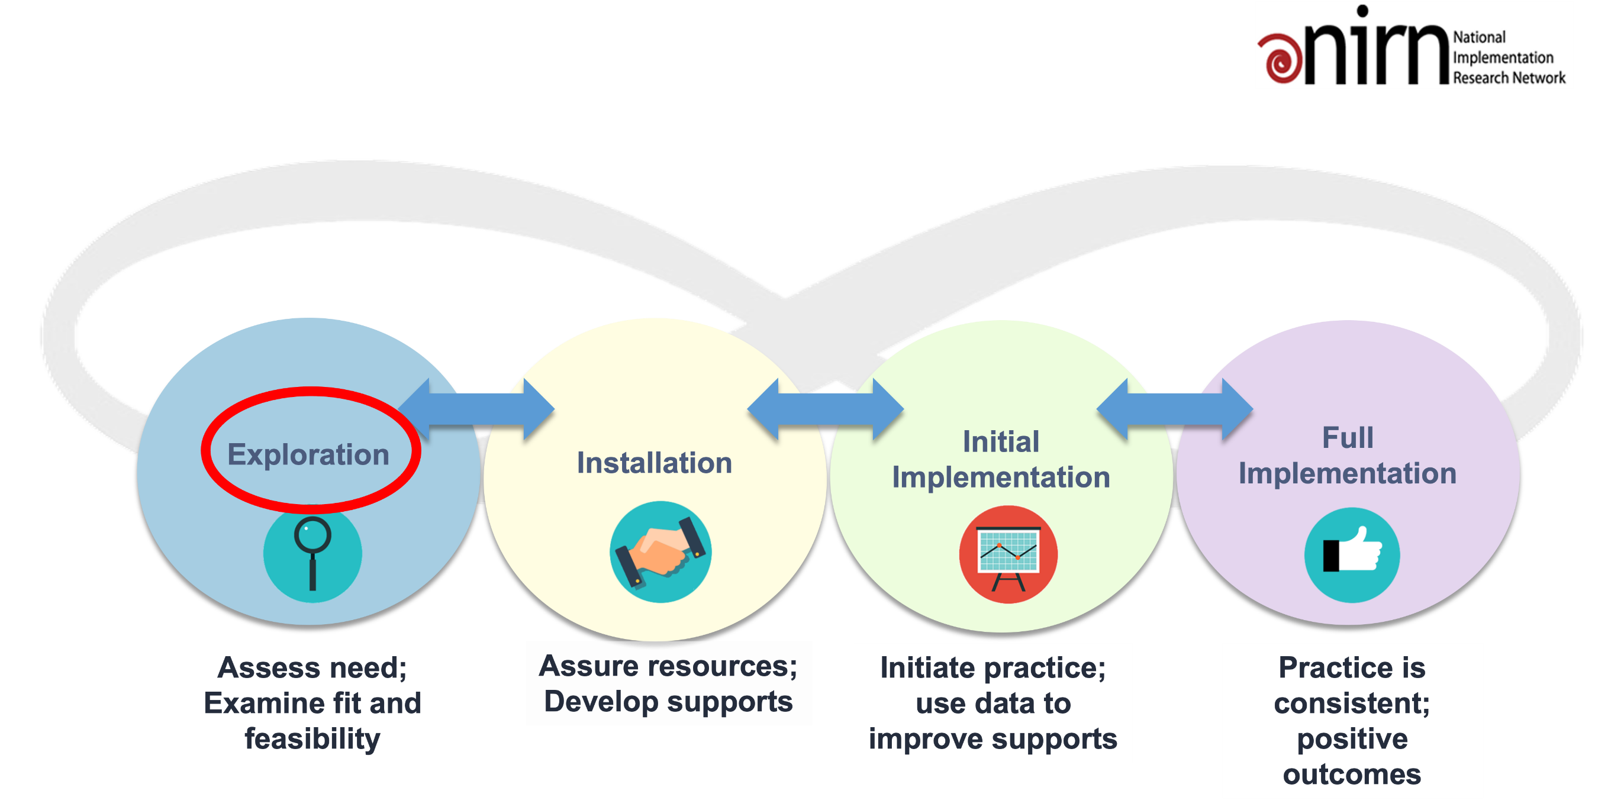
Implementation Stages
Notes:
Time: 2.5 minutes
Talking Points
Last week we discussed the 8 steps for implementation. We will see those slides again soon. This is a different visual to represent the process of implementation. As you can see, we are currently in the “exploration phase.”
This visual emphasizes that implementation is not always a smooth process that goes in a straight linear process. You may have to revisit other steps, even after fully implementing the strategy.
Right now, you’re likely here to explore what’s available to you in this project. You likely see areas that need attention in your organization based on the data we just explored. So, what is a good strategy for you to start using to address the strategy. This is the key question of ”exploration.”
“Installation” is when you are ensuring you have the resources (including time and staff) and support for the strategy or practice that you want to use. This is when you start planning and communicating.
Initial implementation is about those first steps you’ll take to implement the strategy. Prior to implementation, you’ll want to make sure you have an evaluation system in place to give you needed feedback about how things are going.
When you’ve been implementing for some time (maybe around 2 years or more), you’ll notice that a successful practice will become more consistent in how you do things. You’ll start seeing the positive outcomes that you’re expecting to see. However, we also know from research that things like staff turnover and lack of support can inhibit practices from reaching full implementation, or it can take longer to reach full implementation. Or perhaps things change in your organization, community, or state and you need to readjust the plan again.
Facilitator Note: [Slide used with permission from Caryn Ward (Julie Kramme received permission in May 2019).]

Slide 12
8 Steps for Implementation - Workforce Strategies
Step 4
Step 3
Identify
barriers to implementation
Step 2
Identify components of the strategy
Step 1
Select an intervention strategy
Identify and assess the problem
Larson & Hewitt, 2005
Notes:
Time: 2 minutes
Talking points:
And here are the 8 steps of implementation that we started talk about last week. We will refer to them throughout today and in future consultations as you implement workforce strategies.
These 8 steps are the foundation for our work together.
Our goal is that you will be able to understand when you will be using each step and as you start to think about your next steps.
Last week we dove deep into how you can identify and assess your organization’s challenges. This week, we will focus on steps 2-8.
Looking at these Steps
Using the Self-Assessment Workbook and your organization’s profile, you should be able to Identify and assess your current challenges and think about what is going well in strategies you are using or what strategies could use some improvement.
After identifying the workforce issue, you want to first address, you will select an intervention strategy. Today we will be giving a brief overview of those strategies.
We have webinars on each of the tools available to you to watch at any time at tenncare.ici.umn.edu. These webinars are more in depth and will be a great resource for your team and will help you not only select your strategy, but also will help you with step 3: Identifying components of the strategy.
After you have selected an intervention, you will consider Steps 3,4 & 5, which are to identify components of the strategy, identify the barriers to implementation and identify the support that you have for implementing the strategy.
Facilitator Note:
Continued on next slide

Slide 13
8 Steps for Implementation - Workforce Strategies - continued
Step 8
Step 7
Evaluate success
Step 6
Implement
the strategy
Step 5
Set goals,
measure progress & establish a time frame
Identify support for the strategy
Larson & Hewitt, 2005
Notes:
Time: 45 seconds
Talking Points:
In the sixth step you will decide on your goal, how you will measure your progress and establish a time frame that works for you organization. We will be reviewing a worksheet in the Self assessment workbook for you to utilize to help you with this.
Next is the implementation of strategy and finally evaluating if the strategy was successful. As mentioned earlier, you may have to go back and revisit steps as situations change.

Slide 14
Workforce Initiative Timeline-Cohort 3
Workforce Initiative Timeline-Cohort 3
OCTOBER 2021 | NOVEMBER 2021 | DECEMBER 2021 | JANUARY –FEBRUARY 2022 | MARCH–JULY 2022 | AUGUST 2022 and beyond
GETTING STARTED Email invitation to kick-off events Identify key contacts, potential team members SESSION ONE: Kickoff workshop Workforce Initiatives Overview Understanding your data: Overview of Survey Results, Profiles and Interpreting Data Introduce Self-Assessment Workbook & Eight Steps of Implementation | SESSION TWO: Kickoff workshop (cont’d) Assess your needs: Evidence Based Practices and Organizational Capacity Overview of TennCare Workforce Toolkit: Recruitment, Selection and Retention Planning your next steps: Measuring Outcomes of Implementation and Creating a Practical Action Plan for Change Collaborative Consultation Conference | SELF-PACED AND ENGAGEMENT Complete Self-Assessment Workbook Review toolkit & view webinars Confirm organizational readiness (begins) Collaborative Consultation Conference (cont’d) Participate in Community of Practice | ENGAGEMENT Organization consultation virtual meetings begin Participate in Workforce Development Workshops | ENGAGEMENT Organization consultation virtual meetings Organization Team implement the strategy (begins) Participate in Regional Community of Practice Participate in Year 4 2021 Survey | ENGAGEMENT Participation in Community of Practice Year 4 2021 Survey Results Participate in webinar to review Year 4 – 2021 Survey Organizational Profile
Notes:
Time:
Talking Points
Let’s take a look at the Timeline for the Workforce Initiative for this cohort, also on page 18 of your self assessment workbook.
In October
You were invited to the Kick-off that started on Oct 27.
You have received your organizations’ profile at the kick-off, and you were introduced to the Self –Assessment Workbook.
You will also begin to consider the level of technical assistance that your organization prefers. You will learn more about this in a bit.
In Nov Part 2 of the Kick-off.
Through-out the workshops you have been and will be learning how to use the self assessment workbook .
You will make decisions on the level of technical assistance you want.
During this time, you will have access to and can begin to watch the toolkit webinars on Recruitment, Selection and Retention.
Action plans will be started.
In December
You complete the Self- Assessment workbook and review what you have learned with your team. Organizations will be assessing and confirming their readiness.
You will have the option to participate in the Community of Practice, which you will hear more about later today.
From January and February
Organizations who decide to have individual technical assistance will begin these virtual consultations with your MCOs.
Organizations will have the opportunity to participate in Workforce Development Workshops
March through July organization will be working on their implementation of their action plan with technical assistance as desired.
Organization virtual consultations continue or begin.
The organizations workforce team will decide on and begin to implement a strategy.
Organizations will have the opportunity to participate in the Year 4, 2021 Survey.
You will be invited to participate in the Regional Community of Practice , which will occur about ??? Times a year. More to come on that later.
August and beyond
You will receive the Year 4, 2021 survey results for your organization, your region and the state.
We will have a webinar about the Year 4, 2021 results
You will be invited to continue being supported through the community of practice.
During this year, your organization will be moving through the 8 steps of implementation at your own pace. And with still being in the pandemic, we know that priorities shift according to what is occurring with COVID-19 and the people who accept services from you and the people who provide services.
This timeline and the 8 steps are included in the Self Assessment Workbook
Are there any questions?

Slide 15
Intervention Strategies
Step 2 – Select an Intervention Strategy
Notes:
Time: 5 seconds
Transition slide
Talking Points:
Let’s move into step 2 of the 8-step process, selecting an intervention strategy

Slide 16
Workforce Strategies
Recruitment Strategies | Selection Strategies | Retention Strategies
Effective Marketing Public service announcements (PSA) Targeted recruitment marketing Recruitment (or referral) and new hiring bonuses Recruitments sources (Inside, outside and pipelines) | Structured behavioral interviews Realistic job preview | Orientation and onboarding Competency-based training Employee Development Job Analysis Job Descriptions Recognition Programs Coaching & Mentoring Mentoring Performance coaching Networking Employee Engagement & Organizational Participation Professional Development Developing career paths Professionalizing DSP roles Wage and Benefit Policy Change
Notes:
Time: 4 minutes
Talking Points:
These are the three major sections of workforce strategies.
Recruitment is how you market positions and bring people to apply to your organization.
Effective Marketing includes
Public service announcements (PSA)
Targeted recruitment marketing
Recruitment (or referral) and new hiring bonuses
Recruitments sources (Inside, outside and pipelines)
Selection is how you select applicants to become employees. Selection is often overlooked, as many organizations have more positions open than applicants. However, having a proper selection process that helps you find the right candidates for positions can save you training money and time, in the long-term. The two main areas that we are going to focus on are:
Structured behavioral interviews
Realistic job preview
Retention is how to orientate and onboard new staff, how you develop them as employees and how you keep them engaged in the organization.
Orientation and onboarding
Competency-based training
Employee Development
Job Analysis
Job Descriptions
Recognition Programs
Coaching & Mentoring
Mentoring
Performance coaching
Networking
Employee Engagement & Organizational Participation
Professional Development
Developing career paths
Professionalizing DSP roles
Wage and Benefit Policy Change
We do know that all these areas really do connect and are depended on each other for success. Where an organization may be very strong in one area, they may have room for improvement in another.
As you look at your data and your current strategies, this is our opportunity to support you in understanding where you can start.
During this session we will briefly review the resources we have available to you on the toolkit. This will allow you to dig deeper into the workforce strategy you choose to implement. You can work with MCO coaches to review your data, select a strategy, and implement the strategy when you are ready.

Slide 17
Evidence-based Practice and Organizational Readiness
Reflection: Section 1: Assessment and Using Workforce Data
Notes:
Time: 45 sec
Talking Points:
We are going to begin to talk about evidence-based practice and organizational readiness.
It is common for organizations to go from identifying a problem to implementing a solution without including steps for assessment, measurement and evaluation.
The research tells us that following the 8 steps of implementation matters and that it really can take time. You won’t see the changes immediately.
If you have tried a strategy in the past, but didn’t have the support, time, or staff to implement, or you didn’t know what your goal was – in other words, you didn’t know how you were going to measure success, you are unlikely to see the changes you hope to see.
Transition to next slide

Slide 18
Self-Assessment Workbook
Section 2: Organizational Capacity and Processes
Notes:
Time: 5 seconds
In your self-assessment workbook turn to page 5.
You’ll get a chance to think about your organization’s current practices and reflect on where you’re at.

Slide 19
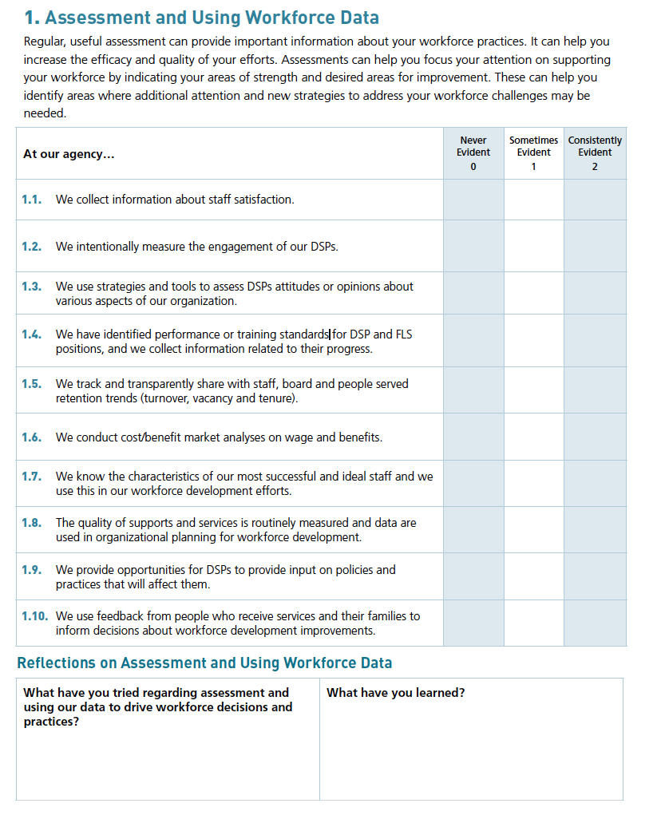
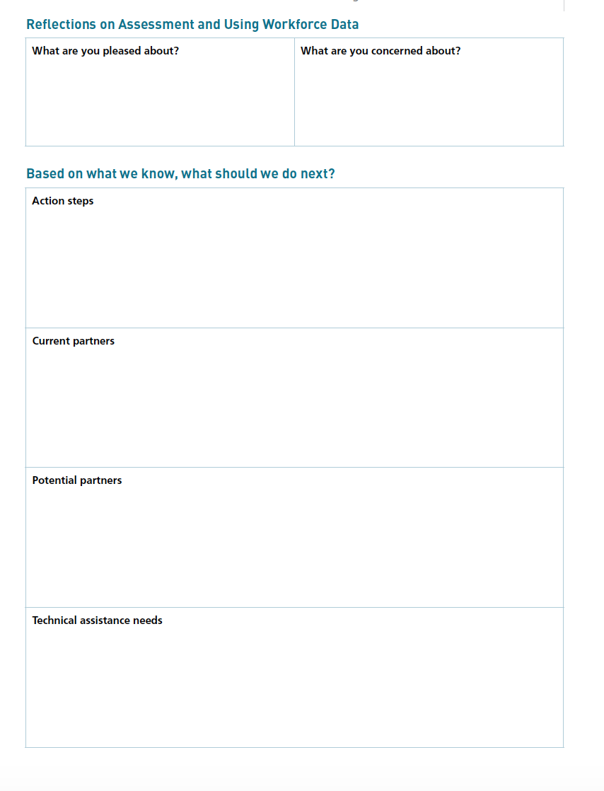
Self-Assessment Workbook section 1. Assessing and Using Workforce
Notes:
Time: 12 – Doing activity
Talking Points:
Last session we asked you to complete section 1 of your Organizational Self-Assessment on Assessment and Using Workforce Data. It looks like this.
Using the thumbs' up reaction, you were able to review this over the last week? I understand you have full schedules. I just wanted to check in to get a sense of where the group is at.
We will have two things we will go here based on if you have completed the assessment or not.
We will take about 10 minutes to the time to do this activity.
If you have already completed it, please review your responses. Is any thing surprising to you? Take another look at your responses. Is there anything else to add or change? If you are here with a teammate discuss your responses.
For those who haven’t had time to do it we will read through the 10 questions and give you a little time to answer them. We will also have sometime to start the reflections and what you should think about doing next based upon what you have learned.
Facilitator Note: read questions 1.1 to 1.10 and allow time for participants to answer in their workbook.

Slide 20
Self-Assessment Workbook section 2. Organizational Capacity and Processes
Notes:
Time: 12 minutes – do the activity
Talking Points:
An important part of the first step of the 8 steps for implementation is reviewing each section of the self-assessment workbook. These will be important to complete with your team before implementing a strategy as you plan your next steps.
Section 2 looks like what you are being shown on your screen and is on page 7. It is about organizational practices and processes. This section gives you more of an idea as to your organizational capacity for change.
Let’s take a few moments for you to answer questions 2.1 – 2.6.
Facilitor Notes: Facilitor as you did on the previous slide, (except everyone will be filling this out together). Give them time to do the reflections as well as Based on what they know now, what should they do next..
This can either be individually or with the organization.

Slide 21
Reflecting on Your Organizational Capacity and Processes
What is your organization’s capacity for change?
What processes are in place to respond to changes in workforce development practices?
Notes:
Time: 5 seconds
Talking point
Now that you have completed the Organizational Capacity and Processes assessment, is are important questions that you will want to come back to with you team to reflect on these two questions. They are pivotal to your next steps.
What is your organization’s capacity for change?
What processes are in place to respond to changes in workforce development practices?

Slide 22
Connecting Workforce Challenges & Strategies
Page 22 TN Workforce Initiative Organizational Self-Assessment Workbook
Notes:
Transition slide
Time: 5 seconds
Facilitor Note
This last piece that we just did was to set the stage for connecting workforce challenges to the strategies/tools

Slide 23
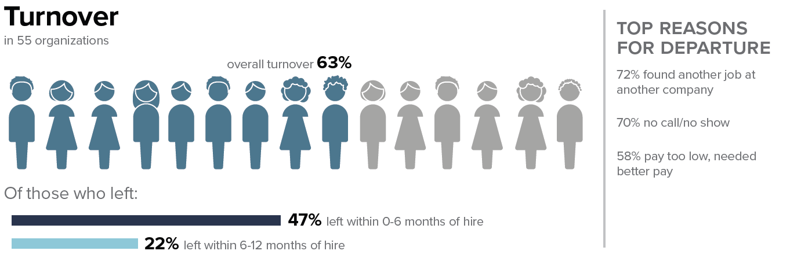
Implementing a Workforce Strategy
Notes:
Time: 1 minute
Those of you who joined us last week have had time to look at your profile. Your page on turnover will look similar to this.
For all of you, when you look at at your turnover for DSPs what do you see? Do you need to improve in this area? I suspect everyone answers yes to that questions.
There are tools and strategies you can use to improve those numbers.
We are going to give a quick overview about those recruitment, and selection and retention strategies.
You can use the webinars in the Tenncare Toolkit to learn about the steps and processes. We will share that website in a bit.

Slide 24
Poll Question #1 - What is the single most important workforce challenge you have today? (Select one)
Few qualified applicants/trouble finding new workers
Turnover rates are too high/New hires quit in first 6 months
New DSPs unsure of job roles and functions
Supervisors have difficulty finding the time to coach and mentor new staff
Lack of training opportunities
Poor Performance/Training doesn’t produce desired results
Supervisor reporting being overwhelmed, don’t know how to do their job
Morale problems
Conflict between staff and supervisors or managers
Co-workers don’t get along
Notes:
Time: 3 minutes
Poll
Talking points
If you have looked at your data and maybe even worked ahead in your self-assessment workbook, you can understand how it can inform your workforce activities.
You may have a good idea as to which workforce challenge is the biggest and most important challenge for your organization.
The Poll is asking What is the single most important workforce challenge you have today? Your answers are anonymous.
Facilitor Notes
Read slide.
In debrief poll, review results.

Slide 25
Activity
Matching challenges with Intervention strategies
Notes:
Time: 4 minutes
Talking Points:
You should have your organization’s profile in front of you, turn to page 22 in your self-assessment workbook. The page in the workbook should have a chart on it, like the one on your screen.
In the poll you just took, we asked you to identify the single most important workforce challenge your organization is facing, the challenge most of you selected was [facilitator insert challenge with most votes] if you locate that challenge in the far-left column, then look in the column just to the right, you see a number of strategies that you might consider or for some of you already doing that align with that challenge.
As you read along, feel free to take your own notes, you might highlight strategies you've already tried or circle those you're interested in learning more about. This is an activity that you can take back to your organization and review with others who are working with you on workforce development.
We wanted you to see the connection between workforce challenges and strategies to consider as you work through your 8 steps to implementation.
Facilitator Note: You can walk through this worksheet with participants using the poll responses to guide which challenges to review and invite participants to follow along in page 24 for and note those strategies they have tried or circle those they are interest in learning more about. The intent of this activity is to set the stage for the organizations to see how challenges and strategies go hand in hand. .

Slide 26
Stretch Break
10 minutes stretch and refresh
Notes:
Time: 30 second then a 10-minute break
Talking Points
When we come back, we’ll talk about the strategies available to you.
Turn off video and audio when you leave. Turn video back on when you return so we know you are back.
Facilitor Note
To check in with folks who don’t have their video on, ask for reactions

Slide 27
Questions?
Questions?
Notes:
Time: up to 6 minutes
Talking Points
We have a little time for questions.
When you think about the material we just covered, what are you wondering about?

Slide 28
Planning Your Next Steps:
Measuring Outcomes of Implementation and Creating a Practical Action Plan for Change
Notes:
Time: 45sec
Talking Points:
Today we have given you a brief 10,000-foot overview of the tools for recruitment, selection, and retention.
We have provided you with the TennCare Toolkit so that you can go at your own pace with the tools that you want to learn more about and possibility use.
Next, we will be talking about next steps, and giving you resources for creating your own workforce development action plan.
We will also be reviewing the options you have to work in collaboration with your MCOs moving forward.

Slide 29
Goals for Part 4
Explore the connection between assessment and evaluation
Learn about methods and practices for evaluating success in implementing workforce strategies
Learn about the regional workforce communities of practice that the role of the TN Workforce Coaches and UMN Consultants
Begin to prepare for first meeting with Workforce Consultants and Coaches in January.
Notes:
Time: 1 minute
Talking Points:
Our goals for the last part of the Kick-off are focused on getting you ready for taking your next steps.
We are going to take a look closer at the implementation process to better understand the connection between assessment and evaluation. You will start to think about what will success look like?
You will start to think about how you will measure your progress during implementation of the workforce strategy that you’ve selected.
We will also share information about the workforce community of practice in each region, that will support your efforts to improve workforce stability in your organization.
Finally, you’ll have a chance to being to prepare for your first 1:1 meeting with the MCO workforce coaches, if you so choose.
This final session will be more of a working session with time for you to reflect on where you’re headed.

Slide 30
Review of Intervention Strategies
Step 2 – Select an Intervention Strategy
Step 3 - Identify components of the strategy
Notes:
Time:
Timing for section (slides 11-12): 2 minutes
Let’s move into step 2: selecting an intervention strategy

Slide 31
Workforce Strategies
Recruitment Strategies | Selection Strategies | Retention Strategies
Effective Marketing Public service announcements (PSA) Targeted marketing Recruitment and hiring bonuses Recruitments sources | Structured behavioral interviews Realistic job preview | Orientation and onboarding Competency-based training Employee Development Job Analysis Job Descriptions Recognition Programs Coaching & Mentoring Mentoring Performance coaching Networking Employee Engagement & Organizational Participation Professional Development Developing career paths Professionalizing DSP roles Wage and Benefit Policy Change
Notes:
Time: 30 seconds
Talking Points:
Before we look at the next sections in the Self-Assessment workbook, I just wanted to show this slide to remind you that there are different tools or strategies that can be use in the areas of Recruitment, Selection, and Retention. You will want to think about the strategies your organization uses when you complete the assessments in these areas.

Slide 32
Self-Assessment Workbook section 3: Recruitment Practices
Notes:
Time: 12 minutes for this Activity
Talking Points:
Again, page 10?? of your Self-Assessment workbook you are able to examine your current recruitment practices. We’ll go through page 10 now.
Facilitator Note: read each question and allow time for participants to answer in their workbook.
Do you know where your DSPs are being recruited from and what recruitment strategies you are already using?
When you look at your scores, are you doing more than you realized?
Do you see areas that you may want to explore more?
My yourself complete the reflections on the bottom of the fist page and top of next page.
If you have time start the next section “Based on what you know, what should we do next
Facilitator Note:
People can either work individually on with their team on the reflections and what should we do next.
Whole activity needs to be done in 12 minutes max.

Slide 33
Self-Assessment Workbook section 4: Selection Practices
Notes:
Time: 12 minutes
Talking points
Section 4 looks like the images on your screen. Section 4 is about reflecting on the selection practices that can support your efforts and processes you may already have in place. This is intended to be a discovery tool to help you explore what you’re already doing and areas where you might want to put some attention as you move forward.
Facilitor Note: Lead the activity the same way you did on previous slide.

Slide 34
Self-Assessment Workbook section 5: Retention Practices
Notes:
Time: 12 minutes
Talking Points:
Section 5 of the self assessment workbook looks like the images on your screen. Section 5 is about reflecting on the organizational practices and processes that can support your efforts and processes you may already have in place. This is intended to be a discovery tool to help you explore what you’re already doing and areas where you might want to put some attention as you move forward.
Facilitor Note: Lead the activity the same way you did on previous slide.

Slide 35
Toolkit Link: tenncare.ici.umn.edu
Notes:
Time: 5 minutes
Share tenncare.ici.umn.edu browser on your screen – navigate through the toolkit and explain where the tools can be found.

Slide 36
Creating A Practical Action Plan for Change In Your Organization
Step 6 - Set goals, measure progress & establish a time frame
Step 7 – Implement the strategy
Notes:
Time: 1 minute
Talking Points:
When you’re thinking about steps 6 and 7. This is where you plan for and implement the strategy you choose, and it may be intimidating. You may want to consult with your MCO workforce consultants to as you develop your action plan and start to implement an evidence-based practice or strategy.
It’s important at this point that you have a clear vision of the change you want to see, both short-term and long-term. These will both look different.
Consider how you are going to ensure staff buy-in and feasibility for implementation.

Slide 37
Methods for Taking Action
Section 2: Organizational Capacity and Processes
Notes:
Time: 15 seconds
Talking Points:
We’ll talk about methods for taking action at your organization, including what you can do today and what you will take back to your organization

Slide 38
Change Strategies
How direct support professionals are:
recruited,
selected, and
on-boarded
trained
Aim: Improve the likelihood that employees you hire will be able to meet the needs of the individuals being supported.
Notes:
Time:
Talking Points:
We know its all a lot to think about. Making changes in how an organization does things can take time and isn’t without its challenges.
Let’s not forget that real reason you’re a committed to improve the workforce situation at your organization. It is for the people you support. They are the reason for making changes to how you recruit, select, orientate and onboard, as well as train and support DSP. These changes should result in improving the likelihood that employees hired will be able to meet the needs of the individuals being supported as well as improve staff retention

Slide 39
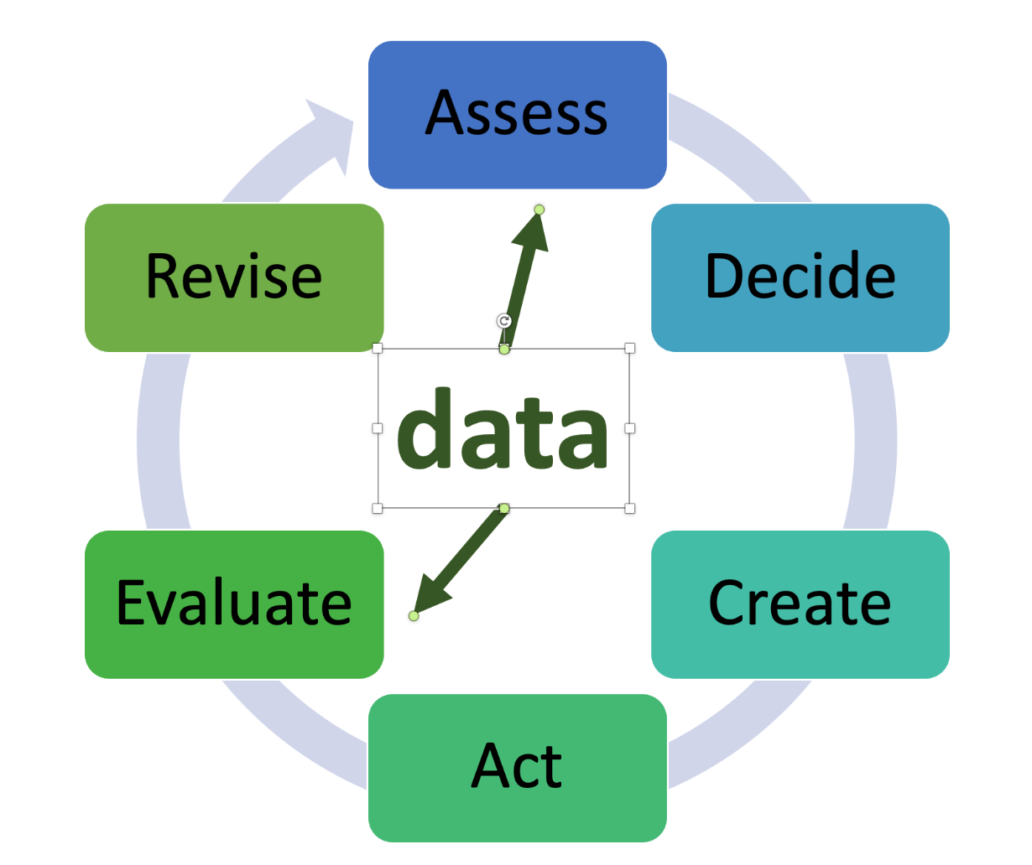
The Change Process
Assess to Identify Problems and Successes
  Know the scope and nature of the problem(s)
  Make sure you also maintain what is going well for continued success
Notes:
Time: 45 seconds
Talking Points:
The change process is a cycle that includes:
assessing the situation,
deciding what is the greatest need,
planning a strategy to address the need,
acting to put the plan into action,
evaluating the results, and
revising the plan based on the evaluation.
We will focus on strategies and information that will help you in the assessment and evaluation phases of the cycle for Direct Support Professional Workforce issues.

Slide 40
Why is an Action Plan important?
Create a strong vision regarding the importance and outcome of change.
Find a leader or group of leaders who are interested and invested in change.
Give the planning and development process sufficient time and resources.
Set target completion dates within the plan for the achievement of specific goals.
Plan to revise and update the plan itself on a regular basis.
Notes:
Time: 45 seconds
Talking Points:
To create change you need an action plan. An action plan can…
Help create a strong vision the importance and outcome of change
Helps you find a leaders who are interested and invested in change
Gives the planning and development process sufficient time and resources,
It helps you set target dates for achieving specific goals
It helps the team make a plan for when and why you will update and revise the plan on a regular basis. We need to comeback and revisit what is happening with the plan so that we can be proactive in taking action.

Slide 41
Organization Self-Assessment Workbook
Pages: 26 – 27
Action Planning Worksheet
Notes:
Time: 15 seconds
Talking Points:
The action planning worksheet can be used to develop your strategies and divide the work among your team. You may already have a strategic plan, but the action planning worksheet will provide a more detailed plan for you to implement with your team.

Slide 42
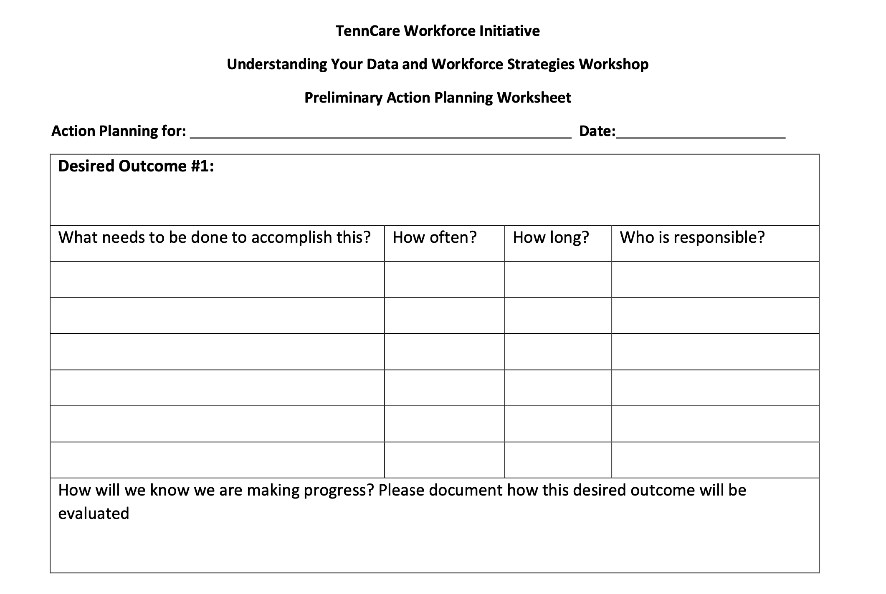
Preliminary Action Planning Worksheet
Notes:
Time: 15 seconds
Talking Points:
Turn to page 26?? in the Self Assessment workbook
This action plan is a good start for any plan to help you move forward in implementing a strategy.

Slide 43
Preliminary Action Planning Worksheet – Desired Outcome #1
Notes:
Time: 2 minutes
Note to facilitators: Give time to fill out each part of this slide (2 min/slide). Come up with your own “desired outcome” (example: improve orientation and onboarding to reduce 6 month turnover).
Talking Points:
How many of you are starting to think about action plans? You may already have a similar planning process within your organization that you will use. For others, using the action planning worksheet on page 26-27?? may be a way to bring focus to some of your current and future workforce activities.
We will be working through the different areas of the action plan together.
First, we will take a minute or so for you to identify what the strategy is and the desired outcome. Page 24?? in the self assessment workbook can give inspiration or ideas for desired outcomes.
Give 1 minute

Slide 44
Same worksheet as last slide – What needs to be done to accomplish this?
Notes:
Time: 2 minutes
Note to facilitators: Give time to fill out each part of this slide (2 min/slide). Come up with your own “desired outcome” (example: improve orientation and onboarding to reduce 6 month turnover).
Talking Points:
Jot down one thing that needs to be done to accomplish your desired outcome.
Then how often it needs to be done and for how long along with who is responsible for it.
We will give you a minute.

Slide 45
Same worksheet as last slide – How will we know we are making progress? Please document how this desired outcome will be evaluated?
Notes:
Time: 2
Now, how will you know you are making progress? This is where you think about measuring the desired outcomes that you want as a result of the strategy you chose.
If you aren’t sure how to measure your outcomes, we will be talking more about this later today
I suggest including when and how often you will evaluate it as well.

Slide 46
Stretch Break #2
Take 10 minutes to stretch and refresh
Notes:
Time:
Talking Points:
Turn off video and audio when you leave. Turn video back on when you return so we know you are back.
To check in with folks who don’t have their video on, ask for reactions

Slide 47
Evaluating Success
Workbook Section 6: Evaluation Practices
Notes:
Time: 1 minute
Talking Points:
Let’s talk about how to evaluate. It’s important to see what assessment tools you already have in place that you can also use to evaluate progress.
Evaluating any implemented workforce strategy is essential to ensure the efficacy of your efforts. It provides needed feedback for your implementation team about your progress toward the desired outcome we discussed earlier. Collecting baseline information that is useful for informing your efforts and regularly collecting and reflecting as a team upon information related to your progress is needed. This practice will help you determine when you need additional supports, to shift directions, or to stay the course so that you can remain on track to achieve your goals.

Slide 48
Why Assess?
Identify staffing challenges
  Site specific challenges can be important (consider site-by-site assessments and data collection)
Select strategies to address challenges
Use baseline data to track which interventions are working
Notes:
Time: 1 minute
Talking Points:
We can use assessment in different ways. For example, you already have workforce data for your organization; however, you may want to drill down and look at assessment of the problem at the site level. The Retention Trends and Summary worksheet on page 22?? is a resource for you to use to understand turnover and retention at a site level.
Assessments can also help in the selection of strategies and be used as baseline data to track which strategies or interventions are working or not working.

Slide 49
Which types of data do you already collect?
Retention Trends
Attitudes or Opinions
Performance or Training Standards
Cost and/or Benefits
Notes:
Time: 2 minutes, 15 seconds
Talking Points:
Depending on the type of intervention that you implement, these additional types of data might be essential pieces of evaluation to support its success over time. For example, you might want to survey or hold focus groups to learn more about staff satisfaction. You might want to collect exit interviews, as possible. You might already collect important data on performance or training standards that would help inform your efforts, including performance reviews, training needs assessments or job analyses.
Finally, especially important to administration and boards when implementing a new initiative is providing cost and benefits analysis. What is meant by this is keeping track of staff and resources needed to implement an intervention and the cost savings that result.
It is estimated that it costs between $3000-5000 to replace each DSP that turns over. An intervention that increases retention can result in exponential cost savings for your organization when it results in staff that stay longer in the job. For example, a credentialing initiative in an organization in another state was relatively resource heavy for the organization. However the increased skill and retention of those staff has kept the program running over more than a decade of funding cuts and shifts experienced in the organization. It is now viewed as a retention strategy that they cannot afford not to do.

Slide 50
Using your data
Baseline
Ongoing monitoring
Periodic Review
Notes:
Time: 1.5 minutes
Talking Points:
It’s important to think about data collection before you start a strategy.
One note on assessment is to collect information about where you’re currently at – before changing anything about your current practices. This is your “baseline’ measurement.
Plan to measure your progress over time – figure out how frequently it would be helpful to monitor your progress (and remember to be practical). You’ll have the opportunity to participate in the Year 4 (2021) survey next spring, but you might want to set up a spreadsheet or report with some meaningful data by quarter or month to help your team better understand your progress. We’ll talk more about this when we talk with you about evaluation.
The third component is to set aside time to review your data. Its important to not just collect your data, but to use it to help you inform your efforts. And most importantly, you can use the data you collect to celebrate your successes. Some organizations also like to provide their data for stakeholder and share with others about the successes of their efforts.
This can really tell you if a strategy is working and if you need to make changes to the strategy.

Slide 51
Self-Assessment Workbook section 6: Evaluation Practices
Notes:
Time: 30 seconds
Talking Points:
On page 16 of your Self-Assessment workbook we ask you to examine your current evaluation practices. It looks like the images on your screen
Section 6 is about reflecting on the organizational practices and processes that can support your evaluation efforts and processes you may already have in place.
This is intended to be a simple tool to help you start thinking about what you’re currently doing.
Facilitator Note
There will not be time to do the activity – it would take about 12 minutes.
Optional activity: read each statement and give time for providers to fill out form.

Slide 52
Preliminary Action Planning Worksheet: How will we know we are making progress? Please document how this desired outcome will be evaluated
Notes:
Time: 15 seconds
Talking Points:
When you have your evaluation methods to measure your progress, you can fill that in on your action planning sheet on page 26-27 if you haven’t already.

Slide 53

Image of floodwaters washing away a highway
Notes:
Time: 15 seconds
Timing for section (slides 31-36): 7-15 minutes (depending on optional activity)
Talking Points:
After everything we have cover in both session , it might be hard to determine next steps and may feel like the road has given out.
We are looking forward to working with each of you one-on-one to determine the new road ahead.

Slide 54

Image of road sign “new road layout ahead” with smooth road in county side
Notes:
Time: 1 minute
Talking Points:
When one road washes out, we pause, look at our map and then find a new route to our destination. If I’m using my handy GPS there would likely be several prompts to make a U-turn at the next light to resume original route, but eventually even the GPS person gives up and maps out a new route to my destination.
Some things to consider during your process:
Planning takes more time than you think.
Learning curves are a real thing!
New training environments/platforms requires learning new technical skills.
Connecting in a virtual environment can work.
Everything takes 3 times longer than what we think.
Communication and reminder prompts work

Slide 55
Moving Towards Improvement
Reflections for Improvement Activity
Notes:
Time: 5 seconds
Talking Points:
Transition slide
It’s important to keep everything we’ve discussed today in mind for your plan to move towards improvement.

Slide 56
Poll Question #5
Which step is your organization at for implementing workforce strategies?
Step 1: Identify and assess the problem
Step 2: Select an intervention strategy
Step 3: Identify components of the strategy
Step 4: Identify barriers to implementation
Step 5: Identify support for the strategy
Step 6: Set goals, measure progress & establish a time frame
Step 7: Implement the strategy
Step 8: Evaluate success
Notes:
Time: 2 minutes
Poll
Let’s take a quick poll. - you can pick multiple answers. Your answer are anonymous. Read slide.
In debrief poll, review results.
Ask: Anything surprise or jump out at you – spend no more than 3 minutes on this-watch/resist the deep dive conversation

Slide 57
Workforce Initiative Timeline-October 2021 through 2022
Workforce Initiative Timeline-Cohort 3
OCTOBER 2021 | NOVEMBER 2021 | DECEMBER 2021 | JANUARY –FEBRUARY 2022 | MARCH–JULY 2022 | AUGUST 2022 and beyond
GETTING STARTED Email invitation to kick-off events Identify key contacts, potential team members SESSION ONE: Kickoff workshop Workforce Initiatives Overview Understanding your data: Overview of Survey Results, Profiles and Interpreting Data Introduce Self-Assessment Workbook & Eight Steps of Implementation | SESSION TWO: Kickoff workshop (cont’d) Assess your needs: Evidence Based Practices and Organizational Capacity Overview of TennCare Workforce Toolkit: Recruitment, Selection and Retention Planning your next steps: Measuring Outcomes of Implementation and Creating a Practical Action Plan for Change Collaborative Consultation Conference | SELF-PACED AND ENGAGEMENT Complete Self-Assessment Workbook Review toolkit & view webinars Confirm organizational readiness (begins) Collaborative Consultation Conference (cont’d) Participate in Community of Practice | ENGAGEMENT Organization consultation virtual meetings begin Participate in Workforce Development Workshops | ENGAGEMENT Organization consultation virtual meetings Organization Team implement the strategy (begins) Participate in Regional Community of Practice Participate in Year 4 2021 Survey | ENGAGEMENT Participation in Community of Practice Year 4 2021 Survey Results Participate in webinar to review Year 4 – 2021 Survey Organizational Profile
Notes:
Time: 1 minutes
Talking Points
You have seen this slide a few times.
Based upon your answer to the poll, think about where you are in relationship to this timeline. We know that each organization is unique in what state you are at and what your next step is.
Have you completed the self-assessment workbook?
Is you next step to meet with the staff at your organization who are involved in workforce development and discuss the self-assessment?
Are you at the point where you are ready to spend some time with the TennCare Toolkit and watch some webinars?
Are there any questions?

Slide 58
Breakout Conversation
What problem/challenge does this organization need to address?
How big is the challenge? What is the baseline level of performance regarding this challenge?
What strategy would you propose to address this challenge?
What are the major components of this strategy:
  Who will be involved?
  What are the steps needed to implement?
  What are the possible costs associated with this strategy?
What are the main barriers to using this strategy?
What will be needed to enlist the support of stakeholders?
How will progress be monitored? What are the timelines?
How will the organization assess whether the strategy worked?
Larson & Hewitt, 2015
Notes:
Time: 2 minutes – 17 minutes if have breakout groups
Facilitator Note: Direct to open to the Challenge / Strategies Matrix on page 24? of the SAW
Talking Points:
If time, do breakout to answer these questions. Otherwise, talk through them before moving on. Use an example if you can think of one.
Many of these questions we have discussed before. These are all important questions to consider when planning for implementation. They will help you address any barriers you may have and plan for success.
Whether you are at the beginning of the process or you are already on your way, it is important to assess what is happening and how you will respond to it.
Based upon what you have learned thought your data and the assessments you have done. Look at Page 24, the Challenge / Strategies Matrix as you match your organizations challenge with a strategy that is an evidence based practice.

Slide 59
Your Next Steps
Notes:
Time: 5 seconds
Transition slide
Talking Points:
We will talk about your next steps and how we are able to support you.

Slide 60
Deciding on Next Step
Identify who will be part of your workforce team
Choose from the Menu of Technical Assistance Options
Complete your Organizational Workforce Self-Assessment (Online or workbook)
Check out Workforce Strategies and Tools on TN DSP Workforce Toolkit: https://tenncare.ici.umn.edu/
Register for the Community of Practice
Notes:
Time: 1 minute
Talking Points:
When you’re thinking about the next steps, these are some of the things we ask you to consider doing.
We’ll review them now.
Identify who will be part of your workforce team
Choose from the Menu of Technical Assistance Options
Complete your Organizational Workforce Self-Assessment (Online or workbook)
Check out Workforce Strategies and Tools on TN DSP Workforce Toolkit: https://tenncare.ici.umn.edu/

Slide 61
Organization Self-Assessment Workbook
Purpose:
To identify areas of strengths and areas of needed improvement in your respective organizations to build capacity to address direct support workforce issues.
z.umn.edu/TennCareSelfAssessment
Notes:
Time: 1.5 minutes
Talking Points:
The self-assessment workbook was intended to be an important discovery tool for your team to understand your areas of strength and areas for growth. This information is intended to help you and your MCO workforce consultant to understand your priorities and needs.
During the kickoff workshop, we have completed most of the workbook together.
The link on the screen is a place for your team to enter the information to provide you with an electronic record and to communicate with your consultants.
By completing the online self assessment workbook and submitting it, it will be easy for your workforce consultant to access your self assessment. Using you workbook is fine too.

Slide 62
Menu of Technical Assistance
Naveh Eldar
BlueCare Tennessee
Naveh_Eldar@bcbst.com
Joy Dalton
Amerigroup
Joy.dalton@Amerigroup.com
Nichelle Johnson
UnitedHealthcare
Nichelle_h_johnson@uhc.com
Robin Wilmoth
DIDD
Robin.wilmoth@tn.gov
Survey Data
Access to Workforce toolkit
Option to participate in Community of Practice
AND
Notes:
Everyone gets data, option for community of practice, toolkit, meeting with collaborative WFD team to determine level of engagement ( we will get the notes written for this)

Slide 63

Your Tennessee Workforce Coaches
Notes:
Time: 1 minute
Talking Points:
Your Tennessee Workforce Coaches are here to support you as you take your next steps.
If you today is your first day, we wanted to make sure you are familiar with the Workforce Coaches in Tennessee.
As noted on the last slide Naveh Elder is from BlueCare Tennessee also from Blue Care is Ashante Hodges.
Beulah Books is with Progress Inc., a provider in Middle Tennessee. She will be involved in the Communities of Practice that we will talk about in a minute.
Joy Dalton and Dana Scott are from Amerigroup
Faith Franklin and Nichelle Johnson are with UnitedHealthcare
And Robin Wilmoth is with DIDD.

Slide 64


University of Minnesota Consultants
Megan Sanders
Chet Tschetter​
Notes:
Time: 15 second
Talking Points:
The Tennessee Workforce Coaches have been collaborating with workforce consultants from the University of MN, and Megan and Chet have been involved in these Kick-off sessions.

Slide 65
Supporting Your Success
Notes:
Facilitator Note: Transitions slide
Time: 30 seconds
Talking Points:
We have focused on change and growth in these kickoff workshops. However, we also acknowledge the importance of celebrating what you have learned, tried, and what has been successful! We have created opportunity to celebrate your successes and be kept up-to-date on what’s going on in the Tennessee DSW through Communities of Practice.

Slide 66

Tennessee Regional Community of Practice
Purpose:
To continue to support the ongoing development, implementation and evaluation of workforce strategies that improve workforce stability across the state of Tennessee at the organizational, regional and state levels.
Notes:
Time: 45 seconds
Talking Points:
As this slide states, the purpose of the Community of Practice is to continue to support the ongoing development, implementation and evaluation of workforce strategies that improve workforce stability across the state of Tennessee at the organizational, regional and state levels.
We know that we are stronger together and that we can learn from each other, but that can only happen when we are meeting to share out stories, and work together on solutions.

Slide 67
2021-2022 Regional
Community of Practice Schedule
  Who: All 3 Cohorts
  Where: Zoom. Register @ tenncare.ici.umn.edu/community-of-practice
  When:
    East – Monday, December 6, 2021, 10am -12pm CST / 11am - 1pm EST
    Middle – Thursday, December 9, 2021, 10am – 12pm CST / 11am - 1pm EST
    West – Tuesday, December 7, 2021, 2pm - 4pm CST / 3pm - 5pm EST
  2022 Community of Practice dates to be determined.
    Will occur in the months of March, June, September, December
Notes:
Time: 1 minute
Talking Points:
Our first COP for you to participate in is…read slide.
Later dates are not yet scheduled due to the nature of the pandemic, but COPs will occur on a quarterly basis in these months (read months)

Slide 68

Community of Practice-Sample Agenda
Welcome/Opening Round
Regional Workforce Updates
Organization Sharing-Facilitated Conversation
  What strategies have you tried?
  What did you like?
  What did you learn?
  What concerns do you have?
  Based on what you’ve shared, what are next steps your organization might take?
Topic for Discussion
Celebration/Recognition of Workforce Successes
Wrap up/Next Meeting
Notes:
Time: 1
Talking Points:
This is an example of a COP agenda to give you an idea of what we will be talking about during the two hours.
Facilitator Note: Talk though the parts of the agenda if time allows.

Slide 69
Your next steps
1) You will receive the slides from today’s workshop so that you can have further discussions about the information in this session.
2) Your Tennessee Workforce Coach will contact you to talk about the Technical Assistance your organization decided to utilized.
Notes:
Time: 30 seconds
Facilitator Note: improvised based upon the amount of time left. Take questions if time, otherwise give contact info. Need 2 minutes for the last slides.

Slide 70
Kickoff Workshop Evaluation
Please share about your experience:
Type in your browser:
https://z.umn.edu/Cohort3Kickoff
Notes:
Time:
Talking Points:
Please take a minute to share with us about your experiences and any recommendations for the Kickoff Workshop. This will help us understand what was helpful to you as well as ways we can improve the experience in the future.
Type the text into your browser and complete the survey there.
Give 5-10 min for this slide.

Slide 71
Thank you
We look forward to connecting with you in December!
Notes:
Time: 5
Thank you and talk to you soon.

