Slide 1
Prep Slide ONLY
Description For Learning Lab Workshop
Developing a Score Guide for the Structured Behavioral Interview
The questions asked in a Structured Behavioral Interview are critical to communicating with the candidate about the job, the culture and mission of the provider. Knowing what you are looking for in response to an interview questions is equally important. Learn how to develop and use a Score Guide as a part of the interview process.
Notes:
Prep slide only

Slide 2
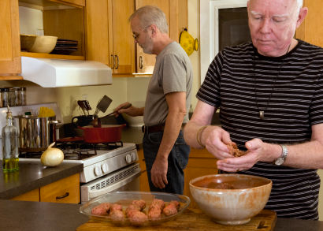
Presenter Prep Slide Only
Notes:
To Prepare:
Turn on Live Transcript and record if applicable
prepare (Name of Learning Lab) and PDF of slides (without notes) to put in chat
Slide #2 – Update presenter names
Check that the presenter can share their screen
Prepare polls/breakout groups if a large group
Assign an attendance taker, timekeeper, chat monitor
Note to Facilitator:
Bold Text = Timing
Italicized Text = Notes – do not read
Regular Text = Talking Points

Slide 3
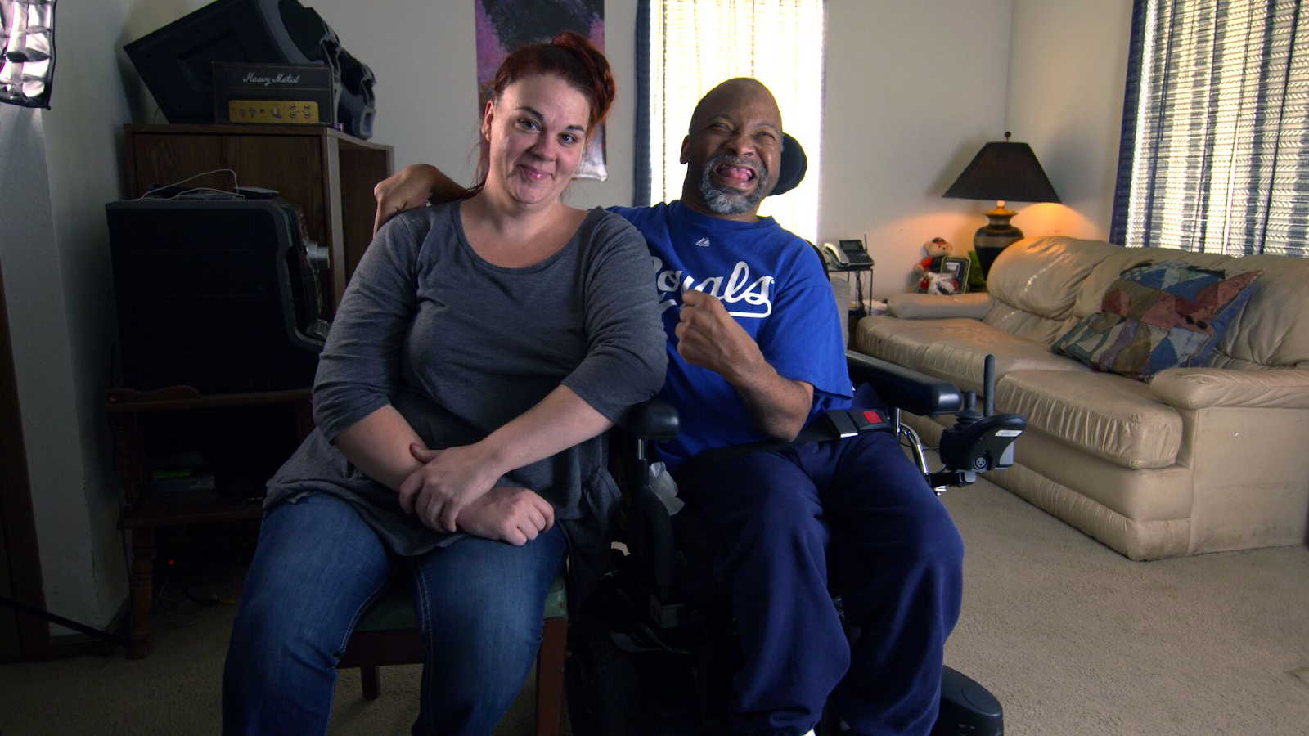
Employment and Community First CHOICES
Workforce QuILTSS Initiative
Learning Lab
Developing a Score Guide as a part of the Interview Process
Presenter name and affiliation
tenncare.ici.umn.edu
Notes:
Time 1 minute
Talking Points
Welcome to our xx Learning Lab – xx
My name is xx and I am a xx with xx.
Acknowledge other UMN staff and the Regional Coaches (Don’t all on them for opening round)
Learning Lab is being recorded

Slide 4
Using Zoom
Your microphones will be muted when enter. Please keep them turned off unless you're speaking.
Name yourself
  First name
  Name of your organization
Use for questions or comments.
We will use “Reactions” such as “thumbs up” though-out the workshop.
Live Script
Camera on as you are able and comfortable.
Take care of your needs. If you need a break, take one.
Be Understanding of “co-workers”
Chat
Notes:
Time: 30-60 seconds
Talking Points:
Some of us are used to working on Zoom in a group, while others are less familiar.
Please keep your microphone on mute when you’re not speaking today to help reduce background noise. When you’re in breakout groups, feel free to unmute and discuss the topic within your group. If you are able, we’d appreciate it if you keep your video on today. Its important for all of us to be able to see and get to know one another in these meetings. We understand if you need to shut off your video for a few moments if you need to step away, but please turn your video back on when you return.
When you logged into Zoom today, you might have typed in a name for yourself. To help us get to know one another, we ask you to rename yourself with this information on your screen:
Your name, your organization name. If you are a group of people watching from one computer in an organization, you can shorten to first names and your organization name.
To do this, look on the bottom of your screen for participants, click on that and on the right side of your screen a white column will appear. Hoover over your name and two buttons will appear mute and more. Click on more, then click on rename. Rename yourself then click OK.
The Chat function is at the bottom of the page. It looks like a little speaking bubble. If you have a questions or something you want to add to the discussion you can use Chat. We will be monitoring Chat throughout the session.
Using Chat to submit a question, simply click on the button that looks like this in your toolbar.
Please feel free to send questions at any time during the presentation. We will have time at the end for discussion and questions, so you can type them in the Chat feature and we’ll go over them at the end.
When you click on “Participants,” you’ll see some buttons to interact with the presentation. You can say yes, no, go slower, go faster, and when you click on “More” you will find that you can use the thumbs up or thumbs down buttons. You can also let us know if you need to step away for a quick break to use the rest room or fill your coffee cup. Suffering is optional.
When we take breaks, we do ask that everyone turn their camera during the break then turn it back on when you return or use reactions when you return so that we know when we are ready to start again.
Finally, we are all still working from home at the University of Minnesota. Explain “coworkers” you share your space with.

Slide 5
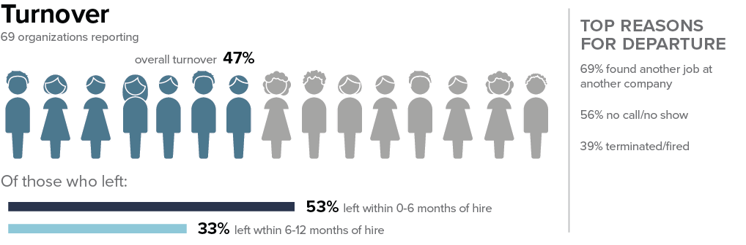
Early Turnover – State
Notes:
Time: 1-2 minutes
Talking Points
Why are we talking about this today?
We are taking about the Selection Process. We all know that questions asked in a Structured Behavioral Interview are critical to communicating with the candidate about the job, the culture and mission of the provider. Knowing what you are looking for in response to an interview questions is equally important. Learn how to develop and use a Score Guide as a part of the interview process.
Why does it matter?
This slide shows your 2019 data from Tennessee organizations who participated in our survey. From talking with providers in TN over the last year, I suspect those numbers are higher for 2020.
Most organizations that we work with in TN and across the country are struggling with staff retention. Many DSPs leave the organization within the first 6 months. This shows that 88% leave with in the first year.
Turnover like this has many negative effects. 1) support provided to the people the organization provides support to suffers, 2) staff turnover is tough on existing staff 3) costly to the organization.
You can see the reason’s staff give for leaving their role as a DSP. When providers were able to find out why DSP’s left to go to other jobs or company’s many times, they said 1) they didn’t realize what was expected of them as a DSP – it was harder than they expected. (personal cares, driving their own vehicle, the time away from their family on the weekend or the evening – wasn’t worth the low rate of pay 2) they could get paid more somewhere else, where the hours were better and there was less responsibility. 3) they weren’t a good match for the people they were hired to support.
We wanted to drill down today on how to develop the score guide because by using it as a part of the interview can help your organization be more consistent in the selection process.
Facilitor Note: Below is the Content from the Kick-off Workshop
Talking Points
We also included some tenure specific information related to turnover. In addition to reporting the number of DSPs who left in the calendar year, we asked you to report how many who left who had been employed between 0-6 months when they left, and those who had been employed between 6-12 months before they left. This formula for early turnover is also on page 19 of the workbook. It is calculated as a percentage of the DSPs who left.
In the state, of those DSPs who left the organization, 53% left with 0-6 months of hire. 33% who left had been employed between 6-12 months of hire.
What this can indicate is that more strategies are needed to hire DSPs with appropriate expectations about the job, and more support for training, supervision, matching or mentoring DSPs in the early months of the job. Over half of the workforce who left had been working for less than six months. Many who have worked as DSPs know that six months is not long enough to have learned this role, and when workers leave within six months of being hired this is likely to impact peoples’ quality of life and the morale of other workers. The good news is that there are strategies identified to help address these challenges over time.
As a note, if your organization did not provide any vacancy data for DSPs, turnover could not be computed. Turnover could be computed only if all the data points were provided. Otherwise, your profile will say “data not available.” if you can find the applicable data, you can use the formulas on page 19 of your workbook to compute any missing data points on the infographic.

Slide 6
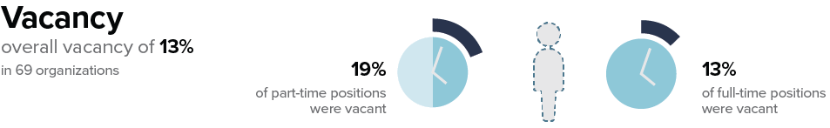
Vacancy - State
Notes:
Time: 30 seconds
Facilitator Notes
Use this slide if you feel like it is needed here or later based upon feedback.
Talking Points
Here are ways to keep in touch with us and continue your learning.
TN Statewide 2019
there was an overall vacancy rate of 13%. This means that 13% of DSP positions in the state were unfilled on the last day of the year.
Of note, there was a higher vacancy rate among part time DSP positions.

Slide 7
Open Round
Getting to Know You
Your name and role in the organization
What is one question you have regarding developing and using a Score Guide in the interview process?
Notes:
Time: 3-5 min
Facilitor note:
If more than 10 providers – use Chat Do not ask the MCO/Coaches or the UMN Staff
Talking Points
We would like to start with a little time to get to know you and see if you have any initial questions.
Please introduce yourself with the following: read slide

Slide 8
Takeaway for this Learning Lab
Understand why developing a score guide for the interview is important to reduce turnover.
How to develop a Score Guide for Structured Behavioral Interviews
Notes:
Time: 1 minutes
Talking Points
Our goal for today’s learning lab is read slide

Slide 9
Building & Strengthening the DSP Workforce
Recruitment Strategies | Selection Strategies | Retention Strategies
Effective Marketing Public service announcements (PSA) Targeted marketing Recruitment and hiring bonuses Recruitments sources | Structured behavioral interviews Score Guide Realistic job preview | Orientation and onboarding Competency-based training Employee Development Job Analysis Job Descriptions Recognition Programs Coaching & Mentoring Mentoring Performance coaching Networking Employee Engagement & Organizational Participation Professional Development Developing career paths Professionalizing DSP roles Wage and Benefit Policy Change
Notes:
Time: 30 seconds
Facilitator Note
Remind attendees to consider the problem they are trying to solve with this tool – explain where the strategy falls.

Slide 10
Consistency in Scoring
Studies show that the consistency of interview scoring
across raters can be increased if:
Questions are based on a job description and are closely related to the job
There is a written scoring guide
Interviews are scored question by question
An interview panel is used rather than a single rater to evaluate responses
Interviewers take notes during the interview
Notes:
Time: 1-2 minutes
Talking Points
You know that it is important to ask behavioral and situational questions in an interview, and to ask all candidates the same questions.
Using a Score Guide that is developed by the group of people who develop the interview questions (FLS, Best DSP, People Supported /Their families), is really a companion tool that is meant to be used whether just one person does the interview or if a team of people do the interview.
Using a score guide has some real advantages
Facilitator Notes
Talk through the points in the slide.

Slide 11
The Score Guide
After determining the interview questions, establish clear criteria for evaluating responses to the questions.
Involve your best performing staff, Frontline Supervisors, persons supported and their families, who develop the interview questions to develop the score guide.
Identify what is an excellent, good or poor response.
Document the score guide.
Everyone who interview uses it.
Notes:
Time 1-2 minute
Talking Points
Involve the best performing DSPs and FLS to develop the score guide.
Discuss and agree on a rating scale for question responses.
Many people use:1-3, 1-4 or 1-5 scale
Develop example responses for each questions
Score guides allow:
An interview panel to be consistent in scoring
A solo interviewer to be consistent with themselves.

Slide 12
First Example – Score Guide
Tell me about a time when you disagreed with a supervisor or teacher.
What did you do to handle the situation?
What was the outcome?
Notes:
Time: 30 seconds
Talking Points
You might use a similar question in your interviews, if not you may want to consider using it or some think like it. “Tell me about a time when you disagreed with a supervisor or a teach. What did you do in this situation? What was the result of your action?

Slide 13
First Example – Score Guide Rating Scale
when you disagreed with a supervisor or teacher.
What did you do 1 = Poor, 2 = Average or Okay, 3 = Excellent
Score of 1 = I knew their decision was wrong, so I confronted them to let them know it. They didn’t like that I did that. I decided to quit the job, so I didn’t have to deal with them anymore.
Score of 2 = I didn’t like their decision, but I could see their point of view. When I had a chance, I asked them about it.
Score of 3 = While I didn’t agree with it, I thought about how important it was. I decided that I could live with it but wanted to know if they understood some of the reasons why I saw it another way. I contacted my supervisor and asked for a time to talk about it. They agreed and, in the end, they stayed with their decision, but they appreciated that I contacted them and gave them some insight.
Notes:
Time: 2-3 minutes
Talking Points
You might use a similar question in your interviews, if not you may want to consider using it or some think like it. “Tell me about a time when you disagreed with a supervisor or a teach. What did you do in this situation? What was the result of your action?
I have set up a rating scale of 1-2-3
Here are examples of answers that the team developed that could be used for the behavioral question we looked at earlier. Read the Example responses.
While the candidate isn’t going to give the exact response – they may something similar – and that gives the interviewer a guide for how to score.
Interviewing is somewhat subjective; this helps us be more objective and precise with scoring.
When I was a camp director, we always had interview questions. But after the summer of 2005, we started to use a score guide, because we had 6 people interviewing with 6 different perspectives. We developed the interview questions together and we developed the score guide for each questions. This helped us to score answers similarly and make better hiring decisions.
We used a 1-5 scale. And together we decided that we could only hire people whose average score was 4 or 5. If there was a candidate who scored 1,2 or 3s, they were not offered a position. However, we said that if there was someone who scored a 3 and we were left thinking that there was something about them that make them a good fit for another position or if the interviewer decided to “take them under their wing” and give them a chance – the interview had to come to me (as the supervisor) and talk it over. We would make a decision.
Tell me about a time when you disagreed with a supervisor or teacher.
What did you do in this situation?
What was the result of your action?

Slide 14
Second Example – Score Guide
Image that you work on the same shift as a co-worker who you had difficulty getting along with. There is a task that you must do together on your shift each time you work.
What would you do in this situation?
What would you expect the result to be?
Notes:
Time: 30 seconds
Another example:
Image that you work on the same shift as a co-worker who you had difficulty getting along with. There is a task that you must do together on your shift each time you work.
What would you do in this situation?
What would you expect the result to be?

Slide 15
Second Example – Score Guide Rating Scale
Rate 1 = Poor, 2 = Average / Okay, 3 - Excellent
Score of 1 = I would avoid doing the task with them until I absolutely had to do it. Or I would try to do it myself without them. I would try to get it done
Score of 2 = I would work with the person to complete the task. I would negotiation with them on how we could best to complete the task in the best way possible. I would be respectful even if they were hard to get along with . We would get it done as assigned.
Score of 3 = The task needs to be done, so we need to do it, and I would talk this opportunity to get to the other person better. I would take with them about how we can accomplish the task together in the best way possible. I would keep in mind how the people we support benefit from the task. I would expect this might be harder at the beginning but would get better over time for both of us.
Notes:
Time: 2-3 minutes
Another example:
Image that you work on the same shift as a co-worker who you had difficulty getting along with. There is a task that you must do together on your shift each time you work.
What would you do in this situation?
What would you expect the result to be?
These are responses that the team developed. Read the slide / responses.
While the candidate isn’t going to give the exact response – they may something similar – and that gives the interviewer a guide for how to score.

Slide 16
Tips for using a Score Guide – Option 1
Determine what is an acceptable score
Option 1 – Average the score. The candidate must score 75% or more to meet the criteria to more forward in the selection process.
    10 Interview Questions
    Likert scale of 1-3 is used
    E.g., The candidate scores 25 of 30 possible points.
    Divide 25 by 30 = 80%
    The candidate meets the criteria to move forward in the selection process
Notes:
Time: 1-2 minutes
Talking Points
The Team determines what an acceptable final score is.
Facilitor Note: Read through the slide information.
One way to determine if the candidates meets the criteria for moving on in the hiring process is to look at the average score of their interview. [Explain the example on the slide]
It is important to use the same method with all interviews.
Do you see how determining how to score a question can help you with the making a hiring decision?

Slide 17
Tips for using a Score Guide – Option 2
Determine what is an acceptable score
Option 2 – All scores must be a 2 or 3 to meet the criteria to move forward in the selection process.
  10 Interview Questions
  Likert scale of 1-3 is used
  E.g., The candidate scores:
  1 point = 0 times
  2 points = 6 times
  3 points = 4 times.
  This candidate’s scores meet the criteria for moving forward in the selection process.
Notes:
Time: 1-2 minutes
Talking Points
Another way is to look determine that the ratings for each questions must be at a certain level. Let’s say that all ratings much be at the 2 or 3 level in order for the candidate to move forward in the selection process.
Facilitor Note: Explain the example on the side.
Do you see how determining how to score a question can help you with the making a hiring decision?

Slide 18
Discussion + Questions
Notes:
Timing: 5-7 minutes
Facilitor Note: Stay together for this conversation if 10 or less participants. Use small break out groups if there are more.
Talking Points
Are there any questions about this tool?
Do you use a score guide? If so, tell us about it.
What are your questions about the tool?
How do you think this tool can help with retention?

Slide 19
Closing Round
  What’s your next step?
Notes:
Time: up to 8 minutes
Facilitator Note:
Ask one person to report their next step, then explain we’re here to help as you think about your next steps.
Encourage them to think about next step of applying what they learned today, and to add it to their action plan.
Transition to next slide to explain if they have questions or want help planning, they can attend office hours or schedule 1:1 consultation time.
If there is a whiteboard take this information down.

Slide 20
Questions?
Other ways to learn more:
Checkout the Tenncare Workforce Toolkit at: tenncare.ici.umn.edu
Contact your consultant at: dsp-tn@umn.edu
Join our Monthly Office Hours
Notes:
Time: 15 seconds
Talking Points
Here are ways to keep in touch with us and continue your learning.

Slide 21
For more details on selection
tenncare.umn.ici.edu
Toolkit
Selection
Structured Behavioral Interview
Webinar
Notes:
Time: 30 seconds
Explain that this learning lab was just a place to start – the webinar is more detailed
Talking Points
This the path to the Structured Behavioral Interview webinar. It is on the tenncare website, go to the DSP Workforce Toolkit, Selection and then go to the SBI section.

Slide 22
Upcoming Events
Upcoming Learning Labs:
Hold the Ladder: Taking the First Step to Implement a Career Ladder to Retain Quality Staff,
  August 12, 2-2:45pm CT / 3-3:45pm ET
Upcoming Community of Practice:
West Region: Monday, August 16, 10am-12pm CT, 11am-1pm ET
East Region: Wednesday, August 18, 10am-12pm CT, 11am-1pm ET
tenncare.ici.umn.edu
Notes:
Time: 30-60 seconds
Facilitor Note: Talk about information on the slide.
Edit slide as needed regarding upcoming workshops

Slide 23
Thank you

