Slide 1
Applying for Comprehensive Transition and Postsecondary (CTP) Program Approval
Cate Weir
November 14, 2023

Slide 2
What is a comprehensive transition and postsecondary program?
What is a comprehensive transition and postsecondary (CTP) program?
Why should I apply to be a CTP?
What are the steps to becoming a CTP?
How do I write a successful CTP application?
What happens when we are approved?

Slide 3
CTP defined in the Higher Education Opportunity Act (2008)
(a) Comprehensive transition and postsecondary program means a degree, certificate, non-degree, or non-certificate program that— (1) Is offered by a participating institution; (2) Is delivered to students physically attending the institution; (3) Is designed to support students with intellectual disabilities who are seeking to continue academic, career and technical, and independent living instruction at an institution of higher education in order to prepare for gainful employment; (4) Includes an advising and curriculum structure;

Slide 4
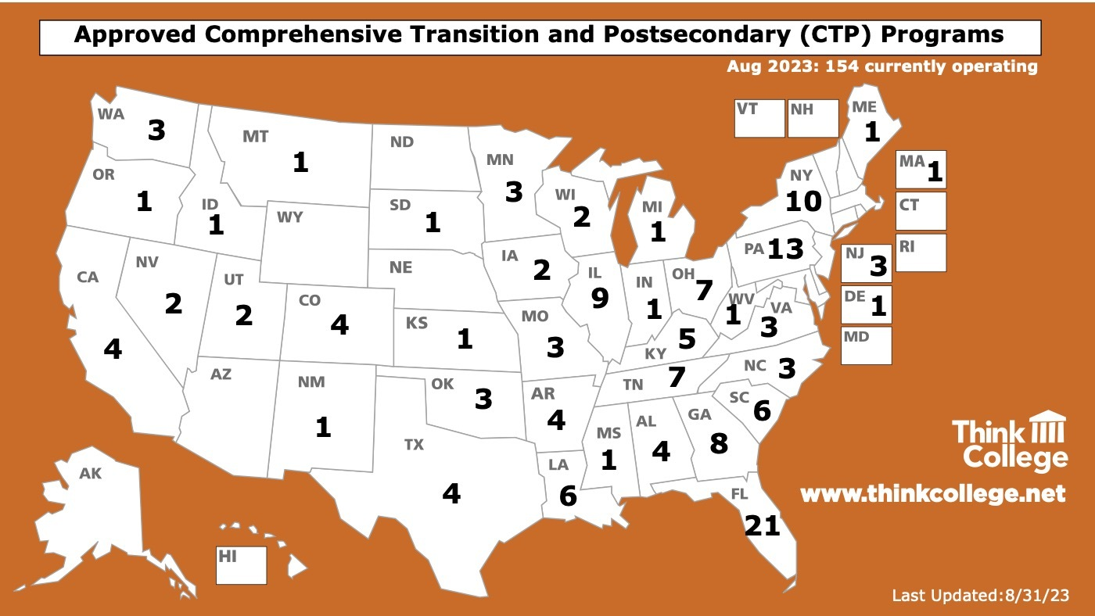
Approved Comprehensive Transition and Postsecondary (CTP) Programs

Slide 5
Impact of CTP approval on access to aid
Pathway to Title IV (i.e., federal) financial aid for students with intellectual disability (ID)
For students with ID attending an approved CTP program, these requirements for accessing Title IV financial aid are WAIVED:
Required to be working toward a degree or certificate
Required to have a high school diploma, GED, or have passed an ability-to-benefit test
Expands the types of learning activities that are covered by financial aid

Slide 6
Why should I apply to be a CTP?
Access to financial aid for students with ID
Recognition on US Department of Education website
Legitimize your efforts on campus
May open doors to other forms of student assistance

Slide 7
Access to Title IV Financial Aid
Federal Pell Grant
Federal Supplemental Education Opportunity Grant
Federal Work-Study
NOT federal student loan programs

Slide 8
How is ID defined for CTP programs?
(b) Student with an intellectual disability means a student: (1) With a cognitive impairment characterized by significant limitations in— (i) Intellectual and cognitive functioning; and (ii) Adaptive behavior as expressed in conceptual, social, and practical adaptive skills; and (2) Who is currently, or was formerly, eligible for special education and related services under the Individuals with Disabilities Education Act (IDEA) (20 U.S.C. 1401), including a student who was determined eligible for special education or related services under the IDEA but was home-schooled or attended private school.

Slide 9
Steps to becoming a CTP Program
Meet with your financial aid office
Prepare a detailed narrative, Satisfactory Academic Progress policy, and letter to accrediting agency
Notify college’s accrediting agency in writing
Financial aid office adds CTP program to the college’s E-App
Email application materials to FSA_PEPS@ed.gov
Wait......respond to queries

Slide 10
How do I write a successful CTP application?
Use the application template to ensure you respond to each required component.
Specify all learning activities required for students to earn the credential offered by the program
Include inclusive college courses as well as learning activities to support career development, independent living and social skills/self determination
State time required to earn the credential in credit hours, equivalent credit hours or clock hours
Provide a Satisfactory Academic Progress policy
Notes:
Examples of all of these in the TC Learn module

Slide 11
Hot Tips
Have meetings with your financial aid office EARLY in the process. Make sure they understand the CTP program EXCEPTIONS.
Dig up and address any concerns your financial aid office has.
Get clear on how to specify the length of your program in both weeks and hours.
Understand there is no specified number of weeks or hours a CTP program must be to considered full time.

Slide 12
Comprehensive Transition Postsecondary (CTP) Program Approval
https://thinkcollege.net/sites/default/files/courses/ctp/index.html#/

Slide 13
We are a CTP! Now what?
Meet with your financial aid office
Establish a process for sharing information:
You need to know FAFSA info (“expected family contribution” or EFC) for students.
The financial aid office needs to know that you have documentation of ID.
A shared Google spreadsheet is a useful tool
Students and families will need support with FAFSA – they may not have heard of it or understand it
As much as possible, have the financial aid office provide this support

Slide 14
Thank You!
thinkcollegeTA@gmail.com

