Slide 1
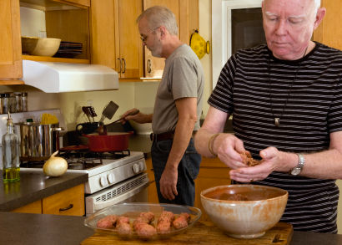
Presenter Prep Slide Only
Notes:
To Prepare:
Turn on Live Transcript and record if applicable
prepare (Name of Learning Lab) and PDF of slides (without notes) to put in chat
Slide #2 – Update presenter names
Check that the presenter can share their screen
Prepare polls/breakout groups if a large group
Assign an attendance taker, timekeeper, chat monitor
Note to Facilitator:
Bold Text = Timing
Italicized Text = Notes – do not read
Regular Text = Talking Points

Slide 2
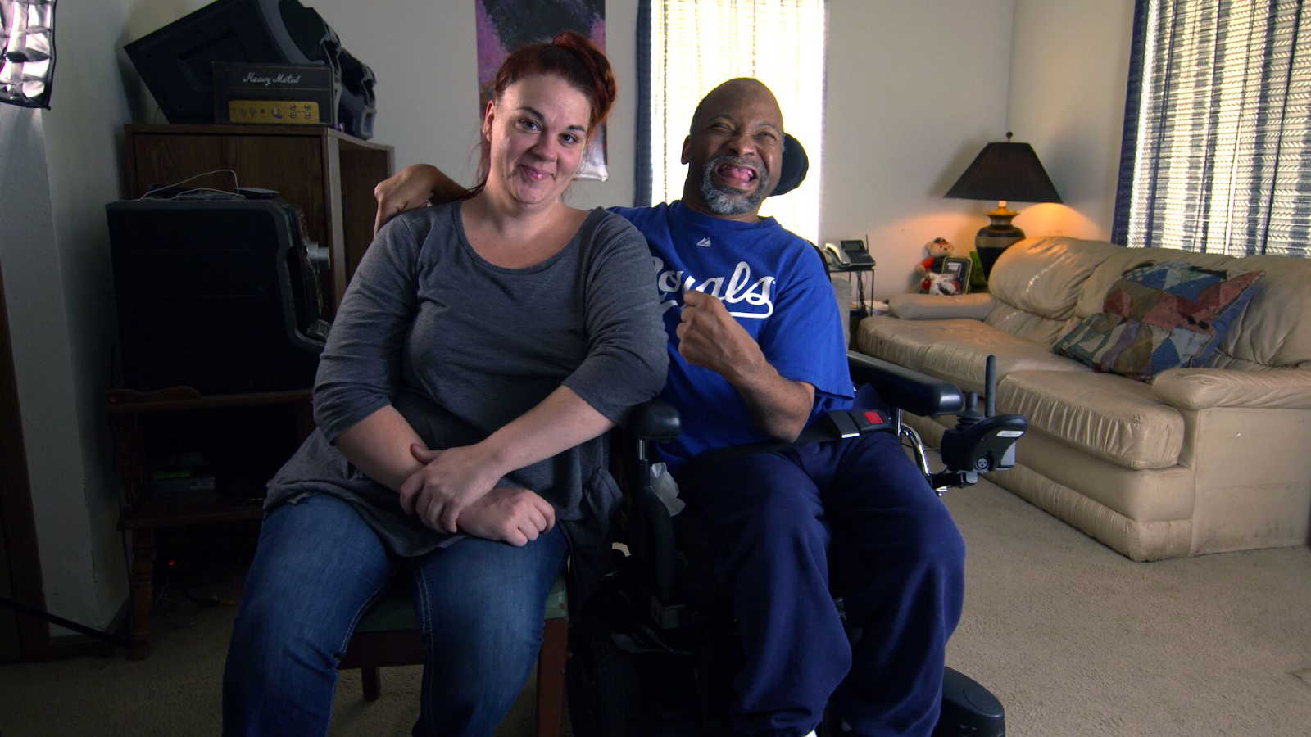
Employment and Community First CHOICES
Workforce QuILTSS Initiative
Learning Lab
Collecting and Learning about Retention through DSP Feedback
Presenter's name and affiliation
tenncare.ici.umn.edu
Notes:
Time: 15 seconds
Talking Points
Welcome to our first Learning Lab – What is the Cost of a New Hire?​
My name is xx and I am a xx with xx.​
​
If Learning Lab is being recorded, let them know they can contact you if they would like a copy. ​

Slide 3
Using Zoom
Your microphones will be muted when enter. Please keep them turned off unless you're speaking.
Name yourself
  First name
  Name of your organization
Use for questions or comments.
We will use “Reactions” such as “thumbs up” though-out the workshop.
Live Script
Camera on as you are able to and comfortable.
Take care of your needs. If you need a break, take one.
Be Understanding of “co-workers”
Chat
Notes:
Time: 30-60 seconds
Talking Points:​
Some of us are used to working on Zoom in a group, while others are less familiar. ​
Please keep your microphone on mute when you’re not speaking today to help reduce background noise. When you’re in breakout groups, feel free to unmute and discuss the topic within your group. If you are able, we’d appreciate it if you keep your video on today. Its important for all of us to be able to see and get to know one another in these meetings. We understand if you need to shut off your video for a few moments if you need to step away, but please turn your video back on when you return.​
When you logged into Zoom today, you might have typed in a name for yourself. To help us get to know one another, we ask you to rename yourself with this information on your screen:​
Your name, your organization name. If you are a group of people watching from one computer in an organization, you can shorten to first names and your organization name.​
To do this, look on the bottom of your screen for participants, click on that and on the right side of your screen a white column will appear. Hoover over your name and two buttons will appear mute and more. Click on more, then click on rename. Rename yourself then click OK. ​
The Chat function is at the bottom of the page. It looks like a little speaking bubble. If you have a questions or something you want to add to the discussion you can use Chat. We will be monitoring Chat throughout the session. ​
Using Chat to submit a question, simply click on the button that looks like this in your toolbar.​
Please feel free to send questions at any time during the presentation. We will have time at the end for discussion and questions, so you can type them in the chat and we’ll go over them at the end. ​
Also when you click on “Participants,” you’ll see some buttons to interact with the presentation. You can say yes, no, go slower, go faster, and when you click on “More” you will find that you can use the thumbs up or thumbs down buttons. You can also let us know if you need to step away for a quick break to use the rest room or fill your coffee cup. Suffering is optional.​
When we take breaks we do ask that everyone turn their camera during the break then turn it back on when you return or use reactions when you return so that we know when we are ready to start again. ​
Finally, we are all still working from home at the University of Minnesota. Explain “coworkers” you share your space with. ​

Slide 4
Open Round
Getting to Know You
Your name and role in the organization
What is one question you have about using staff feedback?
Notes:
Time: up to 8 minutes
Talking Points:
We would like to start with a little time to get to know you and see if you have any initial questions. We’ll try to make sure we cover these questions. Please introduce yourself with the following: read slide​
​
Note: If group is large, can have them type in chat.​
Alternate question: What is one thing you hope to get out of today’s Learning Lab? / What is one question you have on this topic?​

Slide 5
Goals for the Staff Survey session
Discuss how better surveys gather better data
Share how using this data can impact change
Notes:
Time: 30-60 seconds
Talking Points:
We have several goals for today’s session. These goals include: read slide

Slide 6
Building & Strengthening the DSP Workforce
Recruitment Strategies | Selection Strategies | Retention Strategies
Effective Marketing Public service announcements (PSA) Targeted marketing Recruitment and hiring bonuses Recruitments sources | Structured behavioral interviews Realistic job preview | Orientation and onboarding Competency-based training Employee Development Job Analysis Job Descriptions Recognition Programs Coaching & Mentoring Mentoring Performance coaching Networking Employee Engagement & Organizational Participation Professional Development Developing career paths Professionalizing DSP roles Wage and Benefit Policy Change
Notes:
Time: 30 seconds
Talking Points:
Tie in that the survey can provide information that can help to you decide which strategies to develop. Likely in retention but can cut across all facets of the organization workforce development plan.

Slide 7
Image of cycle first time
Plan
Gather data
Analyze data
Action plan
Report (celebrate)
Notes:
Time: 1-2 minutes
Talking Points:
In this session, we will focus on planning for a survey that collects meaningful information from your staff related to turnover and/or retention. Know that it is important in the planning phase to consider how you will gather and analyze data, and what you will do with the data. Utilizing an action plan to think about your next steps after you gather and analyze your data can help you to stay on course with making improvements that matter. Finally, it is important to report out what you learned and what you’ll be doing with what you learned. Collecting data and having your staff wonder what was done with it may be worse than not collecting data at all!
As you collect data and make improvements over time, make sure plan to celebrate your successes. This will support your efforts. We’ll focus here mostly on planning to gather information from your staff.

Slide 8
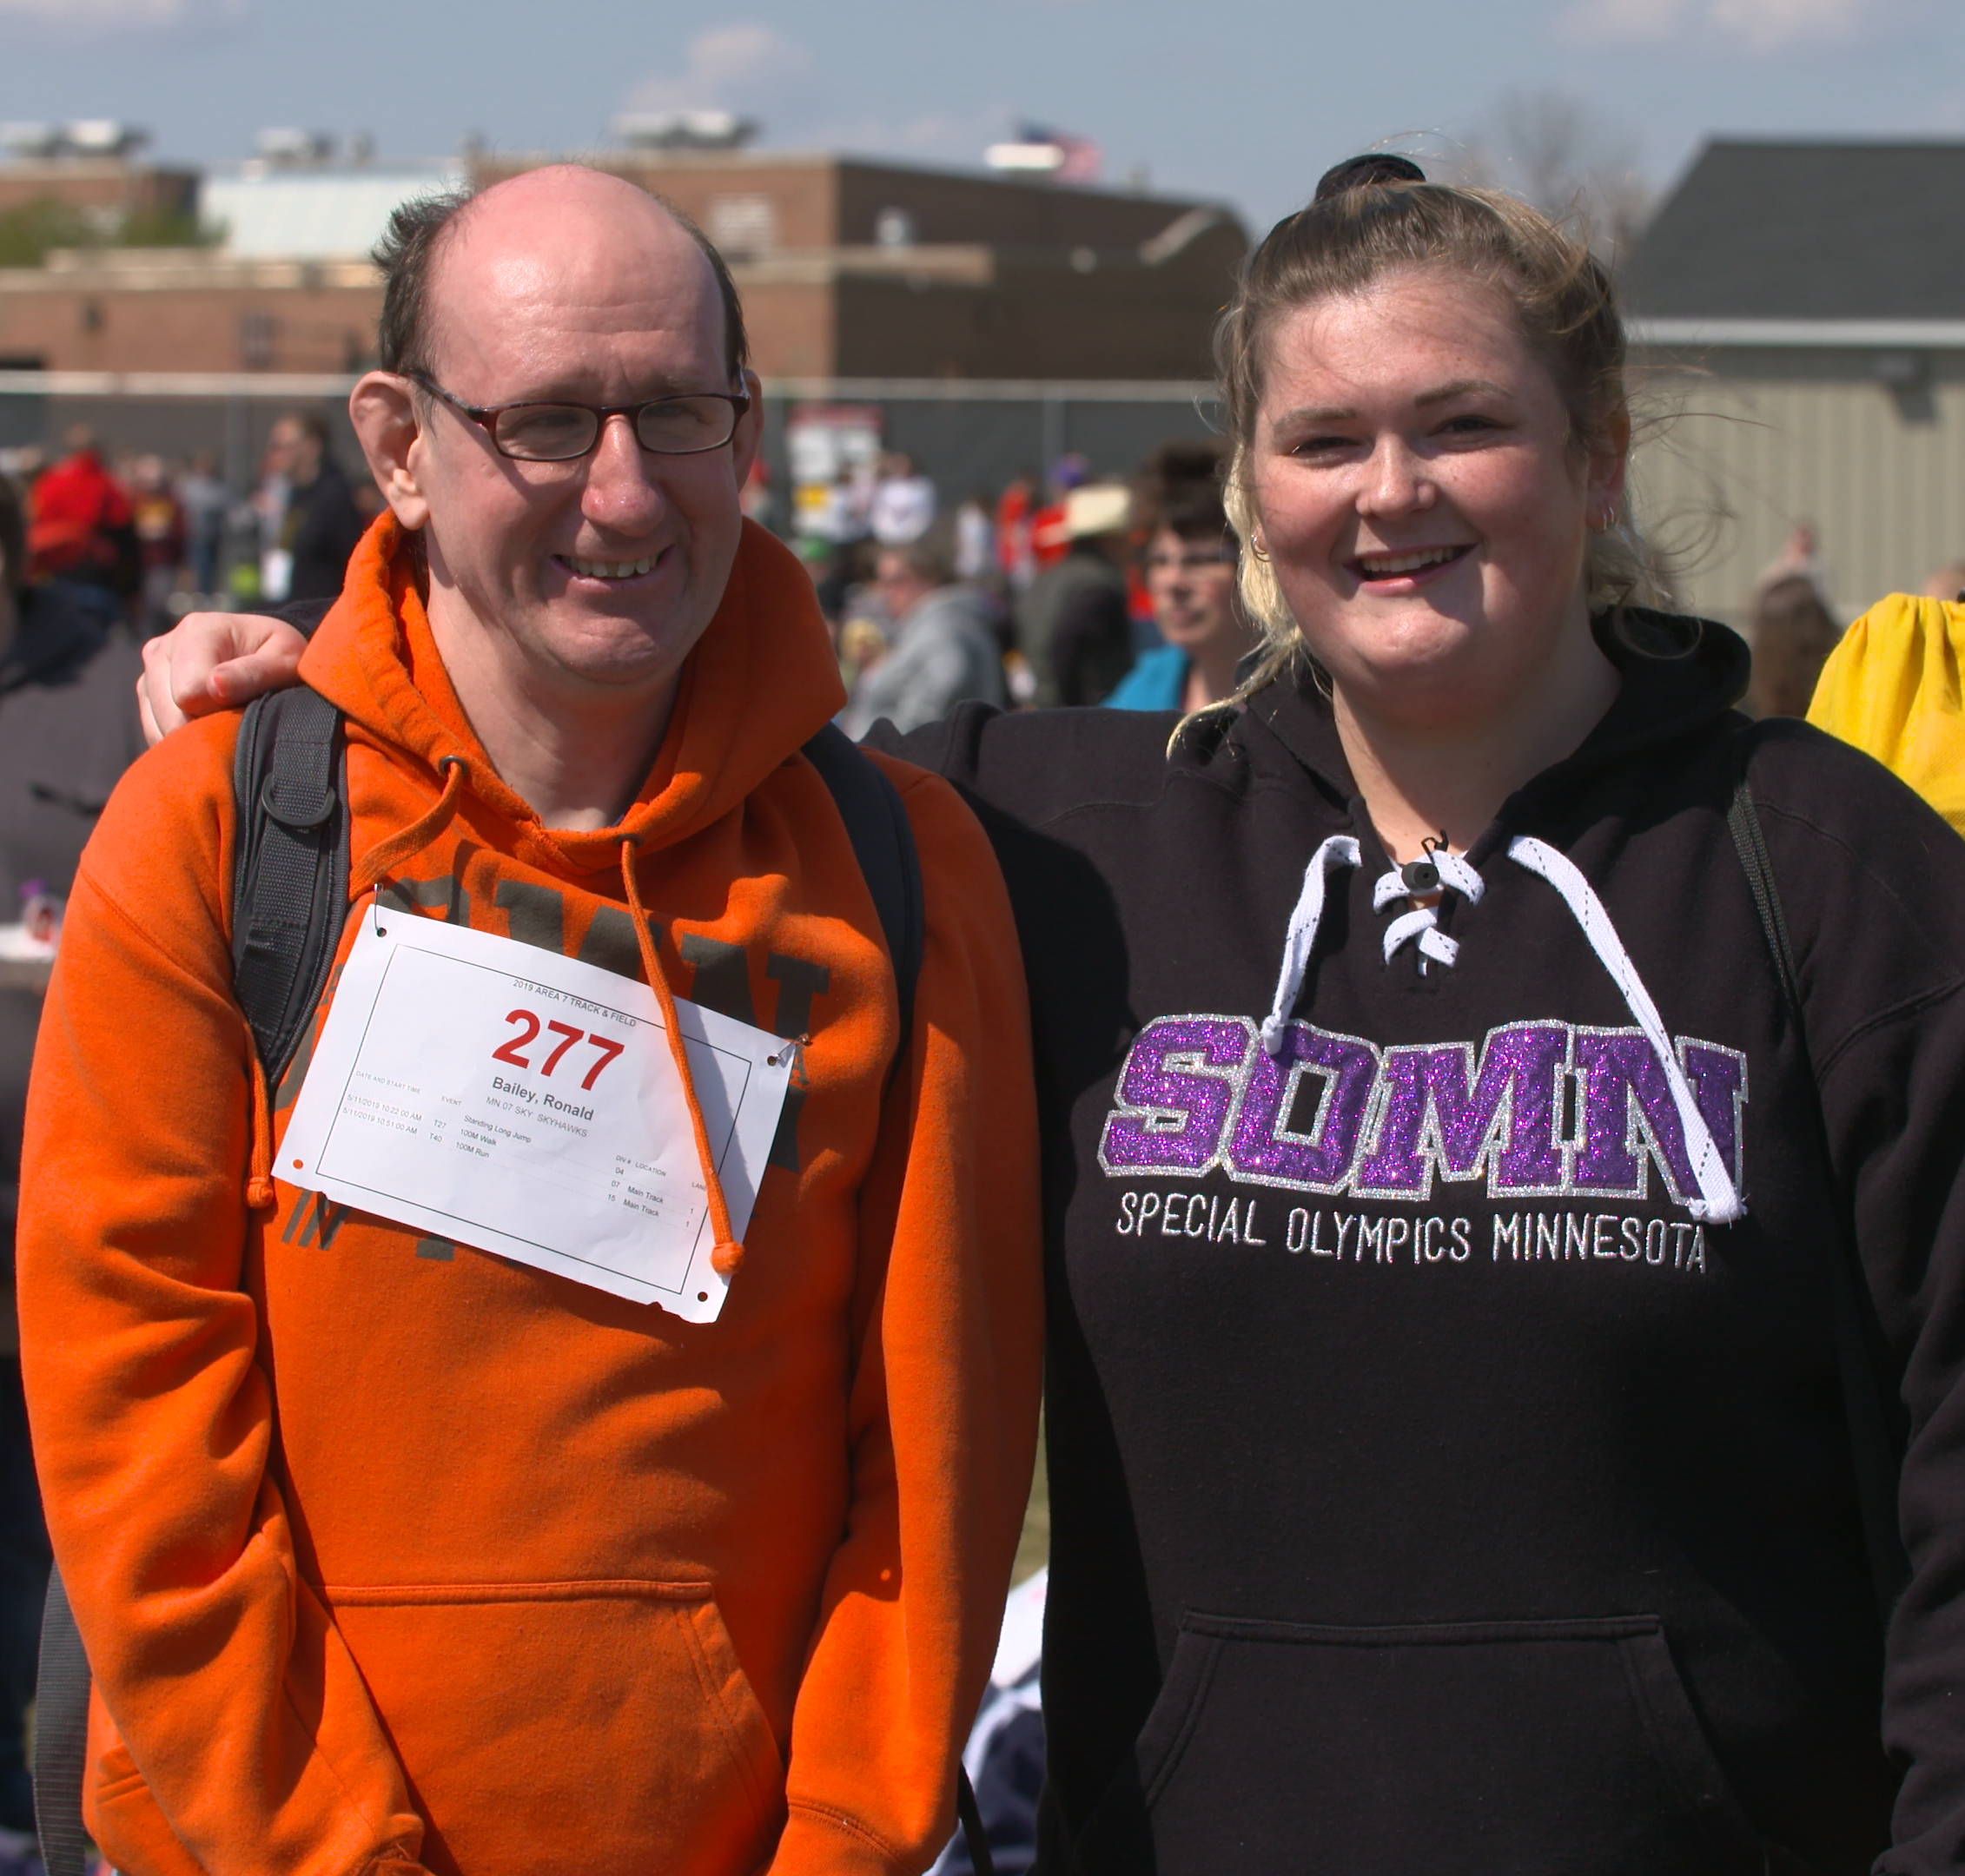
Why do DSPs leave their job?
Lack of respect from management
Lack of respect from society
Poor management
Work or family conflicts
Long job hours
Job site is a long distance from home
Difficulty of the work
Low pay and lack of benefits
(Mittal et al., 2009; Hewitt et al., 2018)
Notes:
Time: 1-2 minutes
Talking Points:
This is an animated slide. Ask participants to speak up or write in the chat why DSPs leave? See if their answers match or add to research.
Now, let’s look at some of the research that’s been conducted related to the workforce on why DSPs leave their jobs.
Lack of respect from management and society
Poor management: uncaring, uninvolved
Work or family conflicts
Long job hours and long distance from home
Difficulty of the work (physically and emotionally)
Low pay and lack of benefits
Knowing these kinds of things can help you respond with strategies to try support your workforce or adjust working conditions to support them.
Mittal et al. - Seven focus groups with 47 CNAs and PCAs in Pennsylvania.
We asked about reasons for leaving to DSPs in the COVID survey (55% said they knew staff who left during the pandemic): https://publications.ici.umn.edu/community-living/covid19-survey-6-month-followup/main#Pandemic-Impact-on-Turnover-and-Vacancy

Slide 9
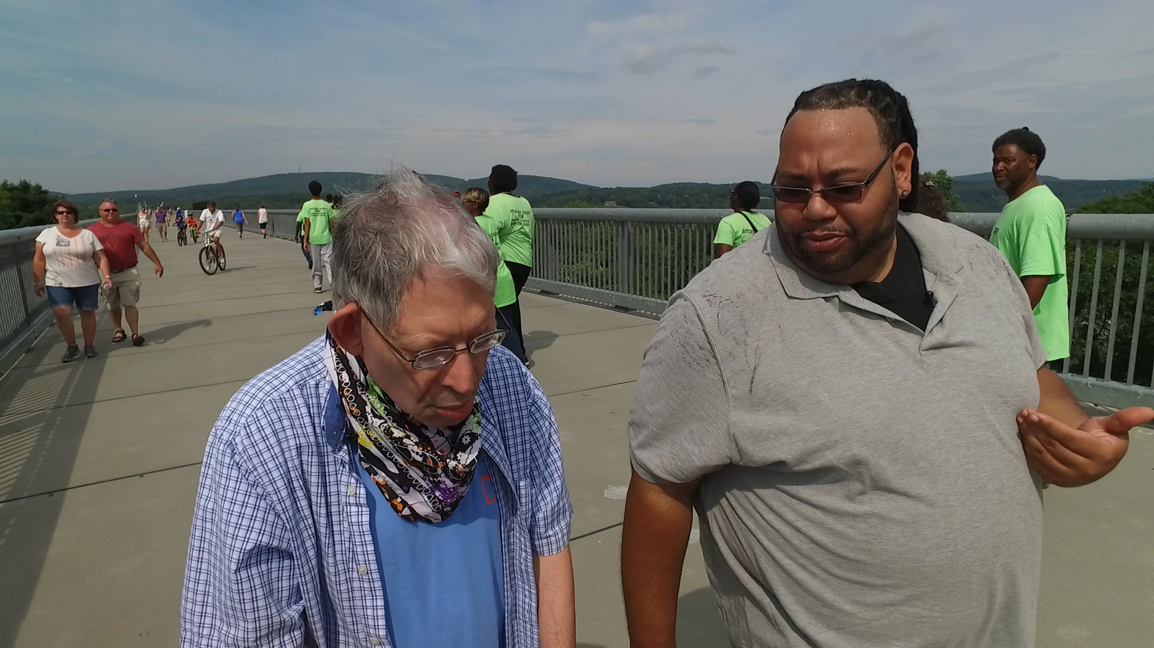
And, related to COVID-19 Pandemic?
55% of DSPs knew 1+ colleagues who left due to the pandemic
z.umn.edu/dsp-covid19
Notes:
Time: 1 minute
Talking Points:
This past year was difficult for everybody. We collected surveys from over 9000 DSPs related to their experiences during the pandemic, including some DSPs from TN. Over half of DSPs knew one or more colleagues who left due to the pandemic. Recognizing the stresses of this last year might be important in considering what to include in your survey this year. You can learn more about what DSPs reported by following the link on the slide.
[just in case anyone asks: Reasons from covid survey: Fear of becoming infected, family reasons, lack of childcare, testing positive for COVID-19, fear of infecting others, furloughed.]
It might help you to plan for future waves of the pandemic to ask your DSPs about their experiences in the last year.

Slide 10


"Survey Says."
Notes:
Time: 1 minutes
POLL: Best TV gameshow host: Richard Dawson, Steve Harvey, Ellen DeGeneres, Drew Carey, Pat Sajak, Jane Lynch, Alex Trebek, Other
Talking Points:
How could I have made my poll or basic survey better? Field answers.
Key point is get input from group about who to add to the poll. The questions in any good survey come from all over. observation, conversation, direct questions on what people think should be asked.

Slide 11
There are no perfect surveys…only useful ones
Basic Likert Scale with canned questions
Basic Likert Scale with management prepared questions
Likert Scale (or not) with broad input on questions both standard and time sensitive.
Notes:
Time: 1-2 minutes
Talking points:
The Family Feud poll was a basic survey with canned answers rather than questions. The point is anything canned is going to give you limited data, which can lead to bad decisions and poor results.
A better more impactful survey will be based on input and previous data. Here I would encourage you to revisit your agency profile. There may be data that will help you decide on what could be impactful. If it is reviewed by management and data driven decisions are made on what to ask. That is a step forward towards gaining more impact.
Lastly you may be able to get better more impactful participation by gathering input from key players on what to ask open ended questions such as the like learn change model can be a processing nightmare for large organizations, but it often yields good information to support the numbers.

Slide 12
Image of Cycle 2nd time
Plan
Gather data
Analyze data
Action plan
Report (celebrate)
Notes:
Talking Points:
Process for surveys:
Planning – recognize that it is not quick and easy to collect data. Make a comprehensive plan and follow through. Incomplete steps may be worse than not asking at all.
Gathering data – figure out a realistic way to make sure that you can hear from a representative sample of your DSPs (or target your survey to a specific group of DSPs). Have an electronic version and support for people who want to fill it out on paper. Make it “no cost.” Also, try to have a way to figure out if your sample is representative enough. Is 10% completion rate enough?
Analyzing data – make sure you’ll be able to use the data you collect. If you have 100 staff, recognize that asking each staff 5 open ended questions may be impractical.
Action plan – using what you learn, do some action planning about next steps to improve your workforce and/or services. Make sure that you invite multiple “stakeholders” to participate
Reporting (celebrating) – Make sure that everyone who participated has access to something tangible about what you’re doing with the results. Share with your board of directors, put it on your website. Share it on social media.

Slide 13
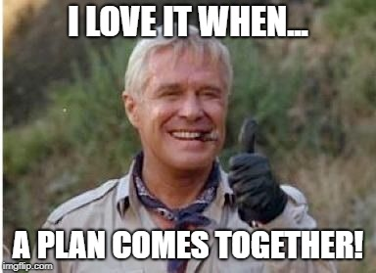
Image of Thumbs up – plans comes together
Notes:
Time: 30 seconds
(Hannibal Smith aka George Pepard )
Talking Points:
In the short time we have today we are going to focus mostly on planning a survey. It is the key component to making the survey begin. Proper planning produces positive action. Conversely poor planning produces poor results.

Slide 14
Consider Broad input from across your agency
Board and management
Frontline Supervisors
Direct Support Professionals
People Supported/ and family members
Anonymous vs. Identified. (opt in possibility)
Notes:
Time: 1 minute
Talking Points:
Read slide
Person Centered practices across the board for everyone. You gather perspectives that can inform and possibly drive survey planning towards more impactful questions.

Slide 15

Image of the word DATA
Notes:
Time: 1-2 minutes
Talking Points:
Gathering Data section:
Well-developed questions
Some that carry from year to year for better comparison and solid numerical data (give example)
Some that are developed to gather timely information (give example such as COVID)
Closed ended questions will be more practical if you have a lot of staff. You might also provide an opportunity for a “write in” or one open ended question that you’d like to know more about. Or use a focus group to learn more.
Force a decision: Strongly disagree – disagree – agree – strongly agree. Don’t have a “neutral” option.
Make sure your answer options are comprehensive.
Select the most important questions and delete the rest (avoid survey fatigue).
Pilot your survey.

Slide 16
3rd
Plan
Gather data
Analyze data
Action plan
Report (celebrate)
Notes:
Time: 1-2 minutes
Talking Points:
Planning – recognize that it is not quick and easy to collect data. Make a comprehensive plan and follow through. Incomplete steps may be worse than not asking at all.
Gathering data – figure out a realistic way to make sure that you can hear from a representative sample of your DSPs (or target your survey to a specific group of DSPs). Have an electronic version and support for people who want to fill it out on paper. Make it “no cost.” Also, try to have a way to figure out if your sample is representative enough. Is 10% completion rate enough?
Analyzing data – make sure you’ll be able to use the data you collect. If you have 100 staff, recognize that asking each staff 5 open ended questions may be impractical.
Action plan – using what you learn, do some action planning about next steps to improve your workforce and/or services. Make sure that you invite multiple “stakeholders” to participate
Reporting (celebrating) – Make sure that everyone who participated has access to something tangible about what you’re doing with the results. Share with your board of directors, put it on your website. Share it on social media.

Slide 17
Discussion + Questions
Notes:
Time: up to 10 minutes
Discussion:
Use a round to make sure everyone responds to these question
Discussion Questions:
What type of survey do you use now?
Where will you begin? What data are you gathering now?
Who do you involve in survey planning? Who might you add?
What do you usually use your data for?
What data might you like to gather?

Slide 18
Closing Round
  What’s your next step?
Notes:
Time: 1-5 minutes
How will you use this tool? What is important for you? What is your next step? OR what is one word to describe today?
If large group, ask one person and explain that we can help plan next steps in 1:1 consultation.

Slide 19
Resources
Sample questions available at the end of this chapter:
Larson et al. (2012). Assessing and evaluating workforce challenges. In Staff Recruitment, Retention, and Training Strategies for Community Human Service Organizations. Larson & Hewitt, Eds. https://ici.umn.edu/products/docs/Staff_Recruitment_book/Ch_13.pdf
Notes:
Time: 15 seconds
Talking Points
Explain that this is a resource for sample survey questions

Slide 20
Resources continued.
Why do DSPs stay and leave?
Mittal et al. (2009). A dual-driver model of retention and turnover in the direct care workforce. Gerontologist, 49(5). 623-634. 10.1093/geront/gnp054
Hewitt et al. (2019). Minnesota direct support worker survey: Final report. https://ici-s.umn.edu/files/97yqCJKfgd/direct-support-worker-survey_v5ar
Notes:
Time: 15 seconds
Talking Points

Slide 21
Questions?
Other ways to learn more:
Checkout the Tenncare Workforce Toolkit at: tenncare.ici.umn.edu
Contact your consultant at: dsp-tn@umn.edu
Join our Monthly Office Hours
Notes:
Time: 15 seconds
Talking Points
Here are ways to keep in touch with us and continue your learning.

Slide 22
Office Hours
  East Region:
    1st Friday 9-11:00 am CST
    3rd Friday 9-11:00 am CST
  Middle Region:
    1st Wednesday 1-3:00 pm CST
    3rd Wednesday 1-3:00 pm CST
  West Region:
    2nd Monday 9-11:00 am
    2nd Wednesday 9:00–11:00 am
Notes:
Time: 30 seconds
Talking Points
Update slide with upcoming events

Slide 23
Upcoming Events
Upcoming Learning Labs:
  Assessing Your Website – May 17 10:30-11:15 am CST
Upcoming Community of Practice:
  East: April 13, 12:00 - 2:00pm CST, 1:00 – 3:00pm EST
  Middle: April 19, 10:00am - 12:00pm CST
  West: April 21, 9:00 – 11:00 am CST
Notes:
Time: 30 seconds
Talking Points
Update slide with upcoming events

Slide 24
Thank you
Notes:
Thanks, and goodbyes

