Slide 1
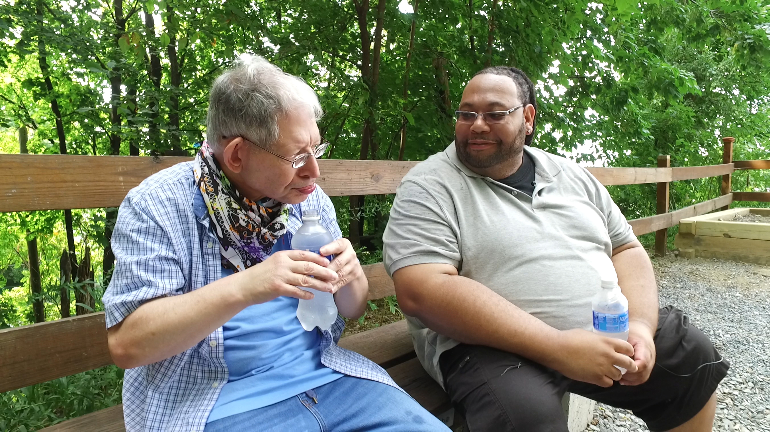
Notes:
Host and Co-host notes for pre-meeting setup
Actions before the session:
Slide #1 – Update presenter names
Hide other region consultant slide, as applicable
Hide other regions workshop slide for Upcoming Workshops, as applicable
In the Practice session before participants log on
Check that the presenter can share their screen and run videos as needed
Check that the presenter marks “Share Computer sounds” and “Optimize Screen sharing for video clip” so that any videos shown can be heard by others – it is on the same screen that you choose which screen to share.
Confirm polls are loaded
Turn on transcript
Break-out Groups
Take attendance
Timekeeper
Host / Welcome people as they arrive & arrive late
Monitor Chat
Turn on record, as desired
Subtitles – turned on, each participant can control turning on and off
At end of presentation:
MAKE SURE TO STOP RECORDING AT THANK YOU SLIDE
Note to Facilitator
Bold Text = Timing
Italicized Text = Notes – do not read
Regular Text = Talking Points

Slide 2

Understanding Your Data and Workforce Strategies
Workshop Series
Presenter's name and affiliation
tenncare.ici.umn.edu
Notes:
Timing for Intro/Welcome (slides 2-10): 10-15 minutes
Action – Record as desired
Talking Points:
Welcome to session # in our QuILTSS Initiative kickoff workshop series.
My name is xx and I am a xx with the Institute on Community Integration at the University of Minnesota. I am here today with my colleagues from the University of MN, __________ and ________________. Also Regional Coaches from Tennessee ____________________ and ___________________.
Thank you so much for joining us today. During today’s session, we will finish reviewing retention strategies.
If being recorded: This webinar is currently being recorded. We will send the recording to you if you would like to view again or share with others in your organization.

Slide 3
Welcome to Session 6: Overview of TennCare Workforce Toolkit: Retention Strategies – Part 2
Notes:
Talking Points:
Today we are going to continue to look at Retention strategies for DSPs. Last week looked at: Orientation and Onboarding, Competency Based Training, and Employee Development.
Because retention is such an important issue and there are several strategies that can be implemented to impact it, that we needed to break it into 2 sessions.

Slide 4
Using Zoom
Your microphones will be muted when enter. Please keep them turned off unless you're speaking.
Name yourself
  First name
  Name of your organization
Use for questions or comments.
We will use “Reactions” such as “thumbs up” though-out the workshop.
Live Script
Camera on as you are able to and comfortable.
Take care of your needs. If you need a break, take one.
Be Understanding of “co-workers”
Chat
Notes:
Talking Points:
Some of us are used to working on Zoom in a group, while others are less familiar.
Please keep your microphone on mute when you’re not speaking today to help reduce background noise. When you’re in breakout groups, feel free to unmute and discuss the topic within your group. If you are able, we’d appreciate it if you keep your video on today. Its important for all of us to be able to see and get to know one another in these meetings. We understand if you need to shut off your video for a few moments if you need to step away, but please turn your video back on when you return.
When you logged into Zoom today, you might have typed in a name for yourself. To help us get to know one another, we ask you to rename yourself with this information on your screen:
Your name, your organization name. If you are a group of people watching from one computer in an organization, you can shorten to first names and your organization name.
To do this, look on the bottom of your screen for participants, click on that and on the right side of your screen a white column will appear. Hoover over your name and two buttons will appear mute and more. Click on more, then click on rename. Rename yourself then click OK.
The Chat function is at the bottom of the page. It looks like a little speaking bubble. If you have a questions or something you want to add to the discussion you can use Chat. We will be monitoring Chat throughout the session.
Using Chat to submit a question, simply click on the button that looks like this in your toolbar.
Please feel free to send questions at any time during the presentation. We will have time at the end for discussion and questions, so you can type them in the chat and we’ll go over them at the end.
When you click on “Participants,” you’ll see some buttons to interact with the presentation. You can say yes, no, go slower, go faster, and when you click on “More” you will find that you can use the thumbs up or thumbs down buttons. You can also let us know if you need to step away for a quick break to use the rest room or fill your coffee cup. Suffering is optional.
When we take breaks, we do ask that everyone turn their camera during the break then turn it back on when you return or use reactions when you return so that we know when we are ready to start again.
Finally, we are all still working from home at the University of Minnesota. Explain “coworkers” you share your space with.

Slide 5
Items to have with you today:
2020 Tennessee Workforce Initiative Organizational Self Assessment Workbook (www.tenncare.ici.umn.edu )
Your organization’s 2019 profile
Notes:
Talking Points:
During today’s session we will be using the 2020 TN Workforce Initiative Organizational Self Assessment Workbook. You will also want to have a copy of your organization’s profile with you for reference.
Do you have your copy with you? If not, take a moment to get it. I’ll ask one of my UMN team member to put the link in the chat for you to download from the TennCare Workforce Toolkit.
Action: Put self assessment workbook link in chat: https://tenncare.ici.umn.edu/dsp-workforce-toolkit/organizational-readiness/tenncare-self-assessment-workbook-and-action-plan

Slide 6
Welcome & Introductions
Notes:
Transition slide

Slide 7
Breakout Group Activity
Getting to Know You
Your name / organization
Your role in the organization today
What is one retention strategy that caught your attention from last week’s session?
Notes:
Activity: (5 minutes) – 5 people per breakout, each person gets one minute, assign 1 consultant or coach to each breakout group
Purpose: Gives consultants and coaches opportunity to learn who is in the room.
Talking Points:
We are going to have the opportunity to get to know who is in the workshop today. In a moment but not yet, you will be send to a Breakout room with 5-6 others.
Everyone will have the:
Opportunity to introduce your self with your name, your organization and your role in the organization.
And answer the questions on the screen.
What is one retention strategy that caught your attention from last week’s session?
When you get to your group, find one facilitator and another person to report back for the group the responses to the two questions.
When the group returns call on the reporter from each group to report back on themes for questions #1 and #2.

Slide 8
Goals for this session
Learn about additional retention strategies and tools available in the Tennessee Workforce Toolkit.
Learn about the key components of these retention strategies and tools covered during this session.
Continue to think about which retention strategies would address your organization's specific workforce challenges.
Notes:
Talking Points:
During our last session we started talking about retention strategies to address turnover that occurs during that 6-12 month tenure for a new employee. We will continue discussing retention strategies today.
Our goals for this session include: read slide

Slide 9
8 Steps for Implementation - Workforce Strategies
Step 4
Step 3
Identify
barriers to implementation
Step 2
Identify components of the strategy
Step 1
Select an intervention strategy
Identify and assess the problem
Larson & Hewitt, 2005
Notes:
Talking Points:
Consistent with implementation science, reminder that:
We will be using the 8 step framework for implementation of workforce strategies – let’s do a quick overview as we will be revisiting these in more depth in future sessions
Step one is identifying and accessing the workforce challenge that your organization decided to address.
In Step 2 you will select an intervention strategy from the workforce toolkit.
During Step 3 your team will identify the components of the strategy.
Then you will identify barriers to implementing the strategy

Slide 10
8 Steps for Implementation - Workforce Strategies
Step 8
Step 7
Evaluate success
Step 6
Implement
the strategy
Step 5
Set goals,
measure progress & establish a time frame
Identify support for the strategy
Larson & Hewitt, 2005
Notes:
Talking Points:
In the sixth step you will decide on your goal, how you will measure your progress and establish a time frame that works for you organization
Next is the implementation of strategy and finally evaluating if the strategy was successful.

Slide 11
Intervention Strategies
Step 2 – Select an Intervention Strategy
Notes:
Timing for section (slides 11-17): 8 minutes
Talking Points:
Let’s move into step 2 of implementation: selecting an intervention strategy

Slide 12
Building & Strengthening the DSP Workforce
Recruitment Strategies | Selection Strategies | Retention Strategies
Effective Marketing Public service announcements (PSA) Targeted marketing Recruitment and hiring bonuses Recruitments sources | Structured behavioral interviews Realistic job preview | Orientation and onboarding Competency-based training Employee Development Job Analysis Job Descriptions Recognition Programs Coaching & Mentoring Mentoring Performance coaching Networking Employee Engagement & Organizational Participation Professional Development Developing career paths Professionalizing DSP roles Wage and Benefit Policy Change
Notes:
Talking Points:
These are the three major section of the different areas we have been discussing. We have already talked about recruitment strategies, selection strategies, and some retention strategies.
During this session we will continue to explore Retention Strategies
We will focus today on the final strategies: Recognition programs, coaching and mentoring, employee engagement and organization participation, and professional development.

Slide 13
Retention
Workbook Section 5: Recruitment
Notes:
Transition Slide

Slide 14
Notes:
Talking Points:
Last week we reviewed section 5 of the self assessment workbook, which looks like the images on your screen. Section 5 is about reflecting on the organizational practices and processes that can support your efforts and processes you may already have in place. This is intended to be a discovery tool to help you explore what you’re already doing and areas where you might want to put some attention as you move forward.

Slide 15
Identify and Assess- Retention
Step 1 – Identify and assess the problem
Notes:
Transition Slide

Slide 16
Poll Question #1 – Which of these retention strategies has or does your organization use to retain DSPs? (Select all that apply)
Recognition Programs
Mentoring
Performance coaching
Networking
Employee Engagement & Organizational Participation
Professional Development
Notes:
Poll
Talking Points:
Let’s take a quick poll. - you can pick multiple answers. Your answer are anonymous. A reminder that this is the second half of retention strategies – our poll last week addressed the rest. Read slide.
In debrief poll, review results.
Ask: Anything surprise or jump out at you – spend no more than 3 minutes on this-watch/resist the deep dive conversation

Slide 17
Retention Strategies
Recognition Programs
Mentoring
Performance coaching
Networking
Employee Engagement & Organizational Participation
Professional Development
Notes:
Talking Points:
These are the remaining Retention Strategies we are going to cover during this week’s session. Read slide

Slide 18
Recognition Programs
Step 2 – Select an intervention strategy
Step 3 – Identify components of the strategy
Notes:
Timing for section (slides 18-21): 3 minutes
Talking Points:
We have been talking with you about the 8 steps
You’ll want to think about Steps 2 & 3 as we look at each of the tools, starting with Recognition programs

Slide 19
Recognition Programs
Awards
DSP week activities
Stories in newsletter or local newspapers
Opportunities to meet with key leaders
Birthdays and key life events recognized and celebrated
Small annual bonuses
Gift cards for coffee, gas, etc.
Notes:
Talking Points:
Here are a few recognition ideas we know people use. We always encourage organizations to individualize when possible.
Using Person Centered Thinking skills to tease out how each DSP likes to be recognized that is more effective than the one size fits all.
Share example (i.ei. I have a colleague who likes letters of appreciation so I send them letters. Others appreciate recognition at larger meetings)

Slide 20
Recognition, Respect and Value
Purposeful actions of recognition
Some ideas:
Neighborhood bar-b-ques that focus on the DSPs
Get to know me cards or One Page Descriptions.
Media interviews
Local celebrity spokespeople who celebrate DSPs
Your ideas?
Notes:
Talking Points:
Purposeful actions are needed by your organization, to make sure everyone in your community knows who DSPs are and what they do.
Some ideas I thought of read a few on slide
What are some other ideas that you have used to recognize the DSPs?

Slide 21
For more details
tenncare.ici.umn.edu
Toolkit
Employee Development
Webinar
Retention
Notes:
Talking Points:
You can find more information on recognition in the webinars on Employee Development on the website

Slide 22
Peer Mentoring
Step 2 – Select an intervention strategy
Step 3 – Identify components of the strategy
Notes:
Timing for section (slides 22-27): 5 minutes
Talking Points:
As we take a look at Coaching and Mentoring we want you want to think about Steps 2 & 3.
DSPs who quit soon after being hired would stay longer if they had better support, direction, and training.
Mentoring is a win-win for employers and employees because new hires are more likely to stay longer and there is a relatively low cost of implementing a mentoring program.
When organizations reduce the fiscal and human costs of turnover, the substantial amounts of agency dollars and staff energy can be redirected to the work of supporting people.

Slide 23
Mentoring
Experienced direct support professional (DSPs) support new or less experienced staff
Feel welcome and supported
Acquire knowledge
Learn, refine and build new skills
Understand employers practices, culture, and values
Written agreement between Mentor and Mentee
Notes:
Talking Points:
The goal of mentoring is to help mentees feel supported and welcome as well as support their growth and development in specific competencies. Mentoring also allows other DSPs to take on a leadership role in your organization.
Mentoring occurs when an experienced direct support professional (DSP), regardless of age or current job function, helps someone with less direct support knowledge and skill to reflect on current practices, culture, and values and to expand, refine, and build new skills.
If the organization wants to formalize mentoring, then they will want to consider having a written agreement with the Mentor and the Mentee as a part of a Peer Mentoring Program, that outlines the expected goals and has a beginning and ending date.

Slide 24
For more details
tenncare.ici.umn.edu
Toolkit
Peer Mentoring
Webinar
Retention
Notes:
Talking Points:
For more information on Peer Mentoring and other types of employee development go to the Retention page of the website to see that webinar.

Slide 25
Performance Coaching
A job skill training strategy that helps DSPs reach their highest potential.
It encourages DSPs to excel and complete job expectations to the best of their ability.
It includes development of critical thinking, focused work behaviors, and innovative ideas needed for job tasks.
Notes:
Talking Points:
Performance coaching is another strategy that can be utilized to help DSPs excel in their position.
Performance coaching involves working with DSPs to develop critical thinking skills, work behaviors, and innovative ideas needed for their job tasks.
Read slide
Each professionalizes and develops the staff member as an employee. Developing your staff’s skill and knowledge can lead to retention.

Slide 26
Strategies to increase effectiveness of remote supervision
Communicate frequently and listen
Use technology
Staff –centered
communication approach
Phone
Text
E-mail
Communicate accountabilities and follow up often
Use animated gifs and emoticons to convey emotion
Provide right tools
Notes:
Talking Points (use slide 26 or 27 – not both):
Remote supervision creates challenges, but has become more common especially when faced with a staffing crisis and during the time of a world pandemic.
With staff working remotely and with the staffing shortage, supervisors are required to have increased communication skills, that often involved technology.
To have effective remote supervision, supervisors find success when they communicate frequently and really need to listen.
Supervisor who use a person-centered approach find more success than those who don’t.
Using technology, including phone, text, and email is an effective way to stay in communication, but using the preferred method for the staff person is important to consider.
Perhaps gifs or emojis would be a good method to convey emotion in text so that texts do not get misunderstood.
Supervisors who are accountable to respond to staff members and who follow up often, while providing the right tools for the DSP, will help the DSP to succeed. DSPs who feel successful and connected to their supervisor often “stay” at the job.

Slide 27
Strategies to increase effectiveness of remote supervision
Face-to-face time
Network focused
Relationship building
Not all business (staff meetings don’t count)
Make time weekly
for one-to-one
Make time for
small talk
Use video
Skype
Google Hangouts
Zoom
Teams
Notes:
Talking Points (use slide 26 or 27 – not both):
While remote supervision is important, it’s also important to have some face-to-face contact—preferably weekly-- that gives time for small talk, relationship building, and is network focused.
We know that when DSPs have good relationships with their supervisors, it can help mitigate relationships with coworkers. This can help with turnover—and support professionalization for DSPs.
If “real” face-to-face contact isn’t possible especially now during a time of COVID 19, the use of technology—such as Zoom, Google Hangouts, or Facetime—may be a the next best method to interact with the DSP, if they have access to one of these methods.
Face-to-face time is critical for supervisors and DSPs
It promotes opportunities to network
It promotes relationship building
Make sure the time between supervisors and employees isn’t all business (staff meetings don’t count)
Make time weekly for one-to-one (this let’s the DSP know that they have the supervisors undivided attention on a regular basis that they can talk about what is on their mind.
Make time for small talk

Slide 28
Employee Engagement & Organizational Participation
Step 2 – Select an intervention strategy
Step 3 – Identify components of the strategy
Notes:
Timing for Section (slides 28-32): 6 minutes
Talking Points:
We will continue with reviewing intervention strategies and talk about employee engagement and organizational participation.

Slide 29
Employee Engagement and Organizational Participation
It is critical to use strategies that keep DSPs connected to each other, supervisors and the organization
Some ideas
Weekly purposeful check in calls
with supervisor
Intentional peer check ins via phone or virtually (Zoom, Skype etc.)
What are you actively doing?
Social media groups
Notes:
Talking Points:
Employee engagement is key to retention, so strategically working to keep people connected is key.
This may be especially difficult right now during COVID where we may not be able to meet in groups.
Some ideas might be read slide
What are you actively doing? Use chat feature for question. Then discuss.

Slide 30
Characteristics of Effective Organizations
Characteristics of effective organizations
Intentional learning
Leader who knows the staff by name
Goes out of their way to engage
Periodically practices direct support
Celebrates DSPs
Individual story-driven
Data-driven
Makes data driven decisions regarding workforce
Monitoring is routine
Engages DSPs at all levels
Notes:
Talking Points:
Let’s discuss the Characteristics of effective organizations and how each is important.
Organizations that celebrate individual growth across the board and the shift focuses from compliance to development
The leader who knows DSPs by name says they value that DSP as a person.
Leaders also are effective them they: a) go out of their say to engage, b) practice direct support from time to time, and c) who celebrates the DSPs is not only showing DSPs they celebrate their work, but they also show they value each DSP as a professional and a person.
Story driven: There are so many great stories that celebrate the work and there are stories that can guide growth. Use them.
Data Driven: Focus on making data driven decisions about the workforce. Monitoring leads to good data that allows for evaluative change to happen.
Engagement is important and needed across the agency to show value of the role of the DSP. Invite select DSPs to be part of the organization where their interests and talents lie. If someone is a great storyteller having them assist with telling the stories of the organization’s success stories, might be a strategy. If someone is interested in building expertise in a certain area engaging them if a variety of departments to build on that skills may be good.

Slide 31
Creating a Competitive Edge
Organization culture is your competitive edge
It takes a lot of effort and work to create an organizational culture that supports DSP
“DSP week” is 52 weeks a year!
Notes:
Talking Points:
Focusing on engaging DSPs and all employees creates a competitive edge.
When a DSP or other staff member feels valued and engaged in the company more often than just DSP week, they want to stay.
They are also more likely to invite others to come and work with them making recruitment a little bit easier.

Slide 32
How Do You Engage the DSPs to Learn From Them?
Know what your DSPs see challenges and ways to improve
Ask them, be on the pulse
Informal talking sessions with leadership
Engagement survey
Focused conversation at staff meeting with supervisors
Text with simple question
Notes:
Optional Poll/Discussion
If time allows use this exercise. From the four bullets with the question plus an “other” choice: “Which methods have you used to find out what challenges DSPs are facing?”
Follow up poll with quick debrief and ask what the other methods people are using if other had answers..
First Facilitate Discussion on Engagement surveys using open Mics and chat what would you need to assess, what barriers may be in place, what basic implementation idea might you suggest and what data would you want to glean.

Slide 33
Breakout Conversation
Reflecting on Your Retention Practices
Which retention strategies that we just covered have you tried in your organization to address workforce challenges?
  What were you pleased about?
  What have you learned?
  What are you concerned about?
Based on this, what next steps are you thinking about?
Notes:
Timing for activity: 10 min
Activity : (5 minutes) – 5 people per breakout, each person gets one minute, assign 1 consultant or coach to each breakout group
Purpose: Gives consultants and coaches opportunity to learn who is in the room.
Talking Points:
We are going to have the opportunity to get to know who is in the workshop today. In a moment but not yet, you will be send to a Breakout room with 5-6 others.
Everyone will have the opportunity to:
answer the questions on the screen.
When you get to your group, find one facilitator and another person to report back for the group the responses to the two questions.
When the group returns call on the reporter from each group to report back on themes for questions #1 and #2.

Slide 34
Stretch Break
Take 5 minutes to stretch and refresh
Notes:
Turn off video and audio when you leave. Turn video back on when you return so we know you are back.
To check in with folks who don’t have their video on, ask for reactions

Slide 35
Professional Development & Networking
Step 2 – Select an intervention strategy
Step 3 – Identify components of the strategy
Notes:
Timing for section (slides 35-46): 10 min
Talking Points:
We will continue with professional development and networking

Slide 36
Professionalism
Developing career paths
Professionalizing DSP roles
Wage and benefit policy change
Notes:
Talking Points:
The ways we can really professionalize the Direct Support Professional is by:
Creating career paths or ladders
Using Core Competencies in the job description, during the interview, in training and employee goal setting and performance reviews.
We can also do this through wage and benefit policy change.
We talked about some wage campaigns when we discussed PSAs, but there are other examples throughout the United States (share example if you can think of it)

Slide 37
Career Ladder and Credentials
Career Ladders
Credentials
Notes:
Talking Points:
Career Ladders and Credentials are two ways to professionalize DSPs. While they sound similar, they are very different.
Career ladders are ways DSPs can gain recognition within their organization, and in the field for training and specialized skills, while credentials are recognized on a larger level, state- or nation-wide. They have training requirements and an exam where the learner earns a specialized degree upon a successful completion.

Slide 38
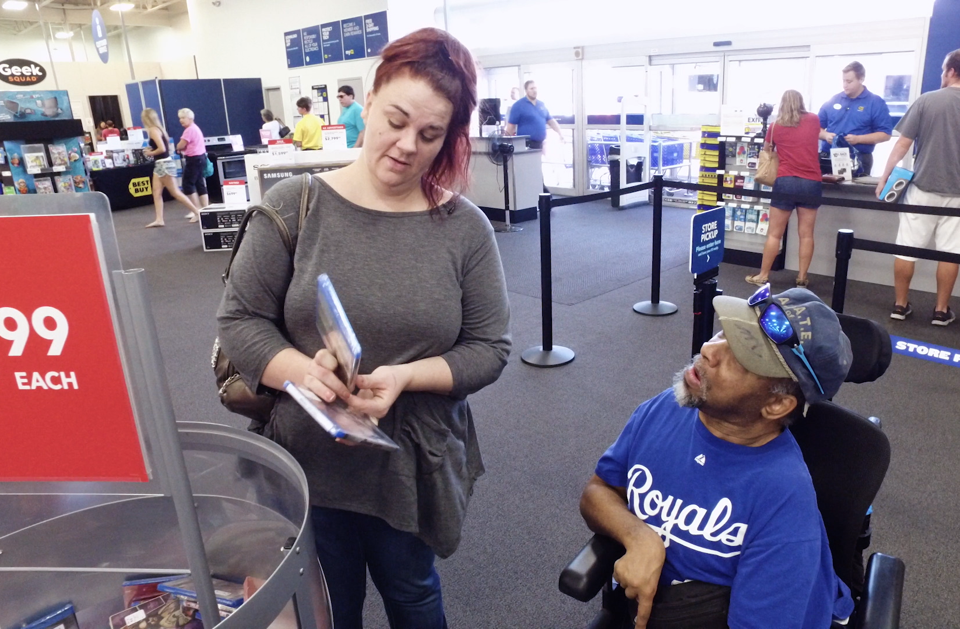
Why a Career Ladder?
Improve skills of workers
Create professional career paths
Improve quality and safety of supports
Entice workers to stay in the field
Improve pay and benefits
Enhance the status of DSPs & FLSs
Improve access to competency-based education and training
Notes:
Talking Points:
Within your organization, career ladders can improve the skills of workers, professionalize DSPs and increase their pay and benefits, improve access to various education and training for DSPs and FLSs, and improve supports for the people served. Career ladders can entice workers to stay in the field longer.
Organizations can create multiple ladders or a lattice that encourage and compensate DSPs for becoming better at their jobs in different ways. To retain top quality DSPs, there must be more ladders than the management pathway.

Slide 39
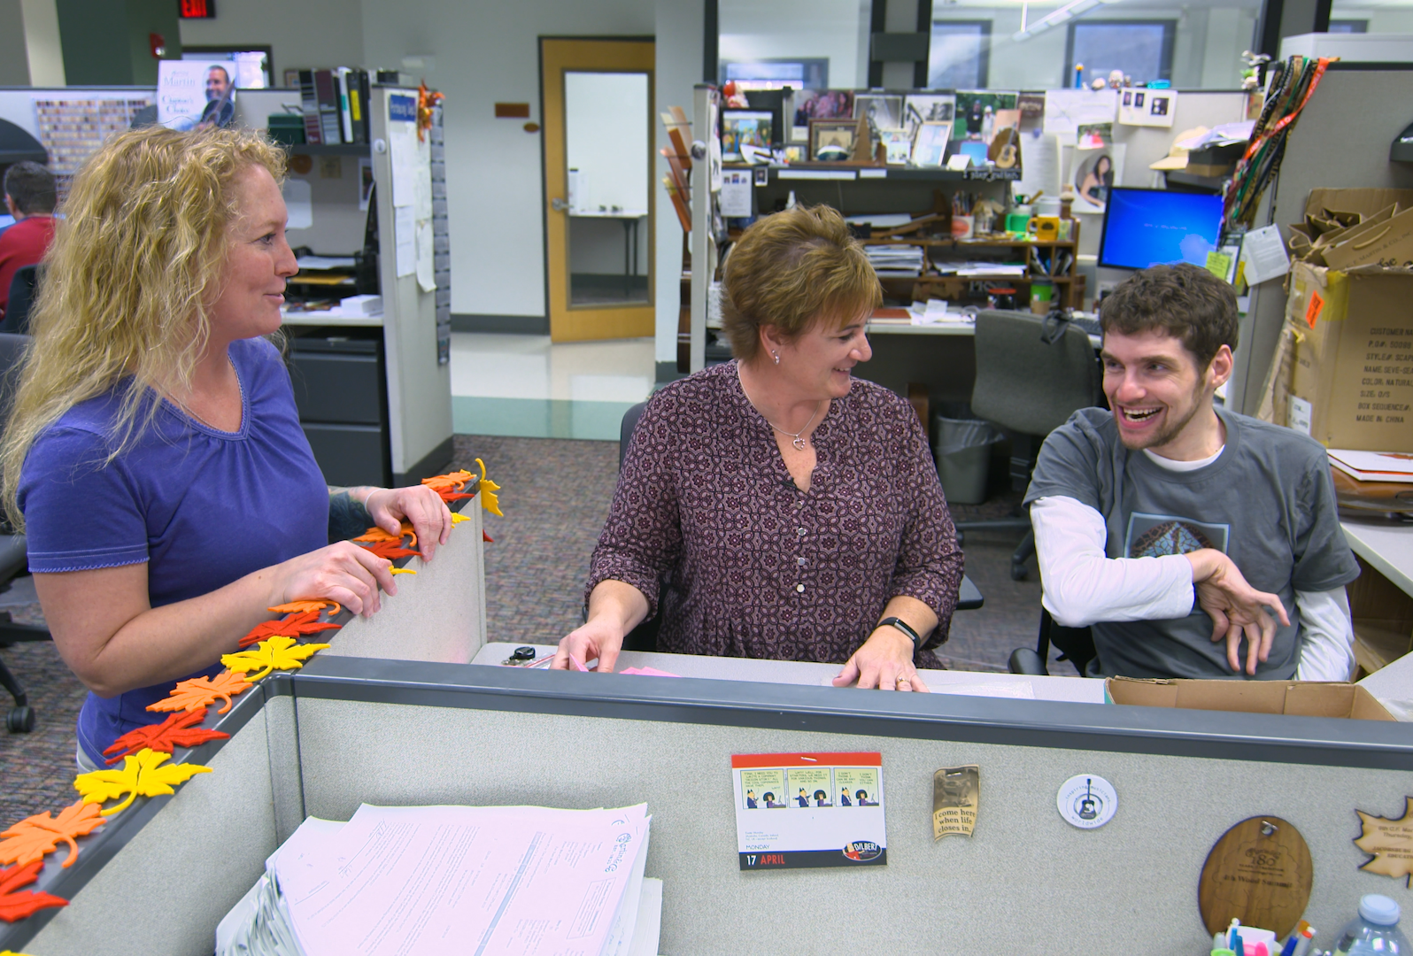
Eight Steps to Build a DSP Career Ladder
Hold stakeholder group gathering
Develop mission, vision, values, and goals
Create framework
Investigate and locate possible funding sources
Design training components
Implement program
Evaluate program
Plan for sustainability
Notes:
Talking Points:
When building a DSP Career ladder thinking about is is a sequences of steps in critical. These steps are not dissimilar to the 8 steps of implementation that we have been reviewing with you each session. The fundamental difference is looking as this as developing the best career ladder for your organization.
For example the following section of the 8 steps of implantation can be seen in the Eights steps to building a DSP career ladder. Note: If running behind, can just review quickly. If you want to go deeper:
Hold stakeholder group gathering - Gathering feedback from those with a stake in the process with support you in making informed decisions about your career ladder, and aligning the MVV and goals of that ladder with your organizational MVV and goals is important.
Step 1: Identify and assess the problem
Step 4: Identify barriers to implementation
Develop mission, vision, values, and goals – Does this align with your organizational MVV and Goals?
Step 1: Identify and assess the problem
Create framework- By creating a framework for what the career ladder is you will support people to understand to important steps to success in climbing it.
Step 3: Identify components of the strategy
Step 6: Set goals, measure progress & establish a time frame
Investigate and locate possible funding sources – What are ways you will be able to financially sustain this program? What are other ways it will need to be “funded”. Who can you enroll to ensure you have buy in to keep it going?
Step 5: Identify support for the strategy
Design training components – This is a long term plan that starts with orienting and onboarding people into the program and then has a clearly laid out path of training based upon competencies that they will need to success in their upcoming roles as they move up the ladder.
Step 3: Identify components of the strategy
Implement program – What is the role out plan. How is it communicated? What does it look like? Who is involved in getting the word out? Do you start small with one program and scale up at different points of measurement.
Step 7: Implement the strategy
Evaluate program – What worked and what did not work? What needs to change, what needs to remain the same?
Step 8: Evaluate success (7)
Plan for sustainability – This needs to be done along the way and informed by the other steps. Its can’t be an after thought. What does this look like going forward. Sometimes that may mean reviews and changes at specific intervals. Sometimes it will mean adjustments on the fly.
Step 5: Identify support for the strategy

Slide 40
Benchmarks of a Quality Credential Program
Competency Based
Transportable
Stakeholder Guided
Accessible
Articulates to other educational awards
Adds value
Uses valid, reliable, fair assessments
Incorporates method of revising standards
Requires periodic recertification/renewal
https://z.umn.edu/FICredentialing
From Taylor, M. A. (2007). If you build it, they will come. Frontline Initiative: Credentialing, 7(2).
Notes:
Talking Points:
A quality credential program should be Review bullets

Slide 41
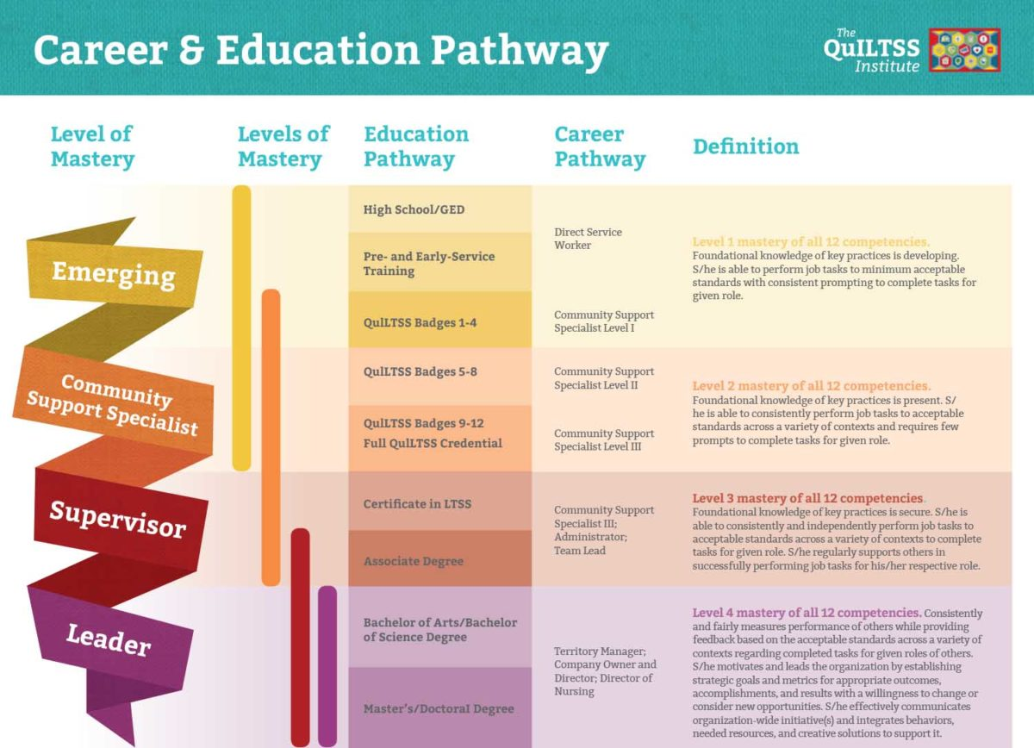
Notes:
Talking Points:
As Shannon from TennCare talked about in Session 1, the QuILTSS Program will be offering a Career and Education Pathway. We will have a webinar on this and the QuILTSS apprenticeship program in 2021.

Slide 42

National Alliance for Direct Support Professionals
NADSP Vision
A world with a highly qualified and professional direct support workforce that partners with, supports and empowers people with disabilities to lead a life of their choosing.
NADSP Mission
To elevate the status of direct support professionals by improving practice standards, promoting system reform, and advancing their knowledge, skills and values.
Notes:
Talking Points:
Recently the NADSP has come up with a Badging program to support their national credential. It is based upon their mission, vision and values to create highly skilled and recognized DSP. They were able to take this MVV and translate it to what they want to be sure their program produces as far as credentialed workers. Not A Mission vision and values statements are just one portion of it. Let's take a look at some other components the accompany this credentialling program.
Intro NADSP Mission and Vision Statements Discuss the importance of mission and vision statements being simple and easy for all to work towards. Tie that to the next slide and how the products work towards the mission and vision.

Slide 43
NADSP Voluntary Credentialing Program
NADSP Code of Ethics
Accredited Education Training on 15 NADSP Competency Areas
Skill Demonstration and Assessment-The DSP Portfolio
Portfolio Development-NADSP
E-Badge Academy
Portfolio Review and Assessment
Notes:
Talking Points:
Briefly discuss these points of the Voluntary Credential Program.

Slide 44
DSP Networking
Helps builds a successful DSP career.
Is a valuable part of a good orientation process.
New DSPs can get to know their new colleagues.
DSPs learn from others who have been in their position.
Get advice
Learn how to excel
Get new ideas
Share their knowledge and skills with colleagues.
Notes:
Talking Points:
Networking is significant for DSPs to build a successful career.
Networking precedes a good orientation process, allowing new employees to get to know their new colleagues.
When networking is successful, DSPs can reach out to others within the organization who have been in similar roles or positions to help them learn more about their new position. DSPs can get advice about their roles, learn how to excel, get new ideas, make new friends, and learn from one another.
They can collaborate to provide better opportunities for the people they serve.

Slide 45

Professional Identity and Recognition
Notes:
Talking Points:
DSPs may feel isolated within their own organization.
Frontline initiative is an online publication developed by ICI at U of MN in partnership with NADSP.
It can be used as a resource for DSP and FLS to find national identity.

Slide 46
For more details
tenncare.ici.umn.edu
Toolkit
Retention
Webinar
Employee Development
Notes:
Review Slide

Slide 47
What are the Challenges?
Step 4: Identify barriers to implementation
Step 5: Identify support for the strategy
Notes:
Timing for slides 47-50: 5 minutes
Talking Points:
Let’s say that the challenges your organization is facing is that DSP’s are quitting between 6-12 months or even after working in your organization after a year. They tell you that they are unsure of their job roles, they don’t get enough training and or support from their supervisors.
Some of the strategies we discussed align with these strategies.
If you are considering using one of the strategies that we just discussed, you will want to think about what barriers you might face to implement. If you’ve already tried some of these strategies and you didn’t get the results you expected, explore why. What got in the way?
Once you’ve identified barriers to implementation and have plans in place to address them, the next step is to ensure you have adequate support to implement. What resources both financial and human do you have available? Do you need the support of the board? The executive leadership?
These are just some things to consider in steps 4 and 5.

Slide 48
Connecting challenges, data, and information to strategies
Step 6 – Set goals, measure progress and establish a time frame
Notes:
Talking Points:
As we talked about earlier, the next step in implementation is to think about the goal(s) you want to set.
You will also need to consider your timeline for implementation and how you will measure progress, will you meet regularly to review and track progress? How often will you meet? What results/data will you focus on in measuring your progress?

Slide 49
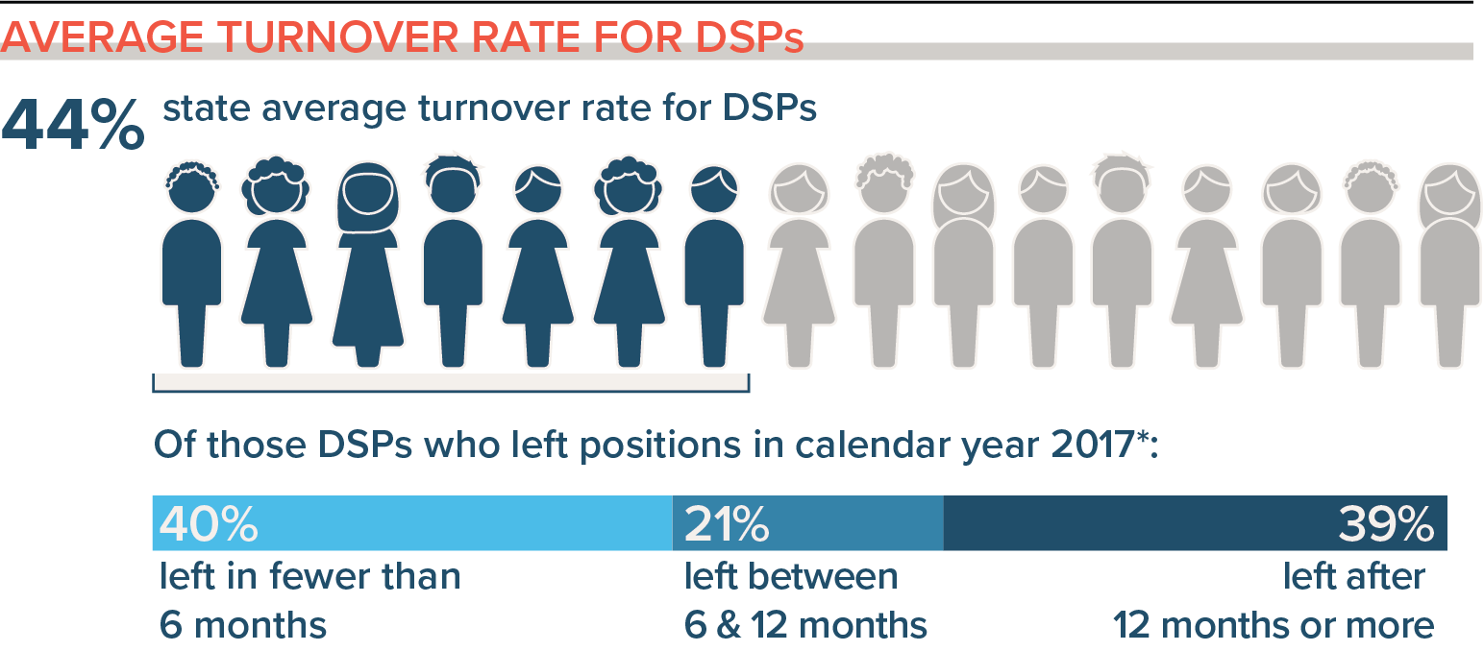
Retention Strategies
Connecting strategies with the data
Notes:
Talking Points:
This data is from NCI (National Core Indicators)
What does your organizations Profile tell you about turnover?
If the data you are focusing on is the turnover rate, you will need to select the strategies that will work best for your organization.
It should be based on the detail in your data, then you can select and fully develop the strategy through all of the implementation stages to get the best result.
If you don’t get positive results, you may have selected the wrong strategy. But you skill have good data that can guide you to what to try next.

Slide 50
Self-Assessment Workbook
Matrix - workbook page 24
Step 2-Select an Intervention Strategy
Challenges
Conflict between staff and supervisors or managers
Intervention Strategies
Training doesn’t produce results
Participatory management
Recognition
Morale problems
Support & train supervisors
Teams/Team-building
Rewarding long-term employees (high performers)
Supervisors have difficulty finding time to coach and mentor new staff
Develop peer mentoring programs
Notes:
Talking Points:
In the Self-Assessment workbook, on page 24 you will find a Matrix of Workforce Challenges and Intervention Strategies.
When your challenges are: read challenges
These are the intervention strategies: read

Slide 51
Breakout Conversation
Reflecting on Your Retention Practices
What retention strategies have you tried in your organization to address workforce challenges?
  What were you pleased about?
  What have you learned?
  What are you concerned about?
Based on this, what next steps are you thinking about?
Notes:
Total Timing for activity: 10 minutes
Activity : (5 minutes) – 5 people per breakout, each person gets one minute, assign 1 consultant or coach to each breakout group
Purpose: Gives consultants and coaches opportunity to learn who is in the room.
Talking Points:
We are going to have the opportunity to get to know who is in the workshop today. In a moment but not yet, you will be send to a Breakout room with 5-6 others.
Everyone will have the opportunity to:
answer the questions on the screen.
When you get to your group, find one facilitator and another person to report back for the group the responses to the two questions.
When the group returns call on the reporter from each group to report back on themes for questions #1 and #2.

Slide 52
Goals Setting and Measurement
What change do we want to see?
(SMART Goals)
How are we going to measure
Trackable and measurable
vs. anecdotal
How long will this take/how long will we measure for?
How will we know its working?
(Step 8 – Evaluate Success)
Notes:
Timing for slides 52-57 (slides before conclusion): 4 minutes
As a reminder, When you are ready to set your goals and measurements you may want to use these questions. Read slide
Notes about SMART Goal for facilitators, not script
S = Specific
Be as clear and specific as possible with what you want to achieve. The more narrow your goal, the more you’ll understand the steps necessary to achieve it.
Example: “I want to earn a position managing a development team for a startup tech company.”
M = Measurable
What evidence will prove you’re making progress toward your goal? For example, if your goal is to earn a position managing a development team for a startup tech company, you might measure progress by the number of management positions you’ve applied for and the number of interviews you’ve completed. Setting milestones along the way will give you the opportunity to re-evaluate and course-correct as needed. When you achieve your milestones, remember to reward yourself in small but meaningful ways.
Example: “I will apply to three open positions for the manager of a development team at a tech startup.”
A = Achievable
Have you set an achievable goal? Setting goals you can reasonably accomplish within a certain timeframe will help keep you motivated and focused. Using the above example of earning a job managing a development team, you should know the credentials, experience and skills necessary to earn a leadership position. Before you begin working toward a goal, decide whether it’s something you can achieve now or whether there are additional preliminary steps you should take to become better prepared.
Example: “I will update my resume with relevant qualifications, so I can apply to three open positions for the manager of a development team at a tech startup.”
R = Relevant
When setting goals for yourself, consider whether or not they are relevant. Each of your goals should align with your values and larger, long-term goals. If a goal doesn’t contribute toward your broader objectives, you might rethink it. Ask yourself why the goal is important to you, how achieving it will help you and how it will contribute toward your long-term goals.
Example: “To achieve my goal of being in leadership, I will update my resume with relevant qualifications so I can apply to three open positions for the manager of a development team at a tech startup.”
T = Time-based
What is your goal time-frame? An end-date can help provide motivation and help you prioritize. For example, if your goal is to earn a promotion to a more senior position, you might give yourself six months. If you haven’t achieved your goal in that timeframe, take time to consider why. Your timeframe might have been unrealistic, you might have run into unexpected roadblocks or your goal might have been unachievable.
Example: “To achieve my goal of being in leadership, I will update my resume with relevant qualifications so I can apply to three open positions for the manager of a development team at a tech startup this week.”
Why should I use SMART goals?
Using the SMART goal framework sets boundaries and defines the steps you’ll need to take, resources necessary to get there and milestones that indicate progress along the way. With SMART goals, you’re more likely to achieve your goal efficiently and effectively.

Slide 53
Putting the Plan into Action
Step 7 – Implement the strategy
Notes:
Talking Points:
When a strategy has been assessed and developed it is time for step 7: implementation.

Slide 54
Organization Self-Assessment Workbook
Pages: 26 – 27
Action Planning Worksheet
Notes:
Talking Points:
The action planning worksheet can be used to develop your strategies and divide the work among your team.

Slide 55
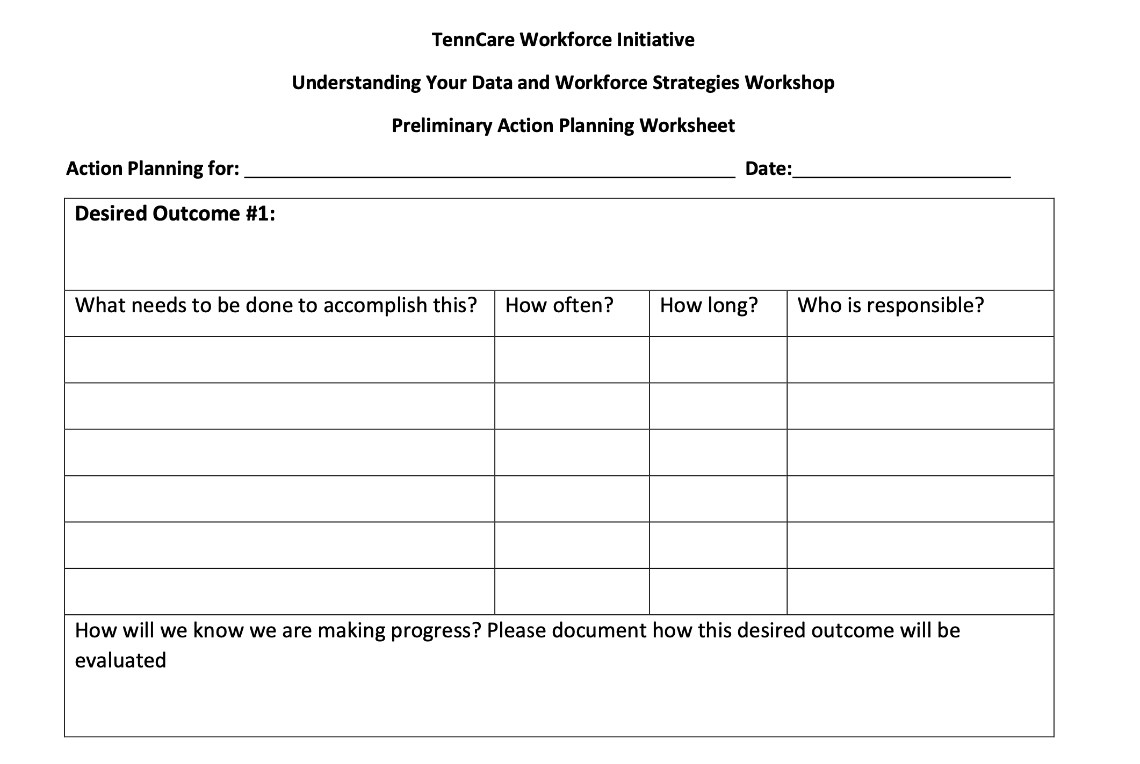
Notes:
Talking Points:
Identify what the strategy is and the desired outcome
What steps will need to be done to accomplish the outcome?
How often or when will you start the working on that step?
How long will it take?
Who will be responsible for it?
How many of you are starting to think about action plans? (use reactions) You may already have a similar planning process within your organization that you will use. For others, using the action planning worksheet may be a way to bring focus to some of your current and future workforce activities.

Slide 56
Evaluating the Efforts
Step 8 - Evaluate Success
Notes:
Talking Points:
Step 8, Evaluation, is extremely important because it helps the organization to circle back and celebrate success, learn where additional needs may arise and revise plans to move forward.

Slide 57
Notes:
Talking Points:
It is important to decided when you will evaluate your progress and
How you will know if you are making progress, or in other words how will you evaluate it?
What data do you collect or would you need to collect to know you are making progress?

Slide 58
Organization Self-Assessment Workbook
Purpose:
To identify areas of strengths and areas of needed improvement in your respective organizations to build capacity to address direct support workforce issues.
z.umn.edu/TennCareSelfAssessment
Please submit online using this link by the end of session 7. There will be time during session 7 to submit.
Notes:
Talking Points:
The self-assessment workbook is intended to be an important discovery tool for your team to understand your areas of strength and areas for growth. This information is intended to help you and your consultant team to understand your priorities and needs.
The link on the screen is a place for your team to enter the information to provide you with an electronic record and to communicate with your consultants. Please complete the self assessment workbook and submit using the link by the end of the Kickoff Workshop session 7.

Slide 59
Menu of Technical Assistance
**Please complete by the end of session 7 z.umn.edu/TennCareTAOptions
Option C
Access to online Tennessee Workforce Toolkit
Option B
Consultation from UMN workforce consultants upon request
Option A
Regular monthly individualized consultation with UMN workforce consultants and TN Regional Coaches
Access to online Tennessee Workforce Toolkit
Option to participate in Regional Workforce Community of Practice
Access to online Tennessee Workforce Toolkit
Option to participate in Regional Workforce Community of Practice
Option to participate in Regional Workforce Community of Practice
Notes:
Talking Points:
As we have discussed throughout the Kickoff Workshop, there are opportunities to continue the conversation by accessing resources related to this project after the workshop is finished. There are three options that your organization can choose from.
All the options include access to the online TN Workforce Toolkit and the option to participation in the Regional Workforce Community of Practice. Option C includes these items.
Option B gives you access to consultation from UMN workforce consultants (that’s us) upon request. That means that you can reach out to consultants to schedule a phone call or virtual meeting as desired.
In Option A, you can receive monthly individualized consultation with UMN Workforce Consultants to help you move through selecting, implementing and evaluating the strategy you choose.
Please complete the survey for your organization by the end of the Kickoff Workshops (session 7). Consult with your organization to determine the level of technical assistance that is best for your team. You can change the level of Technical Assistance that you would like to receive at any time during the consultation year by emailing your consultant or dsp-tn@umn.edu.

Slide 60
Questions about Retention Strategies Covered Today?
You will receive the slides from today’s workshop so that you can have further discussions about the information in this session.
If you have questions:
Contact your University of Minnesota workforce consultant
Email us at: dsp-tn@umn.edu
If you haven’t provided us with your Key Contacts please do
at: https://z.umn.edu/C2KeyContacts
Notes:
Facilitator Note: improvise based upon the amount of time left. If time, can ask for questions now, if not, read the slide.

Slide 61
What’s Next
You will receive the slides from today’s workshop so that you can have further discussions about the information in this session.
Session #7: Planning Your Next Steps: Measuring Outcomes of Implementation and Creating a Practical Action Plan for Change
Homework before our next session:
  Review the Organizational Workforce Self-Assessment Workbook sections on Retention with your teams
  Make a plan with your team to complete your Online Organizational Workforce Self-Assessment
  Check out Retention Strategies and Tools on TN DSP Workforce Toolkit: https://tenncare.ici.umn.edu/
Notes:
Talking Points:
Your final Workshop is Session # where we will discuss……………………………………. We will be meeting on: (insert date and time)
Your organizations key contacts should plan to attend this workshop. You can invite other members of your team to attend any of the upcoming workshops as you like.
You should have already received the link to this and the other workshops. If you don’t have the links please contact us at the email address on the preview screen: dsp-tn@umn.edu
Your homework is to: read slide
Go to the last slide

Slide 62
Thank you
See you next week!
Notes:
Thanks and goodbyes

