Slide 1



Welcome to the Webinar Series on the Workforce Toolkit.
We will begin at 2:00 pm central
Notes:
Facilitor Notes:
Host and Co-host notes for pre-meeting setup​​
Actions before the session:​​
Slide #1 – Update presenter names​​
Hide the other region consultant slide, as applicable​​
Hide other regions workshop slide for Upcoming Workshops, as applicable​​
In the Practice session before participants log on​​
Check that the presenter can share their screen and run videos as needed​​
Check that the presenter marks “Share Computer sounds” and “Optimize Screen sharing for video clip” so that any videos shown can be heard by others – it is on the same screen that you choose which screen to share. ​​
Make Coaches "Co-hosts"​​
Confirm polls are loaded - host​​
Turn on transcript –host ​​
Break-out Groups – host ​​
Take attendance​​
Time keeper​​
Host / Welcome people as they arrive & arrive late – assign someone​​
Monitor Chat – assign someone ​​
Turn on record, as desired ​​
Subtitles – turned on, each participant can control turning on and off ​​
At end of presentation:​​
MAKE SURE TO STOP RECORDING AT THANK YOU SLIDE​​
​
Note to Facilitator​​
Bold Text = Timing ​​
Italicized Text = Notes – do not read ​​
Regular Text = Talking Points ​​

Slide 2
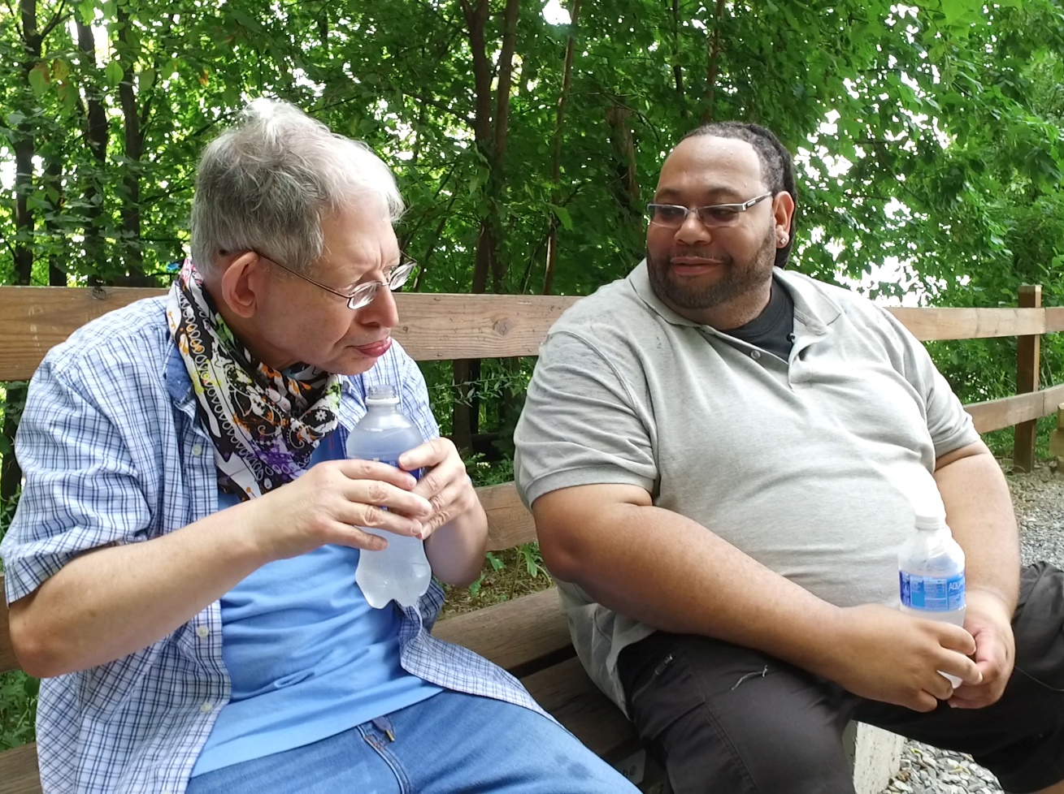
Structured Behavioral Interviews
Insert Presenter name and affiliation
Notes:
Facilitator Note: Update slide presenter information
Time: This slide deck is meant to be completed in 40-45 minutes. Content slide each take about 1 minute per slide.
Action – Record as desired
Talking Points:
Welcome.
My name is xx and I am a xx with the Institute on Community Integration at the University of Minnesota. I am here today with my colleagues from the University of MN, __________ and ________________. Also Regional Coaches from Tennessee ____________________ and ___________________.
Thank you so much for joining us today.
Facilitor Note:
If this is being recorded: This webinar is currently being recorded. We will send the recording to you if you would like to view again or share with others in your organization.
Talking points:
I’m pleased to have the opportunity to speak today on this important part of the section process, the Structured Behavioral Interview.
What is the Structured Behavioral Interview?
It is a technique used in the selection process for hiring direct support professionals.
Using structured behavioral interviewing techniques can help increase DSP retention by helping organizations get to know the candidate better and to select the best matched candidate for the position.
Selection is based on the premise that a mismatch between the employee’s skills and the job requirements can lead to
- poor performance and termination of the employee
- under qualified and / or dissatisfied employees who voluntarily quit,
- and / or overqualified employee who quits early in their tenure.
Structured interviews are a technique designed to increase the likelihood that the employer will gather the information needed to determine whether an applicant is a good match with the organization’s culture and has skills needed for the job.
It includes interview questions that provide the interviewer with valuable information about the candidate.
The candidate’s answers are scored based on established clear criteria for evaluating responses. Using a score guide helps the interviewer rate responses to interview questions and provides scoring consistency among interviewers.
Another aspect to the structured behavioral Interview technique is working with a team of people to develop interview questions that are relevant to the role and expectations of the job for the DSP.
This same team develops a score guide that describes what constitutes an excellent, average, and poor response to the questions.
A word of caution when developing questions:
- Organizations must attend to developing and asking legally defensible questions in the interview process.
-There are many legal issues related to hiring and selection practices that are not addressed in this webinar.
- To be sure always consult human resources or legal departments to make sure the questions you develop and ask are allowable.

Slide 3
A Structured Behavioral Interview
Predicts future behavior
Measures a candidate's response to a situation, behavior, or outcome
Focuses on DSP core competencies
Notes:
Talking Points
Let’s dig in now and talk about the components for a Structured Behavioral Interview.
Research tells us that the best predictor of future behavior is past behavior in similar situations. Asking candidates how they have handled situations and what the outcome was, will give you information that is valuable in understanding the candidate and how they might handle a similar situation in the future.
Asking situational questions regarding the extent of situations where the candidate describes the situation with best/worst, hardest/easiest, or most/least can tell you a lot about the person’s tolerance level of difficult situations.
This will tell you if they are a match for the organizations mission and values.
If how the person handled the situation is not a match for the organization, would you consider providing training so they would learn how to handle the situation differently if they worked for you.
These situational questions are best when they are built on the NADSP competency areas and are related to an actual job-related situation.
NADSP is the National Alliance for Direct Support Professionals.

Slide 4
Example:
NADSP Competency Area 1: Participant Empowerment
Describe a situation when you assisted an individual in recognizing that they had several choices in how to handle a difficult problem.
What did you do in the situation?
What was the outcome?
Notes:
Talking Points
This is an example in the first NADSP Competency Area called Participant Empowerment.
Describe a situation when you assisted an individual in recognizing that they had several choices in how to handle a difficult problem.
What did you do in the situation?
What was the outcome?

Slide 5
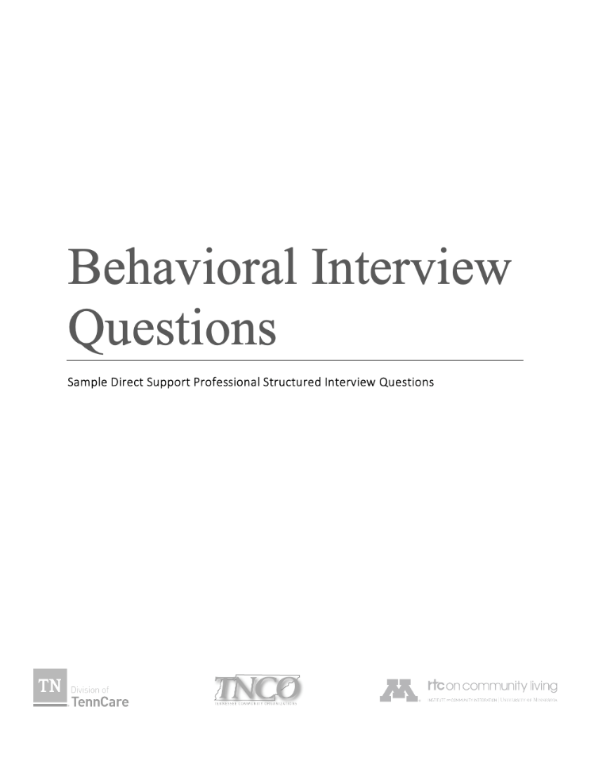
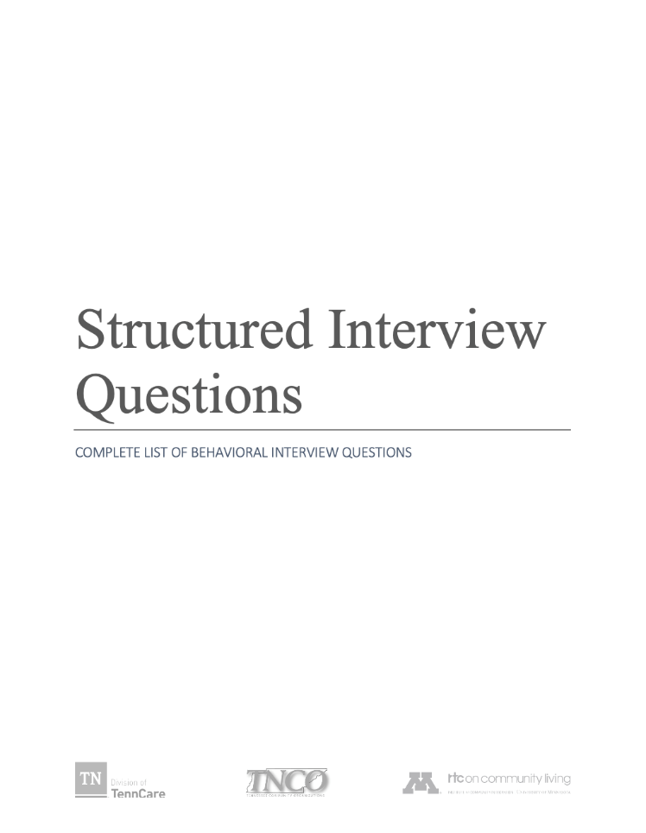
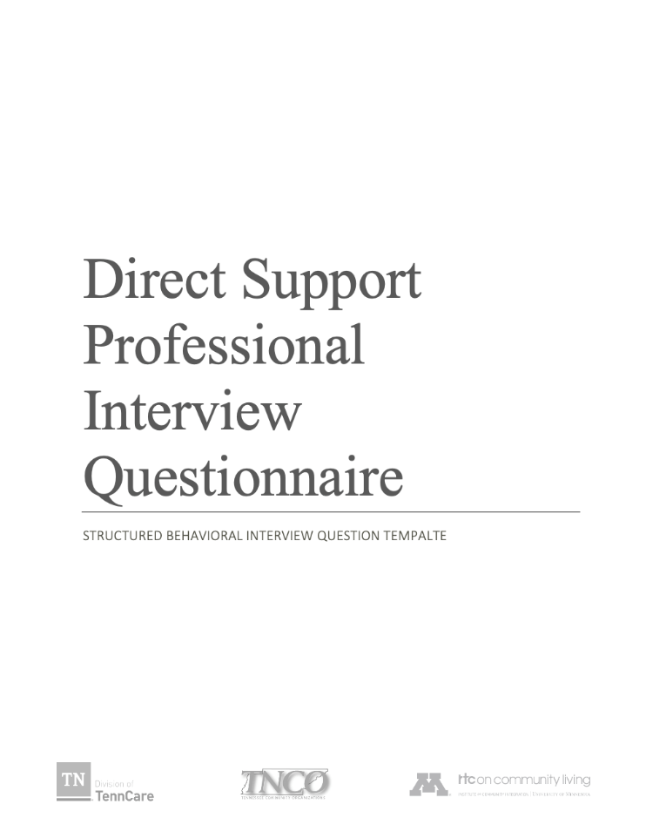
Structured Behavioral Interviews for DSPs
Notes:
Talking Points
We have three tools available for you. Contact your UMN consultant if you want these resources sent to you.
The first is the “A Users Quick Guide” to behavioral interviewing.
It provides instruction regarding determining the important components of the interview. It includes things like, who to include in writing the interview questions, and the” importance of” and “how” to set up the Score Guide.
The Structured Interview Questions: Complete List of Behavioral Questions is a series of questions designed to produce behavioral oriented responses aligned with national competencies for DSPs.
There are 3-6 sample questions in each competency area. You may decide to use the questions in the tool or use the questions to spark an idea for a question that is relevant to your organization.
The Interview Questionnaire a sample template for the interview, along with an example score guide.

Slide 6
Structured Behavioral Interviews
Determine screening or pre-interview questions
Determine the behavioral / situational questions
Determine the baseline for scoring the responses
Determine how to make a hiring decision and job offer
Notes:
Talking Points
Let’s take a deeper dive into what and how structured behavior interview techniques are used in the selection process.
These are four components we are going to talk about today regarding the development of Structured Behavioral Interviews.
First, we will talk about Pre-Interview or Screening questions to learn if the candidate meets your job requirements.
Second, we will talk about how to determine your behavioral and situational questions
Third, we will discuss how to develop your Score Guide to use for all interviews.
Fourth, we will discuss how to make your hiring decision and how to use matching and job carving to determine the best role for the candidate.
We will discuss each of these steps in more detail on the following slides.

Slide 7
Screening or Pre-Interview Questions
Are they qualified?
  What experience do you have supporting people with disabilities or children?
  How did you hear about this job?
  Do you have a valid driver’s license?
  Can you lift a certain number of pounds?
  Have you ever been convicted of…
  Are you available to work specific days and hours when there are openings?
Notes:
Talking Points
Do you have screening or Pre-interview questions? For some organizations this is done by the HR department.
For smaller organizations, it might be the person who is interviewing.

Slide 8
Components of the Structured Interview
Use consistent interview questions for all candidates.
  Include frontline supervisors and the best DSPs to determine the questions and the score guide
  Job-related questions may be based upon the National Alliance for Direct Support Professionals (NADSP) Competency Areas
  Ask all candidates the same intentional, job-related questions
Notes:
Talking Points
Now that you know what behavioral and situational interview questions are. Now is the time to consider the main components.
Make sure everyone who is helping develop the questions knows the employer’s mission and values. Involve your frontline supervisor and the best DSPs.
Use the NADSP competency areas to then determine which areas are most important for you to focus on in the first interview.
If you do a second interview, you may focus on different competency areas.
It is important that all interviewers us the same job-related questions for each candidate.

Slide 9
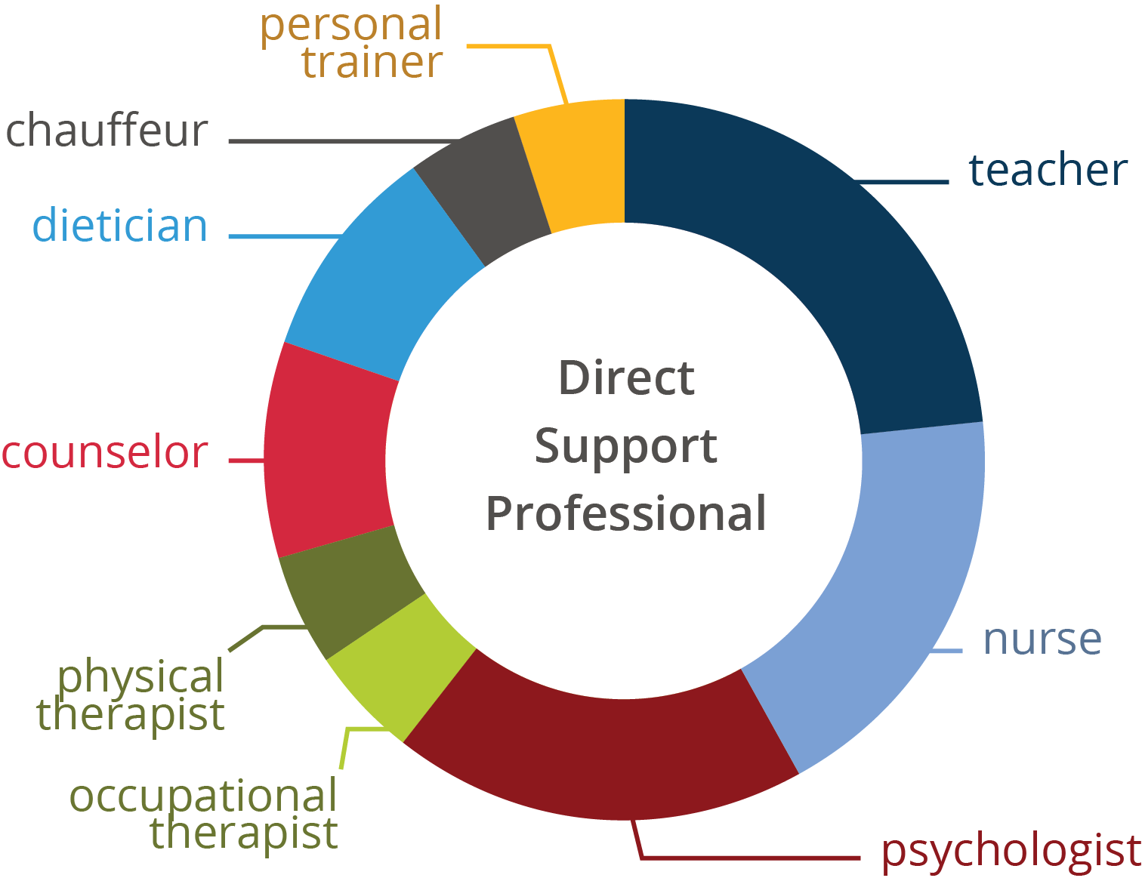
Direct Support Professionals Scope of Practice
Hewitt 2017
Notes:
Talking Points
The DSP wears many hats. This is one provider’s DSP scope of practice.
This visual may be helpful for the individuals who are developing the interview to keep those multiple roles in mind when developing the questions.
You may want to use this visual with DSP candidates during the interview so they can get a better idea of the many parts of a DSP’s job responsibilities.
Seeing the roles visually will help the candidate better understand the duties of a DSP.
It may prompt questions for them to ask the interviewer.

Slide 10
Developing the Questions
All questions should be relevant to the job. For example:
We know that DSPs need to think on their feet.
Tell me a time when you had to make a quick decision.
Notes:
Talking Points
All questions need to be relevant to the job.
Ask questions that will also help the candidate know what is expected in the job.
If they will be assisting people who need help with personal care, then ask them if they have ever assisted a child or adult with bathing, tooth brushing, or using the bathroom. If they have, what was that experience? Lastly, how did they feel about helping with these tasks?
If the position requires them to work with individuals who show challenging behaviors, ask if they have experienced with anyone who has challenging behaviors or actions.
Ask them to explain a situation and what they did in that situation.
Follow up with asking if they are willing to support people who sometimes have challenging behaviors.
This would be a good time to descript situations that they might encounter on the job if they work with your organization.
You can also talk about the type of training you will provide them to handle these situations.

Slide 11
Behavioral and Situational Questions
The best indicator of future behavior is:
Past behavior in similar circumstances
Past recent behavior or longstanding behavior
Notes:
Talking Points
Another type of behavior situational question asks the candidate to choose between how they would handle a situation based upon the greatest extent of a situation.
For example: Tell me about your best day at your last job.
Tell me about your toughest day at your last job.

Slide 12
Behavioral Questions – Example 1
Behavioral questions ask the candidate to describe a situation that they faced, what they did, and what the result was. For example:
Describe a time when you didn’t understand a task that you were asked to complete. What did you do and what was the result of your actions?
Notes:
Talking Points
How they answer the question will give you a great deal of insight on how the candidate will handle situations that might arise.
Responses indicate skills, ability, and personality of the candidate.
Basically, the logic for these questions is that how a candidate handled past situations may predict how they will react to new or current situations.
These are not yes or no questions. The candidate is expected to explain or discuss their past experiences.
This type of questions will yield the information that you need to understand the candidate.

Slide 13
Behavioral Questions – Example 2
The best behavioral interviews ask the candidate to describe the greatest extent of a situation:
best/worst
most/least
hardest/easiest
Notes:
Talking Points
The candidate’s response to the question will give you an indication of:
if the work environment is a match for them,
what they will do to get undesired work done well, and
their barometer of what is hard for them.
Examples:
Describe the best work environment for you.
Tell me about the household chore you enjoyed the least. How do you ensure it gets done?
Share the hardest job task or school assignment you have been given.
This type of open-ended question will give you a response that indicates how they view extremes of situations.

Slide 14
Behavioral Questions – Example 3
Effective behavioral questions ask the candidate about the first and the last time a situation occurred and how they handled the situation each time.
Did they handle it the same each time or did they change their response based on what they learned the first time the situation occurred?
Notes:
Talking Points
Asking questions regarding the first and the last time a situation occurred and how they handled it is another type of behavioral question.
As an interviewer, you are able to discover if they learned anything from the first time it occurred and if they were able to handle the situation better than they did the first time.
You can learn if they have become more skilled in their approaches to challenges.

Slide 15
Behavioral Questions – Example 4
Describe the first time you dealt with a child or adult who was upset and acting out.
  What did you do? What was the result?
Describe the last time you dealt with a child or adult who was upset and acting out.
  What did you do? What was the result?
Notes:
Talking Points
Here are two example of questions that ask about the first and the last time a situation occurred.
Describe the first time you dealt with a child or adult who was upset and acting out.
What did you do? What was the result?
Describe the last time you dealt with a child or adult who was upset and acting out.
What did you do? What was the result?
Through these behavioral questions, you will learn how well did they handle the stress of the situation?
You could do a follow up, such as “if that situation presented itself again, how would you handle it today?”

Slide 16
Behavioral Questions – Example 5
Ask the candidate about their most significant accomplishments.
What will you learn about the person through this question?
Notes:
Talking Points
Asking the candidate about their most significant accomplishment tells you what the person values, what they take pride in, and to what extent they are willing to go to achieve something important to them.

Slide 17
Situational Questions
Are based on goal-setting theory
  Suggests that intentions are related to actual behavior.
Are situational dilemmas
  Forced to choose between two or more equally desirable or undesirable courses of action.
Notes:
Talking Points
Situational Questions are based on the goal-setting theory which suggest that intentions are related to actual behavior.
In this type of question, the candidate is given a situation which there is a dilemma. They are then forced to choose between two or more equally desirable or undesirable ways to handle the situation.
Here are two examples:
#1
Image that you observed one of you co-workers interact with a family member of a person that you are supporting in a blatantly disrespectful way. The family member knows that you observed the interactions and has asked for your help to report it to the supervisor. The co-worker is a friend of yours and recently has confided in you that they have been under a lot of stress due to a serious family situation. Do you report the co-worker to the supervisor and run the risk of losing a friend and co-worker that you like or do you let it go, knowing that if you don’t report it, it could come back to you and that you covered up the situation by not reporting it?
#2
Your supervisor contacted you and said you have been awarded employee of the year. For your reward, you get to choose between having a “celebration” in your honor where you decide “where and when” the celebration will occur and who you want to invite, OR you can take 5 extra Payed Time Off days at the time of your choosing, OR a gift card to a local store for $1,000. Which do you choose and why?

Slide 18
Which type of interview question is most effective?
Studies have shown that both behavioral and situational questions can help identify the best candidate if:
  Questions are based upon the job responsibilities
  All candidates are asked the same questions
  Scoring guides are used
  Panels are used rather than one-to-one interviews
Notes:
Talking Points
You might wonder if the behavioral or the situational interview questions are more effective.
Research shows that both are effective as long as the questions are based on the job assessment and all candidates are asked the same questions.
Using a score guide for every interview is needed and it is better to have a panel of interviewers, verses having just one interviewer.

Slide 19
Eliciting More Information
Clarifying questions such as “What do you mean by…”
Seeking more information to build on previous statements, such as “Could you tell me more about…?”
Repeating a question that was asked but not answered
Clarifying what has been said that seems to be inconsistent
Summarizing key ideas
Notes:
Talking Points
Sometimes you need to learn more from the candidate.
Even if you ask open-ended questions, some candidate’s answers may be short and not yield as much information as you need in order to best understand the candidate and why they responded the way they did.
You can ask clarifying questions such as: “What do you mean by...?” or “Could you tell me more about…?”
Sometime candidates ask to come back to a question later.
When you come back to it, you may need to rephrase the question.
If they are having trouble understanding the intent of the question, further explain by giving an example.
If there seem to be some inconsistencies between what they said, or what they provided on their application, ask about the discrepancy.
You can ask a candidate to summarize key points if their answer was lengthy.
During the interview is the time to learn as much as you can to make a good hiring or matching decision.

Slide 20
Bonus Question to Gauge Their Interest
One a scale from 1- 10, with 1 being the least interested and 10 being the most interested, how interested are you in the job and why?
If they aren’t at a 8-10, ask “What could get your score higher?”
Notes:
Talking Points
This a great indicator to see if you should consider moving forward with this candidate.
You can ask – “Now that you have had a chance to learn and ask questions about the position and the organization, on a scale from 1-10, how interested are you?
One a scale from 1- 10, with 1 being the least interested and 10 being the most interested, how interested are you in the job and why? ​
If they are interested, then you know how interested they are.
If they are interested but give an interest score of less than 7, you can ask, what would get them to a higher rating? By asking this question you can learn a lot about what you many need to do to make the job more attractive to a candidate you are interested in.
If they are not interested, you will learn that during the interview. This can save you time from moving them further into the interview process.

Slide 21
Additional Considerations
Does information in the interview match or conflict with anything on the application?
Does the candidate show discomfort in discussing certain information regarding their background?
Was the candidate on time or early for the interview? This could be a predictor if they will be on time or early for work.
Notes:
Talking Points
The interviewer has additional things to consider when making a selection decision.
Was there anything that didn’t match up, or was inconsistent, between the interview and the application?
Was there anything that the candidate seemed uncomfortable with during the interview or when interacting with others?
Was the candidate early or on time for the interview?
These factors may influence your hiring decision.
The questions they ask also will give clues as to how interested they may be. Interviewers can also gage things like the candidate’s attitude about supporting individuals who receive services.

Slide 22
Work Samples
Have candidates complete a work sample
The sample would be a task that is related to the actual job.
It gives the candidate the opportunity to experience a bit of the job.
  For example, the candidate could use an augmentative or alterative communication device to interact with individuals who receive services.
Notes:
Talking Points
Work samples can provide additional information about the job candidate.
Work samples are an assignment given to job candidates based on typical work done on the job.
Then they are used to evaluate and gage the candidate’s skills in completing these assignments.
They are based on real job expectations.
They provide different information than the interview questions.
Work sample assignments can be done at the time of the interview, or they can be something candidates are asked to submit prior to or at the time of interview.
There are candidates who don’t interview well. This may reveal some of their other skills.
You can be creative to think about how to have the candidate do a work sample.
Most DSPs are required to document progress notes. You could have them watch a video of a situation and then document what they observed. This will give you sample of their writing skills.
If they are applying to work at an employment program, you could visit the location with the candidate and observe how they interact with the people receiving services. Are they comfortable or not? How did the people receiving services respond to them?

Slide 23
The Score Guide
After determining the interview questions, establish clear criteria for evaluating responses to the questions.
Identify what makes up an excellent vs. poor response
Involve your best performing DSPs and Frontline Supervisors to determine the questions and what constitutes the best to worst responses
Write down the scoring guide that everyone will use for all candidates.
Notes:
Talking Points
A scoring guide is a rating scale use to evaluate candidates based on their responses to the questions and other information you gather during the interview.
This helps you compare candidates and make decisions if the candidate is a match for the position and the organization.
All interviewers need to use the same questions.
And there needs to be the scoring guide for each questions that has been thoughtfully developed.
All interviewers should receive training on the interview questions and how to use the score guide.
Rating scales can be very simple such as: “meets qualifications/requirements” or “does not meet qualifications/requirements”; and /or “satisfactory” or “unsatisfactory”.
Scales can also be more complex using a Likert scale (scale of 1-3 or 1-5) such as: 1 = unqualified, 2 = below requirements, 3 = meets requirements, 4 = exceeds requirements, and 5 = highly exceeds requirements.
In Larson and Hewitt’s (2012) Staff Recruitment, Retention, Training Strategies book on page 87, Table 4.2, they show an example of a scoring guide

Slide 24
Consistency in Scoring
Studies show that the consistency of interview scoring across raters can be increased if:
  Questions are based on a job description and are closely related to the job
  There is a written scoring guide
  Interviews are scored question by question
  An interview panel is used rather than a single rater to evaluate responses
  Interviewers take notes during the interview
Notes:
Talking Points
You want to use a score guide because it helps with the consistency in scoring.
The DSPs, FLSs, and others involved in developing the interview questions decide what constitutes the quality of a response.
They decide what an acceptable answer is and is not. This should be based upon the mission, vison, and values of the team and the organization.
Once the rating scale is set it is important to define the meaning of each score so it can be consistently applied by each interviewer for each candidate.
Sometimes there are more than one interviewer, other times there is just one.
Using a panel of interviewers will help provide an unbiased score.
Interviewers use the score guide to rate responses during the interview
Scoring after each question helps the interviewers so they don’t have to try to remember how the candidate answered after the interview is over.

Slide 25
Developing the Score Guide
Best performing DSPs and FLS should help develop the guide
Discuss and agree on a rating scale for question responses.
Score guides allow:
  An interview panel to be consistent in scoring
  A solo interviewer to be consistent with themselves.
Notes:
Talking Points
It is just as important to take time to work together to develop the score guide with those that developed the interview questions.
It will require discussion and agreement to set the rating scale for each question.
The score guide provides consistency for a panel of interviewers.
If there is one interviewer, it provides a tool for then to be consistent with them self.

Slide 26
Example Interview Question:
Describe the household chore that you like least. How do you ensure that the chore is completed?
Notes:
Talking Points
Let’s look at this interview question and then an example score guide
Describe the household chore that you like least.
How do you ensure that the chore is completed?

Slide 27
Example Response Score Guide
Excellent (5 Points) – I negotiate with my housemate or partner to do a task they strongly dislike in exchange for helping me or for completing the chore. This way, the chore is complete when needed and is done well.
Average (3 Points) – I do the task as required, but if I can find someone else to do it or hire someone to do the chore for me, I do.
Poor (1 Point) – I yell at my kids, partner, or housemate until they complete the chore, or I just don’t do it.
Notes:
Talking Points
The team decided that the first response is excellent.
I negotiate with my housemate or partner to do a task they strongly dislike in exchange for helping me or completing the chore. This way, the chores is complete when needed and is done well. ​
The teamed decided the second example is a good to average response:
I do the task as required, but if I can find someone else to do it or I hire someone to do the chore for me, I do.
The teamed decided the third example is a poor response:
I yell at my kids, partner, or housemate until they complete it, or I just don’t do it.
It is unlikely the responses will be just like the responses on the score guide, but it gives the interviewer an idea of how to rate the candidate's response.

Slide 28
Know your expectations
Make hiring decisions based upon pre-determined scores
If you use a rating scale, you may pre-determine what score meets your hiring expectations.
  Example: On a rating scale of 1-5. candidate must score an average of 4 to be considered
Pre-determining these criteria can be very helpful when either one or multiple people are interviewing for the organization.
Notes:
Facilitor Note: Here is one example that a UMN Consultant used as an example. In my past role as a camp director, this tool was critical to hiring the right people. We hired 150- 200 primarily college students every year. We used a 1-5 scale and had decided that if someone scored 3 or above and met our other criteria, they could be offered a position. Then the summer of 2005 occurred. Because we weren’t hiring individuals who were really good candidates for the job we ended up losing many of them either voluntarily or non-voluntarily. After that summer we changed our expectations. We would not hire anyone who didn’t score a 4 or 5 on the scale. We had better retention and better supports for the campers after that.
Talking Points
I know we are in a difficult job market today.
You may have 1 candidate and several positions open.
After your interview, consider what the person scored on the interview and compare it to your bottom line.
Considering this:
Who are good matches for them to support or be on a team with?
If they did not score high on their interview, are there other strengths and attributes that they have that you find valuable?
Are they willing and able to be trained on how to do the job? Are they passionate?
Do they match with the mission of the organization? Is there an advantage of hiring someone who hasn’t done the work before and train them to do the job you want them to do over a person with a lot of experience?
Facilitator Note (Chet’s story)
As a camp director I often hired individuals with no experience in the field based upon their attitude, enthusiasm, and ability to be trained and desire to carry out the work the way I wanted them to do it. They usually turned out to be wonderful staff members – especially if we supported them the way they needed to be supported as an individual.

Slide 29
Making a Final Hiring Decision
Assess if the person has met your hiring expectations based upon the candidate’s:
  Application and resume
  Interview
  Work samples
  References
  Background check
  Their fit for the people receiving services?
  Their fit for the team?
  Their interest in the job
Notes:
Talking Points
The interview is an important part of the selection process, but it is just one part of the hiring decision.
There are other things to consider such as:
Application/resume​
Interview​
Work samples​
References​
Background check​
Ask yourself:
Are they a match for the people receiving services? ​
Are they a match for a team? ​
How interested are they in the job?
These things all contribute to making a hiring decision.

Slide 30
Matching
If you have more than one qualified candidate for a position, you can compare candidates using:
  Interview scores
  Interest in the job
  References
  Background check
  Their fit or match with the:
    Specific job/role
    Person(s) they will support
    Team members
Notes:
Talking Points
If you have the luxury of having more than one candidate for a position, there are several things to look at to make a selection decision.
Look at:
Who has the highest score on the interview​?
Who has the highest interest in the job​?
Consider the candidate’s references and what you learned about the candidate through the interview. ​
Did the candidate pass the background check​?
If candidates are similar in these areas, you can decide who is the best match to the:
Specific job/role​
Person(s) they will support​
Team members

Slide 31
Job Carving
Looking at the skills of the candidate
How skills can be applied to the work that needs to be done.
Create a position that is different than before. A new position based upon:
  The person’s skills
  Match with the team
  Match to person(s) they would support.
Notes:
Talking Points
Sometimes you have a candidate that meets some of your job requirements but not all.
For example, it may be a person who met all the hiring requirements, they did great on the interview, they have a positive attitude, and they would be a good match for one of the people receiving supports, but they are missing one thing. Maybe they don’t currently have a state driver’s license.
Consider if there is another way it could work out.
Could candidate be hired to do the job even though they are not currently a driver.
Have a conversation with the supervisor and the other staff members to problem solve together as to how to overcome the barrier as a team.
Perhaps some job responsibilities can be switched around when this individual works.
Having the team brainstorm on a solution will help everyone buy into the solution and be more flexible.
When using job carving as a strategy for selecting candidates remember to be consistent in how you apply this strategy to avoid discrimination in hiring or other legal issues. Check with your HR and legal departments for advice on using this strategy.

Slide 32
Extending a Job Offer
Once a candidate has been selected, it’s time to make an offer.
  The offer should be in person, on the telephone, or via video conferencing.
  Follow up with an email with the same information.
  Include the name of the position being offered, starting date, and the salary.
  Candidates may have questions at that time and/or ask for time to make a decision.
Notes:
Talking Points
Once a hiring decision has been made, it is time to offer the candidate the job.
This offer should be through an interaction with the person such as in person, on the phone, or through a video chat.
Be prepared to talk about the position offered, the schedule, the start date, and the wages and benefits. Ask if they have any questions about the position, the job expectations and the organization.
The person may want some time to consider the offer. Decide on a time that is reasonable for the candidate and the employer.
Once the offer has been accepted, with the following information: the position name, the start date, the schedule and hours, and the wages and benefits in writing.
After the position has been accepted, follow the employer’s policy for discussions with individuals who are not offered the position.

Slide 33
“No Offer” Communication
Once an offer has been accepted or the job is no longer available, it is time to contact the other candidates.
The hiring authority should keep all the applications and other documentation, including the completed rating scale.
Candidates not offered a position should be notified by a phone call, email, or letter.
Candidates not interviewed can be contacted via email or mail.
Notes:
Talking Points
You need to contact individuals who are not being offered the position as a respectful way of communicating that the job is no longer available.
Follow the employer’s policy for discussions with individuals not offered the position.
This may be a person that you want to consider later so keep your documentation – follow your organizations policy.
Send an email or a letter to those candidates you are going to interview so they know their status.

Slide 34
Take Away
The Structured Behavioral Interview
Helps you learn what you need to know about the candidate.
Informs the candidate about the job and its duties.
Informs the candidate about the culture, mission, and values of the employer.
Helps you make better selection choices leading to better retention.
Notes:
Talking Points
Take away for today.
The Structured Behavioral Interview will:
1) Helps you really learn what you need to know the candidate
2) The candidate learns about the position
3) The candidate learns about the culture, the mission and values of the employer
4) Making better selection choices leads to better retention.

Slide 35
Resources
Contact your UMN Consultant for:
Behavioral Interviewing: A User's Quick Guide
Structured Interview Questions: A Complete List of Behavioral Interview Questions
Interview Questionnaire: Interview Template
Staff Recruitment, Retention, & Training Strategies for Community Human Services Organizations, Larson and Hewitt https://ici.umn.edu/products/580 Free Download
Notes:
Talking Points
Resources for the SBI

Slide 36
Contacts
For more information contact your consultant
or TN-DSP@umn.edu
Notes:
Talking Points
You can contact us at:

Slide 37
Questions?
Thank you for attending!

