Slide 1
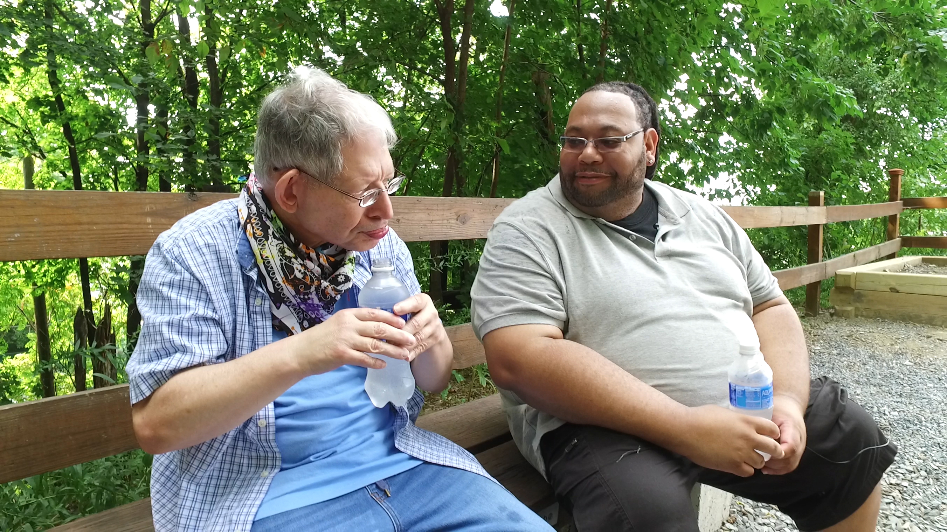
Notes:
Host and Co-host notes for pre-meeting setup
Actions before the session:
Slide #1 – Update presenter names
Hide the other region’s consultant slide, as applicable
Hide other regions workshop slide for Upcoming Workshops, as applicable
In the Practice session before participants log on
Check that the presenter can share their screen and run videos as needed
Check that the presenter marks “Share Computer sounds” and “Optimize Screen sharing for video clip” so that any videos shown can be heard by others – it is on the same screen that you choose which screen to share.
Make Coaches "Co-hosts"
Confirm polls are loaded - host
Turn on transcript –host - Megan
Break-out Groups – host - Megan
Take attendance – Megan
Timekeeper – assign someone Dana
Host / Welcome people as they arrive & arrive late – assign someone - Robin
Monitor Chat – assign someone - Robin
Turn on record, as desired – host NA For East
Subtitles – turned on, each participant can control turning on and off
At end of presentation:
MAKE SURE TO STOP RECORDING AT THANK YOU SLIDE
Note to Facilitator
Bold Text = Timing
Italicized Text = Notes – do not read
Regular Text = Talking Points

Slide 2

Understanding Your Data and Workforce Strategies
Workshop Series
Insert presenter and affilation
tenncare.ici.umn.edu
Notes:
Action – Record as desired
Timing for Intro/Welcome (slides 2-9): 10-15 minutes
Talking points
Welcome to session # in our QuILTSS Initiative kickoff workshop series.
My name is xx and I am a xx with the Institute on Community Integration at the University of Minnesota. I am here today with my colleagues from the University of MN, __________ and ________________. The Regional Coaches from Tennessee ____________________ and ___________________.
Thank you so much for joining us today. During today’s session we will talk about some retention strategies.
If being recorded: This webinar is currently being recorded. We will send the recording to you if you would like to view again or share with others in your organization.

Slide 3
Welcome to Session 4: Overview of TennCare Workforce Toolkit: Recruitment & Selection Strategies
Notes:
Talking points
Today we are going to look at Recruitment and Selection strategies for DSPs. These are tools in the Workforce Toolkit.
We will start with looking at recruitment and then move on to selections after our break.

Slide 4
Using Zoom
Your microphones will be muted when enter. Please keep them turned off unless you're speaking.
Name yourself
  First name
  Name of your organization
Use for questions or comments.
We will use “Reactions” such as “thumbs up” though-out the workshop.
Live Script
Camera on as you are able to and comfortable.
Take care of your needs. If you need a break, take one.
Be Understanding of “co-workers”
Chat
Notes:
Talking Points:
Some of us are used to working on Zoom in a group, while others are less familiar.
Please keep your microphone on mute when you’re not speaking today to help reduce background noise. When you’re in breakout groups, feel free to unmute and discuss the topic within your group. If you are able, we’d appreciate it if you keep your video on today. Its important for all of us to be able to see and get to know one another in these meetings. We understand if you need to shut off your video for a few moments if you need to step away, but please turn your video back on when you return.
When you logged into Zoom today, you might have typed in a name for yourself. To help us get to know one another, we ask you to rename yourself with this information on your screen:
Your name, your organization name. If you are a group of people watching from one computer in an organization, you can shorten to first names and your organization name.
To do this, look on the bottom of your screen for participants, click on that and on the right side of your screen a white column will appear. Hoover over your name and two buttons will appear mute and more. Click on more, then click on rename. Rename yourself then click OK.
The Chat function is at the bottom of the page. It looks like a little speaking bubble. If you have a questions or something you want to add to the discussion you can use Chat. We will be monitoring Chat throughout the session.
Using Chat to submit a question, simply click on the button that looks like this in your toolbar.
Please feel free to send questions at any time during the presentation. We will have time at the end for discussion and questions, so you can type them in the Chat and we’ll go over them at the end.
When you click on “Participants,” you’ll see some buttons to interact with the presentation. You can say yes, no, go slower, go faster, and when you click on “More” you will find that you can use the thumbs up or thumbs down buttons. You can also let us know if you need to step away for a quick break to use the rest room or fill your coffee cup. Suffering is optional.
When we take breaks, we do ask that everyone turn their camera during the break then turn it back on when you return or use reactions when you return so that we know when we are ready to start again.
Finally, we are all still working from home at the University of Minnesota. Explain “coworkers” you share your space with.

Slide 5
Welcome & Introductions
Notes:
Transition slide

Slide 6
Breakout Group Activity
Getting to Know You Your name / organization
Your role in the organization
What is one thing you want to learn about recruitment or selection today?
Breakout Group
  1 facilitator in each group and 1 reporter
  Give everyone enough time to have a turn.
Notes:
Facilitator Note:
Activity: (5 minutes) – 5 people per breakout, each person gets one minute, assign 1 consultant or coach to each breakout group
Purpose: Gives consultants and coaches opportunity to learn who is in the room.
Talking Points:
We are going to have the opportunity to get to know who is in the workshop today. In a moment but not yet, you will be sent to a Breakout room with 5-6 others.
Everyone will have the:
Opportunity to introduce your self with your name, your organization and your role in the organization.
And answer the questions on the screen.
What is one thing you want to learn about recruitment or selection today?
When you get to your group, find one facilitator and another person to report back for the group the responses to the two questions.
When the group returns call on the reporter from each group to report back on themes for questions #1 and #2.

Slide 7
Goals for this session
Learn about recruitment and selection strategies and tools available in the TN Workforce Toolkit.
Learn about components of recruitment and selection strategies and tools.
Begin to think about which recruitment and selection strategies would address your organization's specific workforce challenges.
Notes:
Talking Points:
Today we will be focusing on recruitment and selection strategies, focusing on the turnover that occurs during the first six months of employment. Next time we will be focusing on retention.
Our goals for this session include: read slide

Slide 8
8 Steps for Implementation - Workforce Strategies
Step 4
Step 3
Identify
barriers to implementation
Step 2
Identify components of the strategy
Step 1
Select an intervention strategy
Identify and assess the problem
Larson & Hewitt, 2005
Notes:
Talking points:
We have been talking about the 8 Steps of Implementation since the beginning. These 8 steps are the foundation for our work together.
We are going to include these 8 steps during each session so that you will be able to understand when you will be using each step and as you start to think about your action plan.
Looking at these Steps
Using the Self-Assessment Workbook and your organization’s profile, you should be able to Identify and assess your current problems and think about what is going well in strategies you are using or what strategies could use some improvement.
After identifying the workforce issue, you want to first address, you will select an intervention strategy. Today and for the next two sessions, we will be exploring strategies-or tools- that are in the toolkit.
We have webinars on each of the tools available to you to watch at any time at tenncare.ici.umn.edu. These webinars are more in depth and will be a great resource for your team.
After you have selected an intervention, you will consider Steps 3,4 & 5, which are to identify components of the strategy, identify the barriers to implementation and identify the support that you have for implementing the strategy.
Facilitator Note:
Continued on next slide

Slide 9
8 Steps for Implementation - Workforce Strategies
Step 8
Step 7
Evaluate success
Step 6
Implement
the strategy
Step 5
Set goals,
measure progress & establish a time frame
Identify support for the strategy
Larson & Hewitt, 2005
Notes:
Talking Points:
In the sixth step you will decide on your goal, how you will measure your progress and establish a time frame that works for you organization
Next is the implementation of strategy and finally evaluating if the strategy was successful.

Slide 10
Interventions Strategies
Step 2 – Select an Intervention Strategy
Notes:
Transition slide
Timing for slides 10 and 11: 2-3 minutes
Let’s move into step 2 of the 8-step process, selecting an intervention strategy

Slide 11
Building & Strengthening the DSP Workforce
Recruitment Strategies | Selection Strategies | Retention Strategies
Effective Marketing Public service announcements (PSA) Targeted marketing Recruitment and hiring bonuses Recruitments sources | Structured behavioral interviews Realistic job preview | Orientation and onboarding Competency-based training Employee Development Job Analysis Job Descriptions Recognition Programs Coaching & Mentoring Mentoring Performance coaching Networking Employee Engagement & Organizational Participation Professional Development Developing career paths Professionalizing DSP roles Wage and Benefit Policy Change
Notes:
Talking Points:
These are the three major sections of strategies we will be learning about. The first part of this session we will be focusing on Recruitment.
We do know that all these areas really do connect. And are depended on each other for success. Where an organization may be very strong in one area, they may have room for improvement in another.
As you look at your data and your current strategies, this is our opportunity to support you in understanding where you can start
During this session we will first be exploring recruitment strategies, including read recruitment strategy content
Following the review of recruitment strategies, we will review selection strategies, including read selection strategy areas

Slide 12
Recruitment
Workbook Section 3: Recruitment
Notes:
Transition Slide
Timing for this section (slides 12-14): 8-10 minutes

Slide 13
Assessing Recruitment Strategies and Tools -
Self-Assessment Workbook
Interventions are connected to data
Knowing the organization’s data is important
Factors that influence workforce actions:
  Size of organization
  Geographic location
  Typical employee profile ( best stayers, most successful)
Notes:
Talking Points:
In the Self-Assessment workbook, page 10 allows you to review the recruitment practices that your organization currently uses.
The interventions that you are considering should be connected to your data. What data do you have that helps you make decisions on interventions?
Other things that may influence the actions you decide to take are:
The size of the organization
Where the organization is located. If you have services in more than one location, you will need to consider those locations.
Consider who your employees are. What is the profile of you best stayers? Most successful staff members?

Slide 14
Notes:
Talking Points:
Again, page 10 of your Self-Assessment workbook allows you to examine your current recruitment practices. We’ll go through page 10 now. Note: read each question and allow time for participants to answer in their workbook. If time, see optional 10 minute activity below.
Do you know where your DSPs are being recruited from and what recruitment strategies you are already using?
When you look at your scores, are you doing more than you realized?
Do you see areas that you may want to explore more?
Facilitator Note:
If time: Can allow time for participants to fill out page 10-11 in the workbook and facilitate discussion in small groups.

Slide 15
Identify and Assess- Recruitment
Step 1 – Identify and assess the problem
Notes:
Transition Slide
Timing (slides 15-27): 15 minutes

Slide 16
Poll Question #1 - What recruitment strategies have you tried? (Select all that apply)
Public Service Announcements
Targeted Marketing for recruitment
Recruitment (Referral) Bonuses
Hiring Bonuses (New hire)
Inside Resources
Other strategies
Notes:
Poll
Let’s take a quick poll. - you can pick multiple answers. Your answer are anonymous. Read slide.
Facilitator Note:
In debrief poll, review results.
Ask: Anything surprise or jump out at you – spend no more than 3 minutes on this-watch/resist the deep dive conversation; if people picked other, ask if they will share what that strategy is.
Talking point
Next, we are going to start to take a closer look at these strategies, starting with Public Service Announcements, or PSAs.

Slide 17
Recruitment Strategies
Effective Marketing
Public service announcements (PSA)
Targeted marketing
Recruitment and hiring bonuses
Recruitment resources
Notes:
Talking Points:
We are gong to start with Recruitment strategies
Recruitment isn’t an activity that stands alone; it is part of an organization’s marketing plan.
Today we are going to take a closer look at effective marketing strategies that you see on the screen.

Slide 18
Public Service Announcements - PSA
Step 2 – Select an intervention strategy
Step 3 – Identify components of the strategy
Notes:
Talking Points:
We often discover that people do not know what it means to be a DSP. They may not even understand that supporting people to live a full life in their community is a real job.
A public service announcement is a way to spread the word about DSPs to a larger audience.
Let’s explore further how a PSA could support you in your recruitment efforts by looking at steps 2 and 3.

Slide 19
What kind of PSA is for you?
PSAs for Recruitment Marketing
  Focused on:
    Changing the attitude and beliefs about the work of DSP
    Greater visibility of DSPs in the community
    Celebrate the profession
    Employment opportunities
PSAs for Marketing the Organization
  Focused on getting your organization more recognized in your community.
    Mission, Vision, Values
Notes:
Talking Points:
PSAs for recruitment marketing are targeted on recruitment and are designed to attract potential new employees. When you think about your recrutment opportunites what is the messaging that you would like to get out for the potential employees to know?
How are you communicating the role of a DSP?
Are you letting people know about your employment opportunities?
Are you communicating it in a positive way that brings awarness to the broader public? Are you celebrating the profession? Some organizations use PSAs as a marketing tool during DSP Recognition week in September.
On the other hand, some PSAs are used to get the word out about who you are and what you do as an organization.
It can raise awareness of a specific initiative you are proud of or want to share with your community.
The message lets the public know what is important to you.

Slide 20
Do these look familiar?
Notes:
Facilitator Note: choose to show either slide 20 or slide 21. Talking points are identical.
Talking Points:
A PSA helps people understand a specific concept.
For those of you who used to watch Saturday morning cartoons, you may remember the G.I Joe cartoon.
At the end of each episode there was a segment called “Knowing is half the battle.” This is an example of a type of PSA. The goal of the GI PSA was to help children navigate out of some sort of difficult situation. This type of PSA is focusing on resources that children could use or actions that children could take.
The second example, “Click it or Ticket,” is a PSA we have probably all seen many times. It’s a PSA to provide information about a law or stature change that the public needs to know.
And the third example, I am sure you can all appreciate it’s the correct way display your Tennessee Tristar.
Also known as public service ads, examples of issues covered in these announcements include drinking and driving, texting and driving, drug addiction, and safe sex. PSAs are found anywhere traditional ads can be seen, including on television and radio, outdoor and online media, direct mail, and in print. A PSA is a message to a larger announce – the public.
By reaching a broader audience you increase your chances of having more people apply.
Maybe it reaches a recent immigrant who is searching for a career and who weren’t aware that this type of work exists.
Or perhaps someone’s parent or grandparent may see it, who then encourages their child or grandchild to apply because they think it would be a good fit.
The key is that the PSA reaches a lot of people that you may not have realized could be interested or could influence others to apply.

Slide 21

Does this look familiar?
Notes:
Facilitator Note: Choose to show either slide 20 or slide 21. Talking points are identical.
Talking Points:
A PSA helps people understand a specific concept.
For those of you who used to watch Saturday morning cartoons, you may remember the G.I Joe cartoon.
At the end of each episode there was a segment called “Knowing is half the battle.” This is an example of a type of PSA. The goal of the GI PSA was to help children navigate out of some sort of difficult situation. This type of PSA is focusing on resources that children could use or actions that children could take.
The second example, “Click it or Ticket,” is a PSA we have probably all seen many times. It’s a PSA to provide information about a law or stature change that the public needs to know.
And the third example, I am sure you can all appreciate it’s the correct way display your Tennessee Tristar.
Also known as public service ads, examples of issues covered in these announcements include drinking and driving, texting and driving, drug addiction, and safe sex. PSAs are found anywhere traditional ads can be seen, including on television and radio, outdoor and online media, direct mail, and in print. A PSA is a message to a larger announce – the public.
By reaching a broader audience you increase your chances of having more people apply.
Maybe it reaches a recent immigrant who is searching for a career and who weren’t aware that this type of work exists.
Or perhaps someone’s parent or grandparent may see it, who then encourages their child or grandchild to apply because they think it would be a good fit.
The key is that the PSA reaches a lot of people that you may not have realized could be interested or could influence others to apply.

Slide 22
Audio and Video Recording
Run the video in your building lobby in conjunction with the Realistic Job Preview
Send to local radio and TV stations, podcasts
Notes:
Talking Points:
PSAs are Audio/Visual.
Read slide contents
They can be expensive to film. Consider how you might collaborate with other providers.

Slide 23
Social Media
Share strategic vision for your organization
Add your organization's “tagline and logo” in the beginning or end of any social media posts
Create a Facebook or twitter banner with the video
Notes:
Talking Points:
Social Media is another powerful tool to use to each a broader audience.
You could post the PSA on your website, your Facebook page, or other social media
You could send it out in an email blast and ask people to share it on their social media.

Slide 24
Everyday Communication
Send out in email blasts
Add to email signatures
Notes:
Talking Points:
Use the PSA in everyday communications
You could send it out in an email blast.
You could add it to your signatures for everyone in the organization.
Can you think of other ways you can share a PSA? Can ask for responses in chat.

Slide 25



Public Service Announcements (PSA)
Three 30-second PSA videos
PSAs designed to raise awareness and change perceptions about the field
Examples from ANCOR DSW Toolkit
Public Service Announcements (PSA)
Notes:
We are going to take a moment to look at a couple PSAs that we developed for ANCOR, that are free and available to you. If you have tech savvy staff member you can add your own tag line or logo, and post any of these on your social media, or run the audio and video on local media stations
PSAs are usually 30-60 seconds long.
Facilitator Note:
If there is enough time, show the clips. If not, post link in comments for later access.

Slide 26
Grassroots Public Awareness and Advocacy Campaigns
BeFair2Directcare
  Facebook - https://www.facebook.com/search/top/?q=befair2directcare
  YouTube - https://www.youtube.com/watch?v=9Q8BjFburXA
MN Best Life Alliance
  http://www.arrm.org/ARRM/Advocacy/Best_Life_Alliance.aspx
Notes:
PSAs can also be used to help the public to learn more about issues faced by the direct support workforce in order to garner advocacy for DSPs.
The bFair2DirectCare campaign was launched in New York State to help raise awareness that DSPs need to be paid a living wage that reflects the costs of living in their area. Here are two types of PSAs that have been used by this campaign.
The Best Life Alliance is a group of advocates in Minnesota that are campaigning to increase wages and stop rate cuts that could further impede direct support jobs being filled.
MN Best Life Alliance
Facilitator Note:
Post links in chat.

Slide 27
For more details
tenncare.ici.umn.edu
Toolkit
PSA
Webinar
Notes:
Talking Points
For more information on PSAs you can watch the webinar that we did for Tennessee providers, by going to the website and looking in the toolkit for the PSA webinar.

Slide 28
Targeted Marketing
Step 2 – Select an intervention strategy
Step 3 – Identify components of the strategy
Notes:
Timing for this section (slides 28-33): 8 minutes
Now let’s talk about targeted marketing.

Slide 29
Targeted Marketing
Targeting marketing to improve recruitment
Focus specifically on groups or people and geographic areas
Looking for people with similar characteristics of your best employees
Expanding your pool to increase pipeline
Modify message about organization and job to appeal to target groups
Notes:
Talking Points:
When you use targeted marketing to recruit new employees you:
Focus on groups of people or people who live in geographic areas. For example: if you live in a college town you may focus on attracting college students from those universities.
Do you know the characteristics of your best employees?
Look for people like them.
For example: your best employees might be people who were special education teachers from a certain community. You may realize that they all knew each other outside of work and encouraged others to apply.
Do you have a pipeline to draw from?
Do you have relationships with high schools, colleges or summer camp who provider camp to kids and adults who receive services? These employees may make wonderful DSPs.
Adjust the message about the job to entice or interest the group of people you want to work at your organization. Let’s look at some examples (next slide).

Slide 30

Customizable Targeted Marketing Flyers
Notes:
Talking Points:
These are some customizable targeted marketing flyers that we designed for ANCOR and that are available on their website. They can be used for social media, electronic marketing as well as reproducible for printing.
You can see the image and message is each one is geared towards a little different audience.
The flyer in the upper right corner is aiming toward a vet who is looking for a next step in their career path while the flyer in the lower right implies college students who are exploring different options.

Slide 31



Find at tenncare.ici.umn.edu
Notes:
Facilitator Note: You can use this slide, the previous slide, or both.
These are some customizable targeted marketing flyers that we designed for ANCOR and that are available on their website. They can be used for social media, electronic marketing as well as reproducible for printing.
You can see the image and message is each one is geared towards a little different audience.
The flyer in the upper right corner is aiming toward a vet who is looking for a next step in their career path while the flyer in the lower right implies college students who are exploring different options.
This is an example of mock of a design for a flyer. You can add your logo and contact information, change the photo or even the message. You can find them on the website.

Slide 32
Poll Question #2 -What is your target recruitment market? (Select all that apply)
College Students
Empty Nesters or Encore generation
Veterans
New Americans
High School Students
Other
Notes:
Poll
Talking points
Let’s take a quick poll. - you can pick multiple answers. Your answer are anonymous. Read slide.
Facilitator Note:
In debrief, review results.
Ask: Anything surprise or jump out at you – spend no more than 3 minutes on this-watch/resist the deep dive conversation

Slide 33
For more details
tenncare.ici.umn.edu
Toolkit
Targeted Marketing
Webinar
Notes:
Talking Points
For more information on Targeted Marketing you can watch the webinar that we did for Tennessee providers, by going to the website and looking in the toolkit for the webinar.

Slide 34
Hiring or Referral Bonuses
Step 2 – Select an intervention strategy
Step 3 – Identify components of the strategy
Notes:
Timing for this section (slides 34-37): 6 minutes
Now we will talk about hiring and referral bonuses as a potential strategy for you to choose.

Slide 35
Poll Question #3-What Recruitment and Hiring Bonuses have you tried? (Select all that apply)
Recruitment bonus paid upon hire
Recruitment bonus paid after specific timelines or goals achieved by the new hire
Combination of A & B
New Hiring Bonus paid upon hire
New Hiring Bonus paid when specific timelines or goals are met
Combination of D& E
Other
None
Notes:
Poll
Talking points
Let’s take a quick poll. Read slide. - Note that you should choose one answer from the options A-C and one answer from the options D-F. If you don’t use recruitment/hiring bonuses, or you have another way of paying out recruitment/hiring bonuses, you can choose other or none as well. Your answer are anonymous.
Facilitor Note:
For more information on PSAs you can watch the webinar that we did for Tennessee providers, by going to the website and looking in the toolkit for the PSA webinar.
In debrief poll, review results.
Ask: Anything surprise or jump out at you – spend no more than 3 minutes on this-watch/resist the deep dive conversation

Slide 36
Recruitment & Hiring Bonuses
Recruitment or Referral Bonus
Bonus to existing employees for referring a new hire
Additional bonus when milestones are meet by new employee
Transparency and market to existing employees how much they will get paid and when
Hiring Bonus (New Hire)
Bonuses given to new hire at the time of hire
Trying to get them in your door before they go to another door
Additional bonus when milestones met
Notes:
A recruitment or referral bonus and new hire bonus are two different tools.
The recruitment or referral bonus is a pay incentive to existing employees for recruiting or referring a new hire.
It is can be paid out in different intervals – One way to handle it is to pay out at the time of hire.
Another way is to pay specific amounts at time of hire and again when the new employee hits their 6- and 12-month anniversary.
If you want employees to spread the word it is important that the recruitment bonus program is transparent and marketed on a regular basis. Be clear how much they will get paid and when and make it easy for the employee to cash in on the bonus.
A New Hire bonus is paid to the new hire.
The ideas is that you want to entice them to come and work for your organization and not someone else.
Know what your competitor is offering for a new hiring bonus – make yours more attractive.
Some organization also give bonuses to a new hire when the person reaches certain milestones such as completing or onboarding, 6- or 12-month anniversary.
This employee should also be in good standing with the organization at the time.

Slide 37
For more details
tenncare.ici.umn.edu
Toolkit
Hiring & Referral Bonus
Webinar
Notes:
Talking Points
For more information on Hiring and Referral Bonus you can watch the webinar that we did for Tennessee providers, by going to the website and looking in the toolkit for the webinar.

Slide 38
Recruitment Sources
Step 2 – Select an intervention strategy
Step 3 – Identify components of the strategy
Notes:
Timing for section (slides 38-42): 5-6 minutes
Now let’s talk about recruitment sources.

Slide 39
Inside Recruitment Sources
Current employees / interns / volunteers
People receiving services and their families / friends
Social media networks that are existing “friends” of the organization
Staff family / friends
Service coordinators or case managers
Board or other committee members
Others?
Notes:
39
Talking Points:
If you are looking at broadening your recruitment sources, remember to look at what’s right in front of you. think of all the people connected to your organizations who are assets in your recruitment process. These are the people who know the people you provide support to and your organization best. Word of mouth of often the very best advertiser because people who really know the job encourage others who would be good “fits” to apply.
Post all jobs internally as well as externally.
Develop a recruiting card that you give to everyone that has information about your organization on it and who to contact if interested in employment or volunteering with the people who accept services or on a committee or board.

Slide 40
Outside Recruitment Sources
Social Media
Website, Indeed, Facebook, LinkedIn, Virtual job boards
Fliers regarding open positions (community centers, places of worship, local businesses, etc.)
Newspaper Advertisements
Internship and volunteer programs in high schools and colleges
Others?
Notes:
40
Talking Points:
These are some common sources that you may use to advertise your open positions
We use the internet in many ways to get the message out that we have open positions. Many of you use your website or Indeed to find candidates.
We will talk more about flyers in a few minutes.
For some communities, the newspaper is still the best place to advertise, and others have abandoned that completely. You have to know your community and audience.
Some other opportunities would be to develop relationships with local high schools and colleges and offer internships or volunteer opportunities.

Slide 41
Use all your Resources
Inside Resources
Current Employees
People receiving services and their families/friends
Current Volunteers (Board of Director, other committee members)
Service Coordinators / Case managers
Others?
Outside Resources
Social media (Facebook, Linked In, plus)
Web-based Job Boards (Indeed, Colleges)
News papers
Flyers in community
College Internships
High-school student employment departments
Others
Notes:
Here are just some resources you can use for recruitment, both inside and outside of your organization.
For more information on PSAs you can watch the webinar that we did for Tennessee providers, by going to the website and looking in the toolkit for the PSA webinar.
Facilitor Note: Read some of these examples or give an example, no need to read the whole list.

Slide 42
Expanded Workforce Pipeline
High school students
  C3P(O) https://opra.org/aws/OPRA/pt/sp/c3po
Immigrants and expanded cultural, ethnic, and linguistic diversity
Tennessee QuILTSS Institute
Tennessee Apprenticeship Initiative
Notes:
Do you have workforce pipelines? These are programs in partnership with places that such as schools where the students receive education, they need to enter the workforce and your organization provides the work experience.

Slide 43
What are the Challenges?
Step 4: Identify barriers to implementation
Step 5: Identify support for the strategy
Notes:
Timing for section (slides 43-47): 16-20 minutes
Talking Points:
If you are considering using new recruitment strategies or improving current recruitment efforts, your next step is to consider and identify the barriers to implementing the strategy.
After you discover your barriers, you’ll want to figure out the support, both in financial and human resources to implement the strategy.

Slide 44
Connecting challenges, data, and information to strategies
Step 6 – Set goals, measure progress, and establish a time frame
Notes:
Talking Points:
Step 8 is to set a goal.
Give an example or use the example below.
For example, you may set the goal of developing an internal recruitment program with a referral bonus. The team will decide on how you will measure your progress along with a time frame
1) we will develop a recruitment program by December 1, 2020.
2) we will print recruitment business cards to give employees, volunteers, people we support and their families by December 15th.
3) We will introduce the recruitment plan and give recruitment business cards to employees, volunteers, people we support, and their families at the Appreciation Event on January 20, 2021.
You see that we decided on a goal, what steps we need to take to meet the goal, and a timeline.

Slide 45
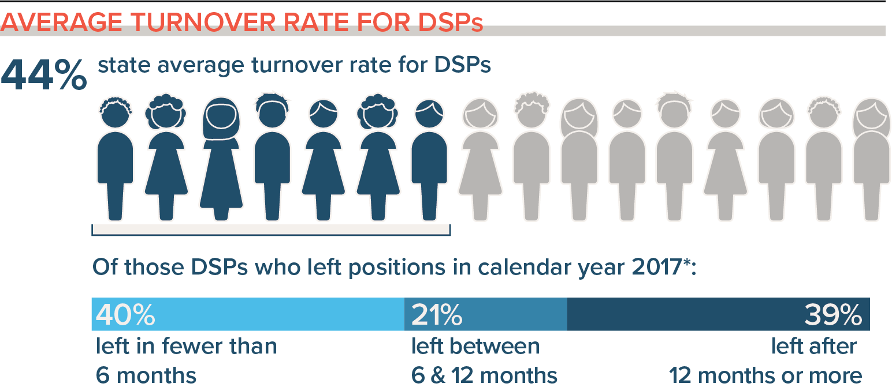
Connecting recruitment strategies with your data
Notes:
Talking Points:
Take a moment to look at your organization profile.
In the area of turnover for DSPs, what is your turnover rate during the first 6 months?
How does that compare to the region and state average?
If you have a high turnover rate in the first 6 months, one of the things that could be happening is that you aren’t recruiting the right people.
There could be other factors to that have to do with selection, training, and engagement but for right now we want to you think about your recruitment strategies.

Slide 46
Self-Assessment Workbook
Matrix - workbook page 24
Challenges
Few qualified applicants
Trouble finding new workers
Intervention Strategies
Expand recruitment sources
Long-term recruitment strategies
Regional recruitment consortia
Market the organization
Implement internship programs for students
Advertise and implement hiring bonuses
Inside source for recruitment
Step 1 Identify and assess
Notes:
Talking Points:
On page 24 of the Self-Assessment workbook, you will find a Matrix of Workforce Challenges and Intervention Strategies.
When your challenges are “few qualified applicants” or “trouble finding new workers,” the strategies that we just discussed may may address those issues.

Slide 47
Breakout Conversation
Reflecting on Your Recruitment Practices
What recruitment strategies have you tried in your organization to address workforce challenges?
  What were you pleased about?
  What have you learned?
  What are you concerned about?
Based on this, what next steps are you thinking about?
Notes:
Facilitator Note
Activity: (5 minutes) – 5 people per breakout, each person gets one minute, assign 1 consultant or coach to each breakout group
Purpose: Gives consultants and coaches opportunity to learn who is in the room.
Talking Points:
We are going to reflect on your recruitment practices. In a moment but not yet, you will be sent to a Breakout room with 5-6 others.
Everyone will have the opportunity to answer the questions on the screen. Read questions on slide.
When you get to your group, find one facilitator and another person to report back for the group the responses to the two questions.
Facilitator Note
When the group returns call on the reporter from each group to report back on themes for questions #1 and #2.

Slide 48
Stretch Break
Take 5 minutes to stretch and refresh
Notes:
Turn off video and audio when you leave. Turn video back on when you return so we know you are back.
Facilitator Note
To check in with folks who don’t have their video on, ask for reactions

Slide 49
Selection
Workbook Section 4: Selection Practices
Notes:
Timing for section (slides 49-54): 10 minutes
Now that we’ve addressed some recruitment tools you can use, we’ll talk about selection tools.

Slide 50
Building & Strengthening the DSP Workforce
Recruitment Strategies | Selection Strategies | Retention Strategies
Effective Marketing Public service announcements (PSA) Targeted marketing Recruitment and hiring bonuses Recruitments sources | Structured behavioral interviews Realistic job preview | Orientation and onboarding Competency-based training Employee Development Job Analysis Job Descriptions Recognition Programs Coaching & Mentoring Mentoring Performance coaching Networking Employee Engagement & Organizational Participation Professional Development Developing career paths Professionalizing DSP roles Wage and Benefit Policy Change
Notes:
Talking Points:
We looked at this earlier today and just want to quickly revisit it as we start to look at Selection strategies. Once you have recruited applicants, the next step is to use a selection process to decide who you will interview and who you will offer a position.
We will take a closer look at the Structured Behavioral Interview and the Realistic Job Preview today.
Retention strategies will be covered in the next sessions.

Slide 51
Effective Selection Strategies
Structured Behavioral interviews
Realistic Job Previews
Structured observations
Cognitive ability tests
  Writing exercises
  English proficiency tests
Structured interview with DSPs
Structured interview with individuals and family members
Notes:
51
Talking Points:
There are a number of strategies employers use when selecting the best DSPs.
We are going to focus today on the Structured Behavioral Interviews and the Realistic Job Preview

Slide 52
Selecting the Best Candidates
The process used to assure a good match between
The CANDIDATE…with the right
  Competencies and Skills
  Attitudes and Values
  Interest in and Commitment to do the job
The ORGANIZATION…with its
  Job Requirements and Expectations
  Culture and Climate
  Investment with employees
Notes:
52
Talking Points:
When there is a "mismatch" between the employee’s skills and the job requirements it can lead to:
Poor performance and termination for unqualified employees
Reduced quality of services and increased risk of abuse and neglect
Dissatisfaction and voluntary quitting for an overqualified employee
This is why it is so important to use best practices in selecting the best candidate for the organization.
Organizations need the candidates with the right:
Competencies and skills – that match the job requirements and can meet the expectations
Attitudes and Values that match the culture of the organization
Interest and commitment to the people they will support and to the organization
The candidate needs to understand
The job requirements so they know what is expected of them
the culture and climate of the work environment
They want to know if the organization is willing to invests in them as an employee. Will they be able to grow as a professional.

Slide 53
Breakout Conversation
If you have had experience in selection process:
  What strategies have you found useful?
  What strategies have you found difficult?
Notes:
Facilitator Note
You may not have time for this breakout. Can do a quick round robin or type in chat, or skip the slide. Before breaking out, show the next slide.
Activity: (5 minutes) – 5 people per breakout, each person gets one minute, assign 1 consultant or coach to each breakout group
Purpose: Gives consultants and coaches opportunity to learn who is in the room.
Talking Points:
We are going to reflect on your recruitment practices. In a moment but not yet, you will be sent to a Breakout room with 5-6 others.
Everyone will have the opportunity to answer the questions on the screen. Read questions on slide.
When you get to your group, find one facilitator and another person to report back for the group the responses to the two questions.
Facilitator Note
When the group returns call on the reporter from each group to report back on themes for questions #1 and #2.

Slide 54
Notes:
Talking points
Section 4 looks like the images on your screen. Section 4 is about reflecting on the selection practices that can support your efforts and processes you may already have in place. This is intended to be a discovery tool to help you explore what you’re already doing and areas where you might want to put some attention as you move forward.

Slide 55
Identify and Assess- Selection
Step 1 – Identify and assess the problem
Notes:
Transition Slide
Timing for section (slides 55-56): 4 minutes

Slide 56
Poll Question #4 - What selection strategies have you tried? (Select all that apply)
  Structured Behavioral Interviews
  Scoring Guide
  Realistic Job Preview
  Structured interview including current DSPs and/or FLS
  Structured interview including individuals supported and family members
  Work Samples
  Observations
  Other
Notes:
Poll
Talking Points
Let’s take a quick poll. - you can pick multiple answers. Your answer are anonymous. Read slide.
Facilitator Note
In debrief poll, review results.
Ask: Anything surprise or jump out at you – spend no more than 3 minutes on this-watch/resist the deep dive conversation

Slide 57
Structured Behavioral Interview
Step 2 – Select an intervention strategy
Step 3 – Identify components of the strategy
Notes:
Timing for section (slides 57-68): 15 minutes
As you can see, we are going to start to look at Steps 2 & 3 by looking at Structured Behavioral Interviews.

Slide 58
Pre-Structured Behavioral Interviews
Job Description
Job Analysis
Core Competencies
Notes:
Facilitator Note
optional for engagement: ask for thumbs up/raise hands if participants have completed these
Talking Points
These are some pre-interview activities:
Have you completed a Job Analysis? Do you know what the duties and the functions of position?
When is the last time you updated your job descriptions? Did you write it based upon the job analysis?
Does it include not just the duties, but also the physical demands the work includes like “Lifting, standing, bending, etc”
It is important for the Job Description to be accurate. It really needs to reflect what a person in the position is expected to do.
When do applicants see the Job Description? Before they are offered a job or after they have accepted?
It is helpful to share the job description with applicants before the interview so that you can talk about it and they can ask questions about the job. You can also develop interview questions based upon the Job Description.
Does your job description include Core Competencies? If not, you are going to want to look at a set. If you are not familiar with Core Competencies, we will look at the NADSP competencies today.

Slide 59
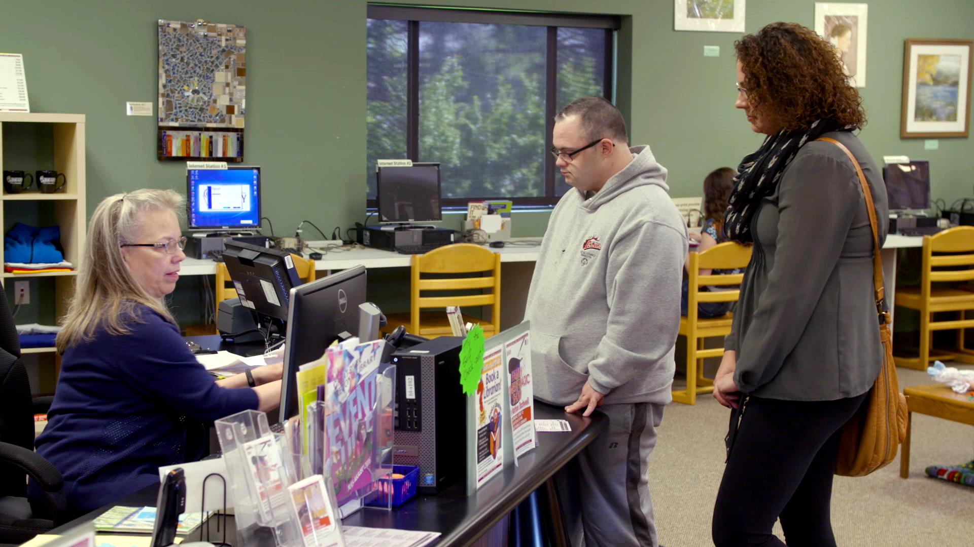
Importance of Competency in Direct Service
Notes:
Talking Points:
Research shows that using competency standards across workforce development strategies can improve recruitment and retention of an organization’s workforce.
The problem? Many organizations are often consumed with the pressures of filling vacancies in their workforce, leaving little time to explore how to incorporate direct support workforce competencies into their organization’s infrastructure.
Competency standards are the foundation to our workforce development tools. We start with competency standards for tools including:
Recruitment, hiring, and selection
Curriculum development
Training program implementation, staff development
Performance evaluation
Career pathways, ladders and lattices:
Apprenticeship programs
Credentialing and certification systems
Depending on time, can ask how they use competency standards or thumbs up/hand raise if they use them at their organization.
59

Slide 60
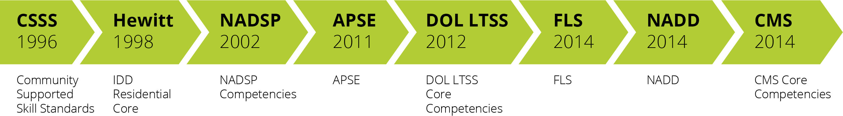
DSP Competency Sets 1996 - 2014
President’s Committee for People with Intellectual Disabilities (PCPID). 2017. America’s Direct Support Workforce Crisis: Effects on People with Intellectual Disabilities, Families, Communities and the U.S. Economy. Washington, D.C.: PCPID. https://acl.gov/sites/default/files/programs/2018-02/2017%20PCPID%20Full%20Report_0.PDF
Notes:
Talking Points:
Each of these competency sets is organized around core competencies of a direct support worker and includes a set of skill standards for each skill competency.
Since 1996, there have been a number of efforts on a national level to identify the critical competencies that direct support professionals need to have. These competencies have changed over time and are mostly similar with a few variations depending on the service and support focus they have. Each set is organized a bit differently, but they share many core areas in which DSPs must be able to demonstrate understanding, skill and a comprehensive value orientation.
By and large, developing competency sets have been an effort to richly describe the knowledge, skills and attitudes that DSPs need to have to successfully support a person to live and participate in their communities.
The initial effort focusing on community services was completed in 1996 with the development of the community support skills standards.
Most recently the Centers for Medicare and Medicaid Services released a set of core competencies that describe the knowledge, skills and attitudes required of DSPs across the sectors of IDD, aging and mental health.
As we dive into best practice in selection strategies, you will notice these competencies are foundational.

Slide 61
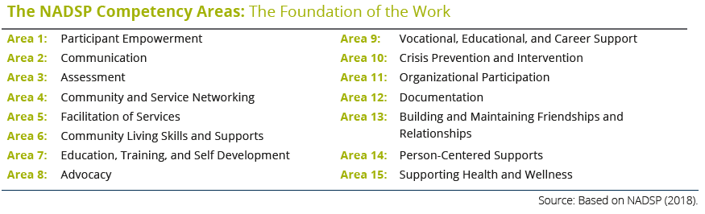
NADSP Core Competency
Notes:
Talking Points:
Here are the NADSP Core Competency Areas. They address the broad areas that DSPs work in.
Take a moment to read the areas listed on the slide
You can customize these to your organization, as there may be some areas that do not apply to your organization or to particular positions.
If DSPs in your organization do work in these areas, these core competencies can be used to set the expectations for everyone.
There are others Core Competency sets you may use that we have not included today.

Slide 62
Developing the Interview Questions
Ask Behavior questions
Recall a past experience and how they handled it
(Situation, Behavior, Outcome)
Notes:
Talking Points:
When developing interview questions, you want to ask questions that are going to tell you what actions the person took in the past. This will be the best indicator of what they will do in the future.
You are asking them to tell you what they did (action or behavior) in a situation, and what the outcome was. We will cover some examples a little later.

Slide 63
Developing the Interview Questions
Ask Situational questions
Present with a hypothetical situation; ask how they would handle it.
(Situation, Behavior, Anticipated Outcome)
Notes:
Talking Points:
In the interview, you also want to set up a situation, ask how they handled it in the past and what the outcome was.

Slide 64
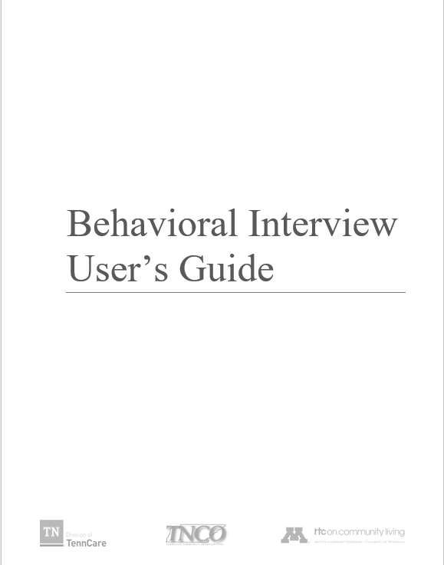

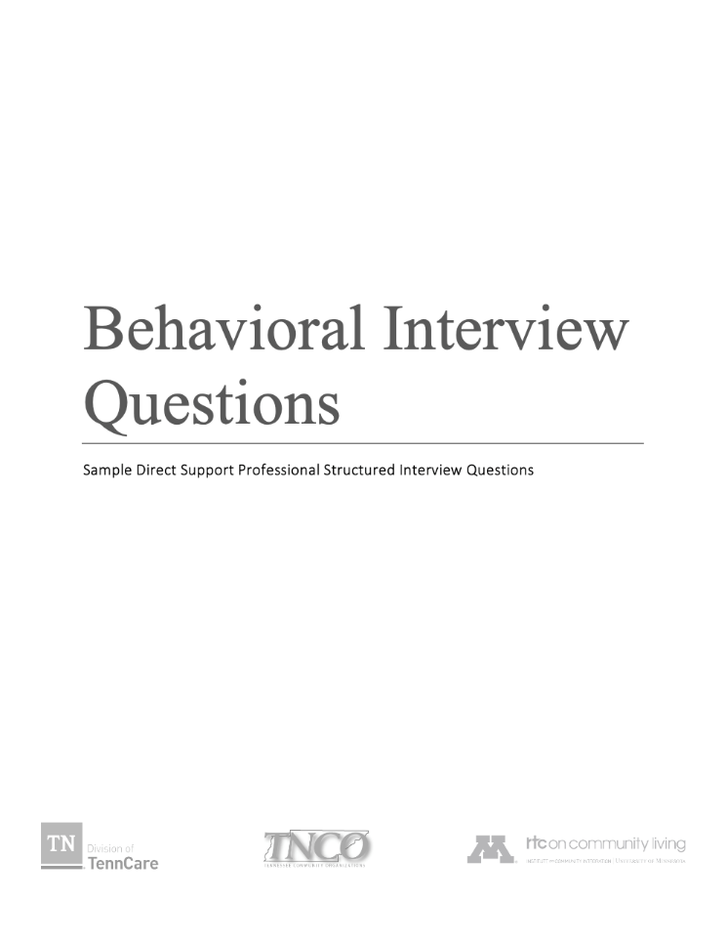

Structured Behavioral Interviews for DSPs
  Tenncare.ici.umn.edu
Notes:
Talking Points:
These three interview tools are available on the TennCare website for provider use. Post link in chat.
The User guide walks though the process of using a structured behavioral Interview
The Structured Interview Questions provide sample questions for each of the competency areas
The DSP Interview Questionnaire is an example questionnaire and score guide template

Slide 65
Complete List of Behavioral Interview Questions
Three to six examples in each of the Core Competencies
You may use these questions, or they may spark and idea for a question that better matches the organization
Notes:
Talking Points:
This tool is available to you on the website in the resource section of the Toolkit. There are 3-6 examples of questions that fall under each of the NADSP Core Competency areas. You can use these questions, or they make spark an idea that better matches your position or organization.

Slide 66
Structured Behavioral Interviews
Sample Question:
Competency area 4: COMMUNITY & SERVICE NETWORKING
Please describe some community resources you have had contact with in your own neighborhood. How might those resources be used by a person with a disability?
Notes:
Talking Points:
This is an example of one of the questions in the documents we just looked at.
This question addresses competency area 4: Community and Service Networking. Read question.

Slide 67
Breakout Conversation
What is your experience with using the Job Analysis and Job Description in developing Interviews questions?
If you haven’t used them to develop interview questions, what value to you think they can bring to the interview?
What is challenging about using them to develop interview questions?
Notes:
Facilitator Note
Use slide if time – there probably won’t be.
Activity: (5 minutes) – 5 people per breakout, each person gets one minute, assign 1 consultant or coach to each breakout group
Purpose: Gives consultants and coaches opportunity to learn who is in the room.
Talking Points:
We are going to have the opportunity to get to know who is in the workshop today. In a moment but not yet, you will be send to a Breakout room with 5-6 others.
Everyone will have the opportunity to:
answer the questions on the screen.
When you get to your group, find one facilitator and another person to report back for the group the responses to the two questions.
Facilitator Note
When the group returns call on the reporter from each group to report back on themes for questions

Slide 68
For more details
tenncare.ici.umn.edu
Toolkit
Structured Behavioral Interview
Webinar
Notes:
Talking Points
For more information on Interview you can watch the webinar that we did for Tennessee providers, by going to the website and looking in the toolkit for the webinar.

Slide 69


Realistic Job Previews (RJPs)
Present non-distorted information to job applicants
about the job
and the organization / family / individual(s)
from the perspective of existing DSPs
before a job offer has been made
Notes:
Timing for section (slides 69-74): 8-10 minutes
Talking Points:
It is important for a person who has applied for a job and offered an interview to have a good idea what a DSP does in their job.
The RJP is seen/or experienced before a job offer is made. It is not a promotional video. Promotional videos show only the positive aspects of the job and the organization.
A realistic job preview—or the RJP—is real information about:
The job
The organization/ the person(s) receiving services and their families
The perspective of existing DSPs

Slide 70
Characteristics of Effective RJP’s
Present the RJP early in the application process before a job offer is made
Make the purpose of the RJP clear to applicant
Include viewpoints of individuals receiving supports and their family members
Use actual observations of DSPs on the job
Include information about how current employees view their jobs
Balance positive and challenging parts of the job to reflect actual work
requirements and experience
Notes:
70
Talking Points:
The RJP will help them decided if the job is right for them before a job offer is made.
Some use it before or during the interview and use it as taking points or ask questions about what the applicant saw or thought. Watch how the applicant responds to the video.

Slide 71
Realistic Job Previews
Methods
Video
Tour
Discussion people receiving supports / family (video or in-person)
Discussion with DSP (video or in-person)
Combination of two or more methods
Volunteering
Photo album
One Page Description of people receiving services – what they are looking for in a support staff
Internships
Notes:
Talking Points:
There are different ways to deliver a RJP – many times we think it is a video, but it doesn’t have to be.
Videos can be expensive depending on how you decide to produce it, or they can be made inexpensively with a smart phone.
Other methods of showing an RJP may be…read slide

Slide 72
Realistic Job Previews Affect Retention
RJPs can improve retention rates by 9% -17%
RJPs increase retention of workers
For agencies with 12% annual retention rates, use of RJP increased it by 50%
For agencies with 24% annual retention rates, use of RJP increased it by 20%
  McEvoy & Cascio 1985; Premack & Wanous, 1985
Notes:
Talking Points:
Data supports that RJP do impact retention.
In the study sited here, it showed that RJPs can increase retention rates by 9-17%. Specifically – for organizations that had a 12% annual retention rate, they increased their retention by 50% ----- from 12% to 24% retention. For organizations with a 24% annual retention rate – when they used an RJP, their retention increased by 20%.

Slide 73
Example of a Realistic Job Previews (RJPs)
Link to access:
ANCOR Realistic Job Preview
https://www.ancor.org/toolkit/employers/realistic-job-preview
For TennCare Providers – full length RJP sample
https://vimeo.com/382624388
Password: RJP/ICI#11-20
Notes:
Talking Points:
Over the years, we’ve developed several RJPs in video format.
We have developed a 15 minutes RJP for ANCOR that is currently available for free on their website. It will be available for free for a limited amount of time. Let’s watch this snippet of the RJP together.
Facilitator note
You can click on either link to access the RJP
The password to the RJP for TennCare (https://vimeo.com/382624388) will be RJP/ICI#11-20.

Slide 74
For more details
tenncare.ici.umn.edu
Toolkit
Realistic Job Preview
Webinar
Notes:
Talking Points
For more information on RJP you can watch the webinar that we did for Tennessee providers, by going to the website and looking in the toolkit for the webinar.

Slide 75
What are the Challenges?
Step 4: Identify barriers to implementation
Step 5: Identify support for the strategy
Notes:
Timing for section (slides 75-84): 23 minutes
Talking Points:
If your challenges are that people quit with in the first 3-6 months, usually because they don’t know the job expectations, are you considering these strategies that we’ve discussed?
If you are, it is time for steps 4 and 5: to identify the barriers to implementation and identify what resources you have in your corner

Slide 76
Connecting challenges, data, and information to strategies
Step 6 – Set goals, measure progress, and establish a time frame
Notes:
Transitional Slide
Talking point
As we talked about previously, the next step is to set a goal and make decisions regarding how you will measure your progress along with a time frame

Slide 77
Connecting selection strategies with your data
Notes:
Talking Points
When you look at your profile on turnover ,what are you seeing?
Is this something you need to consider addressing?

Slide 78
Self-Assessment Workbook
Matrix - workbook page 21
Challenges
Turnover rates too high
Intervention Strategies
Improve selection practices
New hires quit in 3-6 months
Unsure of job roles & functions
Structured behavioral interviewing
Effective orientation
Realistic job previews
Step 1 Identify and assess
Notes:
Talking Points:
On page 21 of the Self-Assessment workbook, you will find a Matrix of Workforce Challenges and Intervention Strategies.
When your challenges are high turn over rates, new hires quite in the first 6 months, and new DSPs are unsure of what they job really are
These are strategies that address those issues. We talked about some of these already, but you can also work to improve your selection practices and provide more effective orientation to new staff.

Slide 79
Match the Strategy to the Challenge
  Challenge:
  Turnover rate is high
  New staff are unsure of the
  job roles and functions
  New staff leave their jobs
  in first 3-6 months
Strategy:
Hiring Bonus
Realistic Job Preview
Recognition Program
Structured Behavioral Interviewing
Peer Mentoring Program
Use Chat to answer – which strategy(s) would address these challenges
Notes:
Talking points
Based upon what the information we have covered today and using the Challenges/Intervention Strategies Matrix on page 24 of the Self Assessment Workbook, if the challenges are: read challenges
Which intervention strategies will address these challenges? Use Chat to tell us your answers.
Discuss the answers (B,D,E)

Slide 80
Breakout Conversation
Reflecting on Your Selection Practices
What selection strategies have you tried in your organization to address workforce challenges?
  What were you pleased about?
  What have you learned?
  What are you concerned about?
Based on this, what next steps are you thinking about?
Notes:
Facilitator note
For more information on Hiring and Referral Bonus you can watch the webinar that we did for Tennessee providers, by going to the website and looking in the toolkit for the webinar.
Activity: (5 minutes) – 5 people per breakout, each person gets one minute, assign 1 consultant or coach to each breakout group
Purpose: Gives providers time to reflect on their current selection practices.
Allow time for them to go through workbook on their own before breakout. If not enough time for both, focus on time for them to fill out the workbook.
Talking Points
For more information on Hiring and Referral Bonus you can watch the webinar that we did for Tennessee providers, by going to the website and looking in the toolkit for the webinar.
Using page 12 in the SAW, we are going to take 15 minutes for you to meet with your small group and talk about the four questions on the bottom of the page. Pick someone from the group to report back to the rest of the group when you come back.
Read questions on slide
We know that you may not get done with all the questions. We just want you to get started. You will want to discuss these questions with others in your organization.
When they return ask someone from the group to report back.

Slide 81
Goal Setting and Measurement
What change do we want to see? (SMART Goals)
How are we going to measure?
  Trackable and measurable vs. anecdotal
How long will this take/how long will we measure for?
How will we know it is working? (Step 8 – Evaluate Success)
Notes:
Talking Points:
When you are ready to set your goals and measurements you may want to use these questions. Read slide

Slide 82
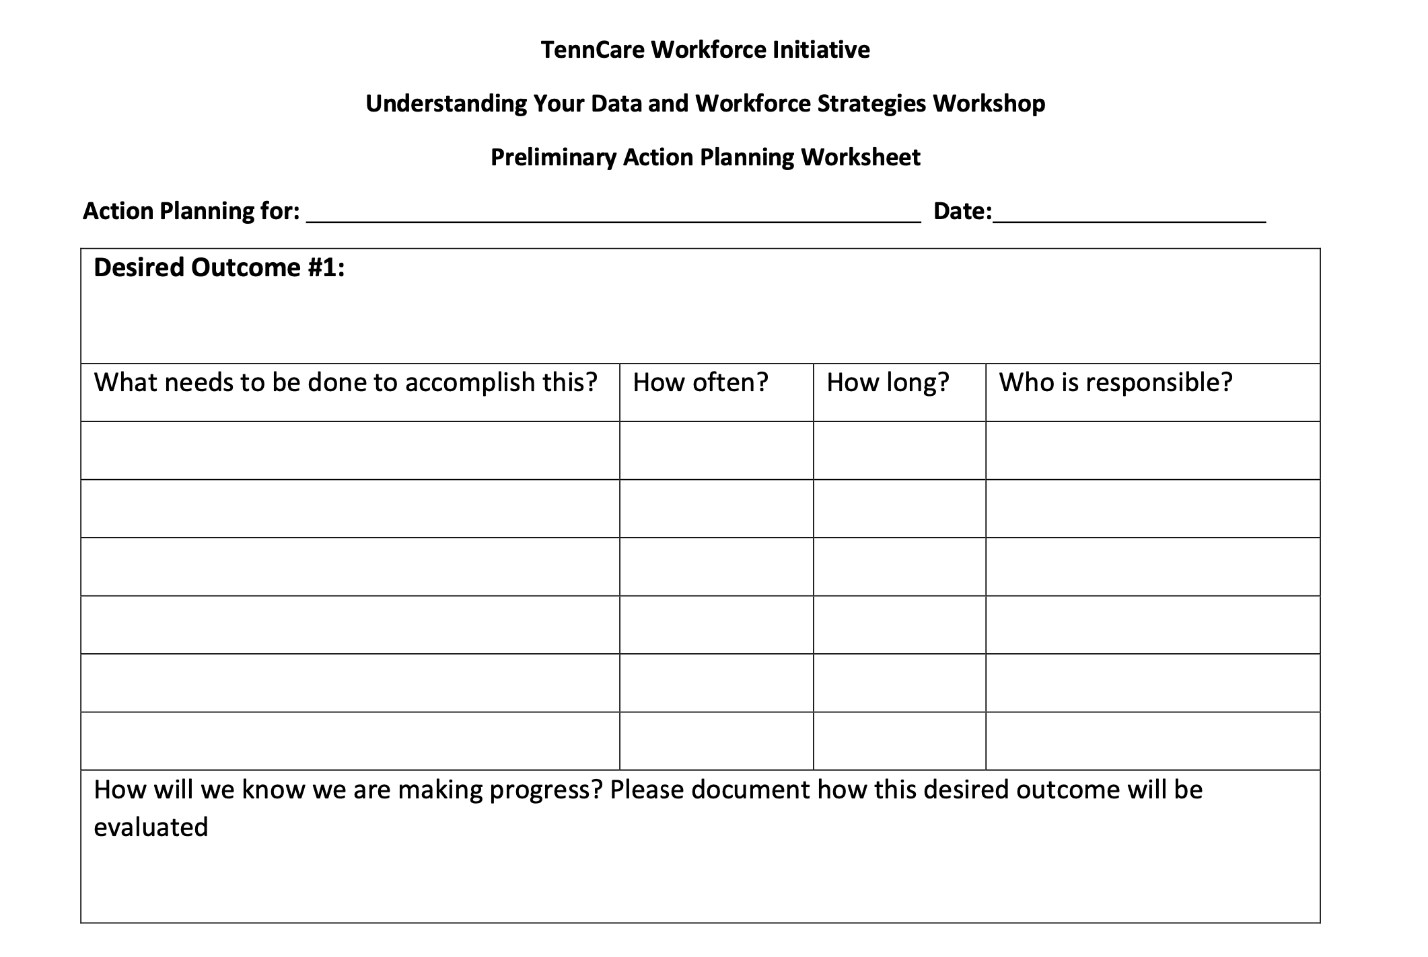
Notes:
Talking Points:
You have action planning worksheets in your self-assessment workbook. It helps you with steps 4-8 of the implementation process. You may have something similar that your organization uses, but this will help you brainstorm and dig deeper to create a full plan. It will help you answer the following questions:
What is the strategy, and the desired outcome from the strategy?
What steps will need to be done to accomplish the outcome?
When and how often will you work on each step? How long will each step take? Who will be responsible for each step?
Finally, how do you know if you are making progress and how will you measure this? This leads to step 8…next slide

Slide 83
Evaluating the Efforts
Step 8 - Evaluate Success
Notes:
Transitional slide

Slide 84
Notes:
Talking points
It is important to decided when you will evaluate your progress and
How you will know if you are making progress, or in other words how will you evaluate it?
Will you use tracked number data or anecdotal information?

Slide 85
Questions about Recruitment and Selection?
You will receive the slides from today’s workshop so that you can have further discussions about the information in this session.
If you have questions:
Contact your University of Minnesota workforce consultant
Email us at: dsp-tn@umn.edu
If you haven’t provided us with your Key Contacts please do
at: https://z.umn.edu/C2KeyContacts
Notes:
Facilitator Note:
Improvised based upon the amount of time left – either give time for questions or just review the last 3 slides.

Slide 86
What’s Next
You will receive the slides from today’s workshop so that you can have further discussions about the information in this session.
Session #5:
Homework before our next session:
Review the Organizational Workforce Self-Assessment Workbook sections on Recruitment and Selection with your teams
Check out Recruitment and Selection Strategies and Tools on TN DSP Workforce Toolkit: https://tenncare.ici.umn.edu/
Notes:
Talking Points:
You will receive the slides from today’s session to share with others in your organization to facilitate further discussion. If you aren’t receiving emails from us, please contact us at the email address on the preview screen: dsp-tn@umn.edu

Slide 87
Upcoming Kick-off Sessions
Session 5: Overview of TennCare Workforce Toolkit: Retention Strategies-Part 1
Session 6: Overview of TennCare Workforce Toolkit: Retention Strategies-Part 2
Session 7: Planning Your Next Steps: Measuring Outcomes of Implementation and Creating a Practical Action Plan for Change
Notes:
Talking Points:
You should have already received the link to this and the other workshops. If not, please contact us.
Your next Workshop is Session # where we will discuss…………………………………….We will be meeting on: (insert date and time)
Facilitator Note: Edit slide as needed regarding upcoming workshops

Slide 88
Thank you
See you next week!

