Slide 1
MIHEC Learning Community Event September 19, 2023

Slide 2
Land Acknowledgement
In Minnesota, we are standing on Miní Sóta Makhóčhe, the rightful homelands of the four Dakhóta Oyáte nations, the seven Anishinaabeg nations, and other indigenous peoples. We recognize that the U.S. did not uphold its end of the land treaties. It is the current and continued displacement of indigenous peoples that allows the State of Minnesota to exist today.

Slide 3
Affirmation of Commitment
At the Institute on Community Integration, we affirm our commitment to address systemic racism, ableism, and all other inequalities and forms of oppression to ensure inclusive communities.

Slide 4
Introductions
Julie Lackey is the Director of
OKIPSE Alliance
Yolanda Scott is the Youth Programs Manager for Central Oklahoma Workforce Innovation Board
Notes:
Julie Lackey is the Director of OKIPSE Alliance. The goal of Oklahoma IPSE Alliance is to educate, advocate, assist, and collaborate for Inclusive Post-Secondary Education (IPSE) options for students with intellectual/developmental disabilities in Oklahoma. She is an OKLEND Fellow, and a member of the Technical Assistance team for Think College. Most importantly, she is the parent of a young adult who walks to his own drumbeat!
Yolanda Scott is the Youth Programs Manager for Central Oklahoma Workforce Innovation Board. She is known and respected as a champion for youth. She works with community stakeholders, industry leaders, and service providers to create training and employment opportunities for young adults in one of the state's largest populated areas. Yolanda holds a master's degree in Education Administration and is an Oklahoma-certified teacher and administrator. She also serves as co-chair of the Oklahoma Transition Council.
Welcome, Julie and Yolanda!

Slide 5
Strategic Partnerships Derived from Common Goals
(Employment Opportunities, Work Skills Training and Transition to Employment after College)

Slide 6
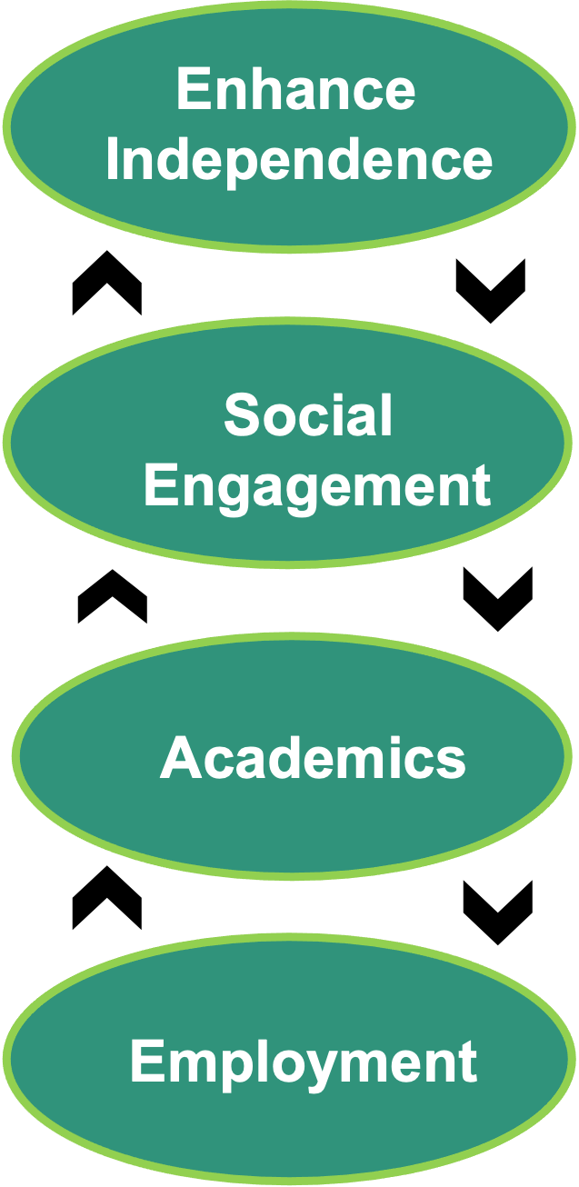
Oklahoma
Northeastern State University - RiverHawks Scholar Program
4-year inclusive certificate program for students with IDD
CTP Designated
Oklahoma State University – Opportunity Orange Scholars
2-Year inclusive certificate program with a 2-Year advanced opportunity for students with IDD (4 year total)
CTP Designated
University of Oklahoma – Sooner Works
4-year inclusive certificate program for students with IDD
CTP Designated
University of Science and Arts of Oklahoma –
Neill-Wint Center for Neurodiversity
4-year degree program provides supports for students with autism
CTP = Comprehensive Transition Program

Slide 7
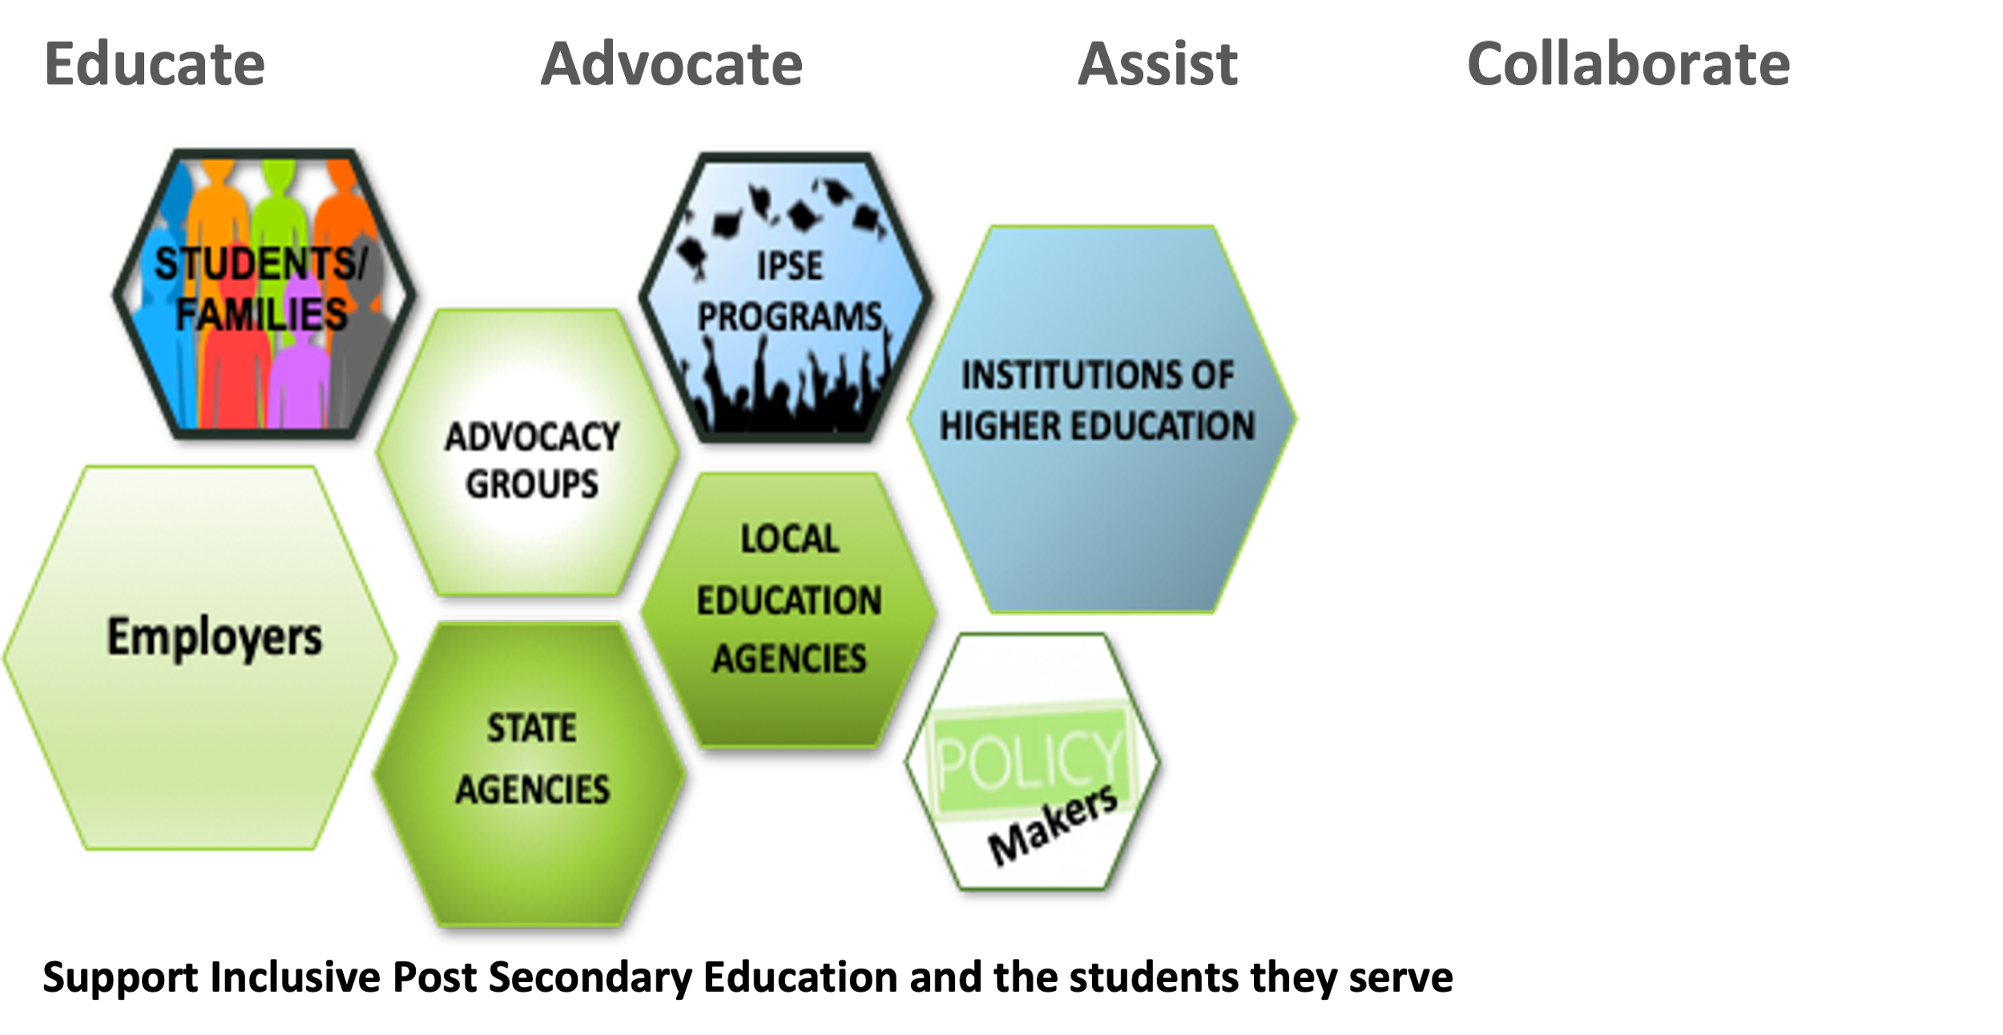
Capacity Building - Alliance

Slide 8
Connected Community
Department of Rehabilitation Services
Vocational Rehabilitation = DRS/VR
Department of Human Services
Developmental Disability Services = DHS/DDS
Board of Regents for Higher Education
Non-Profit Organizations = Service
Workforce Innovation Board = WIB
Parent Support Groups = Autism/Down Syndrome
Family Members
Institutions of Higher Education (Career Tech +)
Policy Makers
IPSE Programs
State Department of Education
National Interest
Employers
Foundations
Students!

Slide 9
Strategic Partnerships Alliance = Connected Community
WHO? | WHAT? | HOW?
Vocational Rehabilitation (VR) | Contract with each program providing up to $3,000 per semester dependent upon family income. Also pays for up to 15 internship hours per week (VR Clients) | -Common Goal – Employment -Subject Matter Experts -Pilot Discussions -Challenges?
Workforce Investment Board (WIB) working with Pre-ETS (Pre-employment Transition Services) Address 5 Required WIOA Categories Job Exploration Counseling Work-Based Learning Post-Secondary Counseling Workplace Readiness Self-Advocacy | IPSE NEXT! Unique Partnership with COWIB providing traveling Work Skills Trainers for IPSE students working off campus while in the IPSE program as well as after graduation. Works with employers, IPSE Staff and Students to assist with meaningful employment | -Common Goal –Employment and Underserved Population -Utilize existing funding -Pilot Discussions -Challenges?

Slide 10
Strategic Partnerships Alliance = Connected Community (2)
WHO? | WHAT? | HOW?
Oklahoma City Community Foundation (OCCF) | Revise scholarship language to include students in CTP designated programs and expand their policy to include IPSE students in new endeavors. With employer connections, provide host site for employer education as well as scholarship/grant support | -Common Goal; Education Focus -Minor changes in existing processes -Expansion
Developmental Disability Services (DDS) | To be Continued…. “Ask” is for students on the Medicaid Waiver to be able to use Self Directed Goods and Services dollars towards IPSE program costs New “Ask” is a working meeting to formulate a pilot acceptable to all parties | -In Process!

Slide 11
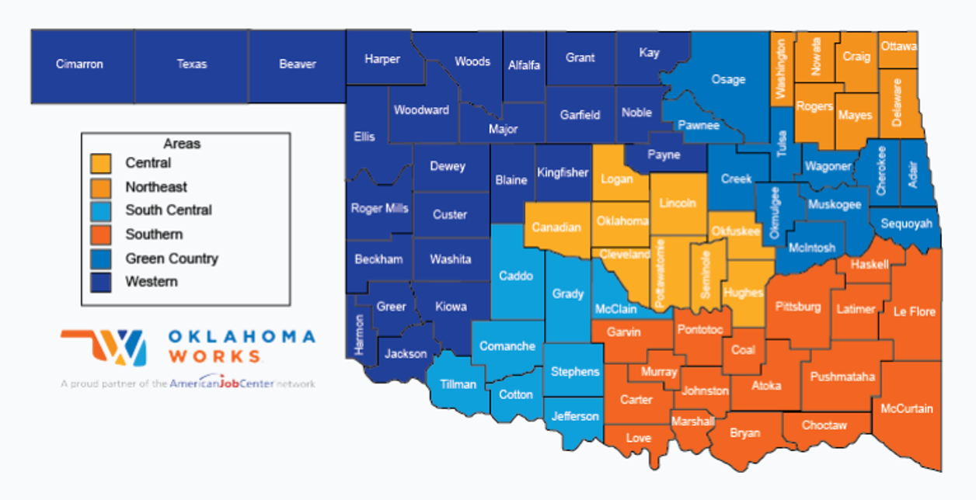
Local Workforce Development Boards

Slide 12
Oklahoma has six Local Workforce Development Boards that make up the state’s public workforce system
These boards:
Link Oklahomans with workforce services and resources to develop the talent of the state’s workforce;
Serve as connectors to local Oklahoma Works, American Job Centers that deliver services to workers and employers;
Develop regional strategic plans and set funding priorities for their area;
Facilitate partnerships between local businesses with similar training needs; and
Provide analysis of labor market information to develop strategies that focus resources on particular high growth industry for their area.

Slide 13
WIOA Youth Program
Education/Training
Tutoring, study skills training, instruction and dropout services
Alt. secondary school or dropout recovery
Short and Long term Occupational Skills Training
Employment
Paid and Unpaid Work Based Learning opportunities
Labor Market Information
Job Search Assistance
Job Placement
Work Readiness
Leadership Development
Adult Mentoring
Follow Up Services
Comprehensive Guidance & Counseling
Financial Literacy Education
Entrepreneurial Skills Training
Resume Building

Slide 14
Youth Program Eligibility
HS Dropout
16 or 17 years old and has not attended school in the most recent calendar quarter
Received HSD, low income and either BSD or ESL
Offender
Currently in foster care or exited foster care after age 16
Pregnant or parenting
Individual with a Disability
Homeless
Needs Additional Assistance-Low Income and...
Parent or guardian currently or previously incarcerated for felony conviction
Parent or guardian lacs a high school diploma or GED
Attends or has attended a chronically underperforming school

Slide 15
COWIB Special Projects
COWIB Partnership for Disconnected Youth-COWIBP3 (DOL)
Central Oklahoma Juvenile Center
Juvenile Relapse Avoidance Project (JRAP)
Career Exploration-Worksite Tours
Working On The Wichitas (WOW)
Building Employment Skills for Today (BEST)
Summer Transition Employment Program (STEP)

Slide 16
IPSE Next Pilot How it Came About...

Slide 17
IPSE-NEXT
Pre-employment Transition Services (Pre-ETS)
14-21 and enrolled in school
Address 5 Required WIOA Categories
Job Exploration Counseling
Work-Based Learning
Post-Secondary Counseling
Workplace Readiness
Self-Advocacy
Increase independent living and inclusion in communities and competitive integrated workplaces
Develop and improve strategies for individuals with intellectual and significant disabilities to live independently, participated in postsecondary education experiences, and obtain and retain competitive integrated employment
Apply evidence based findings to improve policy, procedure, practice and the preparation of personnel

Slide 18
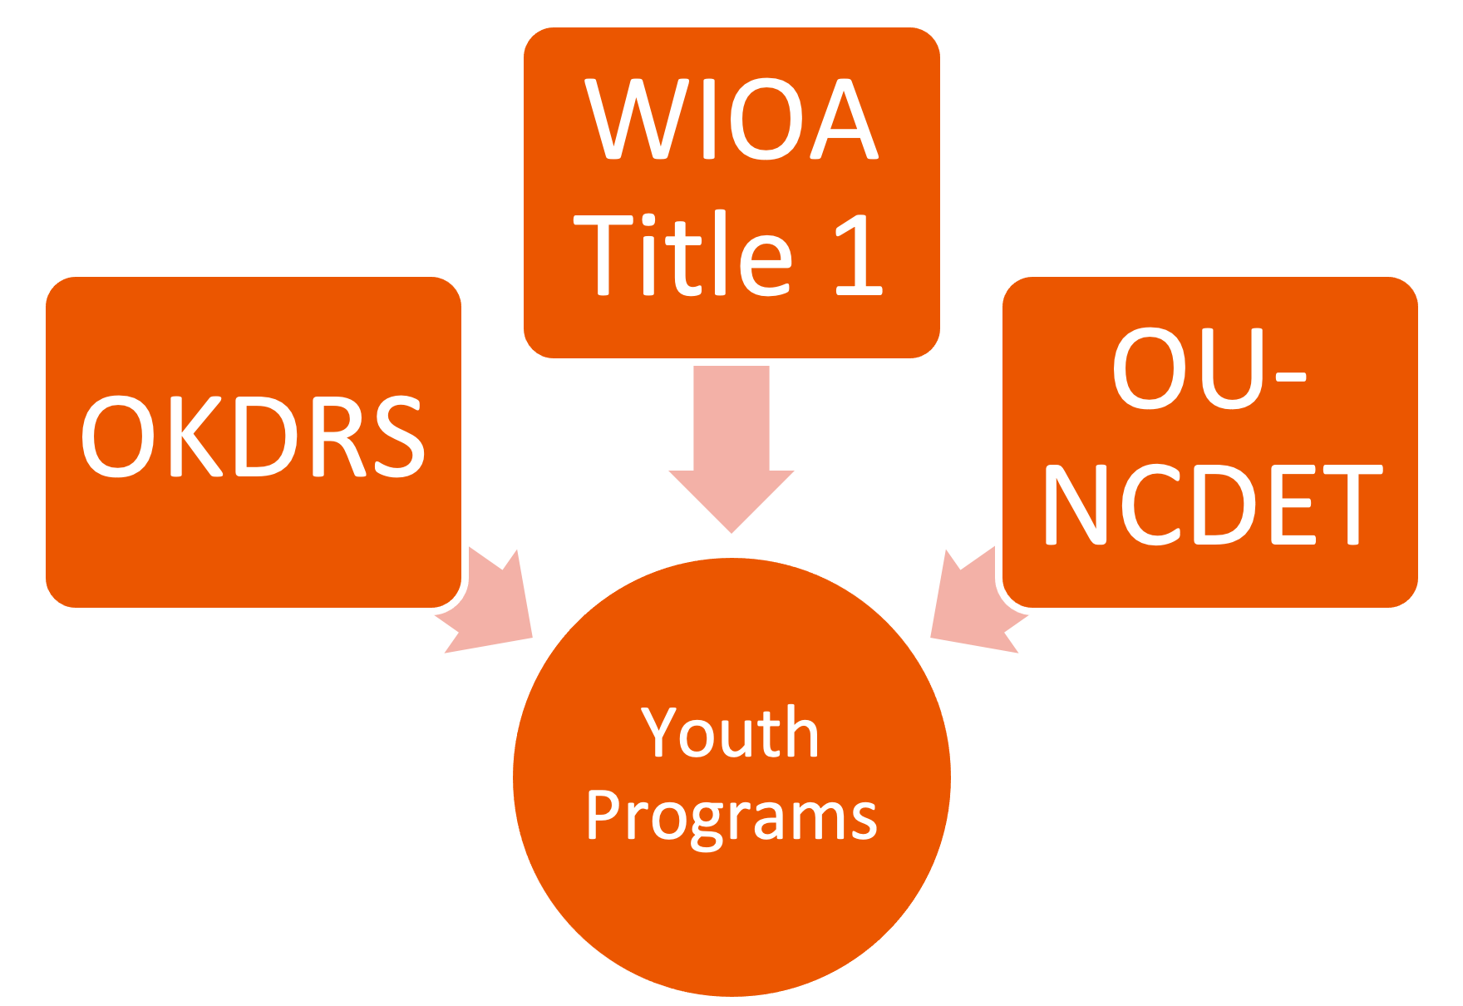
Braided Funding Sources

Slide 19
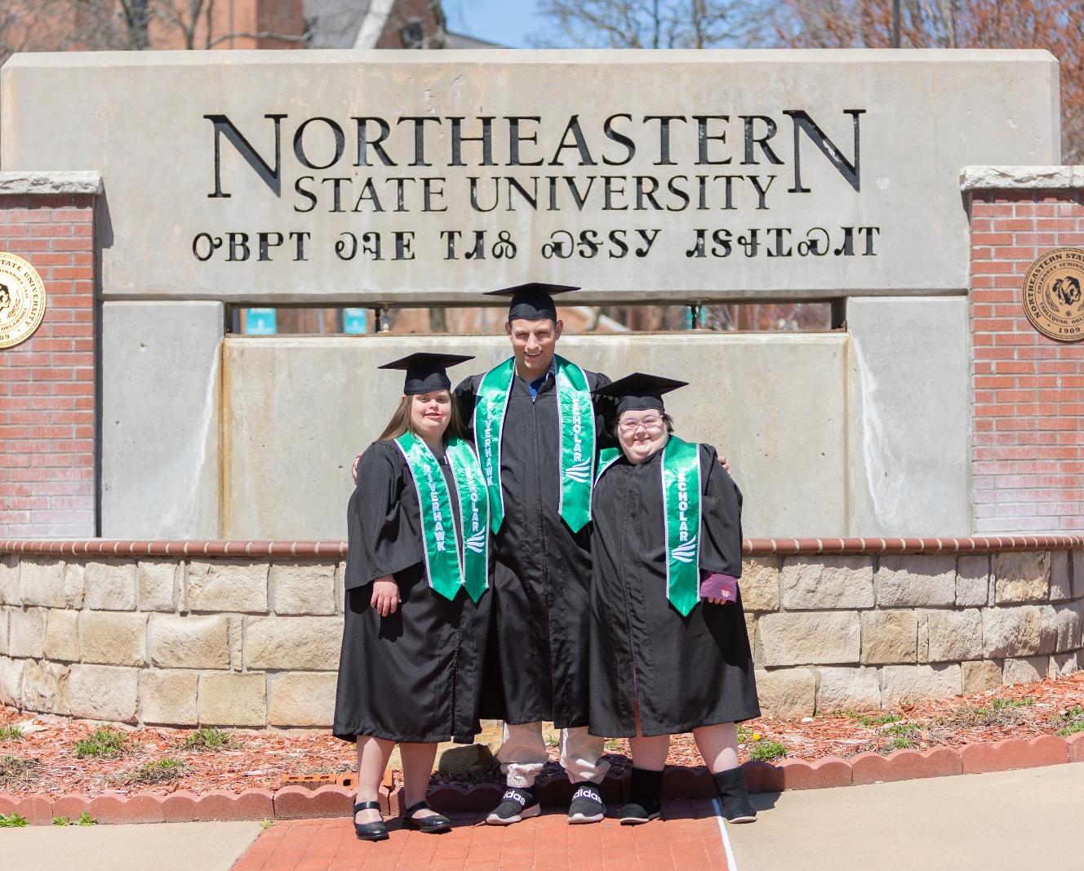
The Reason
Images property of OK IPSE Alliance;
To remain part of presentation as a whole

Slide 20
Connect
Julie Lackey
Director Oklahoma IPSE Alliance
Founder LeadLearnLive
Julie@okipsealliance.org
www.okipsealliance.org
Yolanda Scott
Youth Programs Manager
Central Oklahoma Workforce Innovation Board (COWIB)
405-622-2026 ext. 301

Slide 21
Q and A
Please type your questions and comments for discussion in the chat.
Please complete the poll–we want your feedback!

