Slide 1
Inclusive Higher Education for Students with Intellectual and Developmental Disabilities
2024 MAFAA Conference

Slide 2
Session Objectives
Defining Inclusive Higher Education
What is the Comprehensive Transition and Postsecondary Program (CTP) designation?
How does an institution obtain the CTP designation?
What are the Statewide efforts and Resources available?

Slide 3
What is Inclusive Higher Education - Part 1C
Institution Approved
Leveraging services and systems
Supplemental Advising
Peer Support

Slide 4
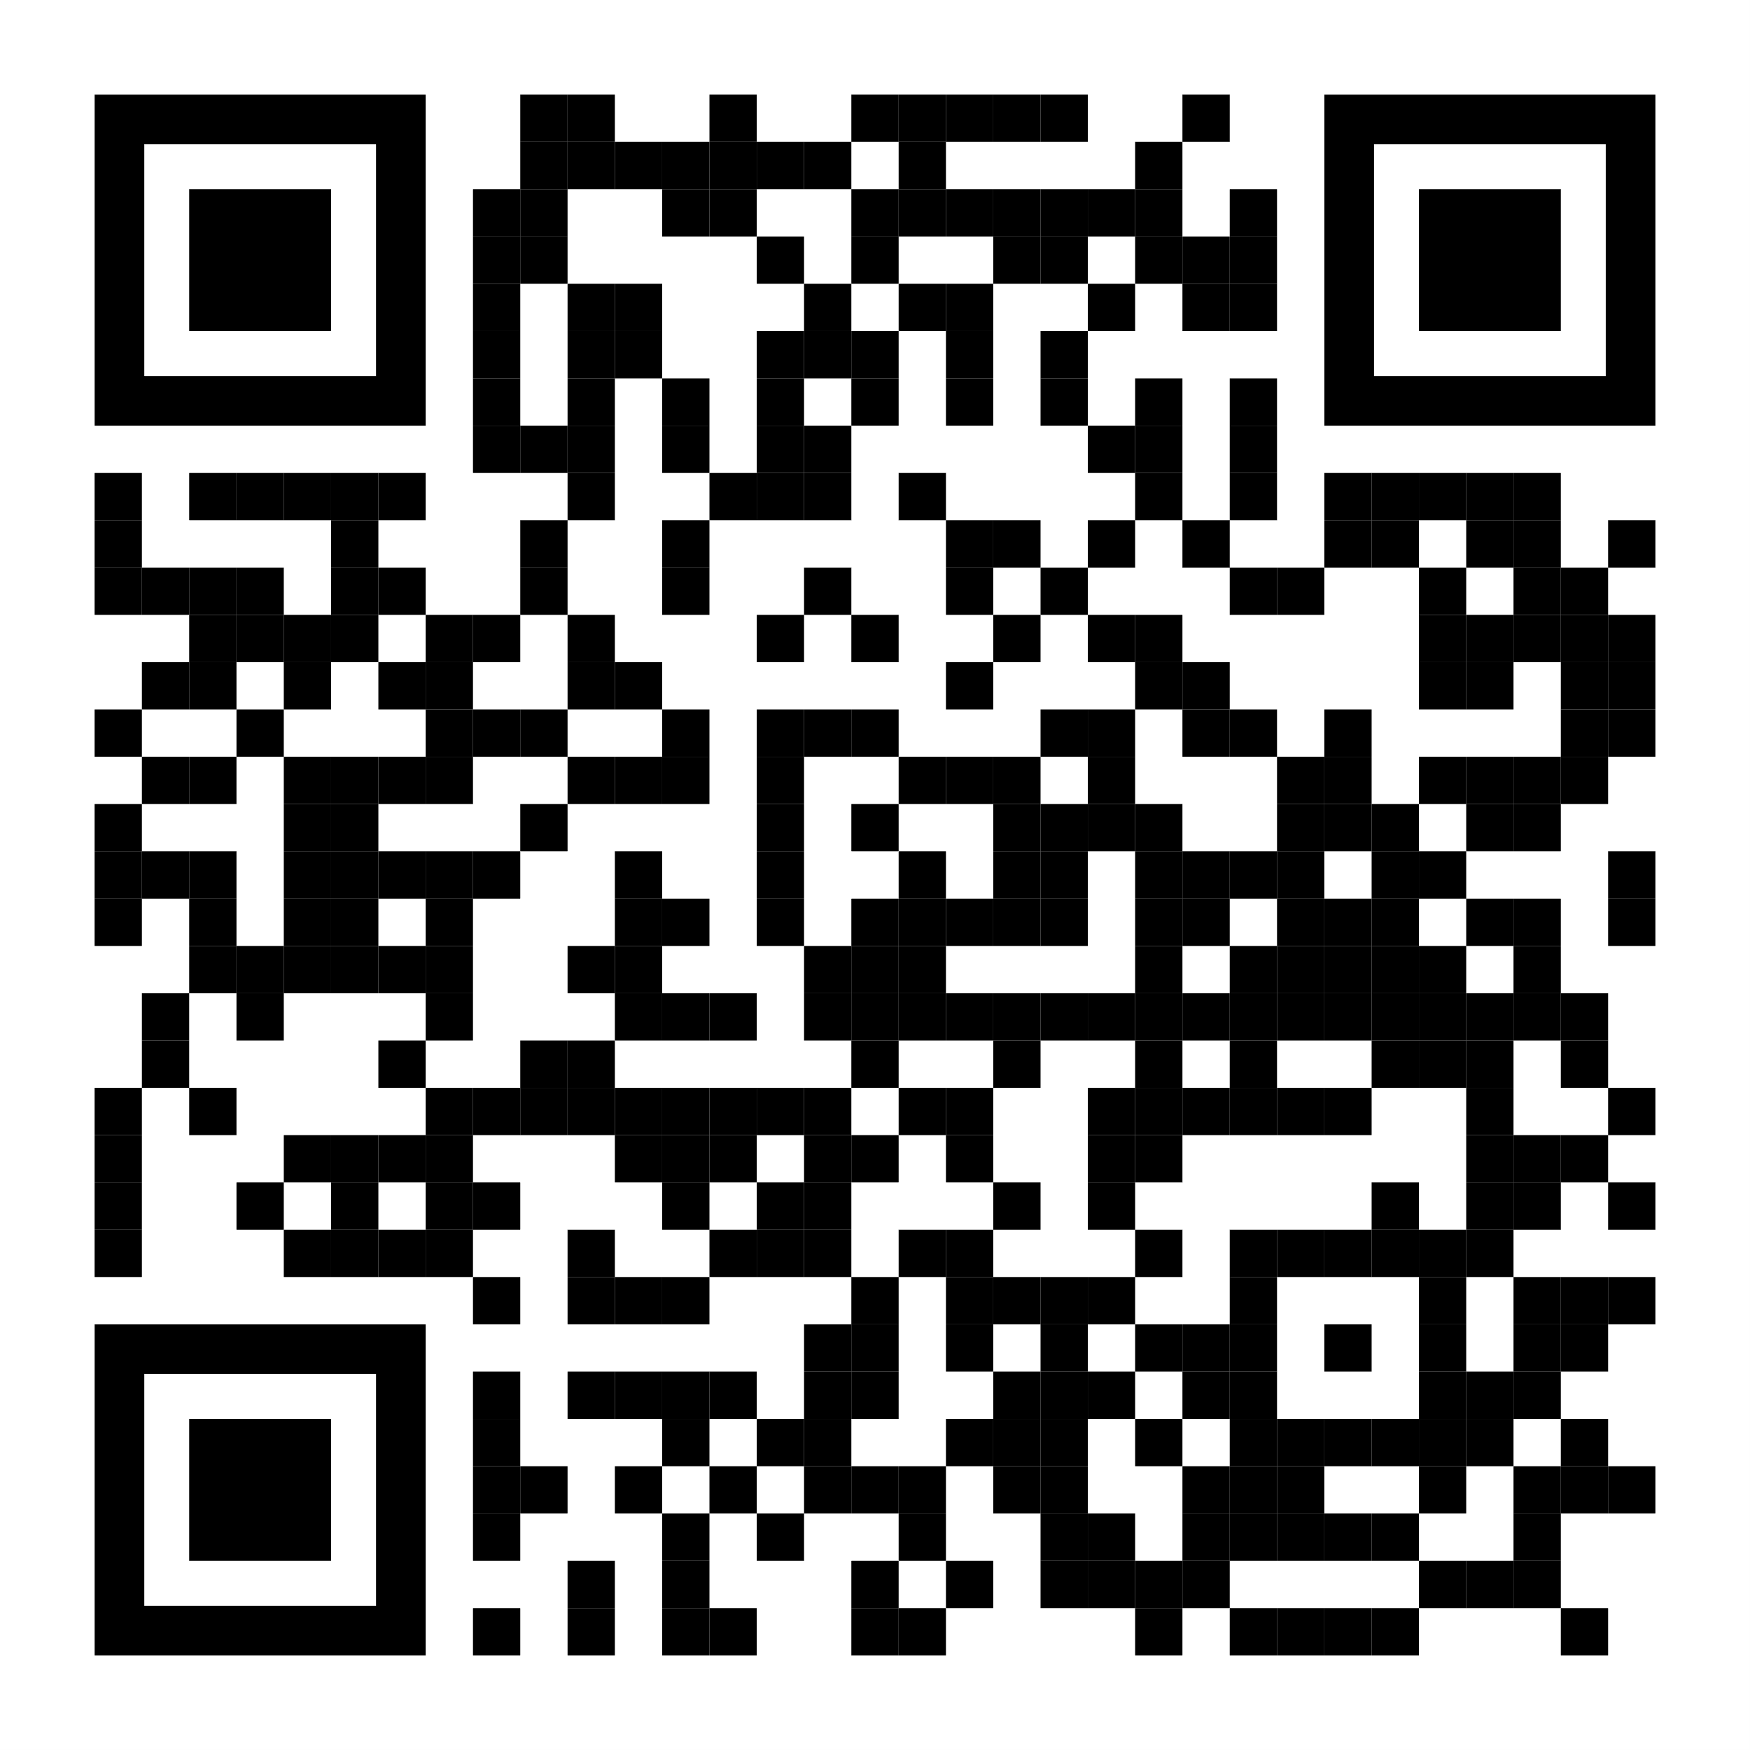
What is Inclusive Higher Education - Part 2C
Academic Program
Career Development
Self-determined Living
Certificate, degree or non-degree credential
z.umn.edu/impact351

Slide 5
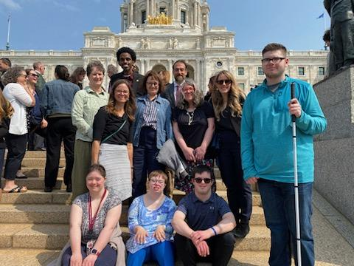
How is Intellectual Disability defined?
Individuals with a cognitive impairment, characterized by significant limitations in:
a. Intellectual and cognitive functioning.
b. Adaptive behavior as expressed in conceptual, social and practical adaptive skills.
c. Who is currently, or was formerly, eligible for free appropriate public education under
IDEA.

Slide 6
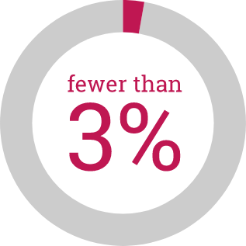
MN Current College Capacity & Prospect Students
5,000 Minnesota Prospective College Students with an intellectual disability
100 Students Current Minnesota College Enrollment Capacity
Less than 3% have access to attend college in Minnesota
Student’s Best Fit College
Source: MDE MARSS Child Count Totals December 2022

Slide 7
Inclusive Higher Education Initiative Planning
Cross Functional Team
Faculty Member
Leadership - President - Provost
Admissions
Housing - Residence Life
Financial Aid
Admissions
Career Services
Disability Resource Services

Slide 8
CTP defined in the Higher Education Opportunity Act (2008)
(a) Comprehensive transition and postsecondary program means a degree, certificate, non-degree, or non-certificate program that— (1) Is offered by a participating institution; (2) Is delivered to students physically attending the institution; (3) Is designed to support students with intellectual disabilities who are seeking to continue academic, career and technical, and independent living instruction at an institution of higher education in order to prepare for competitive integrated employment; (4) Includes an advising and curriculum structure;

Slide 9
Impact of CTP approval on access to aid
Pathway to Title IV (i.e., federal) financial aid for students with intellectual disability (ID)
For students with ID attending an approved CTP program, these requirements for accessing Title IV financial aid are WAIVED:
Required to be working toward a degree or certificate
Required to have a high school diploma, GED, or have passed an ability-to-benefit test
Expands the types of learning activities that are covered by financial aid

Slide 10
Access to Title IV Financial Aid
Federal Financial Aid Eligibility
Federal Pell Grant
Federal Supplemental Education Opportunity Grant
Federal Work-Study
NOT federal student loan programs

Slide 11
Minnesota Aid Eligibility
Minnesota State Grant
Minnesota Indian Scholarship
Minnesota GI Bill
Grants for Students with ID
Work Study
Fostering Independence Grants
North Star Promise Scholarship
Sec. 136A.101 MN Statutes

Slide 12
Steps to becoming a CTP Program
Faculty/Staff Leading the Initiative
Meet with your financial aid office
Prepare Inclusive Higher Education Documentation
Detailed narrative
Satisfactory Academic Progress policy
Letter to accrediting agency
Notify college’s accrediting agency in writing
Financial Aid Office Staff
Financial aid office adds CTP program to the college’s E-App
Email application materials to FSA_PEPS@ed.gov
Wait......respond to queries

Slide 13
Comprehensive Transition Postsecondary (CTP) Program Approval
Think College Online Course

Slide 14
Capacity Building Resources - Part 1
Technical Assistance Center
Consulting
Inclusive Higher Education Expertise
Intellectual and Developmental Disabilities
Professional Development
Learning Community Webinars
Community of Practice Gatherings
Annual Conference
Regional & National Network of Colleagues
Think College - National Technical Assistance

Slide 15
Capacity Building Resources - Part 2
Competitive Grants
First Round RFP Spring 2024
Multi Year Funding
First Year Planning
Up to $200K per year for years 1-4
up to $100K per year for years 5-10
Funding for start up to self-sustaining

Slide 16
Contact information
Mary Hauff hauff004@umn.edu Institute on Community Integration University of Minnesota
Cha Her cha.her@state.mn.us Office of Higher Education

