Slide 1
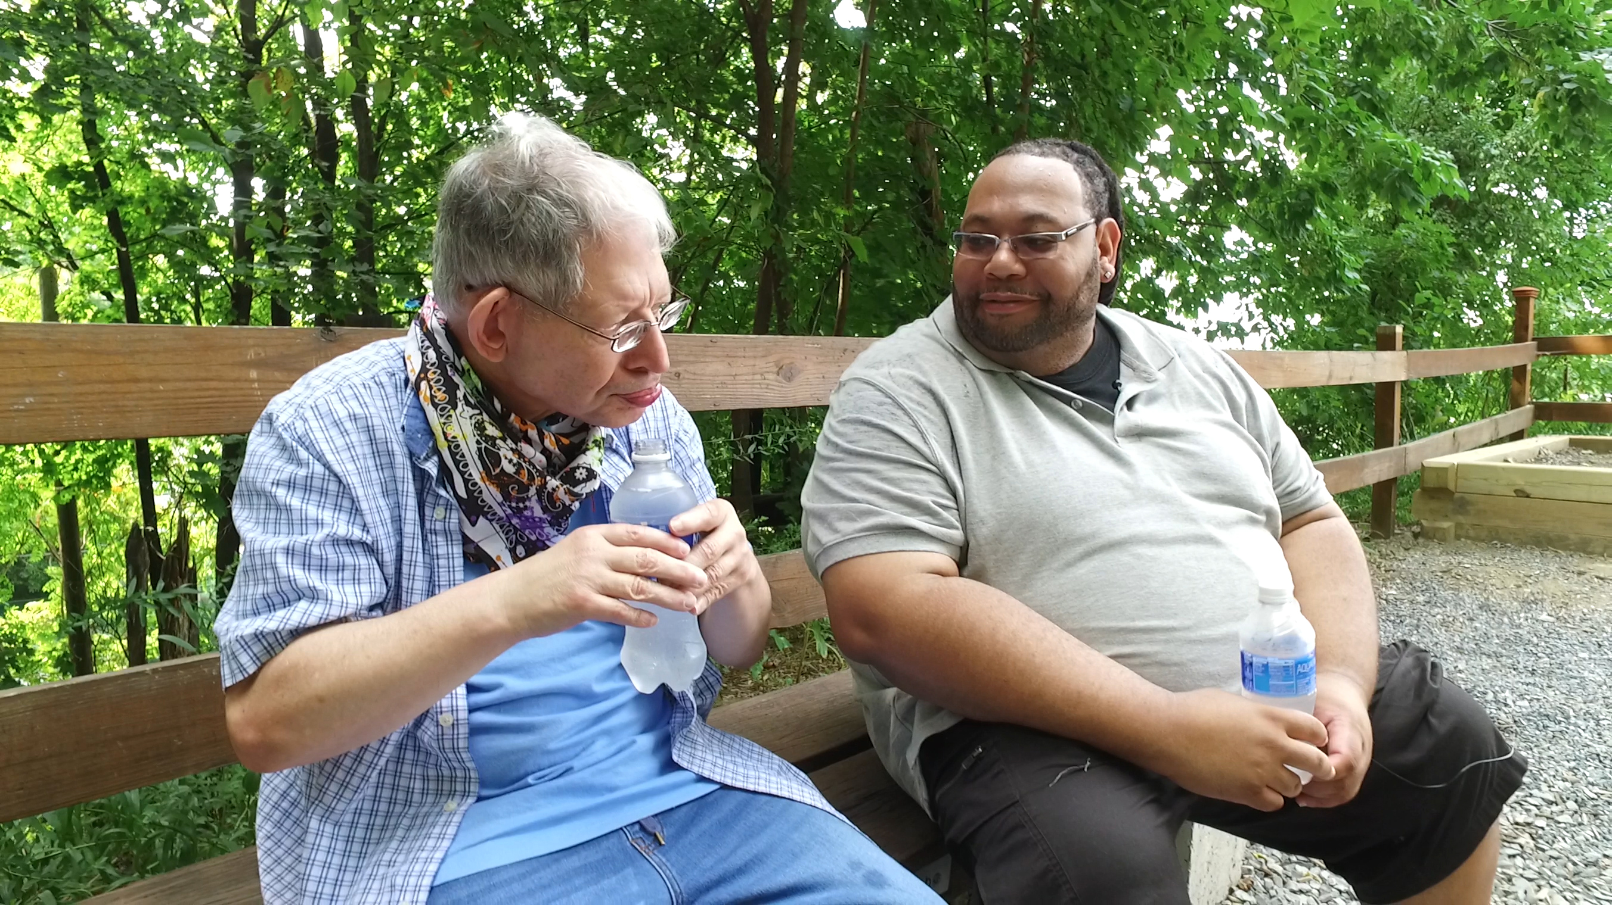
Notes:
Facilitator’s Notes:
Actions for Prior to the session:
Slide #1 – Update presenter names
Hide the other region consultant slide (8,9 or 10)
Hide other regions workshop slide (79,80,or 81) for Upcoming Workshops
Set up Polls
Update Opening Round Question
Facilitator’s Notes:
Actions for Prep time just before the session:
Check that the presenter can share their screen, run videos and video work
Check that the presenter marks “Share Computer sounds” and “Optimize Screen sharing for video clip” so that any videos shown can be heard by others – it is on the same screen that you choose which screen to share.
Check you polls -
Turn on transcript –
Assign someone to set up Break-out Groups
Assign taking attendance
Assign a time keeper
Assign a Host
Assign someone to monitor Chat
Assign someone to turn on record
Turn on Auto-script

Slide 2
Understanding Your Data and Workforce Strategies
Workshop Series
Presenter's name and affiliation
tenncare.ici.umn.edu
Notes:
Facilitator’s Notes:
Actions 10 minutes Prior to the session as people log in so they can know they are in the right place:
Opening slide

Slide 3

Welcome to Session 1
Getting Started:
TN Workforce Initiative Overview and Understanding DSP Workforce Issues
Notes:
Facilitator’s Notes:
Start to Record​
Time: 15 minutes for Introduction Section
Talking Points:
WELCOME:​
Welcome to everyone to the Workforce Initiatives Kick Off Session 1. ​
It is brought to you by Tenncare, TNCO and the University of Minnesota. ​
My name is __________________. I am __________________________________one of your workforce consultants from the University of Minnesota.​
Thank you so much for joining us today.​
This session is ideally suited for organizations leadership, Human Resources Directors, and others to are involved in managing employee data or implementing strategies in DSP recruitment, selection and retention.​
This session is currently being recorded... ​
and we will send the recording to you upon request if you would like to view again or share with others in your organization.​

Slide 4
Using Zoom
Name yourself
  First name
  Name of your organization
Use Chat for questions or comments.
Please keep your Microphone off unless you're speaking.
Keep your Camera on if you are comfortable and able.
Live Script is available.
You may use Reactions such as thumbs up throughout.
Thank you for being understanding of colleagues.
Chat
Notes:
Talking Points:
Some of us are use to working on Zoom in a group, while others are less familiar. So we will take a few minutes to talk about some guide lines that will help us work together better.
Please re-name yourself with your first name and the name of you organization.
You an use Chat for questions or comments. We will be monitoring Chat throughout the session.
Please keep your microphone on mute while others are speaking today to help reduce background noise. We do understand that we will When you’re in breakout groups, please unmute and discuss the topic within your group.
Keep you camera on if you are able and comfortable. The decision is yours.
We have turned on the Live Script for you. You are able to Hide it if you don’t want to see it – find it on the ribbon on the bottom of the page.

Slide 5
Welcome & Introductions
Notes:
Transition slide
Next, we will have introductions.

Slide 6
Introductions – TennCare & TNCO
TennCare
Patty Killingsworth
Shannon Nehus
TNCO
Robin Atwood
Notes:
Facilitator’s Notes:
Timing - no more than 2-3 minutes for slides 6-10 so you have time for introductions.
Plan to hide the slides from the other region and only introduce consultants in this region
Talking Points:
We are going to start with introductions starting with the leaders from Tenncare and TNCO
Shannon will you start us off please
Thank you

Slide 7










Meet Your U of M Workforce Consultants
Amy Hewitt
Barb Kleist
Sandy Pettingell
Bill Tapp
West Region
Middle Region
East Region
Julie Kramme & Chet Tschetter
Claire Benway & Sarah Hall
Megan Sanders & Mark Olson
Notes:
Talking Points:
I would like you to meet the team from the University of Minnesota.
On the top we have Amy Hewitt is the Director of the Institute on Community Integration at UMN. While she won’t be part of these workshops she has been instrumental with our work together.
Barb Kleist is the Project Manager.
Sandy Pettingell is a Research Associate at ICI. She has been deeply involved in the survey and providing profiles to each organization.
Bill Tapp from Knoxville – Our local coordinator/consultant in Tennessee
As you can see there are two consults in each region.
Finish with “Together with ________________ we will be leading all of the workshops and providing consultations to organizations.
Timing - no more than 2-3 minutes for slides 6-10 so you have time for introductions.

Slide 8



Meet Your West Tennessee Consultants & Coaches
Ashante Hodges
Julie Kramme
Chet Tschetter​
Victoria Burgess
Erica Hurd
Notes:
Talking Points:
With us in each regions are your Regional
Let’s start with __________________________________. Please say your name, where you work and the role you play there.
Call upon each Coach
Thank you everyone. Before we have you introduce yourself, we are going to give you an overview of what we will be doing today and over the next month in these workshops.

Slide 9



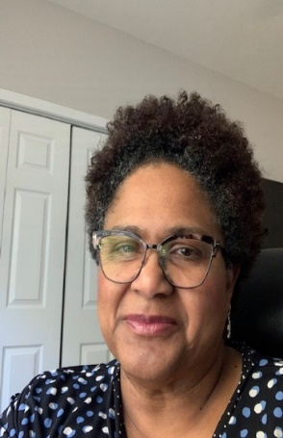
Meet Your Middle Tennessee Consultants & Coaches
Beulah Brooks
Claire Benway
Sarah Hall
Joy Dalton
Faith Franklin
Linda Carpenter
Notes:
Talking Points:
With us in each regions are your Regional
Let’s start with __________________________________. Please say your name, where you work and the role you play there.
Call upon each Coach
Thank you everyone. Before we have you introduce yourself, we are going to give you an overview of what we will be doing today and over the next month in these workshops.

Slide 10
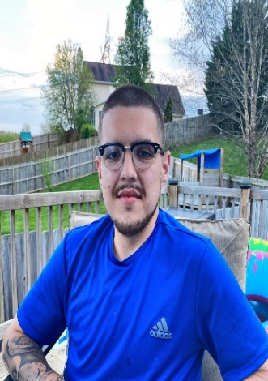
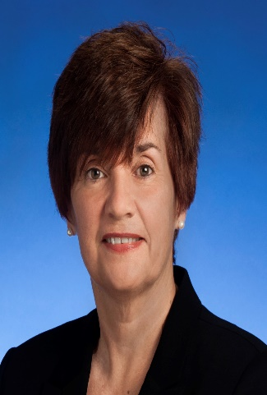


Meet Your East Tennessee Consultants & Coaches
Dakota Luna
Megan Sanders
Mark Olson
Robin Wilmoth
Dana Scott
Nichelle Johnson
Notes:
Talking Points:
With us in each regions are your Regional
Let’s start with __________________________________. Please say your name, where you work and the role you play there.
Call upon each Coach
Thank you everyone. Before we have you introduce yourself, we are going to give you an overview of what we will be doing today and over the next month in these workshops.

Slide 11
Poll Question #1 - What are some of the roles, current or past, that influence your work? (Select all that apply)
Person with lived experience/person with a disability
Parent
Sibling/Family member
Friend
Guardian
Ally/Advocate
Direct Support Professional
Frontline Supervisor/Manager
Executive Director/CEO
Health & Human Services Professional/Policymaker
Notes:
Added poll question slide to precede conversation – Can keep or delete depending on timing.
Talking Points:
Many of us working in this field have worn and maybe are still wearing different hats that inform and influence our work. Let’s do a quick poll to see what are the different roles you have both currently and in the past the influence your work today supporting people with disabilities in community living.
Read slide

Slide 12
Breakout Group Activity
Getting to Know You
Breakout Group
  1 facilitator and 1 reporter in each group
  Give everyone enough time to have a turn.
Your name and organization
Your role in the organization today
What is one thing your organization did to celebrate DSP week or recognize DSPs during the year?
Notes:
Activity : (5 minutes) – 5 people per breakout, each person gets one minute, assign 1 consultant or coach to each breakout group
Purpose: Gives consultants and coaches opportunity to learn who is in the room.
Talking Points:
We are going to have the opportunity to get to know who is in the workshop today. In a moment but not yet, you will be send to a Breakout room with 5-6 others.
Everyone will have the:
Opportunity to introduce your self with your name, your organization and your role in the organization.
And answer the questions on the screen.
What is one thing your organization did to celebrate DSP week or to recognize DSPs during the year.
When you get to your group, find one facilitator and another person to report back for the group the responses to the two questions.
When the group returns call on the reporter from each group to report back on themes for questions #1 and #2.

Slide 13
Overview of Workshop Series
What we will cover in Session 1-7
Notes:
Time: 6 minutes for Overview of Series Section
Facilitator’s Notes:
BRIEFLY go over the workshop series do not get into the weeds, high level overview
Talking Points:
Next, we will give you an overview of the entire kick-off workshop series.

Slide 14
Goals for the Kick-Off Workshop Series
Review & understand organizational workforce survey data
Assess organizational capacity for workforce development
Learn about tools and strategies for workforce recruitment, selection, and retention
Explore tools and strategies based on data
Learn about measuring outcomes of implementation
Notes:
Facilitator’s Notes:
BRIEFLY go over the workshop series do not get into the weeds, high level overview
Talking Points
During the Kickoff Workshops we have a number of things that we want to you do and learn about.
The first is that you review and understand your organizations workforce survey data.
Each organization took the 2019 workforce survey and has been provided with a profile that is unique to your organization.
You also have the regions and the state data to compare it to.
We will be covering the survey thoroughly in Session 3.
You will have the opportunity to assess your organizations capacity for workforce development.
It is important to know if the organization is ready, meaning do you have the resources to develop and implement workforce strategies.
Learn about the tools and strategies in the Workforce Toolkit. There are tools on Recruitment, Selection, and Retention that you will be leaning about in Session 5 & 6. The tools strategies are based on data.

Slide 15
Kick-Off Workshop Sessions
Session 1
  Getting Started: TN Workforce Initiative Overview and Understanding DSP Workforce Issues
Session 2
  Understanding Your Data: Overview of Survey Results Profile and Interpreting Data
Session 3
  Assessing Your Need: Evidence-Based Practices and Organizational Capacity
Session 4
  Overview of TennCare Workforce Toolkit: Recruitment & Selection Strategies
Notes:
Talking Points
Session 1 is a general overview of the project and a change to get to know who is involved in this project.
Session 2 will be about helping everyone understand the workforce issues that we are facing with Direct Support Professional in Tennessee and the county.
During session 3 we will be giving you an overview of the survey profiles. We will look at each section and answer your questions.
In session 4 you will lean about Organization Readiness and the 8 steps of implementation

Slide 16
Kick-off Workshop Sessions
Session 5
  Overview of TennCare Workforce Toolkit: Retention Strategies-Part 1
Session 6
  Overview of TennCare Workforce Toolkit: Retention Strategies-Part 2
Session 7
  Planning Your Next Steps: Measuring Outcomes of Implementation and Creating a Practical Action Plan for Change
Notes:
Talking Points
We will start to dig deeply into the Workforce Strategies in the Toolkit in sessions 5 & 6.
We first start by looking at Recruitment and Selection followed on Onboarding and Orientation and wrapping up on Retention.
In the last session, session 7 we will be a session where you select strategies based on your workforce issues and your data. You will consider which workforce strategies we cover in Session 5 & 6 will be the best match for your organization.
During this session you will start an action plan that is practical for your workforce challenges.

Slide 17
Overview of TN Workforce Initiative
QuILTSS Workforce Development – Shannon Nehus
Notes:
Time: 26 minutes for Overview of TN Workforce Initiative Section
Talking Points
We wanted to make sure we have shared understanding of this project.
We begin with Shannon to talk about TennCare Workforce Development

Slide 18
Workforce Development
Notes:
Facilitator’s Notes:
Slides 18-31 are Shannon’s slides. We do not have the script.

Slide 19
QuILTSS Workforce Development
  Where we began
  Stakeholder feedback from meetings conducted across the state identified the quality and competency of the workforce as one of the most important drivers of quality that impacts the day-to-day lives of people who receive services
  Workforce development is a foundational component of quality improvement – of value-based delivery system reform

Slide 20
LTSS Workforce Development
Develop a comprehensive competency based workforce development program and credentialing registry.¹
Better for Workforce
Opportunity to both learn and earn acquiring shorter term credentials with clear labor market value
Portable credentials across providers, programs, and service settings
Earn college credit and certificate; apply toward degree program—education path for direct support professionals
Build competencies to access higher wages and advanced jobs—career path for direct support professionals
Learning and relationship management system matches worker with coach/mentors/career planning support
Better for Members
& Providers
Promotes delivery of high quality person-centered services
Supports competency and continuity of staff for members and providers
Online registry for matching by individuals, families, providers based on needs/interests of individual
Alignment improves member experience
Agencies employing better trained and qualified staff will be appropriately compensated for the increased competency of staff and higher quality of care experienced by individuals they serve
¹ for deployment through secondary, vo-tech, trade schools, community colleges, and 4-year institutions, offering portable, stackable credentials and college credit toward certificate and/or degree program

Slide 21












QuILTSS Badges

Slide 22
QuILTSS Workforce Development
  7 Key Tenets
Competency-Based
Require Demonstration
Micro-Credentialing System
Portability through Registry
Faculty, Coach and Mentor Supported
Clear Career and College Pathways
Credit-Bearing Framework

Slide 23
QuILTSS Workforce Development
Connected to Governor’s higher ed priorities
  Drive to 55* and the “Last Dollar Funding” programs
    Tennessee Promise and Tennessee Reconnect**
Partnered with Tennessee Board of Regents and Tennessee Higher Education Commission
  Tennessee Community Colleges (CCs)
  Tennessee Colleges of Applied Technology (TCATs)
Award 18 hours of college credit and a post-secondary credential
  Integrates work-based learning hours
  Embed within a variety of degree paths including new Associates Degree
*Governor-led initiative to get 55% of Tennessee’s adults with a post-secondary credential by 2025
**Last dollar funding programs which offer up to 2 years of post-secondary education at a CC, TCAT,
or other eligible institution for students after high school or returning adult learners, respectively

Slide 24
Understanding Workforce Challenges
New “Insights”:
  Escalating challenges with recruitment and retention in longstanding Section 1915(c) waivers
    51% based on 2018 Staff Stability Survey (NCI)
    Most significant factor impacting implementation of Employment and Community First CHOICES
    To provide high quality services and supports, must have competent staff to deliver them

Slide 25
Addressing Workforce Challenges
New “Opportunities”:
  Design and implement additional competency-based training and education programs to align with and sustain VBP models
    Pre- and Early-Service components across LTSS programs
    Self-Direction of Health Care Tasks
      Medication Administration
    Respiratory Care
    Diabetes Management
  A competency-based training program for employment supports staff
  A competency-based training program on supporting people with challenging behavior support needs
  A competency-based training program for Alzheimer’s/Dementia
  A competency-based training program for HealthLink (behavioral health home) providers to increase their capacity to provide high quality services and achieve VBP performance expectations
  Competency-based education for physicians on serving people with I/DD and the use of psychotropics

Slide 26
Addressing Workforce Challenges
New “Opportunities”: A Multi-Prong Approach
(in addition to competency-based training)
Workforce Capacity-Building Investments
Establish processes for collection/use of workforce-related data at provider and system levels to target and measure improvement efforts over time
  Comprehensive statewide data analysis to target investments, track improvement over time
  Provider-specific analysis and training/technical assistance to providers in analyzing and using their own data to guide/evaluate their organization’s efforts to address workforce issues
Engage national experts to provide capacity-building training and technical assistance to providers to support adoption of evidence-based and best practices that have been shown to result in more effective recruitment, increased retention, and better outcomes for people served

Slide 27
Addressing Workforce Challenges
New “Opportunities”: A Multi-Prong Approach
(in addition to competency-based training)
  Workforce Incentives in the form of increased wages for higher
  levels of competency, i.e., training/certification, and tenure
  Provider Incentives for practices that will lead to desired
  outcomes:
    Data collection, reporting, and use at the provider level
    Adoption of evidence-based and best practice approaches to workforce recruitment/retention and organization culture/business model changes
  Transition to financial incentives for specific workforce and quality of life outcomes once practices expected to result in the outcomes have been effectively adopted
Outcomes for persons served will be ultimate measure

Slide 28

Addressing Workforce Challenges
New “Opportunities”: A Multi-Prong Approach
Competency-Based TRAINING Program
Non-Recurring INVESTMENT in Capacity- Building Supports
Aligned Financial INCENTIVES

Slide 29
QuILTSS Workforce Development
Status Detail
WF 2018 Survey and report complete
WF 2019 Survey and report complete
Annual report includes State and Provider Level Findings Reports (descriptive statistics for key variables such as turnover, vacancy, and wages)
Year 1 Understanding Survey Data Training will occurred September 2019
Year 2 Understanding Survey Data Training for Cohort 2 – October 2020
  Year 1 - Three training sessions in each grand region of Tennessee helped Cohort 1 Providers understand how to best utilize their Survey Report data, including identification of workforce interventions that are provider-specific.
    Understanding Survey data and methods for taking action
    Selecting workforce solution strategies based on data
    Measuring outcomes of implementation
  Year 2 – Replicate survey, analysis, reporting, training, and technical assistance with Cohort 2 Providers

Slide 30
QuILTSS Workforce Development
Status Detail
A Workforce Data Toolkit has been developed. The baseline Workforce Data Toolkit is used for in-person Identified Provider training sessions. The Workforce Data Toolkit includes evidence-based tools to use for workforce solutions pertaining to the following subject matter areas
  Tennessee specific realistic job preview
  Tennessee specific Public Service Announcements
  Structured behavioral interview protocols for all CMS core competency areas
  Tennessee specific targeted marketing materials based on agreed upon markets determined by the established workforce development work group
  Other areas as identified by the workforce group.
A classroom training module that teaches providers how to use the tools in the Workforce Data Toolkit has been developed and is used for each Cohort.

Slide 31
QuILTSS Workforce Development
Status Detail
Post-Regional Technical Assistance to Providers will occurs in Q4 following Workforce Training.
  In addition to Regional Training, targeted in-depth technical consulting is provided to all Identified Providers in three separate phases/cohorts to help Providers understand Survey Report data, develop an action plan, and implement workforce solution strategies
    Phase 1/Cohort 1 completed year-long technical consultation October 2020 with their first Tennessee Community of Practice meetings
Workforce Coaches were identified and trained in Q2 2020 to conduct Post-Regional Training and assist Identified Providers in understanding the Workforce Data Toolkit
  A Workforce Coach will be matched with an assigned mentor for one full Phase of Post-Regional Training. Once the Workforce Coach completes an initial phase of mentoring, the Workforce Coach shall serve in a co-trainer role with the mentor
Building Capacity in Tennessee.
  Following an initial phase of mentorship, and a subsequent phase of co-training, the Workforce Coach shall function as a TA Consultant and conduct Post-Regional Training and provide Workforce Data Toolkit guidance independent from the mentor

Slide 32
Key Project Activities
Annual Workforce Survey
TN DSP Workforce Toolkit
Customized TN-Specific Workforce Tools for Recruitment, Selection, and Retention
Training and Consultation on DSP Workforce Strategies
TN Workforce Coaches Training
Regional Workforce Communities of Practice
Notes:
Time: 6 minutes on Key Projects – Survey-Workbook Section
Talking Points
Thank you, Shannon for that in depth overview.
The University of Minnesota, provided to providers in Cohort 1 and you, Cohort 2 the Workforce Survey between March - May 2020. There will be another survey next year during the same time period.
The consultants will provide Technical Assistance from now until Aug 2021, along with the Regional Coaches from Tennessee
Together with the Regional Coaches we will be leading Communities of Practices in each region.

Slide 33

Annual Survey – Quick Snapshot
12-month calendar year timeframe
2018 (47 organizations)
2019 (75 organizations)
Upcoming 2020 (early 2021)
Changes made in year 2 from feedback
Notes:
Talking Points
We have collected two years of annual organizational data. There were Changes to survey used between year 1 and year 2. The year 3 survey is anticipated to be released in early 2021 to include data from 2020.
Results of year 1 with 2018 data were compiled in the year 1 report, along with state and regional profiles. These are available on the website.
We will look today at results from the Year 2 2019 survey results that are also available in report and profiles and will be available on the website. The profiles contain selected information – not all the information provided by organizations that completed the survey are compiled in the profiles. The profiles are designed to include information that is particularly important for decision making regarding workforce recruitment and retention.
STOP FOR QUESTIONS.

Slide 34
Organization Self-Assessment Workbook
Purpose:
To identify areas of strengths and areas of needed improvement in your respective organizations to build capacity to address direct support workforce issues.
Key Sections:
Organization Key Information
Self-Assessment
Moving Towards Improvement
Tools and Additional Resources
Notes:
Talking Points:
The purpose of this workbook is to have one place for you to capture your work over the 7 workshops so when you go back to your organizations you can share what you’ve already done.
You may have completed the workbook already or you may work on it thought the 7 sessions. You may need input from others in your organization.
This gives you a road map for next steps when to back to your organization to work thought the 8 step of implementation, which we will be talking about later today.
Let’s a quick review of the different sections of the workbook
The first section is the: Organization Key Information – you will want to complete this so everyone on this team from your organizations knows who else is on the team including who your Consultants and Coaches are.
In the next section on: Self-Assessment will ask you to consider how the organization:
Assesses and uses Workforce Data
The Organizational Capacity or Readiness along with your Processes
Recruitment and Selection Processes
How the organizations manages Orientation and Training
Takes a look at your Retention Strategies
And the last section is about your Evaluation practices.
Moving Toward Improvement – by using the workbook in conjunction with the resources we provide you during the workshops your organization can move toward improvement.
You will learn about Tools and additional Resources such as the:
Retention Trends and Summary Worksheet
Challenge/Intervention Strategy Matrix
Summary Overview of Workforce Toolkit
Action Planning Worksheet
All of these resources are in your Self-Assessment Workbook
Possible activity for in person session
Activity: 3-4 minutes
Turn to page 3 of your workbook and fill out the information for your organization.
Throughout the 7 workshops, we will be prompting you to capture your thoughts in this workbook.
Return to the slide with Consult and Coaches contact information

Slide 35
Cohort 2 Overview
Training and Workforce Consultation
Notes:
Time: 10 minutes for content, 15 minutes for breakout session and 7-10 minutes for large group for Cohort 2 Overview – 35 minutes maximum
Transition slide
Next, we will talk about...

Slide 36
Workforce Initiative Timeline-Cohort 2
SEPTEMBER 2020 | OCTOBER 2020 | NOVEMBER –DECEMBER 2020 | JANUARY –FEBRUARY 2021 | MARCH–APRIL 2021 | MAY–JULY 2021 | AUGUST 2021 and beyond
Email with 2019 profile, invitation to view pre-kickoff webinar Identify key contacts, potential team members | Kickoff workshops on Understanding your data and Workforce Toolkit overview Start Self-Assessment Workbook Select level of consultation (begins) Start using an action plan | Kickoff workshops Review Assessment results Complete Self-Assessment Workbook View webinars and review toolkit (begins) Confirm organizational readiness (begins) | Organization Level Meetings via Zoom Video Conference or Conference Call Participate in Year 3 2020 Survey (begins) Organization Team implement the strategy (begins) Participate in Regional Community of Practice | Organization Level Meetings via Zoom Video Conference or Conference Call Participate in Regional Community of Practice | Organization Level Meetings via Zoom Video Conference or Conference Call | Participation in Community of Practice Year 3 2020 Survey Results Participate in webinar to review Year 3 – 2020 Survey Organizational Profile
Step 1: Identify and assess the problem
Step 2: Select an Intervention Strategy
Step 3: Identify components of the strategy
Step 4: Identify barriers to Implementation
Step 5: Identify support for the strategy
Step 6: Set goals, measure progress & establish a time frame
Step 7: Implement the strategy
Step 8: Evaluate success
Notes:
Talking Points
Let’s take a look at the Timeline for the Workforce Initiative for this cohort.
In Sept you received your organizations’ profile, along with your region and the state profile.
You were invited to the Kick-off workshops and asked to you to identify two key contacts who would attend the kick-off workshops.
In October – we are starting the Workshops, and you will be introduced to the Self –Assessment Workbook.
You will also begin to consider the level of technical assistance that your organization prefers. You will learn more about this in a bit.
Action plans will be started.
In Nov & Dec. we will continue and wrap up the workshops.
Through-out the workshops you will be completing the self assessment and reviewing your self assessment. Organizations will be assessing and confirming their readiness.
You will make decisions on the level of technical assistance you want.
During this time, you will have access to and can begin to watch the toolkit webinars on Recruitment, Selection and Retention.
From January and February – Organizations who decide to have individual technical assistance will begin consultations. The consultation will be with the Staff from the University of MN and the regional coaches.
Organizations will have the opportunity to participate in the Year 2, 2020 Survey.
The organizations workforce team will decide on and begin to implement a strategy.
There will be a virtual Community of Practice in January that you will be invited to. More to come on that later.
March through July organization will be working on their implementation of their action plan with technical assistance as desired. There will be another community of practice in April.
In August you will receive the Year 3, 2020 survey results for your organization, your region and the state. We will have a webinar about the Year 3 2020 results, and you will be invited to continue being supported through the community of practice.
During this year, your organization will be moving through the 8 steps of implementation at your own pace. And with being in the middle of a pandemic, we know that priorities shift according to what is occurring with COVID-19 and the people who accept services from you and the people who provide services.
We will talk more about the 8 steps on the next slide.
This timeline and the 8 steps are included in the Self Assessment Workbook
Are there any questions?

Slide 37
8 Steps for Implementation – Workforce Strategies
Step 4
Step 3
Identify
barriers to implementation
Step 2
Identify components of the strategy
Step 1
Select an intervention strategy
Identify and assess the problem
Larson & Hewitt, 2005
Notes:
Talking Points
We will be using the 8 step framework for implementation of workforce strategies – let’s do a quick overview as we will be revisiting these in more depth in future sessions
Step one is identifying and accessing the workforce challenge that your organization decided to address.
In Step 2 you will select an intervention strategy from the workforce toolkit.
During Step 3 your team will identify the components of the strategy.
Then you will identify barriers to implementing the strategy

Slide 38
8 Steps for Implementation – Workforce Strategies
Step 8
Step 7
Evaluate success
Step 6
Implement
the strategy
Step 5
Set goals,
measure progress, & establish a time frame
Identify support for the strategy
Larson & Hewitt, 2005
Notes:
Talking Points
Next will be figuring out the supports that you need and are available to you.
Step 6 is where you will set your goals, based upon what you have learned in step 1-5, while establishing how you will measure your process, and a timeframe.
Then it is time to implement the strategy and using what you decided in Step 6, you will evaluate the success of the strategy.
I know this was brief, but it gives you an idea of how you will prepare for and them implement a strategy.

Slide 39
Menu of Technical Assistance – Option A
  Regular monthly individualized consultation on implementing workforce strategies scheduled by the UMN workforce consultants and TN Regional Coaches
  Full access to online Tennessee Workforce Toolkit
  Participate in Regional Workforce Community of Practice
Notes:
Talking Points
Your organization can choose the level of technical assistance that you prefer.
There are three options that we are offering.
We will ask you to choose an option by the end of the workshops so that we can best support you in the way you want to be supported.
You are able to change your level of TA support at anytime. Just let your TA consultant know what you want to do.
This is the first of the three options and offers the most support.
Your organization will receive regular monthly individualized consultation on implementing workforce strategies by phone or Zoom meetings set up by the UMN workforce consultants and TN Regional Coaches.
Your organization will receive access to online TN Workforce Toolkit and
the option to participate in the Regional Workforce Community of Practice.

Slide 40
Menu of Technical Assistance – Option B
Consultation from UMN workforce consultants upon request
Full access to online TN Workforce Toolkit
Option to participate in the Regional Workforce Community of Practice
Notes:
Talking Points
In Option B
Your organization will receive consultation from UMN workforce consultants upon request, through email, phone, or Zoom meetings.
You will receive full access to online TN Workforce Toolkit and
the option to participate in the Regional Workforce Community of Practice.

Slide 41
Menu of Technical Assistance – Option C
Access to online TN Workforce Toolkit
Option to participate in the Regional Workforce Community of Practice
Notes:
Talking Points
If you chose option C:
Your organization will receive access to online TN Workforce Toolkit and
the option to participate in the Regional Workforce Community of Practice.
We will ask you about the level of TA support you are opting for later in the Workshop series.
Are they any questions about the options?

Slide 42
Breakout Conversation
  What is one thing that caught your attention about the overview?
  What is most exciting?
  What concerns you?
  What is something you want to know more about?
Notes:
Facilitator Notes:
Timing: 15 minutes before break
Breakout Time in small group 10 minutes
Breakout groups – 4-5 per group, follow-up similar pattern of splitting MCOs between groups, select someone to take notes and someone to report – can be the same person
Report Out to Large group- 5 minutes
May stay in large group depending on size. If breaking off bring back to have each group report out on what they learned or discovered.
Let people discuss in small groups then share out their group discussion with the larger group.
Breakout questions:
Use round robin to make sure everyone responds to this question
What is one thing that caught your attention about the overview?
Remaining questions can be done popcorn style, whoever wants to answer.
What is most exciting?
What concerns you?
What is something you want to know more about?
Large group report out: Facilitator question for large group report:
What did you hear/learn?
If there is a whiteboard take this information down.

Slide 43
Stretch Break
Take 5 minutes to stretch and refresh.
Notes:
Time: 10 Minutes, Break should occur 5 minutes before the start of the second hour of the session.
Talking Points
Turn off video and audio when you leave. Turn video back on when you return so we know you are back.

Slide 44
Understanding DSP Workforce Issues
Workforce is the Key to Quality
Notes:
Time: 30 minutes for both Understanding and Defining DSP Workforce Issues
Talking Points
Welcome back from break.
In the next section, we will look into understanding workforce issues. To better understand the issues, we need to first understand who DSPs are and what they do.
Direct support workers are a key to quality of life for people with IDD. Direct support workers help people access living, working and enjoying the community. Lack of qualified and consistent direct support workers severely limits peoples’ access to any of these things.

Slide 45


Intersection
Direct Support Workforce Quality Long-Term Services and Supports
Notes:
Talking Points
In our work at ICI there is a strong intersection between the direct support workforce and quality long term services and supports.
What we know from our research is that you really can’t talk about quality of long-term services and supports without talking about the direct support workforce.
The quality of supports a person receives affects their quality of nearly all areas of life. And we continue to study the relationship between the two.
So...we want to improve the DSP workforce so that people with disabilities receive better long-term services and supports and, thus, experience a greater quality of life.
The workforce is a domain in this framework (dark green box on the right), so is part of the LTSS that people with disabilities receive.
NQF=National Quality Forum

Slide 46

Workforce
Notes:
Talking Points
Recently the workforce was added as a domain to the NQF Framework for home and community-based services (HCBS) Outcome Measurement.
This is significant in that it gives us the opportunity to look closer at the relationship between workforce outcomes and outcomes of people.
We can use this research to positively influence policy and system changes to address the systemic failure of the direct support workforce.

Slide 47

Who are we talking about?
Direct Support Professionals
  personal care attendant
  direct care worker
  direct support staff
  community living specialist
  job coach
  employment specialist
  etc.
Notes:
Talking Points
How we answer this questions is a big part of the problem.
We use so many different names of we use for Direct Support Professionals or DSPs
And what most people don't understand are the many roles that DSPs play. They are teachers, health care workers, cooks, drivers and so much more
First let's talk about the names that DSPs go by.
These are some of the names that we have heard in Tennessee for DSPs.
What titles does your organization use? (only take a minute on this question)
It is important to note DSPs are not recognized by the Bureau of Labor Statistics, and does not have its own job category, but are most often reflected in the job category of personal care attendants.
This is not an accurate placement by job duties as it does not reflect the community-based aspect of the work.
It also does not allow us to accurately capture wages and worker benefits when so many different jobs are lumped into the one category.
Efforts to work with a group of federal agencies to address this issue has been ongoing and continues to be a critical issue if we are to provide better information to policy makers about the workforce realities of these distinct groups of workers.

Slide 48

Notes:
Facilitator’s Notes:
When sharing video on screen – make sure to check the box for other to be able to hear the video
Talking points
We'd like you to watch this short 1 minute video clip from the movie Invaluable to hear about the many roles DSP’s play across the county, as well as the scope of their work.
Play video, when it is over, go to the next slide to talk about the scope of work.
Link to clip: https://www.youtube.com/watch?v=WvWNyVp_JPM&list=PLbrrhT8nj86wpPGTGTdwwpbrGQ_Q7h9Qr&index=6

Slide 49
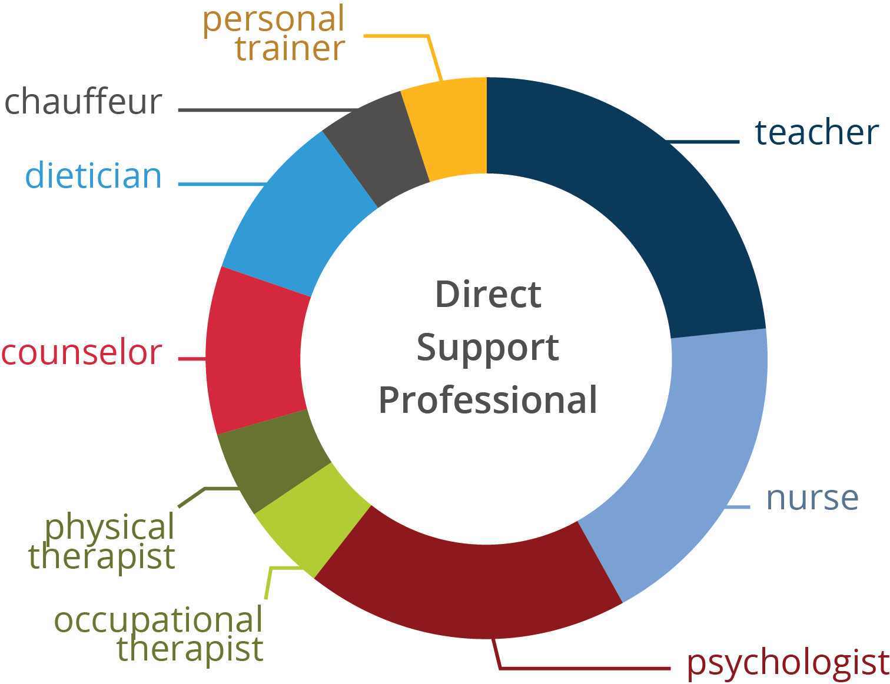
DSP Scope of Practice - Multidisciplinary
Notes:
Talking Points
The scope of the DSPs work is broad and complex.
On any given day, a DSP may required to take on the role of a nurse (dispense meds) , teacher (help someone learn a new bus schedule), psychologist (support someone to process their feelings), dietician (plan and prepare nutritious meals) etc.
Our descriptive language too often speaks of these DSPs as being entry level and low wage workers. And that narrative has to change.
DSPs do many things that in many states licensed practical nurses (LPNs) are not allowed to do. We need to focus on the complex skills these employees need to evolve to be competent and confident at what they do.
I also want you to take note that most of the different roles represented on this circle that a DSP might have on any given day require some form of certification or licensure, yet in many states if not most, DSPs do not have this requirement.

Slide 50


An Increasingly Diverse Home Care Workforce
The typical home care worker is a woman in her 40s — many are
immigrants and/or older women of color. The demographics are changing.
87%
WOMEN
50%
PUBLIC ASSISTANCE
60%
PEOPLE OF COLOR
47
MEDIAN AGE
29%
IMMIGRANTS
SOURCE: PHI (2018). For detailed citations and information about PHI's research methodology, please contact info@phinational.org
Notes:
Talking Points
This is a snapshot of the workforce from PHI for 2018. The profile of a typical home care worker in the United states is a woman in her 40’s and many are immigrants and/or women of color.
As we track trends in these data points, we see that the demographics are changing. Two things in particular that we continue to look at are the median age and the increasing numbers of direct care workers who are accessing public assistance benefits.
How does this profile compare to your organization?
Looking at the PHI snapshot of data from Tennessee
89% of your direct workforce are women TN
38% of your workforce uses Public Assistance TN
39% are people of Color TN
40 years old is the median age and TN
8% of Tennessee direct care workforce are immigrants TN
PHI is a national organization that is focused on the direct care workforce. They are one of the key sources of national data related to the direct care workforce and we regularly reference their national/state data in our work at ICI. They have ties to the union/labor movement. Here is a link: https://phinational.org/ to learn more about their work.

Slide 51
Defining the Workforce Issues
Notes:
Talking Points
Now that we have a better understanding of the DSPs in the workforce, we will explore the issues faced in the workforce.

Slide 52
Factors Influencing the Crisis
Growth # of People with ID/DD Receive Services (390% in 20 years)
Major shifts in service system
Changing expectations toward person centered
People with IDD live longer (age 66)
Changing demographics (more aging Americans)
Growing diversity
Economic stability and growth
Notes:
Talking points
There are a number of factors influencing the workforce crisis, a few factors include:
Aging = increased demand for support with ADLs
In 2014 there were 46.2 million Americans 65 years or older, making them roughly 15% of the U.S. population (one in every seven people in the U.S.). This number is expected to double by 2060, to approximately 98 million (ACL, 2017). Among this demographic, roughly 30% of those who live in the community report having difficulty with activities of daily living (ADLs), and 95% of those who receive institutional care report needing such support.
Fewer younger = fewer adults entering workforce in 2020
Adults age 16–24 and 104,697,000 adults age 25–54 will enter the workforce in 2020, representing a projected decline since 1994 of 13% and 4% respectively
Growing diversity = driven by immigration and increases of diverse racial and ethnic groups already residing in the United States
By 2055, the U.S. will not have a single racial or ethnic majority. This significant projected change has been and will continue to be driven by immigration and increases of diverse racial and ethnic groups already residing in the United States. According to a recent Pew Research Center report, nearly 59 million immigrants have arrived in the U.S. in the past 50 years, mostly from Central and South America, the Caribbean and Asia. Roughly 14% of the U.S. population is foreign-born, compared with just 5% in 1965 (Pew Research Center, 2016). In the upcoming decades, it is anticipated that most of the U.S. population growth will be linked to new Asian and Hispanic immigration and to growth in the population the U.S. Census calls “native-born,” who may also be of Asian, Hispanic/Latino and other ethnicities

Slide 53
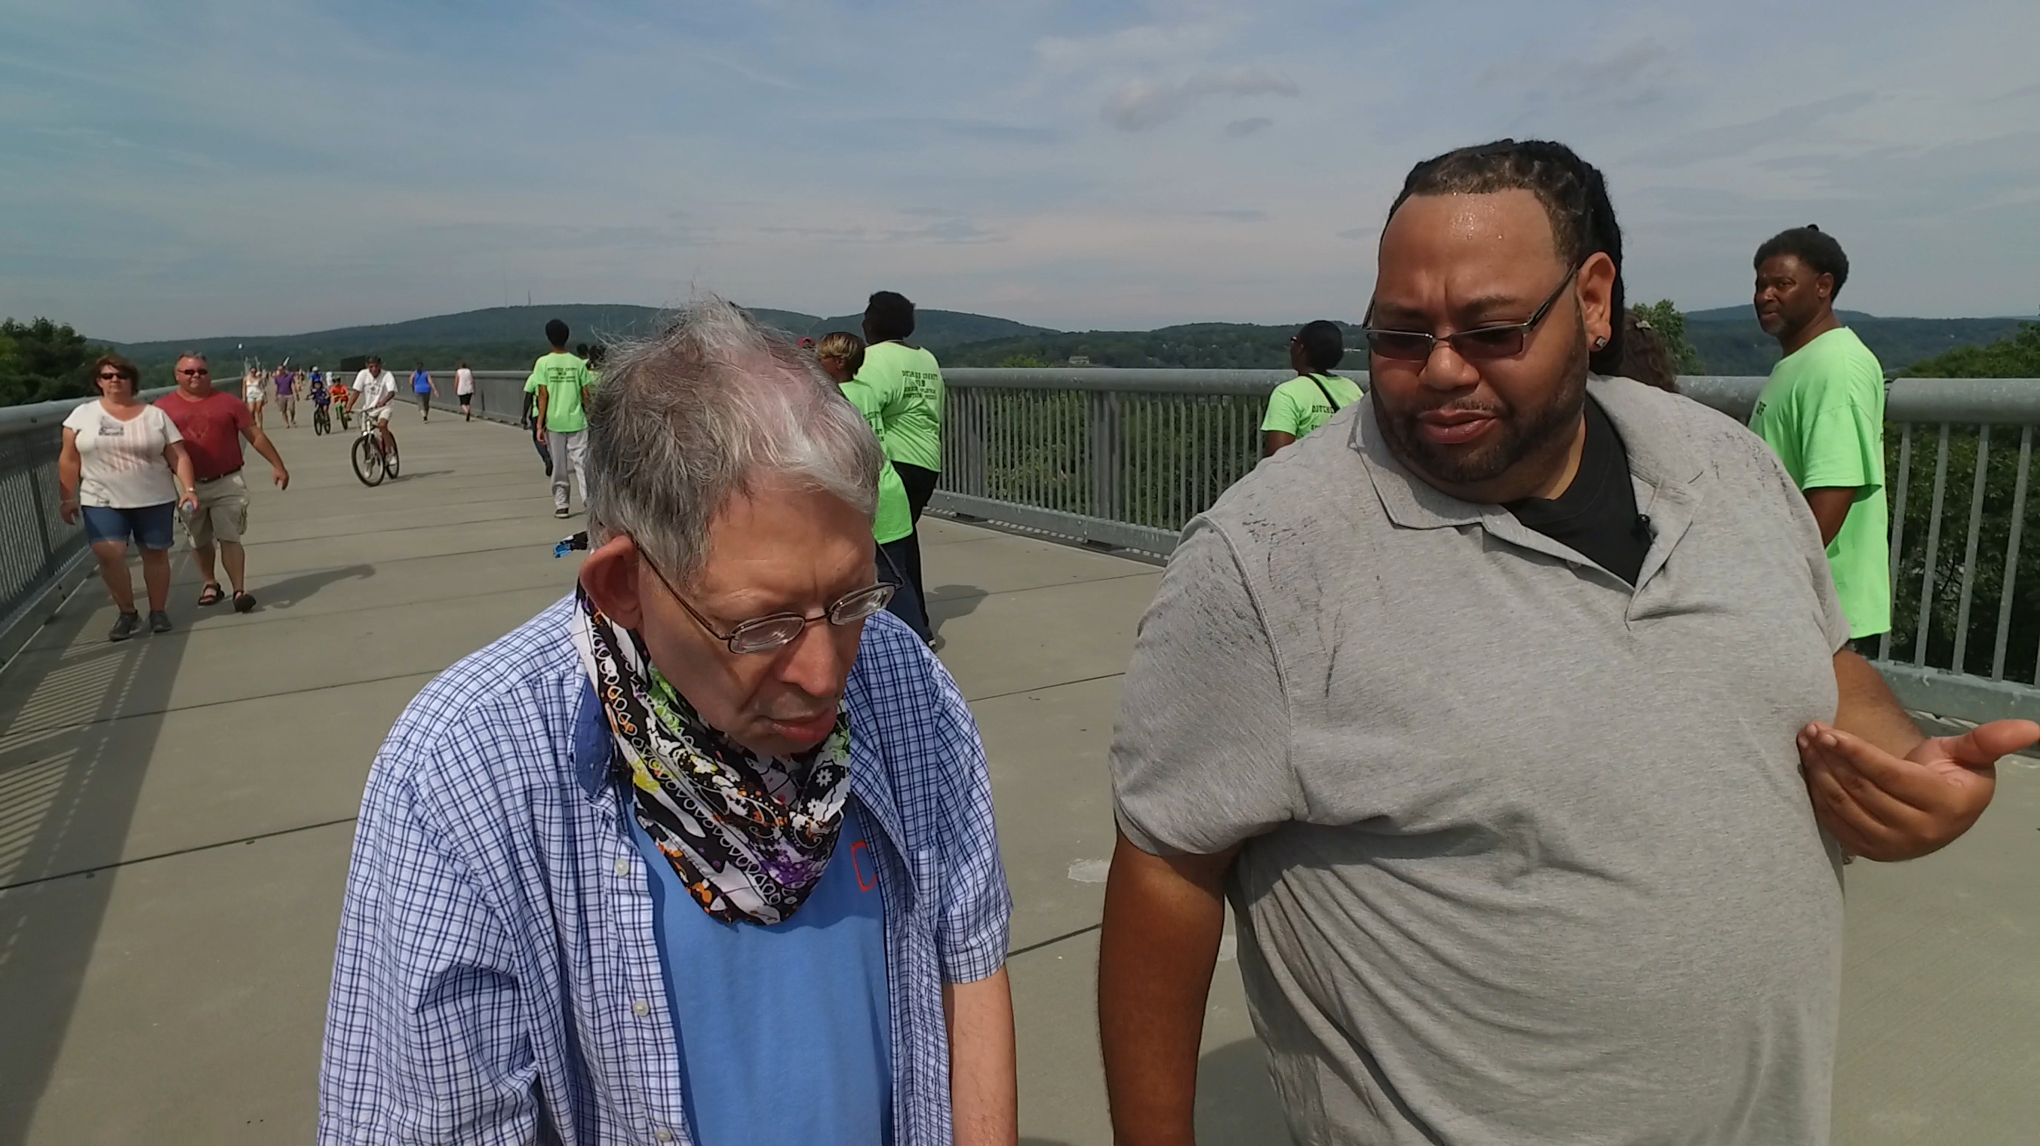
Growth in DSP Workforce
Increasing need for direct support workers
Largest occupational groups
Notes:
Talking Points
Tracking trends over the last decade, the number of Direct support workers (home care, nursing home, other industries) continues to rise every year.

Slide 54
Direct Support Workers
From: Occupational Projections for Direct-Care Workers 2012–2022
Notes:
Talking Points
In addition, direct care workers is the among the largest occupational groups in the U.S. in 2020, above retail salespeople, teachers, cashiers, law enforcement officers, fast food workers, and registered nurses.
We need strategies to better support this workforce and organizations that employ them in order to support the growing need for qualified, competent people in these positions.
According to recent PHI reporting, nationally, by 2028 the total project job openings will reach nearly 8.2 million. In Tennessee this projected total is 56,580 which represents a 6% rate of growth.
The critical question continues to be where will we find these DSPs and how do we keep them.

Slide 55
Number of DSPs in U.S.
PHI. “Workforce Data Center.” Last modified December 17, 2018.
https://phinational.org/policy-research/workforce-data-center/
Notes:
Facilitator’s Notes:
This slide has not been updated for 2019. It is fine to use as an illustration of data visualization for our purposes. In reviewing the 2019 data, the trajectory for the trend lines would continue in the same predictable pattern.
Talking Points
We have found PHI data sets to be most helpful in understanding the scope of the DSW workforce. While there isn’t a standard occupational code for DSP, the PHI data captures the largest group of direct care workers that includes DSPs.
Some trends to note in the number of DSPs in U.S. Between 2007-2017. Updated national and TN State data is available for 2019 at PHI’s workforce data center.
For facilitator information only:
2007
Home care 30%
Nursing homes 21%
Other industries 49%
Total Direct Care Workers 2,820,190
2017
Home care 49%
Nursing homes 14%
Other industries 37%
Total Direct Care Workers 4,310,240

Slide 56
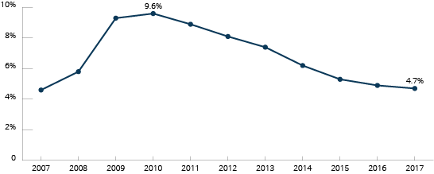
U.S. Unemployment Rate Over Time 2007–2019
2018 4%
2019 3.7%
Notes:
Talking Points
There is a connection between the unemployment and direct support workforce stability. What we know from research is that there is a correlation between recruitment and retention of DSPs and FLSs and the unemployment rate. When unemployment is low the pool of qualified direct support professionals shrinks and competition for workers increases.
There are regional differences at the national and state levels. We have heard stories from cohort 1 organizations about recruitment challenges and the increased competition from other service industries such as retail and fast food.

Slide 57
LTSS and U.S. Economy
2007-2017
1 million+ direct care jobs (54% growth)
1 in 6 new jobs in U.S. was in LTSS
4/5 new jobs were in home care
From: Grarph from PHI Data Brief Here's How we Acheive a Strong Economy: Invest in Direct Care Workers
Source: U.S. Bureau of Labor Statistics (BLS), Current Employment Statistics (CES). 2017. Employment, Hours, and Earnings - National. https://www.bls.gov/ces/; analysis by PHI (October 4, 2017).
Notes:
Talking Points
Looking at the connection between LTSS and the US economy between 2007-2017, according to the US Bureau of Labor Statistics there has been a:
31% growth in the long term care industry compared to overall job growth of 6%
There has been a 1 million plus or 54% growth in direct care jobs
1 in 6 new jobs were in LTSS; and
4 out of 5 of those new jobs were in home care
LTSS = Long Term Services and Supports

Slide 58
Projected Aging of the Direct-Care Workforice in United States
PHI, 2012 for 2010 and 2020 and for 2015: PHI. “Workforce Data Center.” Last modified November 10, 2017.
https://phinational.org/policy-research/workforce-data-center/
Notes:
Talking Points
This graph of national data illustrates the challenge of finding 1 million new workers in a time when the workforce is aging and there is a projected decline in 2 key categories of workers between the ages of 16-34 and 35-54.
So we have looked at some of the factors influencing this workforce crisis now let’s take a look at workforce conditions that discourage people from considering direct support as a profession/career.

Slide 59
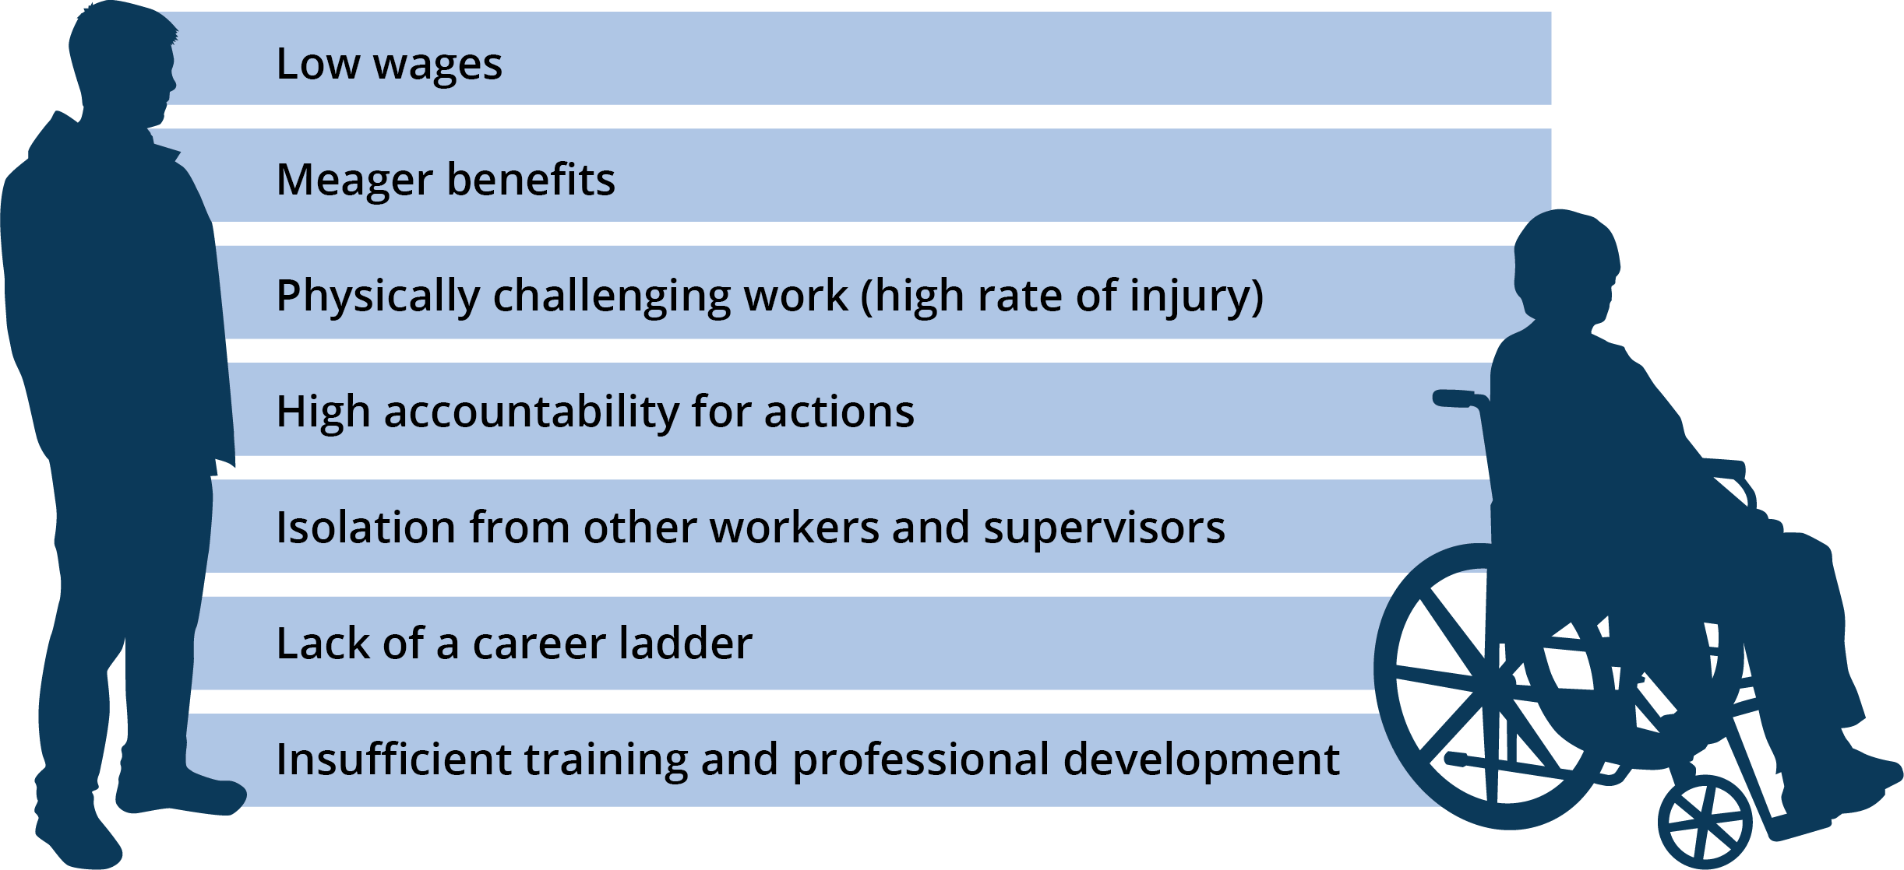
Workforce Conditions that Deter Entry into the Profession
Source: President’s Committee for People with Intellectual Disabilities, 2017
Notes:
Talking Points
Finding and keeping great DSPs is a challenge when you consider they workforce conditions that discourage people to considering a career as DSP.
Over the years, through our research and technical assistance, we have worked on identifying and evaluating strategies in workforce development to address these challenges.
How does your organization stack up against these conditions?

Slide 60


High Expectation Discrepancy
Specialized
knowledge
Work
well with others
Comply with
rules and regulations
Teach
End shift neat & tidy
Maintain
health
& safety
Document
Support
choice
Medical
support
Person-
centered
Culturally
competent
Respect
rights
Problem-
solve
Notes:
60
Talking Points
We know that over the past 30 years as our ideology and understanding of community living and participation have changed so have the expectations placed on DSPs.
We expect a tremendous amount of these workers.
We expect them to……..be person-centered and comply with all the rules and regs, work well with other, and everything else we see here
Yet little else has changed. Training hours have not increased, pay has not increased, opportunities for growth and development have not increased….
And we wonder why the desired outcomes simply are not present.

Slide 61

DSP = Isolated and Alone
Notes:
61
Talking Points
We also know that DSPs are more isolated now then they have ever been.
When community living meant you lived in a large group home and went to the local workshop DSPs had co-workers who worked beside them, they had supervisors who were there much of the time and they had specialists like nurses and therapists and likely a medical doctor that were there occasionally and at least you could call them 24/7.
Now in the predominate community service in the U.S. none of this support is there.
With COVID –19 this issue has become even greater.
It is more typically than not DSPs work alone and there is no opportunity for overlapping hours.
DSPs report that they feel isolated, they want opportunities to learn from and network with one another.

Slide 62
DSPs = Tired and Often Overworked
Notes:
Talking Points
Many DSPs are just plain tired and over worked.
The often are working overtime or multiple jobs to make ends meet.
They are stressed because of money, health insurance, housing, lack of good nutrition, lack of work-life balance
We know that then people aren't at their personal best, they are more likely to make poor decisions or have accidents.
This all effects the lives of the people they are there to support.

Slide 63
Three primary advocacy messages in the past 30 years…
DSPs deserve increase wages because they do critical and important work for vulnerable citizens
Private sector DSPs deserve increased wages because it is unfair that they make on average $2-3/hour less than DSPs who work in public run facilities
Increase provider rates so they can increase wages
Notes:
Talking Points
For the past 30 years there are have three primary advocacy message
1. DSPs deserve an increased wage because they are essential workers for people who need support.
2) DSPs working for private organization get paid less than people who work for public run organizations --- and this is unfair.
3) Provider rates would increase so they can increase wages.
What has this gotten us?

Slide 64
Effects of DSP Workforce Challenges
DSPs, Individuals Supported, Families, Organizations, Systems
Notes:
Time: 6 minutes – Effects of DSP Workforce Challenges
Talking Points
Let's look at how the workforce challenges effect the people closest to the work.

Slide 65

Direct Support Professionals
High stress/burnout
Working 2-3 jobs
Injury
Poverty
Notes:
Talking Points
We all know that the DSPs are experiencing high rates of stress and burnout
They are working multiple jobs
When they are under this type of stress and fatigue, they are more like to make a get injured on the job or make a poor judgement call
Many are dependent on government support and are lacking affordable housing.

Slide 66

Individuals Who Receive LTSS
Health, safety, and well-being risks
Lack of growth and development
  Relationship-based profession
Fewer opportunities for inclusion and participation
Notes:
Talking Points
When our DSPs are preforming their best the people who are accepting supports have higher health and safety risks.
They have less personal growth and development.
Fewer opportunities to build meaningful relationships and participation in their community

Slide 67

Families
Worried about access and quality
Unable to keep jobs or accept promotions
Family member at home longer
Stress and related health issues
Notes:
Talking Points
The workforce challenges really effect the families of the people receiving supports.
Families worry about their loved ones getting access to the services they need, and then they worry about the quality of the services.
Some family members have experienced job loss or haven't been able to accept promotions
Families worry about the safely of their loved one who no longer lives at home. They may be used to being the primary caregiver and shifting their role can be difficult.
Having a loved one with a disability can be stressful, which can take a toll on the family members’ health. They may put their loved one's health and needs before their own.

Slide 68

Organizations
Focus on getting people in
  Lowering expectations of qualifications
Supervisors in crisis management vs mentoring and supervision
Risks and high costs of injury
Notes:
Talking Points
Organizations are struggling to find qualified staff. Many have lowered their expectation of qualifications just to get people in the door and to fill a position. We have people says, "If they have a pulse, they aren't in trouble with the law and the pass a drug test, we will hire them."
Supervisors are working in crisis mode. And when you're doing this, you aren't able to provide supportive supervision that promotes growth of the DSP.
When you combine low expectations for who is being hired and supervisors working in crisis, the risk of injury, for the staff and the people receiving supports increases.

Slide 69
Impact of Staff Turnover on UMN Intervention Implementation Studies
Active Support (Larson, Tichá, & Qian, 2014)
Self-Determination (Abery & Tichá, 2014)
Comprehensive Training (Hewitt, Nord, & Bogenshutz, 2014)
Participatory Planning and Decision-Making Group (PPDM) (Abery, Tichá, & Qian, 2015)
Notes:
Facilitator’s Notes: You don’t need to read them all, just pick one example to share and move on. The point of this slide is to let them know that our research results/outcomes are also affected by turnover.
Talking Points
In our intervention research at the University of Minnesota, we have consistently seen site level turnover impact the effectiveness of our interventions. Here are a few examples:
Researchers replicated the Active Support intervention in Minnesota group homes. Due to high turnover, many DSPs who were trained were no longer present at the homes during follow-up. Only 61% of DSPs received both components of the training at the 3-month observation. This affected intervention fidelity as well as outcomes for those in the group homes.
In the self-determination training intervention, the house "culture" had a stronger effect than any other intervention variable. This likely included staff turnover and its impact on the behavior of individuals served.
In the comprehensive training intervention, similar patterns emerged among the 136 sites. Overall, turnover and vacancies were predictors of employment, friendship, social relationships, choice, and community participation outcomes for people with disabilities.
Participatory Planning and Decision-Making Groups were held to understand the barriers and facilitators for the successful implementation of interventions in residential settings for individuals with disabilities. Staff turnover was identified as a barrier to program implementation and sustainability by national and international experts. One related anecdotal theme that has been coming up repeatedly has been the effect of the economic situation (low levels of unemployment) on the quality of staff pool, and consequently the lack of stable high-quality staff in the homes of people with IDD
So, all of this is to say that the workforce matters. Whatever it is that we are trying to do to support people through our research, training, outreach and technical assistance is affected by the direct support workforce.
69

Slide 70
Addressing Workforce Challenges
Taking Action to Improve Workforce Outcomes
Notes:
Time: 30 minutes for Addressing Workforce Issues –includes content, poll, breakout and large group
Talking Points
Now that we have talked about workforce challenges and the effects they have, we will talk about taking action to address these workforce challenges.

Slide 71
Importance of Data
Legislative advocacy
Separate information accurately about DSPs who work with specific populations or service types
Make informed policy and practice decisions
Create wage scales within organizations
Other reasons?
Notes:
Talking Points
We need data regarding what is happening in the workforce to help us talk about and show our state representatives.
They need this information to make informed policy decisions.
Data can help organizations look at their wages and make decisions about how to move forward with wage scales within the organization.
What are some other reasons you can think of?

Slide 72
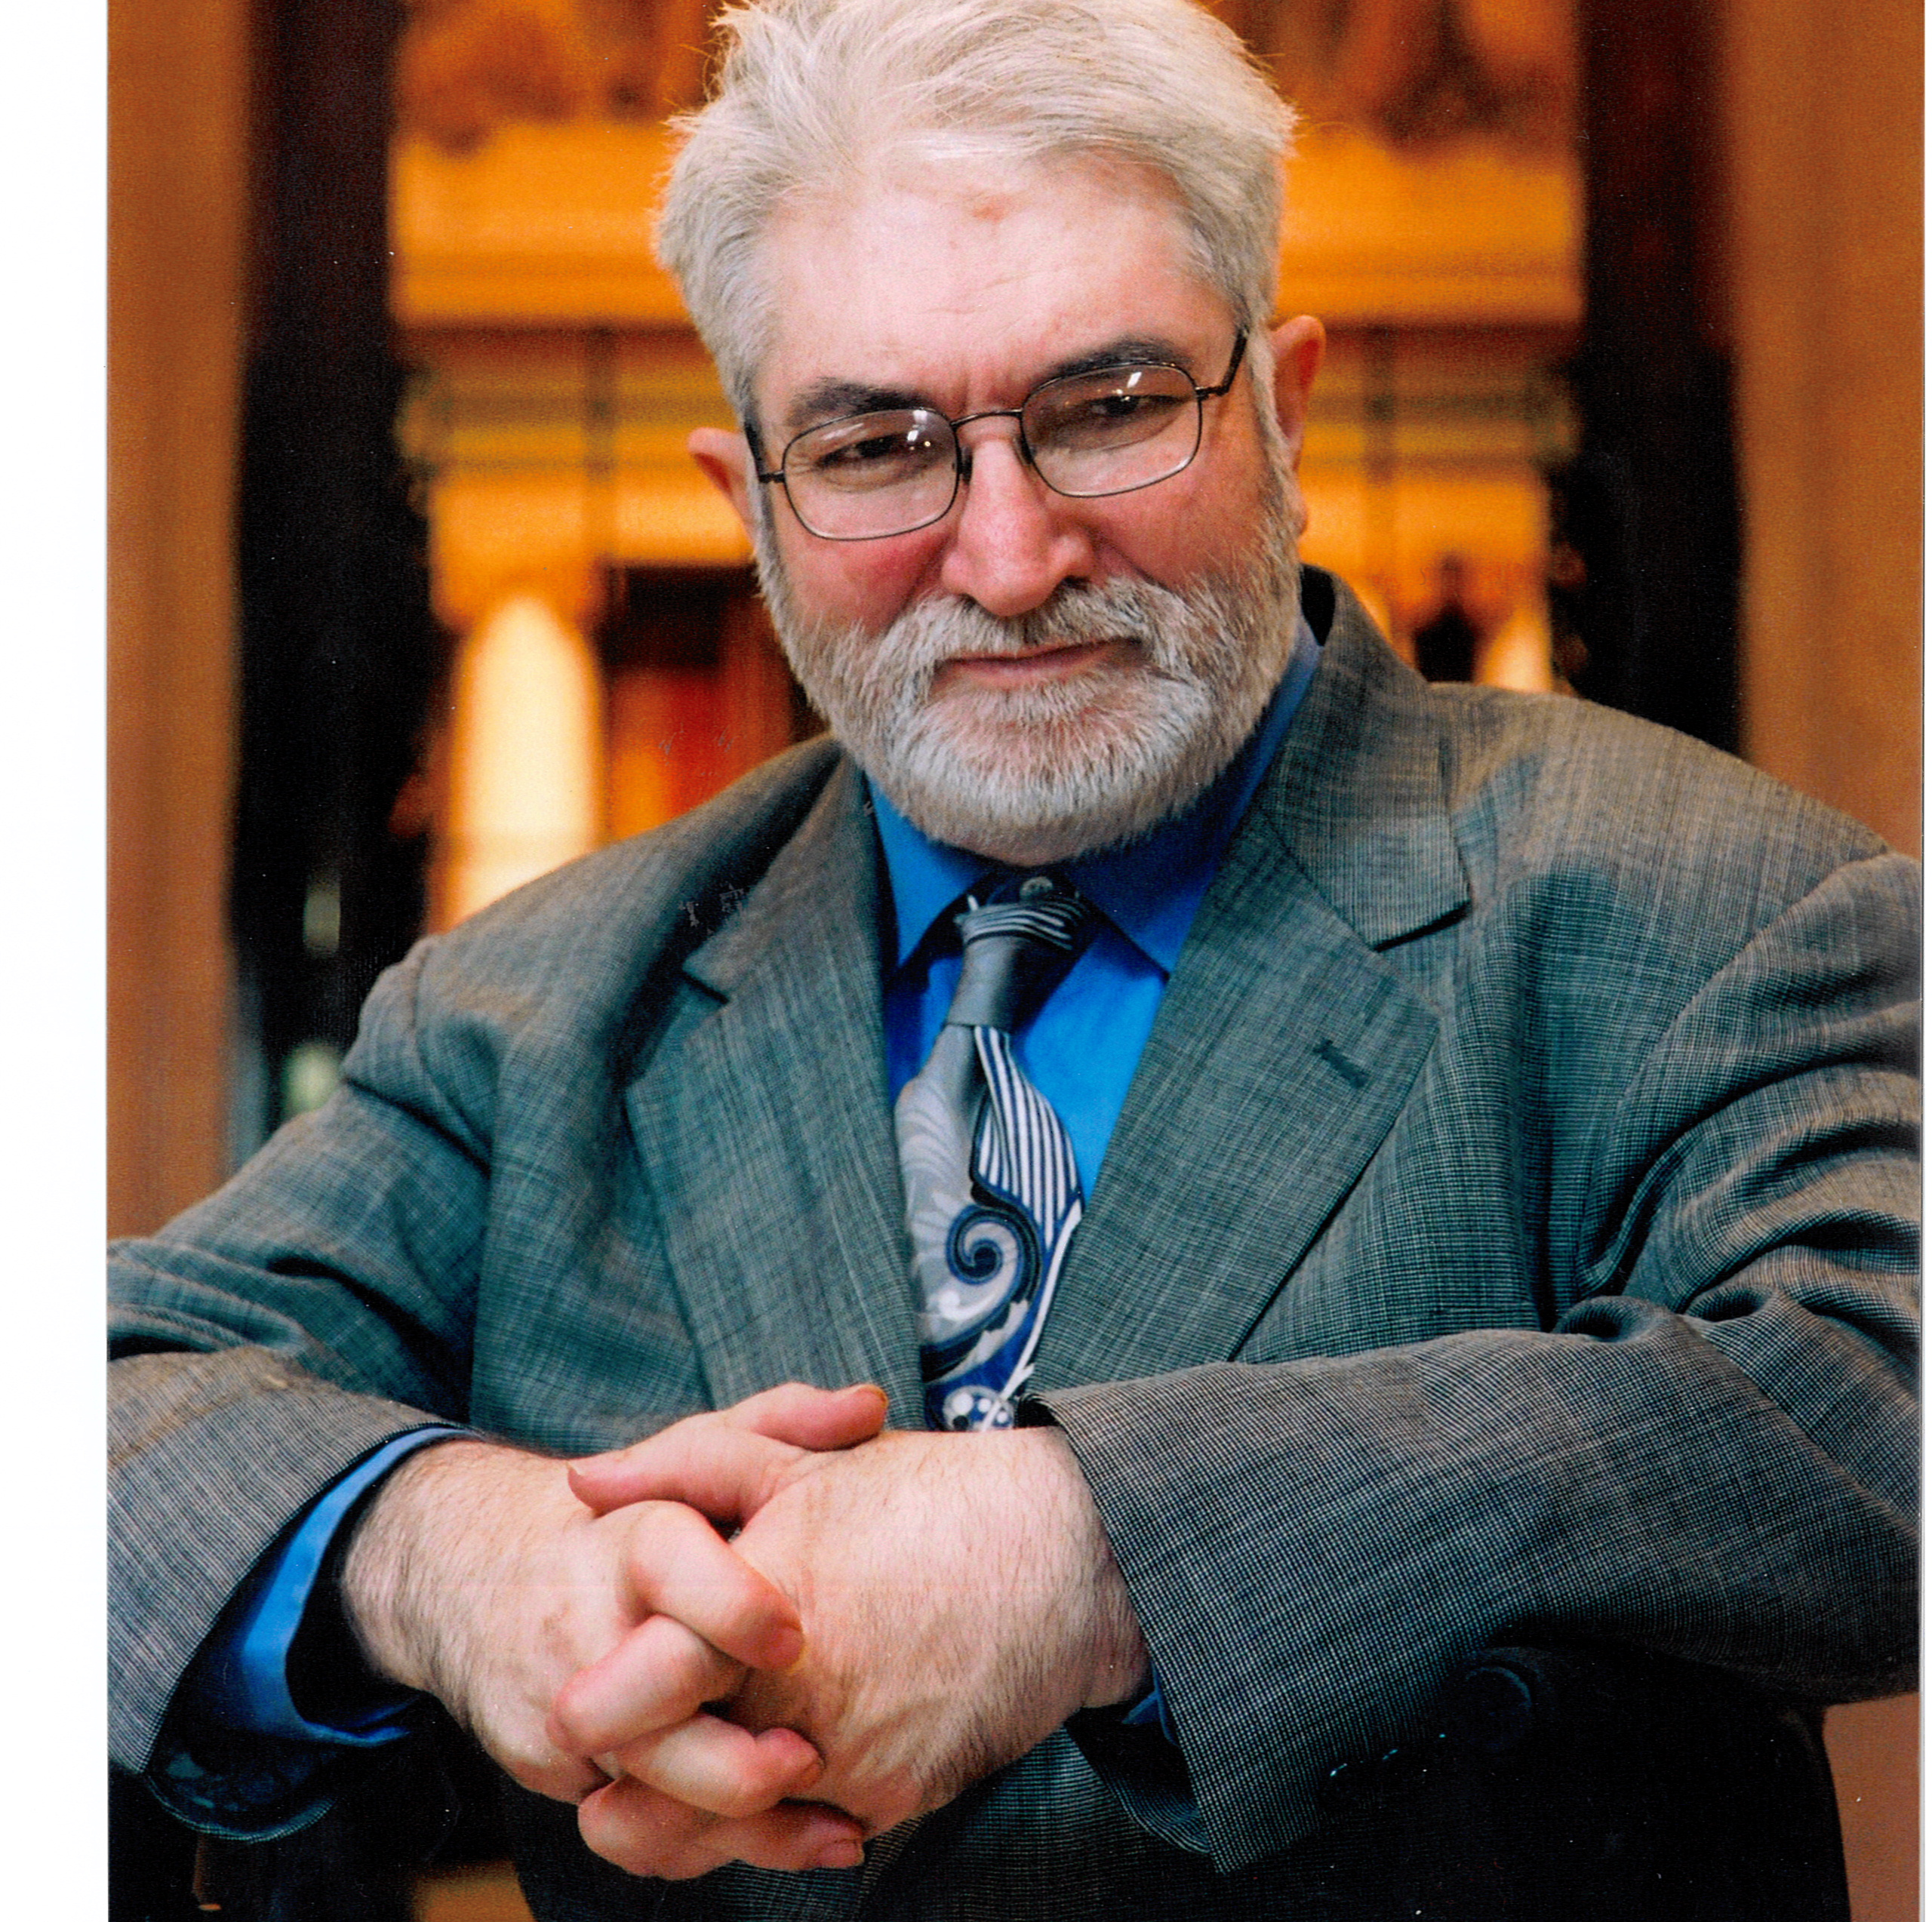
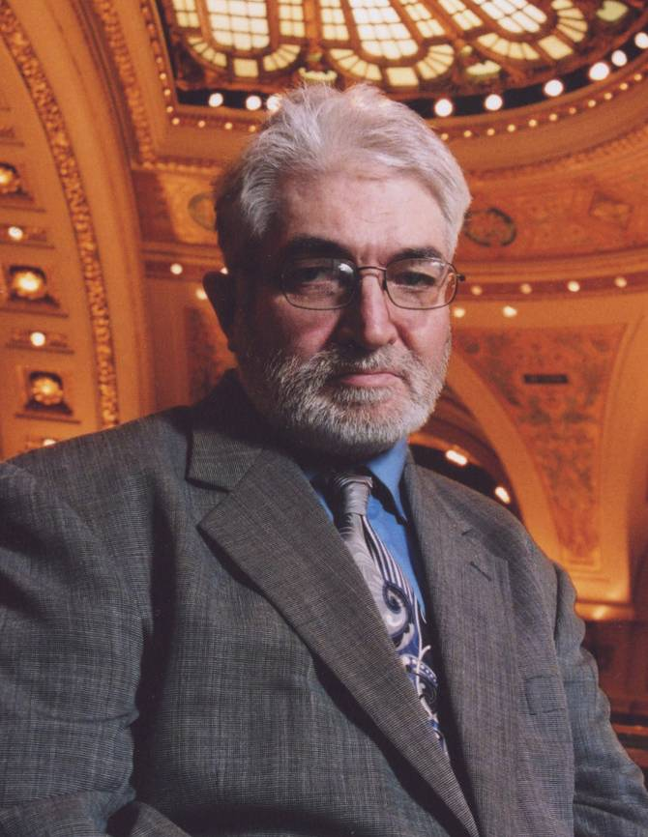
Recruitment & Retention:
A Self-Advocate Perspective
We want staff who show up on time and help us get the stuff done we need to get done.
We want people who are paid enough to stay so they like what they are doing.
We want people who respect us and are respected for what they do and the pay they earn.
Source: IMPACT, 2008
Cliff Poetz, Advocacy Leader
Notes:
Talking Points
Our colleague Cliff reminds us that when we talk about the workforce and need for systemic change that the data only tells a part of the story. Here’s what I think Cliff is trying to tell us.
Showing up on time means stability in our staff who are reliable and respect for our needs and our time
It means being able to do one job and make a living. Happy staff who get their needs met do a better job meeting our needs. That helps us to be stable.
And finally, when our staff treat us with respect, and we respect their professionalism we are their ally in getting respect from others.

Slide 73
Understanding the Problem(s)
COMPLEX issues
No single solution
Your team must own the issues and lead change
Notes:
Talking Points
The reality is that if it were easy to address the workforce crisis, it would have been solved long ago.
The challenges that organizations are experiencing are complex. There is no single solution, and likely multiple solutions are needed to address the issues.
We challenge your organization to start understanding and tracking your data while addressing a critical workforce challenge in your organization.
You may identify multiple strategies that you would like to try. That’s great, and you can note them on your action plan.
We challenge you to start addressing one, and then progressively refine your efforts to incorporate additional strategies when you are ready and have the resources to do so.

Slide 74
Ensure that others know who DSPs are, what they do, and why they are important
Improve DSP identity, respect, and recognition
Create an occupational title in BLS
Fund use of competency-based training models that result in credentialed or certified staff with wage increase
Develop industry specific pipeline programs
Gather comprehensive data at site, organization, state, and national levels
Provide and use evidence-based interventions
Promote increased use of self-directed options
Increase use of technology-enhanced supports
Source: Amy Hewitt (UMN RTC/CL), Joe MacBeth (NADSP),
Barbara Merrill (ANCOR), & Barb Kleist (UMN RTC/CL), 2018
Notes:
Talking Points
I want to close by sharing 9 key actions and strategies that were identified as promising practices in changing the current workforce trajectory in a recent issue of Impact highlighting on the Direct Support Workforce Crisis.
If we want to bring person centered supports to scale, we must give DSPs their voice, give them the training and support they need to do their jobs and the professional recognition they deserve.
A number of things I touched on during this session align with one of these 9 strategies. And we continue to use these as guideposts for future research, training and technical assistance in workforce development at the Institute on Community Integration.
BLS = Bureau of Labor Statistics

Slide 75
Poll Question # 2 - Which action do you think is the most important in helping your organization address workforce challenges?
Ensure that others know who DSPs are, what they do, and why they are important
Improve DSP identity, respect, and recognition
Create an occupational title in BLS
Fund use of competency-based training models that result in credentialed or certified staff with wage increase
Develop industry specific pipeline programs
Gather comprehensive data at site, organization, state, and national levels
Provide and use evidence-based interventions
Promote increased use of self-directed options
Increase use of technology-enhanced supports
Notes:
Facilitator’s Notes:
Added poll question slide to precede conversation – Can keep or delete depending on timing.
This is a macro question – to gain insight and understanding to what organizations might be thinking about in terms of system level pressures/influences/opportunities
Talking Points
Thinking about the call to action, which of these actions are currently underway in Tennessee? Which one is the highest priority?
Read through the choices and ask them to answer the question in the poll
Activity
Poll Question #2 – Which action do you think is the most important in helping your organization address workforce challenges?
Ensure that others know who DSPs are, what they do, and why they are important
Improve DSP identity, respect, and recognition
Create an occupational title in BLS (Bureau of Labor Statistics)
Fund use of competency based training models that result in credentialed or certified staff with wage increase
Develop industry specific pipeline programs
Gather comprehensive data at site, organization, state, and national levels
Provide and use evidence-based interventions
Promote increased use of self-directed options
Increase use of technology-enhanced supports
Share Poll Results and talk about them.

Slide 76
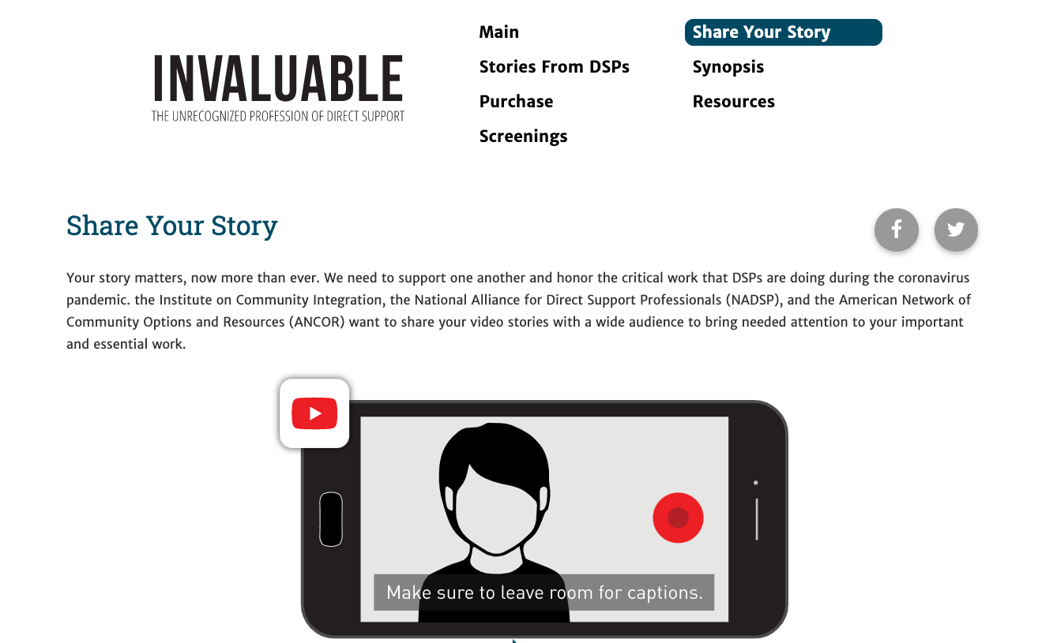
z.umn.edu/InvaluableDSPs
Notes:
Talking Points
Encourage the DSPs to share their story by making a short 1-3 minutes video that will be shared with a wide audience to bring attending to the importance of the work, and to show how essential DSPs really are in our world.
ICI has teamed up with NADSP to capture those videos and share the stories.
You can go the website for Invaluable, find the Share you Story button and instructions for making the video and how to submit it.
Link: https://z.umn.edu/InvaluableDSPs

Slide 77
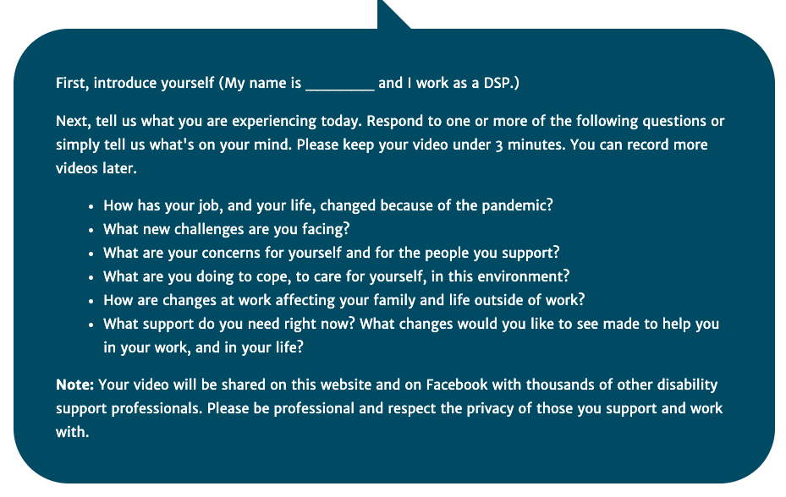
Notes:
Talking points
This is the template for the short video that you can provide to DSPs. It isn’t complicated and keeping it short and professional is a key, as it will be shared with others on Facebook.
It starts with introducing themselves and then responding to 1 or more of the questions.
How has your job/your life changed because of the pandemic?
What new challenges are you facing at work?
These are two examples.

Slide 78
Breakout Conversation
  What did you hear that was an “Ah-Ha” moment?
  What is something you want to know more about?
Notes:
Facilitator’s note.
Breakout room conversation:
Timing: 15 minutes before break
Breakout Time in small group 10 minutes
Breakout groups – 4-5 per group, follow-up similar pattern of splitting MCOs between groups, select someone to take notes and someone to report – can be the same person
Report Out to Large group- 5 minutes
May stay in large group depending on size. If breaking off bring back to have each group report out on what they learned or discovered.
Let people discuss in small groups then share out their group discussion with the larger group.
When they return from breakout rooms - Record the information using the Zoom White board feature.
Talking Points
Now that you have had an opportunity to learn about the DSP Workforce Issues in context, we are going to break out into smaller groups to discuss what you heard.
In your small groups please have a conversation about what you found out that was new.
What did you hear that was an ah ha moment?
What is something you want to know more about?
When we come back together, please designate one person to sum up your group conversation.

Slide 79
What’s Next
Session 2
Understanding your Data: Overview of Survey Results Profile and Interpreting Data
Homework
Review the Organizational Workforce Self-Assessment Workbook & complete the online self-assessment
Explore the DSP Workforce Toolkit at: https://tenncare.ici.umn.edu/
Notes:
Time: 6-10 minutes
Talking Points
Your next Workshop is Session 2 where we will spend time looking the DSP workforce issues together.
Your organizations key contacts should plan to attend this workshop.
You can invite other members of your team to attend any of the upcoming workshops as you like.
Reminder that if you are unable to attend your specific region you will be seeing data from other regions.
It's suggested that you attend the session #2 according to your region in order to hear the data from your region. If this is not possible, you can access your region’s profile on the website. Make sure that you have a copy of your organization’s profile when you attend session #2.
We will be meeting on: (insert date and time)
You should have already received a Zoom invitation to this and the other workshops.
If you didn’t, please contact us at the email address on the bottom of the screen: dsp-tn@umn.edu
Your homework is:
To complete the Self-Assessment Workbook if you haven’t already
Check out the Workforce website to see what is available to you. This is a rich resource of tools that are not available to you. This website has been developed for Tennessee providers who are involved in this Workforce Initiative, so the website and tools should not be shared with other organizations or individuals who are not a part of this project.

Slide 80
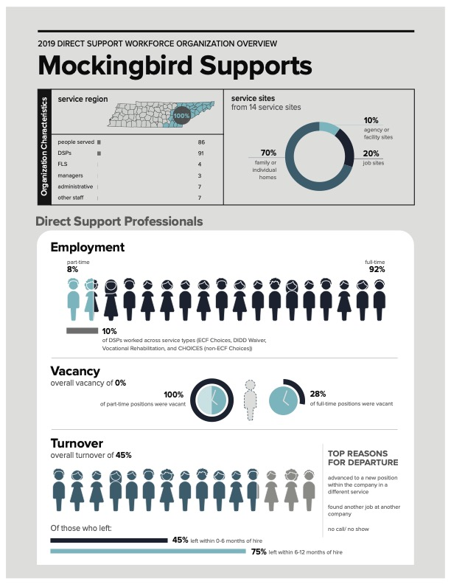
Bring your organization’s profile to session #2
Notes:
Talking Points
Please make sure that you have a copy of your organization’s profile data when you attend session #2. This information was emailed to your organization in September. If you do not have access to this information, please check with the person who invited you to the kickoff workshop webinars, or email us at dsp-tn@umn.edu

Slide 81
Upcoming Kick-Off Workshops – West
Session | Date | Time
1 | Friday, October 23, 2020 | 9-11am Central
2 | Friday, October 30, 2020 | 9-11am Central
3 | Friday, November 6, 2020 | 9-11am Central
4 | Friday, November 13, 2020 | 9-11am Central
5 | Friday, November 20, 2020 | 9-11am Central
6 | Friday, December 4, 2020 | 9-11am Central
7 | Friday, December 11, 2020 | 9-11am Central
Notes:
Talking Points
Before you go, here is the schedule for the West Region Workshops.
Thank you for your time and attention today.
We hope that you are starting to get a better idea of what this project is about.
We look forward to continued work together. See you at Session 2.
Facilitator Note:
Stop recording
Wait for participants to log off, debrief with UMN team.
Next steps: Send out PDF of slide deck

Slide 82
Upcoming Kick-Off Workshops – Middle
Session | Date | Time
1 | Thursday, October 22, 2020 | 12-2pm Central
2 | Thursday, October 29, 2020 | 12-2pm Central
3 | Thursday, November 5, 2020 | 12-2pm Central
4 | Thursday, November 12, 2020 | 12-2pm Central
5 | Thursday, November 19, 2020 | 12-2pm Central
6 | Thursday, December 3, 2020 | 12-2pm Central
7 | Thursday, December 10, 2020 | 12-2pm Central
Notes:
Talking Points
Before you go, here is the schedule for the West Region Workshops.
Thank you for your time and attention today.
We hope that you are starting to get a better idea of what this project is about.
We look forward to continued work together. See you at Session 2.
Facilitator Note:
Stop recording
Wait for participants to log off, debrief with UMN team.
Next steps: Send out PDF of slide deck

Slide 83
Upcoming Kick-Off Workshops – East
Session | Date | Time
1 | Monday, October 19, 2020 | 12-2pm Central / 1-3pm Eastern
2 | Monday, October 26, 2020 | 12-2pm Central / 1-3pm Eastern
3 | Monday, November 2, 2020 | 12-2pm Central / 1-3pm Eastern
4 | Monday, November 9, 2020 | 12-2pm Central / 1-3pm Eastern
5 | Monday, November 16, 2020 | 12-2pm Central / 1-3pm Eastern
6 | Monday, November 30, 2020 | 12-2pm Central / 1-3pm Eastern
7 | Monday, December 7, 2020 | 12-2pm Central / 1-3pm Eastern
Notes:
Talking Points
Before you go, here is the schedule for the West Region Workshops.
Thank you for your time and attention today.
We hope that you are starting to get a better idea of what this project is about.
We look forward to continued work together. See you at Session 2.
Facilitator Note:
Stop recording
Wait for participants to log off, debrief with UMN team.
Next steps: Send out PDF of slide deck

Slide 84
Questions?
To receive the slides from today’s webinar or to further discuss information in this session:
Contact your University of Minnesota workforce consultant
Email us at: dsp-tn@umn.edu
Notes:
Facilitator Note: improvised based upon the amount of time left.
Talking Points
We have a little bit of time for questions.
If we don’t have time to answer your questions, please contact your UMN consultant or email us at dsp-tn@umn.edu

Slide 85
Thank you
See you next week!

