Slide 1
Solutions for Inclusive Higher Education
Mary Hauff
MIPSA Webinar
May 1, 2024

Slide 2
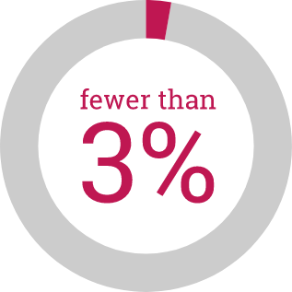
MN College Capacity and Prospective Students
5,000 prospective Minnesota college students with an intellectual disability
Current Minnesota college enrollment capacity = 100 students with an intellectual disability
Fewer than 3% can attend college in Minnesota
Student’s best-fit college
Source: MDE MARSS child count totals, December 2022

Slide 3
Connect to Existing Data and Goals
Statewide Goals
Statewide FAFSA Filing Goal
Postsecondary Educational Attainment Goal 2025
2022 Minnesota Olmstead Plan
Legislative Reports
2017 Minnesota State Report
2018 University of Minnesota Morris Report
Grants for Students with Intellectual and Developmental Disabilities

Slide 4
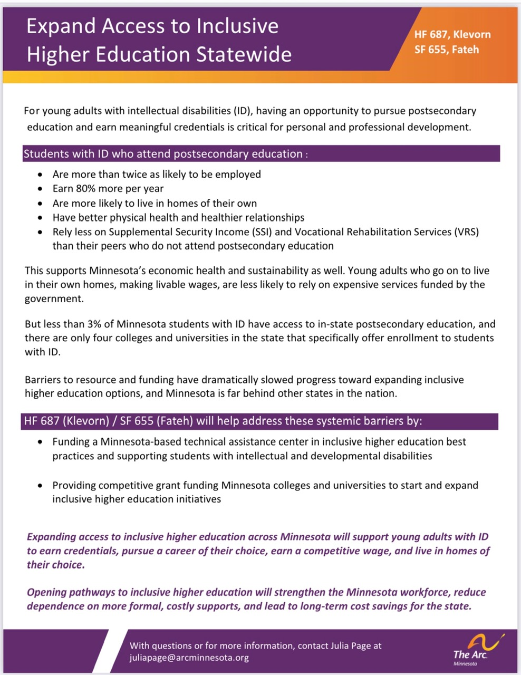
Solutions from the Minnesota Inclusive Higher Education Act (2023)

Slide 5
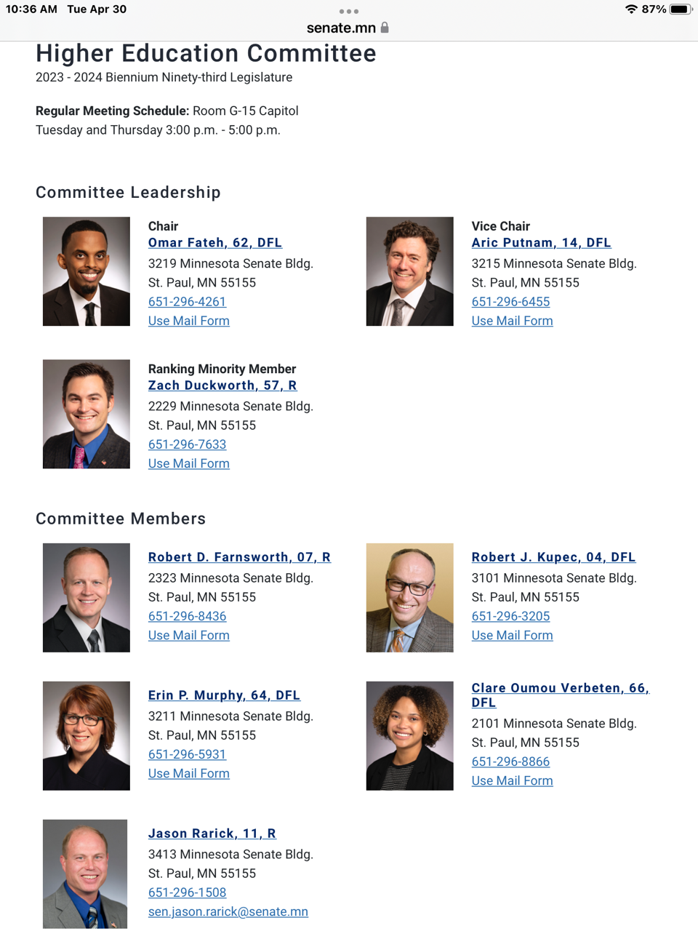
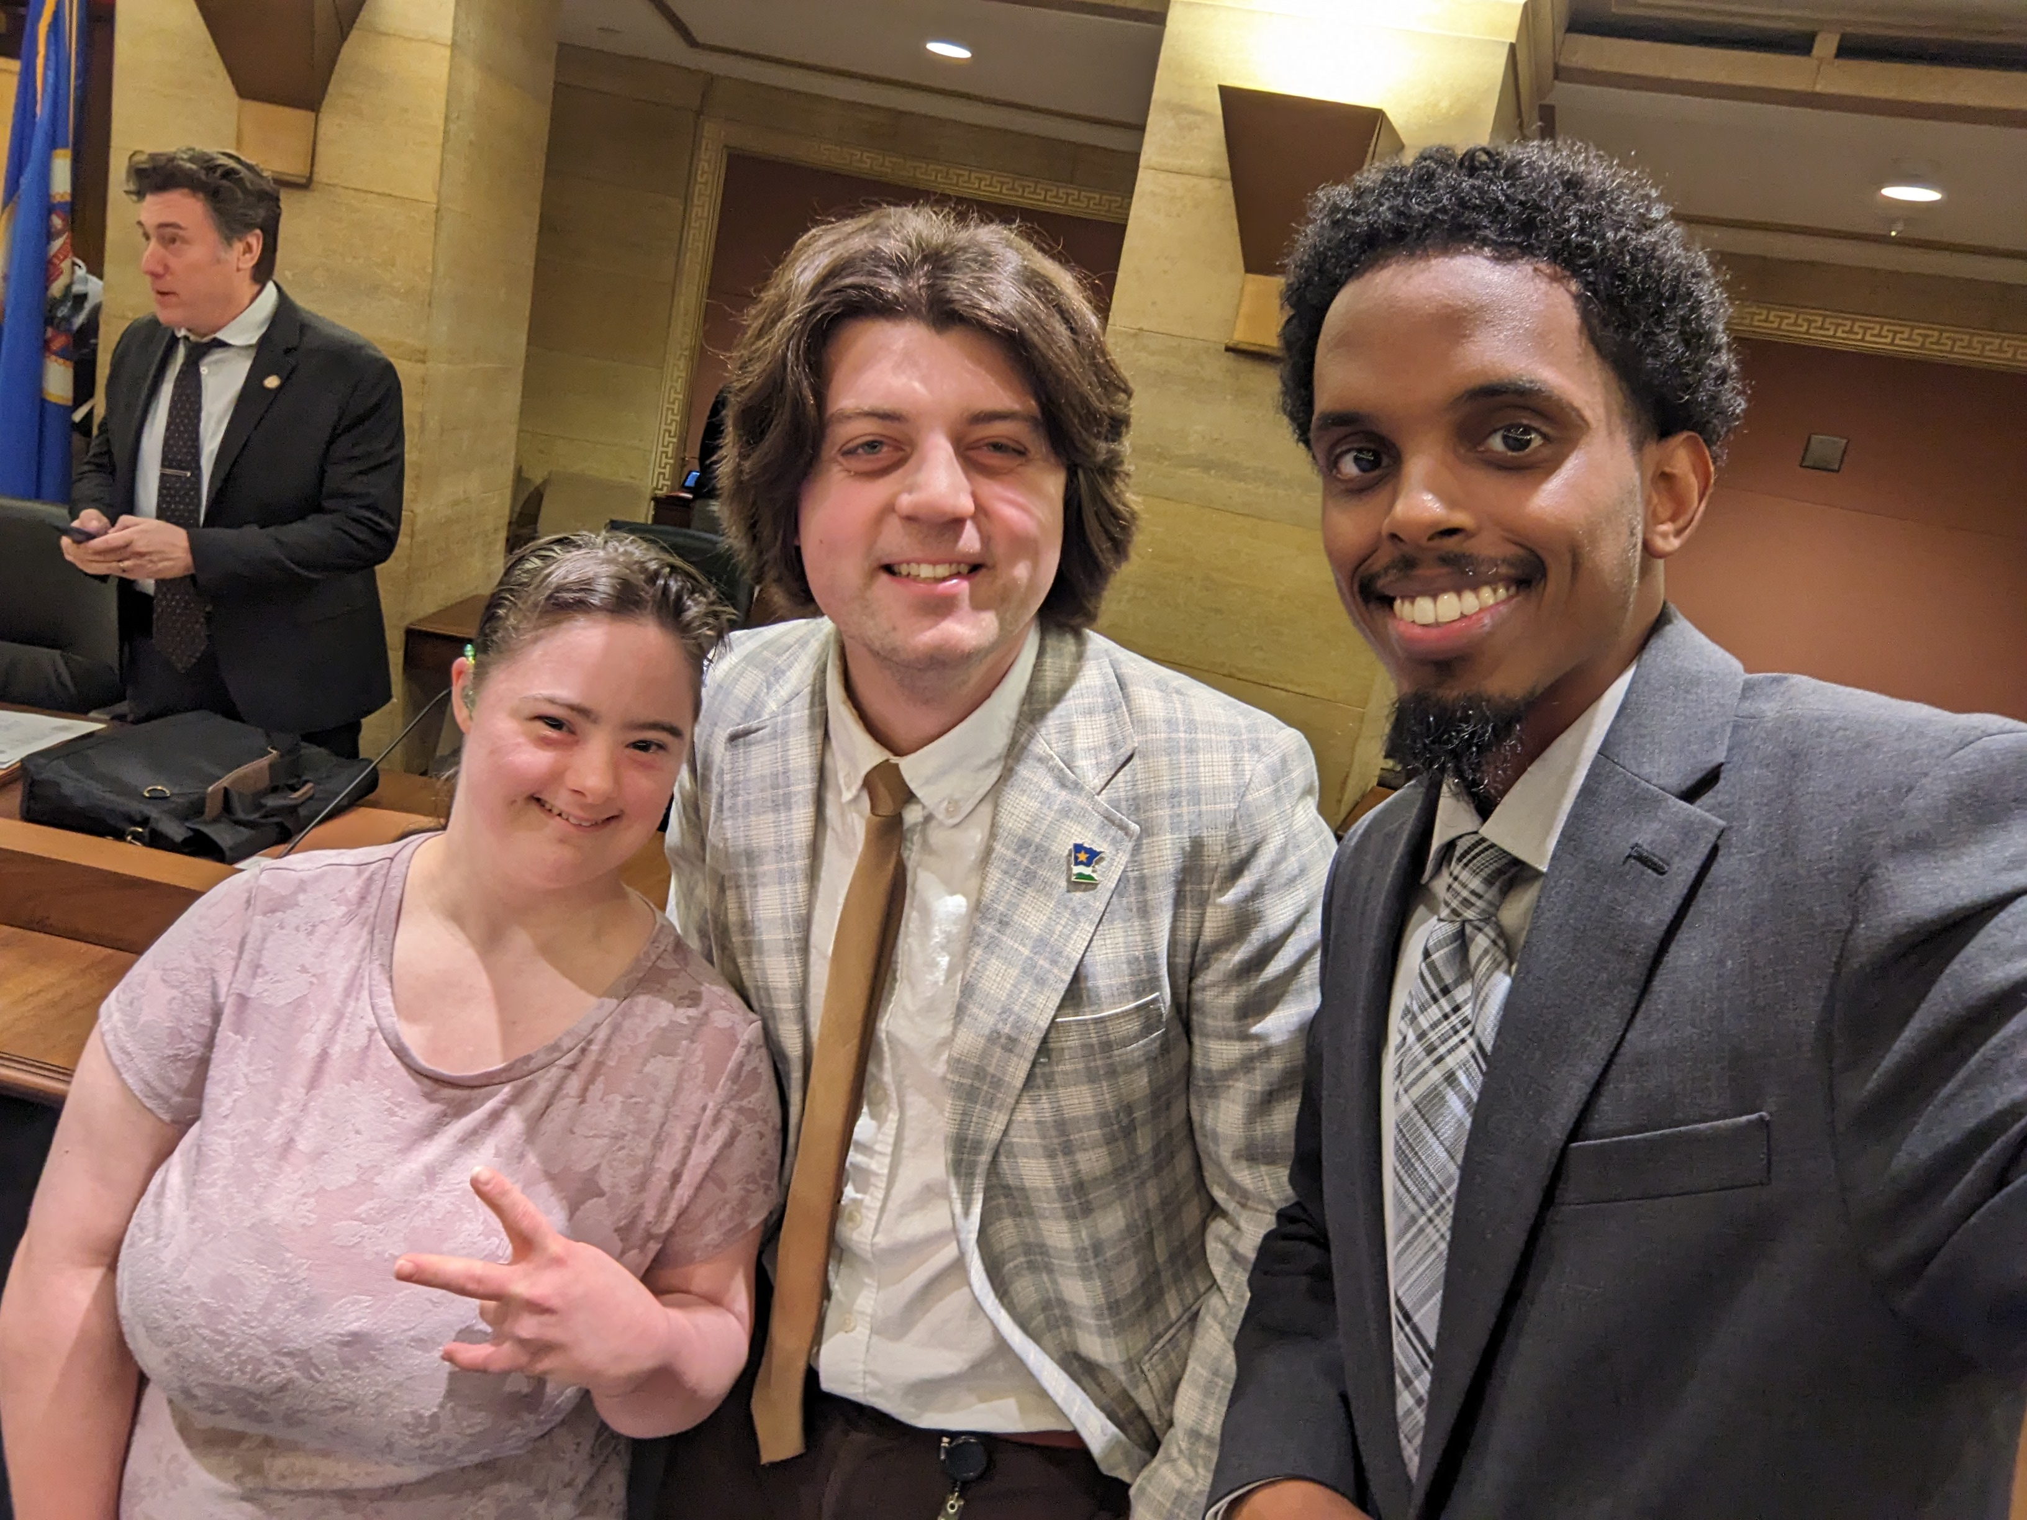
Building Relationships with Higher Education Committees

Slide 6
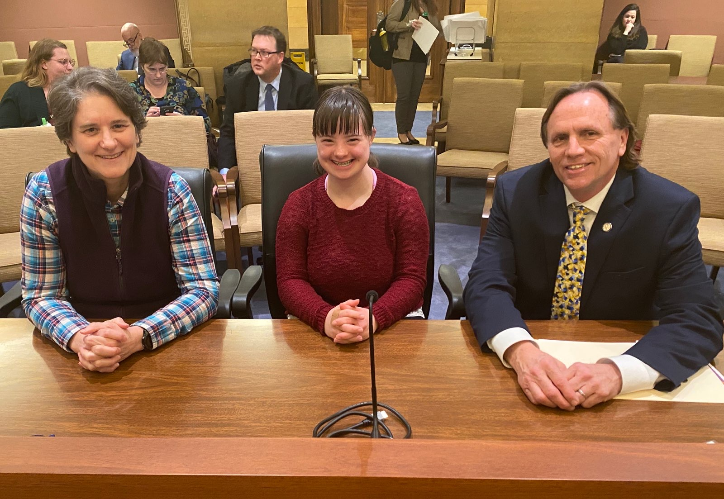
Building Relationships with Legislators

Slide 7
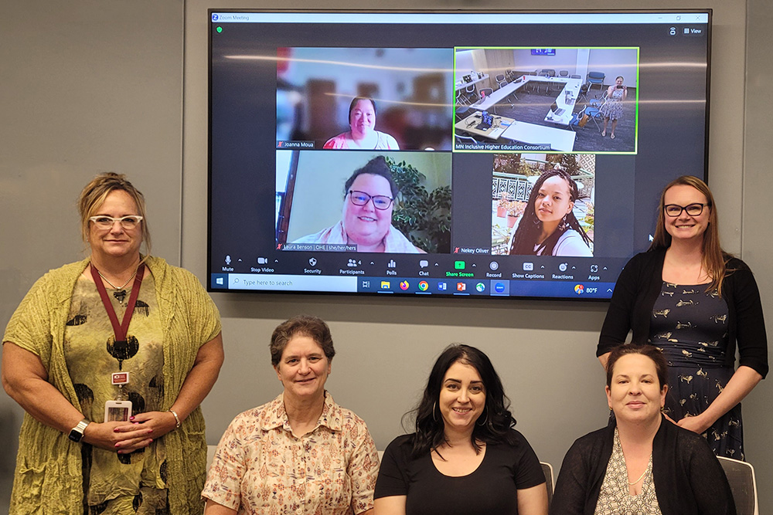
Coalition Allies: State Agencies
Office of Higher Education
Vocational Rehabilitation
Department of Human Services
Department of Education
Minnesota Council on Disabilities
Governor’s Council on Developmental Disabilities
Disability Law Center
Olmstead Implementation Office

Slide 8
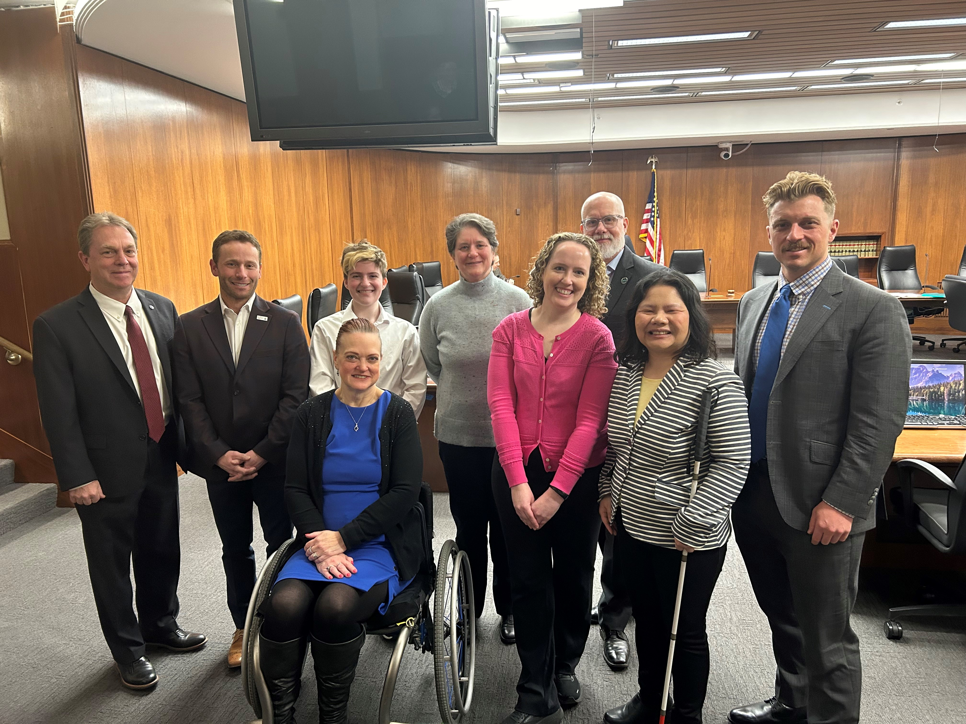
Coalition Allies: Postsecondary Education Organizations
University of Minnesota Government Relations
Minnesota State Government Relations
University of Minnesota Undergraduate Student Government
LEAD MN
Students United
Inter Faculty Organization
Minnesota State College Faculty
Education Minnesota
Minnesota Private College Council

Slide 9
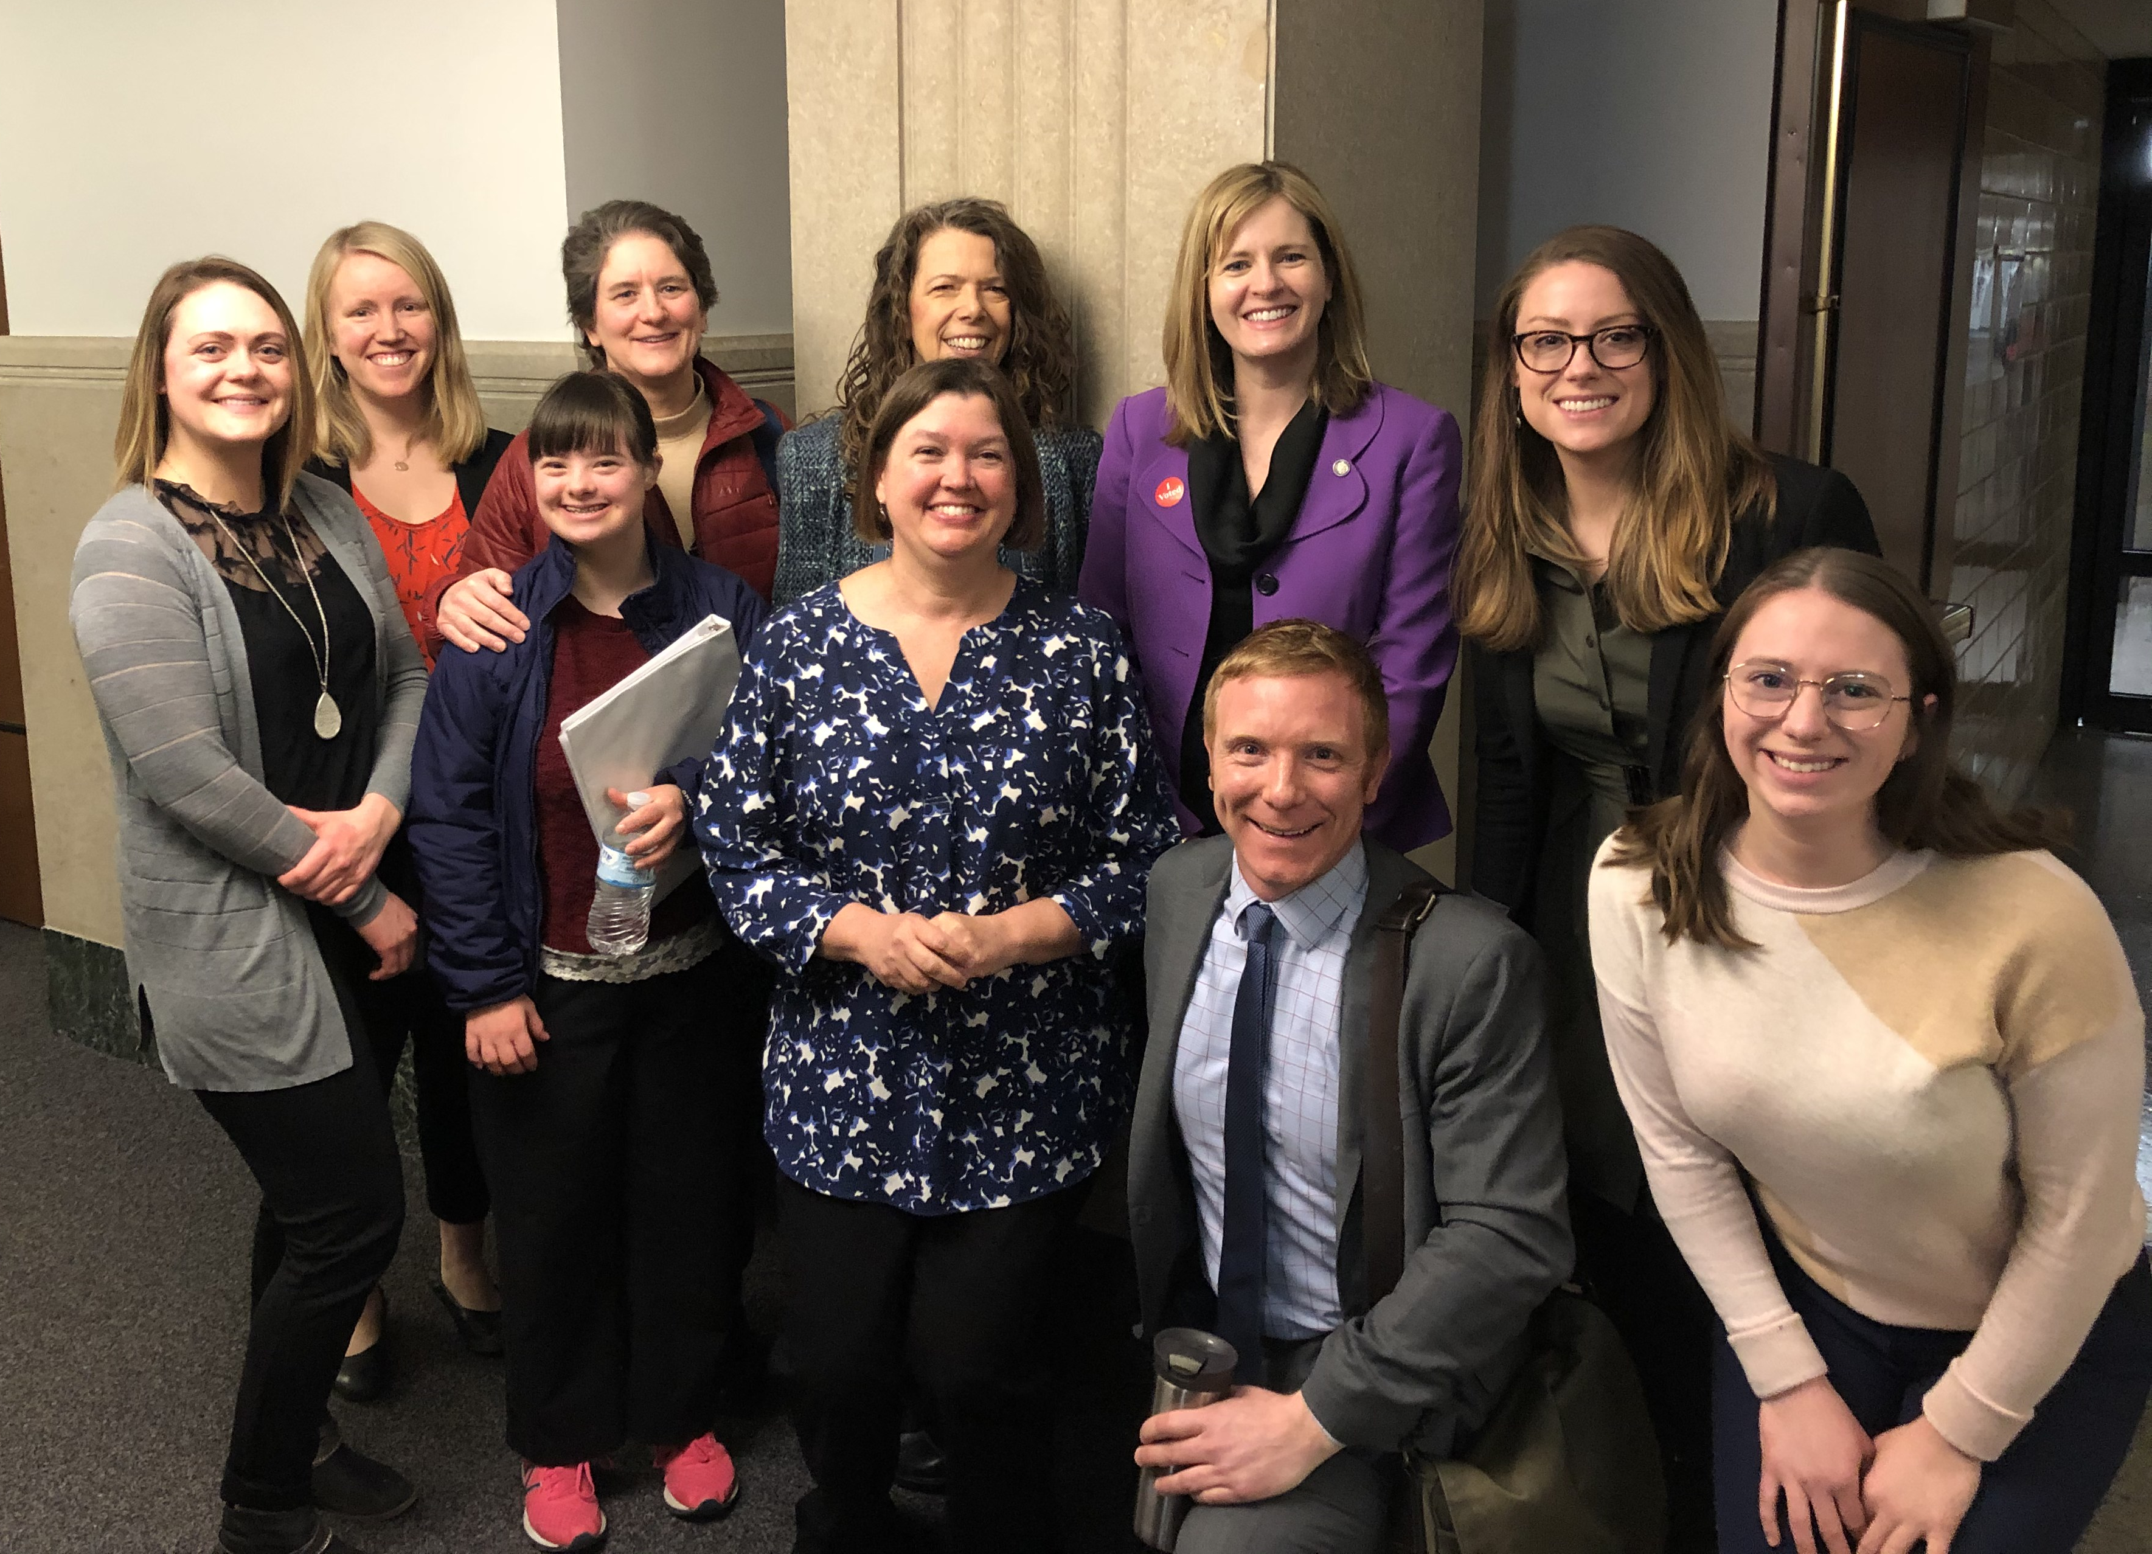
Coalition Allies: Disability Advocacy Nonprofits
Arc Minnesota
Proof Alliance
Autism Society of Minnesota
Down Syndrome Association of Minnesota
Pacer Center
Minnesota Consortium for Citizens with Disabilities

Slide 10
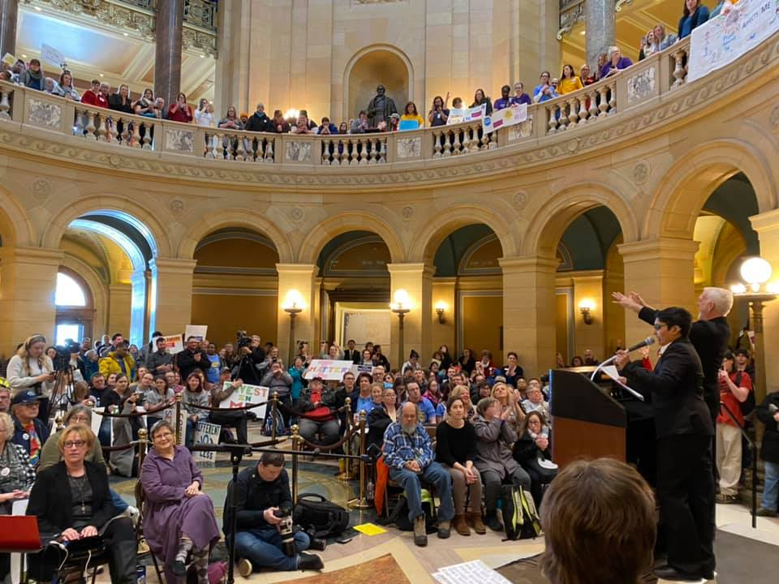
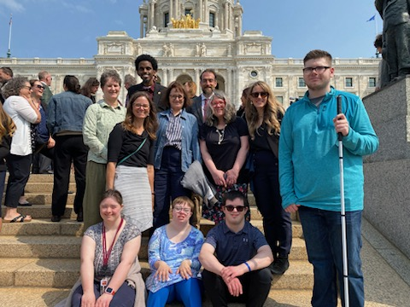
Day at the Capitol

Slide 11
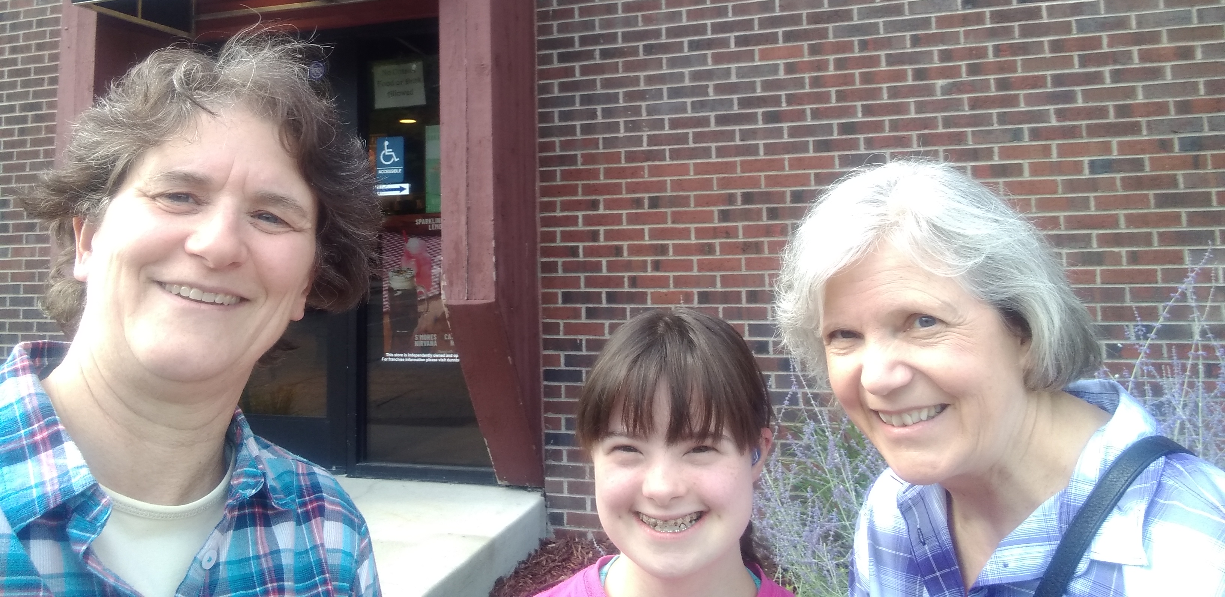
Personal Experience

Slide 12
Contact Information
Mary Hauff hauff004@umn.edu
Minnesota Inclusive Higher Education Consortium Institute on Community Integration University of Minnesota

