Slide 1

National Accreditation Standards and Resources for Program Accreditation
January 23, 2024
MIHEC Meeting
Mary Judge Diegert
Martha Mock

Slide 2
Agenda
Introduction to Accreditation
Overview of the Accreditation Process
Standards, Guidance, Required for Review
Program Accreditation Resources
Moderated Q & A

Slide 3
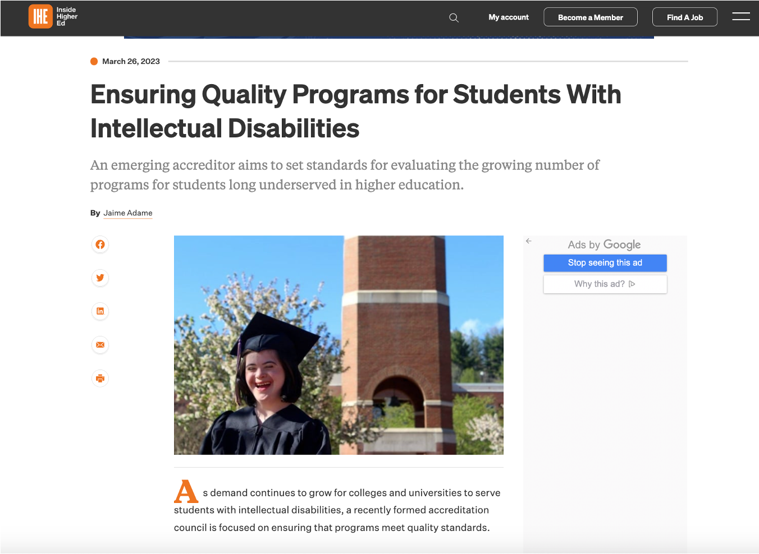

Inside Higher Ed
Notes:
https://www.insidehighered.com/news/2023/03/27/accreditor-emerging-intellectual-disabilities-programs

Slide 4
Questions that Inform Accreditation
Do students complete the program successfully and earn the credential?
Does the program provide the enrolled students with the supports needed to be successful during the program?
Do students and families receive what they expected to receive before, during, and after the program?
Does the college and university support students in the program?
Does the program provide exiting students with the supports needed to be successful in their next step in employment or further education?

Slide 5
Benefits of Program Accreditation
Students know that programs have program offerings, procedures, and policies in place for their success.
Demonstrates a commitment to Continuous Quality Improvement.
Demonstrates a commitment to Quality Assurance.
Ongoing Review to improve practices.
Demonstrates the quality of the program to all.

Slide 6
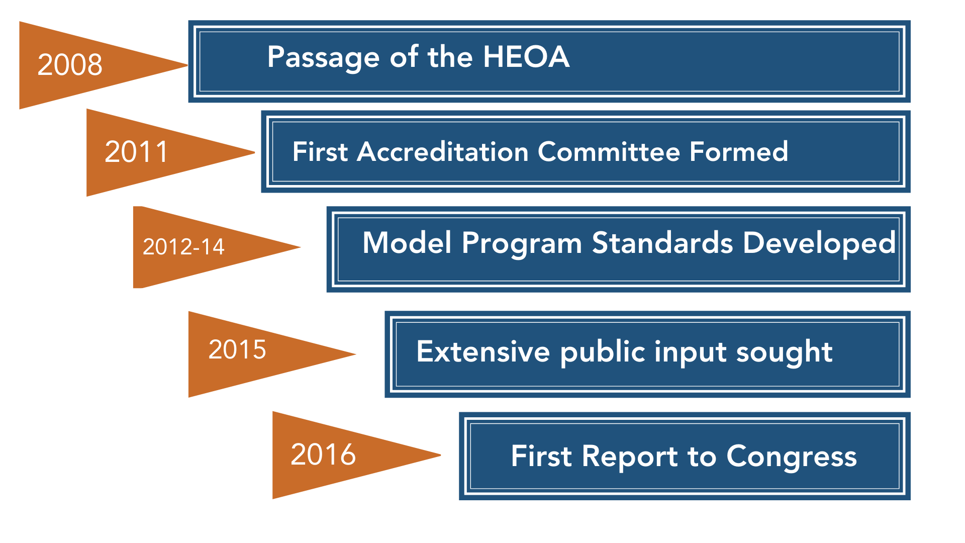
Program Accreditation Timeline 2008-2016

Slide 7
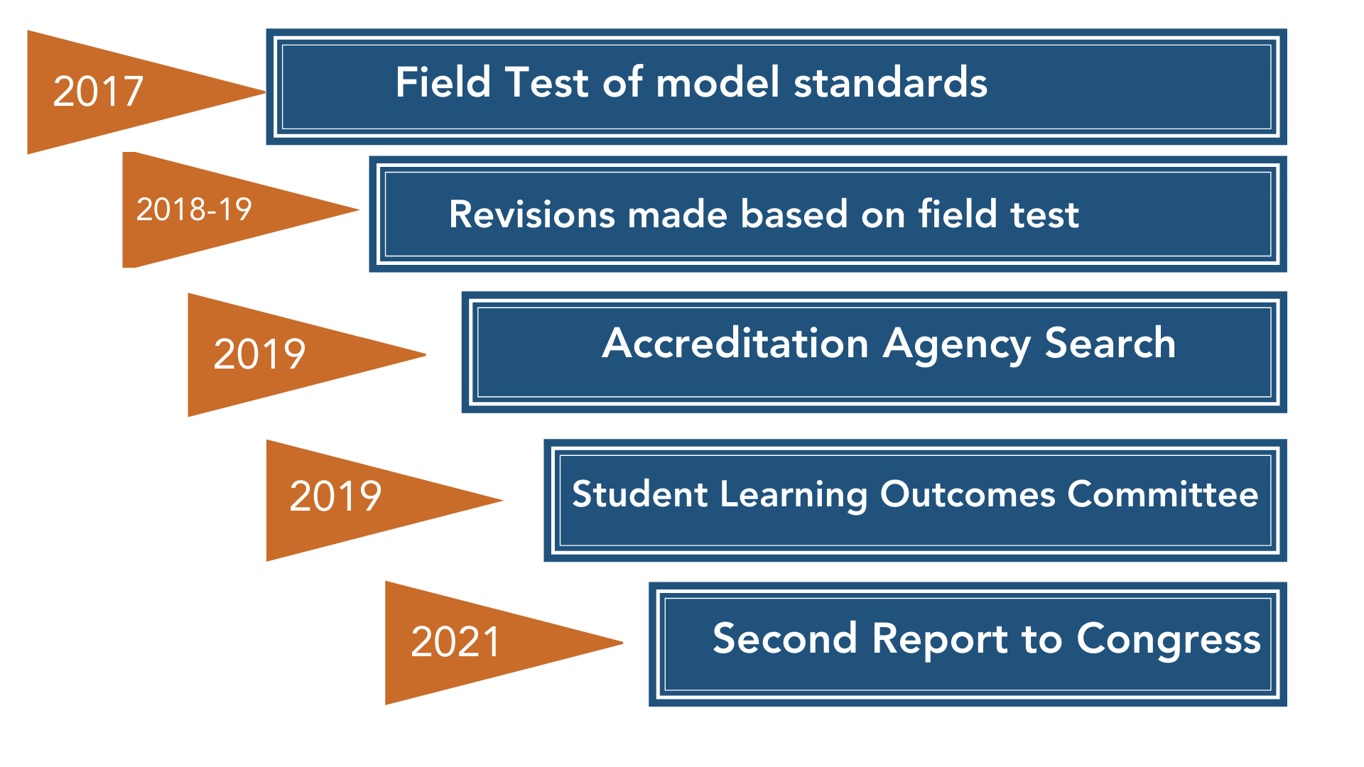
Program Accreditation Timeline 2017-2021

Slide 8
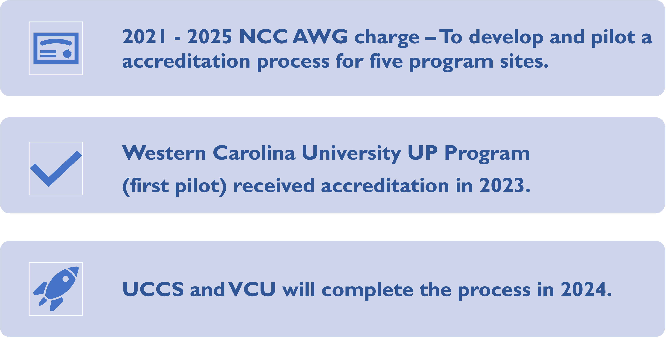
Program Accreditation Milestones

Slide 9
Standards
Guidance and
Required for Review

Slide 10

Accreditation Standards Areas
Mission
Student Achievement
Curriculum
Faculty
Facility, Equipment, and Supply
Administrative and Fiscal Capacity
Student Services
Length and Structure of Program of Study
Student Complaints
Program Development, Planning, and Review

Slide 11
Mission Standard 1
The program has a written mission statement that is consistent with the Higher Education Act (HEA) requirements that the program is a “degree, certificate, or non-degree program at an accredited institution that is designed to support students with intellectual disabilities (ID) who are seeking to continue academic, career and technical, and independent living instruction” to obtain competitive integrated employment (CIE).

Slide 12
Guidance for Mission Standard 1
The mission statement must be consistent with the statutory and regulatory requirements in the HEA. However, a mission statement is not required to explicitly include the language from the definition of a “student with an intellectual disability” and the definition of a “Comprehensive Transition and Postsecondary Program for Students with Intellectual Disabilities” (CTP) in the HEA. The intent of this standard is to ensure that the mission standard aligns with the law and does not contradict it. For instance, the HEA states that programs must serve students with ID. A mission statement that affirms that the program serves students with a variety of disabilities would be contradictory to the intent and language in the HEA. See glossary for CTP, ID, and CIE definitions.
The term “gainful employment” is used in the CTP definition in HEA. However, the US Department of Education (ED) no longer considers CTPs to be gainful employment programs. The updated term “competitive integrated employment” is used instead, as it is defined in the Workforce Innovation and Opportunity Act (WIOA).

Slide 13
Required for Review
Mission Standard 1 (Evidence)
Provide the mission statement.
Describe how the mission aligns to the HEA ID and CTP definitions.
  Provide documentation that the institution is accredited, including the name of the recognized accrediting agency that has accredited the institution.
  Include the weblink to the institution’s accreditation or institutional assessment page.

Slide 14
Curriculum Standard 3
Students with intellectual disabilities (ID) participate in a wide array of postsecondary level courses from multiple disciplines and departmental/college units that are part of the curriculum for degree or certificate programs.

Slide 15
Guidance for Curriculum Standard 3
Students must have a wide array of course options to choose from. Limiting students to a few options, such as only physical education courses, is not acceptable.
However, some programs may have a set curriculum that leads to a credential in a specific career, which would by necessity limit choice in terms of academic courses. In those cases, the required curriculum may be used, but the program must still meet the requirements in the law, as outlined in Curriculum Standard 1, that students spend at least 50% of their time in courses with non-disabled students or work settings with non-disabled individuals.

Slide 16
Required for Review
Curriculum Standard 3 (Evidence)
If restrictions exist that limit course access for students in the program at the institution, provide the access policy.
Provide a list of the college catalog courses that are part of the curriculum for degree or certificate programs that students in the program are or have taken (for credit, audit, or other participation), indicating how many students in the program have taken these courses in the recent past.
The list must indicate the course department or discipline. The college catalog courses included in the list must not be “specialized” courses only for students with ID.
Share several examples of redacted transcripts that clearly show the college catalog courses the students have taken.
If the program uses a set curriculum for a career-specific certificate, provide the curriculum and information about how the students’ participation meets the minimum 50% requirement.

Slide 17
How can the standards be used NOW?
Choose a few standards and begin your own review.
Create or update program evaluation plans.
Create or update program policies, procedures, handbooks.
Establish a data collection system within your program.
Select systems or tools to collect data for accreditation.
Notes:
CATE

Slide 18

Accreditation Process

Slide 19




Key Concepts
Weave
Self-Study
Site Visit
Peer
Reviews

Slide 20

Key Roles
NCC Accreditation Workgroup
Peer Reviewers
IHEAC Liaisons
Inclusive Higher Education Accreditation Council Board Members

Slide 21
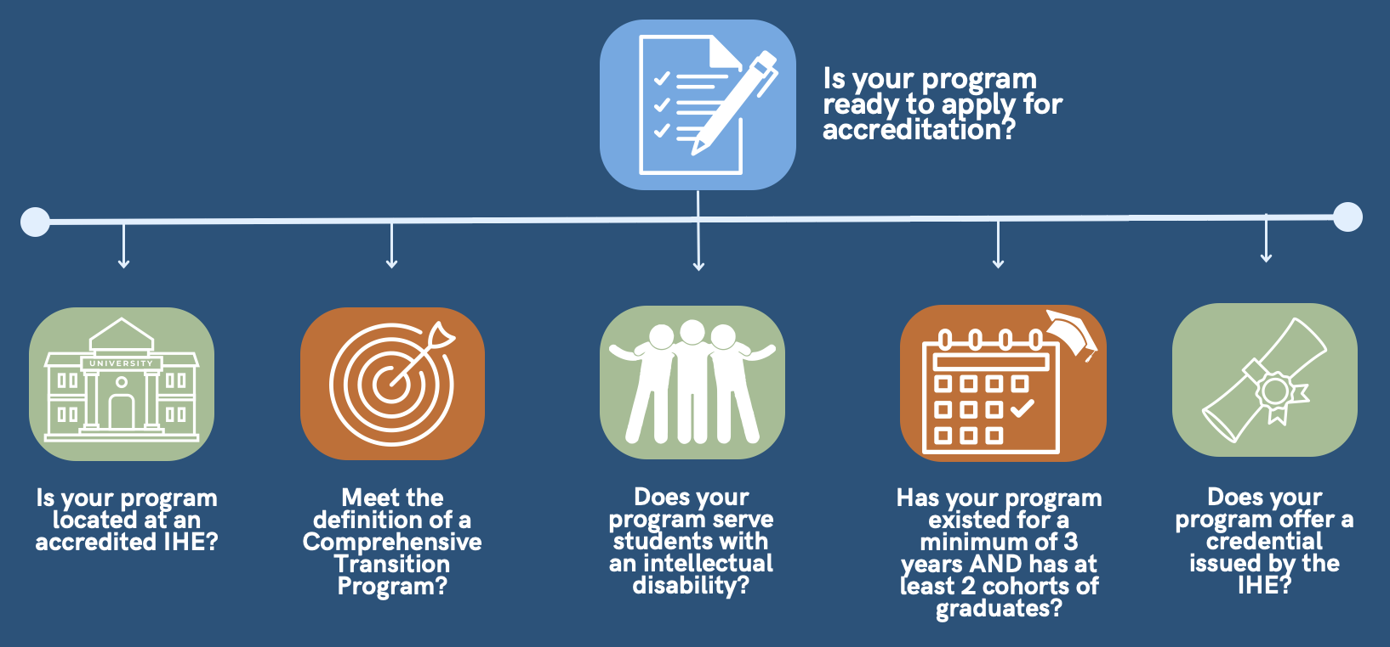
Accreditation Ready
Is you program ready to apply for accreditation?
Is your program located at an accredited IHE?
Meet the definition of Comprehensive Transition Program?
Does your program serve students with an intellectual disability?
Has your program existed for a minimum of 3 years and has at least 2 cohorts of graduates?
Does your program offer a credential issued by the IHE?

Slide 22
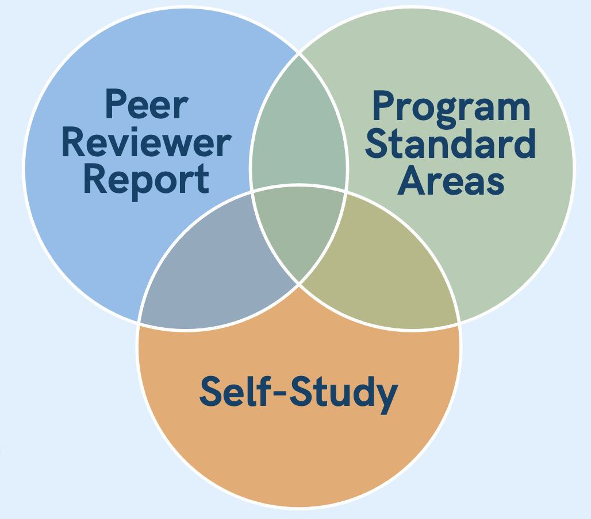
IHEA Council Accreditation Determination
Notes:
www.iheacouncil.org

Slide 23


Next Steps
University of Colorado at Colorado Springs
Virginia Commonwealth University

Slide 24
Inclusive Higher Education Accreditation Council

Slide 25
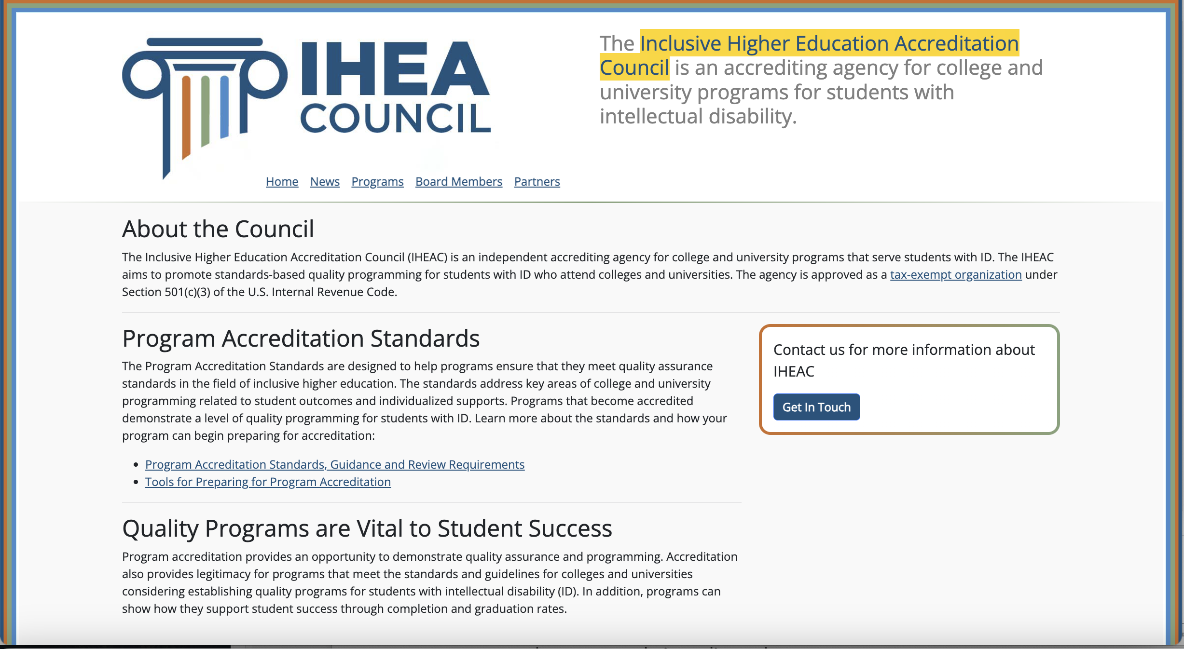
IHEA Council Website
Notes:
www.iheacouncil.org

Slide 26
How and why is accreditation important to students and families?
Implementation will validate and strengthen programs.
Students and parents will have a comparative measure.
Students and parents can look for programs who are committed to pursuing accreditation.

Slide 27
Program Accreditation
Resources

Slide 28
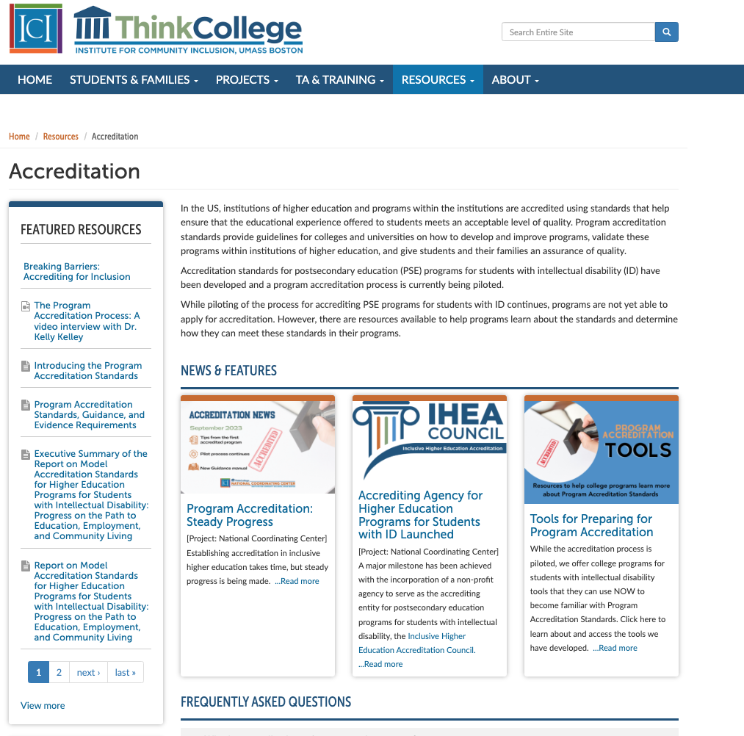
Think College Website
Notes:
https://thinkcollege.net/resources/resources-by-topic/accreditation

Slide 29
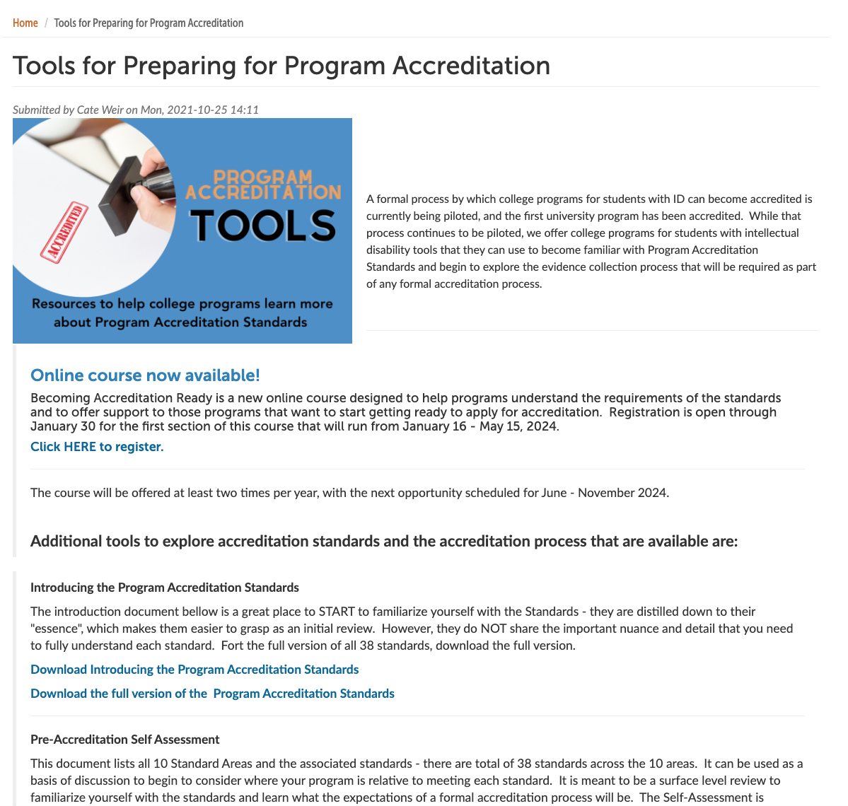
Tools for Preparing for Program Accreditation
Notes:
https://thinkcollege.net/think-college-news/tools-for-preparing-for-program-accreditation

Slide 30
Guide to Accreditation for Higher Ed Programs
2024 Guide to Program Implementation
Intro and Pre-accreditation Self Assessment
Evidence Checklist
System for Organizing Evidence
NEW! Becoming Accreditation Ready
Notes:
https://docs.communityinclusion.org/guide-to-accreditation-for-higher-ed-programs/overview/table-of-contents

Slide 31
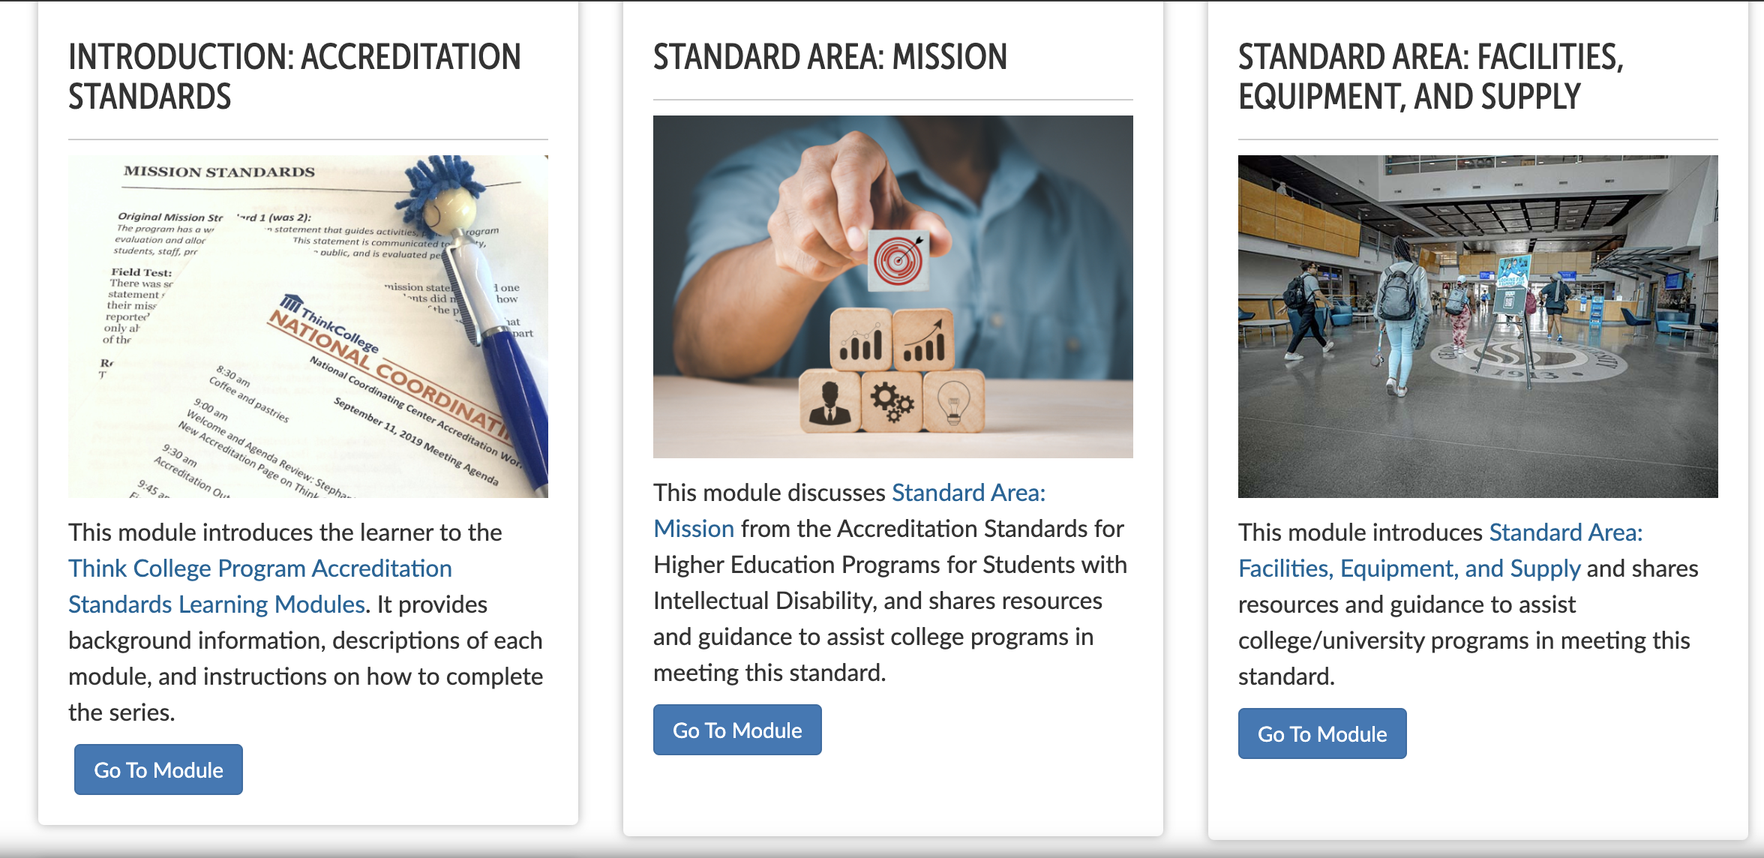
Learning Modules

Slide 32
Online
Course:
Becoming Accreditation Ready
  Seeking interested folks to register as a student and go through asynchronous learning modules free online-course
  Cohort model
  Participate in an online cohort discussion if desired
  Complete feedback surveys about your experience with the online-course
Deadline:
Enroll by
January 30
Notes:
https://elearning.communityinclusion.org/browse/thinkcollege/courses/think-college-accreditation

Slide 33

Contact us:
Martha Mock mmock@ur.rochester.edu
Mary Judge Diegert mjudge@ur.Rochester.edu
Notes:
mmock@ur.Rochester.edu
mjudge@ur.Rochester.edu

