Slide 1

Notes:
Facilitator’s Notes:
Actions for Prior to the session:
Slide #1 – Update presenter names
Hide the other region consultant slide (8,9 or 10)
Hide other regions workshop slide (79,80,or 81) for Upcoming Workshops
Set up Polls
Update Opening Round Question
Facilitator’s Notes:
Actions for team to do 30 minutes prior to the session:
Check that the presenter can share their screen, run videos and video work
Check that the presenter marks “Share Computer sounds” and “Optimize Screen sharing for video clip” so that any videos shown can be heard by others – it is on the same screen that you choose which screen to share.
Check the polls -
Turn on transcript –
Assign someone to set up Break-out Groups
Assign taking attendance
Assign a time-keeper
Assign a Host
Assign someone to monitor Chat
Assign someone to turn on record
Turn on Auto-script

Slide 2

Understanding Your Data and Workforce Strategies
Workshop Series
Add presenter’s name and affiliation
tenncare.ici.umn.edu
Notes:
Facilitator Notes:
Actions Show list slide 10 minutes prior to the session as people log in so they can know they are in the right place:

Slide 3
Welcome to Session 2: Understanding Your Data: Overview of Survey Results Profile and Interpreting Data
Notes:
Time: The Welcome and Introduction section will take 15-18 minutes
Facilitator Note:
Action – Start to record
Talking Points
Welcome to session 2 in our QuILTSS Initiative kickoff workshop webinar series!
My name is xx and I am a xx with the Institute on Community Integration at the University of Minnesota.
Thank you so much for joining us today. Today’s session includes an overview of the 2019 survey results, and the opportunity to examine your organization’s data with reference to your region in the state and the statewide results.
This webinar is currently being recorded. We will send the recording to you if you would like to view again or share with others.

Slide 4
Using Zoom
Name yourself
  First name
  Name of your organization
Use Chat for questions or comments.
Please keep your Microphone off unless you're speaking.
Keep your Camera on if you are comfortable and able.
Live Script is available.
You may use Reactions such as thumbs up throughout.
Thank you for being understanding of colleagues.
Chat
Notes:
Talking Points:
Some of us are used to working on Zoom in a group, while others are less familiar. So we will take a few minutes to talk about some guidelines that will help us work together better.
Please re-name yourself with your first name and the name of you organization.
You can use Chat for questions or comments. We will be monitoring Chat throughout the session.
Please keep your microphone on mute while others are speaking today to help reduce background noise. We do understand that we will When you’re in breakout groups, please unmute and discuss the topic within your group.
Keep your camera on if you are able and comfortable. The decision is yours.
We have turned on the Live Script for you. You are able to Hide it if you don’t want to see it – find it on the ribbon on the bottom of the page.

Slide 5
Welcome & Introductions
Notes:
Transition slide

Slide 6
Poll Question #1 - How long have you been working in the field of supporting people with disabilities?
Less than a year
1-5 years
6-10 years
More than 15 years
More than 20 years
Notes:
Facilitator Notes: The Poll Question to lead into Getting to Know you breakout conversation.
Talking Points
Years of experience informs and influences our work supporting people with disabilities. It is also a valuable metric when thinking about organizational readiness and succession planning. Let’s do a quick poll to see get a sense of the range of experience and wisdom in supporting people with disabilities in community living.
Read the Slide
Poll Question #1 -How long have you been working in the field of supporting people with disabilities?
Less than a year
1-5 years
6-10 years
More than 15 years
More than 20 years
Action - Show and discuss the results.

Slide 7
Breakout Group Activity
Getting to Know You Your name / organization
Your role in the organization today
What is the most important piece of data you currently collect in your organization?
Breakout Group
  1 facilitator in each group and 1 reporter
  Give everyone enough time to have a turn.
Notes:
Facilitator Notes:
Activity : (5-8 minutes) – 5 people per breakout, each person gets one minute, assign 1 consultant or coach to each breakout group
Purpose: Gives consultants and coaches opportunity to learn who is in the room.
Talking Points:
We are going to have the opportunity to get to know who is in the workshop today. In a moment but not yet, you will be send to a Breakout room with 5-6 others.
Everyone will have the:
Opportunity to introduce your self with your name, your organization and your role in the organization.
And answer the questions on the screen.
What is one thing your organization did to celebrate DSP week or to recognize DSPs during the year.
When you get to your group, find one facilitator and another person to report back for the group the responses to the two questions.
Facilitator’s Notes:
When the group returns call on the reporter from each group to report back on themes for question #1.

Slide 8
Goals for this session
Learn more about your organization’s workforce
Review the results of the 2019 QuILTSS Initiative survey by state and region
Compare your organization’s workforce data to region and state averages
Start thinking about your desired workforce outcome
Notes:
Talking Points
We have several goals for today’s session. These goals include:
Learning more about your organization’s workforce, specifically your direct support workforce, including direct support professionals and frontline supervisors.
Review the results of the 2019 survey by the region you are in (the xx region), and the state. The statewide sample included 75 provider organizations.
You will compare your organization’s workforce data to your region and state data. The intention of this is to help identify areas of challenge in your workforce that you would like to address with a strategy from the toolkit.
Finally, we will have time for you to start thinking about your desired workforce outcome that you would like to see, and the steps you might need to take to start forming a team and putting a strategy into place. This will be a task that you will come back to in future sessions as you continue refining your identified challenge.

Slide 9
Items to have with you today:
  Your organization’s 2019 profile
  2019 Organizational Workforce Data Chart located on page 5 in your 2020 Organizational Self Assessment Workbook (www.tenncare.ici.umn.edu )
Notes:
Talking Points
In preparation for reviewing the data presented in this webinar, please make sure that you have the following items close at hand during the webinar:
Your workbook from last year’s kickoff workshop.
Your organization’s individualized profile that was emailed to your key contacts in September 2020
The updated workbook page from the website called “organizational workforce data.” this is the updated chart with the data points included in this year’s profiles for you to reflect on your organizations data as well as state and regional averages. If you have not already, you can download and print this page from the website, which is www.tenncare.ici.umn.edu .

Slide 10
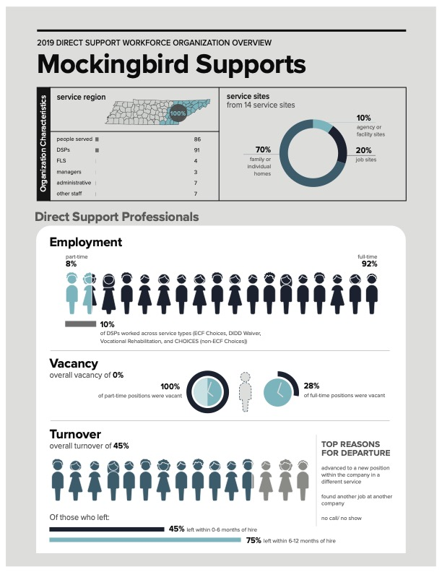
Your organization’s data
Notes:
Time: The Organization Data Activity section – 16 minutes
Talking Points
Your organization received an individualize profile that looks like the one on your screen. The data on it reflects what was submitted earlier this year on the 2019 annual QuILTSS initiative survey. There were a few outcomes on the profile that were computed by the data provided, and we will show you all these formulas in today’s session.
Please pull out the profile to have it in front of you now.
As you are doing that, we’d like you to respond to a quick poll that should appear on your screen now. The question is, how familiar are you with the kinds of data on your profile?
Not at all familiar – I’ve never seen these kind of data before
A little familiar – we track some of these data in our organization
Familiar – we track many of these data regularly
Very familiar – we track these data regularly and we use them for decision making
Facilitator Notes:
Show people the results and report back. Tell them that if they have a lot of questions, we hope the presentation will answer their questions and that they will learn a lot from the presentation.
If they are familiar with the information, this will be a nice chance to review how their data compare to other organizations like theirs.

Slide 11
Activity
Notes:
Talking Points
Now that you have your organizational profile in front of you, turn to page 5 in your self-assessment workbook. The page in the workbook should have a chart on it, like the one on your screen.
On the left of the chart are the types of data that are included on the organizational, regional and state profiles. The data from the top box on the profile are not included in the chart, as those are more descriptive data about your organization and don’t lend them selves as well to comparison. You’ll recall that we discussed those data in the last workshop session.
The middle columns in the chart are labeled at the top with “my organization,” ”my region,” and “my state.” in each of those columns, you’ll have a chance in this presentation to enter the data for each item in the left column in their respective column for organization, region and state.
On the right, there is a small space for you to make notes as we go along today. You can note data where you have some questions or concerns that you’d like to revisit later.
Take a few minutes now to enter your organizations data in the second column from the left which is titled ”my organization.” using your organizational profile, go down the left column to enter the numbers from your organizational profile. You can start with the percent of your on-call or temporary DSPs. Then your percent of DSPs who are not distinguished between full time or part time, then your percent of part time DSPs, and so on.
Take a few minutes now. Feel free to use the chat box or unmute yourself if you have questions.
Facilitator’s Notes:
Allow for 5-6 minutes for participants to enter their organizational data into the workbook.

Slide 12
Data-Based Decision Making
Understanding your organization’s data
Notes:
Talking Points
The importance of looking at your data is not so much to keep score, but to use the data to inform your efforts and decision making about addressing your workforce challenges.
If your organization is like many other provider organizations, you experience difficulties in recruiting, selecting, training, and/or retaining DSPs and FLSs.
Knowing your data and how your data compares to other organizations like yours can help you be better informed about selecting a strategy to address one of these challenges.
As you become more familiar with your data over time, you can compare your organizational data with your own numbers to see your changes over time.
Ultimately, using your data for decision making can help you to work smarter, not harder.

Slide 13


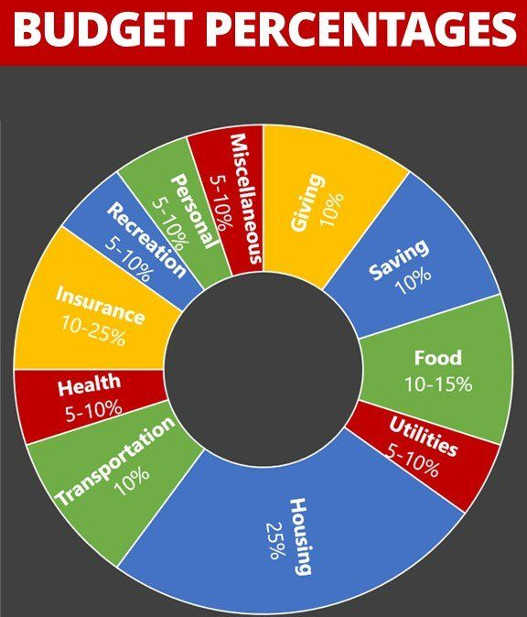
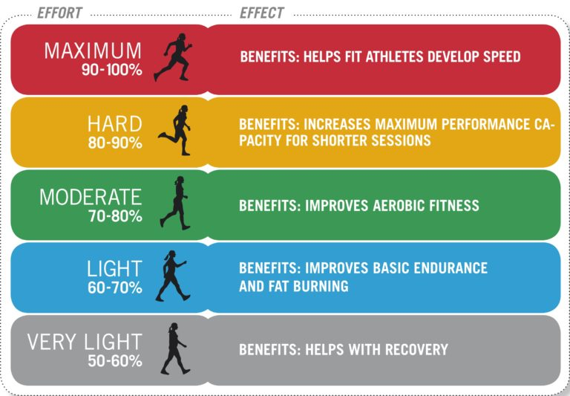
Data we might use for decision-making
Notes:
Talking Points
Thinking more broadly about using data in our lives, are there other kinds of data you use for decision making? Can you think of any kinds?
As you’re thinking, here are a few examples:
Do you have a smart watch with rings that track your active calories burned, or number of times you’ve stood up and walked around today? All the information can be used to inform your choices about exercise and activity.
Do you use a budget to help you track your spending? Maybe you use some kind of rule of thumb like the one on your screen or a credit card report to help you track where your money is going. Knowing how you spend can help you make informed decisions about your choices in the future.
Finally, report cards may have kind of data the help you inform your efforts in spending your time and energy as you or your children or grandchildren study. Ideally, your grade should reflect how well you have mastered the content.
What other kinds of data do you use in your personal or work life? You can use the chat box or unmute your microphone to tell us.
[A few examples: taking temperature when going to work or school during the COVID-19 pandemic (going home if temperature is above 100.4), keeping track of your mileage you’ve driven on this tank of gas to make sure you fill up again before you run out, etc.]

Slide 14
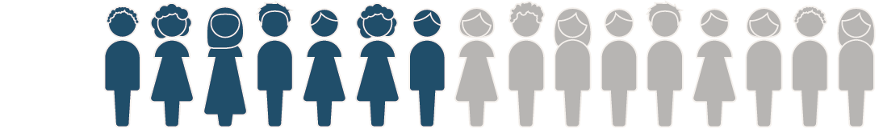


Understanding Direct Support Workforce Data
State level studies
COVID19 national study
Secondary analyses
Staff Stability Survey
BLS data
ACS data
State level studies
Notes:
Talking Points
How many of you collect workforce data in your organizations?
How do you use this data to make decision around which strategies or solutions to try to address a particular workforce challenge you may have? Collecting and analyzing your workforce data is an important step in considering strategies for improving workforce stability in your organizations and really at all levels. Understanding workforce data can you us make decisions about choosing workforce solutions that are most likely to result in improving workforce stability.
These are the current most commonly used data sources and include state level studies, national staff stability survey and data from Bureau of Labor Statistics and census data. We have found PHI data sets to be most helpful in understanding the scope of the DSW workforce. While there isn’t a standard occupational code for DSP, the PHI data captures the largest group of direct care workers that includes DSPs.
Some ways we use workforce data include:
Is in our legislative advocacy
To increase accuracy in separating information DSP who with certain populations or types of services
To make informed policy and practice decisions
To drive Data-based decision making within states, counties and organizations
To create wage scales within organizations
One thing to be cautious of when comparing your data to other data sources is to ensure that the data are computed in similar ways and with similar populations. When we discuss PHI data, for example, we know that the data might include additional workers.

Slide 15

Annual Survey
12-month calendar year
2018 (47 organizations)
2019 (75 organizations)
Upcoming 2020 (early 2021)
Changes were made for year 2 given feedback.
Notes:
Talking Points
We have collected two years of annual organizational data. There were Changes to survey used between year 1 and year 2. The year 3 survey is anticipated to be released in early 2021 to include data from 2020.
Results of year 1 with 2018 data were compiled in the year 1 report, along with state and regional profiles. These are available on the website.
We will look today at results from the Year 2 2019 survey results that are also available in report and profiles, and will be available on the website. The profiles contain selected information – not all the information provided by organizations that completed the survey are compiled in the profiles. The profiles are designed to include information that is particularly important for decision making regarding workforce recruitment and retention.
Facilitator’s Notes:
STOP FOR QUESTIONS.
Quick snapshot of data:
12 month period the data reflects
January 1, 2019 - December 31, 2019
When it was fielded
March 2, 2020; closed May 13, 2020
Response rates
Of the 124 providers in the sample
18.7% (20) did not respond at all
11.3% (12) had incomplete data
70% (75) submitted a year #2 survey
Of the 75 submitted surveys
53.3% (40) participated in Year 1 survey
46.7% (35) were new participants

Slide 16
Regional Distribution
Notes:
Talking Points
A note about regional distribution. .
Statewide data in this presentation includes all available data for organizations that answered the questions.
The regional breakdowns include organizations that provided the highest percentage of services and had their regional office in the region of the state. A small number of organizations provided services in more than one region of the state.
For the regional breakdowns, organizations were assigned to the regional group (that is the east, middle or west region) based on where they provide the highest percentage of services. All the organizations also had their administrative offices located in the region with the highest percentage of service s provided. Both of these were questions on the survey, so based on each organization’s response to these items they were assigned to these regions. In addition, you were invited to this workshop based on this designation.
For today’s presentation, we will look at the regional breakdown of the xx region. The other regional data are available online in the full 2019 report if you are interested to look at data in other regions.

Slide 17
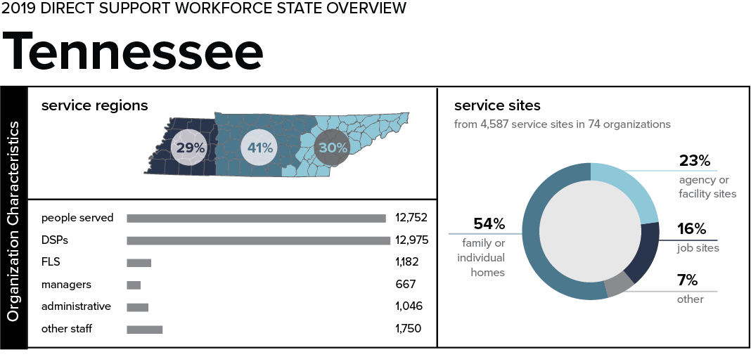
Organizational Characteristics
Notes:
Time: Organizational Characteristics section 3-5
Talking points
Shown on your screen is the first box from the state of Tennessee profile from the 2019 survey results. These data are not included in the chart in your self-assessment workbook, so you don’t need to enter them there.
In the organizational characteristics section of the profiles, there is some descriptive information provided that we will cover briefly.
In the service regions section, 41% of people served are in the middle region of the state, 30% are in the east region, and 29% in the west region of the state.
There were 12,752 people who received services across the organizations that reported. 12,975 DSPs were employed and 1,182 FLSs. The other employees at the organizations are also listed in the state profile. [don’t read the rest of them…]
There were 4,587 services sites reported, which broke down into the following percentages: 54% of services were provided in family or individual homes, 23% were in agency or facility sites (including group homes), 16% in job sites, and 7% were provided in other types of sites. You can find more information about the other types of sites in the report.

Slide 18
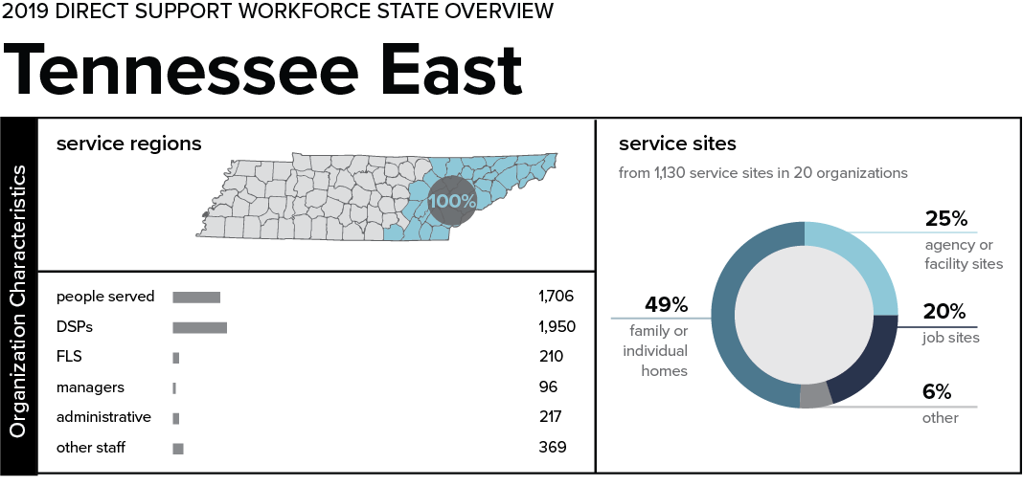
Organizational Characteristics - East
Notes:
Talking Points
In the East region of Tennessee in 2019.
All of the organizations that indicated that they provided services primarily in the east region of TN served all of their people in the east region of TN.
There were 1,706 people who received services across the organizations that reported. 1,950 DSPs were employed and 210 FLSs. The other employees at the organizations are also listed in the regional profile.
There were 1,130 services sites reported, which broke down into the following percentages: 49% of services were provided in family or individual homes. 25% were in agency or facility sites (including group homes), 20% in job sites, and 6% were provided in other types of sites.

Slide 19
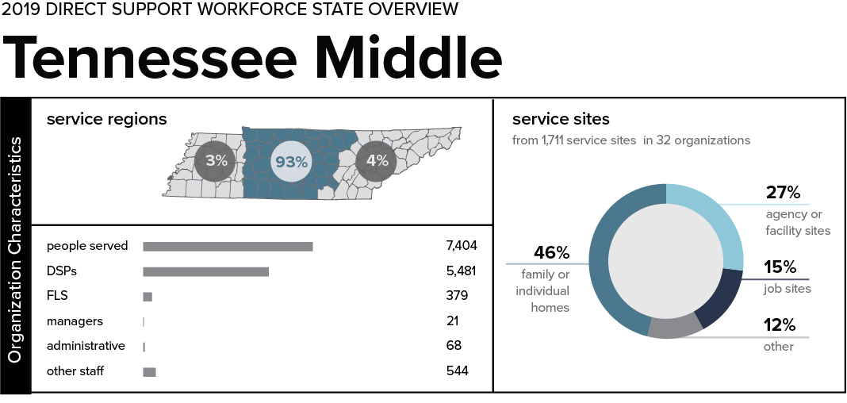
Organizational Characteristics - Middle
Notes:
Talking Points
In the Middle region of Tennessee in 2019.
93% of people served by these organization were in the middle region of the state. 4% were in the east region, and 3% in the west region.
There were 7,404 people who received services across the organizations that reported. 5,481 DSPs were employed and 379 FLSs. The other employees at the organizations are also listed in the regional profile.
There were 1,711 services sites reported, which broke down into the following percentages: 46% of services were provided in family or individual homes. 27% were in agency or facility sites (including group homes), 15% in job sites, and 12% were provided in other types of sites.

Slide 20
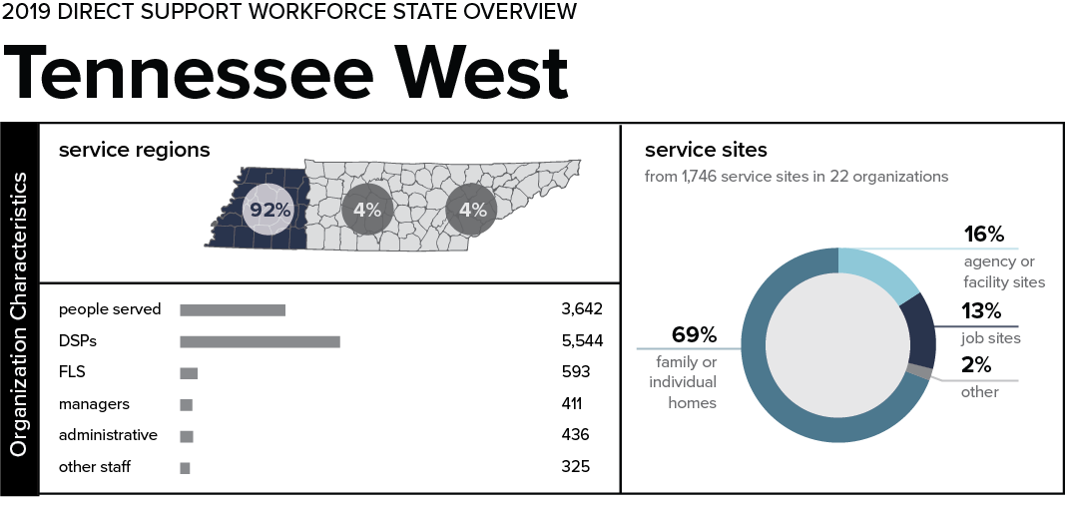
Organizational Characteristics - West
Notes:
Talking Points
In the West region of Tennessee in 2019.
92% of people served by these organization were in the west region of the state. 4% were in the middle region, and 4% in the east region.
There were 3,642 people who received services across the organizations that reported. 5,544 DSPs were employed and 411 FLSs. The other employees at the organizations are also listed in the regional profile.
There were 1,746 services sites reported, which broke down into the following percentages: 69% of services were provided in family or individual homes. 16% were in agency or facility sites (including group homes), 13% in job sites, and 2% were provided in other types of sites.

Slide 21
Direct Support Professionals
Employment
Notes:
Time: DSP Employment 25 minutes
Talking Points
The next section of will include information about state and regional comparison data on the employment of direct support professionals. Moving down the profile, this information is below the organization characteristics section.

Slide 22
Direct Support Professionals
50%+ hours spent in direct support tasks (e.g. personal care, home care, community integration)
Notes:
Talking Points
There are many job titles for both direct support professionals and frontline supervisors, so before we discuss the information reported on these workers, we wanted to be clear about the definitions we provided in the survey for these workers when we asked about them.
Please note that these definitions are based on job descriptions for employees. Given that some workers may shift into different roles or work additional hours, the job descriptions are the best way to categorize employees and is also more likely to align with the ways that human resource staff can provided data.
Direct support professionals were defined as, “those employees whose job descriptions require them to provide at least 50% of their scheduled hours doing direct support tasks.” Depending on the settings where you provide services, these may include personal care, medication administration, job supports, transportation, budgeting, and other tasks. Some DSPs provide supervision to other DSPs, but many organizations have found it helpful to use this designation to separate DSPs from FLSs, whose primary task is supervision of DSPs.
The survey included organizations that employ DSPs in family model provider.

Slide 23
Direct Support Professionals
Frontline Supervisor
50%+ hours spent in direct support tasks (e.g. personal care, home care, community integration)
primary responsibility (50%+ of their role) is supervision of DSPs.
Notes:
Talking Points
Frontline supervisors are distinguished by a different definition in which the employee provides at least 50% of their scheduled role in supervision of DSPs. They may also provide some direct support, but their primary responsibility, that is at least 50% of their job description in supervision.
We often get questions about how to count FLS because many are providing direct support due to high vacancy rates and the inability to hire enough staff to fill all funded positions. This is where to refer to job descriptions if you have questions.
FLS may have job titles like program director, house supervisor, house coordinator or others.

Slide 24
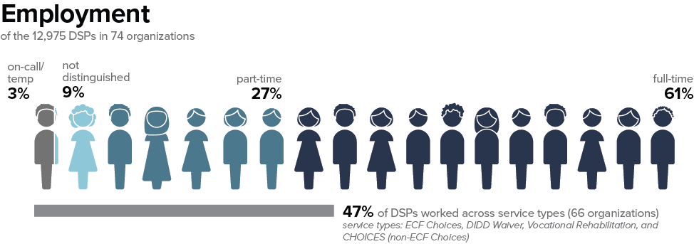
DSPs Employed - State
Notes:
Talking Points
Looking first at the Direct Support Professionals in the state.
These are your first data points to enter into the State of Tennessee” column on your organizational workforce chart.
Of the 12,975 DSPs reported in the state, there are:
3% who are on-call, temporary or PRN staff. These are employees who do not work regular hours. As a note, they are not part time or full time DSPs who work extra hours on an as-needed basis. This 3% are staff who are not considered part time or full time DSPs. On call/temporary DSPs are not included in our numbers for turnover, for example, as we expect them to come and go.
The next data point is “not distinguished.” this category for DSPs is for those organizations that do not or could not designate DSPs as part time or full time – they just have the one category for all DSPs that they employ in regular positions. If you have DSPs in your organizational profile as “not distinguished,” you will not have DSPs as full time or part time and your data will not be broken down in that way on the profile. Statewide, 9% of DSPs were classified in this way.
Across the state 27% of DSPs were part time DSPs.
Finally, 61% of DSPs were considered “full time” by their organization. Organizations may have defined their DSPs as full time in different ways (for example working 30 hours per week, 40 hours per week, or another designation). Organizations also reported on the survey how they define “full time” for DSPs. If you’re interested to see how organizations responded to this question you can consult the 2019 report.
Make sure to note these statewide data points on the organizational workforce data chart. You can pause the video to do this as needed.
Finally, we asked organizations to indicate the percentage of DSPs who work across service types in their organization. Statewide, 47% of DSPs worked across service types, meaning that they worked in ECF CHOICES, as well as another service type including DIDD Waiver, Vocational Rehabilitation, and CHOICE (non-ECF CHOICES). This data point is not on your organizational workforce data chart but is an interesting piece of information to know about ECF Choices providers.

Slide 25
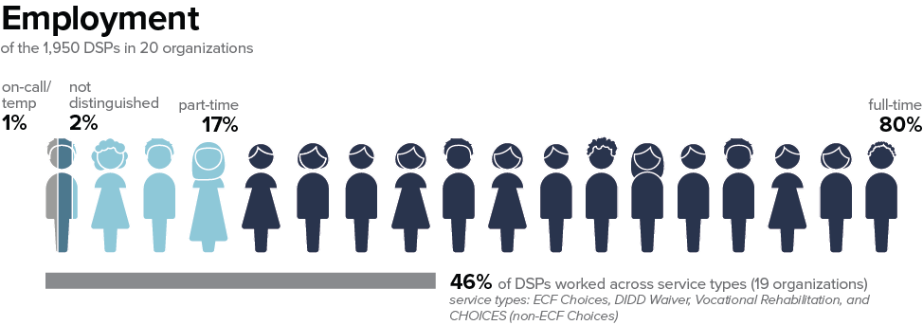
DSPs Employed - East
Notes:
Talking Points
Turning to the east region. Note these data if your organization provides the highest percentage of service in the east region: Of the 1,950 DSPs reported in the east region, there are:
1% who are on-call, temporary or PRN staff.
2% are “not distinguished” between part time or full time.
17% of DSPs were part time.
Finally, 80% of DSPs were considered “full time. Again, organizations may have defined their DSPs as full time in different ways.

Slide 26
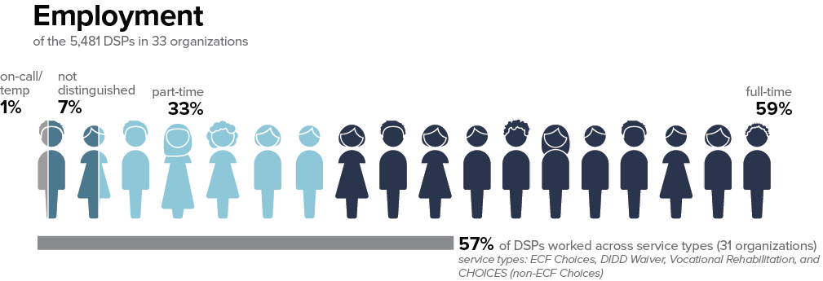
DSPs Employed - Middle
Notes:
Talking Points
Turning to the middle region, and note these if your organization provides the highest percentage of service in the middle region
Of the 5,481 DSPs reported in the middle region, there are:
1% who are on-call, temporary or PRN staff.
7% are “not distinguished” between part time or full time.
33% of DSPs were part time.
Finally, 59% of DSPs were considered “full time. Again, organizations may have defined their DSPs as full time in different ways.

Slide 27
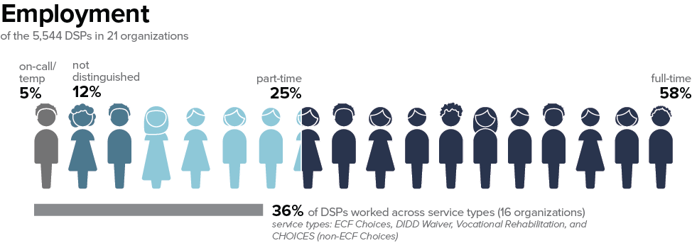
DSPs Employed - West
Notes:
Talking Points
Turning to the west region to note these data in your regional column if your organization provides the highest percentage of services in the west region.
Of the 5,544 DSPs reported in the west region, there are:
5% who are on-call, temporary or PRN staff.
12% are “not distinguished” between part time or full time.
25% of DSPs were part time.
Finally, 58% of DSPs were considered “full time. Again, organizations may have defined their DSPs as full time in different ways.

Slide 28
Projected Growth of Workforce
2016-2026 (BLS)
Percent change from 2016-2026
PHI. “Workforce Data Center.” Last modified December 17, 2018.
Notes:
Talking Points
A few points of comparison with other available data about the direct support workforce. PHI analyzes data collected through the Bureau of Labor Statistics, including projected growth of various workforces over time. If you’ll remember, there is no SOC code for Direct Support Professionals, so one where DSPs are sometimes counted are home care workers. The growth in demand for home care workers is depicted in the top bars on the screen. In 2016, nearly 2 million home care workers were documented. There is a 52% increase in demand for homecare workers projected by 2026. In 2026, the demand for these workers is expected to be over 3 million!
There are some other comparison figures on the screen to show the differences in demand. Demand for nursing home workers is expected to remain steady in the same time period. The average of other industries is expected to grow 16%. This means that the demand for home care workers is expected to grow by over three times that of other workforces.
These help provide some national context for understanding the workforce challenges that many organizations are currently experiencing. Given these statistics, we might expect that there are pipeline programs or other ways for people to learn about careers in home care or as direct support professionals, but unfortunately this is not often the case.

Slide 29
Notes:
Talking Points
PHI includes a data base of state specific data. On the screen are some of data collected by SOC codes, showing the damand for these workers in Tennessee specifically. You can see that demand for all classes of these workers that provide supports in the community is higher than that of all occupations (which is denoted by the gray bar on the bottom). The community based positions, including personal care aids and home health aides is higher than nursing assistants.

Slide 30
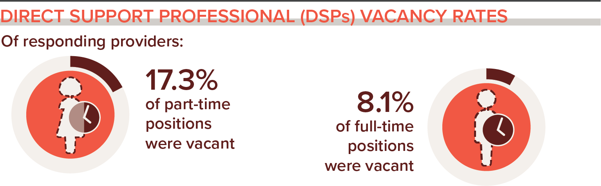
2017 National DSP Vacancy Rates
National Core Indicators. (2019). National Core Indicators 2017 Staff Stability Survey Report. Retrieved from the National Core Indicators website: www.nationalcoreindicators.org/resources/staff-stability-survey/
Notes:
Time: DSP Vacancies section 3-5
Talking Point
Vacancy rates are tied to staffing trends, as the previous information included only those staff who were employed on the last day of 2019. Vacancy rates are those positions that are funded but were unfilled on the last day of the period.
On your screen right now are national data from 2017 from the NCI Staff Stability survey. You’ll recall that these workers are specifically those that employ DSPs. In 2017, 19 states (including some in TN) plus the District of Columbia provided data for this report.
Across these states, over 17% of part time DSP positions were vacant, and 8% of full time DSPs were vacant.
This information is provided in order to help understand the national landscape regarding demand for DSPs.

Slide 31
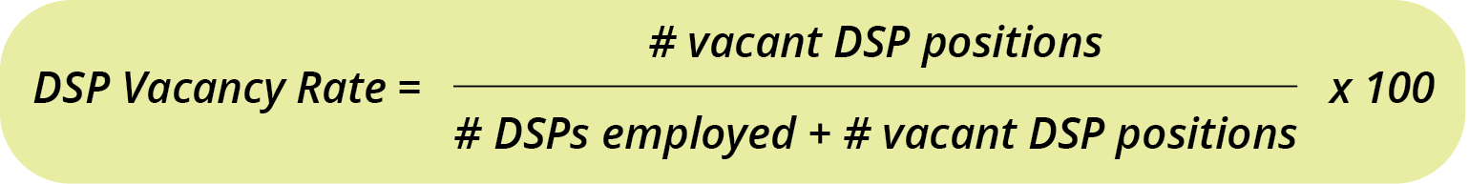
Formula for Vacancy Rate
Notes:
Talking Points
Some significant challenges in our industry stem from a high number of vacant but funded positions.
Vacancy rates are the percentage of positions that are funded but were unfilled on the last day of the period – in this case, on December 31, 2019.
Vacancy is one of the computed measures in the survey – meaning that we utilize the information provided regarding staffing to compute vacancy rates for you.
The formula for vacancy rate is provided in the workbook from the kickoff workshops last year on page 19.
[box] Vacancy is computed by taking the total number of vacant positions on December 31, 2019 divided by the total number of positions on the same date. The total number of positions is:
the total number of DSPs employed plus
the total number of vacant positions. Then this is multiplied by 100 to get a percentage.
In the QuILTTS Survey, we computed this for overall, part time and full time DSPs.

Slide 32
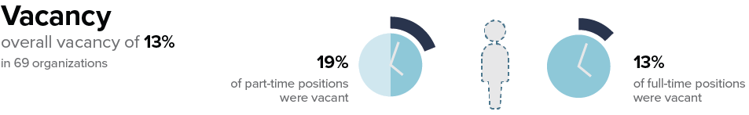
Vacancy - State
Notes:
Talking Points
Statewide,
there was an overall vacancy rate of 13%. This means that 13% of DSP positions in the state were unfilled on the last day of the year.
You can add this into your workbook.
We don’t have spaces for you to add part time and fulltime vacancy rates, but these are provided on the profiles.
Of note, there was a higher vacancy rate among part time DSP positions.

Slide 33
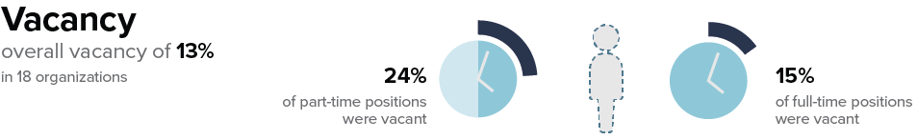
Vacancy - East
Notes:
Talking Points
In the East region
There was also an overall vacancy rate of 13%. And, the part time vacancies are higher than full time vacancies.
You can note the overall vacancy rate of 13% in the chart in the workbook if you provide services in the east region.

Slide 34
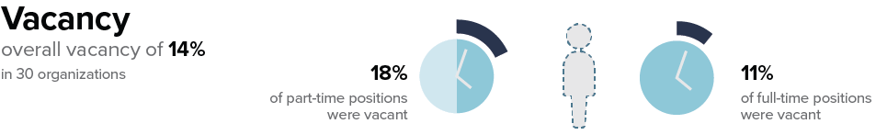
Vacancy - Middle
Notes:
Talking Points
In the middle region,
there was an overall vacancy rate of 14%. And, again the part time vacancies are higher than full time vacancies.
You can note the overall vacancy rate of 14% in the chart in the workbook if you provide services in the middle region.

Slide 35

Vacancy - West
Notes:
Talking Points
In the west region,
There was also an overall vacancy rate of 13%. And, again the part time vacancies are higher than full time vacancies.
You can note the overall vacancy rate of 13% in the chart in the workbook if you provide services in the west region.

Slide 36
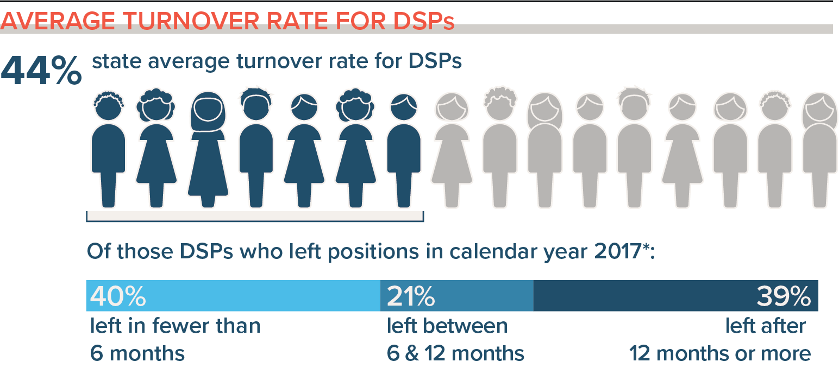
2017 DSP Average Turnover Rate
National Core Indicators. (2019). National Core Indicators 2017 Staff Stability Survey Report. Retrieved from the National Core Indicators website: www.nationalcoreindicators.org/resources/staff-stability-survey/
Notes:
Time: DSP Turnover section – 19 minutes
Talking Points
Looking at the NCI data from 2017 in 19 states including TN and the District of Columbia, 44% of DSPs left their positions in the calendar year. This is similar to the 2019 turnover in the QuILTSS survey, however NCI does not use “vacancies” in their computation for turnover so the formula results in a slightly different result - it is not directly comparable.
Of those who left their position, a slightly percentage of DSPs left between 0-6 months and between 6-12 months.
This can indicate that strategies are needed to support DSPs early in their TN.

Slide 37
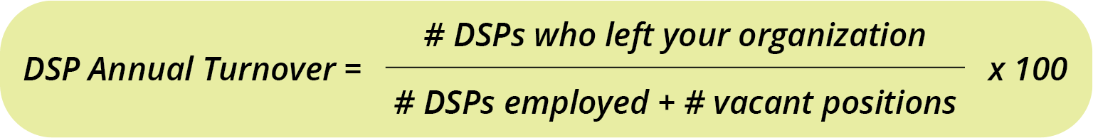
Calculating Annual Turnover
(Crude Separation Rate)
Notes:
Talking Points
Turnover is the other computed measure that we compute for your organization using the formula on the screen. Like the formula for vacancy rate, this formula is also provided in the kickoff workbook on page 19.
There are many ways to calculate turnover, and it is important to make sure that you are comparing data that are computed using the same formula (or note the differences when interpreting).
We compute turnover using the formula for annual crude separation rate.
The formula is:
the total number of DSPs who left in the calendar year (2019 in this case) divided by the total number of DSP positions, which includes:
the number of DSPs employed plus
the number of DSP vacant positions. That number is multiplied by 100 to get a percentage.

Slide 38
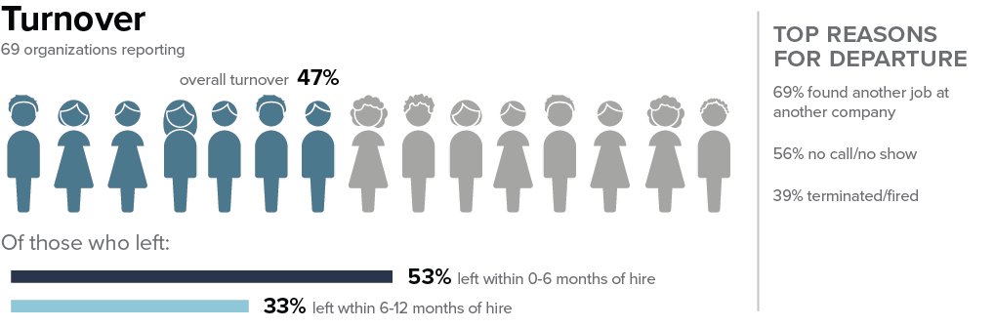
Annual Turnover – State
Notes:
Talking Points
Statewide, 47% of DSPs left their positions in 2019. You can note this number in your workbook chart.
We also collected top reasons for DSP departure from organizations that collected this information. Organizations could select the top three reasons, as well as the option to write in an “other” reason. The top reasons for DSP departure in the state are on the screen. We will not cover them specifically here, but you can note those in the state and your region and note if any of your reasons differ. This can be particularly helpful information for addressing workforce challenges – specifically trying to address reasons why DSPs leave if those reasons are in your control.

Slide 39
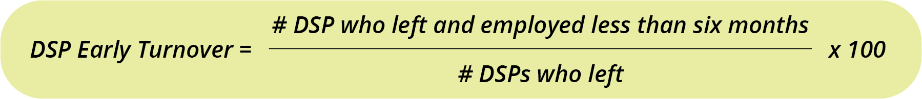
Early Turnover Formula
Notes:
Talking Points
We also included some tenure specific information related to turnover. In addition to reporting the number of DSPs who left in the calendar year, we asked you to report how many who left who had been employed between 0-6 months when they left, and those who had been employed between 6-12 months before they left. This formula is on page xx of the workbook.
Note that this is a portion of the DSPs who left, not a percentage of your DSP staff which includes those who stayed.
To compute early turnover, that is those staff who left between 0-6 months tenure,
take the number of DSPs who left and were employed less than six months by:
the number of DSPs who left in the year (the number you used in the annual turnover computation). Multiply this by 100 to get the rate of DSP early turnover.
The formula is repeated with the number of DSPs who left with 6-12 months of tenure in the calendar year.

Slide 40
Early Turnover – State
Notes:
Talking Points
We also included some tenure specific information related to turnover. In addition to reporting the number of DSPs who left in the calendar year, we asked you to report how many who left who had been employed between 0-6 months when they left, and those who had been employed between 6-12 months before they left. This formula for early turnover is also on page 19 of the workbook. It is calculated as a percentage of the DSPs who left.
In the state, of those DSPs who left the organization, 53% left with 0-6 months of hire. 33% who left had been employed between 6-12 months of hire.
What this can indicate is that more strategies are needed to hire DSPs with appropriate expectations about the job, and more support for training, supervision, matching or mentoring DSPs in the early months of the job. Over half of the workforce who left had been working for less than six months. Many who have worked as DSPs know that six months is not long enough to have learned this role, and when workers leave within six months of being hired this is likely to impact peoples’ quality of life and the morale of other workers. The good news is that there are strategies identified to help address these challenges over time.
As a note, if your organization did not provide any vacancy data for DSPs, turnover could not be computed. Turnover could be computed only if all the data points were provided. Otherwise, your profile will say “data not available.” if you can find the applicable data, you can use the formulas on page 19 of your workbook to compute any missing data points on the infographic.

Slide 41
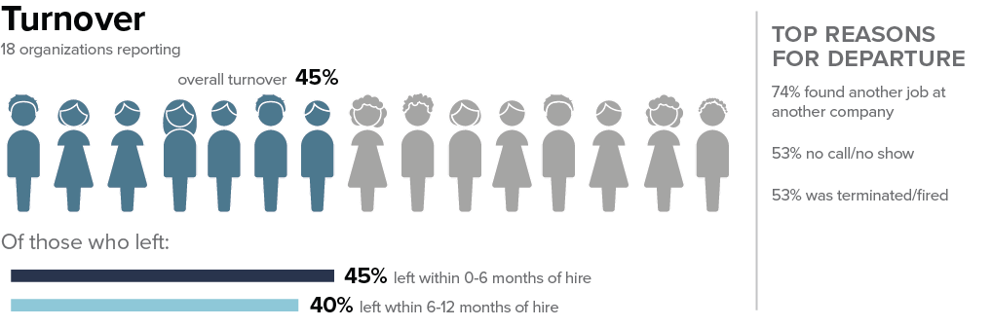
Turnover - East
Notes:
Talking Points
Overall DSP turnover rates in the East are similar to the state at 45%.
Of those DSPs who left their positions, 45% left within 0-6 months of hire, and 40% left within 6-12 months of hire.
Note these regional data in your workbook if you provide service in the East now.

Slide 42
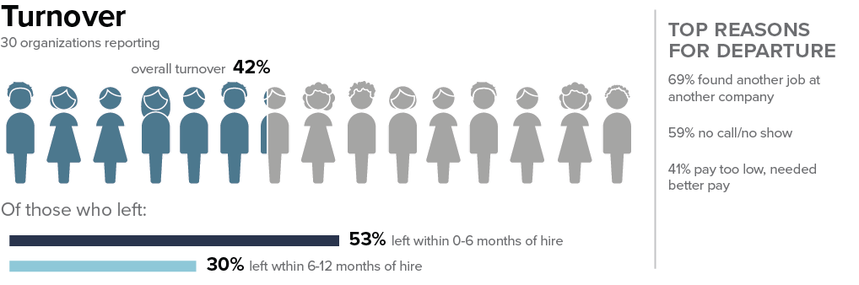
Turnover – Middle
Notes:
Talking Points
Overall DSP turnover rates in the middle region are similar at 42%.
Of those DSPs who left their positions, 53% left within 0-6 months of hire, and 30% left within 6-12 months of hire.
Note these regional data in your workbook if you provide services in the middle now.

Slide 43
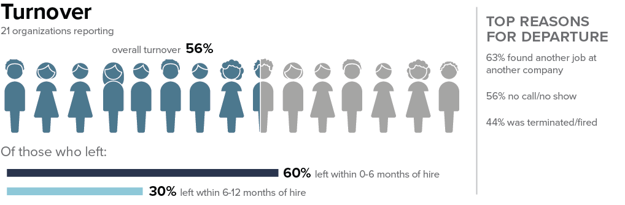
Turnover – West
Notes:
Talking Points
Overall DSP turnover rates in the East are slightly higher at 56%.
Of those DSPs who left their positions, 60% left within 0-6 months of hire, and 30% left within 6-12 months of hire.
Note these regional data in your workbook if you provide services in the west now.

Slide 44
Direct Care Worker Median Hourly Wage Comparison in the United States, 2017
Kickoff
DSPs
U.S. Bureau of Labor Statistics, Occupational Employment Statistics: https://www.bls.gov/oes/
Notes:
Time: DSP Wages section – 8-9 minutes
Talking Points
Wages for direct support professionals have been low when compared to entry level workers that require less skill. On the screen are average hourly wages paid to various worker groups in 2017 based on data from the Bureau of Labor Statistics.
Wages for home health and personal care aids nationally were around $11 per hour, compared to parking enforcement workers earning $18.76 per hour and refuse and recyclable materials collectors earning $17.39 per hour.

Slide 45
United States DSP Wages Over Time
(Median wage adjusted for inflation 2016/17 BLS)
WAGE GROWTH:
Home +$0.37
Nursing +$0.06
Total -$0.24
PHI. “Workforce Data Center.” Last modified December 17, 2018.
https://phinational.org/policy-research/workforce-data-center/.
Notes:
Talking Points
Furthermore, DSP wages are one of the most alarming and discouraging trends. As we track DSP wages over time and adjust for inflation the wage has gone down over time yet cost of living continues to rise for these already low paid workers.
In every state, every year, wage and rate increase campaigns occur. These ask DSPs, people with IDD, families and allies to write letters and go to state capitols and tell their stories. This slide tells you how effective that strategy has been.
While the news is not good, there is something else on this slide that is worth pointing out. In the U.S. Certified Nursing Assistants are required to have a credential that is usually offered in post secondary educational programs or by an employer in partnership with an educational institution. CNAs work in institutional care. Yet they are required to be credentialed. While their wages have on average gone down over time, they earn $2.00 more than non credentialed workers.
“Home Care” includes all direct care workers who are employed in two industries: Services for the Elderly and Persons with Disabilities and Home Health Care Services. “Nursing Homes” reflects nursing assistants employed in the Nursing Care Facilities (Skilled Nursing Homes) industry. Total includes all industries where direct care workers are employed.

Slide 46
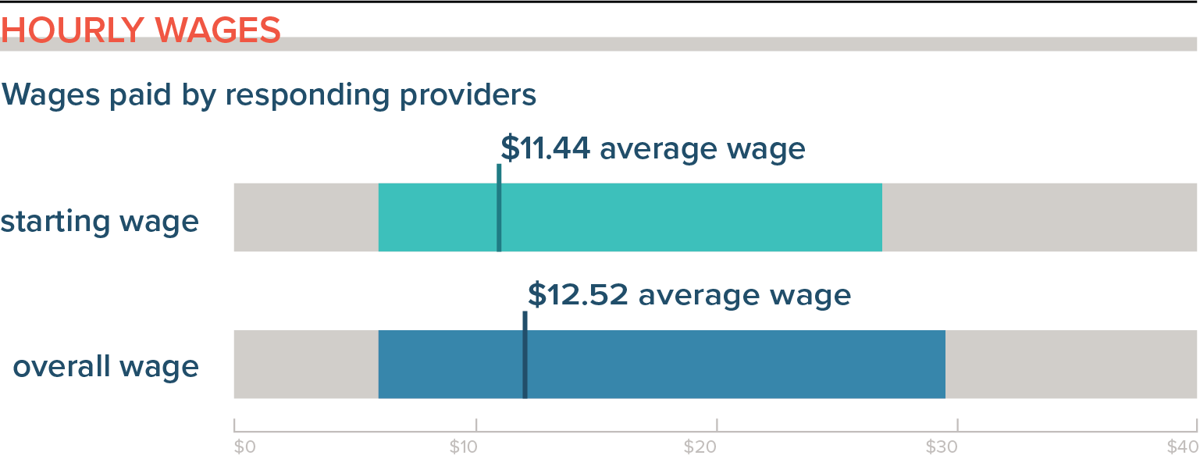
2017 National DSP Wages
National Core Indicators. (2019). National Core Indicators 2017 Staff Stability Survey Report. Retrieved from the National Core Indicators website: www.nationalcoreindicators.org/resources/staff-stability-survey/
Notes:
Talking Points
In 2017 in the NCI Staff Stability Survey, the average starting wage paid to DSPs was $11.44 per hour. It was $12.52 on average for the workforce in the states that participated. This is less than one dollar difference between starting and average wages. One consideration is to look at the wages paid to your veteran workers and determine if the wages paid to them reflect the level of skill that they have developed through longer tenure on the job. Looking at rewarding workers (in a number of ways) for longer tenure is an important retention strategy.

Slide 47
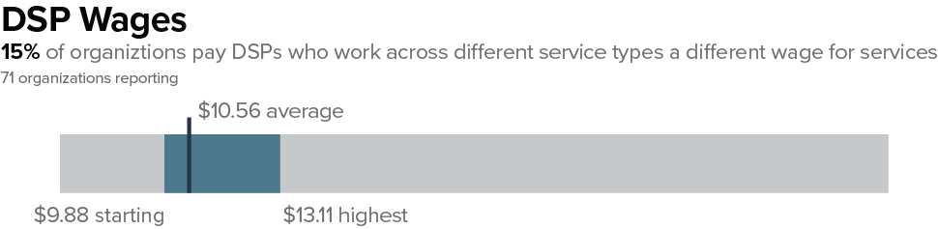
Tennessee Wages
Notes:
Talking Points
In 2019 in Tennessee,
the average starting wage paid to DSPs was $9.88 per hour.
The average wage was $10.56 per hour, and
on average, the highest wage paid to a DSP was $13.11 per hour. Costs of living in Tennessee may be lower than they are nationally, as these numbers are below the national averages in the NCI Staff Stability survey. Asking about costs of living in an area is an important retention question to ask when considering the supports needed for workers to stay on the job.
You can note these wages in the ”state” column on your chart.

Slide 48
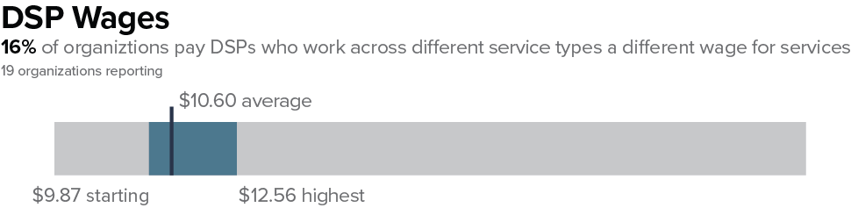
East Tennessee Regional Wages
Notes:
Talking Points
In the east region,
the average starting wage was $9.87 per hour.
The average wage was $10.60,
and on average, the highest wage paid to DSPs was $12.56 per hour.
You can note these wages in the ”region” column on your chart if you provide services in the east.

Slide 49

Middle Tennessee Regional Wages
Notes:
Talking Points
In the middle region,
the average starting wage was slightly higher at $10.29 per hour.
The average wage was $10.98,
and on average, the highest wage paid to DSPs was $13.94 per hour.
You can note these wages in the ”region” column on your chart if you provide services in the middle.

Slide 50
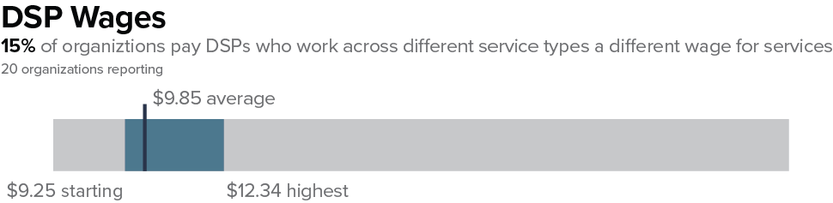
West Tennessee Regional Wages
Notes:
Talking Points
In the west region,
the average starting wage was slightly lower at $9.25 per hour.
The average wage was $9.85,
and on average, the highest wage paid to DSPs was $12.34 per hour.
You can note these wages in the ”region” column on your chart if you provide services in the west.

Slide 51
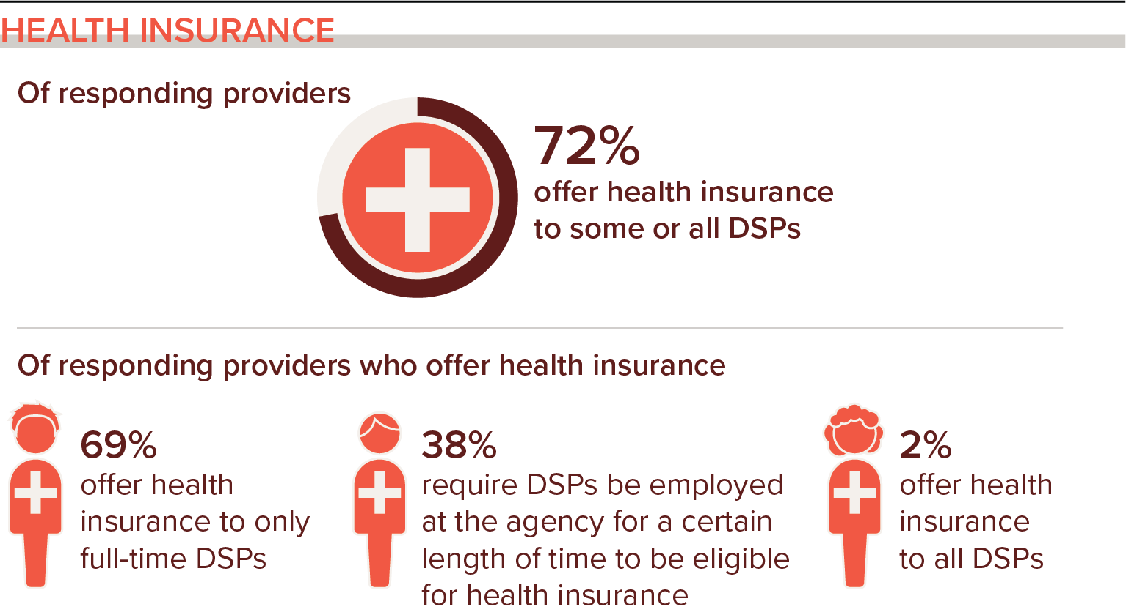
Health Insurance for DSPs
National Core Indicators. (2019). National Core Indicators 2017 Staff Stability Survey Report. Retrieved from the National Core Indicators website: www.nationalcoreindicators.org/resources/staff-stability-survey/
Notes:
Time: DSP Benefits section – 4-6 minutes
Talking Points
Availability of benefits is another important factor in retaining workers over time. NCI asks questions about benefits, specifically about health insurance in slightly different ways that we do on our survey. In 2017, 72% of organizations that participated in that survey offered health insurance to some or all DSPs.
Of those organizations that offer health insurance, 69% of organizations offer health insurance to full time DSPs only.
Of those organizations that offer health insurance, a little more than one third require DSPs to be eligible for a certain length of time to be eligible for benefits.
Only 2% of organizations that offer health insurance offer it to all DSPs.

Slide 52
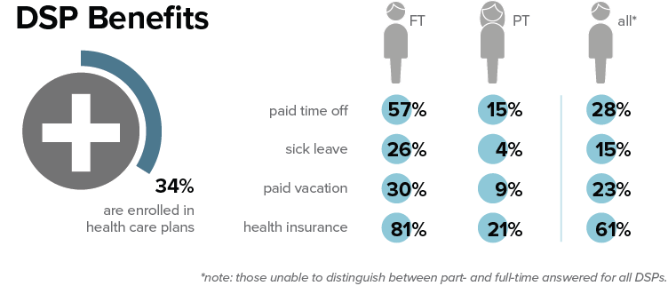
Benefits – State
Notes:
Talking Points
On average across the state, for organizations that offer health insurance,
34% of DSPs are enrolled in health care plans through the organization. You can note this number on your chart in the workbook.
Looking at the numbers in the bubbles on the right side of the screen. These percentages are the number of organizations that checked “yes” to offering these benefits to DSPs. This information will look like check marks on your organizational profile – indicating that you offer the type of benefit if you offer any of these benefits to DSP. The types of benefits that we asked about were:
Paid time off.
Paid sick leave
Paid vacation
Health insurance.
The three columns are for offering the type of benefit to full time DSPs (however the organization defined those workers), to part time DSPs, and to “all DSPs”, which was the organizations that did not distinguish between full time and part time DSPs.
If your organization does not offer these benefits to DSPs, none of the bubbles would be checked. Overall, organizations were more likely to offer these types of benefits to full time DSPs than to part time DSPs. Most organizations offer some type of paid time off to DSPs, but there are some that do not. Just over 81% of organizations offer health insurance to full time DSPs. Given that only 34% on average are enrolled in health care plans when they are offered indicates that DSPs may be offering health insurance through another source, or they may be uninsured.
We have surveyed DSPs in other states to learn more about where they offer health insurance. We will look at those results after looking at the regional data.

Slide 53
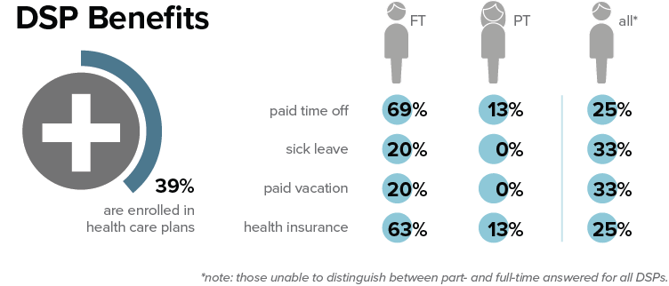
Benefits - East
Notes:
Talking Points
A slightly higher percentage of DSPs in the east region are enrolled in health insurance through their employer.
On average, 39% were enrolled in health care plans in organizations in the east region. You can note this number in the “regional column” on your chart if you provide services in the east region.
You can note the percentage of organizations that offer health insurance and the three types of paid time off in your region, but for time’s sake we will not look specifically at those here.

Slide 54
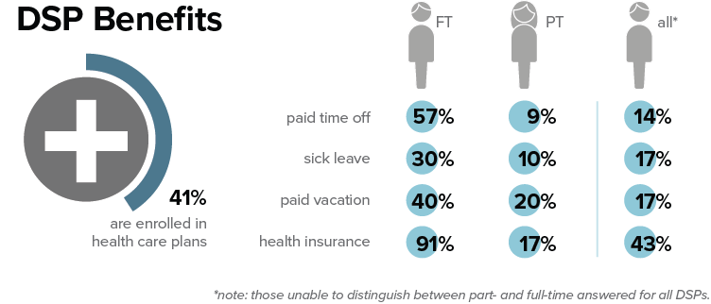
Benefits - Middle
Notes:
Talking Points
A slightly higher percentage of DSPs in the middle region are enrolled in health insurance through their employer.
On average, 41% were enrolled in health care plans in organizations in the middle region. You can note this number in the “regional column” on your chart if you provide services in the middle region.
You can note the percentage of organizations that offer health insurance and the three types of paid time off in your region, but for time’s sake we will not look specifically at those here.

Slide 55
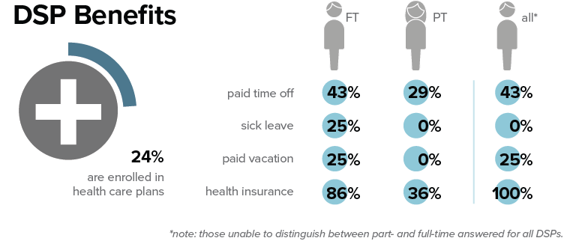
Benefits - West
Notes:
Talking Points
A slightly lower percentage of DSPs in the west region are enrolled in health insurance through their employer.
On average, 24% were enrolled in health care plans in organizations in the west region. You can note this number in the “regional column” on your chart if you provide services in the west region.
You can note the percentage of organizations that offer health insurance and the three types of paid time off in your region, but for time’s sake we will not look specifically at those here.

Slide 56
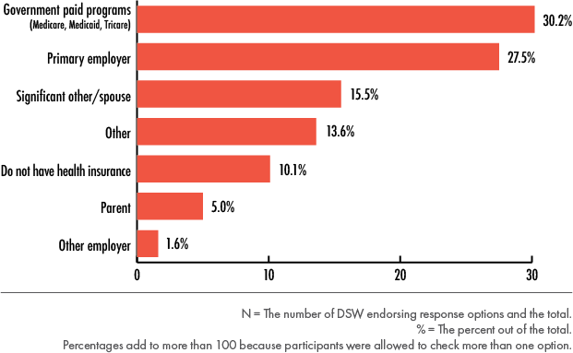
DSWs in Minnesota Source of Health Insurance (2018)
(Hewitt, Pettingell & Kramme, 2019)
Notes:
Talking Points
I mentioned that we have surveyed DSPs in other states about where they access their health insurance benefits. This results that you see on your screen were from several hundred DSPs in Minnesota who responded to a survey in 2018 where we asked them to indicate where they access health insurance.
The results of the survey are noted in the graph on the screen. Over 30% of DSPs accessed through government paid programs. More DSPs access health insurance through a government paid program than any other source.
About 28% accessed from their employer.
Over 20% accessed from their spouse or parent.
Over 10% do not have health insurance.
Knowing this, can you provide resources for your workers about accessing government paid programs when you cannot offer health insurance benefits? Can you provide self-care resources for your DSPs?
We recognize that there is not an easy solution for providing health insurance in our current context. Our point about viewing this as a workforce outcome is being attentive to the numbers to better understand where your workers are at, and to consider options for addressing your workforce challenges.

Slide 57
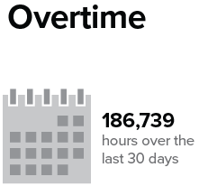
Overtime - State
Notes:
Time: DSP Overtime section – 2-3 minutes
Talking Points
Turning now from benefits to overtime hours paid to DSPs, we know from previous research that many DSPs will work additional hours when asked in order to help make ends meet financially. Additionally, people who receive supports are in need of DSPs to fill vacancies in any reasonable ways possible.
We didn’t provide a column on the chart in your workbook for you to compare your number of overtime hours paid as these numbers reported on this slide and the regional slide are total numbers in the region, rather than average numbers. Overtime hours depends somewhat on the size of your organization and the number of people served, so we provided only the sum total for the state and the region.
Statewide, organizations that completed the survey reported over 186,000 overtime hours in the last 3- day period when they completed the survey. Sometimes overtime hours are more or less dependent upon the time of the year when the survey was completed so this number is reflective of early 2020 numbers.
If you pay out a lot of overtime hours, what may be helpful to consider is that overtime hours are paid at time and half, and it is worth asking the question about raising wages paid to DSPs on the front end (that is, their base wages) rather than paying overtime hours to help stabilize the workforce. However, prior to doing this, it is important to ask your workers who take on overtime hours if they are dependent upon overtime hours to pay their bills and if you could raise wages enough to ensure that they will stay with your company.

Slide 58
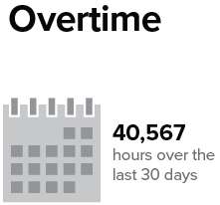
East Tennessee Regional Overtime
Notes:
Talking Points
In the east region, there was a sum of over 40,000 overtime hours paid in a 30-day period.

Slide 59
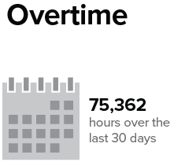
Middle Tennessee Regional Overtime
Notes:
Talking Points
In the middle region, there was a sum of over 75,000 overtime hours paid in a 30-day period.

Slide 60
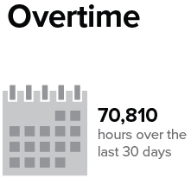
West Tennessee Regional Overtime
Notes:
Talking Points
In the west region, there was a suml of nearly 71,000 overtime hours paid in a 30-day period.

Slide 61
FLS Definition
Direct Support Worker
Frontline Supervisor
50%+ hours spent in direct support tasks (e.g. personal care, home care, community integration)
primary responsibility (50%+ of their role) is supervision of DSWs.
Notes:
Time: FLS Wages section – 4-6 minutes
Talking Points
The next section turns from looking at information related to DSP staffing and compensation to frontline supervisors. We know that FLS are an important reason why DSPs stay in their jobs, and the quality of supervision that DSPs receive from FLS may be a major reason why they stay in or they leave their position. Therefore, knowing the stability of your FLSs can be an important part of the equation for stabilizing your DSP workforce.
As a reminder, FLS are the level of staff whose primary responsibility is to provide supervision to DSPs. While they may provide some direct support, more than 50% of their role is to supervise DSPs.

Slide 62
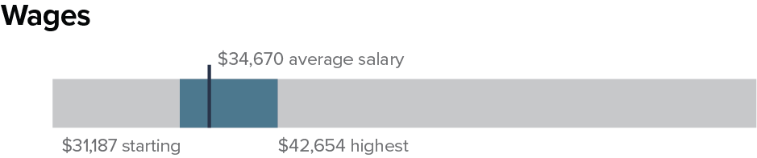
FLS Wages - State
Notes:
Talking Points
For wage data, the survey asked your organization to report annual wage data rather than hourly wage data.
Across the state of Tennessee,
the average starting FLS wage was $31,187 to be exact.
The average FLS salary was $34, 670.
The highest FLS salary was $42,654. You can note these data in your chart in the workbook.

Slide 63
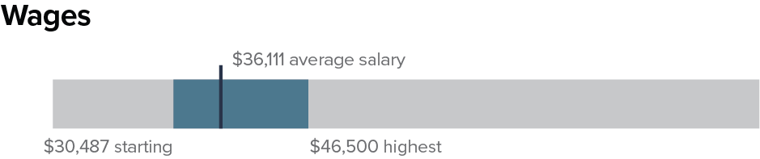
FLS Wages – East
Notes:
Talking Points
In the East region,
the average starting FLS wage was $30,487.
The average FLS salary was $36,111.
The highest FLS salary was $46,500. You can note these data in your chart in the workbook if you provide services in the east region.

Slide 64
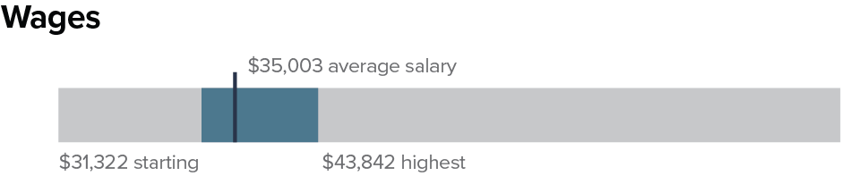
FLS Wages - Middle
Notes:
Talking Points
In the Middle region,
the average starting FLS wage was $31,322.
The average FLS salary was $35,003.
The highest FLS salary was $43,842. You can note these data in your chart in the workbook if you provide services in the middle region.

Slide 65
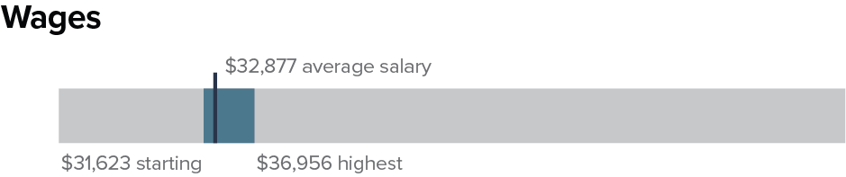
FLS Wages - West
Notes:
Talking Points
In the West region,
the average starting FLS wage was $31,623.
The average FLS salary was $32,877.
The highest FLS salary was $36,956. You can note these data in your chart in the workbook if you provide services in the west region.

Slide 66
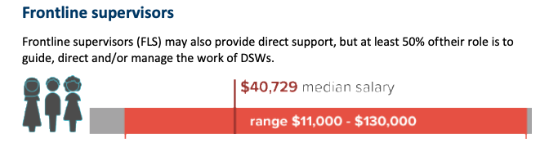
Comparison Info – MN Workforce Project
Pettingell, Kramme & Hewitt, 2019
Notes:
Talking Points
The NCI Staff Stability Survey does not currently ask questions about FLS, so we have included some data from a recent survey of HCBS providers in MN.
The median salary of frontline supervisors who were defined using the same definition as that in the 2019 QuILTSS Initiative survey was $40,729. A median is literally the middle salary reported by the organizations that responded to this survey. The median is often similar to the average. You’ll see that the range of FLS salaries in MN in this year was over a $100,000 difference in average salaries reported! There was a large range reported among FLS in TN, as well. The key idea here is to reflect upon compensation for your FLS and how they are supported in their jobs.

Slide 67
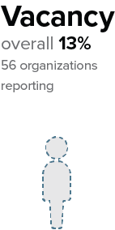
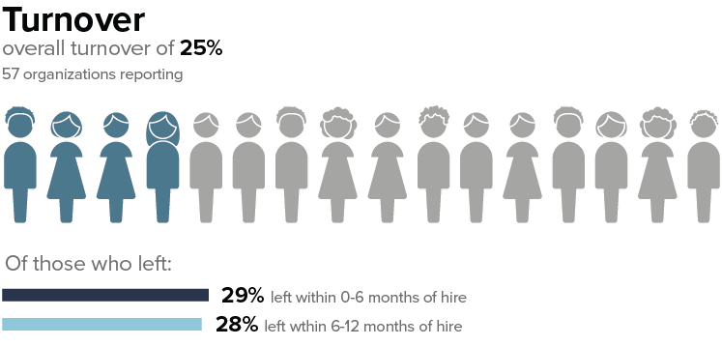
FLS Turnover & Vacancy - State
Notes:
Time: FLS Turnover & Vacancy section – 4-6 minutes
Talking Points
Turnover (or annual crude separation rates) for FLS was calculated in the same way for FLS as they were for DSPs, but just using the data collected from different questions on the survey that asked specifically about FLSs.
For the organizations that reported on FLS, 25% left their positions in the calendar year. You can write this in for the “state” number in the chart.
In the same way that we asked organizations to report on the number of DSPs who left their position who left between 0-6 months tenure and between 6-12 months tenure, we asked organizations to report this information for FLS.
Of the FLS who left in 2019, 29% left within 0-6 months of hire and 28% left within 6-12 months of hire. This indicates that better supports for newly hired FLS may also be needed.
Of the FLS positions in the state, 13% of funded positions were vacant on the last day of 2019.
You can note these data in your workbook now

Slide 68
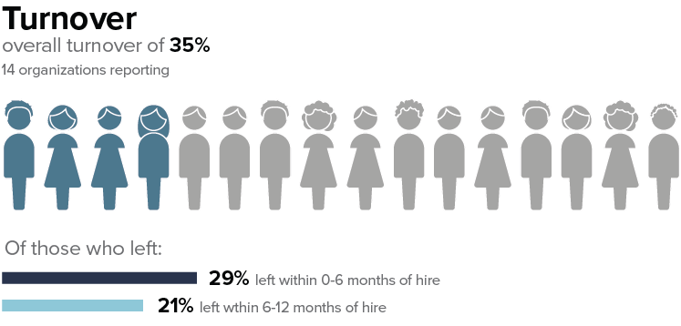
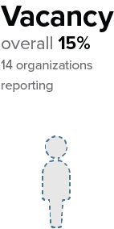
FLS Turnover & Vacancy - East
Notes:
Talking Points
In the east region, for the organizations that reported on FLS,
35% left their positions in the calendar year. You can write this in for the “region” number in the chart if you provide service in the east region.
Of the FLS who left in 2019, 29% left within 0-6 months of hire and
21% left within 6-12 months of hire.
Of the FLS positions in the east region, 15% of funded positions were vacant on the last day of 2019.
You can fill in these numbers to complete the chart in the workbook if you provided services in the east region.

Slide 69
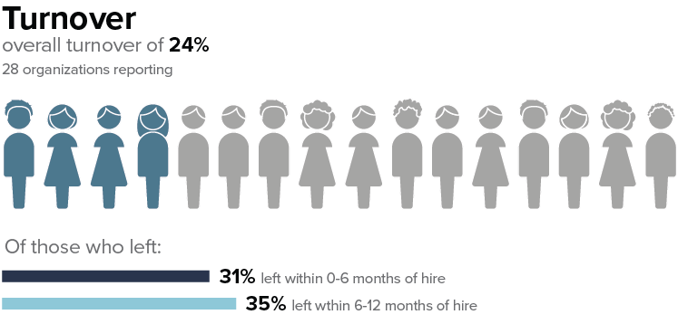
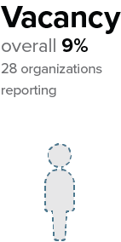
FLS Turnover & Vacancy - Middle
Notes:
Talking Points
In the middle region,
for the organizations that reported on FLS, 24% left their positions in the calendar year. You can write this in for the “region” number in the chart if you provide services in the middle region.
Of the FLS who left in 2019, 31% left within 0-6 months of hire and
35% left within 6-12 months of hire.
Of the FLS positions in the middle region, 9% of funded positions were vacant on the last day of 2019.
You can fill in these numbers to complete the chart in the workbook if you provided service in the middle region.

Slide 70
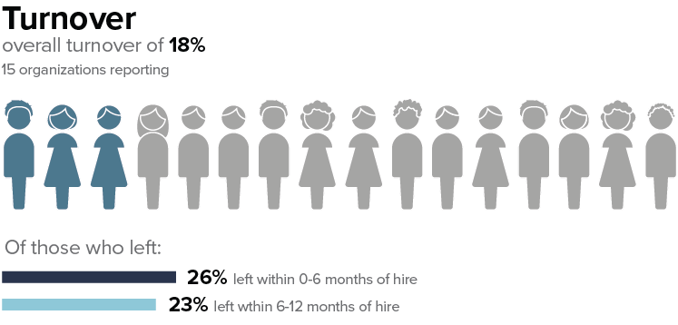

FLS Turnover & Vacancy - West
Notes:
Talking Points
In the west region,
for the organizations that reported on FLS, 18% left their positions in the calendar year. You can write this in for the “region” number in the chart if you provide services in the west region.
Of the FLS who left in 2019, 26% left within 0-6 months of hire and 23% left within 6-12 months of hire.
Of the FLS positions in the middle region, 18% of funded positions were vacant on the last day of 2019.
You can fill in these numbers to complete the chart in the workbook if you provide services in the west region.

Slide 71

Comparison Info - MN Workforce Project
Pettingell, Kramme, & Hewitt, 2019
Notes:
Talking Points
Again, we struggle to find national data sources to compare the FLS turnover data as well. These data are also from the MN Workforce Project and computed using the same formulas for the FLS data in this project.
In MN, there was a 15% annual TO rate among FLS, and 24% left within 6 months of hire. We did not unfortunately ask about turnover between 6-12 months after hire.
9% of the FLS positions were vacant.

Slide 72

Employment and Community First CHOICES Workforce QuILTSS Initiative Survey 2019
Year Two Report
z.umn.edu/tenncare-report-2019
Notes:
Time: Year 2 Survey – Understanding your Data section – 30 minutes (includes breakout groups and large group report back)
Talking Points
You can find the full report on the our Tenncare website. You see the link here on this slide

Slide 73
Which types of data do you already collect?
Retention Trends
Attitudes or Opinions
Performance or Training Standards
Cost and/or Benefits
Notes:
Talking Points
In addition to tracking retention trends, you might collect or want to collect other types of data from your staff or organization about an intervention. You’ll have a chance shortly to think about the types of data you currently collect in your organization that might also provide helpful information about where you’re currently at.
Depending on the type of intervention that you implement, these additional types of data might be essential pieces of evaluation to support its success over time. For example, you might want to survey, or hold focus groups to learn more about staff satisfaction. You might want to collect exit interviews, as possible.
You might already collect important data on performance or training standards that would help inform your efforts, including performance reviews, training needs assessments or job analyses.
Finally, especially important to administration and boards when implementing a new initiative is providing cost and benefits analysis. What is meant by this is keeping track of staff and resources needed to implement an intervention and the cost savings that result. It is estimated that it costs between $3000-5000 to replace each DSP that turns over. An intervention that increases retention can result in exponential cost savings for your organization when it results in staff that stay longer in the job. For example, a credentialing initiative in an organization in another state was relatively resource heavy for the organization. However, the increased skill and retention of those staff has kept the program running over more than a decade of funding cuts and shifts experienced in the organization. It is now viewed as a retention strategy that they cannot afford not to do.
Assessing Attitudes or Opinions
Exit interviews or surveys
New staff survey
Organizational commitment survey
Staff satisfaction survey
Teamwork assessment
Personality or style inventories
Identifying Performance or Training Standards – Mark touches on most of these in the Employee Development (Retention) Webinars
Job description review -
Competency assessments
Inventory of current employee skill
Performance review system
Training needs assessment
Job analysis assessment -
Analyzing Cost and/or Benefit costs
Wage/benefit market analysis
Recruitment and hiring bonuses effectiveness analysis
Recruitment source cost-benefit analysis

Slide 74
Using your data
Baseline
Ongoing monitoring
Periodic Review
Notes:
Talking Points
One note on assessment is to collect information about where you’re currently at – before changing anything about your current practices. This is your “baseline’ measurement.
Plan to measure your progress over time – figure out how frequently it would be helpful to monitor your progress (and remember to be practical). You’ll participate in the annual survey again in January, but you might want to set up a spreadsheet or report with some meaningful data by quarter or month to help your team better understand your progress. We’ll talk more about this when we talk with you about evaluation.
The third component is to set aside time to review your data. Its important to not just collect your data, but to use it to help you inform your efforts. And most importantly, you can use the data you collect to celebrate your successes. Some organizations also like to provide their data for stakeholder and share with others about the successes of their efforts.

Slide 75
Interpreting Your
Organization’s Data
Section by Section Review
Notes:
Talking Points
After this all this data, we wanted to pause for a few minutes to let you take a look at the information presented to start to identify any areas that you might want to target with a strategy to see change over time.

Slide 76
Breakout Conversation
Connecting challenges, data, and information to strategies
  What stands out to you?
  What surprises you?
  What concerns you?
  Who else do you need to talk with in your organization about your workforce data, challenges you’re identifying, and what you’d like to see change?
Notes:
Facilitator note:
Breakout room conversation:
Timing: 15 minutes before the break or this activity can be the first thing after the break depending on timing.
Breakout Time in small group 10 minutes
Breakout groups – 4-5 per group, follow-up similar pattern of splitting MCOs between groups, select someone to take notes and someone to report – can be the same person
Report Out to Large group- 5 minutes
May stay in large group depending on size. If breaking off bring back to have each group report out on what they learned or discovered.
Let people discuss in small groups then share out their group’s discussion with the larger group.
Talking Points
Breakout questions:
Use round robin to make sure everyone responds to this question
What is one thing that stands out to you in your organizational profile?
Remaining questions can be done popcorn style, whoever wants to answer.
What surprises you?
What concerns you?
Who else do you need to talk with in your organization about your workforce data, challenges you’re identifying and what you’d like to see change?
Breakout session facilitators, prompt organizations to take notes in the self assessment workbook of who they want to connect with.
When we return to the large group report out:
What did you hear/learn?
Facilitator note:
Use the Zoom whiteboard take this information down.

Slide 77

Notes:
Facilitator note:
Turn to page 26 in the self-assessment workbook. The title of this page is the “Action Planning Worksheet.”
On this page, you will see several copies of the chart that is pictured on the screen.
In the top box called “Desired outcome #1,” you can jot down ideas from your conversation about what you would like to see changed.
For the present time, you can ignore the rows below this, as we will fill in this information in future sessions in the workshop.
Then, take a xx minute break.

Slide 78
Stretch Break
Take 5 minutes to stretch and refresh
Notes:
Facilitator note: Timing: Break should occur 5 minutes before the start of the second hour of the session.
Talking point
Turn off video and audio when you leave. Turn video back on when you return so we know you are back.

Slide 79
Overview of Implementation Research
Notes:
Time: Overview of Implementation Research section 13 minutes
Talking point
Welcome back.
We will finish you the session today talking about Implementation Research.

Slide 80

Implementation Science
Notes:
Talking point
What is implementation?
Evidence-based practices have been identified!
BUT the effectiveness of the intervention is drastically impacted by the way its implemented.
Implement = Use
[Insert a story]
What we know from research is that implementation matters, and it takes time. If you have tried a strategy in the past, but didn’t have the support, time, or staff to implement you are unlikely to see the changes you hope to see. We will discuss this topic more in the next session but wanted to discuss this briefly here and as we introduce the sections of the self-assessment workbook.

Slide 81





Implementation Stages
Exploration
Installation
Initial Implementation
Full Implementation
Assess need;
Examine fit and feasibility
Assure resources;
Develop supports
Initiate practice; use data to improve supports
Practice is consistent; positive outcomes
Notes:
Facilitor Note: [Slide used with permission from Caryn Ward (Julie Kramme received permission in May 2019).]
Talking point
Implementation is a process, iterative process.
Implementation of a strategy in your organization is a process that takes time and effort, and it is iterative. What that means is that you will likely move along the phases of implementation based on how thing are going in your organization.
Right now, you’re likely here to explore what’s available to you in this project. You likely see areas that need attention in your organization based on the data we just explored. So, what is a good strategy for you to start using to address the strategy. This is the key question of ”exploration.”
When you’ve examined need, fit, and feasibility (which is about how practical it would be to implement this strategy), you attend to “installation.” this means that you make sure you have time, resources, staff, and any other essential items you’d need to start implementing. And it can mean that you start communicating with others about what you’re planning to do. Help them start seeing the need and fit of using this strategy to improve your practices.
Initial implementation is about those first steps you’ll take to implement the strategy. Prior to implementation, you’ll want to make sure you have an evaluation system in place to give you needed feedback about how things are going.
When you’ve been implementing for some time (maybe around 2 years or more), you’ll notice that a successful practice will become more consistent in how you do things. You’ll start seeing the positive outcomes that you’re expecting to see. However, we also know from research that things like staff turnover and lack of support can inhibit practices from reaching full implementation, or it can take longer to reach full implementation.
The key ideas here are about giving a practice time to implement and expect that you may go back and forth between these phases in the ways that things progress. For example, some of our organizations last year recalibrated their process when COVID-19 hit. They needed to adjust their expectations and figure out their priorities as they moved forward.

Slide 82

Active Implementation
Notes:
Facilitor Note: [Slide used with permission from Caryn Ward (Julie Kramme received permission in May 2019).]
Talking Points
We want to acknowledge a body of research that identifies some of the things that we hinted at in the last slide. Active implementation is about identifying an effective practice to implement, and the need to use effective implementation strategies in contexts that encourage and support implementation - all these factors play a role in your team seeing the outcomes improve as you wish.
Effective practices (usable innovations) x effective implementation (Stages, drivers) x enabling contexts (teams, improvement cycles) = improved outcomes

Slide 83
Implementation…
Ensure time and resources are in place – financial and human
Get support from administration and supervisors
Find space
Ensure that equipment and technology resources are in place
Teach staff to implement the innovation – ensure that they are competent before setting them loose
Plan ongoing coaching
Identify how to assess your progress – what data need to be collected?
Check fidelity – how well are you implementing the key ingredients?
Create a training plan - for implementers, administrators, fidelity assessors
Notes:
Talking point
Here are some key components of effective implementation and enabling contexts.
Facilitor Note:
[Here’s additional notes we may or may not want to touch on:]
[Training plan template available on NIRN – key components included
data demonstrating need for training – focus resources on places where greatest need
EBP to be trained – review hexagon tool
hours available for training – how and when it will fit into staff schedules,
trainer qualifications – which KSA should trainers have?
key ingredients – addresses each in the training plan to ensure they are all covered,
outcomes desired – what does the team hope to see as a result of the training? On DSPs, supervisors, people receiving supports, families, other staff?
outcomes measured – how can they determine if they are experiencing improvement? And identify areas that need improvement so that they can correct them? )]

Slide 84
8 Steps for Implementation-Workforce Strategies
Step 4
Step 3
Identify
barriers to implementation
Step 2
Identify components of the strategy
Step 1
Select an intervention strategy
Identify and assess the problem
Larson & Hewitt, 2005
Notes:
Talking point
Consistent with implementation science, reminder that:
We will be using the 8-step framework for implementation of workforce strategies – let’s do a quick overview as we will be revisiting these in more depth in future sessions
Step one is identifying and accessing the workforce challenge that your organization decided to address.
In Step 2 you will select an intervention strategy from the workforce toolkit.
During Step 3 your team will identify the components of the strategy.
Then you will identify barriers to implementing the strategy

Slide 85
8 Steps for Implementation-Workforce Strategies
Step 8
Step 7
Evaluate success
Step 6
Implement
the strategy
Step 5
Set goals,
measure progress & establish a time frame
Identify support for the strategy
Larson & Hewitt, 2005
Notes:
Facilitor Note: Briefly review steps and note that we will be revisiting these in more depth in future sessions
Talking Points
Next will be figuring out the supports that you need and are available to you.
Step 6 is where you will set your goals, based upon what you have learned in step 1-5, while establishing how you will measure your process, and a timeframe.
Then it is time to implement the strategy and using what you decided in Step 6, you will evaluate the success of the strategy.
I know this was brief, but it gives you an idea of how you will prepare for and them implement a strategy.

Slide 86
Workforce Initiative Timeline-Cohort 2
SEPTEMBER 2020 | OCTOBER 2020 | NOVEMBER –DECEMBER 2020 | JANUARY –FEBRUARY 2021 | MARCH–APRIL 2021 | MAY–JULY 2021 | AUGUST 2021 and beyond
Email with 2019 profile, invitation to view pre-kickoff webinar Identify key contacts, potential team members | Kickoff workshops on Understanding your data and Workforce Toolkit overview Start Self-Assessment Workbook Select level of consultation (begins) Start using an action plan | Kickoff workshops Review Assessment results Complete Self-Assessment Workbook View webinars and review toolkit (begins) Confirm organizational readiness (begins) | Organization Level Meetings via Zoom Video Conference or Conference Call Participate in Year 3 2020 Survey (begins) Organization Team implement the strategy (begins) Participate in Regional Community of Practice | Organization Level Meetings via Zoom Video Conference or Conference Call Participate in Regional Community of Practice | Organization Level Meetings via Zoom Video Conference or Conference Call | Participation in Community of Practice Year 3 2020 Survey Results Participate in webinar to review Year 3 – 2020 Survey Organizational Profile
Step 1: Identify and assess the problem
Step 2: Select an Intervention Strategy
Step 3: Identify components of the strategy
Step 4: Identify barriers to Implementation
Step 5: Identify support for the strategy
Step 6: Set goals, measure progress & establish a time frame
Step 7: Implement the strategy
Step 8: Evaluate success
Notes:
Facilitator’s Notes:
This is a slide used to refresh their memory on the timelines
Talking point
Let’s take a look at the Timeline for the Workforce Initiative for the cohort.
In Sept you received your organizations’ profile, along with your region and the state profile.
You were invited to the Kick-off workshops and asked to you to identify two key contacts who would attend the kick-off workshops.
In October – we are starting the Workshops, and you will be introduced to the Self –Assessment Workbook.
You will also begin to consider the level of technical assistance that your organization prefers. You will learn more about this in a bit.
Action plans will be started.
In Nov & Dec. we will continue and wrap up the workshops.
Through-out the workshops you will be completing the self-assessment and reviewing your self assessment. Organizations will be assessing and confirming their readiness.
You will make decisions on the level of technical assistance you want.
During this time you will have access to and can begin to watch the toolkit webinars on Recruitment, Selection and Retention.
From January and February – Organizations who decide to have individual technical assistance will begin consultations. The consultation will be with the Staff from the University of MN and the regional coaches.
Organizations will have the opportunity to participate in the Year 2, 2020 Survey.
The organizations workforce team will decide on and begin to implement a strategy.
There will be a virtual Community of Practice in January that you will be invited to. More to come on that later.
March through July organization will be working on their implementation of their action plan with technical assistance as desired. There will be another community of practice in April.
In August you will receive the Year 3, 2020 survey results for your organization, your region and the state. We will have a webinar about the Year 3 2020 results and you will be invited to continue being supported through the community of practice.
During this year, your organization will be moving through the 8 steps of implementation at your own pace. And with being in the middle of a pandemic, we know that priorities shift according to what is occurring with COVID-19 and the people who accept services from you and the people who provide services.
We will talk more about the 8 steps on the next slide.
This timeline and the 8 steps are included in the Self-Assessment Workbook
Are there any questions?

Slide 87
Likely, not a single solution is needed.
But, a single solution is a place to start.
Notes:
Talking Points
Looking at your data today, and what we know about the workforce from decades of research it is likely that case that there is not a single “silver bullet” solution needed by your organization to solve your workforce issues. However, making an informed decision to implement a strategy with the tools you have can be the first step in improving your practices. You might need to try several strategies over time, but we suggest gathering a team to start with one and we aim to provide you with resources across these sessions to help you get started.

Slide 88
Self-Assessment Workbook
Section 1: Assessment & Using Workforce Data
Notes:
Time: Self-assessment Workbook and What’s next Section – 5 minutes for content ---- plus time for questions.
Talking Points
We are going to move into an activity that you can do in small groups. Turn in your self-assessment workbook to page 6. You’ll get a chance to think about your organization’s current practices and reflect on where you’re at.

Slide 89


Notes:
Talking Points
Section 1 looks like the images on your screen.
Section 1 is about reflecting on the items you already may collect that can be used for assessment of your workforce. This is intended to be a discovery tool to help you explore what you’re already doing and areas where you might want to put some attention as you move forward.
There are ten initial questions that we will lead you through in small groups. You’ll think about what you know you’re currently doing based on the following scale. For each item, you can indicate:
Never evident
Sometimes evident, or
Consistently evident
The difference between sometimes and consistently might be that if the practice is used by some staff or some areas of the organization, you’d rate as “sometimes evident.” If the practice is used consistently by most staff, you’d rate as “consistently evident.” if you don’t know about the practice, rate it is “never evident,” but you put a star next to it and you can ask questions of your colleagues in the next weeks to better understand if someone is doing something with the practice.
This is intended to be a simple tool to help you start thinking about what you’re currently doing.
After you do that, take a few minutes to reflect on what you’ve tried, and what you’ve learned today. If you have time, you can keep working on those reflection questions on page 7.
Facilitor Notes
GO INTO BREAKOUT GROUPS – UMN CONSULTANTS OR COACHES TO FACILITATE. ALLOW PARTICIPANTS TO ASK QUESTIONS AS YOU READ THE ITEMS.
10 minutes: 2-3 minutes for the initial questions, 3-4 minutes for the reflections, 2-3 minutes to share out in small groups.

Slide 90
What’s Next
Session 3: Assessing Your Need: Evidence-based Practices and Organizational Capacity
Homework before our next session:
Review the Organizational Workforce Self-Assessment Workbook
Finish filling out your 2019 Organizational Workforce Data Chart
Check out TN DSP Workforce Toolkit: https://tenncare.ici.umn.edu/
Notes:
Talking Points
Your next Workshop is Session 2 where we will spend time looking the DSP workforce issues together.
Your organizations key contacts should plan to attend this workshop.
You can invite other members of your team to attend any of the upcoming workshops as you like.
We will be meeting on: (insert date and time)
You should have already received a Zoom invitation to this and the other workshops.
If you didn’t please contact us at the email address on the bottom of the screen: dsp-tn@umn.edu
Your homework is:
To complete the Self-Assessment Workbook if you haven’t already
Check out the Workforce website to see what is available to you. This is a rich resource of tools that are not available to you. This website has been developed for Tennessee providers who are involved in this Workforce Initiative, so the website and tools should not be shared with other organizations or individuals who are not a part of this project.

Slide 91
Questions?
You will receive the slides from today’s workshop so that you can have further discussions about the information in this session.
*The slides we share with you will include the data from all regions (East, Middle, West). You can also find the regional profiles on the website.
If you have questions:
Contact your University of Minnesota workforce consultant
Email us at: dsp-tn@umn.edu
Notes:
Facilitator Note: improvised based upon the amount of time left.
Talking Point
We have a little bit of time for questions.
If we don’t have time to answer your questions, please contact your UMN consultant or email us at dsp-tn@umn.edu

Slide 92
Upcoming Kick-off Sessions
Session 3: Assessing Your Need: Evidence-based Practices and Organizational Capacity
Session 4: Overview of TennCare Workforce Toolkit: Recruitment & Selection Strategies
Session 5: Overview of TennCare Workforce Toolkit: Retention Strategies-Part 1
Session 6: Overview of TennCare Workforce Toolkit: Retention Strategies-Part 2
Session 7: Planning Your Next Steps: Measuring Outcomes of Implementation and Creating a Practical Action Plan for Change
Notes:
Facilitator’s Notes:
We can use this slide there is time.

Slide 93
Thank you
See you next week!

