Slide 1
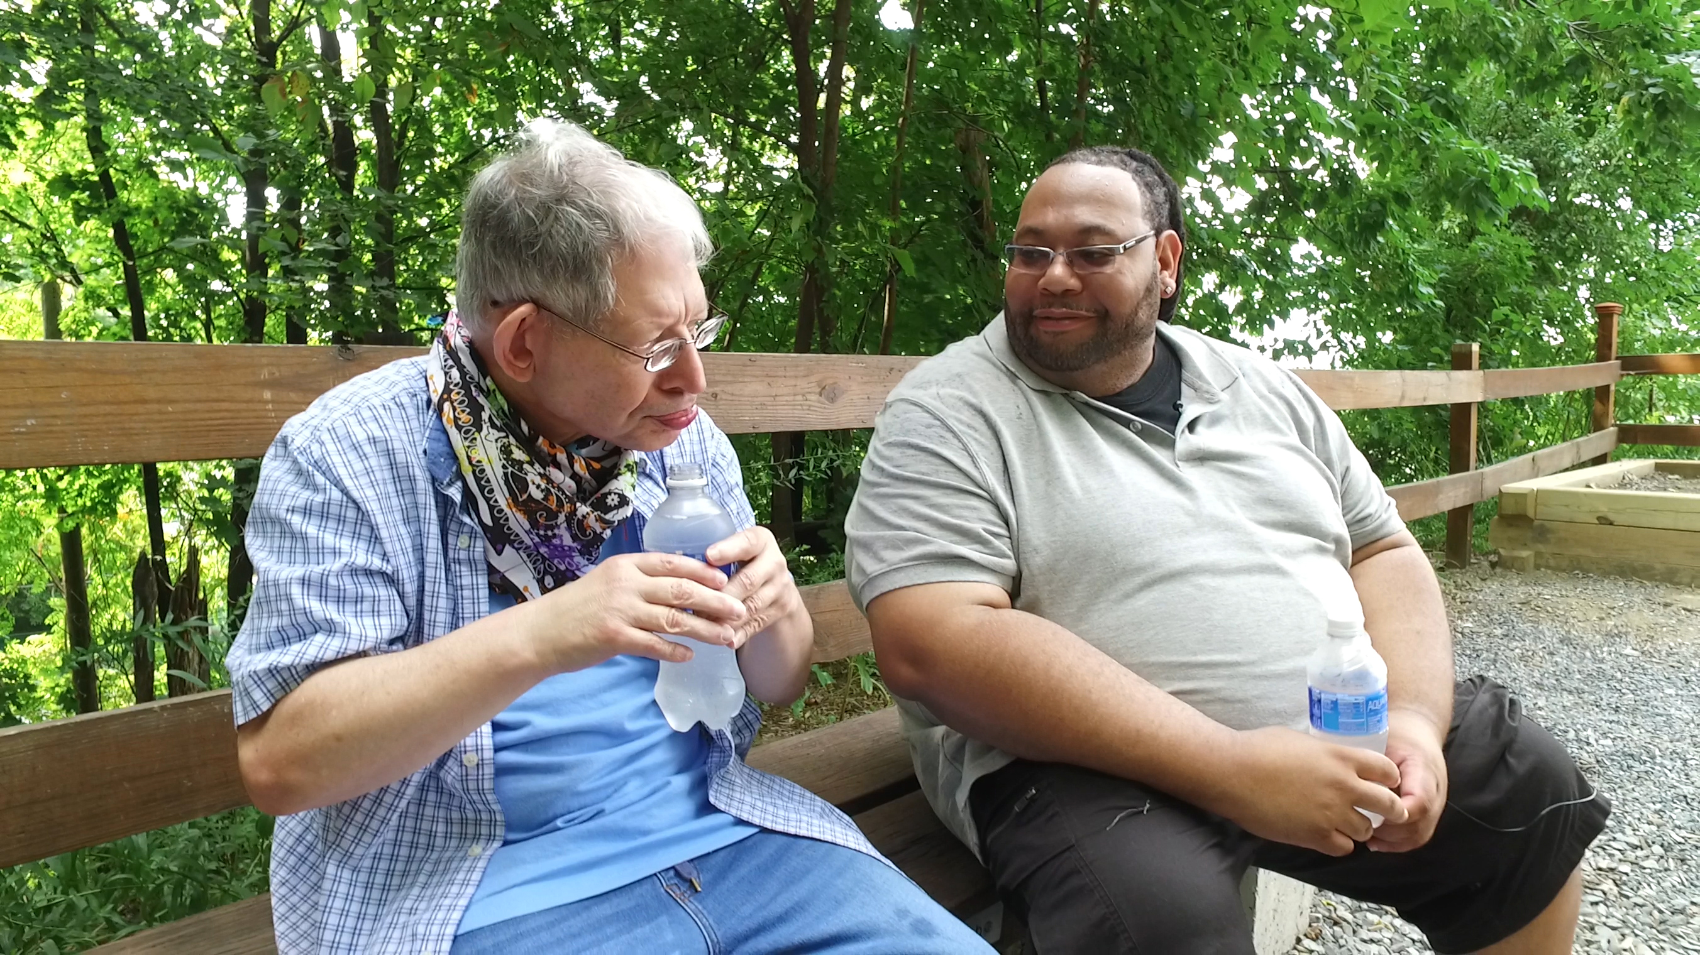
Notes:
Host and Co-host notes for pre-meeting setup
Actions before the session:
Slide #1 – Update presenter names
Hide other region consultant slide, as applicable
Hide other regions workshop slide for Upcoming Workshops, as applicable
In the Practice session before participants log on
Check that the presenter can share their screen and run videos as needed
Check that the presenter marks “Share Computer sounds” and “Optimize Screen sharing for video clip” so that any videos shown can be heard by others – it is on the same screen that you choose which screen to share.
Make Coaches "Co-hosts"
Confirm polls are loaded
Turn on transcript
Break-out Groups
Take attendance
Timekeeper
Host / Welcome people as they arrive & arrive late
Monitor Chat
Turn on record, as desired
Subtitles – turned on, each participant can control turning on and off
At end of presentation:
MAKE SURE TO STOP RECORDING AT THANK YOU SLIDE
Note to Facilitator
Bold Text = Timing
Italicized Text = Notes – do not read
Regular Text = Talking Points

Slide 2

Understanding Your Data and Workforce Strategies
Workshop Series
Presenter's name and affiliation
tenncare.ici.umn.edu
Notes:
Facilitator’s Notes:
Start to Record​
Timing for Intro/Welcome (slides 2-10): 10-15 minutes
Action – Record as desired
Welcome to session # in our QuILTSS Initiative kickoff workshop series.
My name is xx and I am a xx with the Institute on Community Integration at the University of Minnesota. I am here today with my colleagues from the University of MN, __________ and ________________. Also Regional Coaches from Tennessee ____________________ and ___________________.
Thank you so much for joining us today. Today is our final session, and we will be discussing next steps and action plans after learning about all of the tools available to you.
If being recorded: This webinar is currently being recorded. We will send the recording to you if you would like to view again or share with others in your organization.

Slide 3
Welcome to Session 7: Planning Your Next Steps: Measuring Outcomes of Implementation and Creating a Practical Action Plan for Change
Notes:
Talking Points:
The past 6 weeks we have reviewed processes and tools for recruitment, selection, and retention.
Today, we will be talking about next steps, and giving you resources for creation of an action plan. We will also be reviewing the options you have to work in collaboration with us moving forward.

Slide 4
Using Zoom
Your microphones will be muted when enter. Please keep them turned off unless you're speaking.
Name yourself
  First name
  Name of your organization
Use for questions or comments.
We will use “Reactions” such as “thumbs up” though-out the workshop.
Live Script
Camera on as you are able to and comfortable.
Take care of your needs. If you need a break, take one.
Be Understanding of “co-workers”
Chat
Notes:
Talking Points:
Some of us are used to working on Zoom in a group, while others are less familiar.
Please keep your microphone on mute when you’re not speaking today to help reduce background noise. When you’re in breakout groups, feel free to unmute and discuss the topic within your group. If you are able, we’d appreciate it if you keep your video on today. Its important for all of us to be able to see and get to know one another in these meetings. We understand if you need to shut off your video for a few moments if you need to step away, but please turn your video back on when you return.
When you logged into Zoom today, you might have typed in a name for yourself. To help us get to know one another, we ask you to rename yourself with this information on your screen:
Your name, your organization name. If you are a group of people watching from one computer in an organization, you can shorten to first names and your organization name.
To do this, look on the bottom of your screen for participants, click on that and on the right side of your screen a white column will appear. Hoover over your name and two buttons will appear mute and more. Click on more, then click on rename. Rename yourself then click OK.
The Chat function is at the bottom of the page. It looks like a little speaking bubble. If you have a questions or something you want to add to the discussion you can use Chat. We will be monitoring Chat throughout the session.
Using Chat to submit a question, simply click on the button that looks like this in your toolbar.
Please feel free to send questions at any time during the presentation. We will have time at the end for discussion and questions, so you can type them in the chat and we’ll go over them at the end.
When you click on “Participants,” you’ll see some buttons to interact with the presentation. You can say yes, no, go slower, go faster, and when you click on “More” you will find that you can use the thumbs up or thumbs down buttons. You can also let us know if you need to step away for a quick break to use the rest room or fill your coffee cup. Suffering is optional.
When we take breaks, we do ask that everyone turn their camera during the break then turn it back on when you return or use reactions when you return so that we know when we are ready to start again.
Finally, we are all still working from home at the University of Minnesota. Explain “coworkers” you share your space with.

Slide 5
Items to have with you today:
2020 Tennessee Workforce Initiative Organizational Self Assessment Workbook (www.tenncare.ici.umn.edu )
Your organization’s 2019 profile
Notes:
Talking Points:
During today’s session we will be using the 2020 TN Workforce Initiative Organizational Self Assessment Workbook. You will also want to have a copy of your organization’s profile with you for reference.
Do you have your copy with you? If not, take a moment to get it. I’ll ask one of my UMN team member to put the link in the chat for you to download from the TennCare Workforce Toolkit.
Action: Put self assessment workbook link in chat: https://tenncare.ici.umn.edu/dsp-workforce-toolkit/organizational-readiness/tenncare-self-assessment-workbook-and-action-plan

Slide 6
Welcome & Introductions
Notes:
Transition slide

Slide 7
Breakout Group Activity
Getting to Know You
Your name / organization
Your role in the organization today
What is one recent success you’ve had in your organization?
Notes:
Activity: (5 minutes) – 5 people per breakout, each person gets one minute, assign 1 consultant or coach to each breakout group
Purpose: Gives consultants and coaches opportunity to learn who is in the room.
Talking Points:
We are going to have the opportunity to get to know who is in the workshop today. In a moment but not yet, you will be send to a Breakout room with 5-6 others.
Everyone will have the:
Opportunity to introduce your self with your name, your organization and your role in the organization.
And answer the questions on the screen.
What is one recent success you’ve had in your organization?
When you get to your group, find one facilitator and another person to report back for the group the responses to the two questions.
When the group returns call on the reporter from each group to report back on themes for questions #1 and #2.

Slide 8
Goals for this session
Explore the connection between assessment and evaluation
Learn about methods and practices for evaluating success in implementing workforce strategies
Learn about the regional workforce communities of practice that the role of the TN Workforce Coaches and UMN Consultants
Begin to prepare for first meeting with Workforce Consultants and Coaches in January.
Notes:
Talking Points:
During our last session we talked about retention strategies and how workforce strategies can impact the turnover that occurs during the first six months of employment.
For today’s session we’ll look closer at the implementation process to better understand the connection between assessment and evaluation – what will success look like and how will you measure your progress during implementation of the workforce strategy you’ve selected.
We will also share information about the workforce community of practice in each region to support your efforts to improve workforce stability in your organization.
Finally, you’ll have a chance to being to prepare for your first 1:1 meeting with workforce consultants and coaches.
This final session will be more of a working session with time for you to reflect on where you’re headed.

Slide 9
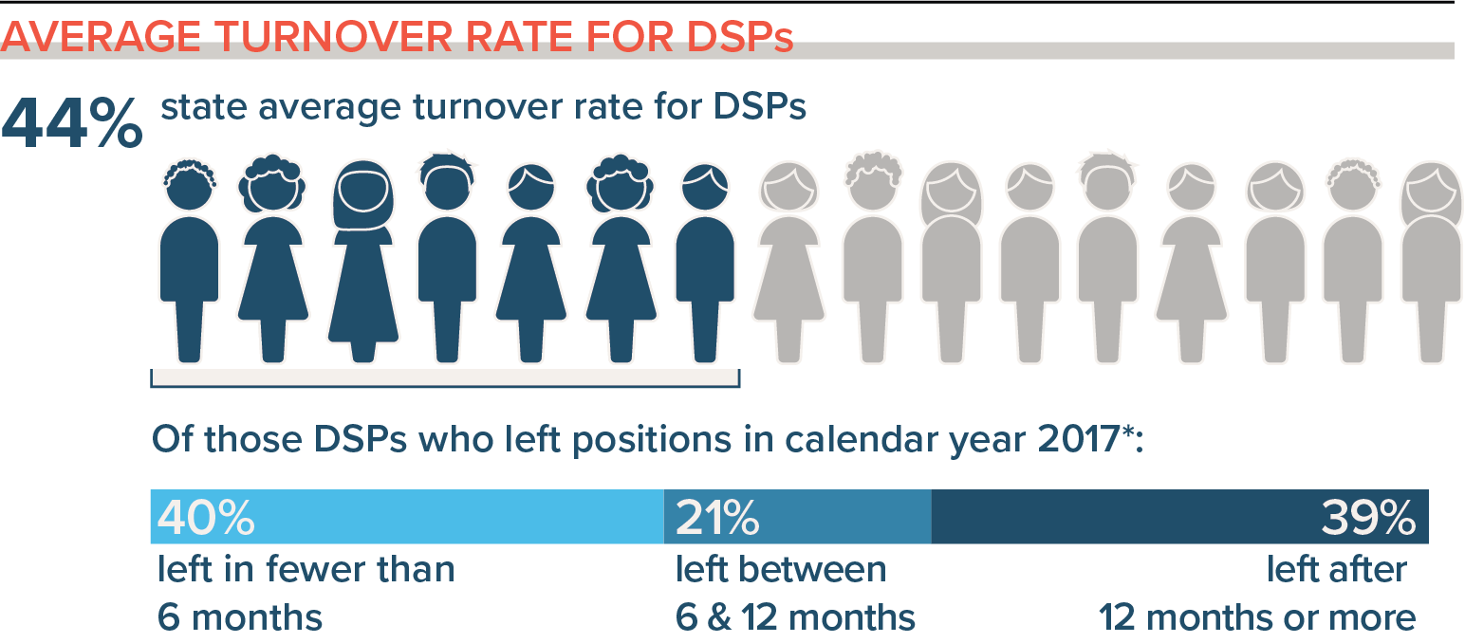
Implementing a Workforce Strategy
Connecting strategies with the data
Notes:
We’ve spent this kickoff workshop looking at your profile, looking at your turnover for DSPs and the tools you can use to improve your recruitment, retention, and selection.

Slide 10
Common Organizational Challenges
Finding qualified employees
Employees do not understand their job roles
Employees quit within a few weeks
or months
(significant effort must be spent to replace them).
Employees don’t have access to timely training
Training is not
effective
Employees display
poor job skills
Employees do not
get along with each other or the people they support
There is conflict between employees
and supervisors or employers
Low employee
morale
Wages or benefits don’t meet the needs of
employees
Lack of employee engagement
Notes:
Talking Points:
From an organizational perspective, we hear the challenges listed on your screen from many organizations.
Note to facilitators: Use what you have heard in past region meetings to give examples.
There may be additional challenges you are experiencing related the location of your organization, or other things. One aim of this webinar is to help you define a challenge that you can address in your efforts to implement person-centered positive supports in your organization. We will revisit this slide later.

Slide 11
Review of Intervention Strategies
Step 2 – Select an Intervention Strategy
Notes:
Timing for section (slides 11-12): 2 minutes
Let’s move into step 2: selecting an intervention strategy

Slide 12
Building & Strengthening the DSP Workforce
Recruitment Strategies | Selection Strategies | Retention Strategies
Effective Marketing Public service announcements (PSA) Targeted marketing Recruitment and hiring bonuses Recruitments sources | Structured behavioral interviews Realistic job preview | Orientation and onboarding Competency-based training Employee Development Job Analysis Job Descriptions Recognition Programs Coaching & Mentoring Mentoring Performance coaching Networking Employee Engagement & Organizational Participation Professional Development Developing career paths Professionalizing DSP roles Wage and Benefit Policy Change
Notes:
Talking Points:
Throughout our kickoff sessions, we covered strategies in the areas of Recruitment, Selection, and Retention
More details and information on these strategies are all in the TN workforce toolkit at tenncare.ici.umn.edu.
Facilitator note: You may add additional scripting as desired.

Slide 13
Creating A Practical Action Plan for Change In Your Organization
Step 6 - Set goals, measure progress & establish a time frame
Step 7 – Implement the strategy
Notes:
Timing for section (slides 13-18): 8 minutes
Talking Points:
When you’re thinking about steps 6 and 7, where you plan for and implement the strategy you choose, it may be intimidating. You can work in consultation with UMN team members to implement your strategy to make a plan of action for evidence-based practice.
It’s important at this point that you have a vision of the change you want to see, but short-term and long-term change. These will both look different.
Consider how you are going to ensure staff buy-in and feasibility for implementation.

Slide 14
Organization Self-Assessment Workbook
Pages: 26 – 27
Action Planning Worksheet
Notes:
Talking Points:
The action planning worksheet can be used to develop your strategies and divide the work among your team. You may already have a strategic plan, but the action planning worksheet will provide a more detailed plan for you to implement with your team.

Slide 15
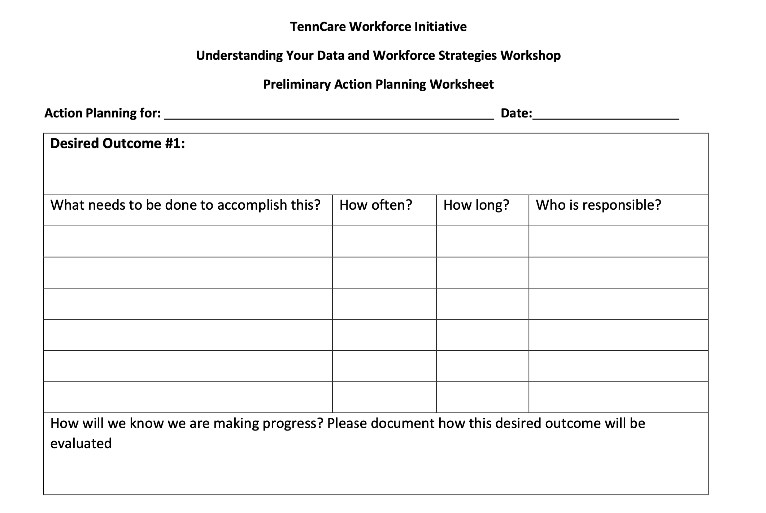
Notes:
Note to facilitators: Give time to fill out each part of this slide (2 min/slide). Come up with your own “desired outcome” (example: improve orientation and onboarding to reduce 6 month turnover).
Talking Points:
How many of you are starting to think about action plans? You may already have a similar planning process within your organization that you will use. For others, using the action planning worksheet on page 26-27 may be a way to bring focus to some of your current and future workforce activities.
Explain the sheet and that we will be working through it together. First, identify what the strategy is and the desired outcome. Page 24 in the self assessment workbook can give inspiration or ideas for desired outcomes.

Slide 16
Notes:
Talking Points:
Now we have time to answer the following questions:
What steps will need to be done to accomplish the outcome?
How often or when will you start the working on that step?
How long will it take?
Who will be responsible for it?

Slide 17
Notes:
Now, how will you know you are making progress? This is where you think about measuring the desired outcomes that you want as a result of the strategy you chose.
If you aren’t sure how to measure your outcomes, we will be talking more about this later today

Slide 18
Notes:
Talking Points:
This action plan is a good start for any plan to help you move forward in implementing a strategy.

Slide 19
Connecting Assessment and Evaluation
Step 1: Identify and Assess the Problem
Step 8: Evaluate Success
Notes:
Timing for section (slides 19-25): 13 minutes
Talking Points:
Regular assessment will provide information about your workforce, and evaluation can determine the quality or effectiveness of your strategy. You may already be collecting workforce data. In Assessment and Evaluation, you can use that data to find out if your intervention is working, or if it would be worth trying a different strategy.

Slide 20
8 Steps for Implementation - Workforce Strategies
Step 4
Step 3
Identify
barriers to implementation
Step 2
Identify components of the strategy
Step 1
Select an intervention strategy
Identify and assess the problem
Larson & Hewitt, 2005
Notes:
Talking Points:
You’ve seen this set of slides every week – but right now we’re focusing on steps 1, identifying and assessing the problem…

Slide 21
8 Steps for Implementation - Workforce Strategies
Step 8
Step 7
Evaluate success
Step 6
Implement
the strategy
Step 5
Set goals,
measure progress & establish a time frame
Identify support for the strategy
Larson & Hewitt, 2005
Notes:
Talking Points:
…and step 8, evaluating success. Both are key to measuring your problems and evaluating your successes.

Slide 22
Poll Question #1
What workforce assessments have you tried?
  Staff satisfaction survey
  New staff survey
  Exit interviews or surveys
  Training needs assessment (new hires)
  Inventory of current employee skills
  Competency assessments
  Organizational commitment survey
  Team work assessment
  Supervisor training needs assessment
  Personality or style inventories
Notes:
Poll
Let’s take a quick poll. - you can pick multiple answers. Your answer are anonymous. Read slide.
In debrief poll, review results.
Ask: Anything surprise or jump out at you – spend no more than 3 minutes on this-watch/resist the deep dive conversation

Slide 23
Assessing Workforce Challenges
Problem and Assessment Guide workbook page 23
Identified Problem | Assessment Area
Trouble finding new employees Difficulties recruiting qualified direct support professionals | Recruitment source cost-benefit analysis Vacancy rates Wage/benefit market analysis Recruitment and hiring bonuses effectiveness analysis
New hires quit in the first six months Constantly hiring new employees to replace those who have left | Tenure of leavers Tenure of current employees Turnover rates Staff satisfaction survey New staff survey Exit interviews or surveys
New employees are unsure of job roles and functions | Job description review Training needs assessment (new hires)
Difficulty finding training that addresses the skills needed by employees | Training needs assessment Inventory of current employee skills
Poor performance Training doesn’t produce desired results | Competency assessments Performance review system
Morale problems | Staff satisfaction survey Organizational commitment survey
Conflict between staff and supervisors or managers Employees complain about their supervisor | Team work assessment Supervisor training needs assessment Staff satisfaction survey
Co-workers don’t get along | Team work assessment Staff satisfaction survey Personality or style inventories
Long-term staff are dissatisfied or quit the organization | Staff satisfaction survey Training needs assessment Exit interview or surveys
Step 1 Identify and assess
Notes:
Talking Points:
Page 23 of your workbook will help determine measurement areas for workforce challenges.
You can see on this page how challenges are clearly connected to assessment strategies.

Slide 24
Poll Question #2
Which area(s) do you want to assess when faced with the following two challenges:
  New hires quit in first six months.
  Constantly hiring new employees to replace those who have just left.
Choose all the apply:
  Tenure of leavers
  Tenure of current employees
  Job description review
  Staff satisfaction survey
  Competency assessments
  Exit interviews or surveys
Notes:
Talking Points:
Read slide and allow time for responses, hinting that page 23 will give them the answer if they’re unsure.
ANSWERS = A,B, D, F

Slide 25
Poll Question #3
Which area(s) do you want to assess when faced with the following two challenges:
    Poor Performance
    Training doesn’t produce results
Choose all the apply:
    Competency assessments
    Teamwork assessment
    Performance review system
    Exit interviews or surveys
    Vacancy rates
    Turnover rates
Notes:
Talking Points:
Read slide and allow time for responses, hinting that page 23 will give them the answer if they’re unsure.
ANSWERS = A,C

Slide 26
Evaluating Success
Workbook Section 6: Evaluation Practices
Notes:
Timing for section (slides 26-29): 11 minutes
Talking Points:
Let’s talk about how to evaluate. It’s important to see what assessment tools you already have in place that you can also use to evaluate progress.
Evaluating any implemented workforce strategy is essential to ensure the efficacy of your efforts. It provides needed feedback for your implementation team about your progress toward the desired outcome we discussed earlier. Collecting baseline information that is useful for informing your efforts and regularly collecting and reflecting as a team upon information related to your progress is needed. This practice will help you determine when you need additional supports, to shift directions, or to stay the course so that you can remain on track to achieve your goals.

Slide 27
Notes:
Talking Points:
On page 16 of your Self-Assessment workbook we ask you to examine your current evaluation practices. It looks like the images on your screen
Section 6 is about reflecting on the organizational practices and processes that can support your evaluation efforts and processes you may already have in place.
This is intended to be a simple tool to help you start thinking about what you’re currently doing.
Optional activity: read each statement and give time for providers to fill out form.

Slide 28
Breakout Conversation
Reflecting on Your Organization’s Evaluation Practices
What evaluation practices does your organization currently use?
  What were you pleased about?
  What have you learned?
  What are you concerned about?
Based on this information, what is one next step you might consider?
Notes:
Note to facilitators: Give time for reflection/recording in the workbook before jumping into discussion
Activity: (5 minutes) – 5 people per breakout, each person gets one minute, assign 1 consultant or coach to each breakout group
Purpose: Gives consultants and coaches opportunity to learn who is in the room.
Talking Points:
We are going to have the opportunity to get to know who is in the workshop today. In a moment but not yet, you will be send to a Breakout room with 5-6 others.
Everyone will have the opportunity to answer these questions on the slide (put questions into chat so that they have access during breakout)
When you get to your group, find one facilitator and another person to report back for the group the responses to the two questions.
When the group returns call on the reporter from each group to report back on themes for questions #1 and #2.

Slide 29
Notes:
Talking Points:
When you have your evaluation methods to measure your progress, you can fill that in on your action planning sheet on page 26-27 if you haven’t already.

Slide 30
Stretch Break
Take 5 minutes to stretch and refresh
Notes:
Talking Points:
Turn off video and audio when you leave. Turn video back on when you return so we know you are back.
To check in with folks who don’t have their video on, ask for reactions

Slide 31

Notes:
Timing for section (slides 31-36): 7-15 minutes (depending on optional activity)
Talking Points:
After pulling everything from the last 7 sessions together, it might be hard to determine next steps and may feel like the road has given out. We are looking forward to working with each of you one-on-one to determine the new road ahead.

Slide 32

tenncare.ici.umn.edu
Notes:
Talking Points:
When one road washes out, we pause, look at our map and then find a new route to our destination. If I’m using my handy GPS there would likely be several prompts to make a U-turn at the next light to resume original route, but eventually even the GPS person gives up and maps out a new route to my destination.
Some things to consider during your process:
Planning takes more time than you think.
Learning curves are a real thing!
New training environments/platforms requires learning new technical skills.
Connecting in a virtual environment can work.
Everything takes 3 times longer than what we think.
Communication and reminder prompts work

Slide 33
Moving Towards Improvement
Reflections for Improvement Activity
Notes:
Talking Points:
Transition slide
It’s important to keep everything we’ve discussed today in mind for your plan to move towards improvement.

Slide 34
Questions to consider
Organizational Self-Assessment Workbook page 18
What area(s) of workforce development seem to already be very strong at this organization? Name 2-3 best practices in workforce development that they’re currently using and want to keep strong. Identify specific commitments they will need to make to keep these successful strategies going strong into the future.
What area(s) seem to need the most improvement in order to address workforce challenges? Identify 2-3 strategies you might want to propose to make improvements in this area?
How will you know this organization is making improvements? What outcomes would you expect to see if they implemented the strategies identified?
Notes:
Talking Points:
During the past kickoff sessions, we’ve discussed different strategies and techniques for recruitment, selection, and retention. You’ve worked through most of the self-assessment workbook and have developed a very thorough knowledge of what you’re doing well and areas for improvement.
Use these questions to reflect upon everything you’ve learned and discussed so far, on page 18 of your SAW.
Note for facilitators: Give time for folks to fill out self assessment workbook, then have discussion around these questions.

Slide 35
Poll Question #4
Which step is your organization at for implementing workforce strategies?
Step 1: Identify and assess the problem
Step 2: Select an intervention strategy
Step 3: Identify components of the strategy
Step 4: Identify barriers to implementation
Step 5: Identify support for the strategy
Step 6: Set goals, measure progress & establish a time frame
Step 7: Implement the strategy
Step 8: Evaluate success
Notes:
Poll
Let’s take a quick poll. - you can pick multiple answers. Your answer are anonymous. Read slide.
In debrief poll, review results.
Ask: Anything surprise or jump out at you – spend no more than 3 minutes on this-watch/resist the deep dive conversation

Slide 36
Breakout Conversation
What problem/challenge does this organization need to address?
How big is the challenge? What is the baseline level of performance regarding this challenge?
What strategy would you propose to address this challenge?
What are the major components of this strategy:
  Who will be involved?
  What are the steps needed to implement?
  What are the possible costs associated with this strategy?
What are the main barriers to using this strategy?
What will be needed to enlist the support of stakeholders?
How will progress be monitored? What are the timelines?
How will the organization assess whether the strategy worked?
Larson & Hewitt, 2015
Notes:
Talking Points:
If time, do breakout to answer these questions. Otherwise, talk through them before moving on. Use an example if you can think of one.
Many of these questions we have discussed before. These are all important questions to consider when planning for implementation. They will help you address any barriers you may have and plan for success.

Slide 37
Your Next Steps
Notes:
Conclusion Sides timing (slides 37-49): 8 minutes
Transition slide
Talking Points:
We will talk about your next steps and how we are able to support you.

Slide 38
Workforce Initiative Timeline-Cohort 2
SEPTEMBER 2020 | OCTOBER 2020 | NOVEMBER –DECEMBER 2020 | JANUARY – FEBRUARY 2021 | MARCH–APRIL 2021 | MAY–JULY 2021 | AUGUST 2021 and beyond
Email with 2019 profile, invitation to view pre-kickoff webinar Identify key contacts, potential team members | Kickoff workshops on Understanding your data and Workforce Toolkit overview Start Self-Assessment Workbook Select level of consultation (begins) Start using an action plan | Kickoff workshops Review Assessment results Complete Self-Assessment Workbook View webinars and review toolkit (begins) Confirm organizational readiness (begins) | Organization Level Meetings via Zoom Video Conference or Conference Call Participate in Year 3 2020 Survey (begins) Organization Team implement the strategy (begins) Participate in Regional Community of Practice | Organization Level Meetings via Zoom Video Conference or Conference Call Participate in Regional Community of Practice | Organization Level Meetings via Zoom Video Conference or Conference Call | Participation in Community of Practice Year 3 2020 Survey Results Participate in webinar to review Year 3 – 2020 Survey Organizational Profile
Step 1: Identify and assess the problem
Step 2: Select an Intervention Strategy
Step 3: Identify components of the strategy
Step 4: Identify barriers to Implementation
Step 5: Identify support for the strategy
Step 6: Set goals, measure progress & establish a time frame
Step 7: Implement the strategy
Step 8: Evaluate success
Notes:
Talking Points:
Timeline slide to refresh memory. Summarize timeline and where we are in the timeline, assert that orgs may each be at different points, which is why the steps are overlapping.
Are there any questions?

Slide 39
Preparing for Your First Workforce Consultation Session
Identify who will be part of your workforce team
Complete Tenncare TA Options form
Complete your Online Organizational Workforce Self-Assessment
Schedule your first monthly meeting with your workforce consultants
Check out Workforce Strategies and Tools on TN DSP Workforce Toolkit: https://tenncare.ici.umn.edu/
Notes:
Talking Points:
When you’re thinking about the next steps, these are some of the things we ask you to complete and work on so that the coaches/consultants can work with you through consultation. We’ll review them now.

Slide 40
Organization Self-Assessment Workbook
Purpose:
To identify areas of strengths and areas of needed improvement in your respective organizations to build capacity to address direct support workforce issues.
z.umn.edu/TennCareSelfAssessment
Please submit online using this link by the end of session 7. There will be time during session 7 to submit.
Notes:
Talking Points:
The self-assessment workbook was intended to be an important discovery tool for your team to understand your areas of strength and areas for growth. This information is intended to help you and your consultant team to understand your priorities and needs. During the kickoff workshop, we have completed most of the workbook together.
The link on the screen is a place for your team to enter the information to provide you with an electronic record and to communicate with your consultants. Please complete the online self assessment workbook and submit using the link by the end of the Kickoff Workshop session 7.

Slide 41
Menu of Technical Assistance
Please complete by the end of session 7 z.umn.edu/TennCareTAOptions
Option C
Access to online Tennessee Workforce Toolkit
Option B
Consultation from U of M workforce consultants upon request
Option A
Regular monthly individualized consultation with U of M workforce consultants and TN Regional Coaches
Access to online Tennessee Workforce Toolkit
Option to participate in Regional Workforce Community of Practice
Access to online Tennessee Workforce Toolkit
Option to participate in Regional Workforce Community of Practice
Option to participate in Regional Workforce Community of Practice
Notes:
Talking Points:
As we have discussed throughout the Kickoff Workshop, there are opportunities to continue the conversation by accessing resources related to this project after the workshop is finished. There are three options that your organization can choose from.
All the options include access to the online TN Workforce Toolkit and the option to participation in the Regional Workforce Community of Practice. Option C includes these items.
Option B gives you access to consultation from UMN workforce consultants (that’s us) upon request. That means that you can reach out to consultants to schedule a phone call or virtual meeting as desired.
In Option A, you can receive monthly individualized consultation with UMN Workforce Consultants to help you move through selecting, implementing and evaluating the strategy you choose.
Please complete the survey for your organization by the end of today. Consult with your organization to determine the level of technical assistance that is best for your team. You can change the level of Technical Assistance that you would like to receive at any time during the consultation year by emailing your consultant or dsp-tn@umn.edu.

Slide 42
Supporting Your Success
Notes:
Talking Points:
We have focused on change and growth in these kickoff workshops. However, we also acknowledge the importance of celebrating what you have learned, tried, and what has been successful! We have created opportunity to celebrate your successes and be kept up-to-date on what’s going on in the Tennessee DSW through Communities of Practice.

Slide 43



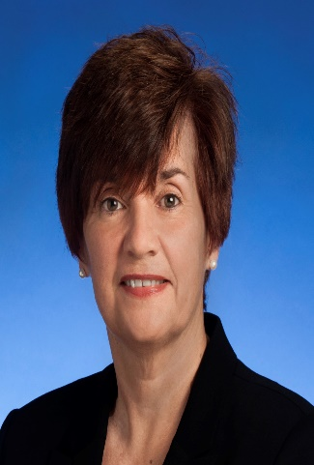


Your East Tennessee Consultants & Coaches
Dakota Luna
Megan Sanders
Mark Olson
Robin Wilmoth
Dana Scott
Nichelle Johnson
Notes:
Talking Points:
As a reminder, these are your East Tennessee Consultants and Coaches.
For organizations who are going to participate in individual consultation, we are available for monthly meetings at your convenience. We will also be leading the East Community of Practice.

Slide 44


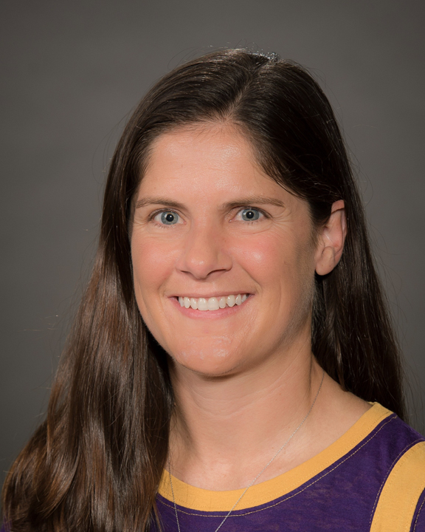


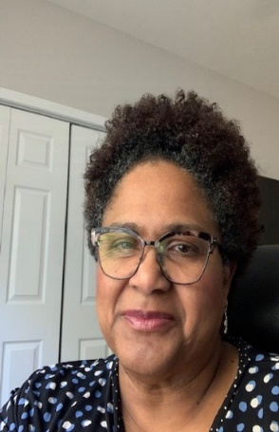
Your Middle Tennessee Consultants & Coaches
Beulah Brooks
Claire Benway
Sarah Hall
Joy Dalton
Faith Franklin
Linda Carpenter
Notes:
Talking Points:
As a reminder, these are your Middle Tennessee Consultants and Coaches.
For organizations who are going to participate in individual consultation, we are available for monthly meetings at your convenience. We will also be leading the Middle Community of Practice.

Slide 45





Your West Tennessee Consultants & Coaches
Ashante Hodges
Julie Kramme
Chet Tschetter​
Victoria Burgess
Erica Hurd
Notes:
Talking Points:
As a reminder, these are your West Tennessee Consultants and Coaches.
For organizations who are going to participate in individual consultation, we are available for monthly meetings at your convenience. We will also be leading the West Community of Practice.

Slide 46

Tennessee Regional Community of Practice
Purpose:
To continue to support the ongoing development, implementation and evaluation of workforce strategies that improve workforce stability across the state of Tennessee at the organizational, regional and state levels.
Notes:
Talking Points:
Read purpose of COP on slide.

Slide 47
Supporting a Community of Practice for
DSP Workforce
U of M Technical Consultation
Workforce Coach Technical Consultation
DSP Workforce Community of Practice
Survey & Toolkit of Strategies
Notes:
Talking Points:
We provide technical assistance, but the COP is a way to continue reflecting on your strategies even after we complete technical assistance. It gives time for you to work with ther organizations and find out what is working and not working for them.

Slide 48
2020-2021 Regional Community of Practice Schedule
Regional Community of Practice Kick-off Sessions with Cohort 1
  East – September 29, 2020 10:00 am-12:00 pm (Central Time)
  Middle – October 1, 2020 1:00-3:00 pm (Eastern Time)
  West - September 30, 2020 10:00 am-12:00 pm (Central Time)
Regional Community of Practice sessions to be scheduled in 2021
  January
  April/May – Tentative In-person meetings, if travel allowed
  July
  October
Notes:
Talking Points:
Our first COP for you to participate in is…read slide.
Later dates are not yet scheduled due to the nature of the pandemic, but COPs will occur on a quarterly basis in these months (read months)

Slide 49

Community of Practice-Sample Agenda
Welcome/Opening Round
Regional Workforce Updates
Organization Sharing-Facilitated Conversation
  What strategies have you tried?
  What did you like?
  What did you learn?
  What concerns do you have?
  Based on what you’ve shared, what are next steps your organization might take?
Topic for Discussion
Celebration/Recognition of Workforce Successes
Wrap up/Next Meeting
Notes:
Talking Points:
This is an example of a COP agenda to give you an idea of what we will be talking about during the two hours.

Slide 50

z.umn.edu/dsp-covid19-survey
Notes:
Talking Points:
Note to facilitator: this survey is now closed; replace this slide with any other TN/national opportunities around the DSP workforce.

Slide 51
Questions about What We Covered Today?
You will receive the slides from today’s workshop so that you can have further discussions about the information in this session.
If you have questions:
Contact your University of Minnesota workforce consultant
Email us at: dsp-tn@umn.edu
If you haven’t provided us with your Key Contacts please do
at: https://z.umn.edu/C2KeyContacts
Notes:
Facilitator Note: improvised based upon the amount of time left. Take questions if time, otherwise give contact info. Need 2 minutes for the last slides.

Slide 52
Kickoff Workshop Evaluation
Please share about your experience:
Type in your browser:
z.umn.edu/TennCareKickoffEvaluation
Notes:
Talking Points:
Please take a minute to share with us about your experiences and any recommendations for the Kickoff Workshop. This will help us understand what was helpful to you as well as ways we can improve the experience in the future.
Type the text into your browser and complete the survey there.

Slide 53
Thank you
We look forward to connecting with you in January!
Notes:
Thank you and goodbyes – reminder to see them in consultation/at COP.

