Slide 1
MIHEC Learning Community Event October 10, 2023

Slide 2
Land Acknowledgement
In Minnesota, we are standing on Miní Sóta Makhóčhe, the rightful homelands of the four Dakhóta Oyáte nations, the seven Anishinaabeg nations, and other indigenous peoples. We recognize that the U.S. did not uphold its end of the land treaties. It is the current and continued displacement of indigenous peoples that allows the State of Minnesota to exist today.

Slide 3
Affirmation of Commitment
At the Institute on Community Integration, we affirm our commitment to address systemic racism, ableism, and all other inequalities and forms of oppression to ensure inclusive communities.

Slide 4
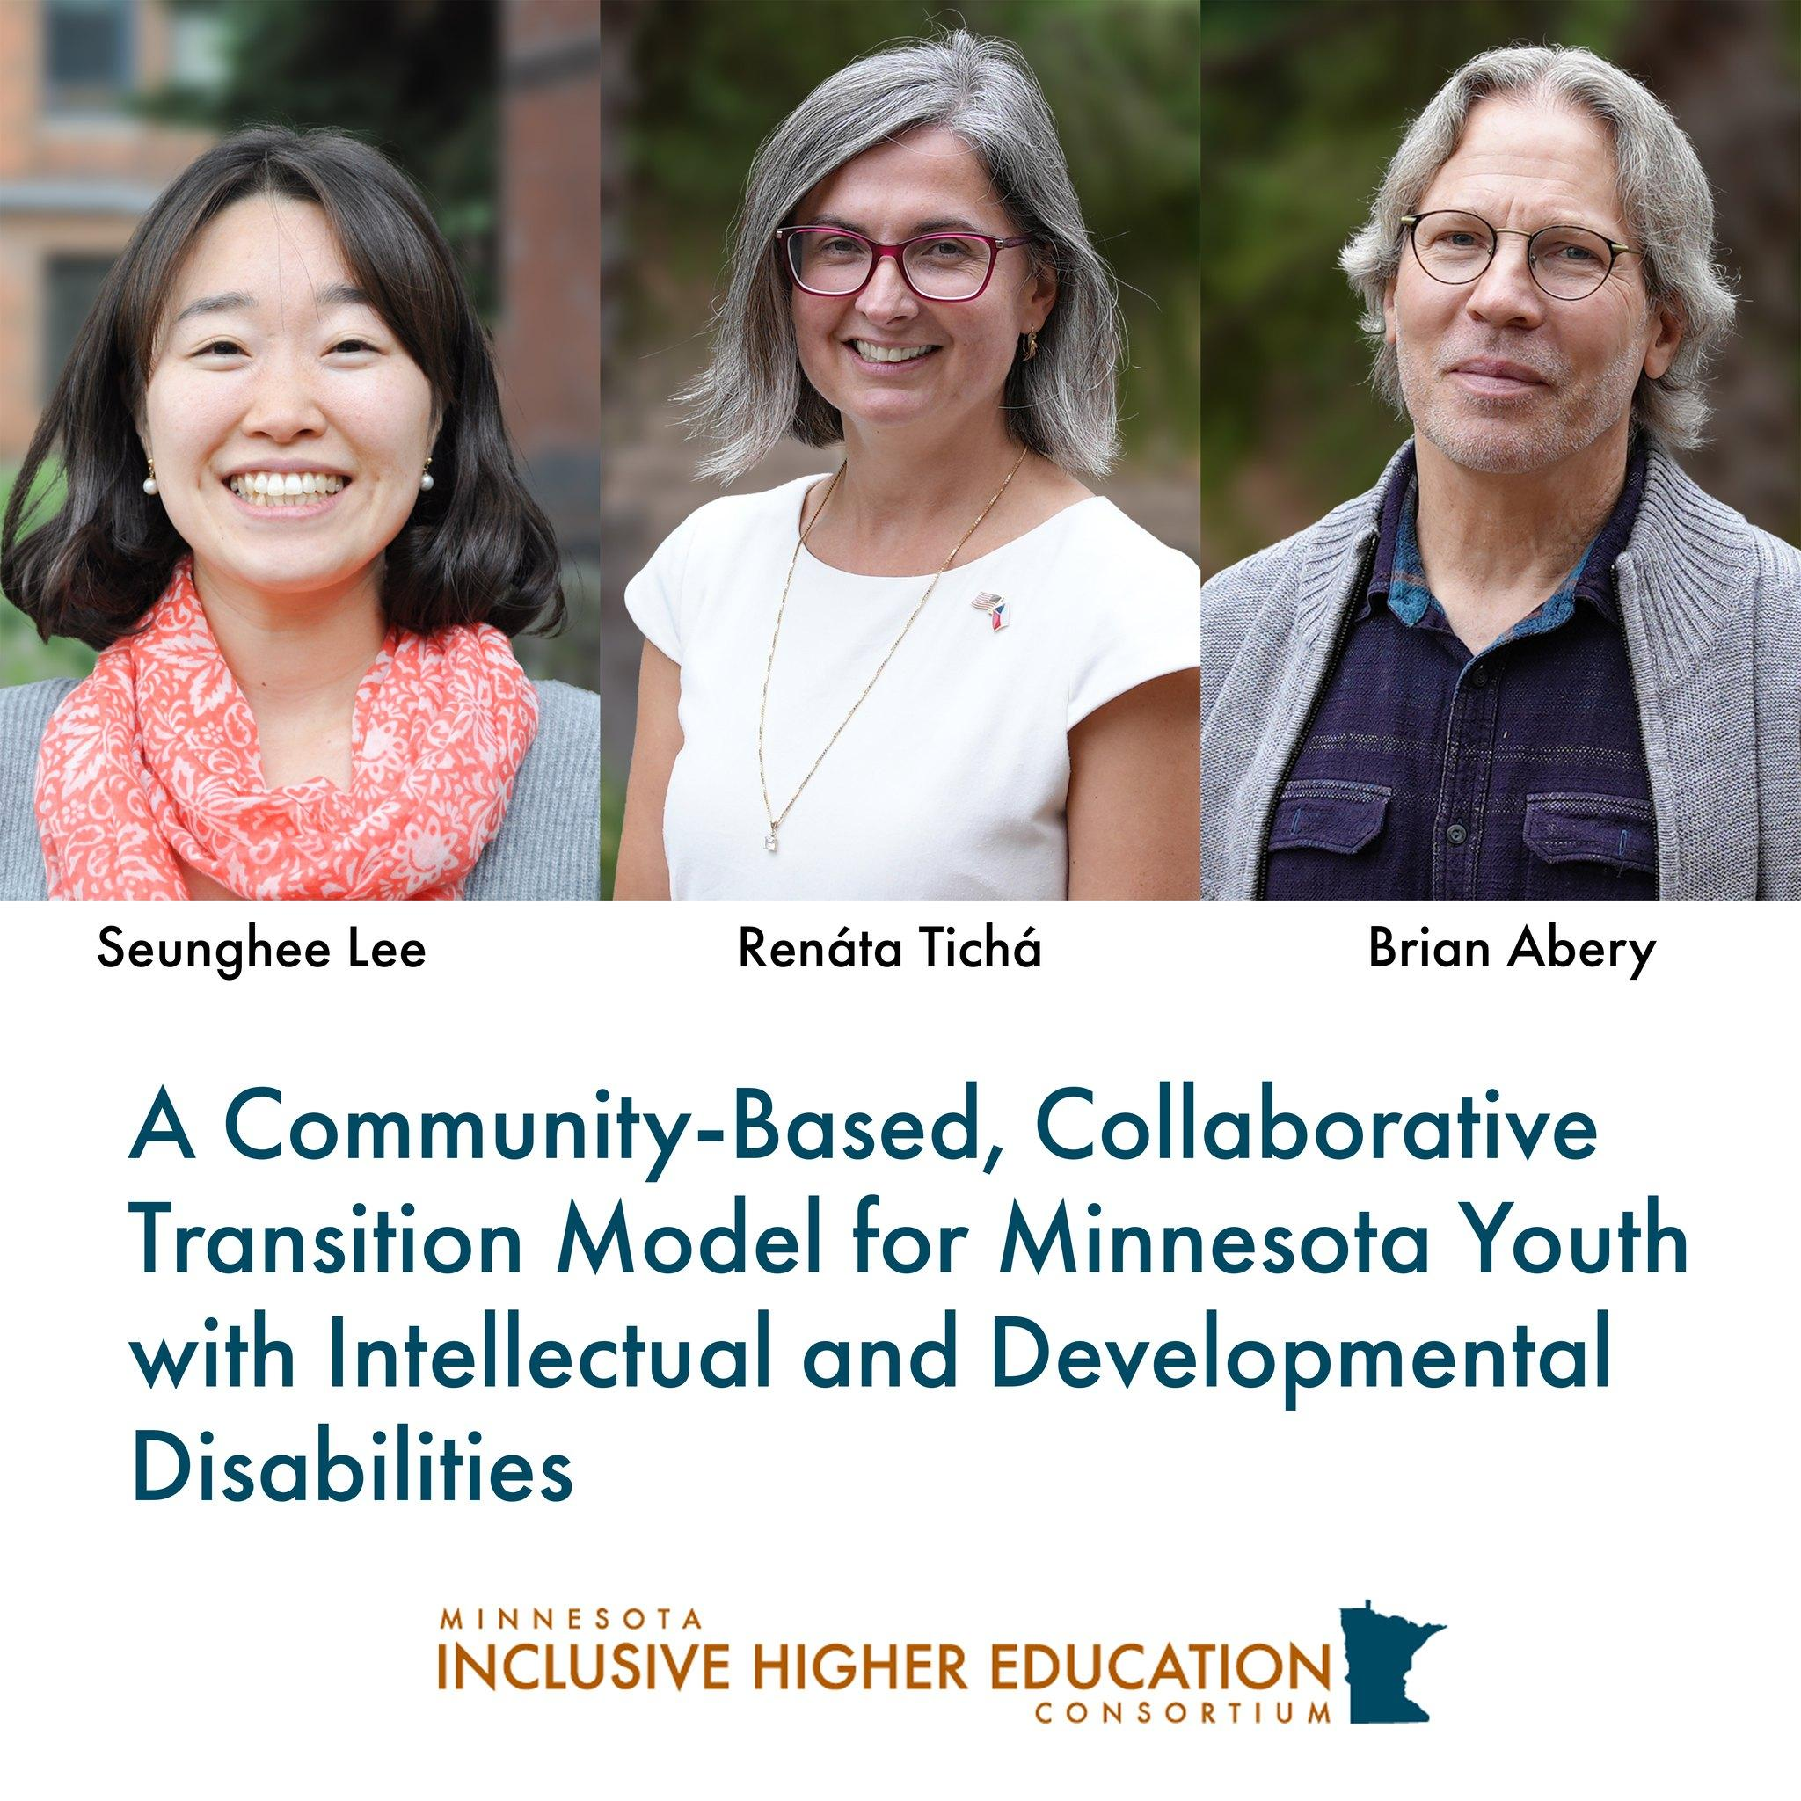
A Community-Based, Collaborative Transition model for Minnesota Youth with Intellectual and Developmental Disabilities

Slide 5
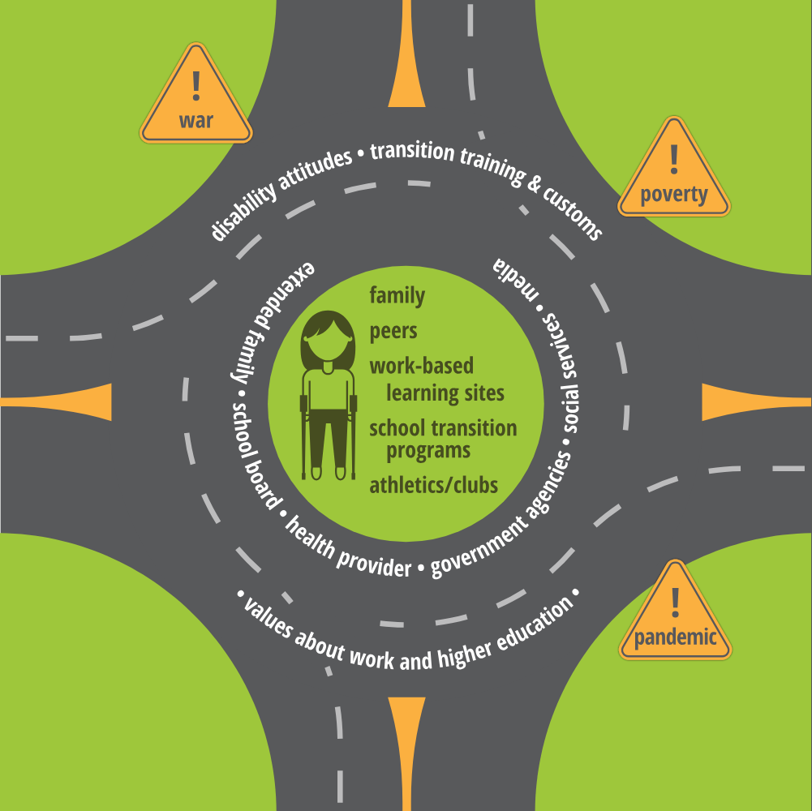
Transition
What is it?
How do young adults with disabilities experience it?

Slide 6
Project Goal
Through development and implementation of a tiered, community-based transition framework increase:
Competitive integrated employment,
Participation in post-secondary education, and Independence
of Minnesota youth with IDD in urban, suburban and rural MN communities
Building on the work already going on in MN

Slide 7
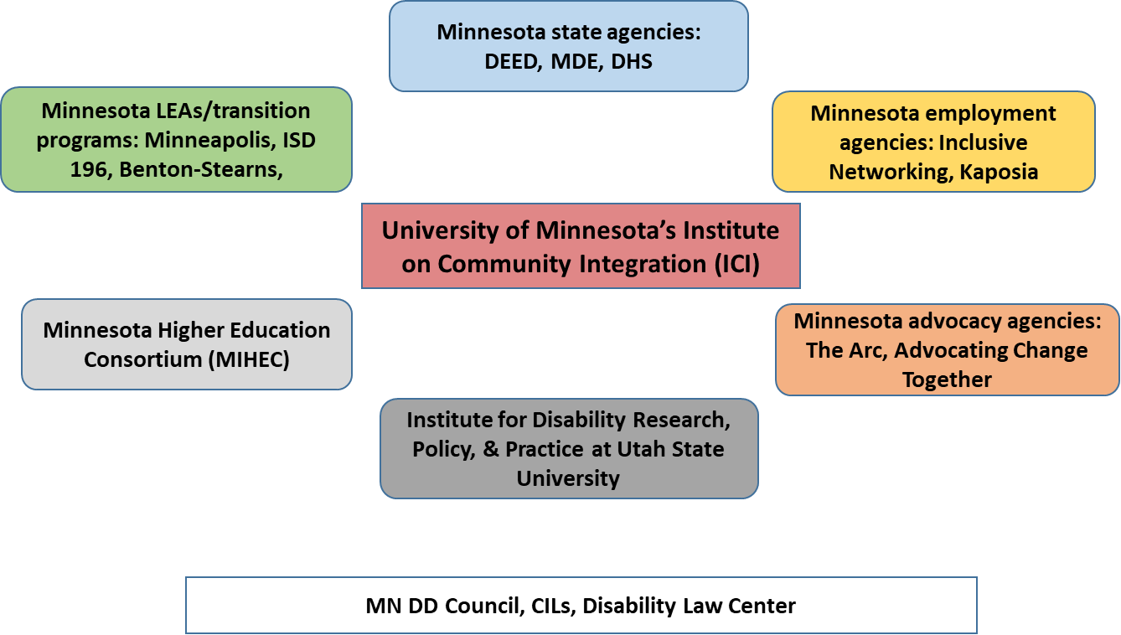
Project Partners

Slide 8
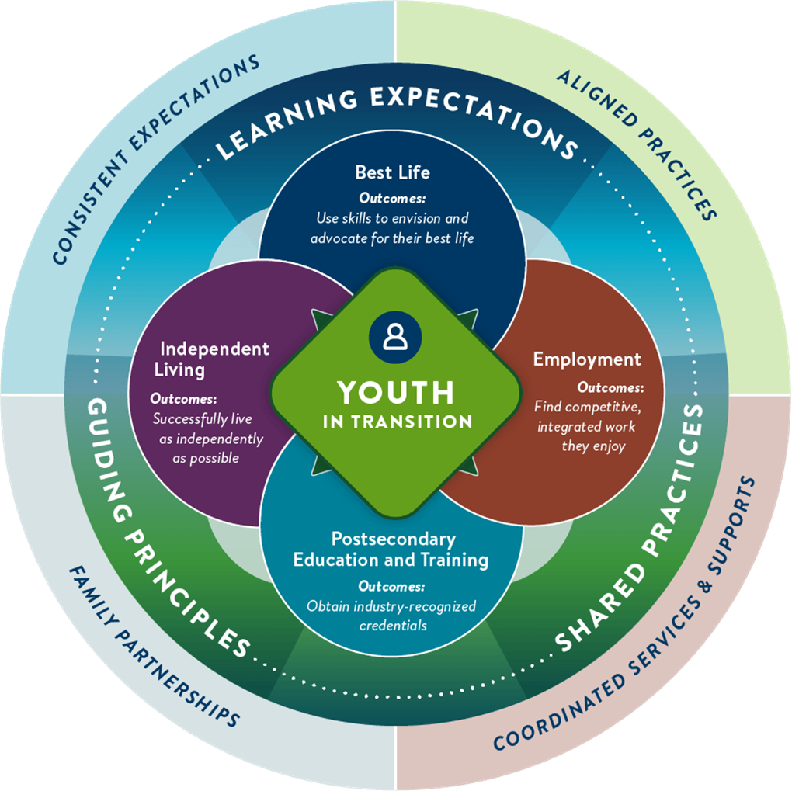
Minnesota Youth in Transition Toolkit/Framework

Slide 9
Minnesota Youth in Transition Toolkit Collaboration
Disability Hub MN
In development before the project started, throughout writing this grant, and during the first year of this grant
Partnership and collaboration on development, refinement and evaluation (DEED, MDE, DHS)

Slide 10
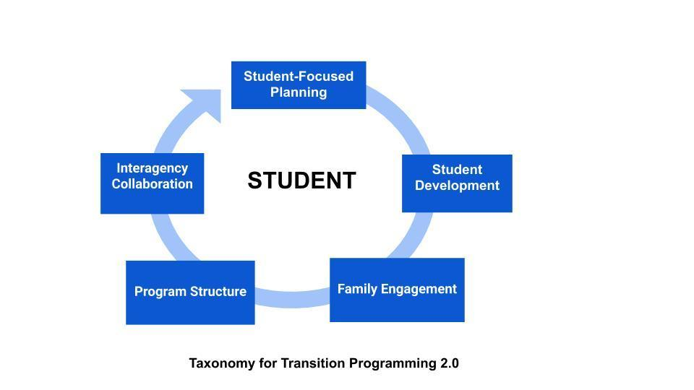
Guiding Transition Model: Taxonomy 2.0 (Kohler)

Slide 11
Approaches to Landscape Analysis
Scoping literature review on transition approaches and strategies
Community-based participatory (CBP) approach with a socio-ecological framework
Transition initiative site visits
High schools, transition programs, work-based learning sites
Youth with IDD, family members, educators and support staff

Slide 12
Approaches to Landscape Analysis Continued
Photo elicitation – youth wih IDD
Longitudinal survey for youth with IDD (in and post-transition), family members, and educators
Evaluation of the Minnesota Youth in Transition Toolkit
Evaluation of work-based learning (WBL) opportunities

Slide 13
Qualitative Study-Site Visits, Focus Groups, & Interviews

Slide 14
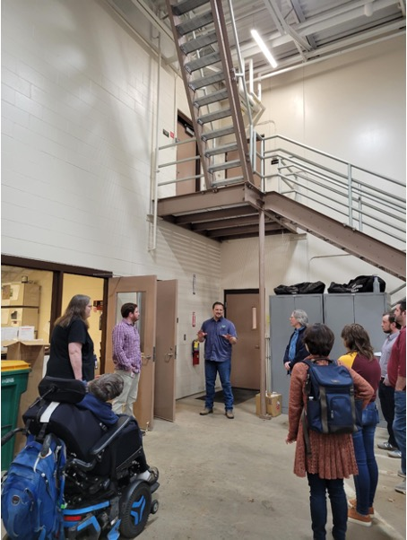
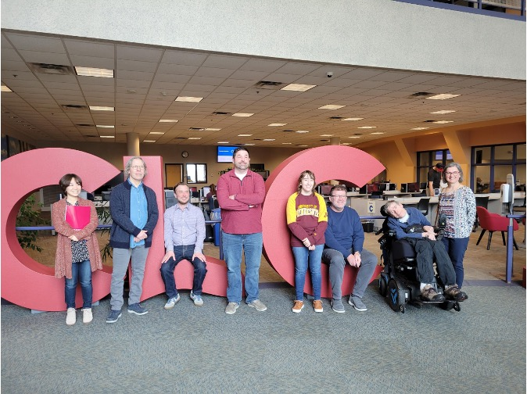
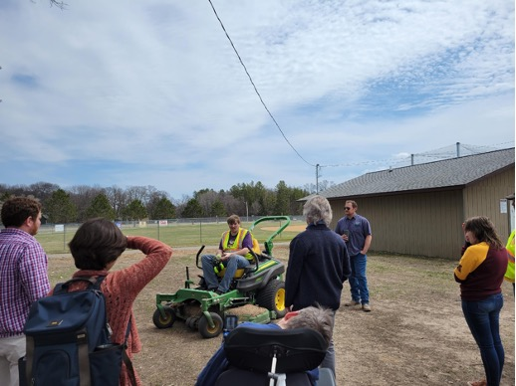
Study-Site Visits

Slide 15
Purpose & Research Questions
Purpose: To explore and describe four transition programs serving students with intellectual and developmental disabilities (IDD) in Minnesota across four geographic regions of the state
Research Questions:
RQ1: What are the most prominent strengths of each program to support students with IDD?
RQ2: What are the most needed areas of each program to support students with IDD?

Slide 16
Method
Phase 1
Site visits
Research notes and reflection
Phase 2
Focus groups: teachers, support staff, families
Interviews: current students and graduates

Slide 17
Site Visits
We visited 4 different transition programs in 4 different regions’ school districts in MN
Group discussion
Coding of transcribed group discussion

Slide 18
Findings from the Site Visits
Different approaches in districts based on whether transition is part of high school or as a separate transition program
Lack of inclusion in transition programs
Different approaches to curricula for transition
Different WBL opportunities
Location and transportation major factors
Limited connections with local colleges

Slide 19
Focus Groups and Interviews
We have conducted 7 focus groups in 2 districts
Educators
Support staff
Vocational rehabilitation or county professionals
Family members
We have conducted 11 interviews with youth with IDD in 2 districts

Slide 20
Findings from Student Interviews
Hopes and dreams do not always match with available opportunities – related to employment and post-secondary options
Program flexibility – “no bells, no homework, no periods, no rush”
Useful classes on independent living in the community (e.g., banking, cooking, spending free time)
Differences between districts

Slide 21
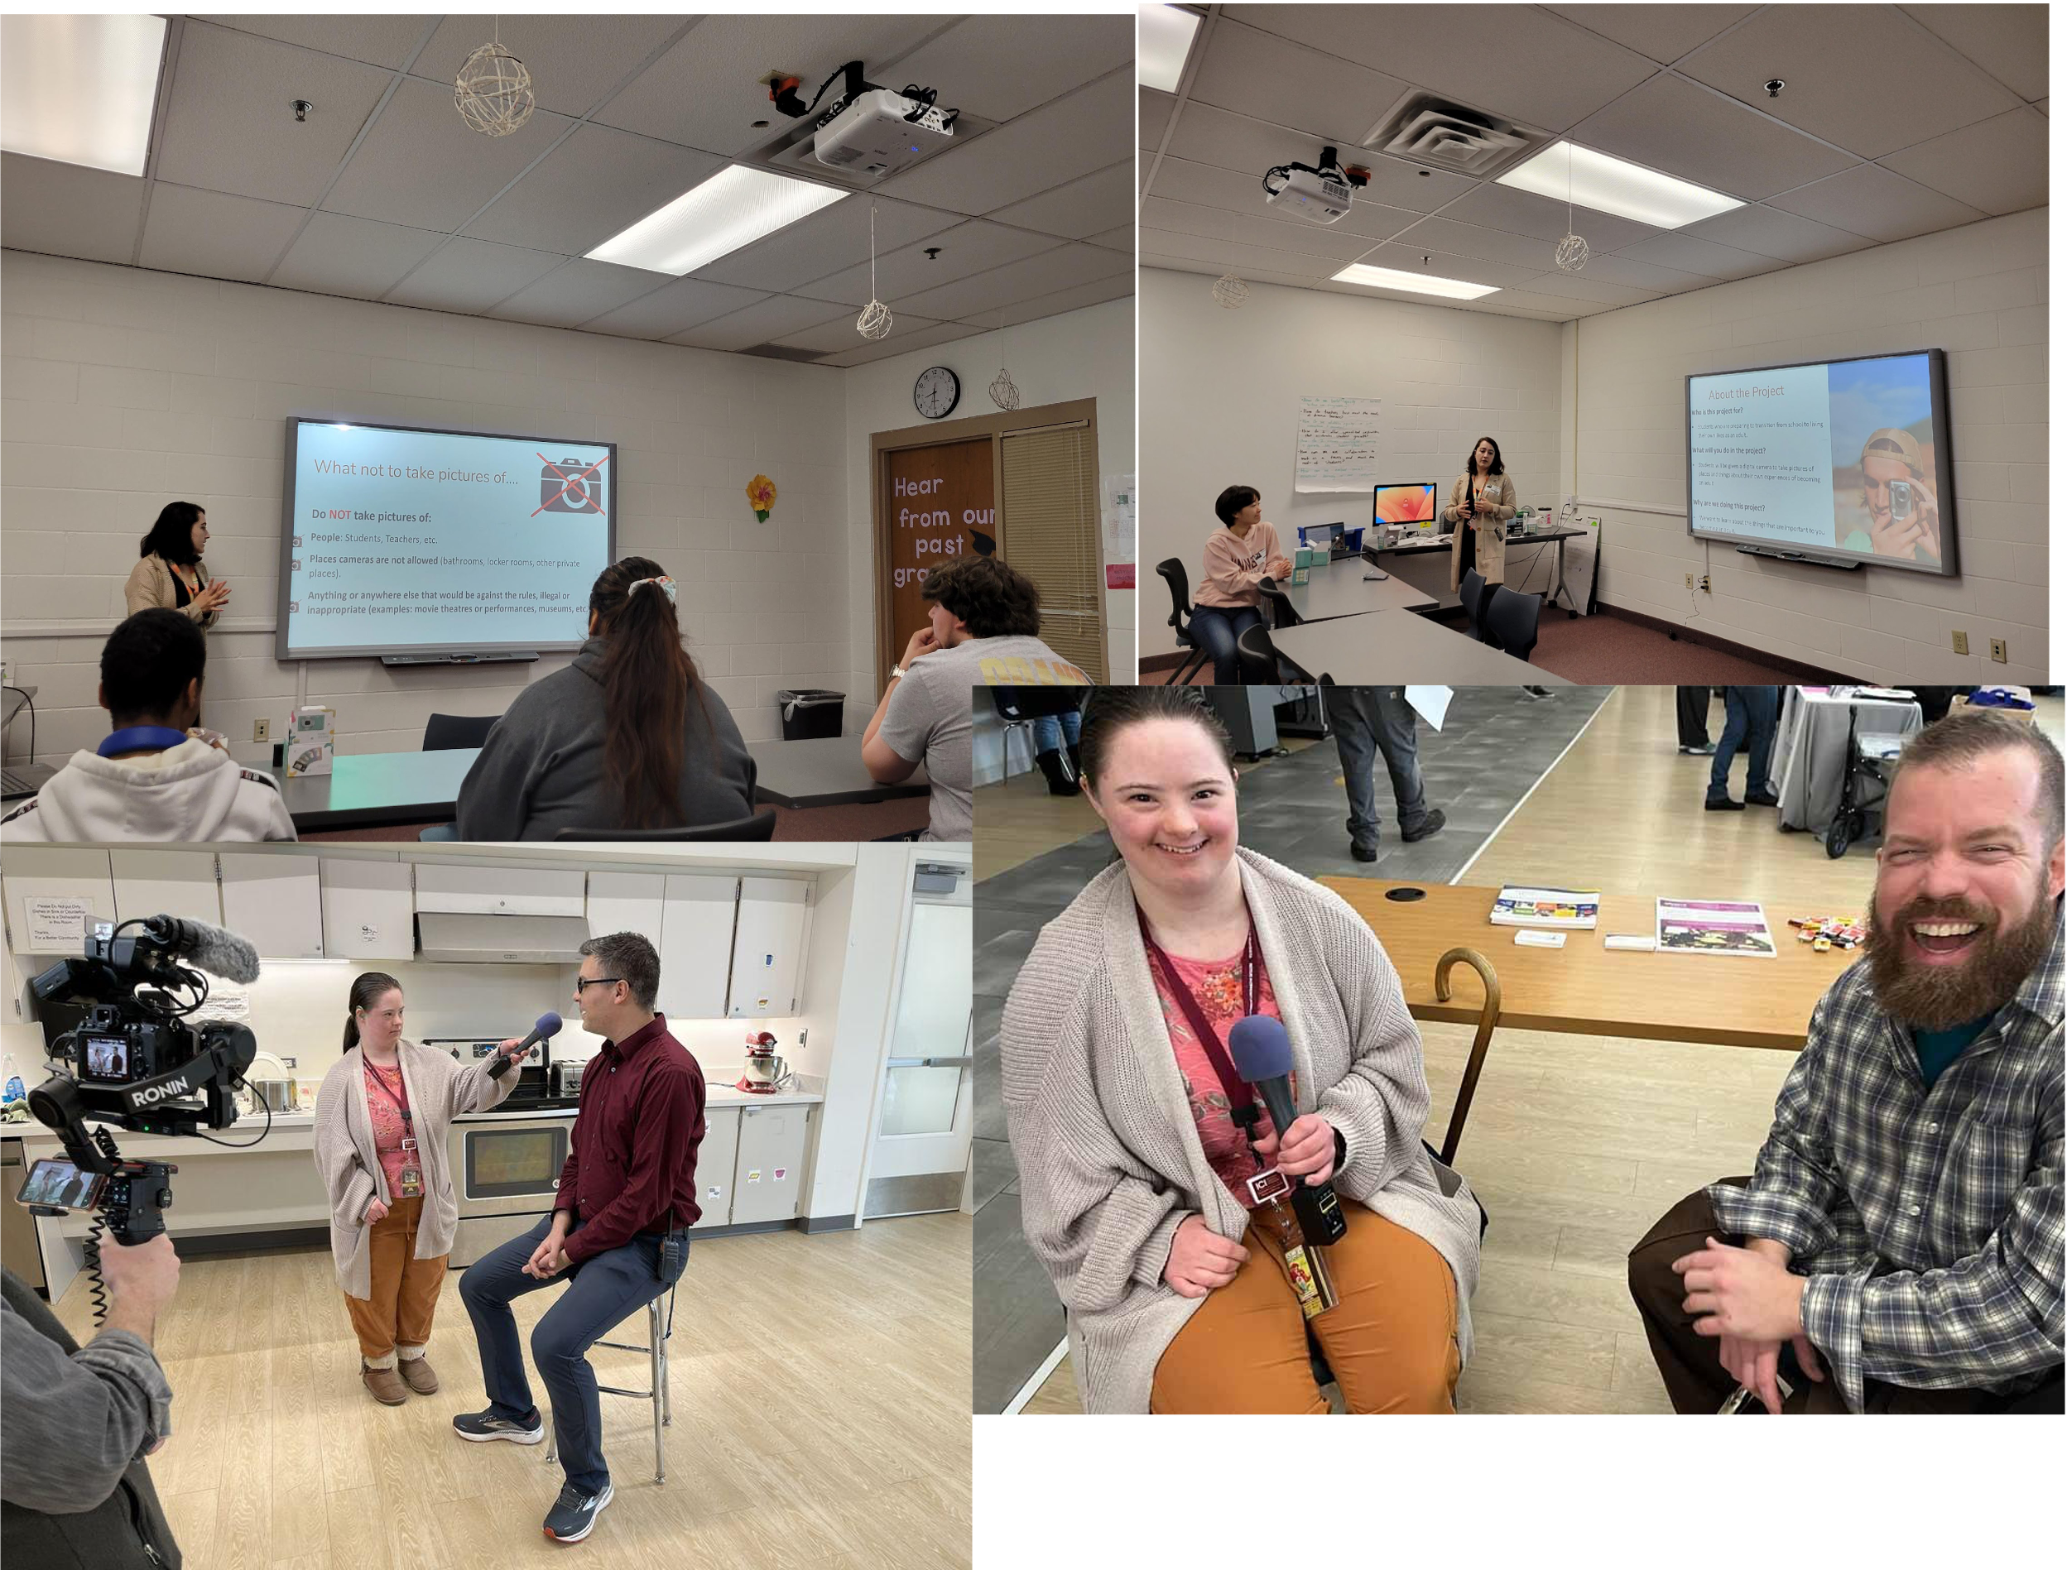
Student interview experience

Slide 22
Work-Based Learning in MN Transition Programs

Slide 23
What we want to know…
What types of work-based learning opportunities are provided to students participating in Minnesota transition programs?
What types of organizations are providing work-based learning experiences?
What types of work are students engaged in?
Are students in paid positions or unpaid internships?
Explored these questions within and across programs.

Slide 24
Research Method
Data gathered from 4 partnering transition programs/initiatives in MN
Asked transition coordinators information about work-based learning opportunities during the 2021/2022 school year:
Types of work sites (e.g., grocery store, restaurant, clothing store, hospital)
Categorized work sites by type of organization (private business, non-profit, school, local government)
Calculated percentages across partnerships
Types of positions (e.g., cleaning, customer service, cashier)
Categorized position types using the U.S. Bureau of Labor Occupation Profiles
Calculated percentages across student positions
Paid/unpaid positions
Categorized:
Paid positions (paid through vocational/rehabilitation services, paid through employer)
Unpaid positions (internships, volunteer positions)
Calculated percentages across student positions

Slide 25
Preliminary results
Across the four transition programs…
The majority of work sites with which districts are partnered are private organizations (59%)
Other partnerships are with non-profit organizations (22%) and local government agencies (17%)
Some transition programs house their own work-based learning opportunities
Majority of position in which students are placed during WBL include:
Building Grounds Keeping and Maintenance (53.13%)
e.g., custodial, landscape
Transportation and Moving Materials (32.76%)
e.g., assembly, stocking, organizing
The percentage of paid positions is variable across districts

Slide 26
Takeaways
Work-based learning experiences vary across the state
Various factors can influence the types of opportunities students have access to:
The number and variety of work sites programs are partnered with
Who is in charge of coordinating work-based learning
Extent to which transportation is accessible
Extent to which programs have easy access to VR services
Consideration for future research:
Exploring approaches for expanding work-based learning opportunities
Exploring approaches for building stronger connections among state agencies

Slide 27
Photo Elicitation

Slide 28
Photo Elicitation Purpose and Goals
Purpose: To capture the transition experiences of students with IDD in the four partnering school districts in MN
Goal: To include students’ own voices by taking pictures of things that are meaningful to their current transition experience
We have conducted 11 interviews with students with IDD in 2 districts

Slide 29
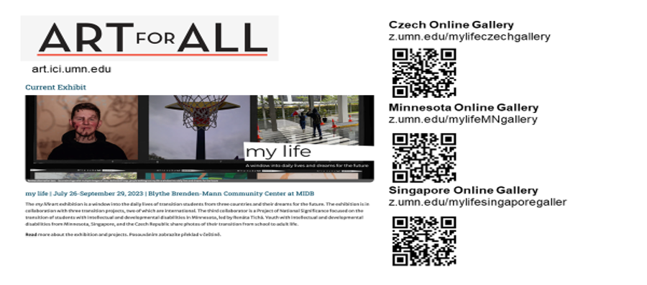
Art for all

Slide 30
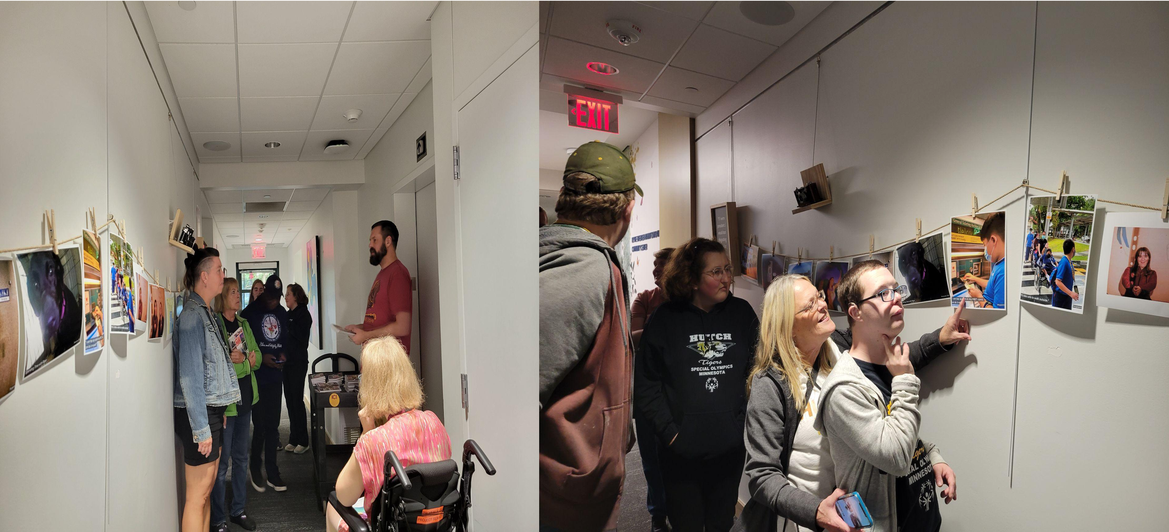
Photo Exhibition: My Life

Slide 31
Upcoming Community Conversations
To engage a broader community of stakeholders
Employers
Local organizations
Local professionals, families, etc.
To validate the finding from Landscape Analysis and explore ideas for innovation and improvement

Slide 32
Food for Thought on Transition to Post-Secondary Education
The US is one of a few countries that legislates transition planning and services
The US is one of a few countries that has initiatives like MIHEC that focus specifically on transition to post-secondary education
Efforts need to be put into working with environment into with the young adult is going and on paying attention to psychological wellbeing of the young adult

Slide 33
Impact Issue on Transition in Global Context
https://publications.ici.umn.edu/impact/35-2/cover

Slide 34
Resources
The Campus Disability Resource (CeDaR) Database
National Center for College Students with Disabilities Training Center
Youth in Trnasition Toolkit

Slide 35
Resources
The Campus Disability Resource (CeDaR) Database
National Center for College Students with Disabilities Training Center
Youth in Trnasition Toolkit

Slide 36
Contact
Renáta Tichá, PhD: tich0018@umn.edu
University of Minnesota
Institute on Community Integration

Slide 37
MIHEC Contact Information
Email: MIHEC@umn.edu
Website: MIHEC.ici.umn.edu
Thank you for joining us!

