Slide 1
MIHEC Learning Community Event February 13, 2024
Notes:
Start close caption and recording
Liz:
Welcome to the February Learning Community event.
My Name is Liz Hannan and I am a member of the MIHEC workgroup.
I have short brown hair, glasses and am wearing a blue shirt.
This event is being recorded and will be posted on our website.
Closed captioning is enabled.
Please share your questions in the chat and we will get to them during the Q and A at the end.

Slide 2
Land Acknowledgement
In Minnesota, we are standing on Miní Sóta Makhóčhe, the rightful homelands of the four Dakhóta Oyáte nations, the seven Anishinaabeg nations, and other indigenous peoples. We recognize that the U.S. did not uphold its end of the land treaties. It is the current and continued displacement of indigenous peoples that allows the State of Minnesota to exist today.
Notes:
We would like to begin with a land acknowledgement that Minnesota is on the rightful homelands of the Dakota and other indigenous peoples.
We recognize that the US did not uphold its end of the land treaties and it is the continued displacement of indigenous peoples that allows the state of MN to exist today.

Slide 3
Affirmation of Commitment
At the Institute on Community Integration, we affirm our commitment to address systemic racism, ableism, and all other inequalities and forms of oppression to ensure inclusive communities.
Notes:
We also want to affirm the commitment of ICI to address systemic racism, ableism, and all other inequalities and forms of oppression to ensure inclusive communities.

Slide 4
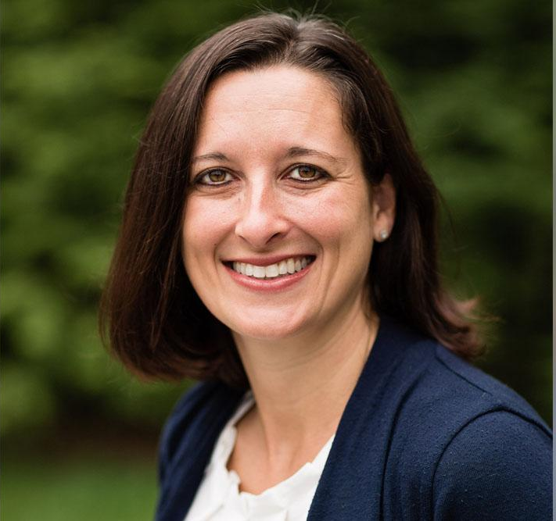
Introductions
Beth Myers is Director of the Taishoff Center for Inclusive Higher Education at Syracuse University, where she is a faculty member. She loves swimming, traveling, crossword puzzles, and spending time with her four kids and her dog, Ziggy.
Beth Myers
Notes:
Liz–It is my pleasure to Beth Myers and Michael Gill, co-editors of the book “Changing Our Own Lives”.
Beth is Director of the Taishoff Center for Inclusive Higher Education at Syracuse University, where she is a faculty member. She loves swimming, traveling, crossword puzzles, and spending time with her four kids and her dog, Ziggy.

Slide 5
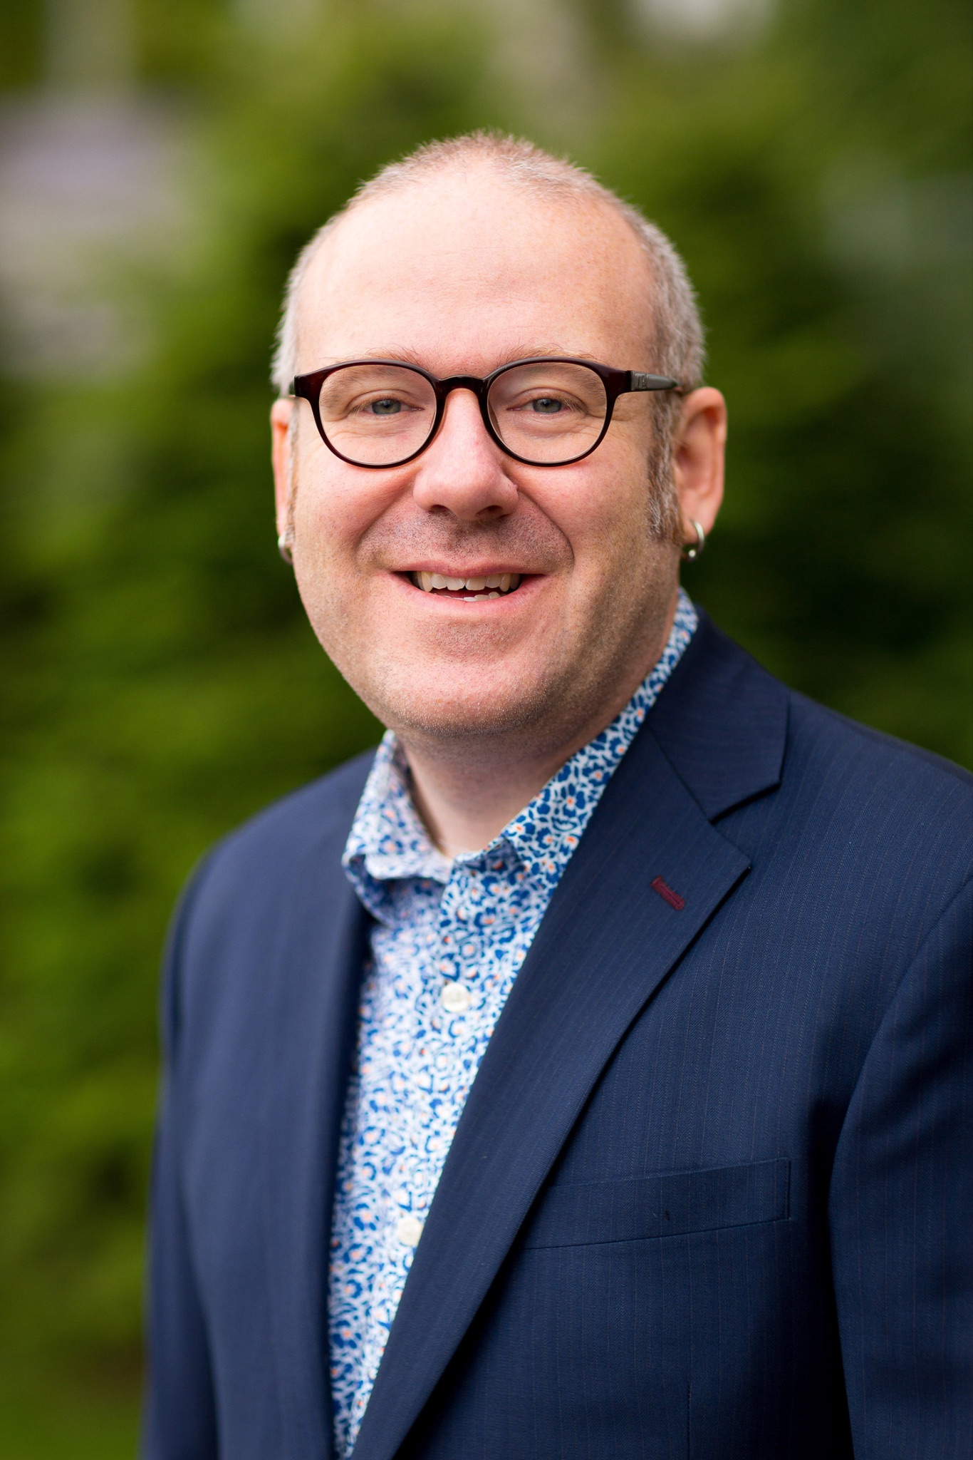
Introductions
Michael Gill is an Associate Professor of Disability Studies at Syracuse University. He loves to ferment, get tattoos, eat spicy food, and cuddle with his dog.
Michael Gill
Notes:
Mike is an Associate Professor of Disability Studies at Syracuse University. He loves to ferment, get tattoos, eat spicy food, and cuddle with his dog.
And now I will turn it over to Beth and Mike and they will introduce the authors.

Slide 6
Introductions
Antonio Contreras is a graduate of Georgia Tech Excel. He currently lives in Atlanta, Georgia and works at JLL and Ansley Golf Club.
Antonio Contreras

Slide 7
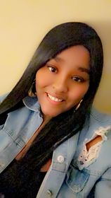
Introductions
Taylor Cathey is a two-time graduate from the Roberts-Wesleyan BELL Program and the SUNY Geneseo LIVES Program. Taylor has autism. She is a freelance writer and enjoys all things involving creativity, feminism, and self-expression.
Taylor Cathey

Slide 8
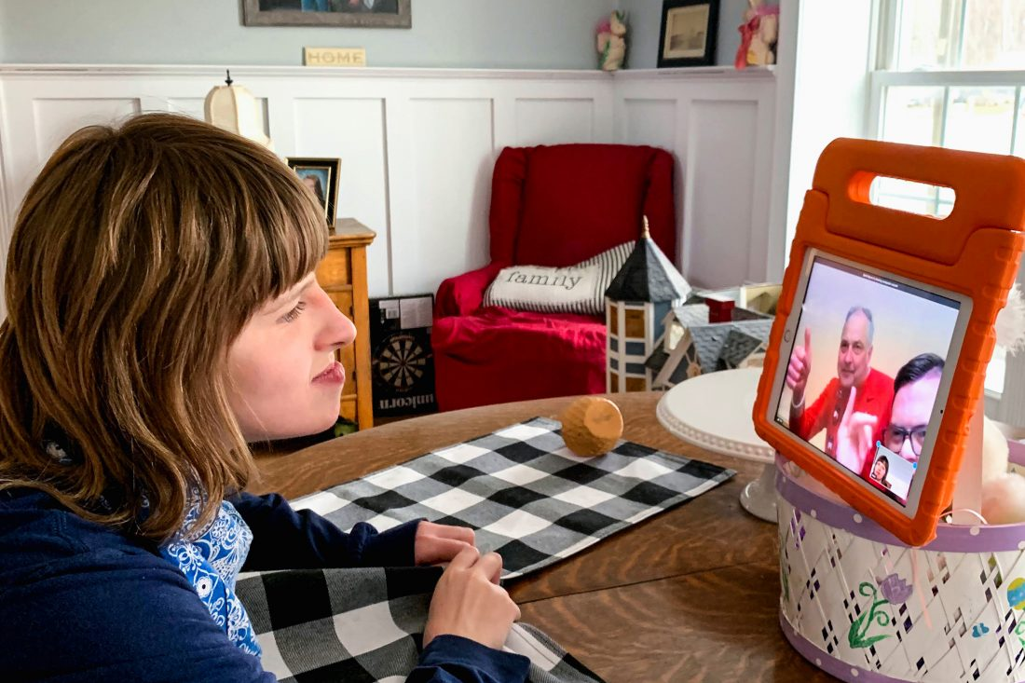
Introductions
Maia Chamberlain is a 2023 graduate of the Syracuse University InclusiveU program. Maia has cerebral palsy and is non-verbal. Usually she travels with her aide/interpreter and uses both sign language and Snap Core First on her ipad to communicate. She is a teaching assistant in upstate New York.
Maia Chamberlain

Slide 9
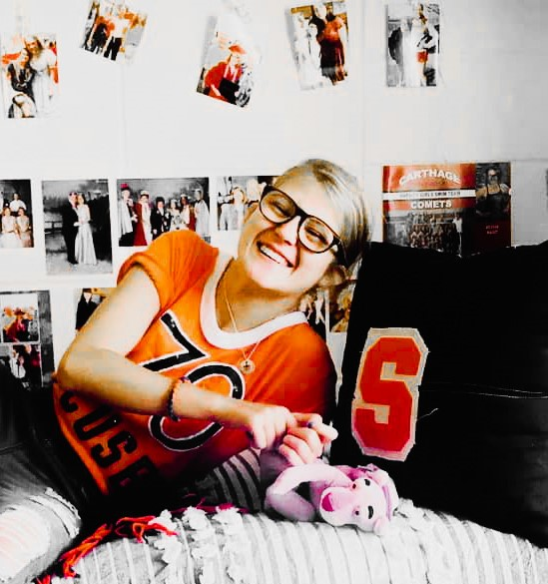
Introductions
Olivia Baist is an alumnus (2022) of the InclusiveU program at Syracuse University, obtaining her certificate in studio arts. Olivia identifies as having an intellectual disability and being disabled. During her freshman year of college, Olivia was featured in the documentary film, And They Were Roommates: Navigating Inclusive Mentorship in Higher Education.
Olivia Baist

Slide 10
Why we created this book
Notes:
Liz share link in chat
https://manifold.umn.edu/projects/creating-our-own-lives

Slide 11
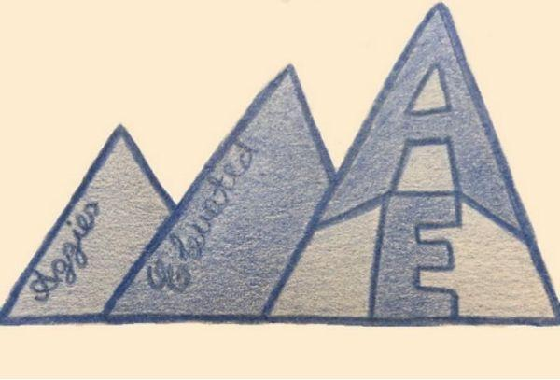
Our Process

Slide 12
I Want to Go to College
Antonio Contreras

Slide 13
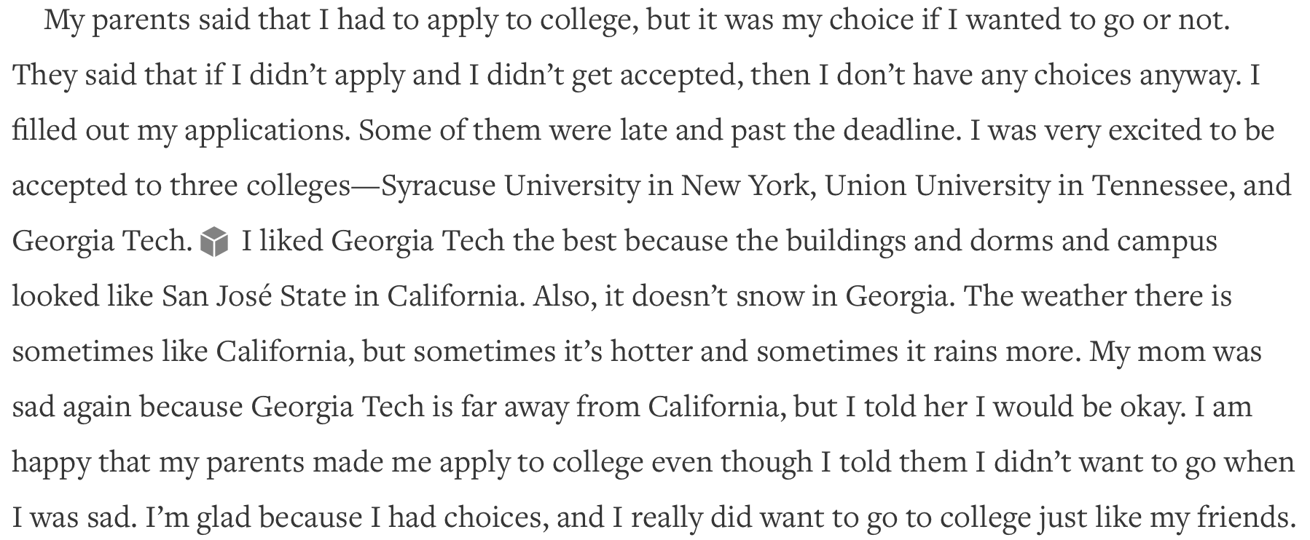

Slide 14
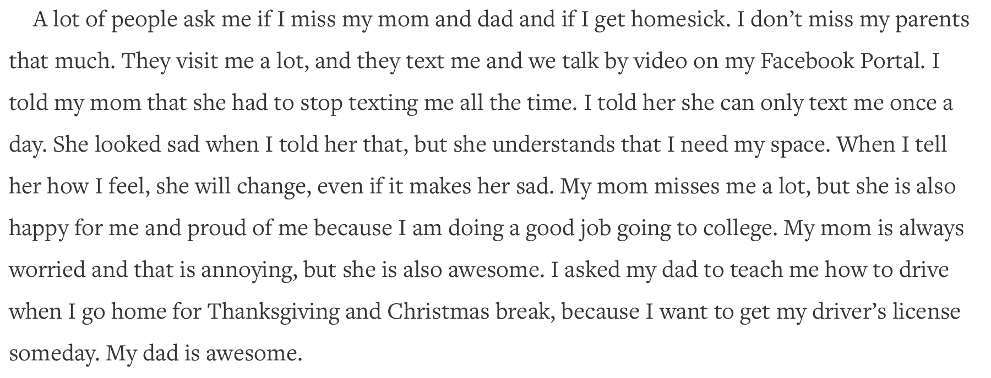

Slide 15
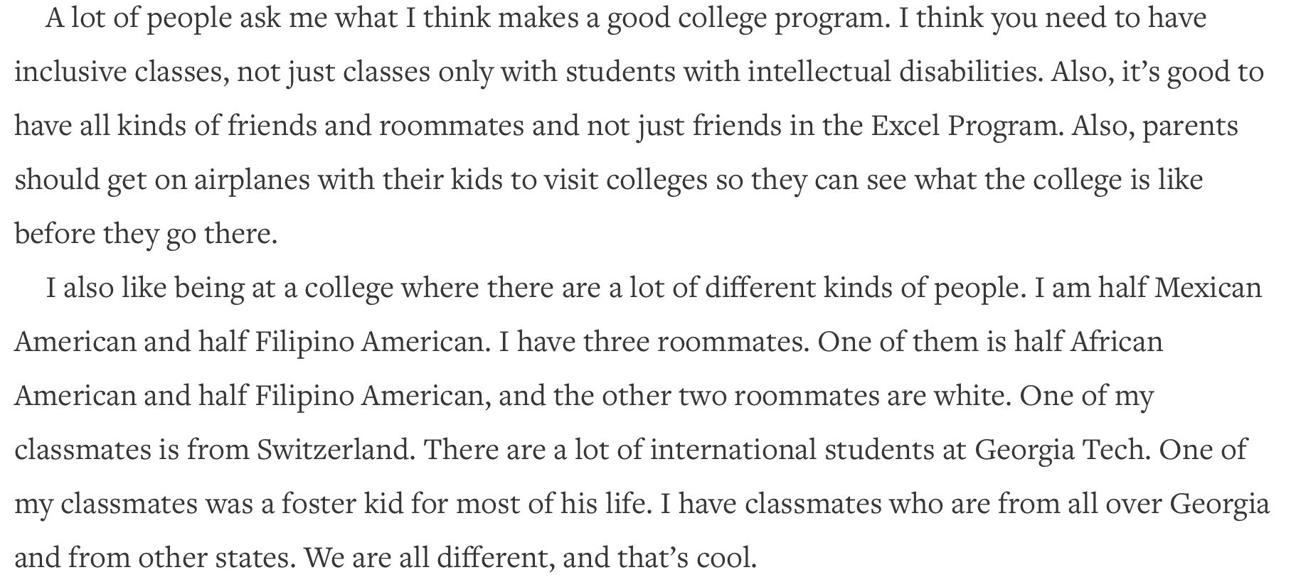

Slide 16
Communicating Successfully in College
Maia Chamberlain

Slide 17
Confidence with Curves
Taylor Cathey

Slide 18
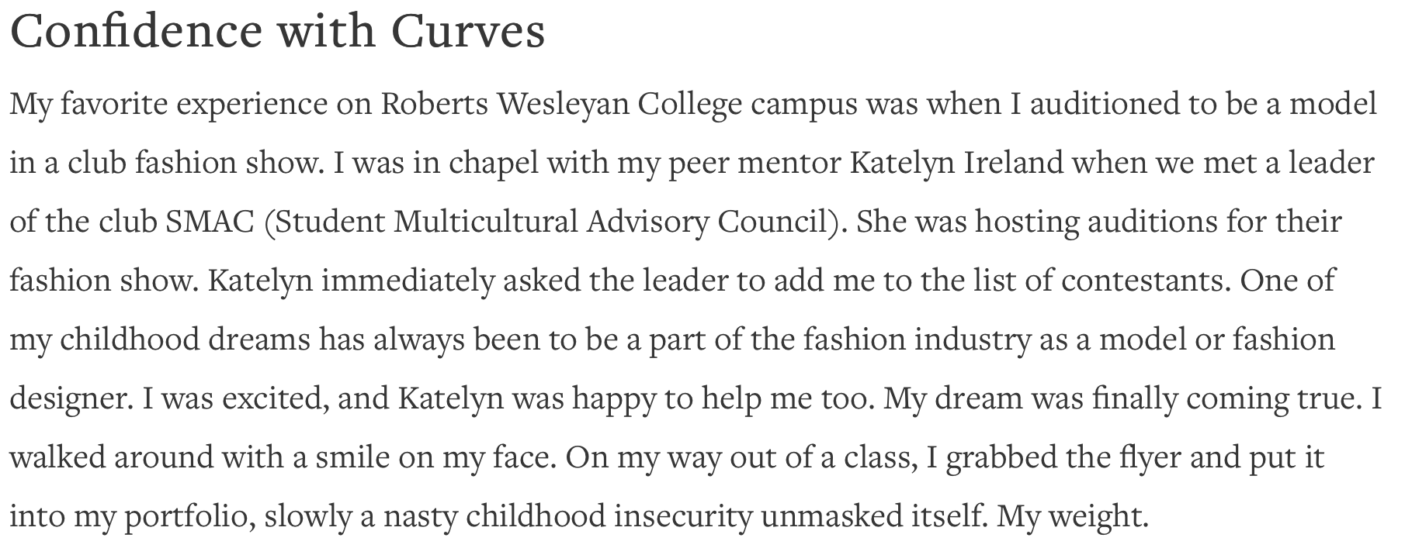

Slide 19
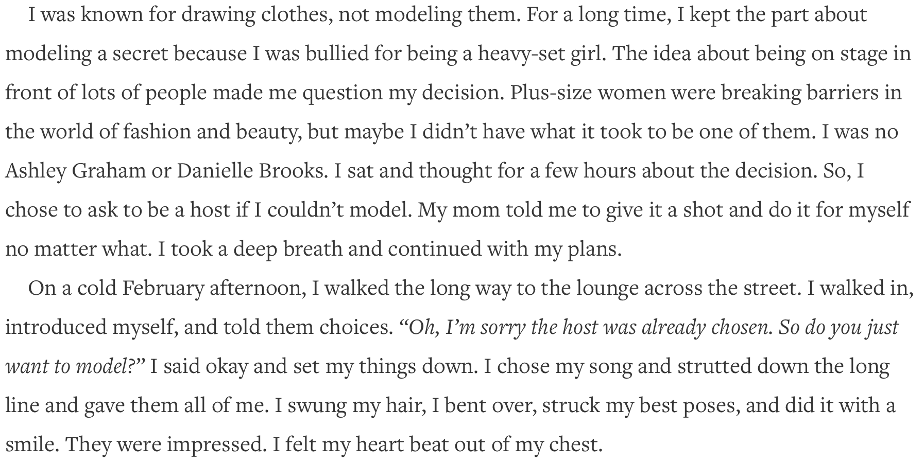

Slide 20
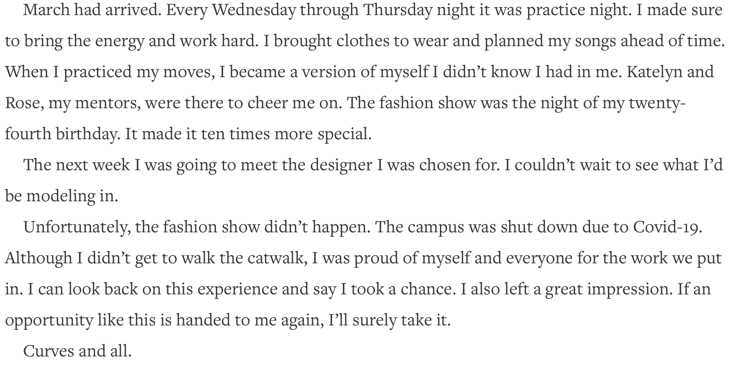

Slide 21
Taking the Llama for a Walk and Other Things that Helped Us
Olivia Baist

Slide 22
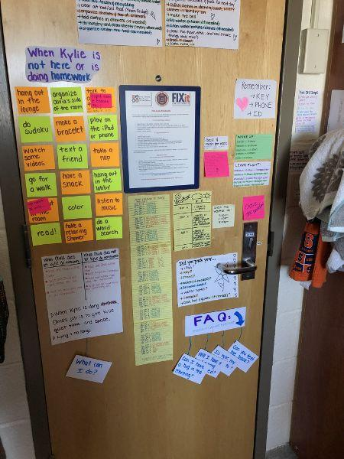
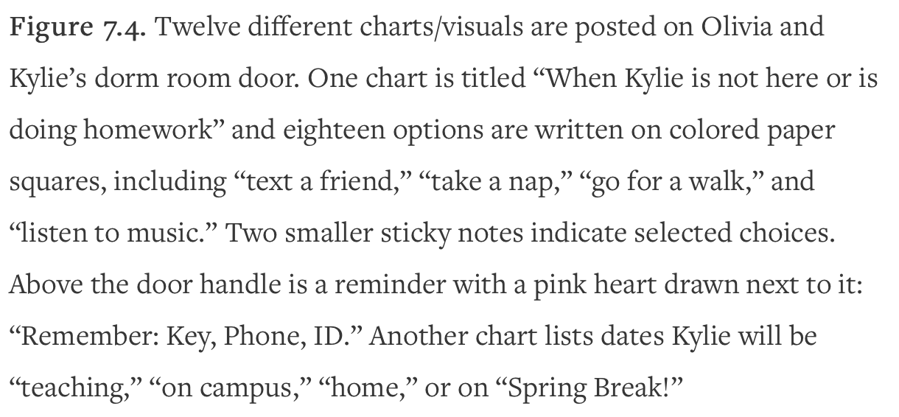
Reading:
“Meeting Each Other”
P. 32

Slide 23
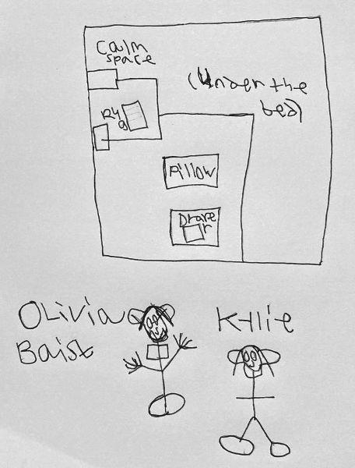
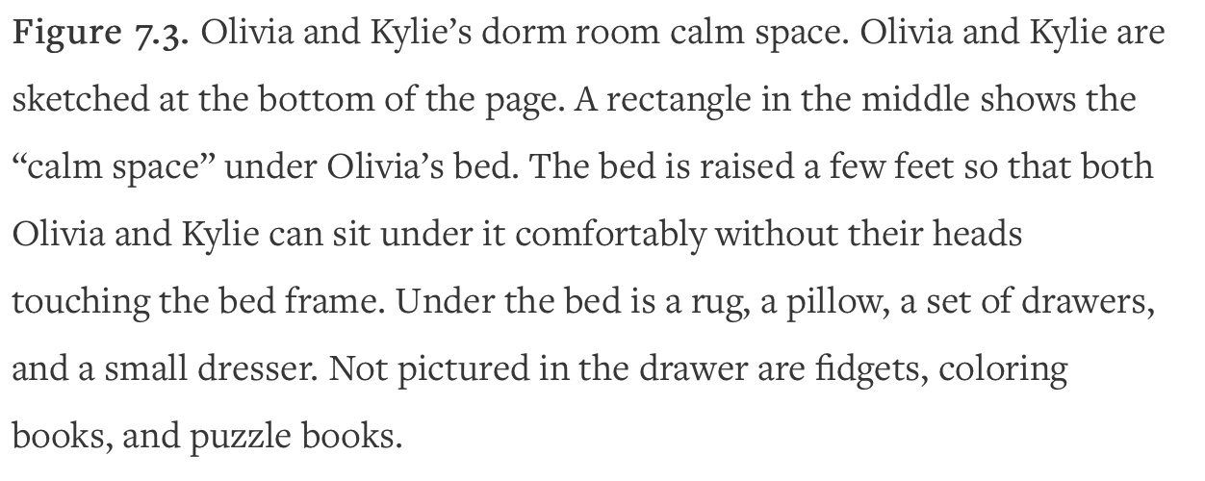
Reading:
120 Stairs
P. 44

Slide 24
Q and A
Please type your questions and comments for discussion in the chat.
Please complete the poll–we appreciate your feedback!
Notes:
Liz:
Thank you so much!
We will now have Q and A.
Type your questions in the chat and we will give them to our panelists.
Seunghee: Launch poll

Slide 25
Contact Information
Email: MIHEC@umn.edu
Website: MIHEC.ici.umn.edu
Thank you for joining us!
Optional further discussion until 7:15 pm

