Slide 1



Welcome to the Webinar Series on the Workforce Toolkit.
We will begin at 2:00 pm central
Notes:
Host and Co-host notes for pre-meeting setup​
Actions before the session:​
Slide #1 – Update presenter names​
Hide other region consultant slide, as applicable​
Hide other regions workshop slide for Upcoming Workshops, as applicable​
In the Practice session before participants log on​
Check that the presenter can share their screen and run videos as needed​
Check that the presenter marks “Share Computer sounds” and “Optimize Screen sharing for video clip” so that any videos shown can be heard by others – it is on the same screen that you choose which screen to share. ​
Make Coaches "Co-hosts"​
Confirm polls are loaded - host​
Turn on transcript –host ​
Break-out Groups – host ​
Take attendance​
Time keeper​
Host / Welcome people as they arrive & arrive late – assign someone​
Monitor Chat – assign someone ​
Turn on record, as desired ​
Subtitles – turned on, each participant can control turning on and off ​
At end of presentation:​
MAKE SURE TO STOP RECORDING AT THANK YOU SLIDE​
Note to Facilitator​
Bold Text = Timing ​
Italicized Text = Notes – do not read ​
Regular Text = Talking Points ​

Slide 2



Preparing the Best- Competency Based Training
Presenter's name and affiliation
Notes:
Total Timing is 40-45 minutes (approx. 1-2 minutes per slide)
Talking Points:
Action – Record as desired​
Welcome
My name is xx and I am a xx with the Institute on Community Integration at the University of Minnesota. I am here today with my colleagues from the University of MN, __________ and ________________. Regional Coaches from Tennessee ____________________ and ___________________.​
Thank you so much for joining us today. During today’s session we will talk about Preparing the Best Competency Based Trainings. ​
If being recorded: This webinar is currently being recorded. We will send the recording to you if you would like to view again or share with others in your organization.
For facilitator: Text From Save the Date:
Competency based training focuses on developing the knowledge, skills, and attitudes of direct support professionals. Competency based training can be used to measure what a person knows, how they approach decision making, what they are able to do, and the way they think about people with disabilities and their job. Effective competency-based training focuses on real work actions that connect required and desired outcomes for the direct support professional and the people receiving supports and services. During this webinar, participants will learn why competency-based training programs are important and identify key components of a competency-based training model. Participants will also receive current nationally validated competency sets for direct support professionals and frontline supervisors.

Slide 3
In today’s webinar you will:
Learn about current competency sets.
Learn why competency-based training programs are important.
Learn about the steps for implementing a competency-based training model in your organization.
Notes:
Talking Points:
We have 3 learning objectives for today.
I’ll be sharing information about current competencies being used in the direct support workforce and why training that is linked to competencies is important. Finally, we’ll talk about the steps for implementing competency-based training model in your organization.
During the webinar I’ll be asking you some questions for you to think about and you are welcome to respond using the chat function; however, to stay within our time, we will not be able to read all the comments. Also, please use the chat box to share your questions during the webinar. We will likely not be able to respond to them all during the webinar, but they will be shared with our workforce consultants for follow-up.

Slide 4


High Expectation Discrepancy
Specialized
knowledge
Work
well with others
Comply with
rules and regulations
Teach
End shift neat & tidy
Maintain
health
& safety
Document
Support
choice
Medical
support
Person-
centered
Culturally
competent
Respect
rights
Problem-
solve
Notes:
4
Talking points:
We know that over the past 30 years, as our ideology and understanding of community living and participation have changed, so have the expectations placed on DSPs. We expect a tremendous amount of these workers. We expect them to…(read examples on sticky notes).
Yet little else has changed. Training hours have not increased, pay has not increased, opportunities for growth and development have not increased, and so on.
And we wonder why the desired outcomes simply are not present.

Slide 5

Isolated and alone
Notes:
5
Talking Points:
We also know that DSPs are more isolated now then they have ever been. When community living meant you lived in a large group home and went to the local workshop DSPs had co-workers who worked beside them, they had supervisors who were there much of the time and they had specialists like nurses and therapists and likely a medical doctor that were there occasionally and at least you could call them 24/7. Now in the predominate community service in the U.S. none of this support is there. More typically than not DSPs work alone and there is no opportunity for overlapping hours.
DSPs report that they feel isolated, they want opportunities to learn from and network with one another.

Slide 6
What are the top competency areas you think a direct support professional should have?
Share your top two in the chat box.
Notes:
Facilitator Note
Read question on the slide, pause for 30 seconds to let people respond in chat box. Read off some of the responses.

Slide 7
Importance of Competency in Direct Service
Competency standards are foundational in key processes of workforce development:
Recruitment, hiring, and selection
Curriculum development
Training program implementation, staff development
Performance evaluation
Career pathways, ladders and lattices:
Apprenticeship programs
  Credentialing and certification systems
Campion et al., 2011
Notes:
Talking Points:
Having competency standards are foundational in the workforce of direct support.
Those competencies really need to be across all the areas that touch DSPs from recruitment to performance evaluation to their career pathways.
7

Slide 8
Introduction to Core Competencies
Competency Area
A broad category within a competency set containing related information that describes knowledge, skills, or abilities for effective work performance.
Competency Description
A statement describing themes of knowledge, skills, or abilities for effective work performance within a discrete competency area.
Skill Statement
A description of a competency standard that incorporates a highly specific, observable action (related to a competency area) that may be demonstrated by the worker.
Notes:
Talking Points:
Core competencies generally have three main components – what the competency areas is related to the knowledge, skills and abilities needed to effectively do the work. A statement describing the knowledge, skills and abilities, along with a skill statement that is observable.

Slide 9
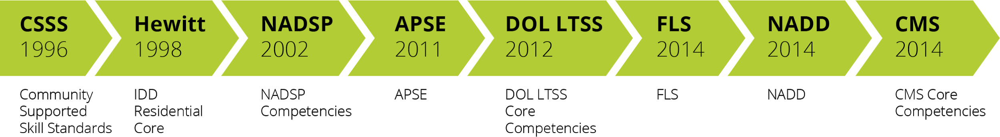
DSP competency sets 1996 - 2014
Notes:
Talking Points:
Since 1996, a number of efforts have taken place on a national level to identify the critical competencies that direct support professionals need to have. These competencies have changed over time. They are mostly similar with a few variations depending on the service and support focus they have. By and large, these have been efforts to richly describe the knowledge, skills, and attitudes that DSPs need to have to successfully support a person to live and participate in their communities. Though each set is organized a bit differently, they share many core areas in which DSPs must be able to demonstrate understanding, skill, and a comprehensive value orientation.
The initial effort focusing on community services was completed in 1996 with the development of the community support skills standards (CSSS). Most recently, the Centers for Medicare and Medicaid Services (CMS) released a set of core competencies that describe the knowledge, skills, and attitudes required of DSPs across the sectors of IDD, aging, and mental health.
Note for Facilitator: Acronyms
NADSP = National Alliance for Direct Support Professionals
APSE = Association of People Supporting Employment First
DOL = Department of Labor
FLS = Frontline Supervisor
DSP = Direct Support Professional
LTSS = Long Term Services and Supports
CMS = Centers for Medicare/Medicaid Services
NADD = National association for individuals with developmental disabilities and mental health needs
IDD = Intellectual and Developmental Disabilities

Slide 10
Competency Sets for the Direct Support Workforce
The 15 National Alliance of Direct Support Professionals (NADSP) Competency Areas
NADD Direct Support Professionals
The NADSP Code of Ethics
National Frontline Supervisor Competency Set
CMS Core Competencies
Notes:
Talking Points:
Each of these competency sets is organized around core competencies of a direct support worker and includes a set of skill standards for each competency.
For purposes of today’s webinar, we will focus on the CMS Core Competencies as this is the competency set that is foundational to the QuILTSS Institute training for DSPs. To learn more about the other competency sets, we’ve provided links to the other competency sets in the resources section of this webinar.
Facilitator Note
If questions:
NADD Competency Areas:
Assessment and observation
Behavior support
Crisis prevention and intervention
Health and wellness
Community collaboration and teamwork
NADSP Code of Ethics:
Person-Centered Supports
Promoting Physical and Emotional Well-Being
Integrity and Responsibility
Confidentiality
Justice, Fairness and Equity
Respect
Relationships
Self-Determination
Advocacy

Slide 11
Overview of the CMS Core Competencies
Notes:
Talking Points:
The CMS core competencies are organized into 14 competency areas. Each competency area includes skill statements that identify the skills a DSW needs to demonstrate their competence in a particular area.

Slide 12
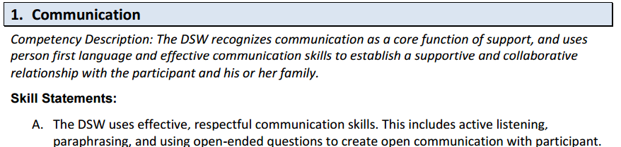
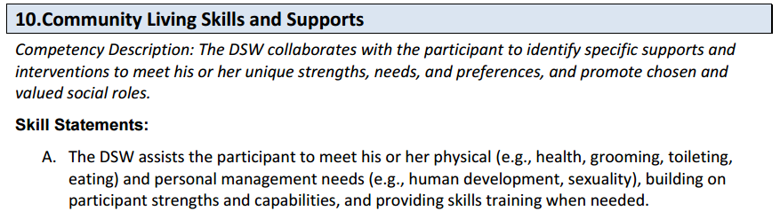
Overview of the CMS Core Competencies
Notes:
Talking Points:
Here are two examples of a competency area, the description of the competency and a skill statement. [Read one of the examples on the slide.]
Thinking about how this looks when implementing training, let’s use this webinar as our example. You are attending this webinar today about competency-based training.
You are gaining knowledge (I hope) about competency based training and strategies for taking back what you learn to use in your organization.
Following the webinar, based on what you learned, you might take one or more actions to demonstrate what you learned. For example you might evaluate your current training and map it against the CMS core competencies to identify gaps in your current training.
Supervisors and managers play an important role in assessing and developing competent DSWs.

Slide 13
Assessing DSP Competency Tools
Direct Support Professional and CMS-DSW Core Competency Job Analysis
Direct Support Professional Self-Development Plan
Notes:
Talking Points:
We developed and have piloted two tools to help organizations and DSPs assess their knowledge, skills and abilities in each of the CMS Core Competency areas.
These tools can be used within an organization to identify training needs for individual DSPs and inform both the development and prioritization of training needs within the organization.
How many of you on the webinar today use an assessment tool to identify training needs within your organization? How might you use this tool in your training development and implementation?

Slide 14
The Importance of Frontline Supervisor Competency
DSP turnover is lower when
DSPs feel valued
DSPs feel they are treated fairly
Reasons DSPs leave
issues with co-workers
issues with supervisors
Source: Larson, 1997
Notes:
Talking Points:
The ability of the FLS to support and maintain positive working relationships, empower staff, be fair with everybody at all times and mediate peer conflicts is key to the success of the team. This is complex work & HOW have we helped them to prepare for this job??
We know through our research, that the role of the frontline Supervisors is critical to the success of DSPs. For Frontline Supervisors to excel in their roles, they need to have very clear job expectations and understand what they need to know and do. The development and validation of a frontline supervisory competency set is the foundational component to all workforce development activities.
The Tennessee regional and statewide results from the 2018 workforce survey about why people leave organizations is consistent with our research on retention over the last 20 years.

Slide 15
National Frontline Supervisor Competencies
Direct Support
Health, Wellness, & Safety
Individual Support Plan Development, Monitoring, and Assessment
Facilitating Community Inclusion Across the Lifespan
Promoting Professional Relations and Teamwork
Staff Recruitment, Selection, and Hiring
Staff Supervision, Training and Development
Quality Assurance
Advocacy & Public Relations
Leadership, Professionalism, & Self-Development
Cultural Responsiveness & Awareness
Notes:
Talking Points:
I would be remiss if I didn’t mention the importance of frontline supervisors in the implementation of interventions designed to improve the direct support workforce. I cannot think of a harder job then that of a frontline supervisor.
Unfortunately, this group of workers often gets promoted from the role of DSP with a trial by error approach to learning about their new job duties. As such efforts have been made to identify the competencies they need to develop and to evolve training programs targeted to FLSs.
15

Slide 16
Supporting frontline supervisors
Use evidence based Frontline Supervisor Competencies that reflect best practice in current service system.
Use on-line workforce development tools utilizing these competencies, including:
  candidate assessment tool
  peer assessment
  selection tool
  training and development tool
  performance evaluation
Notes:
Talking Points:
This is a lot of pressure on frontline supervisors. So how do we prepare and support our Frontline Supervisors.
Competencies serve the function of informing workers, providers, and individuals-supported about the requirements of job performance.
The good news is that we have resources and tools to help you implement training strategies for frontline supervisors.
16

Slide 17
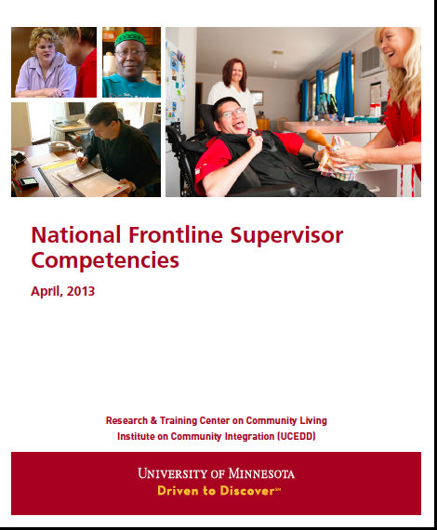
National Frontline Supervisor Competencies
Notes:
Talking Points:
Post link in chat: NFS Competencies document can be found at https://ici.umn.edu/products/view/553
The National Frontline Supervisor Competencies (NFSC) are an evidence-based set of knowledge, skills, and abilities that reflect best practice in the supervision of Direct Support Professionals (DSP) who work with individuals with disabilities in residential, work, and community settings. This competency set should be used as a tool to develop knowledge, skills, and abilities in a FLS within approximately one year of employment, or other established time frame as determined by an organization, to achieve the highest quality service delivery and supervisory skills. It is not intended to suggest an incoming FLS would be competent across all areas to start, but that an organization would use the competencies as a way to develop professional development goals.
Facilitator Note
More information for facilitator From NFS Competencies:
What are the National Frontline Supervisor Competencies?
The National Frontline Supervisor Competencies (NFSC) are an evidence-based set of knowledge, skills, and abilities that reflect best practice in the supervision of Direct Support Professionals (DSP) who work with individuals with disabilities in residential, work, and community settings. Competencies are considered a foundation for workforce development and standardization in all fields and at all levels. When rigorously developed and effectively implemented, competencies serve the important function of providing individuals information about the requirements of a given position and provide a basis for training, orientation, and continuing staff development. The utilization of competencies in the direct service workforce reinforces shared values of all service providers’ skills and growth (Hoge, McFaul, Calcote, & Tallman, 2008). Nationally recognized and validated competencies also serve to promote the recognition of the role of Frontline Supervisors (FLS), the development of career ladders, and the development of a more competent, stable workforce to meet the growing demand of long-term services and supports.
This competency set should be used as a tool to develop knowledge, skills, and abilities in a FLS within approximately one year of employment, or other established time frame as determined by an organization, to achieve the highest quality service delivery and supervisory skills. It is not intended to suggest an incoming FLS would be competent across all areas to start, but that an organization would use the competencies as a way to develop professional development goals.
The NFSC is based in the assumption that the FLS is competent in the National Association of Direct Support Professionals’ (NADSP) competencies.

Slide 18


National Frontline Supervisor Tools
Notes:
Talking Points:
In an earlier webinar on structural behavior interviews you learned about how to use core competencies in your hiring process for DSPs. A similar set of structured behavioral interview questions is important to consider when hiring or promoting from within frontline supervisors. How many of you have promoted a really great DSP, only to find out that they struggled in the role as frontline supervisors. Great DSPs don’t always translate into great frontline supervisors. Using a Frontline Supervisor Assessment of competency can help identify strengths and areas of need for DSPs. The Frontline Supervisor Assessment can be used to identify training needs for the individual.
How many of you use a DSP Competency Assessment or a Frontline Supervisor Assessment in your organization to identify training needs?
Facilitator Note
(use thumbs up, other reaction, etc.)
18

Slide 19
What competencies are currently used in your organization?
How do these affect training requirements?
Notes:
Facilitator Note
Read the question. Give prompt to webinar participants to take a moment to jot down some ideas – 15-30 seconds before moving on.

Slide 20
Scales are tipped severely in the wrong direction
240+ hours
minimally needed to meet basics
40+ hours provided
Balance is achieved when
Training competence
Notes:
Facilitator Note
Explain graphic on page
Talking Point
DSPs need much more training to achieve competence and not just meet the basics of training needs.

Slide 21
Why create a culture of learning with competency based training?
Improve skills of workers
Improve quality and safety of supports
Overcome workforce challenges
Improve pay and benefits
Enhance the status of DSPs & FLSs
Create professional career paths
Improve access to competency based education and training
Notes:
Talking Points:
NOTE: THIS SLIDE HAS ANIMINATION, ALL BULLETS COME IN AFTER SECOND CLICK.
This slide helps to answer the question, “Why should organization create and support a culture of learning for DSPs and FLSs?”
It outlines the benefits of this as a workforce improvement and retention strategy.
A culture of learning encourages workers to not only work together better but to also improve needed skills. It is a way to engage workers in continuous learning. It encourages knowledge transfer and knowledge retention using strategies that reinforce learning. It supports good skill and work habit development. A culture of learning should be a value held and supported by leadership and workers alike. When workers have the skills they need to provide high quality supports, people with disabilities live better lives. Organizations benefit through reduced turnover and vacancy rates. This saves money, which in turn can be used to improve wages and benefits. Organizations also benefit from reduced incidents and accidents when workers have the skills they need, which again saves money – money that can be reallocated to career path programs.

Slide 22
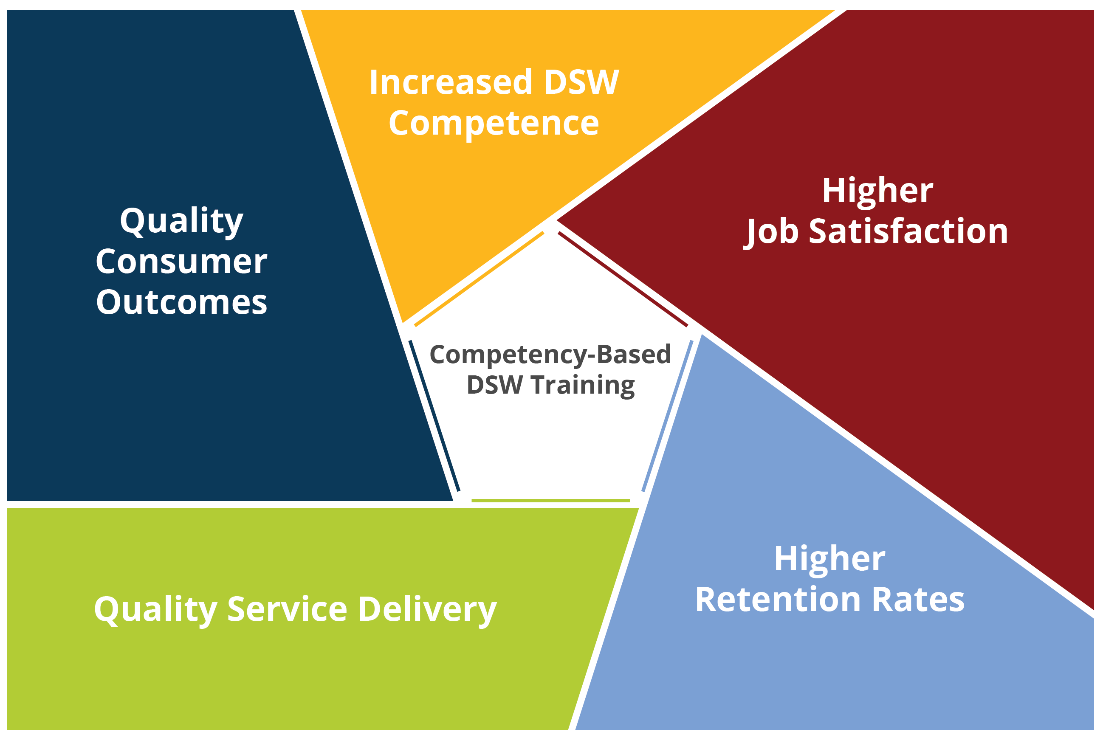
Outcomes Associated with Competency-Based Training
Notes:
Talking Points:
Quality of services depends on the quality and stability of the workforce.
Competency is the key to a well-trained, competent workforce, which promotes satisfaction with one’s job and thus retention rates.
We also know that the demonstration of competence is a justification to increased wages. This is true across industries and has yet to be fully embraced within the Long-Term Services and Supports (LTSS).

Slide 23
What is Competency Based Training?
Training that is focused on developing worker:
  Knowledge (what a person knows)
  Skills (what a person is able to do)
  Attitudes (the way in which a DSP thinks about people with IDD, job and how they approach decision-making)
Based on real work actions
Goal of achieving required/desired outcomes
6
Notes:
Talking Points:
CBT is focused on developing the worker.
Developing their knowledge, skills and attitudes – based on real work action – with a goal of achieving required/desired outcomes

Slide 24
Competency-Based Training Framework
Identify Needed Skills and Competencies
Identify Skill Gaps
Identify and Develop Training Strategies and Content to Fill in the Gaps
Deliver Training
Teach and Demonstrate Job Skills
Identify Training Outcomes
Evaluate the Skills, Performance, and Competencies
Notes:
Talking points:
There are lots of ways to provide training to workers.
By mandates – driven by rules and regulations
By job analysis – What do DSPs need to know and do to support people in a positive person-centered way?
Based on best practices – community inclusion, person-centered supports
Tied to the organization’s mission, vision, and values
Or you can customize training based on the needs, outcomes, and dreams of the people being supported.
Or any combination of these methods
Explain the Competency Based Training (CBT) Model/Framework and why it helps build effective training programs (read slide from “Identify Training Outcomes” and go clockwise).
Applying a CBT Model:
Local level – inform training content and training strategies to develop skills of DSPs – provide better supports – people living better lives in the community
State level – inform training for credentialing and apprenticeship – provide a framework for statewide credentialing programs and inform state mandated training requirements
National level – inform policy, research, and best practice across all disability sectors
Competency Based Training is most effective when use with a Blended approach to learning, using both online and in person approaches.
Let’s look at three different examples of competency based training currently available.

Slide 25
of TN QuILTSS
Source: Charla Long, 2017
Notes:
Talking Points:
The QuILTSS Institute courses align to a recognized career and education pathway. As a direct service worker completes courses and demonstrates competence, the individual is able to advance in the education and talent pipeline. Through the Bureau of TennCare, earning each designation of a Community Support Specialist allows the employee to receive additional wages.
Notes for Facilitator:
The following is from this webpage: https://quiltss.org/our-team/
Semester #1
Person-Centered Practices – 2 credits
Evaluation & Observation – 2 credits
Communication – 1 credit
Professionalism & Ethics – 1 credit
Total credits earned for Semester #1 – 6 credits
Semester #2
Community Inclusion & Networking – 2 credits
Community Living Skills & Supports – 2 credits
Empowerment & Advocacy – 1 credit
Health & Wellness – 1 credit
Total credits earned for Semester #2 – 6 credits
Semester #3
Crisis Prevention & Intervention – 2 credits
Cultural Competency – 2 credits
Education, Training & Self-Development – 1 credit
Safety – 1 credit
Total credits earned for Semester #3 – 6 credits

Slide 26












TN QuILTSS Badges
Notes:
Facilaitor Note
Explain TN QuILLTSS Badges (https://quiltss.org/programs/#juumhijrkn)
Talking Points:
This is what the web page says about where the competencies are based on: Workforce Development Training Courses
The following workforce development offerings are based on the Centers for Medicare & Medicaid Services (CMS) Direct Service Workforce Core Competencies, released in December 2014. These competency courses are designed to strengthen and enhance today’s direct service workforce through the ongoing development of these individuals’ knowledge, skills, abilities, and intellectual behaviors.
The competency areas are the same, but the skill statements are different from the CMS Core competencies. Here is the listing for each of the badges from the webpage:
Professionalism and Ethics
Communication
Evaluation and Observation
Community Living Skills & Supports
Community Inclusion & Networking
Empowerment & Advocacy
Health & Wellness
Cultural Competency
Crisis Prevention & Intervention
Safety
Education, Training & Self-Development

Slide 27

DirectCourse
Online Curricula for Life in Community
College of Direct Support & College of Frontline Supervision & Management University of MN, Research & Training Center on Community Living
College of Employment Services
University of MA/Boston, Institute for Community Inclusion
College of Personal Assistance & Caregiving
University of California San Francisco, Center Community Living Policy
College of Recovery & Community Inclusion
University of MN, Research & Training Center on Community Living & Temple University Collaborative on Community Inclusion of Individuals with Psychiatric Disabilities
Person Centered Counseling Training
University of MN, Research & Training Center on Community Living & The Learning Community for Person Centered Practices
http://directcourseonline.com/
Notes:
Talking Points:
There are also a growing number of curricula that are designed to teach skills and competencies.
An example is the DirectCourse or College of Direct Support because we develop it out of the U of MN. What I think is most important about these various curricula is for there to be an intentionality toward evolving the competencies we know DSPs need and building toward a credential.
DirectCourse/CDS has actually yielded NADSP credentialed DSPs, it has a growing evidence base, CDS also reaches a whole lot of DSPs all over the country; it is an intervention that has been taken to scale and that is rare.

Slide 28
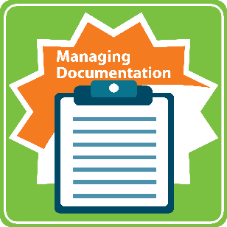






NADSP E-Badge Academy
Notes:
Talking Points:
Explain that NADSP Ebadges are a way to track the competencies that DSPs have learned. Similar to TN QuILTSS Badges

Slide 29
8 Steps for Implementing Competency Based Training
Step 1: Identify and assess the problem
Step 2: Select an intervention strategy
Step 3: Identify components of the strategy
Step 4: Identify barriers to implementation
Larson & Hewitt, 2005
Notes:
Facilitor Note
Read the slide and explain this should be a review, as we’ve used this for implementing other programs throughout these webinars.

Slide 30
8 Steps for Implementing Competency Based Training
Step 5: Identify support for the strategy
Step 6: Set goals, measure progress & establish a time frame
Step 7: Implement the strategy
Step 8: Evaluate success
Larson & Hewitt, 2005
Notes:
Facilitor Note
Read the slide

Slide 31
How could implementing competency-based training improve the direct support workforce in your organization?
Notes:
Facilitor Note
Ask and allow time for responses (note that this is the final slide before the end, so there is time for this discussion)

Slide 32
Resources
15 NADSP Core Competencies
https://www.nadsp.org/dsp-credentialing/15-competency-areas/10-library.html
NADD-DSP Core Competencies
http://acp.thenadd.org/manuals/dsp.pdf
NADSP Code of Ethics
https://www.nadsp.org/library/code-of-ethics.html
Frontline Supervisor Core Competencies
https://ici.umn.edu/products/view/553
CMS Core Competencies
https://www.medicaid.gov/sites/default/files/2019-12/dsw-core-competencies-final-set-2014.pdf
QuiLTSS Institute Orientation
https://quiltss.org/orientation/

Slide 33
Questions?
To receive the slides from today’s webinar or to further discuss this strategy:
Contact your UMN consultant
Or email us at: dsp-tn@umn.edu

Slide 34
Next Workforce Toolkit Webinars
Public Service Announcement
March 2nd, 2-3 pm central
The Critical Role: Frontline Supervisors
March 26th, 2-3 pm central time
Orientation and On-boarding
April 8th, 2-3 central time
Professionalizing DSPs and the their Career Path
April 23, 2-3 central time

