Slide 1

Notes:
To Prepare: ​
Turn on Live Transcript and record if applicable​
prepare Cost of New Hire Tool and PDF of slides (without notes) to put in chat​
Slide #2 – Update presenter names​
Check that the presenter can share their screen ​
Prepare breakout groups if a large group​
Assign an attendance taker, timekeeper, chat monitor​
​
Note to Facilitator:​
Bold Text = Timing​
Italicized Text = Notes – do not read​
Regular Text = Talking Points

Slide 2
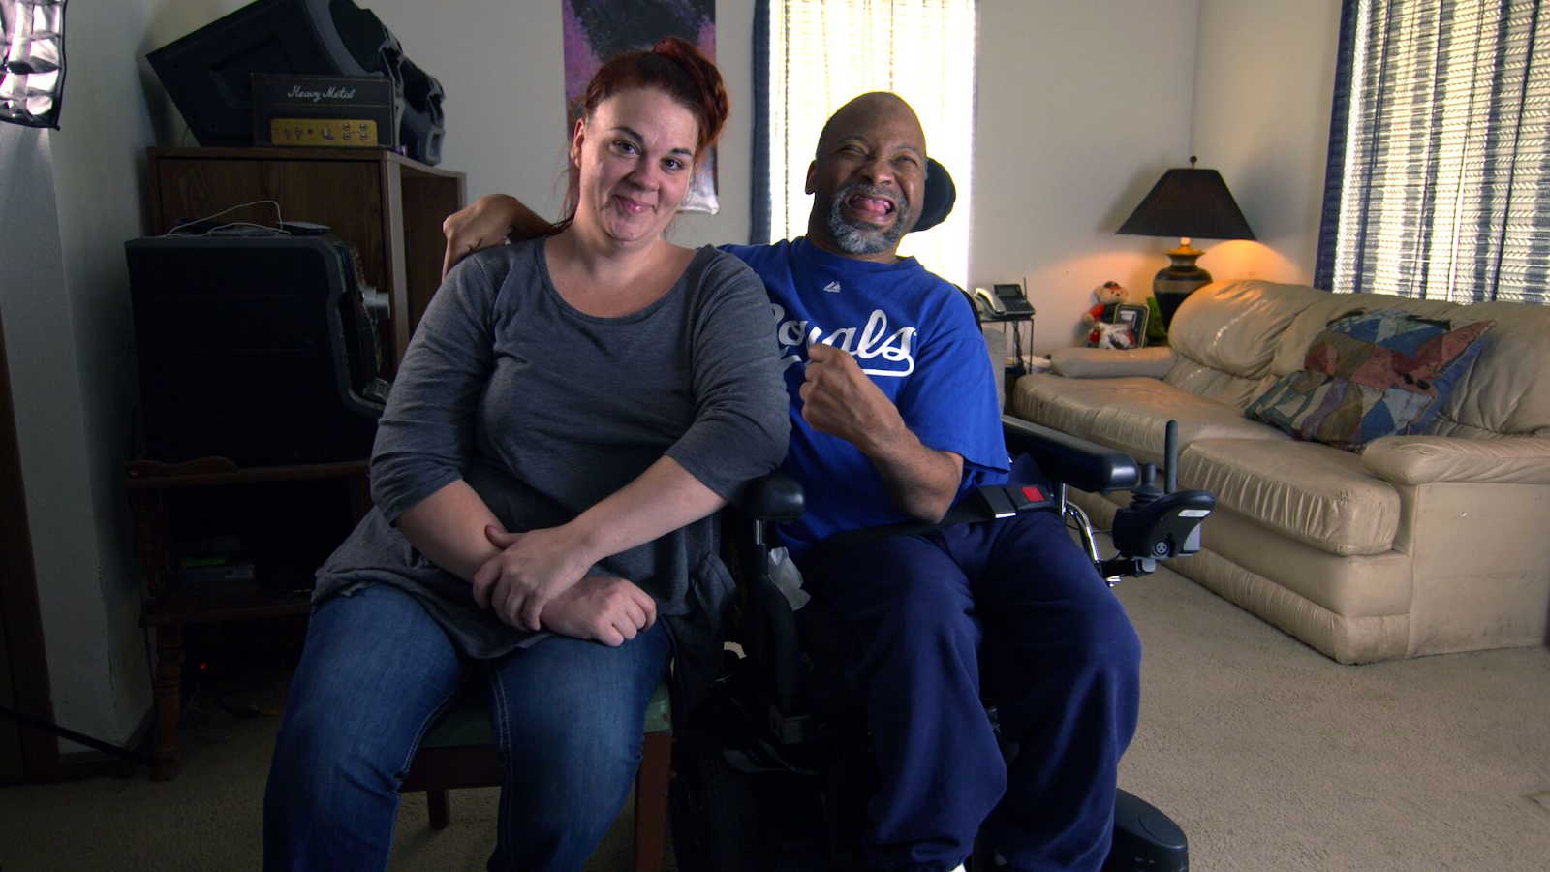
Employment and Community First CHOICES
Workforce QuILTSS Initiative
Learning Lab
Best Practices for Peer Mentoring
Sarah Hall & Mark Olson
Institute on Community Integration
University of Minnesota
tenncare.ici.umn.edu
Notes:
WELCOME:​
Welcome to our first Learning Lab – What is the Cost of a New Hire?​
My name is xx and I am a xx with xx.​
​
If Learning Lab is being recorded, let them know they can contact you if they would like a copy. ​

Slide 3
Using Zoom
Name yourself
  First name
  Name of your organization
Use Chat for questions or comments.
Please keep your Microphone off unless you're speaking.
Keep your Camera on if you are comfortable and able.
Live Script is available.
You may use Reactions such as thumbs up throughout.
Thank you for being understanding of colleagues.
Chat
Notes:
Talking Points:​
Some of us are use to working on Zoom in a group, while others are less familiar. ​
Please keep your microphone on mute when you’re not speaking today to help reduce background noise. When you’re in breakout groups, feel free to unmute and discuss the topic within your group. If you are able, we’d appreciate it if you keep your video on today. Its important for all of us to be able to see and get to know one another in these meetings. We understand if you need to shut off your video for a few moments if you need to step away, but please turn your video back on when you return.​
When you logged into Zoom today, you might have typed in a name for yourself. To help us get to know one another, we ask you to rename yourself with this information on your screen:​
Your name, your organization name. If you are a group of people watching from one computer in an organization, you can shorten to first names and your organization name.​
To do this, look on the bottom of your screen for participants, click on that and on the right side of your screen a white column will appear. Hoover over your name and two buttons will appear mute and more. Click on more, then click on rename. Rename yourself then click OK. ​
The Chat function is at the bottom of the page. It looks like a little speaking bubble. If you have a questions or something you want to add to the discussion you can use Chat. We will be monitoring Chat throughout the session. ​
Using Chat to submit a question, simply click on the button that looks like this in your toolbar.​
Please feel free to send questions at any time during the presentation. We will have time at the end for discussion and questions, so you can type them in the chat and we’ll go over them at the end. ​
Also when you click on “Participants,” you’ll see some buttons to interact with the presentation. You can say yes, no, go slower, go faster, and when you click on “More” you will find that you can use the thumbs up or thumbs down buttons. You can also let us know if you need to step away for a quick break to use the rest room or fill your coffee cup. Suffering is optional.​
When we take breaks we do ask that everyone turn their camera during the break then turn it back on when you return or use reactions when you return so that we know when we are ready to start again. ​
Finally, we are all still working from home at the University of Minnesota. Explain “coworkers” you share your space with. ​

Slide 4
Welcome & Introductions
Notes:
Transition slide

Slide 5
Open Round
Getting to Know You
Your name and role in your organization
What is one question you have about peer mentoring?
Notes:
Time: 5 minutes
Talking Points:
We would like to start with a little time to get to know you and see if you have any initial questions. We’ll try to make sure we cover these questions. Please introduce yourself with the following: read slide​
​
Note: If group is large, can have them type in chat.​
Alternate question: What is one thing you hope to get out of today’s Learning Lab? / What is one question you have on this topic?​

Slide 6
The Peer Empowerment Program
Notes:
Talking Points:
The tool we will talk about today is the Peer Empowerment Program. It is a peer mentoring framework for direct support professionals that you may customize for your organization.

Slide 7
Goals for this session
Given the Peer Empowerment Program, providers should understand what problem the tool solves, how to use the tool, and have resources for the next steps.
Notes:
Read slide

Slide 8
Building & Strengthening the DSP Workforce
Recruitment Strategies | Selection Strategies | Retention Strategies
Effective Marketing Public service announcements (PSA) Targeted marketing Recruitment and hiring bonuses Recruitments sources | Structured behavioral interviews Realistic job preview | Orientation and onboarding Competency-based training Employee Development Job Analysis Job Descriptions Recognition Programs Coaching & Mentoring Peer Mentoring Performance coaching Networking Employee Engagement & Organizational Participation Professional Development Developing career paths Professionalizing DSP roles Wage and Benefit Policy Change
Notes:
Talking Points:
As you can see in this chart, peer mentoring is an effective way to increase retention.
Many DSPs who quit soon after being hired would stay longer if they had better support, direction, and training. Mentoring makes it more likely that new hires will stay longer because they will have the help they need when they need it.
Through mentoring, organizations can reduce the financial and human costs of turnover. These are powerful outcomes that can redirect substantial amounts of dollars and staff energy to the important work of supporting people.

Slide 9

Mentoring
Mentoring is when experienced DSPs, regardless of age or current job function, assist new or less experienced DSPs to:
  Develop specific competencies
  Reflect on current practices, culture, and values
  Learn about all aspects of their job
  Feel supported and welcome
Notes:
(Read slide)
Mentoring your employees will require time, energy, and financial investment. If your employees are already satisfied, productive, competent, and stable and there is a healthy work culture in your organization, you may not need a mentoring program.

Slide 10
The Peer Empowerment Program (PEP)
The Peer Empowerment Program is a toolkit that provides guidance on planning and customizing your own peer mentoring program following a recommended framework.
The toolkit includes:
  Guidance to select, train, and sustain mentors
  Instructions for preparing and supporting mentees
  Content, worksheets, and other tools you will need
Notes:
The Peer Empowerment Program (PEP) is a toolkit that provides guidance on planning and customizing your own peer-to-peer mentoring program following a recommended framework. It provides guidance on how to select, train, and sustain mentors as well as instructions for preparing and supporting mentees. The PEP Toolkit is complete with content, worksheets, and other tools you will need to launch and operate your mentoring program.
PEP is a program that matches and supports volunteers from your pool of experienced direct support professionals (the mentors) with less experienced DSPs (the mentees). Mentors support and socialize mentees to the organization. The partners work together to identify the mentee’s skill development goals and the ways they will work together to achieve those goals.
Both mentor and mentee enter into their relationship voluntarily and negotiate a mutually agreeable written contract to ensure that both partners understand the goals and expectations of the mentoring relationship. Either party can stop the relationship at any time to ensure that people will enter the partnership freely and will stay only if it is working for them.

Slide 11
The PEP Toolkit
Program Coordinator Guide
  Understanding, Planning, and Launching the PEP
The PEP Curriculum – Facilitator & Learner Guides
  The PEP Orientation Session
  The PEP Mentor Development Workshop
Notes:
Talking Points:
The PEP Toolkit is organized into three parts. The first part is a Program Coordinator Guide entitled, Understanding, Planning, and Launching the Peer Empowerment Program. It provides coordinators and program planners with all the information and tools they need to plan and develop the components of PEP before initiating the program within their organization.
The second part of the PEP Toolkit is the Facilitator Guide for conducting the curriculum, including the orientation session and mentor development workshop.
The Orientation is a one-hour session used to orient both prospective mentors and mentees to mentoring.
The Mentor Development Workshop is a step-by-step curriculum designed to be completed in a four-hour workshop with the objective of preparing volunteer DSPs for their role as mentors. It can be formatted as a half-day workshop or as four separate 60-minute training sessions.
The third component of the PEP Toolkit is the Learner Guide. It is designed for mentors and mentees to use as a guide to participate in the learning activities during the Orientation Session. The Learner Guide is also for mentors to use as a workbook during the Mentor Development Workshop and as a reference for both mentors and mentees to use throughout their mentoring partnership.
There are some resources that go with this tool. You can find the link here (insert link to product in chat)

Slide 12
PEP Planning & Implementation Framework
Select Coordinator & Planning Team
Complete Self-Assessment & Plan
Design Evaluation
Market Program
Select Mentors & Mentees
Conduct PEP Orientation
Train Mentors
Arrange Matches
Develop Agreements
Monitor/Support Activities
Conclude Partnerships
Conduct Exit Interviews
Use Feedback to Improve Program
Continue Program Cycle
Notes:
This is the PEP framework. It provides you with an overview of the activities and key elements of PEP. These are the elements that you will customize and use to create your unique mentoring program that meets your organization’s needs and desires.
In the planning stage, you will complete steps 1 to 3: (read steps).
When implementing the program, you will complete steps 4 to 13: (read steps).
We will discuss each step in more detail on the following slides.
Note to facilitator: If limited on time, stop here and don’t discuss the steps further to allow time for questions. Explain that steps are explained in the webinar on the toolkit & Skip to slide 17/18.

Slide 13

Customized Planning
Select a Coordinator
Select a Planning Team
Design Program Evaluation Components
Notes:
Talking Points:
The coordinator’s role is to:
Coordinate planning group and toolkit customization
Implement and evaluate the program
Advocate for ongoing program support
The planning team will assist the coordinator with key planning decisions in the early stage of the program’s development. Later, the planning team could serve as an ongoing advisory committee.
In putting together a planning team, you will want to include newer and experienced DSPs who will be served by the PEP program. Having their input will help them take ownership of the program and to understand that the program is for and about them.
To evaluate the effectiveness of your peer mentoring program, you may:
Track turnover before and after program implementation
Use exit interviews and focus groups to identify PEP participant satisfaction and ways to improve program
Use surveys to determine how mentees applied their learning to the job
Compare customer satisfaction with PEP graduates vs. other DSPs

Slide 14
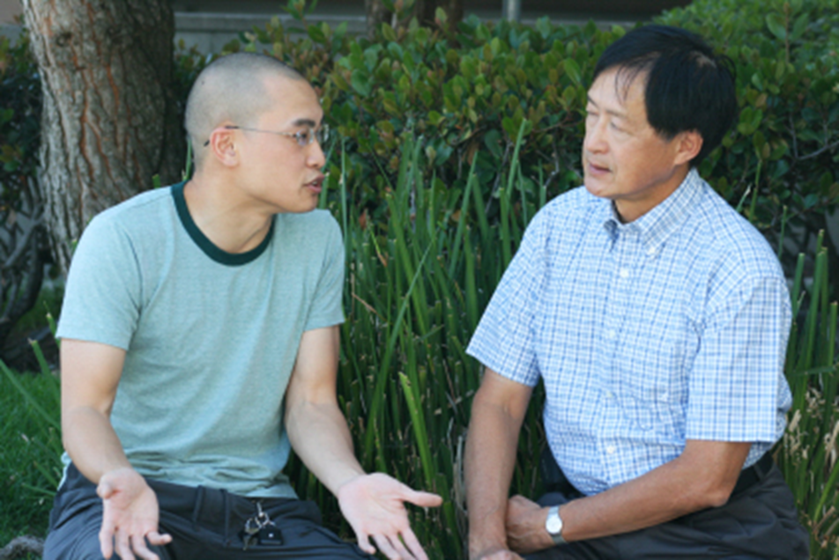
Program Implementation (part 1)
Market the Program
Select Mentors and Mentees
Conduct the PEP Orientation
Train Mentors
Notes:
Talking Points:
Once the coordinator and planning team have designed a peer mentoring program that fits the needs of your organization, it is time to implement the program.
The first step in implementation is to market the program.
The coordinator and other leaders will recruit volunteer mentors by clearly communicating the purpose, benefits, and requirements of the program.
You will need to establish and publicize clear standards regarding eligibility to be a mentor.
The next step is to select mentors and mentees.
Potential mentor volunteers will complete a brief application to signify their interest in becoming a mentor. The coordinator receives and screens mentor applications, eliminating any candidates with poor performance records or who fail to meet other qualifying criteria. Then, candidates are notified of the decision and are placed in a mentor pool, awaiting a match with a new hire.
Each mentee will complete a brief written profile with information that will help the coordinator assign partners.
Prospective mentors and mentees will attend the orientation session, which provides essential information regarding the purpose, benefits, and key characteristics of the program as well as any required elements of the program such as the frequency of meetings, the duration of the experience, and the development of a Partnership Agreement.
All prospective mentors should attend the Mentor Development Workshop, which is a four-hour training session to prepare them to become mentors. The topics covered in this session include:
Roles and activities
Effective coaching and teaching strategies
Practical cultural competence
Communicating vision, values, and mission
The PEP toolkit includes information and resources to conduct the PEP Orientation Session and the PEP Mentor Development Workshop.

Slide 15

Program Implementation (part 2)
Arrange Matches
Develop Partnership Agreements
Support Mentors
Conclude Partnerships
Notes:
Talking Points:
The PEP coordinator will arrange matches to determine the mentor and mentee partners. The coordinator may want to intentionally select mentors who work at the same site, work in fairly close proximity, or provide similar services. Other factors to consider may include culture, primary language, background, age, work hours, and locations.
The mentor and mentee will negotiate an agreement regarding mutual responsibilities, developmental goals, frequency of meetings, length of mentorship, and an outline of activities that will help the mentee achieve his or her goals. This is the Partnership Agreement.
Support mentors: In addition to the initial training, it is a good idea to schedule quarterly or bi-monthly gatherings for new and experienced mentors to receive support from their peers. Some portion of the gathering should be devoted to a discussion of their experiences so they may get advice, reflect on the overall experience of mentoring, celebrate the successes they are having with their mentees, and strengthen and improve the program for everyone involved.
Conclude partnerships: Mentoring partnerships are time-limited. Once their contract ends, both the mentor and mentee should evaluate the extent to which the desired outcomes were achieved and what could be done to improve the program in the future. Mentors and mentees may conclude their partnership or renew their agreement for a longer period of time.

Slide 16

Use Feedback to Improve the Program
Conduct Exit Interviews
Use Feedback to Improve Program
Continue Program Cycle
Notes:
Talking Points:
When partnerships conclude, the coordinator will obtain feedback through exit interviews or a written survey.
The coordinator may also gather information from regular mentor support meetings and other evaluative processes to engage in continuous program improvement. To improve the mentor training curriculum, coordinators may also assess the mentors’ skills after training and in annual performance reviews.
The last step in the process is to continue the program cycle from steps 4 through 13.

Slide 17
PEP Planning & Implementation Framework
Select Coordinator & Planning Team
Complete Self-Assessment & Plan
Design Evaluation
Market Program
Select Mentors & Mentees
Conduct PEP Orientation
Train Mentors
Arrange Matches
Develop Agreements
Monitor/Support Activities
Conclude Partnerships
Conduct Exit Interviews
Use Feedback to Improve Program
Continue Program Cycle
Notes:
Talking Points:
To review, the first three steps in the PEP framework shape the overall planning and customization of the program led by the coordinator and planning team.
After the initial planning is complete, the planning team becomes an advisory committee throughout the life of the program.
The self-assessment is where the customization begins so that the peer mentoring program fits the unique characteristics and needs of your organization.
The plan and evaluation will be revised from what you learn during the first year of the program and should be continually improved upon using feedback from participants each year.
The program cycle will begin again every 6 months to a year. Though each step will be customized to your organization, the general framework will remain the same from steps 4 through 13.

Slide 18
For more details
tenncare.umn.ici.edu
DSP Workforce Toolkit
Retention
Peer Mentoring
Webinar
Peer Empowerment Program toolkit:
https://ici.umn.edu/products/47
Notes:
Talking Points:
To learn more, you may watch the full webinar about Peer Mentoring. You may find it by going to tenncare.umm.ici.edu.
You may also download the PEP toolkit at: https://ici.umn.edu/products/47
Add the name and link to the toolkit in the Chat: Peer Empowerment Program: https://ici.umn.edu/products/47
As a heads-up, the formatting is outdated (think overhead projector templates), but the information and format still applies today.
Since PowerPoint presentations are more common nowadays, we have created template PowerPoint presentations for the orientation and the mentor development workshops that you may use as a starting point for creating an orientation and/or mentor development workshop that fits the needs of your program.
Upload the two PowerPoints to the Chat:
PEP Orientation Session Presentation
PEP Mentor Development Workshop Presentation

Slide 19
Discussion + Questions
Notes:
Time: 10-15 minutes
Talking Points:
Now, let’s take a little time to answer questions about the Peer Empowerment Program and talk about mentoring in general.
Are there any questions about the Peer Empowerment Program?
For those of you who have had a mentoring program, what worked? What didn’t work?
What tips do you have for setting up or implementing a mentoring program?

Slide 20
Closing Round
  What’s your next step?
Notes:
Time: 5-10 minutes
Note to facilitator: can skip slide or ask one person their next step and explain that during 1:1 consultation consultants can help you plan next steps.
For smaller groups: What’s your next step?
For larger groups: One word to describe this lab

Slide 21
Questions?
Check out TN DSP Workforce Toolkit: https://tenncare.ici.umn.edu/
Contact your University of Minnesota workforce consultant
Email us at: dsp-tn@umn.edu
Attend Monthly Office Hours
Notes:
Read slide

Slide 22
Office Hours
  East Region:
    1st Friday 9-11:00 am CST
    3rd Friday 9-11:00 am CST
  Middle Region:
    1st Wednesday 1-3:00 pm CST
    3rd Wednesday 1-3:00 pm CST
  West Region:
    2nd Monday 9-11:00 am
    2nd Wednesday 9:00–11:00 am
Notes:
Read slide

Slide 23
Upcoming Events
Upcoming Learning Labs:
  Staff Satisfaction Surveys and How to Use Them – May 4, 10:00-10:45am CST
  Assessing Your Website – May 17, 10:30-11:15am CST
Upcoming Community of Practice:
  West: April 21, 9:00–11:00am CST
Notes:
Read slide

Slide 24
Thank you
Notes:
Thanks and Goodbye

