Slide 1

Presenter Prep Slide Only
Notes:
To Prepare:
Turn on Live Transcript and record if applicable
prepare (Name of Learning Lab) and PDF of slides (without notes) to put in chat
Slide #2 – Update presenter names
Check that the presenter can share their screen
Prepare polls/breakout groups if a large group
Assign an attendance taker, timekeeper, chat monitor
Note to Facilitator:
Bold Text = Timing
Italicized Text = Notes – do not read
Regular Text = Talking Points

Slide 2
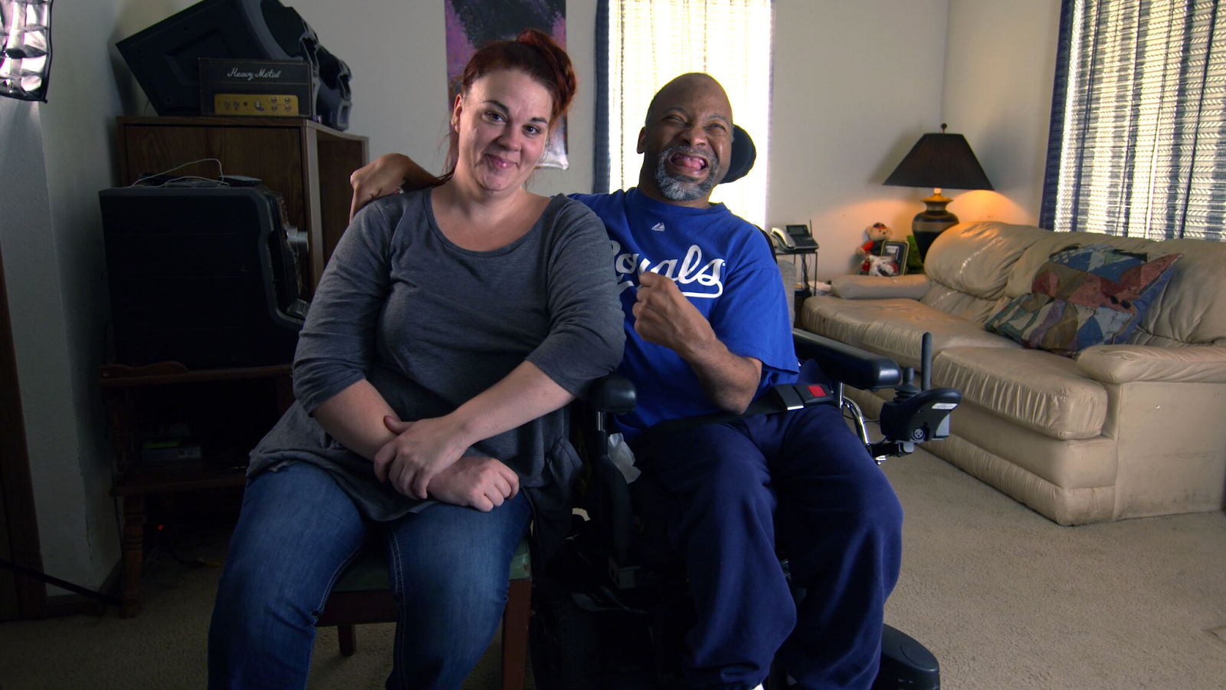
Employment and Community First CHOICES
Workforce QuILTSS Initiative
Learning Lab
Best Practices for
Career Ladders
Mark Olson & Julie Kramme
Institute on Community Integration
University of Minnesota
tenncare.ici.umn.edu
Notes:
Time 30-60 seconds
Talking Points
Welcome to our xx Learning Lab – xx
My name is xx and I am a xx with xx.
Acknowledge other UMN staff and the Regional Coaches (Don’t all on them for opening round)
If Learning Lab is being recorded, let them know they can contact you if they would like a copy.

Slide 3
Using Zoom
Your microphones will be muted when enter. Please keep them turned off unless you're speaking.
Name yourself
  First name
  Name of your organization
Use for questions or comments.
We will use “Reactions” such as “thumbs up” though-out the workshop.
Live Script
Camera on as you are able to and comfortable.
Take care of your needs. If you need a break, take one.
Be Understanding of “co-workers”
Chat
Notes:
Time: 30-60 seconds
Talking Points:
Some of us are used to working on Zoom in a group, while others are less familiar.
Please keep your microphone on mute when you’re not speaking today to help reduce background noise. When you’re in breakout groups, feel free to unmute and discuss the topic within your group. If you are able, we’d appreciate it if you keep your video on today. Its important for all of us to be able to see and get to know one another in these meetings. We understand if you need to shut off your video for a few moments if you need to step away, but please turn your video back on when you return.
When you logged into Zoom today, you might have typed in a name for yourself. To help us get to know one another, we ask you to rename yourself with this information on your screen:
Your name, your organization name. If you are a group of people watching from one computer in an organization, you can shorten to first names and your organization name.
To do this, look on the bottom of your screen for participants, click on that and on the right side of your screen a white column will appear. Hoover over your name and two buttons will appear mute and more. Click on more, then click on rename. Rename yourself then click OK.
The Chat function is at the bottom of the page. It looks like a little speaking bubble. If you have a questions or something you want to add to the discussion you can use Chat. We will be monitoring Chat throughout the session.
Using Chat to submit a question, simply click on the button that looks like this in your toolbar.
Please feel free to send questions at any time during the presentation. We will have time at the end for discussion and questions, so you can type them in the chat and we’ll go over them at the end.
Also when you click on “Participants,” you’ll see some buttons to interact with the presentation. You can say yes, no, go slower, go faster, and when you click on “More” you will find that you can use the thumbs up or thumbs down buttons. You can also let us know if you need to step away for a quick break to use the rest room or fill your coffee cup. Suffering is optional.
When we take breaks we do ask that everyone turn their camera during the break then turn it back on when you return or use reactions when you return so that we know when we are ready to start again.
Finally, we are all still working from home at the University of Minnesota. Explain “coworkers” you share your space with.

Slide 4
Open Round
Getting to Know You
Your name and role in the organization
What is one question you have related to Career Ladders?
Notes:
Time: 3-5 min
If more than 3 providers – use Chat
We would like to start with a little time to get to know you and see if you have any initial questions. We’ll try to make sure we cover these questions. Please introduce yourself with the following: read slide
Note: If group is larger, type in chat
Alternate question: What is one thing you hope to get out of today’s Learning Lab? / What is one question you have on this topic?

Slide 5
Goals for this session
Distinguish career ladder from a credential
Learn about an organizational career ladder in another state.
Hear about key facilitators.
Have discussion
Notes:
Time: 1 minute
Talking Points
Our goal for today’s learning lab is …
Distinguish career ladder from a credential
Considerations for creating one in your organization.
Learn about successful outcomes of career ladders in another state.
Hear about key barriers and facilitators to starting and maintaining an engaging career ladder your staff from organizations that use career ladders.

Slide 6
Building & Strengthening the DSP Workforce
Recruitment Strategies | Selection Strategies | Retention Strategies
Effective Marketing Public service announcements (PSA) Targeted marketing Recruitment and hiring bonuses Recruitments sources | Structured behavioral interviews Realistic job preview | Orientation and onboarding Competency-based training Employee Development Job Analysis Job Descriptions Recognition Programs Coaching & Mentoring Mentoring Performance coaching Networking Employee Engagement & Organizational Participation Professional Development Developing career paths Professionalizing DSP roles Wage and Benefit Policy Change
Notes:
Time: 30 seconds
Talking Points
Remind attendees to consider the problem they are trying to solve with this tool – explain where the strategy falls.
Developing career paths is a retention strategy – focused on retaining high quality and committed DSPs.

Slide 7
Career Ladders
Career ladder: gain professional recognition for training and specialized skills
Credential: state and/or nationally recognized specialized degree upon successful completion
  DOL Apprenticeship Program
Notes:
Time: 1 minute
Talking Points
Career ladders are ways that workers can gain professional recognition within their organization and the field for training and specialized skills
Credentials involve state and/or nationally recognized training requirements and an exam where the learner earns a specialized degree upon successful completion
Such as the DOL Apprenticeship Program

Slide 8
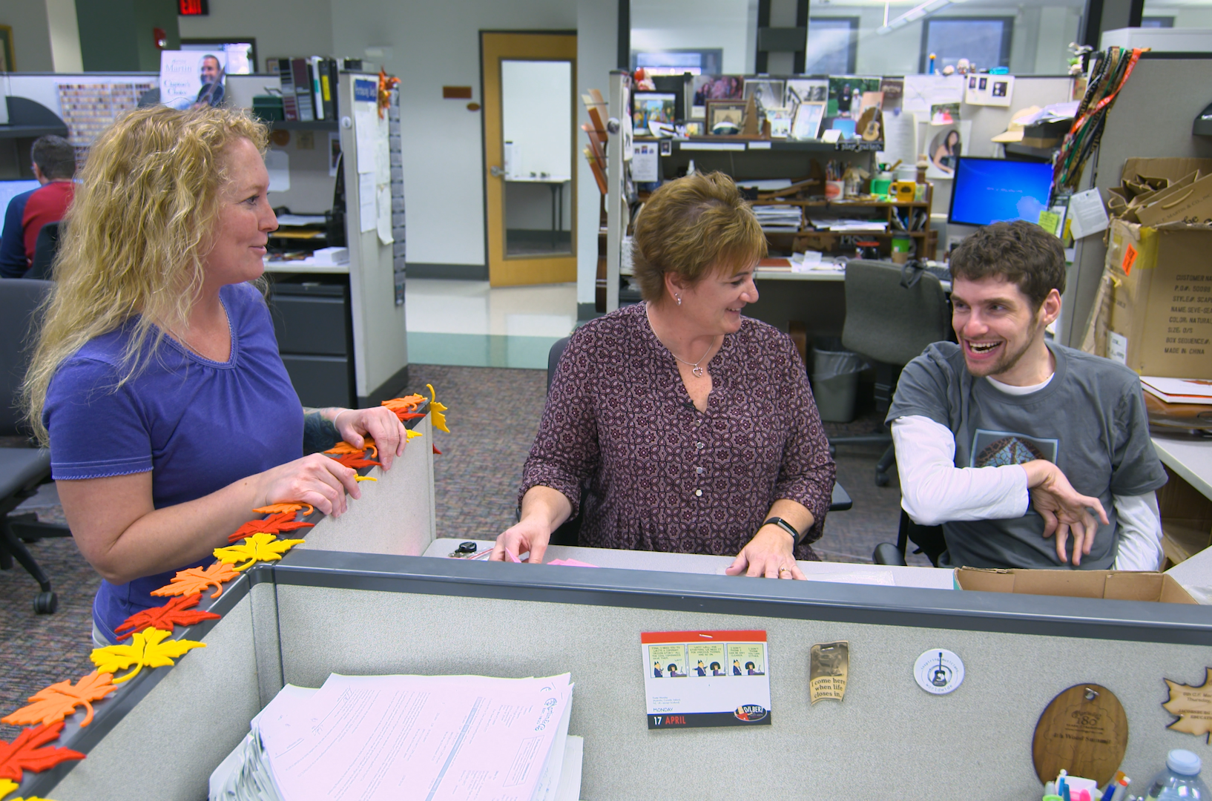
Eight Steps to Build a DSP Career Ladder
Hold stakeholder group gathering
Develop mission, vision, values, and goals
Create framework
Investigate and locate possible funding sources
Design training components
Implement program
Evaluate program
Plan for sustainability
https://tenncare.ici.umn.edu/dsp-workforce-toolkit/retention/career-pathways-for-dsps
Notes:
Time: 2 minutes
Talking Points
In the TennCare toolkit is a helpful webinar that includes 8 steps to building a DSP Career Ladder. You can view this webinar at any point to help get the vision for putting in place a comprehensive and supportive program in your organization that is likely to be sustained over time. We provide details on the pathway to find this webinar at the end of the presentation today (the link is also in the slide).
These steps were informed by some work in evaluating career ladder and credential programs in other states where organizations have implemented organizational credentialing program. In the rest of the presentation, we will share an example of a well-establish organizational career ladder program to help you think about what it might take to implement a career ladder or credentialing program in your organization. If you’re already implementing a career ladder or credential program, reflection on this program might help you think of some ideas for improving or tweaking what you’re already doing.

Slide 9

Ability Beyond Direct Support Professional Credential
353 credentials awarded since 2008
Cohort model (15-20 learners)
Classroom & online learning via CDS
  Since pandemic, fully online
Aligned with DSP Competencies
Eligible after 6 months employment
Approx. 6 mos to complete.
Wage increase: $0.50/hr, plus $500 bonus at graduation + $500 after completing goals
  Potential for up to three additional credentials earned
(Kramme & Hewitt, 2021)
Notes:
Time: 2 minutes
Talking Points
Ability Beyond has a well-established career ladder program that has been in use since 2008. It is a real organization that provides multiple types of services to people with IDD across two states. We wanted to provide an example of a well honed and attended to organizational career ladder program to help you think about what might be possible in your own organization as a strategy to retain quality, committed DSPs.
Ability Beyond has experienced direct support workforce shortages for decades, including a shortage of qualified applicants to fill vacant positions and difficulties retaining DSPs. Their organizational credentialing program, called Pathways to Excellence was piloted and implemented in 2008 as a career pathway to provide opportunities for qualified DSPs to increase their professional skills, career distinction, and receive a commensurate wage increase after completing each step on the career ladder. They have experienced limited budgets for professional development, and this has impacted their program over the time they have been implementing. However over the years that the credentialing program has been operating, discussion about the Pathways to Excellence program has turned from how to allocate funds and resources to support the program to how to INVEST time and resources into the program since the program has been very successful. The return on investment through staff retention, and training a more skilled, engaged, and high quality workforce places a high value on the program. When facing budget cuts, administrators have taken measures to ensure that the credentialing program can continue given its value in retaining DSPs and developing leaders.
Here is how the career ladder works: DSPs at Ability Beyond are hired as “Life Skills Instructors.” When they complete the level one credential in the Pathways to Excellence program, they are distinguished as “Direct Support Professionals.” There is a different job description for Direct Support Professionals, which demands more complex skills and professionalism that learners were exposed to and practiced in Pathways to Excellence. The classroom content in the program emphasizes best practices, and it challenges each learner to set a professional goal with their supervisor. Six months after completing the credential, learners are assessed on their progress toward their goal, and if they meet their goal they are eligible for an additional bonus. Due to the success of this program, Ability Beyond has developed three additional credentialing opportunities for learners who complete the PTE program to further advance their skills. The most commonly offered specialty credential beyond the DSP credential is Mentoring and Supervision.
[Start clicking through points:]
*Since 2008, there have been 353 credentials awarded to DSPs and FLSs.
*The PTE program is a cohort model of 15-20 learners. The cohort meets once monthly for classroom discussion and practice applying strategies.
*The classroom discussion centers on the online coursework that learners have completed through the College of Direct Support, which is an online learning platform of specialized content for direct support professionals. It is similar to what has been developed in the QuILTSS Initiative. This online learning is self-paced and happens for each learner outside the work day. However, since the start of the pandemic, this classroom component has moved online to a virtual platform. This removes barriers for some students, but others would prefer being back in person.
*The coursework is aligned with the state competencies, the Office for People with Developmental Disabilities competencies.
*Employees are eligible to apply for the program after six months of employment, and the learners’ supervisors must approve participation.
*The PTE program takes about six months to complete the coursework. After that, they work towards their professional goal with the support of their supervisor for six months.
*Learners who graduate from the program earn a $.50 per hour wage increase and a $500 bonus. As mentioned, they are eligible to earn another $500 bonus upon completing their goals at six months after graduation.

Slide 10
Ability Beyond DSP Outcomes Summary (2019)
 | Credentialed | Non
Annual Turnover | 11% | 23%
Tenure | 13.5 years | 5.3 years
Wage | $19.59 | $15.51
19% DSPs credentialed
Average DSP wage in the state in 2019: $15.31
(Kramme & Hewitt 2021
Notes:
Time: 1-2 minutes
Talking Points
In terms of evaluating the successes of your career ladder or credential program, many programs focus on the number of staff credentialed, and reductions in turnover, increases in tenure and changes in wages of credentialed staff when compared to non-credentialed staff.
What you see on the slide are a set of point-in-time evaluation information for the Ability Beyond credential program when compared to all other staff in the organization (the non-credentialed staff).
Overall, 19% of their DSPs employed had earned at least one credential at the point in time when these data were collected.
As expected in terms of their outcomes, there was significantly less turnover, longer tenure and higher wages among credentialed staff when compared to non-credentialed staff at the same point in time.
One thing to note about these wage data are that some of these DSPs have completed more than one credential available to them, since Ability Beyond has expanded the credentialling opportunities to a multi-tiered credential. Once the DSP has earned the first credential, they are eligible to participate in additional credentials over time.
As a note, these data from Ability Beyond do not include their credentialed frontline supervisors. At that time, 41% of their FLS employed had earned 1+ credential, and their data are summarized separately in our report.
[NCI SSS from NY in 2019: TO = 36%, wage $15.31]

Slide 11
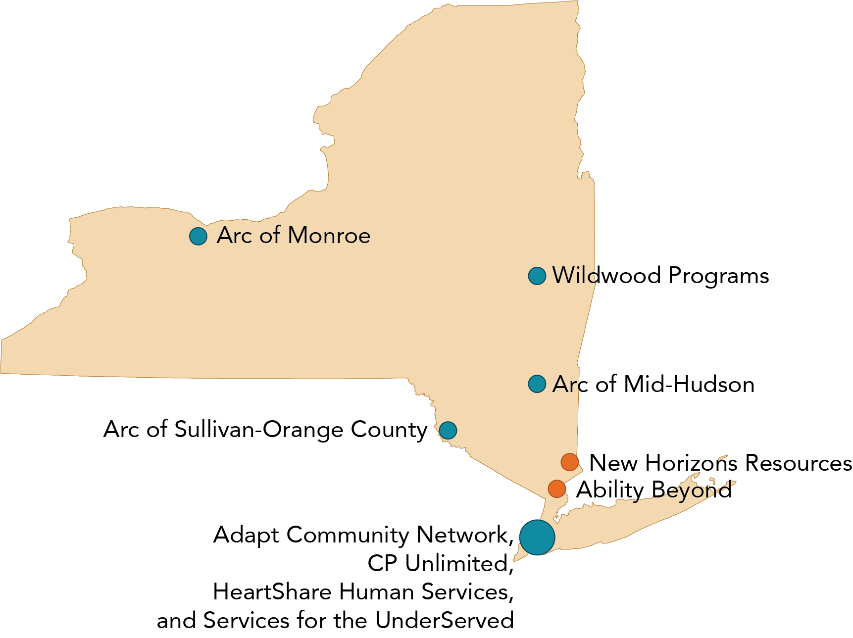
Strategies for Successful Implementation
Utilize ready made curricula or one already used
Utilize technology
Include wage increases
Collaborate with other organizations
Appoint a program administrator
Ensure administrative and supervisor support
Provide supports for learners
Plan to implement for several years
(Kramme & Hewitt, 2021)
Notes:
Time: 2-3 minutes
Talking Points
We evaluated seven credentialing or career ladder programs in the state of NY that used different curricula and designs for their credentialing programs, and summarized the information to look for trends in strategies for successful implementation that were utilized by organizations. These are listed on the screen.
First, organizations utilized ready-made curricula or drew up the ones that were already used. Rather than create a new pathway, they drew upon what was already working in their organizations.
Utilize technology – this streamlines the process for many staff to access the needed content to advance their skills. Using online content, employees can access at a time that works for them.
Collaborate with other organizations – some organizations worked together to create a learning program and access resources needed to deliver instruction (for example, space and trainers). It also provided opportunities for staff to collaborate and learn from one another between organizations as they dealt with differing circumstances or aspects of service delivery (for example, providing residential or day program supports).
Appoint a program administrator – all programs had one or more point people who supported all learners through the programs. We interviewed learners as a part of this project, and learners in the programs talked about the support and encouragement they received from the program administrator, and that this made a difference for their successes.
Ensure administrative and supervisor support- most programs that we evaluated started with administrator support. In addition, supervisor support was often key to learners’ successes. For example, supervisors would have to release learners to attend classroom instruction or discussion, and support learners in on-the-job tasks. Some programs formalized the process of learners obtaining supervisor support in the application process, as this was key to ensuring that learners could complete the credential.
Provide supports for learners- organizations supported by providing technology, learning and language supports.
Finally, plan to implement for several years- every program developed over time, finding strategies that worked and didn’t work. Asking for feedback from learners supported this process for many organizations.

Slide 12
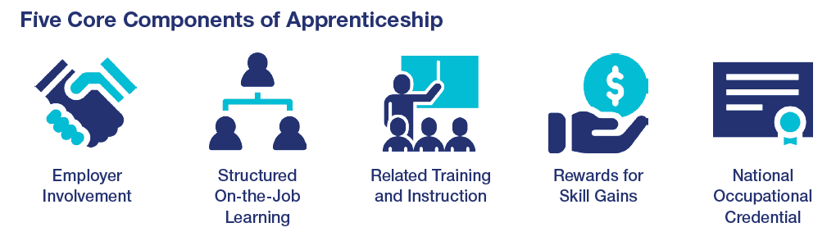
Tennessee Direct Support Professional Apprenticeship

Slide 13
Discussion + Questions
Notes:
Timing: 10 minutes Small group, leaving time for Large group report back – 5-7 minutes
Talking Points
Any questions about the tool?

Slide 14
Closing Round
  What’s your next step?
Notes:
Time: 30 seconds – 5 minutes
Ask one person to report their next step, then explain we’re here to help as you think about your next steps. Encourage them to think about next step of applying what they learned today, and to add it to their action plan. Transition to next slide to explain if they have questions or want help planning, they can attend office hours or schedule 1:1 consultation time.
Facilitator note. If there is a whiteboard take this information down.

Slide 15
Questions?
Other ways to learn more:
Checkout the Tenncare Workforce Toolkit at: tenncare.ici.umn.edu
Contact your consultant at: dsp-tn@umn.edu
Join our Monthly Office Hours
Notes:
Time: 30 seconds
Talking Points
If you have questions about this tool later, these are ways you can contact us. We can work together to figure out next steps in office hours or through individual technical assistance.
Read slide

Slide 16
For more details
tenncare.umn.ici.edu
Toolkit
Retention
Career Pathways
Webinar
Notes:
Time: 30 seconds
Talking Points
Here is the Path on the Tenncare website to find the toolkit for the webinar on Career Pathways.

Slide 17
Upcoming Events
Upcoming Community of Practice:
  Monday, August 16 10a-12p CST (West)
  Wednesday, August 18 10a-12p CST (East)
  October (all regions) – dates to be determined
    All 2021 Community of Practices will be via Zoom
Notes:
Time: 30-60 seconds
Edit slide as needed regarding upcoming workshops
ADD REGISTRATION LINKS TO ZOOM CHAT.

Slide 18
Thank you

