Slide 1



Welcome to the Webinar Series on the Workforce Toolkit.
We will begin at 2:00 pm central
Notes:
Host and Co-host notes for pre-meeting setup​
Actions before the session:​
Slide #1 – Update presenter names​
Hide other region consultant slide, as applicable​
Hide other regions workshop slide for Upcoming Workshops, as applicable​
In the Practice session before participants log on​
Check that the presenter can share their screen and run videos as needed​
Check that the presenter marks “Share Computer sounds” and “Optimize Screen sharing for video clip” so that any videos shown can be heard by others – it is on the same screen that you choose which screen to share. ​
Make Coaches "Co-hosts"​
Confirm polls are loaded - host​
Turn on transcript –host ​
Break-out Groups – host ​
Take attendance​
Time keeper​
Host / Welcome people as they arrive & arrive late
Monitor Chat – assign someone ​
Turn on record, as desired ​
Subtitles – turned on, each participant can control turning on and off ​
At end of presentation:​
MAKE SURE TO STOP RECORDING AT THANK YOU SLIDE​
Note to Facilitator​
Bold Text = Timing ​
Italicized Text = Notes – do not read ​
Regular Text = Talking Points ​

Slide 2
Finding Great DSPs through Targeted Marketing
Notes:
Timing: Total of 40-45 minutes (approx. 1-3 minutes/slide)
Action – Record as desired​​
Welcome
My name is xx and I am a xx with the Institute on Community Integration at the University of Minnesota. I am here today with my colleagues from the University of MN, __________ and ________________. Also Regional Coaches from Tennessee ____________________ and ___________________.​​
Thank you so much for joining us today. During today’s session we will talk about finding great DSPs through targeted marketing. ​​
If being recorded: This webinar is currently being recorded. We will send the recording to you if you would like to view again or share with others in your organization. ​

Slide 3


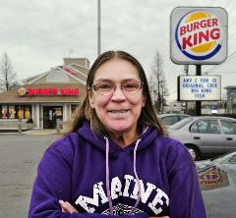




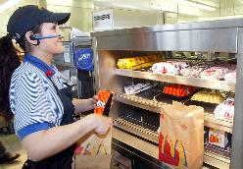
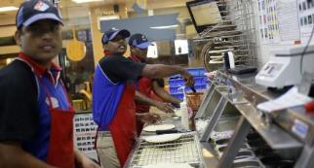

What is this job anyway?
Notes:
Talking Points
If we look at other industries, we can clearly identify the job or role. For example, if you worked in retail or fast food you do not need to explain your job duties to people. They already have an understanding about what it is you do. These industries invest significant amounts of money into marketing their organizations.
This is helpful in supporting their recruitment efforts. They don’t need to explain the job duties or existenceof their positions because people already have a wide base of knowledge and understanding of what that is.
A direct support professional is not a role that is commonly understood as a job, despite being the largest growing profession.

Slide 4
The Challenges & Costs of Recruitment
Traditional candidate pool is shrinking
Economy improving – more competition
Multi-generational workforce
Cost of hiring and training new DSPs is estimated at $4,200 – $5,400 per position
DSP vacancy rates result in increased stress on the remaining workforce
(ANCOR, 2017; Hewitt & Larson, 2007)
Notes:
FYI only - do not spend much time on this.
Talking Points:
Traditional candidate pool is shrinking
Economy improving – more competition
Multi-generational workforce
Estimated cost of hiring and training new DSPs is $4,872 per position - updated data in the 2017 report on DSW Workforce (citation/reference below?)
DSP vacancy rates result in increased stress on the remaining workforce
4

Slide 5
The Purpose of Targeted Marketing
To share job openings with prospective new employees
Clearly identify who is the subject of the marketing
Targeted marketing is one component of a broader marketing campaign.
Notes:
Talking Points:
The purpose of targeted marketing flyers or other media forms is to share the job opening with prospective new employees.
These flyers (or other media) clearly identify who is the subject of the marketing who may include: New Americans, Ex-military service, Volunteers, College students, Retirees, And others, dependent on your specific location.
Targeted marketing is one component of a broader marketing campaign. This works within a larger coordinated marketing plan. Be sure to coordinate messaging across all marketing efforts.

Slide 6
Use Inside Recruitment Sources: Inside Sources
current employees
  Referral bonuses
people receiving services and their families or friends
volunteers
social media networks that are existing “friends” of the organization
staff friends
service coordinators or case managers
board members
others…..
Notes:
6
Talking Points:
Look at what’s right in front of you - think of all the people connected to your organization who are assets in your recruitment process.
Inside sources are those current areas that you are already connected to as an organization. How do you leverage those relationships to better support your recruitment and retention?
These are some examples of inside recruitment sources.

Slide 7
Use Inside Recruitment Sources: Outside Sources
newspaper advertisements
internet ads
  Craig’s list
  Linked in
fliers regarding open positions
job boards and placement offices in high schools and colleges
others?
Notes:
7
Talking Points:
Outside sources are aspects of marketing that you need to reach out to and connect with and include people who may not know the organization.
These are some examples of outside sources.

Slide 8
Consider Your Audience: Direct or Indirect
Direct Audience: people you are seeking based upon your unique organization
  Your ideal worker
Indirect Audience: those that have influence over your target audience
  Parents, grandparents, teachers, etc.
Notes:
Talking Points:
The importance of thinking about the two different audiences that are reached with Targeted Marketing Flyers (TMF) is very important. Marketing is a numbers game. How do I get this information out to as large of an audience as possible? How do I get the information out to those that have influence on your target audience as well?
To understand your target market, you will need to do some discovery around where your most successful employees come from. This includes understanding who your direct and indirect audience is.
The Direct Audience includes people you are seeking based upon your unique organization.
Who is your ideal worker? The ANCOR flyers were designed with input from ANCOR members to fit and message to specific groups. Using them intentionally is important.
Example of putting up the flyer of the retiree in a coffee shop on campus (explain the example more for the presenter to describe).
With intentionality in mind, you must also think of your Indirect Audience: those that have influences over your target audience such as parents, grandparents, teachers, etc. Millennials are increasingly moving back in with their parents. Where might their parents see these job flyers and bring them home to their adult children? Where would grandparents see something for their children and grandchildren?
More ideas:
Look for those who are retiring from full-time work but still looking to connect with people
Go to schools and daycare centers to support bringing people into the field

Slide 9
Strategies to Support the Development of Targeted Marketing Materials
Identify the needs and perceptions of current employees and potential new hires.
Craft an organizational identity.
Create or update the organization’s mission and vision statements.
Identify and remove barriers to attracting high-quality recruits.
Package the organization’s image.
Spread the word to potential employees.
Enhance the organization’s visibility.
Monitor and update the plan as needed.
Notes:
Talking Points:
We will discuss each strategy in more detail on the following slides.
Read slide and don’t go too deeply into this information as you will be doing it throughout the session.

Slide 10
1 – Identify the needs and perceptions of current employees and potential new hires
Who are your current and potential employees?
Hint: Use your staff satisfaction surveys to find out.
Understand why a candidate needs a job to better understand who you are hiring.
Notes:
Talking Points:
Understand who your current and potential employees are. Use your staff satisfaction surveys to explore this and integrate it into regular conversations with your team.
Once you find out who they are, you can see what’s been working for them.
Understand why a candidate needs a job to better understand who you are hiring. Digging into what is important to them is an important to understand what they need from you as an employer.

Slide 11
2 – Craft an organizational identity
Decide how your organization wants to be perceived by the potential new employees and the general public.
This involves people on all levels of the organization.
This can involve making difficult choices.
Include technology and social media.
Notes:
Talking Points:
Decide how the organization wants to be perceived by the potential new employees and the general public.
This involves people on all levels of the organization.
This can involve making difficult choices about what to communicate.
How can Technology and Social Media support you in delivering this message?

Slide 12
3 – Create or update the organization’s mission and vision statements
Do you really do what you say you are going to do?
Match this closely with your marketing messages.
Identify your target image.
Notes:
Talking Points:
It is important to connect the dots between what your marketing says you do and what your organization actually does. Do they align?
Do you really do what you say you are going to do? Does your mission, vision, and values align with reality with what you say you provide for services?
Match this closely with your marketing messages.
Identify your target image.
What do you want to communicate via graphic and design?

Slide 13
4– Identify and remove barriers to attracting high-quality recruits
Evaluate and make changes to bring your organization into compliance with the image and mission.
Train all staff to be competent in their roles.
Evaluate attitudes and needs of staff to better support the people you serve.
Notes:
Talking Points:
There may be barriers to attracting high quality recruits.
Evaluate and make changes to bring your organization into compliance with the image and mission.
Training plays a part. If you don’t have a positive training program for your employees you will not be able to support them.
Evaluate the attitudes and needs of staff to better support the people you serve.
Ask for examples of barriers; be prepared to give an example.

Slide 14
5 – Package the organization’s image
The fun part! – Developing your new brand.
Images, logos, colors, and slogans should be updated regularly so they don’t get stale.
What is new and exciting in the world of social media?
Notes:
Talking Points:
This is where you need to have everyone on board
Develop your new brand. Images, logos, colors, and slogans should be updated regularly so they don’t get stale.
What is new and exciting in the world of social media? How could you use social media to market your organization?
Give example, i.e. The name changes for The Arc.

Slide 15
6 – Spread the word to potential employees
Spread the new image to all employees, people supported, family members, and friends. Get them on board in getting the message out.
Notes:
Talking Points:
Once you have a solid rebranding effort underway. Be sure that you have a plan for dissemination. What are the steps you must consider?
How are you going to get the word out?
Read slide
Be cautious of connecting to weeks of the year that are already dedicated to something else. For example, DSP week is the first week of September. If your rebranding launch does would overshadow your recognition of DSP it would be best to choose a different week. However, if rebranding is focused on supporting DSPs then this would be an opportunity to show them your commitment.

Slide 16
7 – Enhance the organization’s visibility
Get the word out more broadly.
Communicate outside of the organization: workforce centers, radio, online, social media, fundraisers, board member contacts.
Notes:
Talking Points:
Get the word out more broadly by communicating outside of the organization to workforce centers, radio, online, social media, fundraisers, board member contacts.
How do you already communicate your message outside of your organization? What other ways may be helpful for your organization?

Slide 17
8 – Monitor and update the plan as needed
A marketing plan does not end! It requires ongoing attention to be sure it is doing what was intended.
Update and amend; create and innovate!
What can you do next?
Notes:
Talking Points:
A marketing plan does not end. It required ongoing attention to be sure it is doing what was intended. You will update, amend, create, and innovate on a regular basis.
What can you do next?

Slide 18
The Need for Data: Consider the Following Factors
What is your geographic location (rural, urban, suburban)?
What are the different languages spoken?
What is the age of the current workforce in your region?
What are the most commonly used sources of news and information?
What is the current demographic of your most successful employees?
Where did you recruit your current successful employees from?
Are there any community groups, faith communities, volunteer organizations, or other groups that you have a relationship with?
Notes:
Talking Points:
Those are the 8 strategies that you can utilize for targeted marketing.
Data-driven decision making is key.
The different demographics of your community and employees will determine much of your plan for marketing. Much of this you already know, but if you don’t know it’s important to find this out as it will impact your strategy.
Read slide
Give an example (i.e. if your employees speak different languages, are your marketing materials in those languages?)

Slide 19
Target Marketing Strategies and Messages
What sets you apart from other organizations?
How can you use targeting marketing?
Notes:
Talking Points:
These questions will be good places to start reflecting on to determine your targeted marketing strategies and messages.
What sets you apart from other organizations? This is something that you need to clarify at all levels of your organization. This is an opportunity to take a temperature survey of what is going well around the organization.
How can you use targeting marketing? Reviewing the information from previous slides will help you to better understand the needs of the target markets.

Slide 20
Know Your Stayers
What does the data you gather tell you about who stays the longest in your organization?
Who are your best employees?
Where can you gain access to more people with similar characteristics?
How are you marketing and recruiting to find similar employees?
Notes:
Talking Points:
Not only is it important to find out the demographics of your employees, but it’s also important to know your stayers. Who is it that stays the longest in the organization?
Where are you getting your information from? Is there data that you are collecting that can be leveraged to better understand this?
Who are your best employees? This does not always mean the employee that has been there the longest; it may mean the employee that helps others to serve the people you support best. Understand better if you are operating in “warm body” mode or if you are really investing in quality employees.
Where can you gain access to more people with similar characteristics?
How are you marketing and recruiting to find their clones? This is an opportunity to better understand where people were recruited from.

Slide 21
Customizable Marketing Materials
Notes:
Note to facilitator: choose either slide 21 or slide 22.
Talking Points:
These are some examples of marketing materials. Can be used for social media and electronic marketing as well as reproducible for printing. You see there are different target groups for each of these flyers.
The Target Markets in these examples were identified by Arc Leadership.
Ask if attendees can identify the groups of people these materials are marketing.

Slide 22
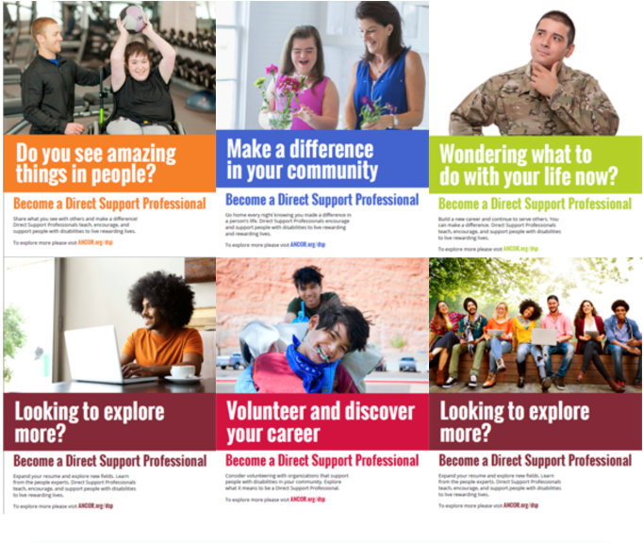
Notes:
Note to facilitator: choose either slide 21 or slide 22.
Talking Points:
These are some examples of marketing materials. Can be used for social media and electronic marketing as well as reproducible for printing. You see there are different target groups for each of these flyers.
The Target Markets in these examples were identified by ANCOR. These materials are available on their website.
Ask if attendees can identify the groups of people these materials are marketing.

Slide 23



Your Turn to Start
Notes:
Talking Points:
We have marketing materials for you on the TennCare website to personalize and use for your organization.

Slide 24
Expanded Workforce Pipeline
High school students
  C3P0 http://www.opra.org/workforce-initiatives/c3po/
Immigrants and expanded cultural, ethnic, and linguistic diversity
Retirees
Notes:
Talking Points:
When it comes to recruitment, think outside of the box.
High school students are starting to become the next generation of DSPs.
One example is C3P0 http://www.opra.org/workforce-initiatives/c3po/2.
Our workforce is changing to include more immigrants and expanded cultural, ethnic, and linguistic diversity. This is an opportunity to be thinking forward to what it may look like in the future.
Many retirees are looking for part-time opportunities.

Slide 25
Questions?
To receive the slides from today’s webinar or to further discuss this strategy:
Contact your UMN consultant
Or email us at: dsp-tn@umn.edu
Notes:
Read slide

Slide 26
References
ANCOR. (2017).
Hewitt, A., & Larson, S. (2007).
The Arc. (2017)

